Slide 1

Nash Equilibrium Solution for Fastball Locations in Two-Strike
Counts
Kevin Tenenbaum and Dave Allen
Middlebury College, Middlebury, VT
SABR Analytics Conference
Phoenix, AZ
March 2013
Notes:
----- Meeting Notes (3/2/13 17:04) -----
Thank you for coming, I'm happy to be here.
Project Dave Allen and I have worked on
Titled:

Slide 3
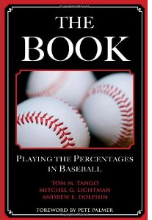
History of Game Theory Work
“The Book”, Tango, Lichtman, and Dolphin (2007)
“When a Pitcher Meets a Hitter”, Gassko (2010)
5 Part Game Theory Series, Matt Swartz (2012)
Notes:
http://www.amazon.ca/The-Book-Playing-Percentages-Baseball/dp/1597971294
----- Meeting Notes (3/2/13 17:04) -----
Litttle Game theoretic work to date
List what is out there
lack of run values.
not an exhaustive list

Slide 4
Question
Where should pitchers locate fastballs in two-strike counts?
When should hitters swing at these fastballs?
Notes:
----- Meeting Notes (3/3/13 15:42) -----
Say restricting ourselves to 2 strike counts to simplify the problem. This is only a first pass at the question.

Slide 5
Outline
Discrete Case
Continuous Case
    Simulation
    Numerical Solution
Interpretation of Results

Slide 6
Data Set- Discrete
All four-seam fastballs from 0-2, 1-2, or 2-2 counts from the years 2009-2011.
We do not control for handedness because we only care about final location

Slide 7
Outline
Discrete Case
Continuous Case
    Simulation
    Numerical Solution
Interpretation of Results

Slide 8
Extended Zone
Normal strike zone plus 10% error on all sides.
We use the Extended Zone to incorporate the error associated with pitcher’s intended locations.
Notes:
----- Meeting Notes (3/2/13 17:04) -----
incorporate lack of pinpoint control for pitchers

Slide 9
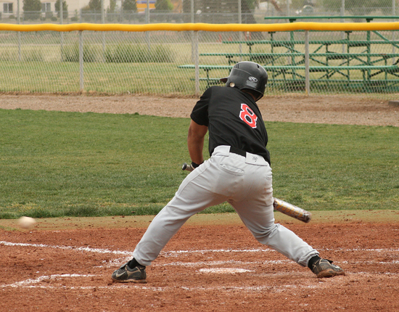
Recognition Uncertainty Issue
Notes:
http://wordpress.nmmi.edu/athletics/2010/04/17/odessa-takes-two-more-from-broncos/
----- Meeting Notes (3/2/13 17:04) -----
Hitters don't always recognize strikes accurately

Slide 10
Solution
65.0 % (Recb) that a pitch was outside the extended zone, it was taken.
  This is the ball recognition probability.
83.5 % (Recs) that a pitch inside the extended zone was swung at.
  This is the strike recognition probability.
We don’t break this up by count because the differences are small from count to count.
Notes:
----- Meeting Notes (3/2/13 17:04) -----
incorporate that probability

Slide 11
Solution to Problem
Strike
Ball
SwingStrike | SwingBall
TakeStrike | TakeBall
Swing
This method incorporates the uncertainty in hitters’ pitch recognition skills.
Take
Strike
Ball
Recs*SwingStrike | (1-Recb)*SwingBall
(1-Recs)*TakeStrike | Recb*TakeBall
Swing
Take
Notes:
----- Meeting Notes (3/3/13 14:48) -----
look at correctness here

Slide 12

General Discrete Game Theory
Pitchers
Hitters
Strike
Ball
Strike
Ball
ZoneSwing | BallSwing
ZoneTake | BallTake
ZoneSwing | BallSwing
ZoneTake | BallTake
Swing
Swing
Take
Take
Utility_{hitter}(Swing)=P(Zone)*RV(ZoneSwing)+(1-P(Zone))*RV(BallSwing)
=Utility_{hitter}(Take)=P(Zone)*RV(ZoneTake)+(1-P(Zone))*RV(BallTake)
Utility_{pitcher}(Zone)=P(Swing)*RV(ZoneSwing)+(1-P(Swing))*RV(ZoneSwing)
=Utility_{pitcher}(Ball)=P(Swing)*RV(BallSwing)+(1-P(Swing))*RV(BallSwing)
Notes:
----- Meeting Notes (3/3/13 15:57) -----
Say we are solving for P(Zone) and P(Take) and why that works.

Slide 13
0-2 Count
Pitchers
Hitters
Strike
Ball
Strike
Ball
-0.01024137 | 0.06639532
0.1006054 | -0.02471019
0.008558415 | -0.02317613
-0.01653239 | 0.01608478
Swing
Swing
Take
Take
Optimal Zone Probability- 61.0 %
Observed Zone Probability- 32.0 %
Optimal Swing Probability- 62.1 %
Observed Swing Probability- 50.4 %
Notes:
----- Meeting Notes (3/3/13 15:57) -----
Note that extended zone is used and they just might not be locating well.

Slide 14
1-2 Count
Pitchers
Hitters
Strike
Ball
Strike
Ball
-0.00312736 | 0.0783484
0.1188906 | - 0.03811485
0.002675613 | -0.03143085
-0.01717375 | 0.0228244
Swing
Swing
Take
Take
Optimal Zone Probability- 73.2%
Observed Zone Probability- 39.8 %
Optimal Swing Probability- 65.8%
Observed Swing Probability- 58.2 %

Slide 15
2-2 Count
Pitchers
Hitters
Strike
Ball
Strike
Ball
0.01500099 | 0.09287928
0.1412664 | -0.08649653
-0.01324456 | -0.04258026
-0.01654058 | 0.04684242
Swing
Swing
Take
Take
Optimal Zone Probability- 96.4 %
Observed Zone Probability- 47.9 %
Optimal Swing Probability- 74.5 %
Observed Swing Probability- 66.2 %

Slide 16
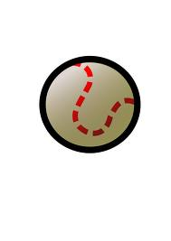
Shortcomings of Discrete Case

Slide 17
Outline
Discrete Case
Continuous Case
    Simulation
    Numerical Solution
Interpretation of Results

Slide 18
Benefits of Continuous Case

Slide 19
Making discrete continuous
n=2

Slide 20
Making discrete continuous
n=5

Slide 21
Making discrete continuous
n=12

Slide 22
Continuous
Lim_{n ➔} ∞ Table_{n x} _{n}
Where the Table is ∞ x ∞
This table is continuous
  n=∞
Notes:
----- Meeting Notes (3/3/13 15:59) -----
pitcher strategy becomes where should i throw?
batter strategy becomes when should I swing based on location?
that location is on D plane.

Slide 23
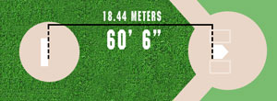
Where Hitters Make Decision
270 Milliseconds to decide whether or not to swing (Dave Baldwin, Baseball Analysts)
D
Notes:
http://www.themilliondollararm.com/?L=header.howtoplay
http://baseballanalysts.com/archives/2009/09/unraveling_the.php

Slide 24
Data Set
All four seam fastballs in 0-2, 1-2, 2-2 counts from RHP to RHB from years 2009-2011.

Slide 25
Outline
Discrete Case
Continuous Case
    Simulation
    Numerical Solution
Interpretation of Results

Slide 26
Why Simulate?
This is a very complicated mathematical problem.
This is a game where the pitcher’s choice is continuous and the batter receives incomplete continuous information
He then must make a discrete choice based on this incomplete information.

Slide 27
Assumptions
All hitters make make swing decision at 270 ms after release.
A finely discrete case is a good approximation of continuous.
Run values are fit from data. They are location and count-specific. They do not change with pitcher or hitter strategy.
Notes:
----- Meeting Notes (3/3/13 15:59) -----
The continuous character makes this a difficult math problem to solve. Simulating may be better.``

Slide 28
Pitcher and batter strategies
Pitcher strategy: chooses location(s) to throw to and fraction of time to throw to each location
Batter strategy: (dx,dz) swing probability matrix

Slide 29
Where does pitch end up and where does batter see it
Pitch to intended location (px₁,pz₁) ends up in a location (px₂, pz₂) drawn from BVN distribution with mean (px₁,pz₁) and σ_{x1,} σ_{z1} and ρ₁ fit from observed data:

Slide 30
Where does pitch end up and where does batter see it
Pitch to intended location (px₁,pz₁) ends up in a location (px₂, pz₂) drawn from BVN distribution with mean (px₁,pz₁) and σ_{x1,} σ_{z1} and ρ₁ fit from observed data:
Batter observes pitch whose actual location is (px₂,pz₂) at (dx₂,dz₂) drawn from BVN with mean (dx,dz) for pitches to (px₂,pz₂) and σ_{x2 ,}σ_{z2} and ρ₂ for all fastball observation spread.
Notes:
The (SD_{x} SD_{z} and rho) in bullet 1 and bullet 2 are DIFFERENT

Slide 31
Run Value result of pitch
Pitch to (px₁,pz₁) observed at (dx₁,dz₁) has run value
RV = Sw(dx₁,dz₁) * RV_{sw}(px₁,pz₁) + (1-Sw(dx₁,dz₁)) * RV_{tk}(px₁,pz₁)
Here Sw(dx,dz) is the batter strategy and RV_{sw} and RV_{tk} are fit from observed count-specific fastballs.

Slide 32
Genetic algorithm
100 pitcher strategies (pitch locations and frequency of pitch to each location) are created from the seed population, by randomly “mating” and “mutating” the seed population.
Same for 100 batter strategies (detection-location swing frequency matrix)
Each pitcher strategy plays against each batter strategy
Best (highest/lowest average RV) 10 of each become seed of next generation
Repeat the above steps 500 times, and observe the best pitcher and batter strategy at that point.
Notes:
Here you can say for more details contact Dave Allen

Slide 33
Results based on count
Notes:
Batter strat in grey, pither in red. Note that with more balls picher has to get more conservative (as expected). Here say that the best pitcher strategy always produced just one point. Over the 500 generations it ‘tried out’ multiple location strategies but the single location strategy always won out. Also say that we ‘pulled the batter strat’ forward from (dx,dz) to (px,pz) to make it more informatve, but the actual batter strat is in dx,dz
Swing contours are 90%, 60% and 30%.
For the pitch contours 30% of pitches end up inside the smallest ellipse, 60% in the middle and 90% in the biggest. These are using Rivera’s SDs and rho.

Slide 34
Results based on pitcher command
Notes:
With better command the pitcehr can throw even more to the edges (also as expected, Rivera and Livan hernandez throw to the edges, guys with poor command have their pitch locaitons centered at the middle of the zone)
ON the left is Rivera’s fit and on the right is your 0.25, 0.25.

Slide 35
Outline
Discrete Case
Continuous Case
    Simulation
    Numerical Solution
Interpretation of Results

Slide 36
Assumptions
Hitters should swing at all pitches that are strikes.
Hitters should take all pitches that are balls
The strike zone is called as the rulebook defines it.
Notes:
This is a hard problem so we made significant simplifying assumptions.
assume batter behaves this way. Now only interested in pitcher strategy.

Slide 37
Finding when hitters should swing
Fit data to Bivariate Normal Distribution:
Parameters:
  µx=-0.6467337
  µz=3.0288264
  σx=1.0303671
  σz=0.8552755
  ρ=-0.2578331
Notes:
Maximum Likelihood Estimation-
Minimize he negative log(likelihood)
Need equations to approximate swing probability by location
and run value by location
This model is a probability in the D plane ends up in the rulebook strike zone. This is our swing probability.

Slide 38
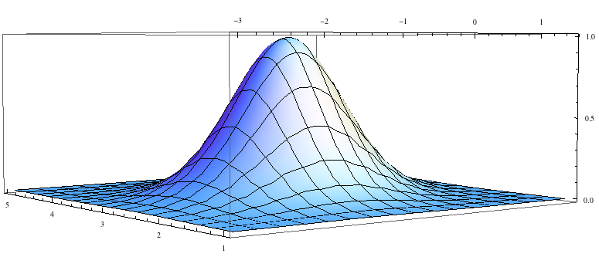
Hitter’s swing probability
Optimal Swing Probability on the Plane D
dx
RV
dz
Notes:
Label axes.

Slide 39
Making Run Value Functions
Basis : b= (1,x,z,x²,z²,x³,z³,x⁴,z⁴)
Use this to solve the linear system:
A^{T}A=A^{T}c
A= Matrix of locations dx, dz, dx², dz², … , dz⁴
b= Orthonormal Basis above
c=Run Values that correspond to (dx,dz) coordinates
Notes:
Actually projecting b onto the column space of A.
Column space of A is the set of all possible linear combinations of the vectors in A.
Talk less about math.
Make clear need for functions.

Slide 40
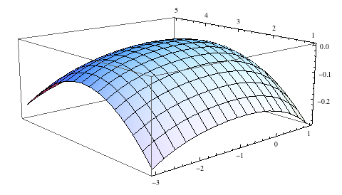
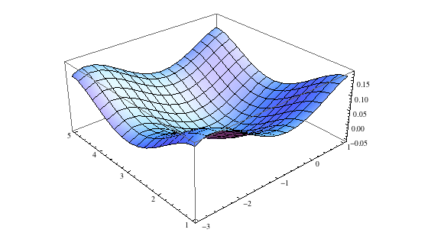
Run Value by Location
dz
RV
RVSwing(x,y)
dx
RVTake(x,y)
RV
dz
dx
Notes:
Label axes.

Slide 41
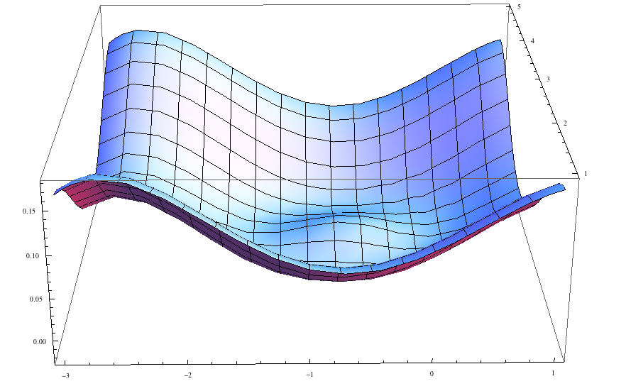
Payoff Function
P(x,z)*RVSwing(x,y)+(1-P(x,z))*RVTake(x,z)
dz
RV
dx

Slide 42
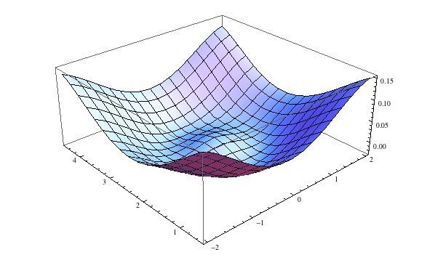
Transformation to Pitcher’s Perspective
Px ~ 0.728817+1.139699*dx
Pz ~1.227403+1.219921*dz
RV
pz
px
Notes:
This transformation is a lot less noisy because the pitches are all FF.
R-sqared was ~.9 for both regressions.

Slide 43
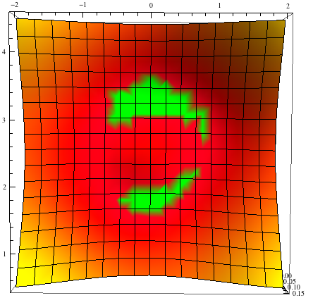
Minimizing runs
px
Randomize pitches over these locations.
pz
Notes:
Location specific run values are static. Therefore, the model is unrealistic as the run values would change.
Model doesn’t account for hitter guessing location and tendency to miss or make weak contact based on that.

Slide 44
Outline
Discrete Case
Continuous Case
    Simulation
    Numerical Solution
Interpretation of Results

Slide 45
Conflicting results
Caused by Incorporation of Standard Deviation
Notes:
Pitchers may already know the strategy. That is only half the battle though as execution is just as important.

Slide 46
Applications
Helping catchers with pitch calling.
Helping front offices locate undervalued assets.
Evaluate catchers pitch calling abilities.
Compare to current hitter response.

Slide 47
Further research
Improve strike zone definition.
Find hitter’s optimal strategy with out defining it as probability of strike.
Perform same process on other pitch types.

Slide 48
Acknowledgements/Questions
Middlebury College
Sportsvision
SABR
MLB Advanced Media
Brandon Henry
Emails:
  Kevin Tenenbaum: ktenenbaum@middlebury.edu
  Dave Allen: dallen@middlebury.edu

