Slide 1
A TALE OF TWO SEASONS: Louisville 1889- 1890

Slide 2
Tim Wendel Author, writer in residence at Johns Hopkins University
A Salute to Baseball's First 'Worst-to-First' Winners
“Almost a quarter-century ago [1991], the Minnesota Twins and the Atlanta Braves met in one of the best World Series of all time. …
“Yet this time of year, at the start of a brand-new season, both teams are best remembered for going from last place to winning the pennant in their respective leagues -- the first time it had ever been done in major league baseball. “
Huffington Post, April 1, 2014.
http://www.huffingtonpost.com/tim-wendel/a-salute-to-baseballs-fir_b_5066735.html

Slide 3
MLB.com Columnist
Tracy Ringolsby
“Worst-to-first finishes becoming more common”
“In the first 90 years of Major League Baseball, no team had ever gone from worst to first.”
MLB.com, September 21, 2013
http://m.mlb.com/news/article/61302802/

Slide 4
Worst-to-First Since 1990
Team Year Result
Atlanta Braves 1990-1991 Won NL Pennant, Lost World Ser. Minnesota Twins 1990-1991 Won World Series
Philadelphia Phillies 1992-1993 Won NL Pennant, Lost World Ser. San Francisco Giants 1996-1997 Won NL West, Lost Division Series
San Diego Padres 1997-1998 Won NL Pennant Lost World Ser. Arizona Diamondbacks 1998-1999 Won NL West, Lost Division Series
Arizona Diamondbacks 2006-2007 Won NL West, Lost LCS
Chicago Cubs 2006-2007 Won NL Central, Lost Division Ser. Tampa Bay Rays 2007-2008 Won AL Pennant, Lost World Ser. Arizona Diamondbacks 2010-2011 Won NL West, Lost Division Series
Boston Red Sox 2012-2013 Won World Series
Texas Rangers 2014-2015 Won AL West , Lost Division Ser. Boston Red Sox 2015-2016 Won AL East, Lost Division Series

Slide 5
First to Worst
Philadelphia(A) 1914-1915
Oakland 1992-1993
Montreal 1994-1995
San Diego 1996-1997
California 1996-1997
Florida 1997-1998
Texas 1999-2000
Minnesota 2010-2011
Boston 2013-2014
Detroit 2014-2015
Minnesota 2020-2021

Slide 6
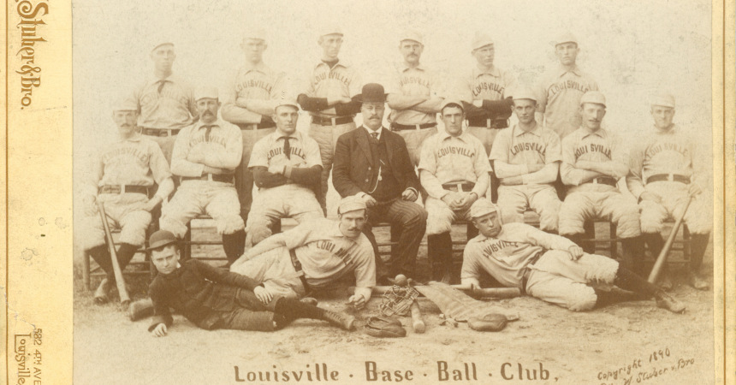
Louisville Colonels Team Photo- 1890

Slide 7
1889 American Association Standings
Team Wins Loses W-L% GB
Brooklyn Bridegrooms 93 44 .679 -
St. Louis Browns 90 45 .667 2.0
Philadelphia Athletics 75 58 .564 16.0
Cincinnati Red Stockings 76 63 .547 18.0
Baltimore Orioles 70 65 .519 22.0
Columbus Solons 60 78 .435 33.5
Kansas City Cowboys 44 82 .401 38.0
Louisville Colonels 27 111 .195 66.5

Slide 8
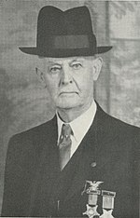
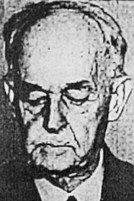
Mordecai Davidson
Circa 1910
Mordecai Davidson
1940

Slide 9
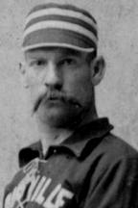
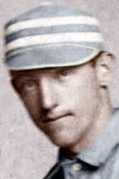
Louisville Strikers
Pete Browning
Paul Cook
Red
Ehret
Guy Hecker
Harry Raymond
Dan Shannon

Slide 10
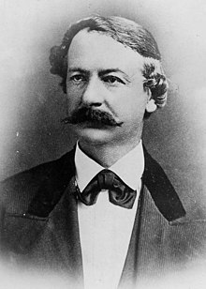
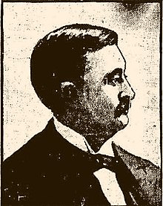
New Louisville Ownership
No Available Photo of William L. Lyons
William L. Jackson
Zach Phelps

Slide 11
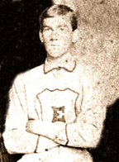
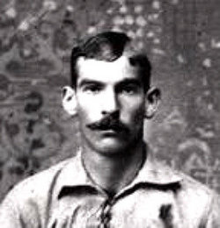
Teenage Pete Browning of the semi-pro Louisville Eclipse, circa 1880
Pete Browning
Portrait
circa 1886

Slide 12
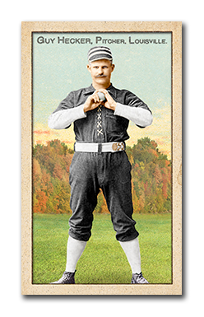
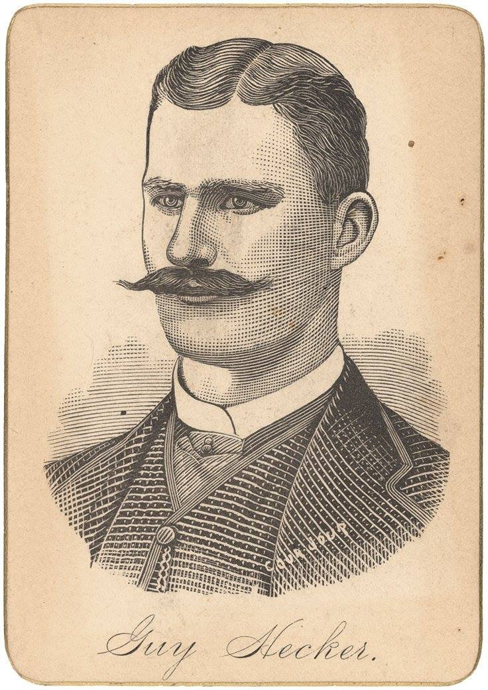
Guy Hecker

Slide 13
Jack Chapman- Playing Career
Clubs
Enterprise Club 1861
Atlantics 1862-66,
1868-70, 1874
Quaker City 1867
Eckfords 1871
St. Louis 1875
Notable Playing Appearance
RF on June 14, 1870, when Atlantics beat Cincinnati

Slide 14
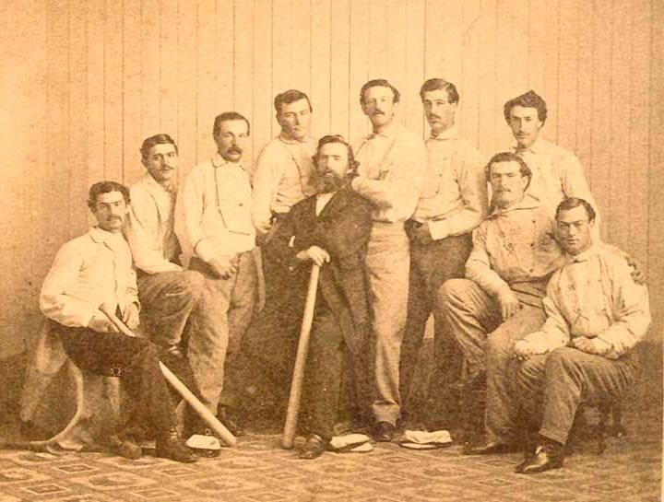
Brooklyn Atlantics 1865

Slide 15
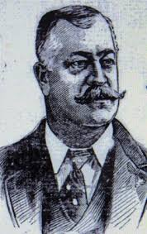
Jack Chapman- Manager Career
Major League Managerial Stops
Louisville 1876-77 (NL) 1890-92(AA)
Milwaukee 1878 (NL)
Worcester 1882 (NL)
Detroit 1883-84 (NL)
Buffalo 1885 (NL)
Minor League Manager
Buffalo 1886-88, 1893-94
Syracuse 1889
Rochester 1895
Wilkes-Barre 1896
Meriden 1897-98
Newark 1899
Norwich 1899

Slide 16
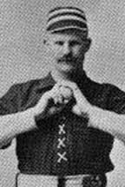
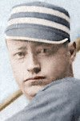
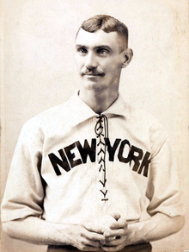
Comings &Goings: Gone
Pete Browning OF
Guy Hecker 1B
Toad Ramsey P
Paul Cook C
John Ewing P
Dan Shannon 2B

Slide 17
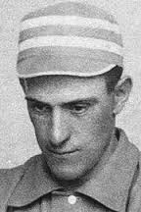
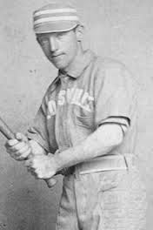
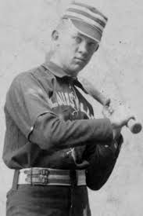
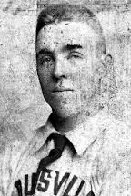
Comings & Goings: Retained
Phil Tomney SS
Harry Raymond 3B
Red Ehret P
Chicken Wolf OF
Scott Stratton P
Farmer Weaver OF
Jack Ryan C

Slide 18
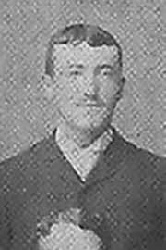
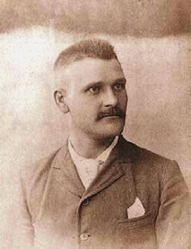
Comings & Goings: New
Harry Taylor 1B
Herb Goodall P
George Meakim P
Tim Shinnick 2B
Charlie Hamburg OF
Ed Daily P

Slide 19
American Association Comparison 1889-1890
Category | 1890 | 1889 | %∆
Games | 540 | 559 | (3.4)
Runs | 6042 | 6783 | (10.9)
Runs/Game | 5.59 | 6.07 | (7.9)
Batting Ave. | .253 | .262 | (3.4)
Slugging Ave. | .332 | .354 | (6.2)
Hits | 9345 | 10,184 | (8.2)
ERA | 3.86 | 3.84 | (.5)
ER | 4015 | 4149 | (3.2)
Unearned Runs (UER) | 2027 | 2634 | (23.0)
UER/Game | 1.9 | 2.4 | (20.1)
Fielding % | .923 | .916 | 7.6
Errors | 3444 | 3992 | (13.7)
Errors/Game | 3.2 | 3.6 | (11.1}

Slide 20
Louisville Team Comparison 1889-1890
Category | 1890 | 1889 | %∆
Games | 136 | 140 | (2.9)
Runs | 819 | 632 | 29.5
Runs/Game | 6.02 | 4.51 | 33.8
Batting Average | .279 | .252 | 10.7
Slugging Ave. | .350 | .330 | 6.1
Hits | 1310 | 1249 | 4.9
ERA | 2.75 | 4.81 | (42.8)
Earned Runs | 354 | 656 | (46.0)
Unearned Runs (UER) | 243 | 435 | (44.1)
UER/Game | 1.7 | 3.1 | (45.2)
Fielding % | .934 | .906 | 3.1
Errors | 380 | 584 | (34.9)
Errors/Game | 2.7 | 4.2 | (35.7)

Slide 21
Louisville Batting Comparison 1890-1889
 |  | 1890 |  |  |  | 1889
Pos |  | Ave. | Runs | RBI |  | Ave. | Runs | RBI
1B | Harry Taylor | .306 | 115 | 53 | Guy Hecker | .284 | 42 | 36
2B | Tim Shinnick | .256 | 87 | 82 | Dan Shannon | .257 | 90 | 48
SS | Phil Tomney | .277 | 72 | 58 | Phil Tomney | .213 | 61 | 38
3B | Harry Raymond | .259 | 91 | 51 | Harry Raymond | .239 | 58 | 47
OF | Chicken Wolf | .363 | 100 | 98 | Chicken Wolf | .291 | 72 | 57
OF | Farmer Weaver | .289 | 101 | 67 | Farmer Weaver | .291 | 62 | 60
OF | Charlie Hamburg | .272 | 93 | 77 | Pete Browning | .256 | 39 | 32
C | Jack Ryan | .217 | 43 | 35 | Paul Cook | .227 | 34 | 15

Slide 22
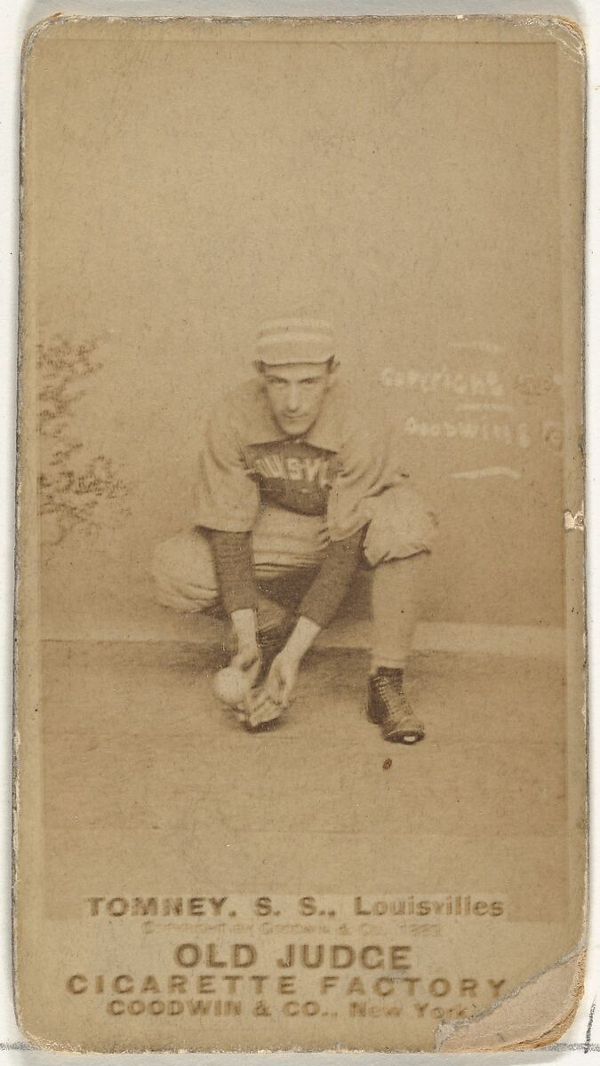
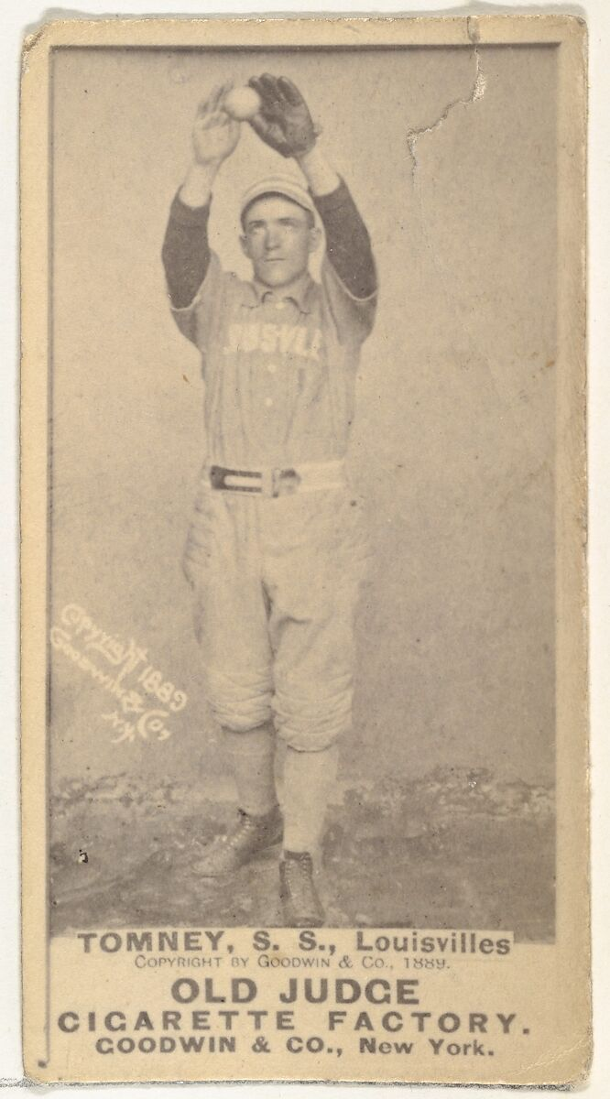
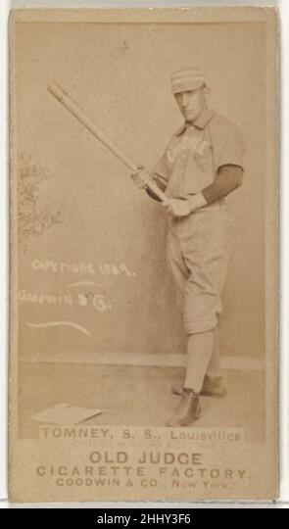
Phil Tomney Fielding Comparison
Year Games Chances PO Assists Errors Errors/G Fielding %
112 797 229 454 114 1.02 .857
1890 108 650 180 406 64 .59 .902

Slide 23
Louisville Fielding Comparison 1890-1889
 |  | 1890 |  |  |  | 1889
Pos |  | Errors | E/G | RF/G* |  | Errors | E/G | RF/G*
1B | Harry Taylor | 36 | .27 | 10.7 | Guy Hecker | 23 | .27 | 7.9
2B | Tim Shinnick | 53 | .40 | 4.9 | Dan Shannon | 69 | .57 | 5.8
SS | Phil Tomney | 64 | .59 | 5.4 | Phil Tomney | 114 | 1.02 | 6.1
3B | Harry Raymond | 62 | .51 | 3.8 | Harry Raymond | 60 | .46 | 3.6
OF | Chicken Wolf | 18 | .13 | 1.8 | Chicken Wolf | 35 | .26 | 3.4
OF | Farmer Weaver | 22 | .17 | 2.0 | Farmer Weaver | 28 | .22 | 2.3
OF | Charlie Hamburg | 14 | .11 | 1.9 | Pete Browning | 22 | .27 | 2.0
C | Jack Ryan | 43 | .46 | 6.0 | Paul Cook | 37 | .45 | 5.6
* RF/G = Range Factor per Game

Slide 24
Louisville Team Fielding Comparison 1890-1889
Category | 1890 | 1889 | %∆
Chances | 5715 | 6237 | (8.4)
Put Outs | 3613 | 3674 | (1.7)
Assists | 1722 | 1979 | (13.0)
Fielding Ave. | .937 | .906 | 3.4
Errors | 380 | 584 | (34.9)
Errors/Game | 2.8 | 4.2 | (33.3)
RF/Game | 4.29 | 4.31 | (.5)
Double Plays | 79 | 117 | (32.5)

Slide 25
Louisville Team Pitching Comparison 1890-1889
Category | 1890 | 1889 | %∆
ERA | 2.57 | 4.81 | (46.6)
Runs | 588 | 1091 | (46.1)
Earned Runs | 345 | 656 | (47.4)
Unearned Runs | 243 | 435 | (44.1)
Strike Outs | 587 | 451 | 30.2
Walks | 293 | 475 | (38.3)

Slide 26
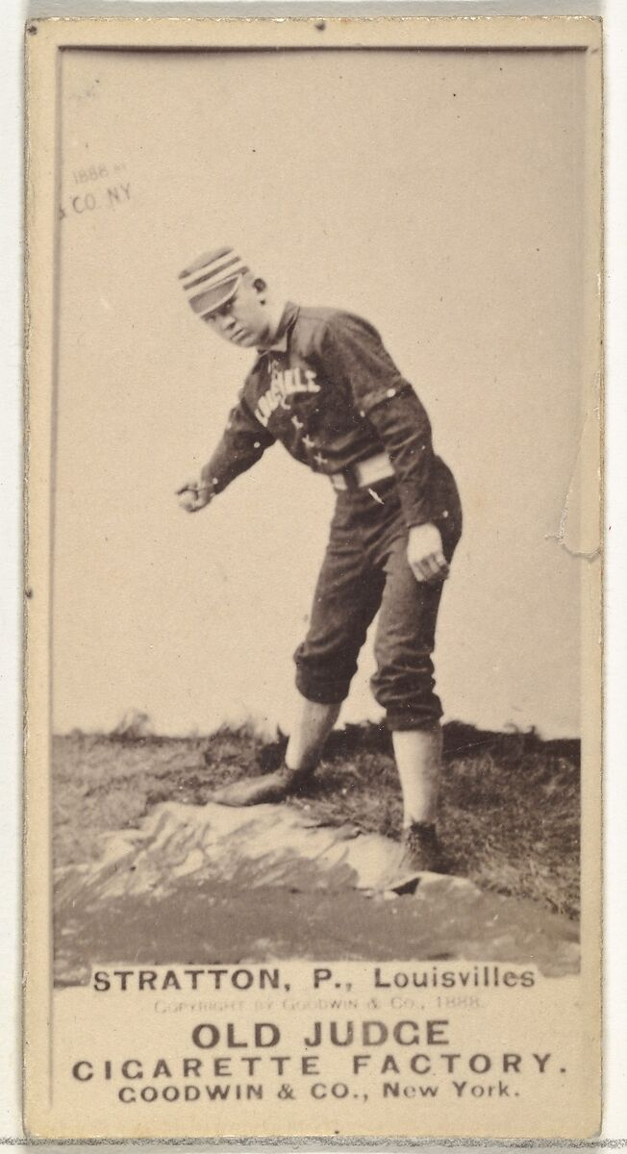
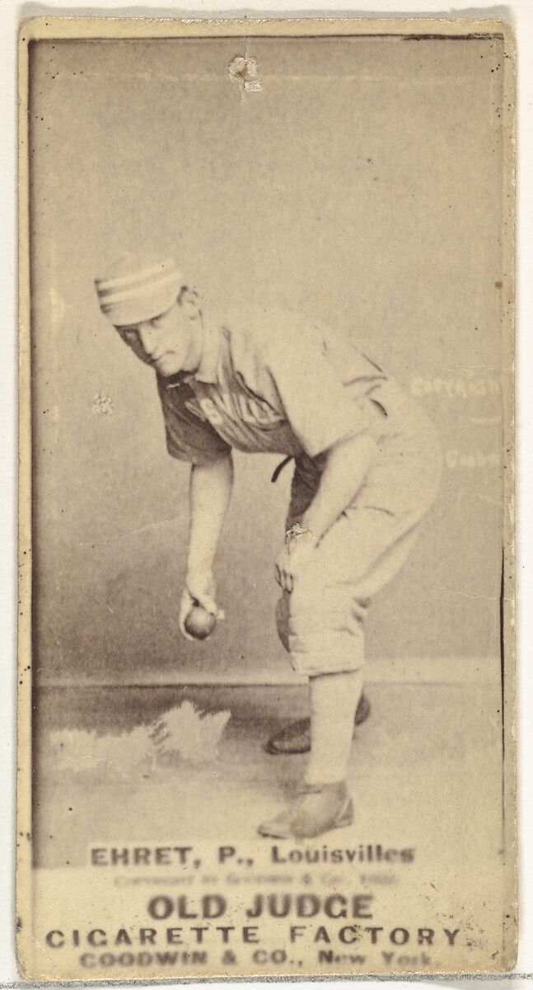

Slide 27
Louisville Individual Pitching Statistics- 1890 v. 1889
1890
1889
 | IP | W-L | ERA | ER | UER |  | IP | W-L | ERA | ER | UER
Scott Stratton | 431.0 | 34-14 | 2.36 | 113 | 73 | Scott Stratton | 133.2 | 3-13 | 3.23 | 48 | 78
Red Ehret | 359.0 | 25-14 | 2.53 | 93 | 81 | Red Ehret | 364.0 | 10-29 | 4.80 | 194 | 93
George Meakim | 192.0 | 12-7 | 2.91 | 62 | 38 | John Ewing | 267.1 | 6-30 | 4.87 | 179 | 117
Herb Goodall | 109.0 | 8-5 | 3.39 | 41 | 32 | Guy Hecker | 119.2 | 5-13 | 5.59 | 94 | 51
Ed Daily | 93.0 | 6-3 | 1.94 | 20 | 15 | Toad Ramsey | 41.0 | 1-16 | 5.59 | 87 | 65

Slide 30
Two Batting Champs
Name | Age | G | AB | R | H | TB | BA | OBP | SA
Player 1 | 28 | 134 | 543 | 100 | 197 | 260 | .363 | .421 | .479
Player 2 | 27 | 159 | 535 | 119 | 193 | 201 | .361 | .487 | .662
Career Records
Player 1 |  |  |  |  |  |  | .290 | .327 | .388
Player 2 |  |  |  |  |  |  | .271 | .374 | .488

Slide 31
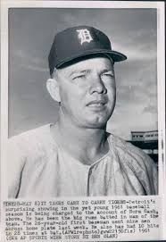
Chicken Wolf- 1890
Norm Cash- 1961
Name | Age | G | AB | R | H | TB | BA | OBP | SA
Chicken Wolf | 28 | 134 | 543 | 100 | 197 | 260 | .363 | .421 | .479
Norm Cash | 27 | 159 | 535 | 119 | 193 | 201 | .361 | .487 | .662
Career
Chicken Wolf |  |  |  |  |  |  | .290 | .327 | .388
Norm Cash |  |  |  |  |  |  | .271 | .374 | .488

