Slide 1
Bill Hutchison: A Forgotten Star Standing 55½ Feet From Home Plate
By Gregory H. Wolf
The Society for American Baseball Research
19th-Century Baseball Speaker Series
December 12, 2023

Slide 2
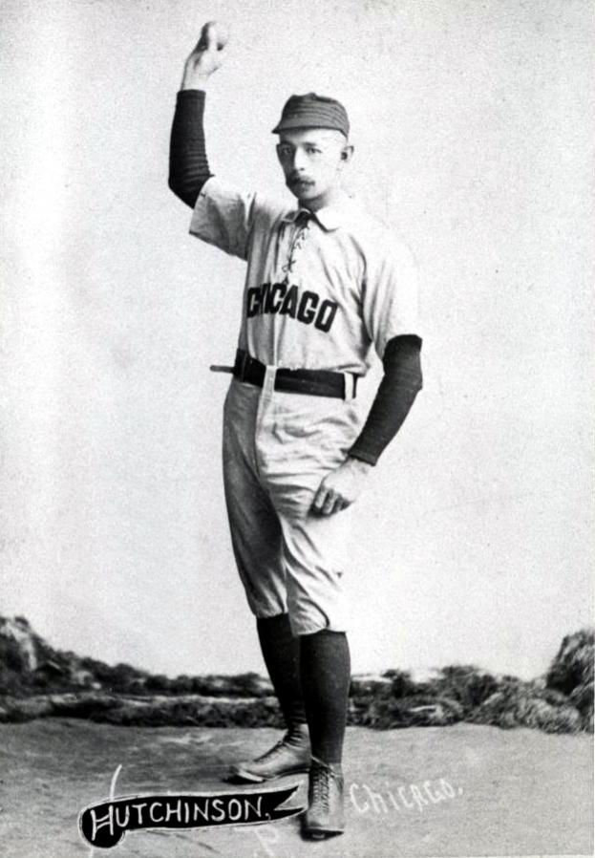
Bill Hutchison,
Chicago
Career-long albatross: Misspelled Name

Slide 3
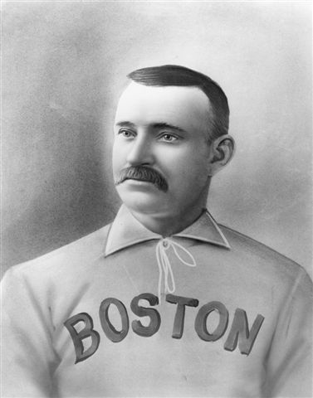
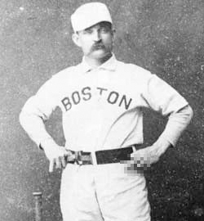
Old Hoss Radbourn (310)

Slide 4
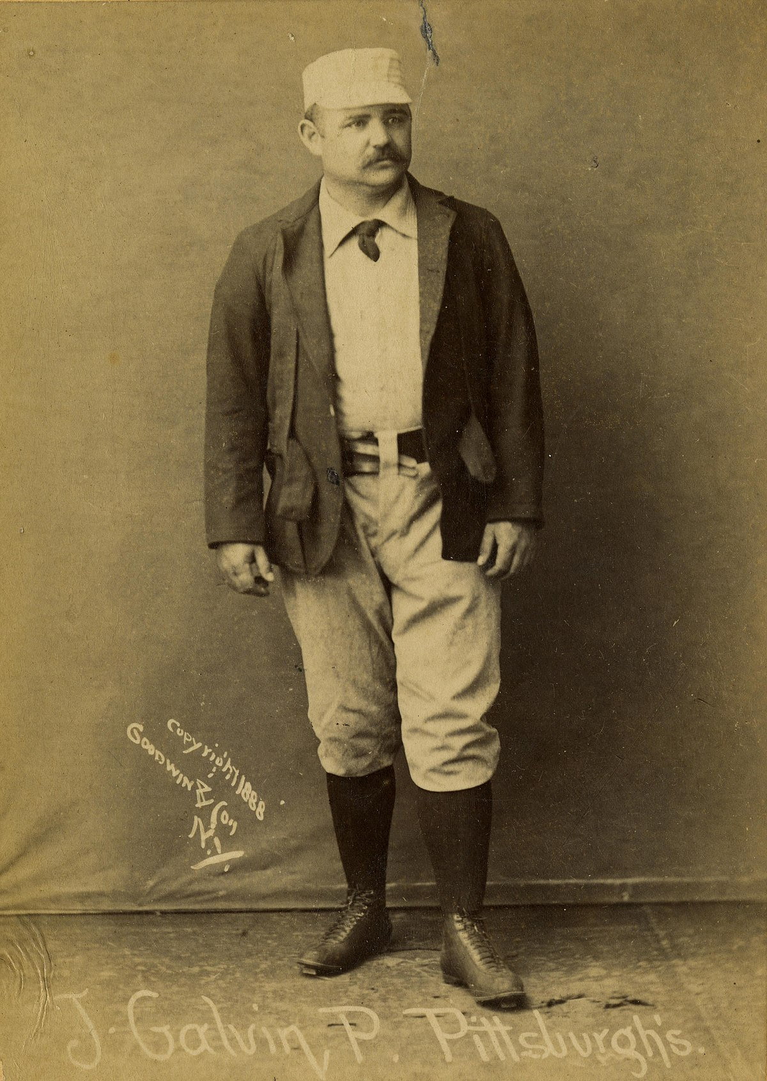
Pud Galvin (365)

Slide 5
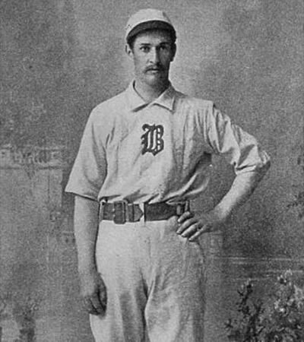
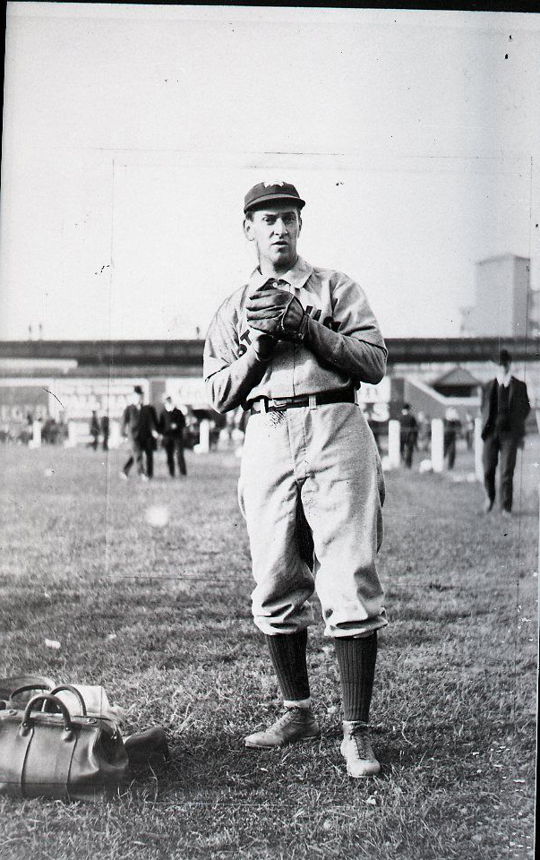
Kid Nichols (362)

Slide 6
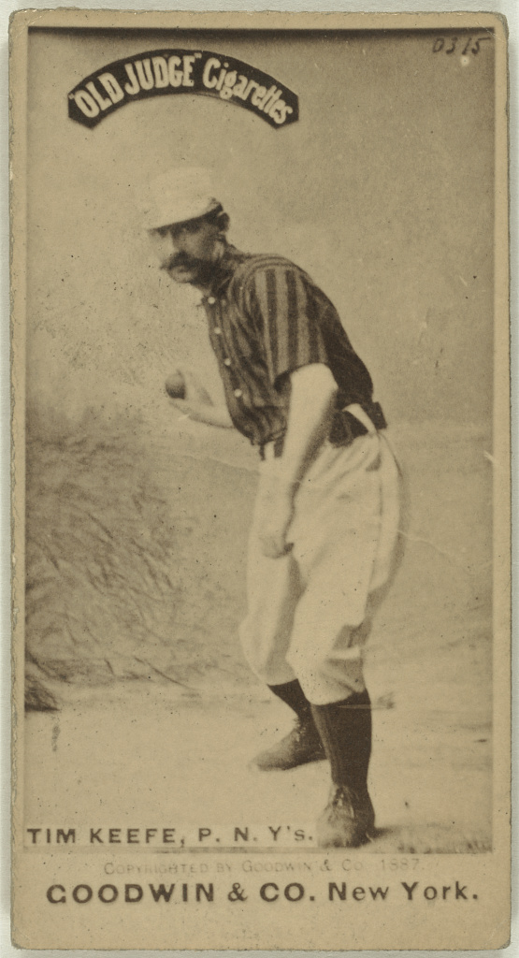
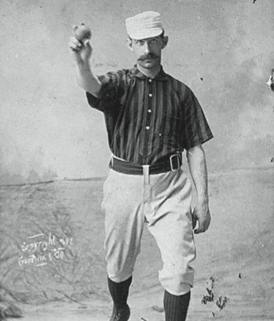
Tim Keefe (342)

Slide 7
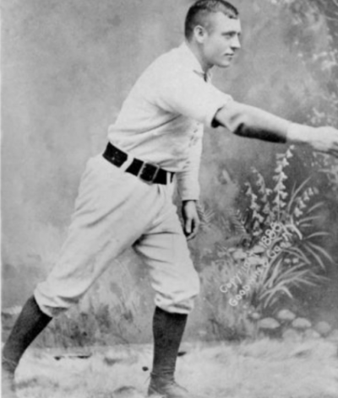
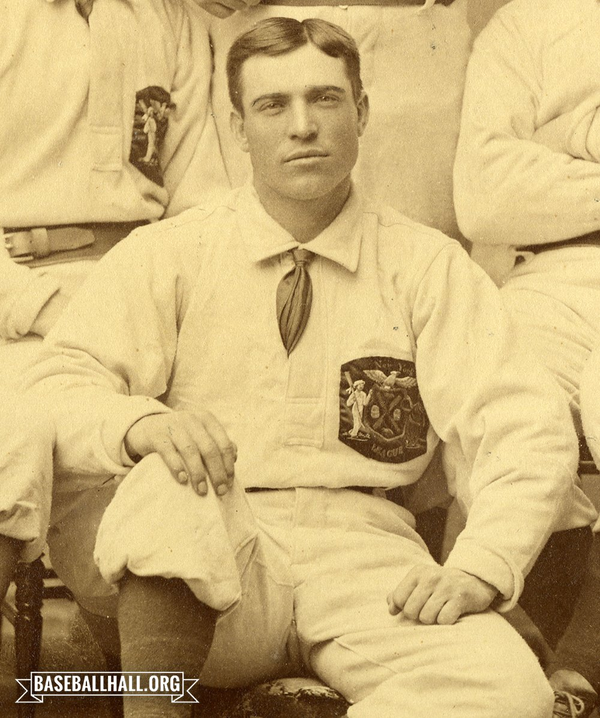
Mickey Welch (307)

Slide 8
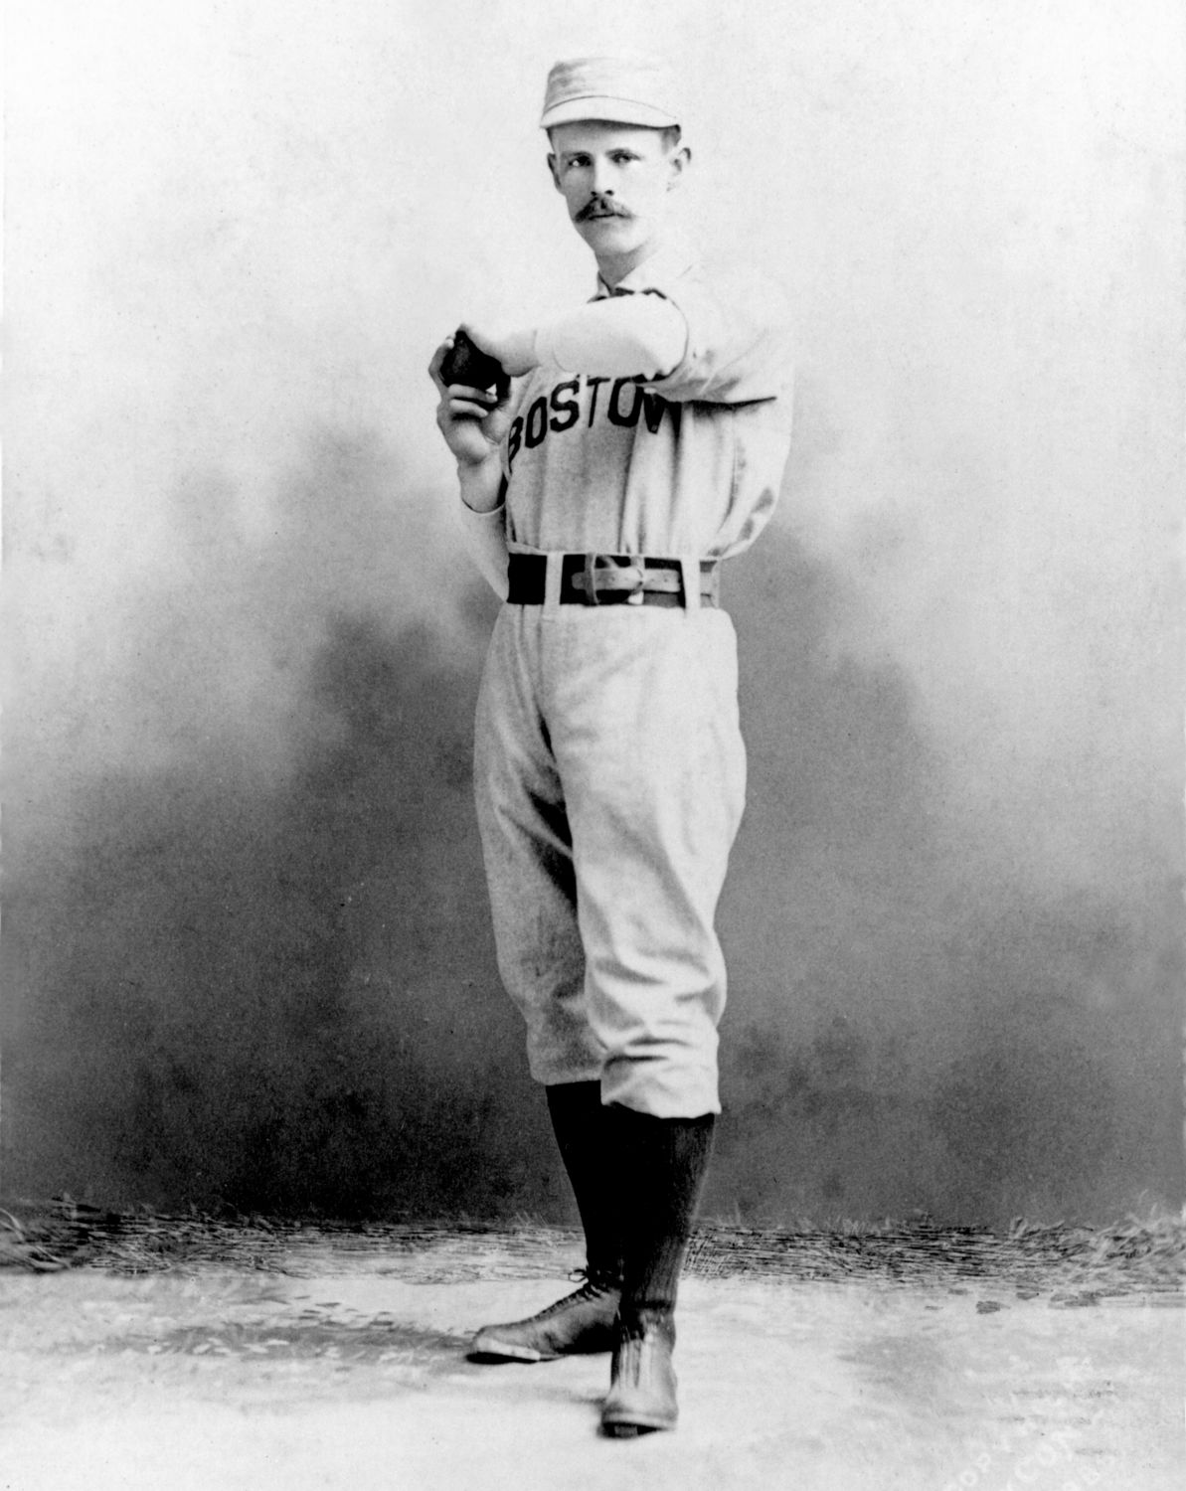
John Clarkson (328)

Slide 9
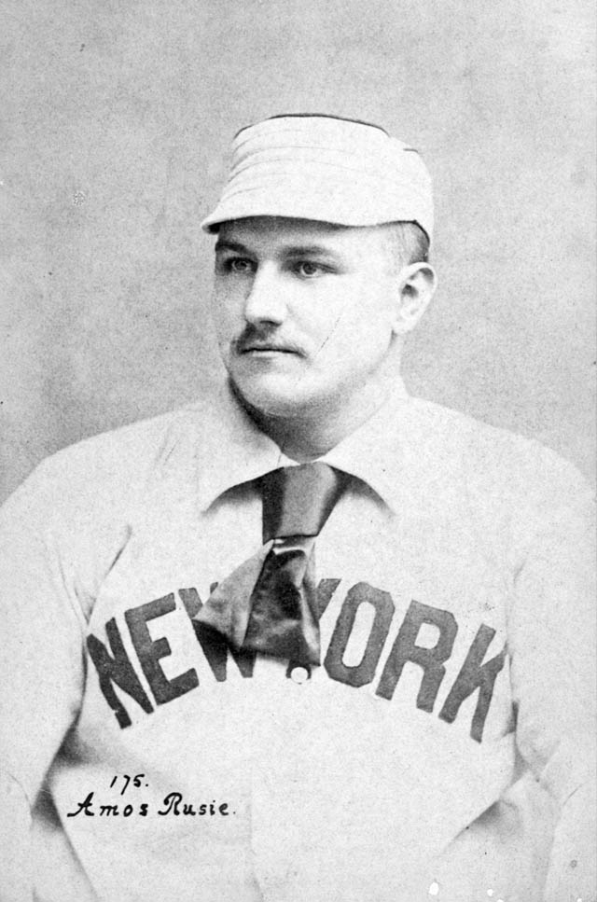
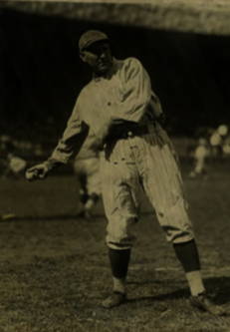
Amos Rusie (246)

Slide 10
Wins | Games | Games Starts | Complete Games | Innings
41 | 71 | 66 | 65 | 603
44 | 66 | 58 | 56 | 561
36 | 75 | 70 | 67 | 622

Slide 11
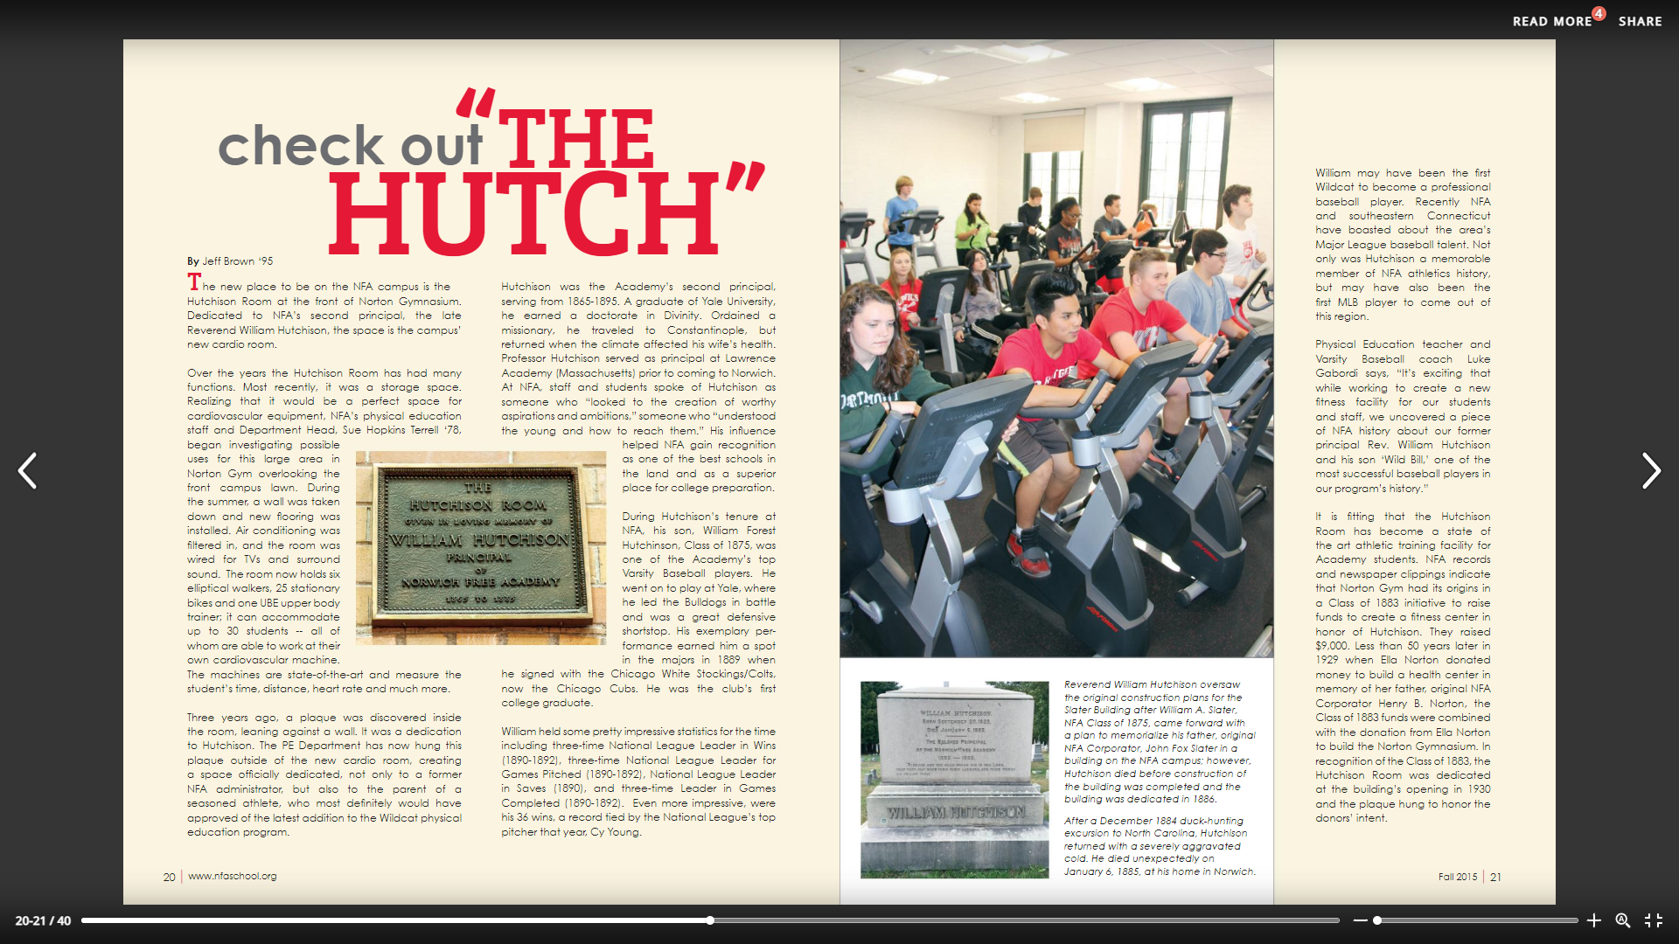
Norwich Free Academy in Connecticut

Slide 12
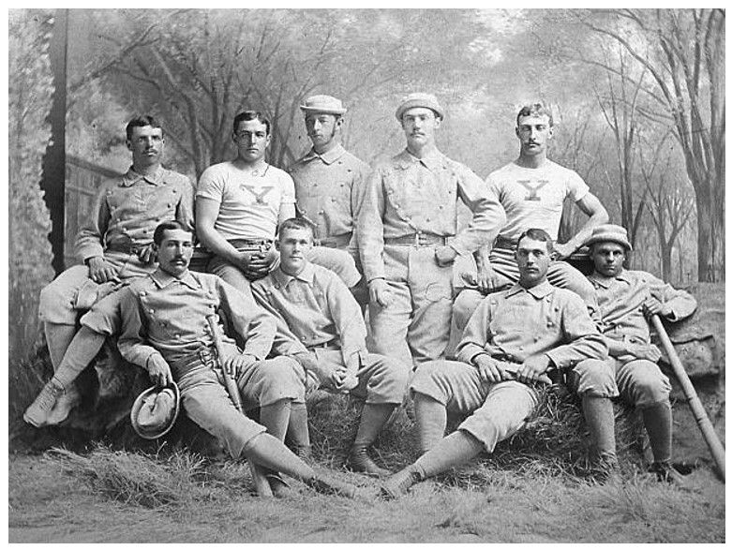
1880 Yale Baseball Team
Thanks to Keith Olbermann
BH

Slide 13
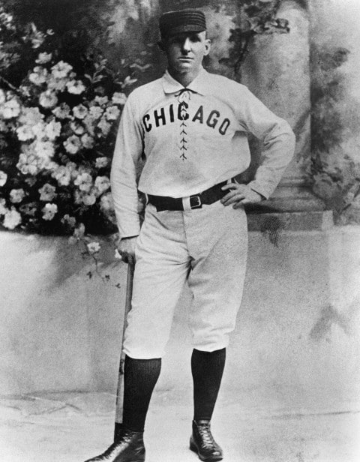
Cap Anson, Chicago
Circa 1889

Slide 14
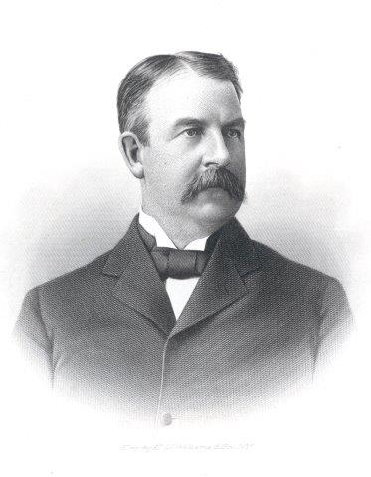
John Clarkson, Boston Beaneaters, circa 1889
Al Spalding, Chicago president

Slide 15
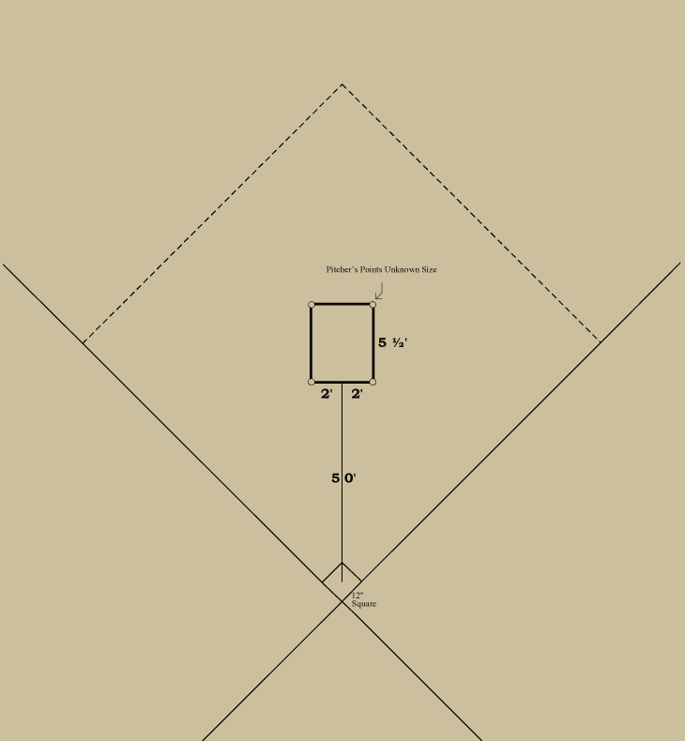
1887-1892 National League
Source:
Eric Miklich, 19th Century Baseball

Slide 16
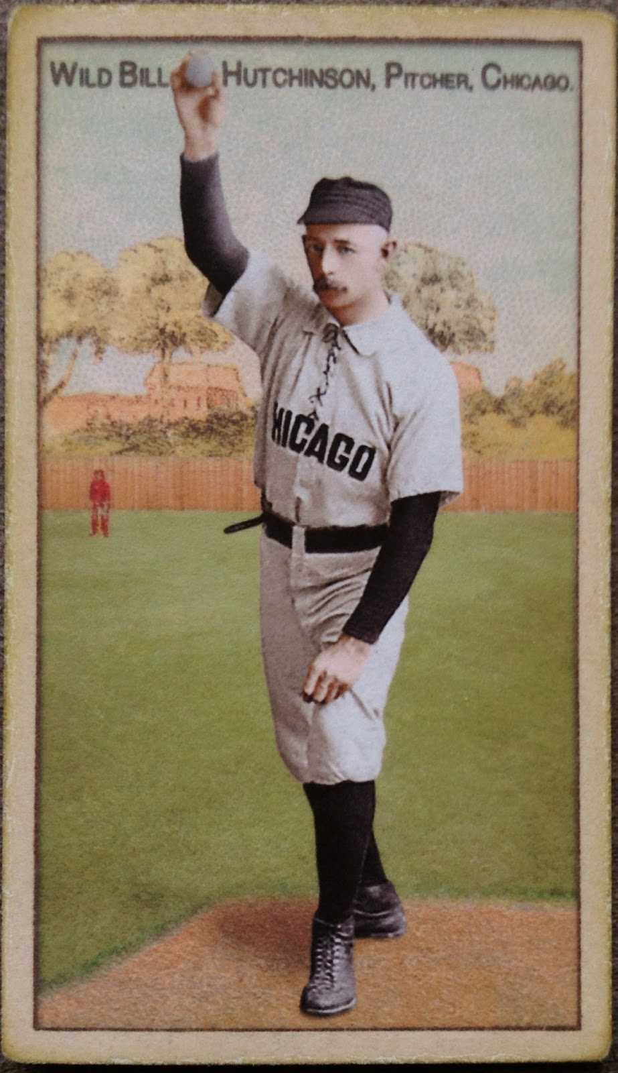
Ars Longa, contemporary collectible art card
Don’t expect a
whiskey & a cigar!

Slide 17
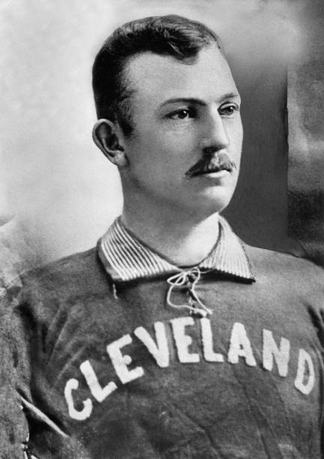
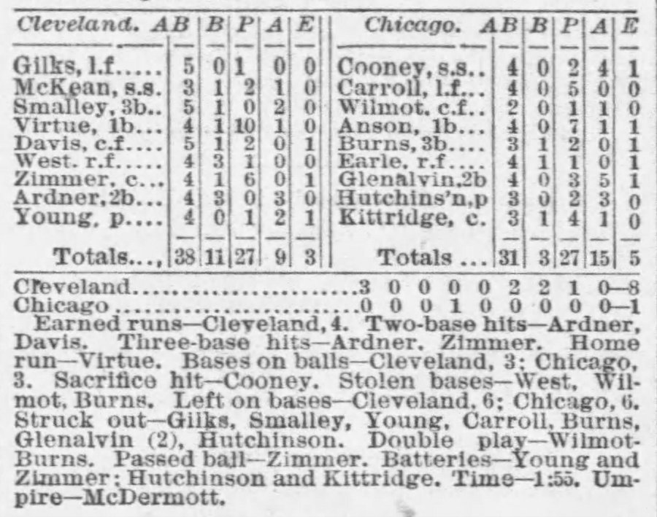
Cy Young, Cleveland Spiders
Debut (3-hitter) vs Hutchison in 1890

Slide 18
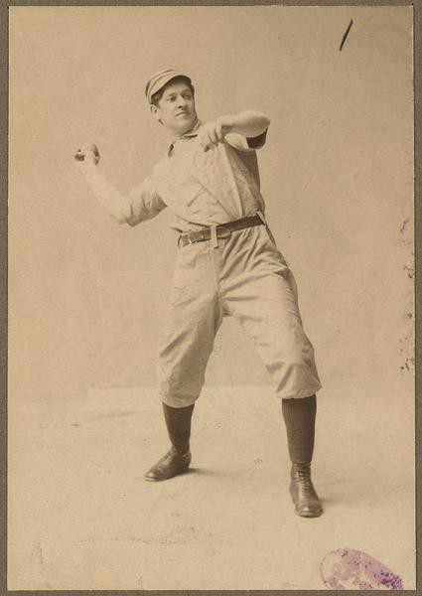
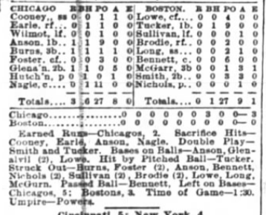
Hutchison’s one-hitter vs rookie Kid Nichols & Beaneaters on
September 29, 1890

Slide 19
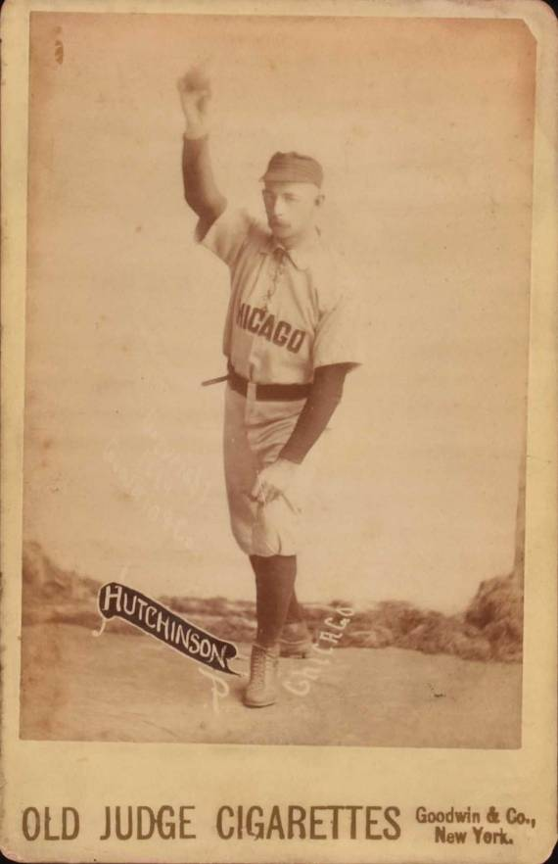
Old Judge Cigarette Cards,
Circa 1890
N172 produced 1887-1890

Slide 20
The Hoosier Thunderbolt
Amos Rusie
New York Giants
Circa 1890

Slide 21
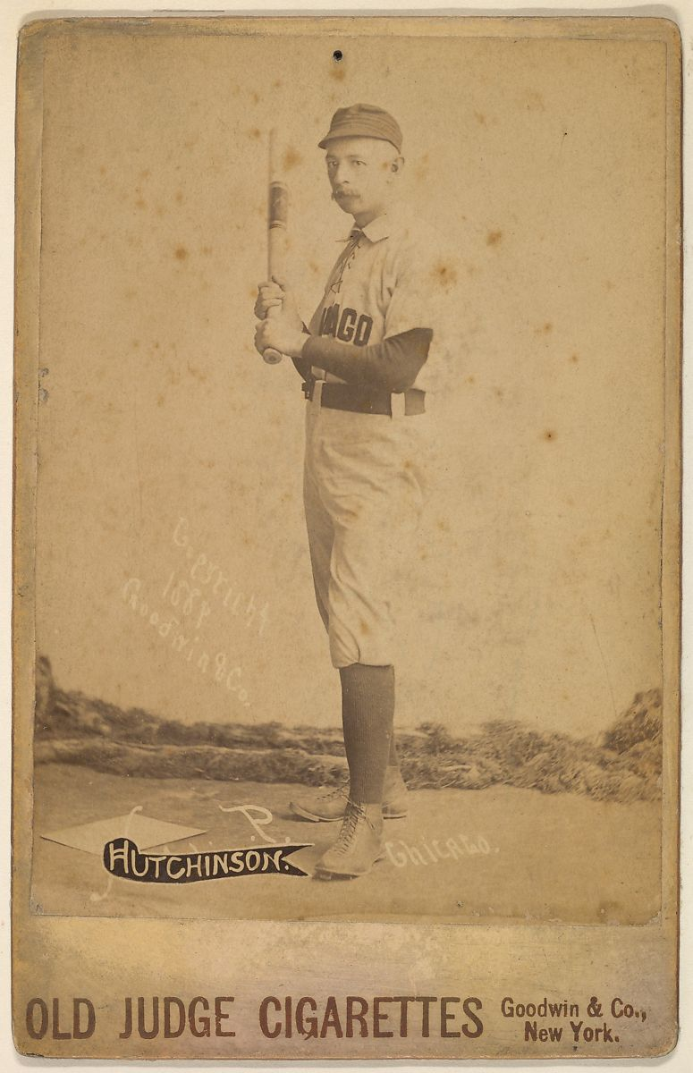
Old Judge Cigarette Cards,
Circa 1890
How hard did
Hutchison throw?

Slide 22
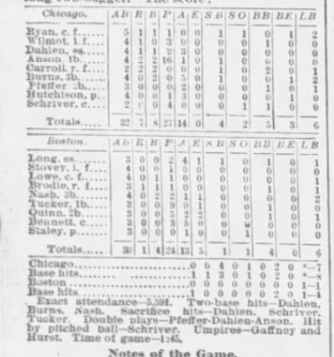
Hutchison’s four-hit, 7-1 victory over
Boston on September 14, 1891
Tribune: “Anson and his Colts have captured the
pennant beyond question.”

Slide 23
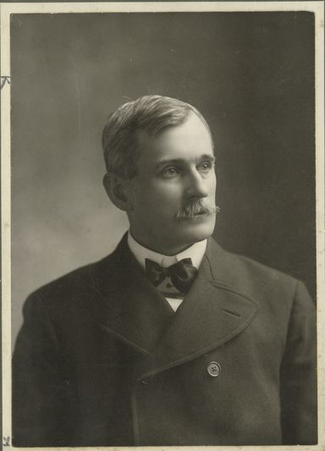
1891 Season-ending Controversy
John A. Hart, president of Chicago, files formal complaint with NL

Slide 24
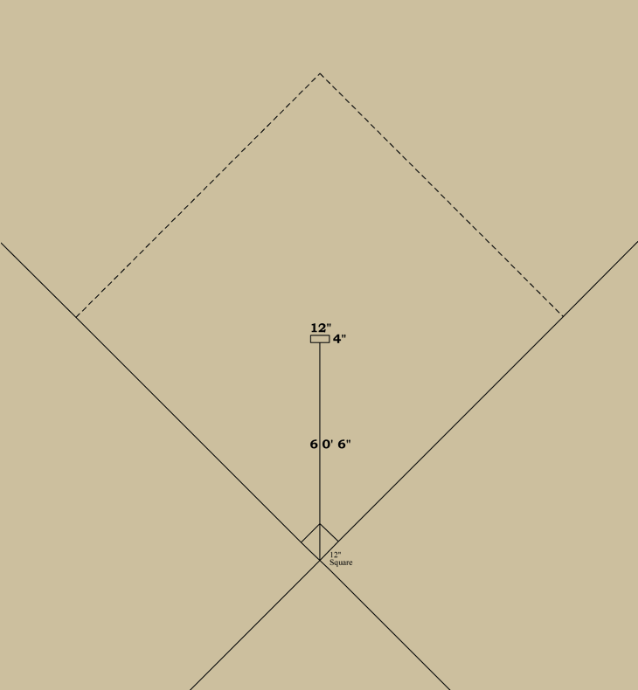
1893 National League
Sources:
Eric Miklich, 19th Century Baseball
John Thorn, Our Game

Slide 25
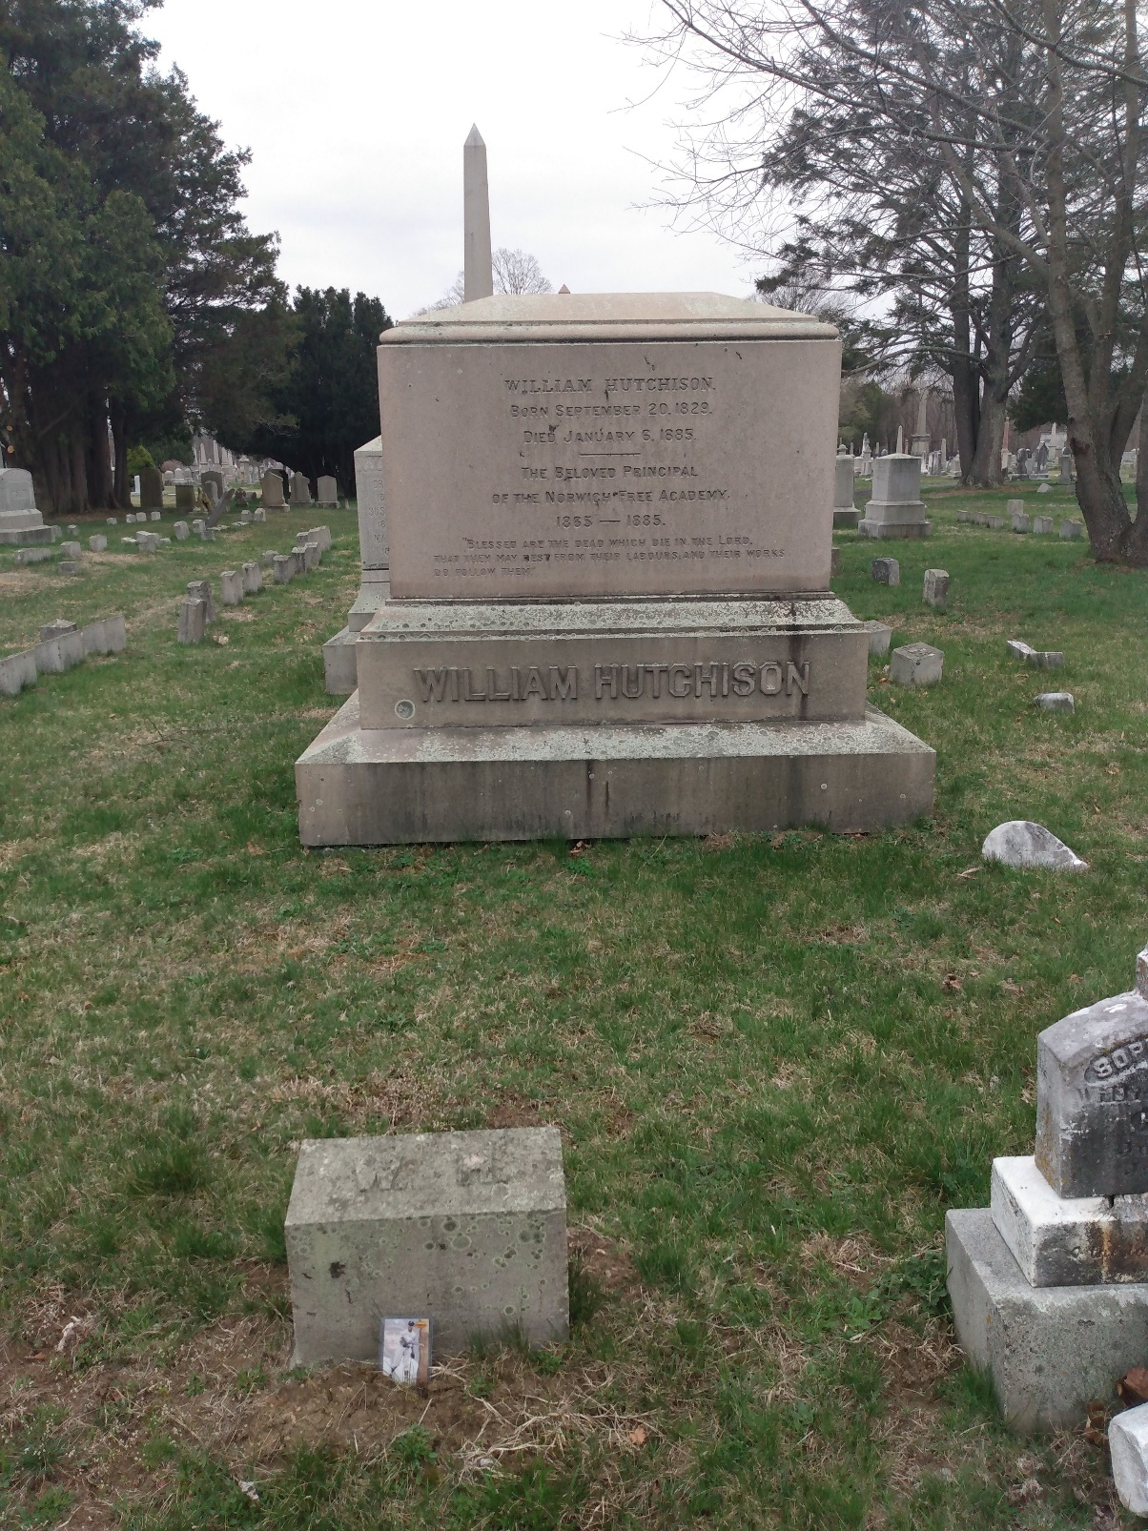
Yantic Cemetery in Norwich, Connecticut

