Slide 1
The Dodgers in Jersey City: The Giants-Dodgers Games
John J. Burbridge, Jr. and John R. Harris
SABR 47
June 30, 2017

Slide 2
Trivia Question
What pitcher was the winning pitcher against the Brooklyn Dodgers in three different ballparks in the same year during the regular season?

Slide 3
The Dodgers in Jersey City
In August 1955 Walter O’Malley announced that the Brooklyn Dodgers would play seven games in Jersey City in both the 1956 and 1957 seasons.
Dodgers would pay $10,000 per year for use of Roosevelt Stadium, upgrade the ballpark and receive both the gate and parking receipts
O’Malley also said Dodgers would not play in Ebbets Field in 1958 and Jersey City may be a viable alternative
It is surmised that O’Malley felt this announcement would put further pressure on politicians and officials to provide the Dodgers with a new stadium in Brooklyn

Slide 4
Jersey City
Directly across the Hudson River from lower Manhattan
Home to Roosevelt Stadium
Jersey City Giants played in the International League between 1937 and 1950
Jackie Robinson made his professional debut in Jersey City in 1946
Limited public transportation to Roosevelt Stadium which is on west side of City

Slide 5
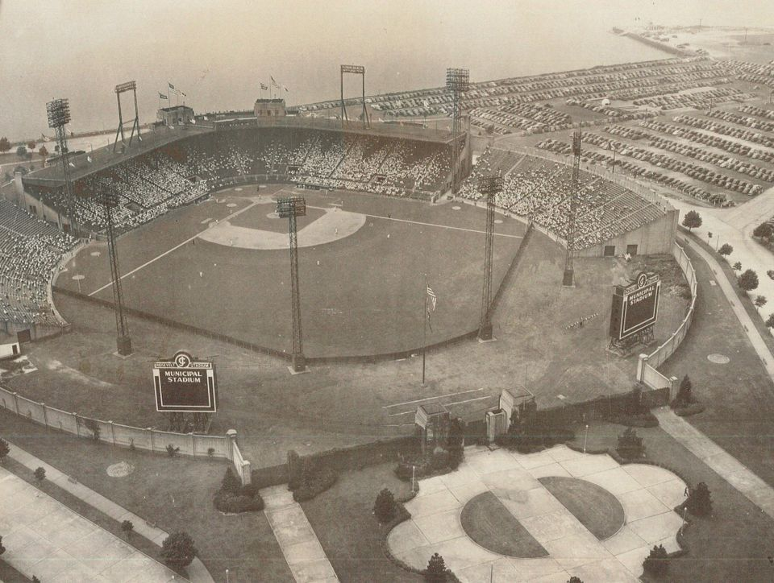
Roosevelt Stadium

Slide 6
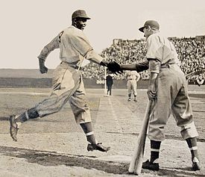
A Handshake for the Ages

Slide 7
1956 The First Six Games in Jersey City
The plan was for the Dodgers to play each of the NL teams once each season
The first game was played on April 12, 1956 against the Philadelphia Phillies. Dodgers won 4-3 before a disappointing 12,214
The Dodgers managed to win the next five games in Jersey City with only the Braves game a sellout
And now to the anticipated Giants-Dodgers 1956 game

Slide 8
The Giants-Dodgers Game August 15, 1956
The Giants were struggling with a 40-66 record while the Dodgers were in first place with a record of 60-45
Second game of a three game series - Giants won first game 3-1 with three runs in the 8th
Robinson, Reese, Hodges and Snider were in Dodgers lineup while Mays, Dusty Rhodes and Antonelli played on 1954 Giants team

Slide 9
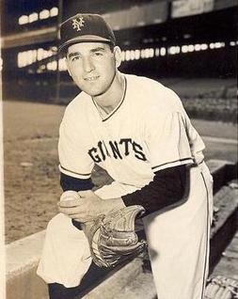
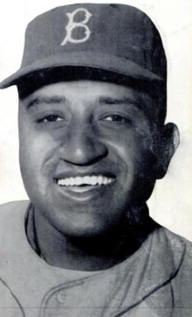
The Opposing Pitchers
Johnny Antonelli
Don Newcombe

Slide 10
The Giants-Dodgers Game August 15, 1956
Both Antonelli and Newcombe were sharp and there was no score after three innings
Willie Mays hit a home run as second batter in the top of the fourth (out of Roosevelt Stadium?)
Antonelli retired 15 batters in a row between 2nd and 7th innings
Charlie Neal doubled in 8th inning and was the only Dodger to reach 2nd base
Antonelli was masterful allowing two hits, one walk and striking out 11- ”Best game I ever pitched”, Johnny Antonelli, 5/24/2017.

Slide 11
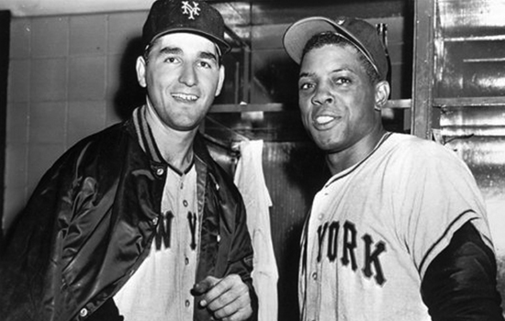
The Giants-Dodgers Game August 15, 1956 Stars of the Game

Slide 12
The First Year in Jersey City
Attendance was disappointing
Jersey City experience did not appear to create great anxiety in New York officials
O’Malley stated in August 1956 that the current number of games in Jersey City were appropriate
Dodgers win the pennant in 1956 but lose to the Yankees in World Series as Jersey City Johnny Kucks shuts out Dodgers in Game 7
And now to the 1957 game

Slide 13
The Giants-Dodgers Game August 7, 1957
It’s Antonelli vs. Newcombe once again
Newcombe pitched into the 9th inning with the Dodgers leading 5-3
Giants scored 5 runs in the 9th with a 3 run pinch-hit HR by Hank Sauer the big blow
Newcombe was booed and one report in the Jersey Journal said he spit at the crowd
Marv Grissom was the WP with three scoreless innings of relief
The Giants swept the Dodgers in the two Jersey City games

Slide 14
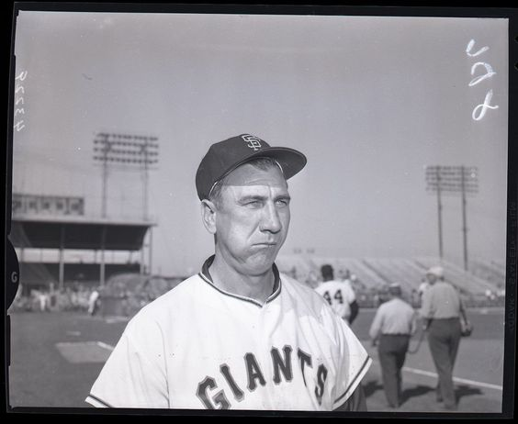
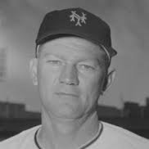
The Giants Dodgers Game August 7, 1957 Stars of the Game
Hank Sauer
Marv Grissom

Slide 15
The Experiment Is Over!!
The Giants voted to move to SF on August 17, 1957
The Dodgers played two more games in Jersey City in August and September, winning one and losing one
The Dodgers announced the move to LA at season’s end
What did the Dodgers accomplish by playing in Jersey City? More in the Poster Session…

Slide 16
What’s Left for Jersey City?
With Dodgers leaving, there was some hope that the Dodgers experiment would result in a minor league franchise
The Havana Sugar Kings moved to Jersey City in 1960
The Sugar Kings moved at the end of 1961 season
Minor league baseball does return in the 1970s but without much support!!

Slide 17
Conclusions
The Dodgers increased their revenue with the Jersey City experience
The Jersey City games did not sway Robert Moses or Robert Wagner to meet O’Malley’s desires
Jersey City received exposure that probably contributed to the Sugar Kings moving there in 1960
The Giants sweep of the Dodgers made 1956 and 1957 a bit more palatable for a Jersey City native who is a Giants fan!!

Slide 18
Questions!!

