Slide 1
“In Spite of His Color:”
19th Century ‘Integrated’ Baseball
at Phillips Academy Andover
Elena Dugan
Phillips Academy Andover & Harvard University

Slide 2
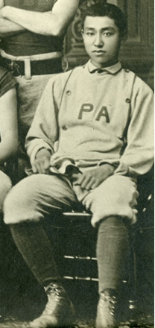
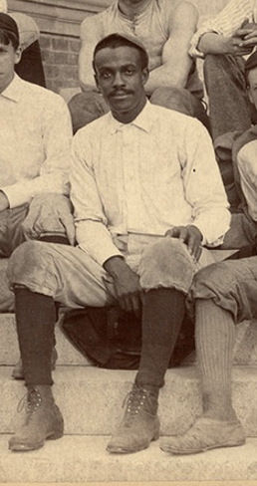
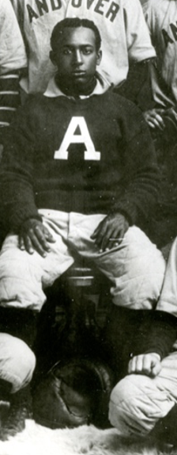
Today’s Talk:
01
02
03
Chentung Liang Cheng, Class of 1881
William Taylor Burwell Williams, Class of 1893
William Clarence Matthews, Class of 1901

Slide 3
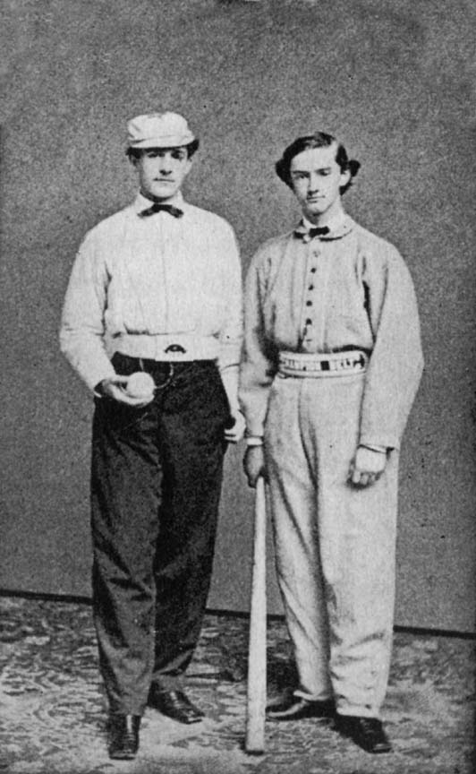
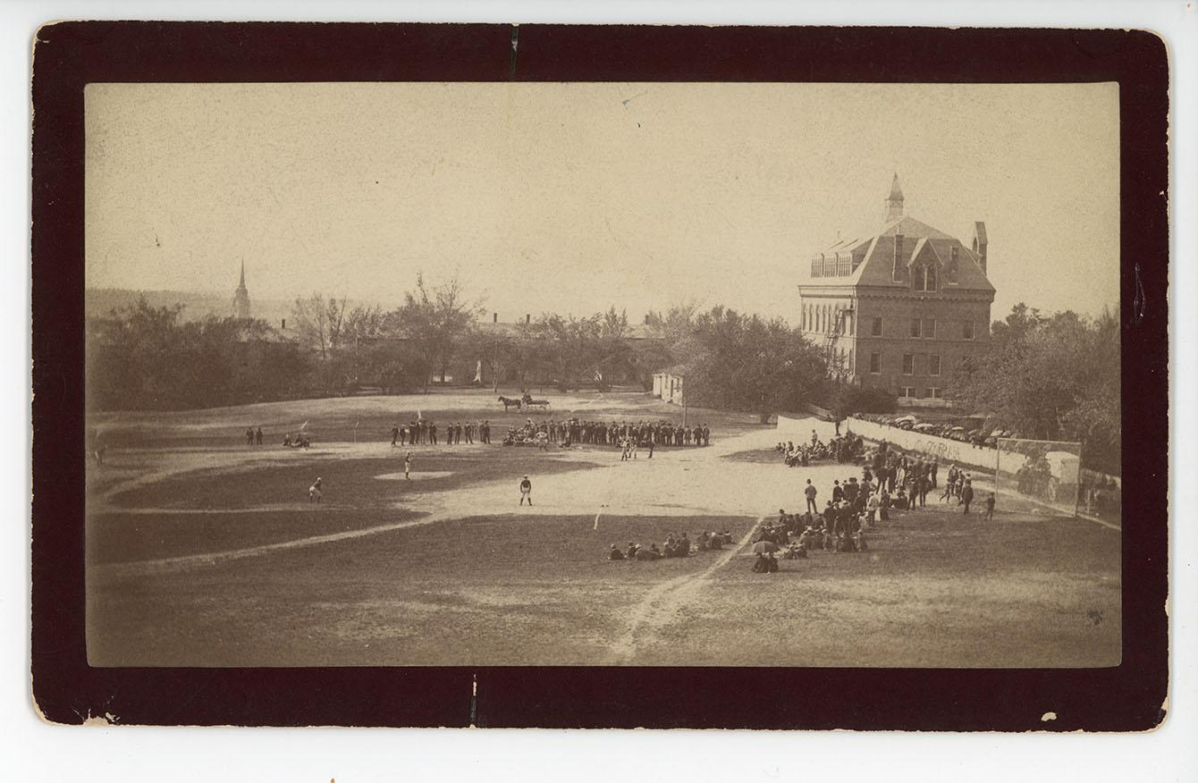
Baseball at Andover
Archie Bush, expelled (!) 1867
Harvard @Andover, 1885

Slide 4
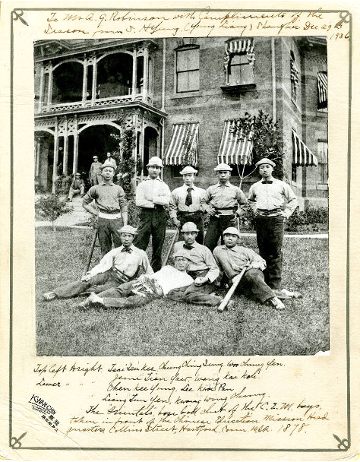
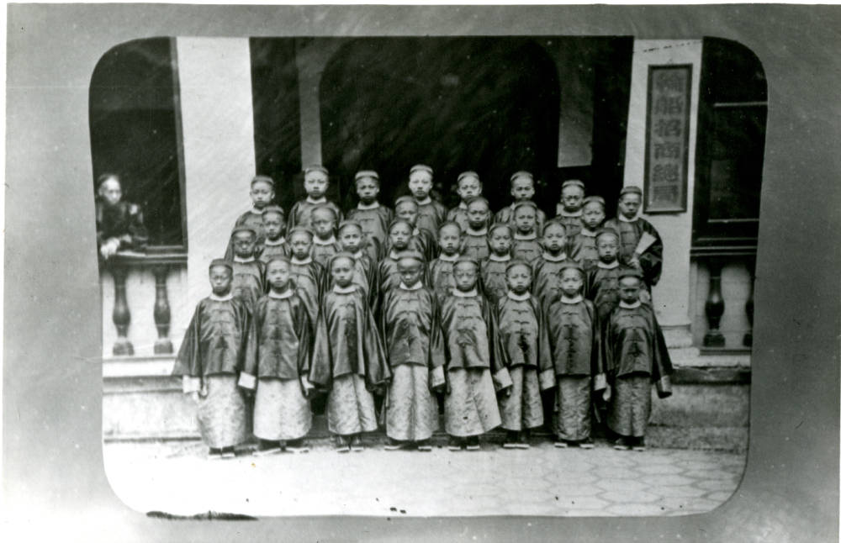
Chinese Educational Mission (1872-1881)
Boys of CEM, undated (likely 1870s)
The Hartford “Orientals,” 1878

Slide 5
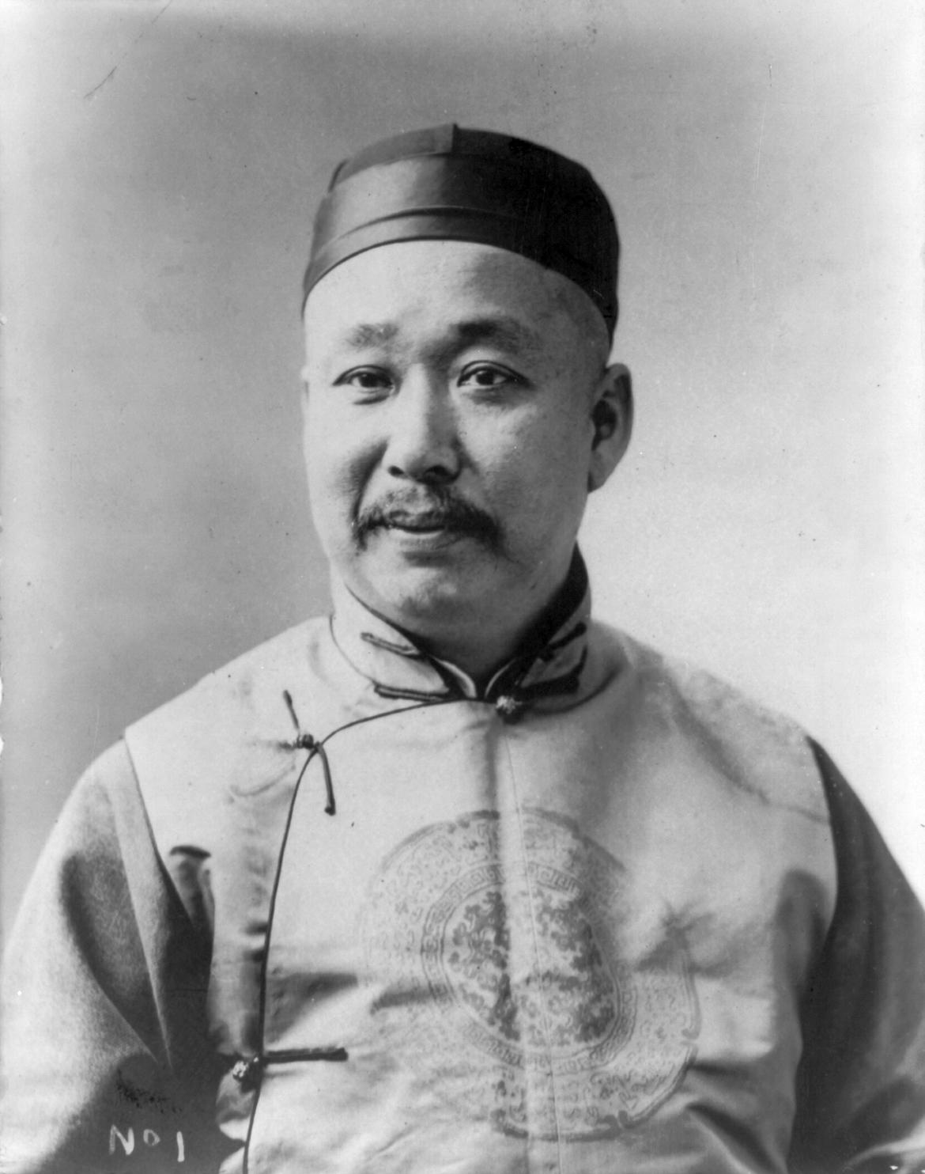
Chentung Liang Cheng
(Pi Yuk)

Slide 6
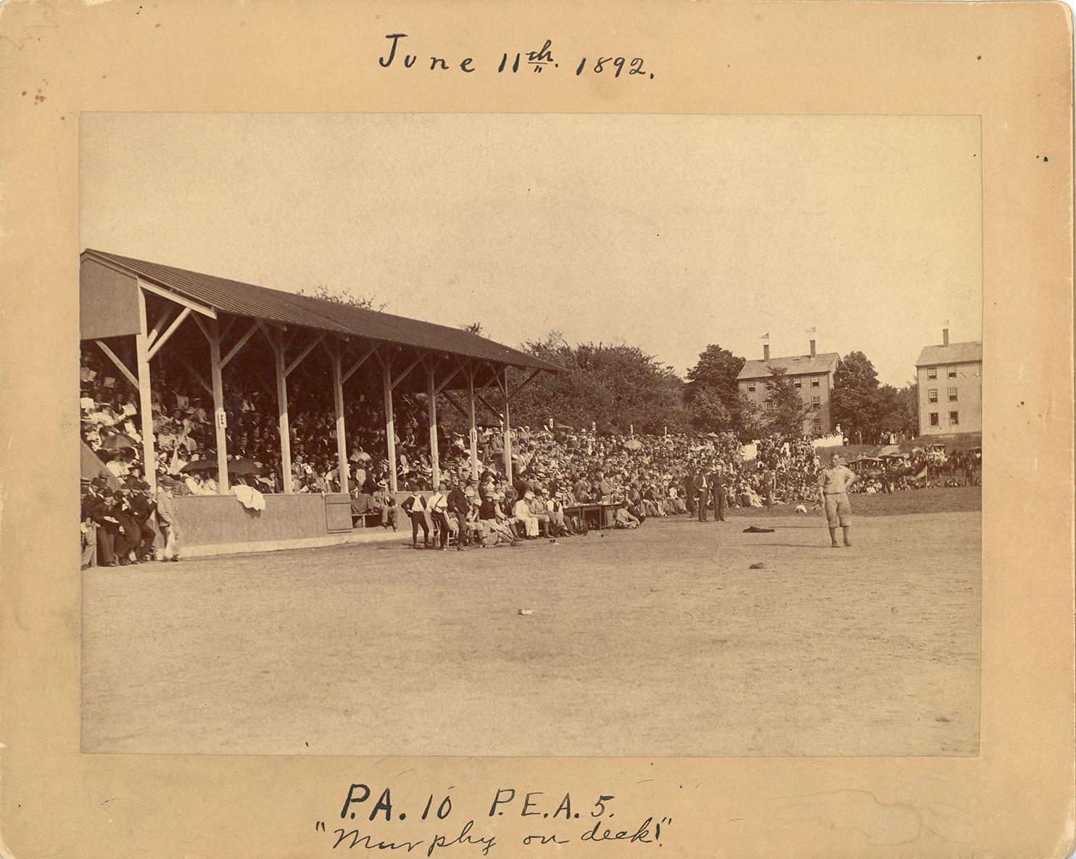
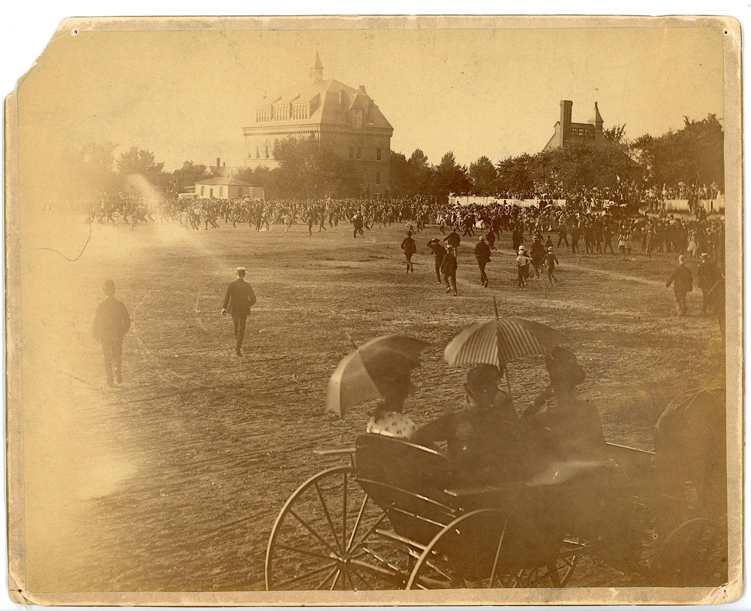
Andover-Exeter: A Storied Rivalry
1892
1888

Slide 7
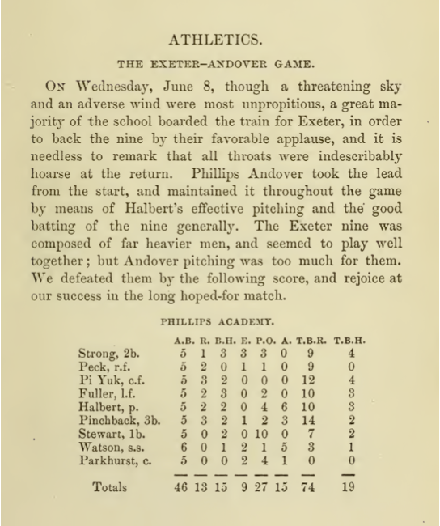
-Liang Cheng, 1903
Even Rome could not have received Caesar with greater enthusiasm and pride when he returned from his famous campaigns in triumph!”

Slide 8
-Liang Cheng, 1907
“President Roosevelt told him that an Andover student he met in one of his hunting trips in the West had informed him that he thought the new Chinese minister was the Chinese boy that played on the Andover nine in the ‘80’s and won a championship game by a hit. ‘When I assured the President that I was the same person,’ said Sir Liang, from that moment the relations between President Roosevelt and myself became ten-fold stronger and closer.”

Slide 9
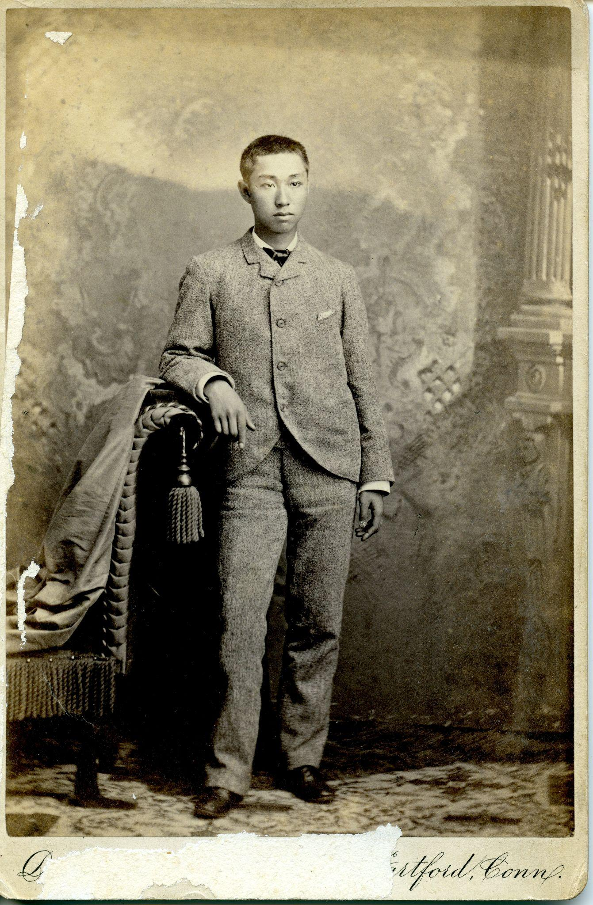
“Minister Liang an Athlete,” New York Times, 1903
“The Phillips Academy boys at first took the idea of the Chinaman’s playing baseball as a joke, and were disposed to guy him out of the box when he undertook to pitch…The young Mongolian had been playing in the field for a long time and had shown that he was worth the while at a long fly or a sharp play, but no one thought he knew a thing about pitching until one day the regular pitcher was away and he volunteered to take his place. There was a laugh all over the field when he went to the middle of the diamond. He had hardly got down to work before they discovered that he had got the knack of twisting the ball to suit himself, and that he could curve the best men on the other nine out of every time…As long as he stayed at Andover he had the honor of pitching in the first nine of the school.”

Slide 10
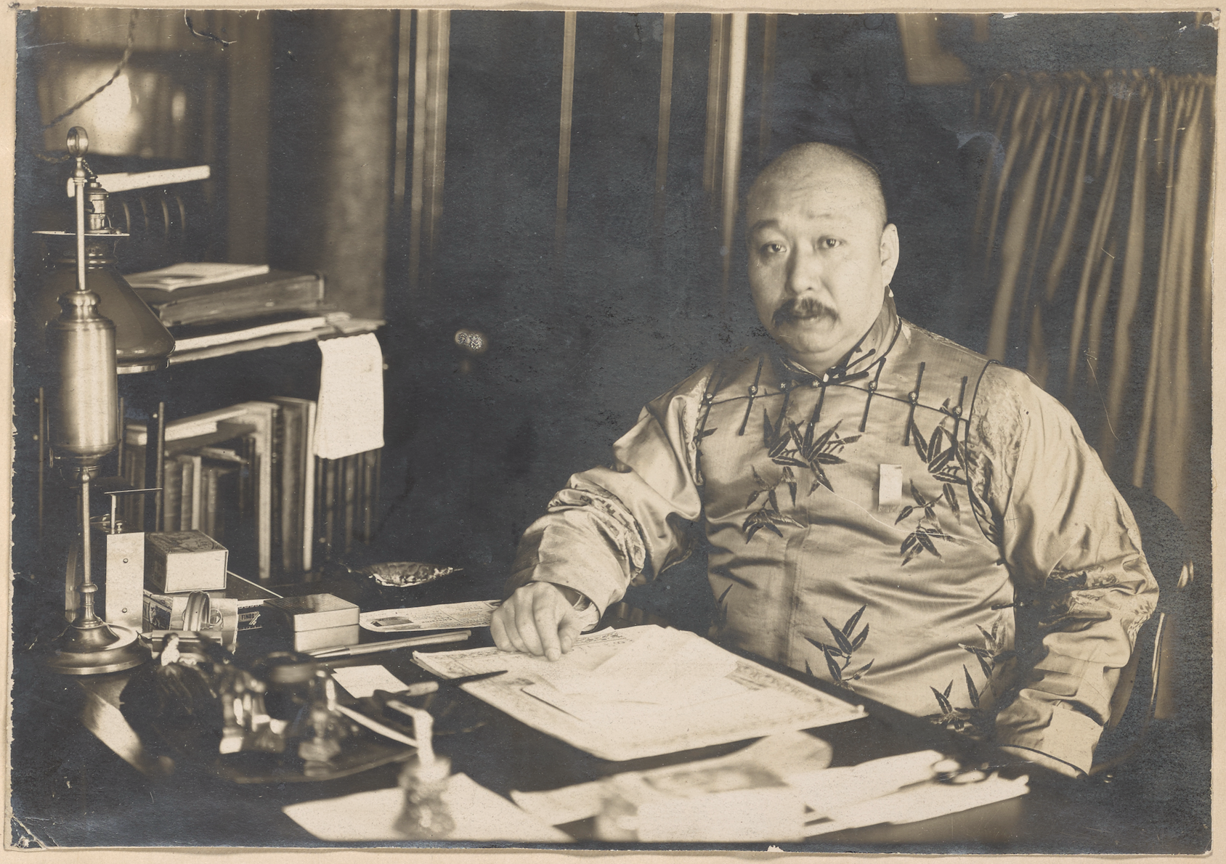
“Sir Liang’s Baseball Days,” Washington Post, 1905
“Could you give us now one of those down shoots you used to hand out when we were up against Yale or Harvard?” asked one of the alumni well acquainted with the Minister. “Not in these clothes,” whispered the Minister, glancing at his silken robes.”

Slide 11
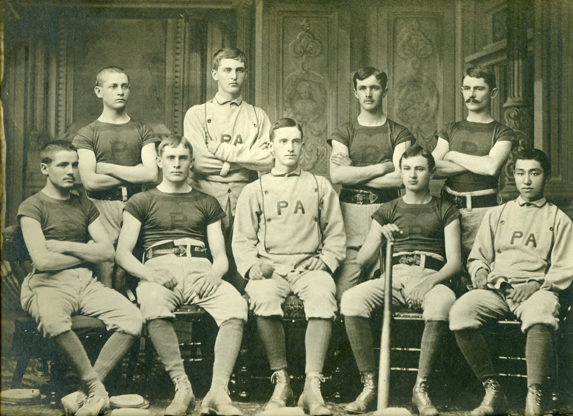
The Hartford “Orientals,” 1878
Phillips Academy Starting Nine, 1881
Liang Cheng, first row, far right.

Slide 12
Chentung Liang Cheng
(Pi Yuk)

Slide 13
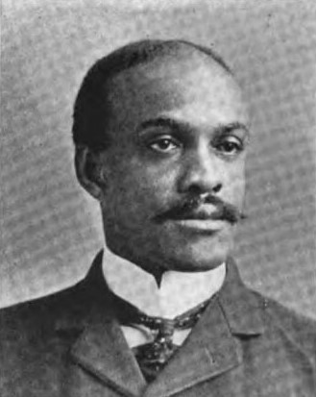
William Taylor Burwell Williams

Slide 14
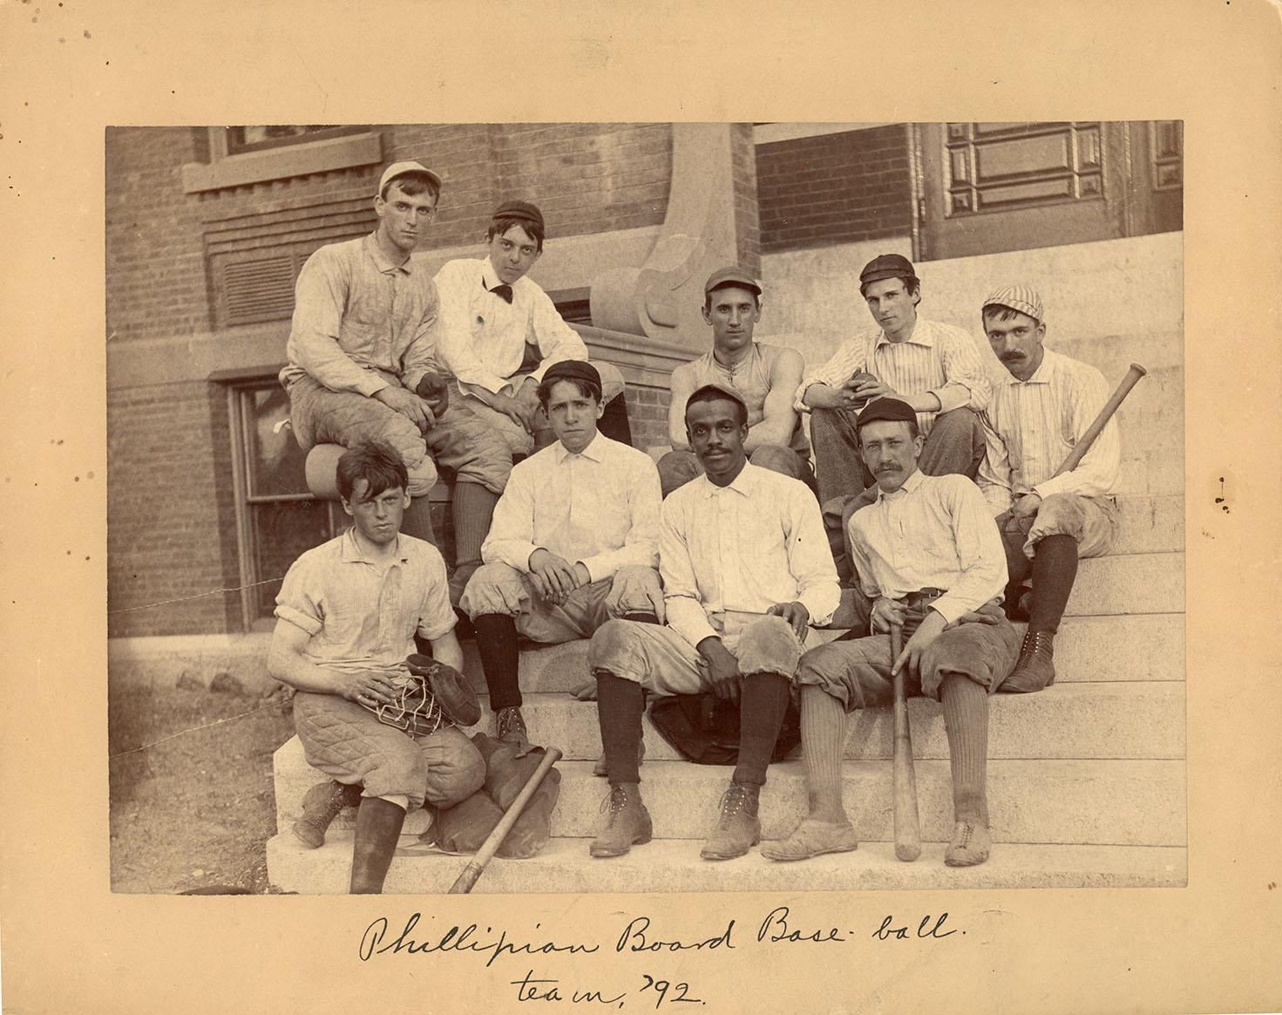
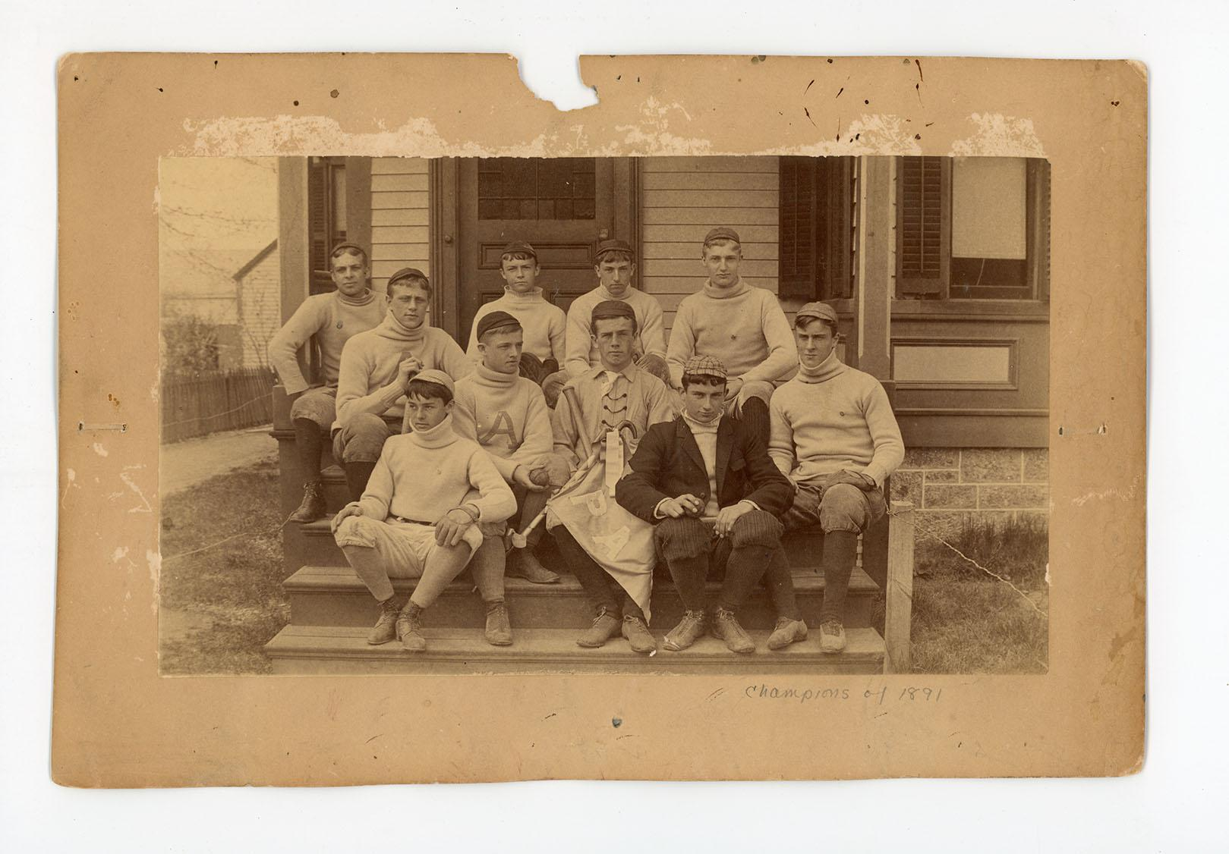
Phillipian Board Baseball Team, 1892
W.T.B. Williams, first row, second from right
Morton Street Baseball Team, 1891
One of the many informal campus teams

Slide 15
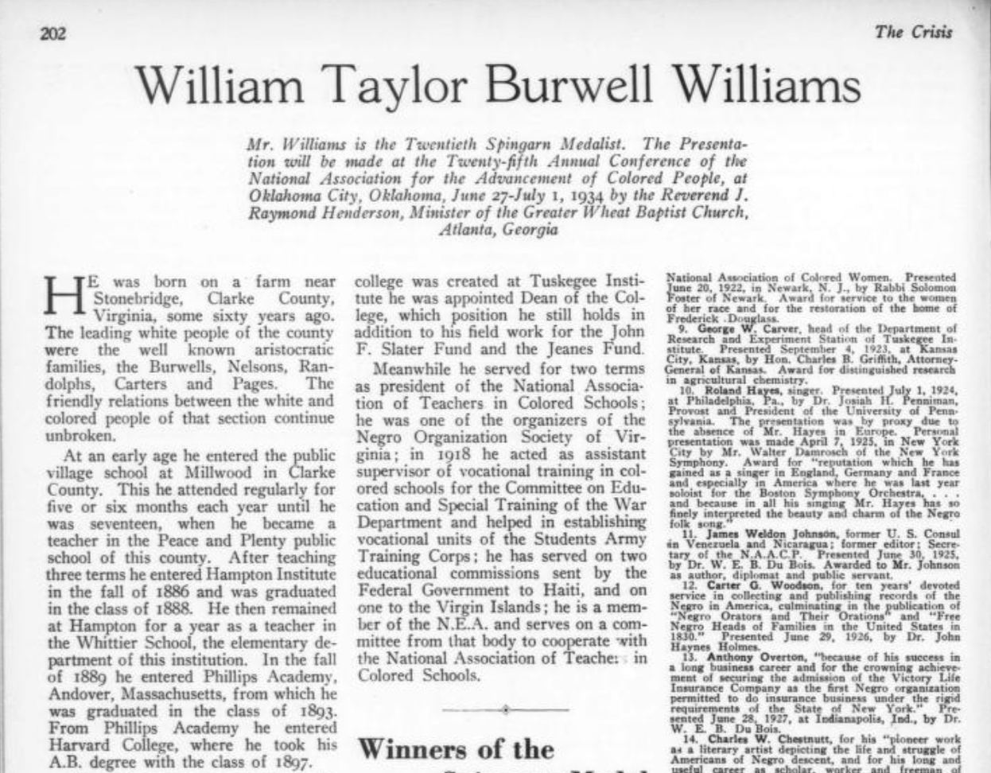
1934 Profile in the NAACP’s Magazine, The Crisis

Slide 16
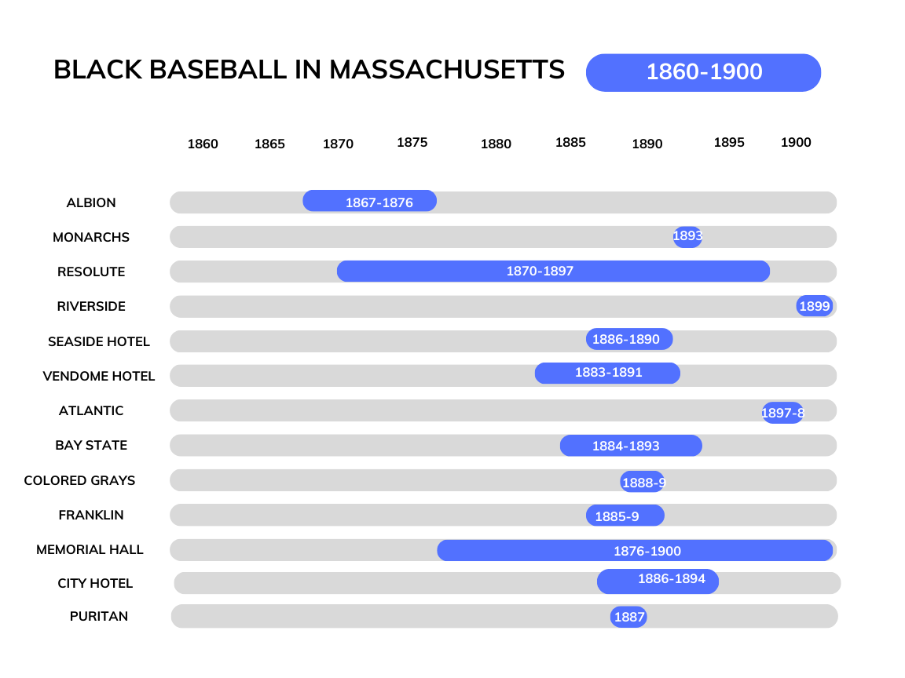
Data drawn from James E. Brunson, Black Baseball, 1858-1900: A Comprehensive Record of the Teams, Players, Managers, Owners and Umpires, vol. 2 (Jefferson, North Carolina: McFarland & Company, Inc., Publishers, 2019), 116–20.

Slide 17
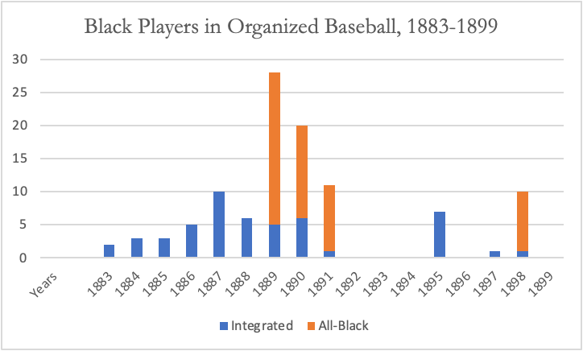
Data drawn from Merl F. Kleinknecht, “Blacks in 19th Century Organized Baseball,” Baseball Research Journal 6 (1977): 118–26.

Slide 18
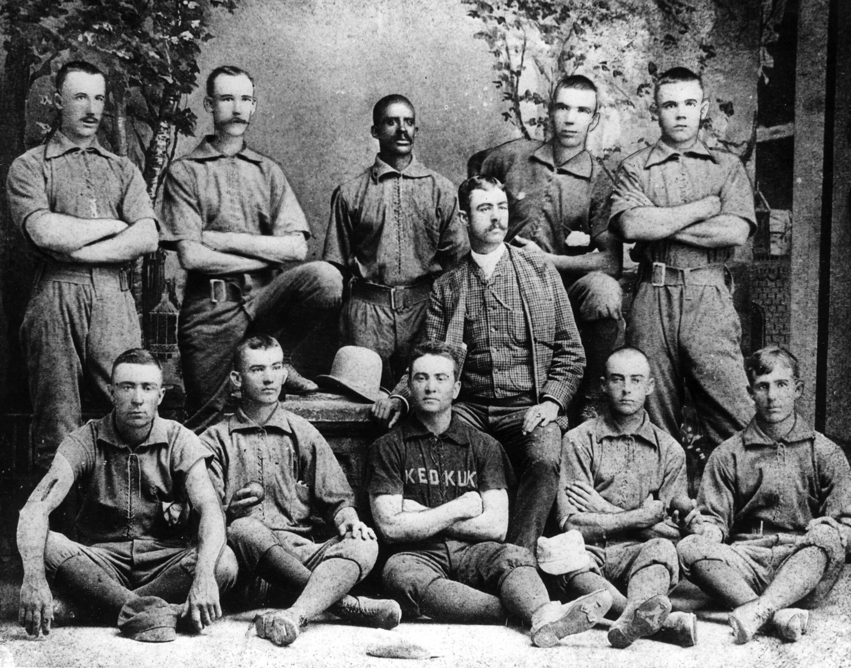
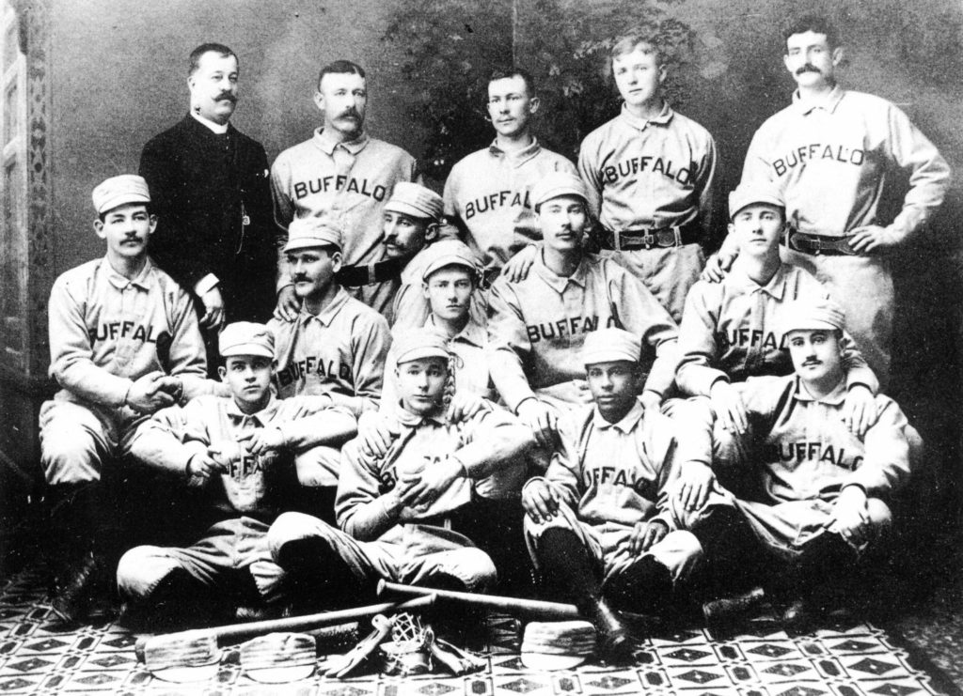
1887 Keokuk Hawkeyes
Bud Fowler–back row, middle.
1887 Buffalo Bisons,
Frank Grant–first row, second from right.

Slide 19
Data drawn from Merl F. Kleinknecht, “Blacks in 19th Century Organized Baseball,” Baseball Research Journal 6 (1977): 118–26.

Slide 20
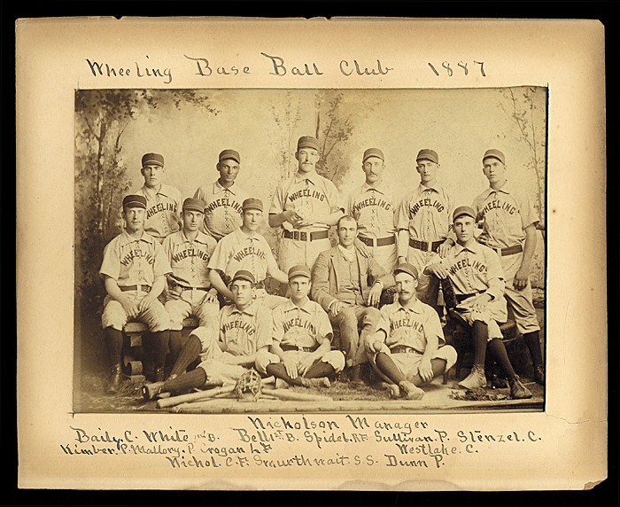
“1887 [was] a banner year for colored talent in the white leagues. But this year marked the beginning of the elimination of colored players from white clubs. All the leagues, during the Winter of 1887 and 1888, drew the color line, or had a clause inserted in their constitutions limiting the number of colored players to be employed by each club.”
-Sol White
1887 Wheeling Green Stockings
Sol White–back row, second from left.

Slide 21
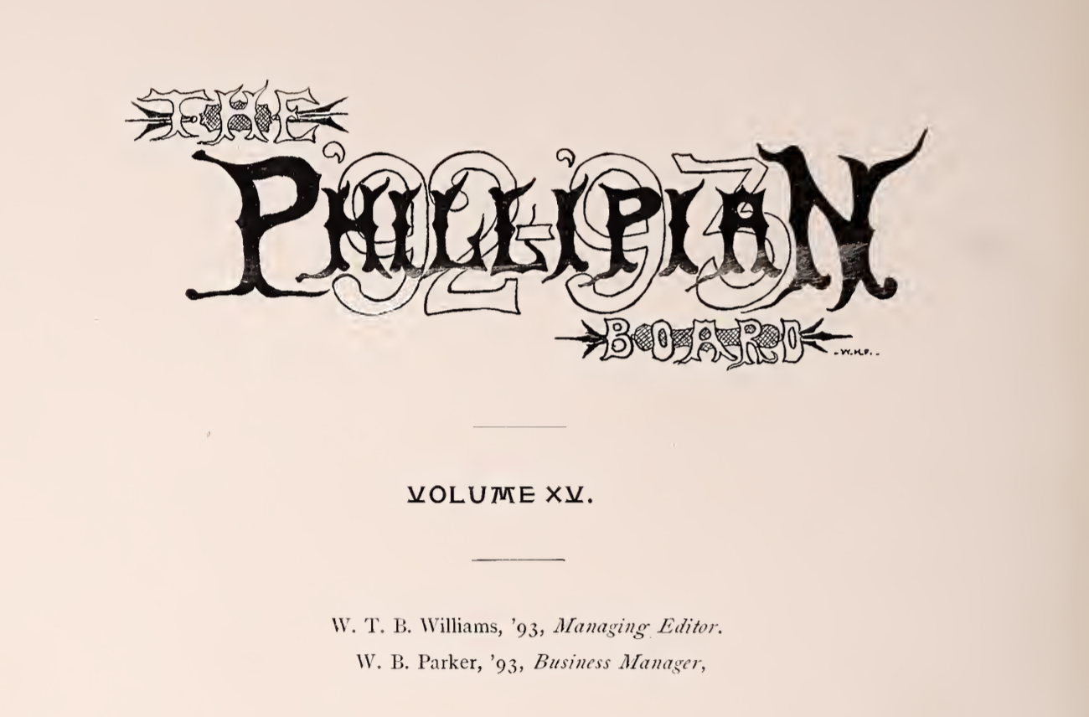
W.T.B. Williams at School

Slide 22
“As usual Williams is never left out and so I find his card. This man is a hard worker. Is managing editor of the Phillipian, has won first Draper prize, second Means and so on. No doubt he has a great career if it could only be found, however, this much has been ascertained. For eight years previous to his coming to Andover he worked on a perpetual motion machine and seems to have perfected the instrument in his own tongue.”
Harry B. Winters on W.T.B. Williams
The Masque (Yearbook), 1893

Slide 23
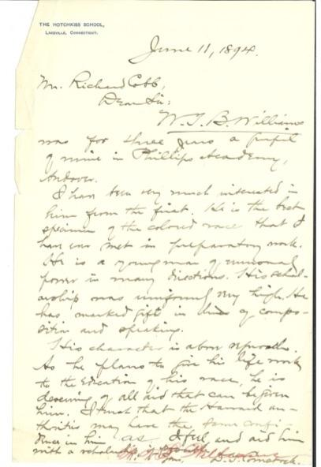
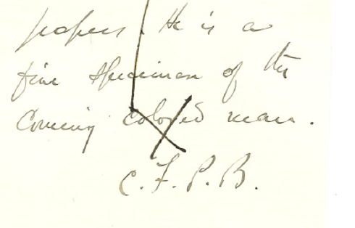
(left) “He is the best specimen of the colored man that I have ever met in preparatory work.”
-Richard Cobb on W.T.B. Williams, 1894
“He is a fine specimen of the cunning colored man.”
-Cecil P. Bancroft, Headmaster of Phillips Academy

Slide 24
Phillipian Board Baseball Team, 1892
W.T.B. Williams, first row, second from right
Morton Street Baseball Team, 1891
One of the many informal campus teams

Slide 25
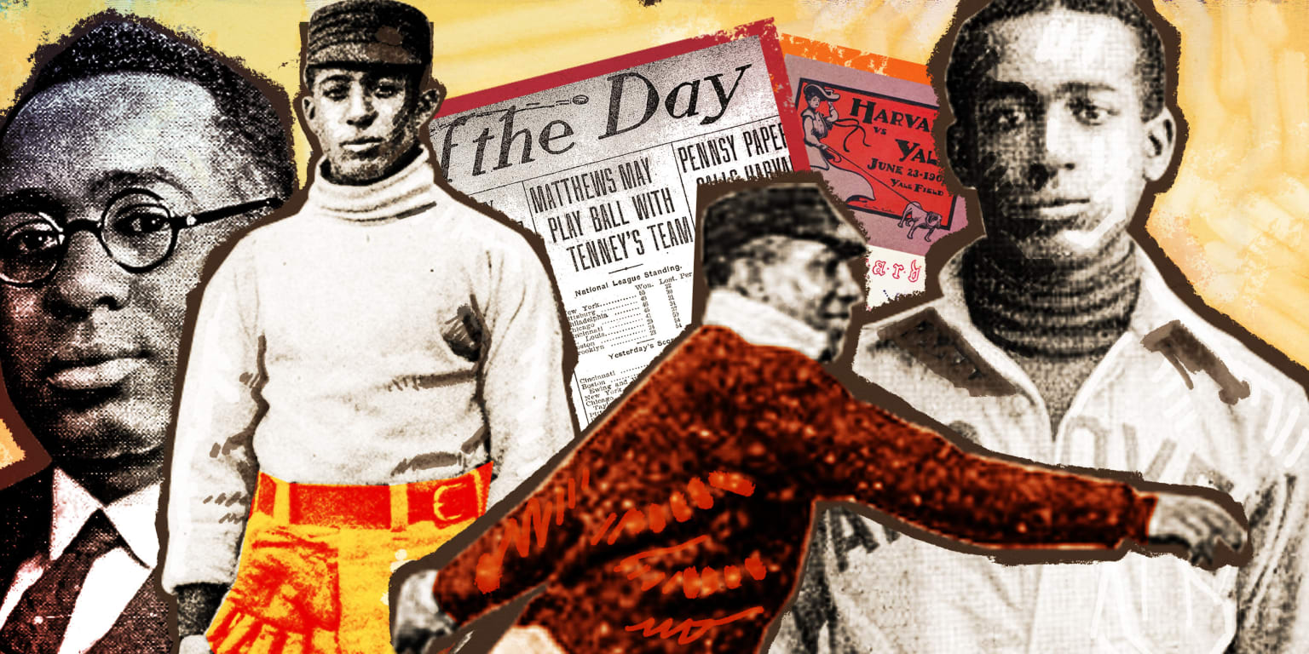
William Clarence Matthews
Art by Tom Forget, for mlb.com

Slide 26
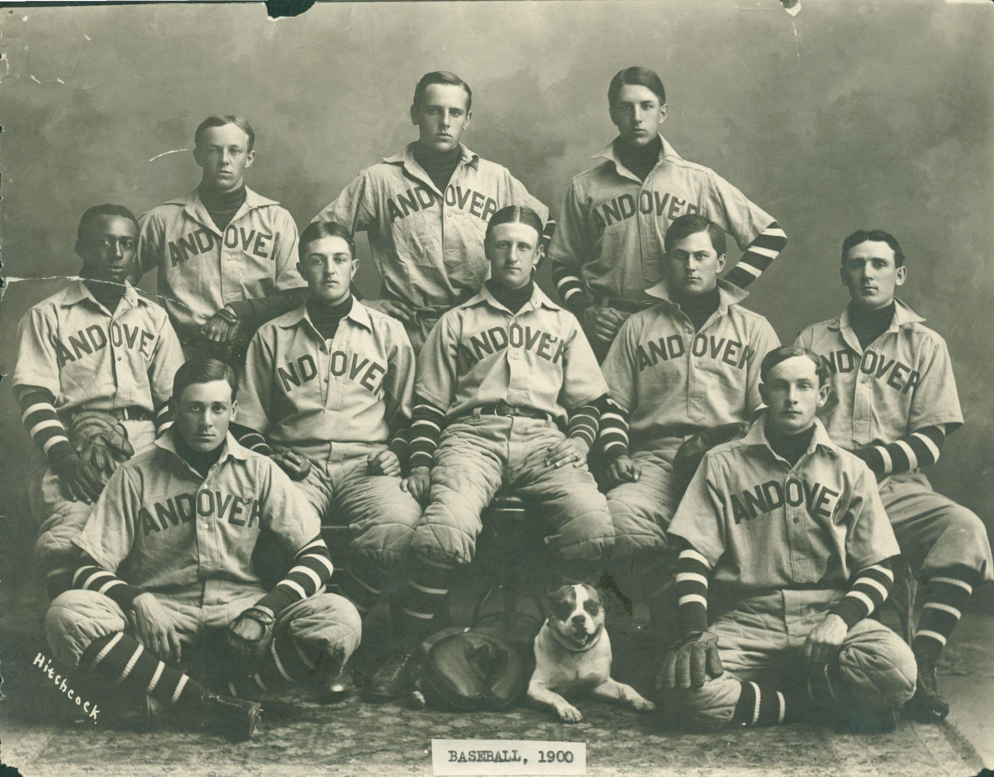
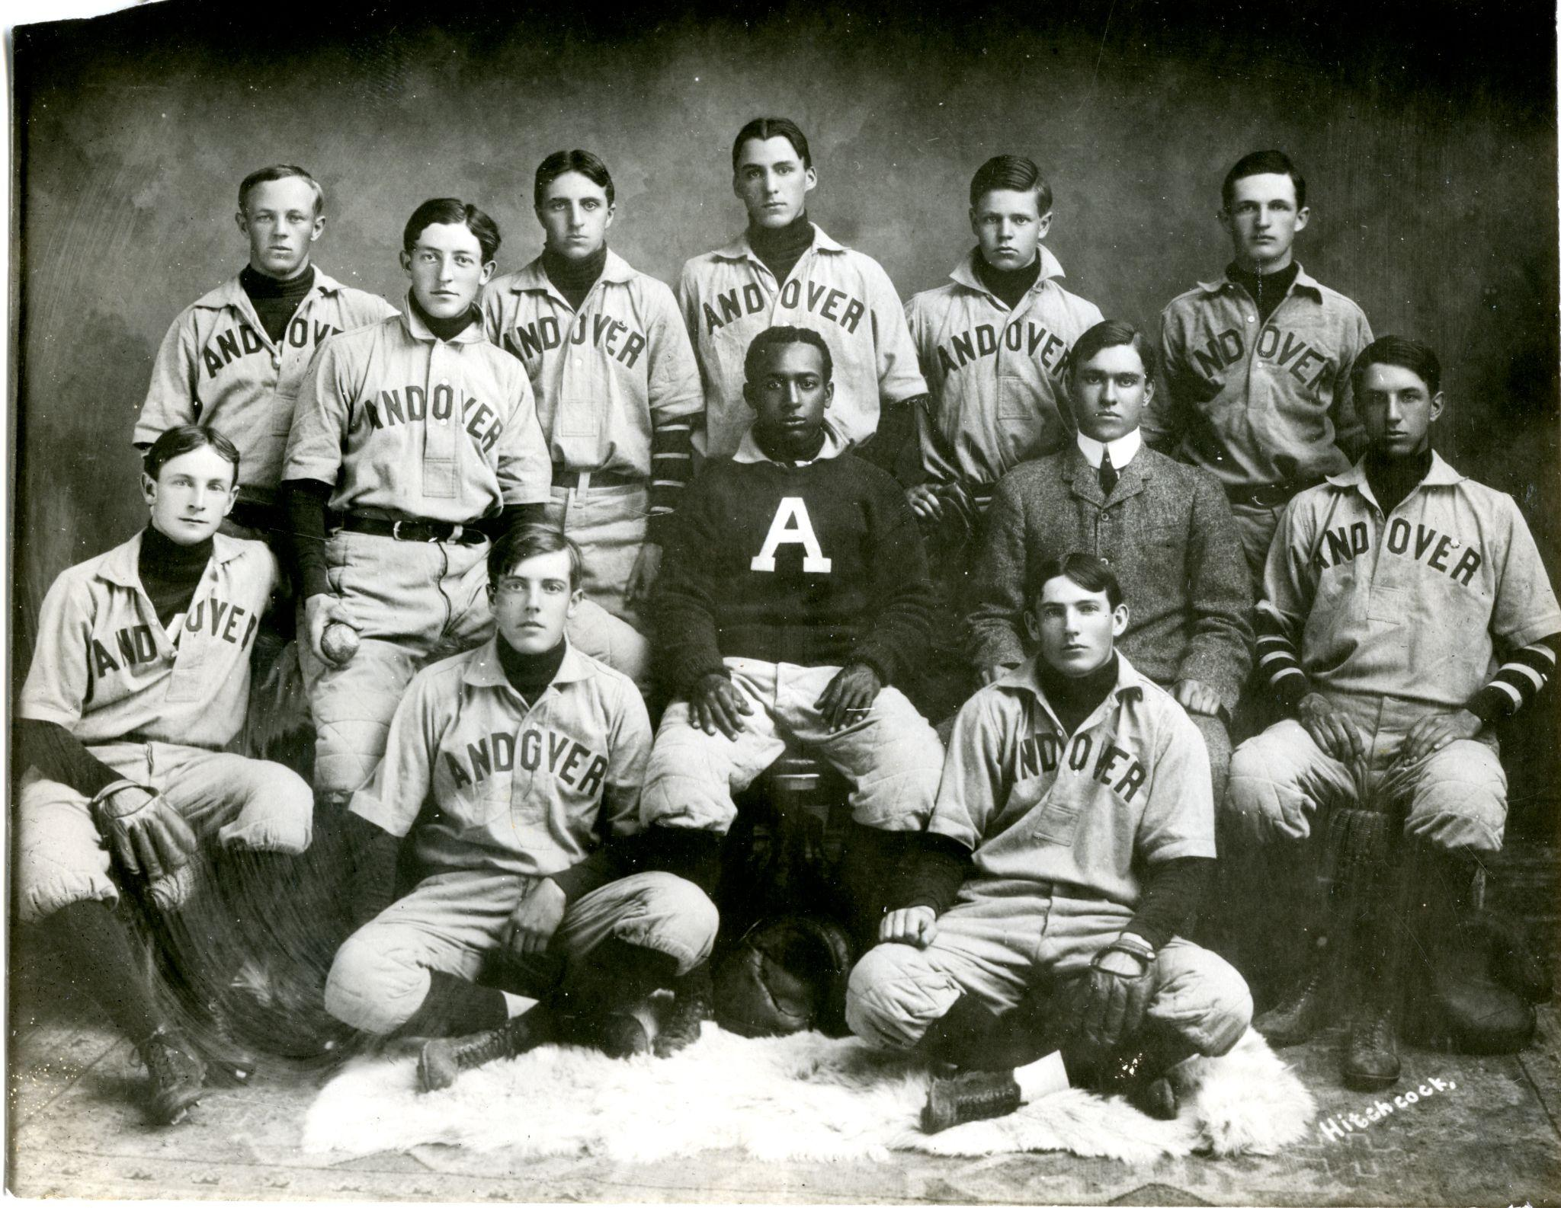
Andover Starting Nine,
1900
Andover Starting Nine,
1901

Slide 27
19th Century Black Ballplayers on Integrated College Teams
Player | School | Confirmed Years
William Edward White | Brown University | 1879-1880
Moses Fleetwood Walker | Oberlin College/ University of Michigan | 1881/1881-1882
Weldy Walker | Oberlin College/ University of Michigan | 1881/1882-1884
George Albert Flippin | University of Nebraska | 1891-1894 (?)
James Francis Gregory | Amherst College | 1895-1898
Eugene Gregory | Harvard University (non-varsity) | 1897
Frank Armstrong | Cornell College (Iowa) | 1898-1900

Slide 28
Early 20th Century Black Ballplayers on Integrated College Teams
Player | School | Confirmed Years
William Clarence Matthews | Harvard University | 1901-1905
Merton P. Robinson | Oberlin College | 1902
Charles Lee Thomas | Ohio Wesleyan University | 1903
Thomas Taylor | Wesleyan University | 1905
George Walter Williams | University of Vermont | 1905-1906
Fenwick Henri Watkins | University of Vermont | 1906
Samuel Ransom | Beloit College | 1906
Howard N. Robinson | Oberlin College | 1904-1908
Oscar Brown | Syracuse University | 1908

Slide 29
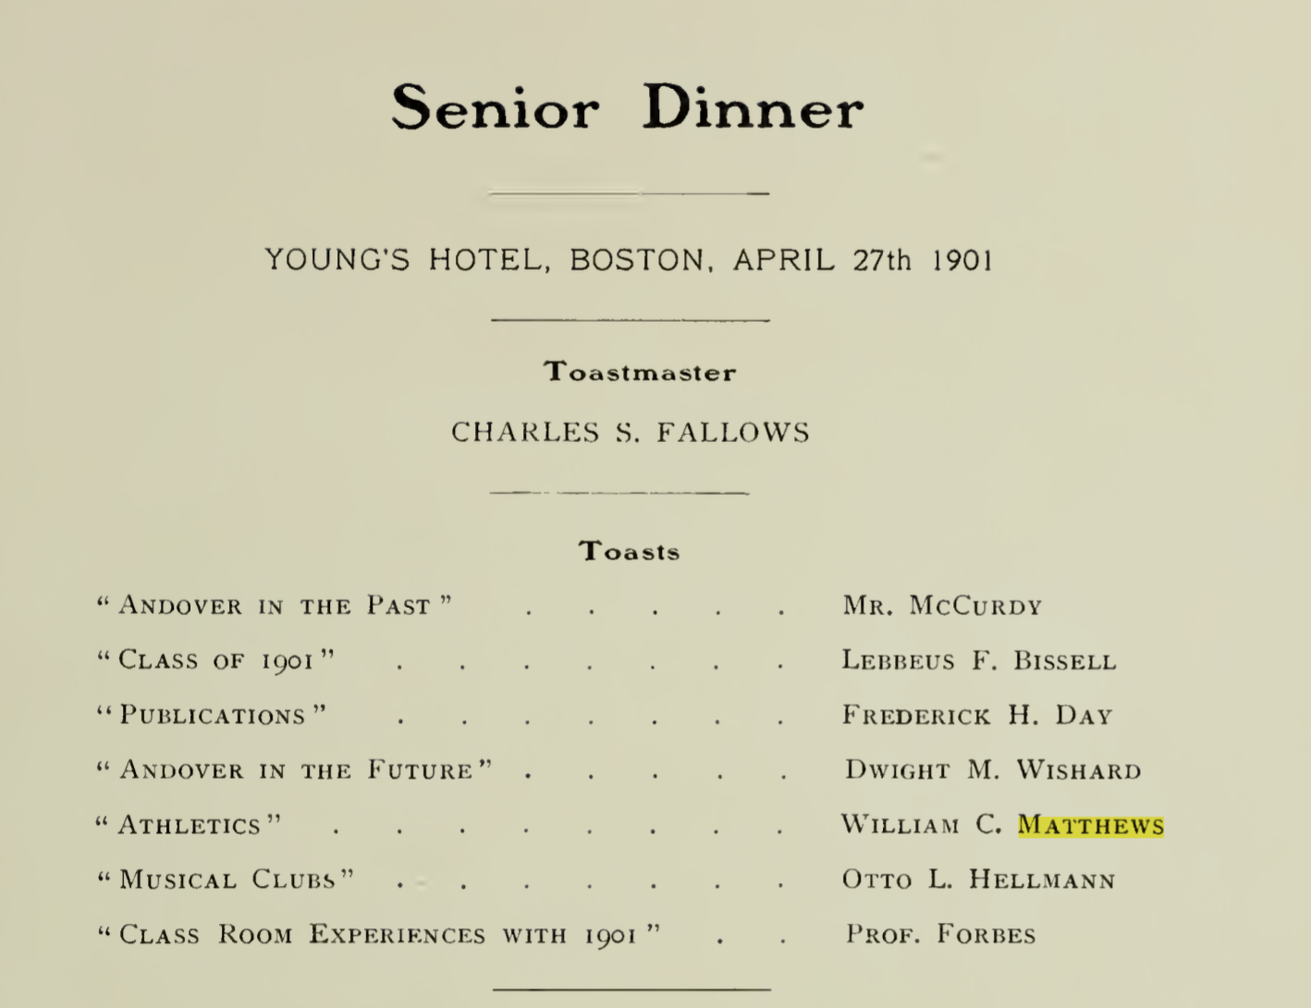
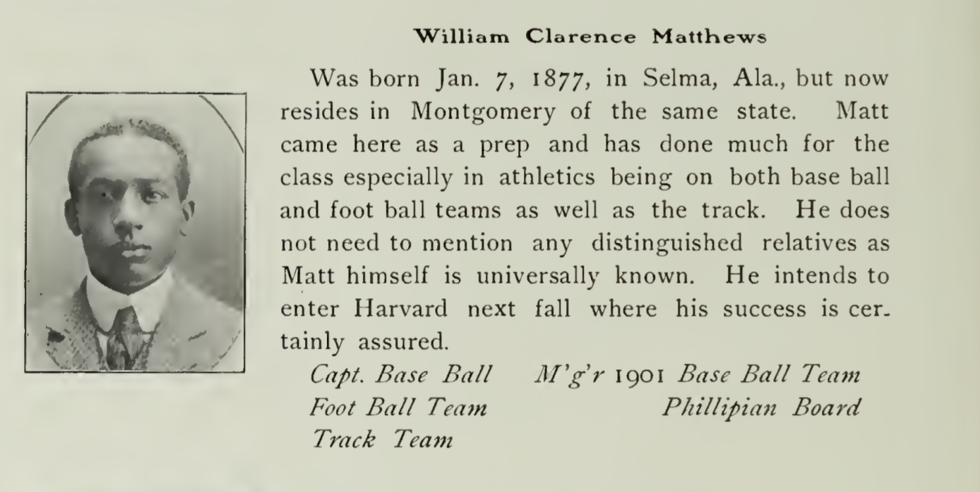
William Clarence Matthews–from his 1901 Yearbook

Slide 30
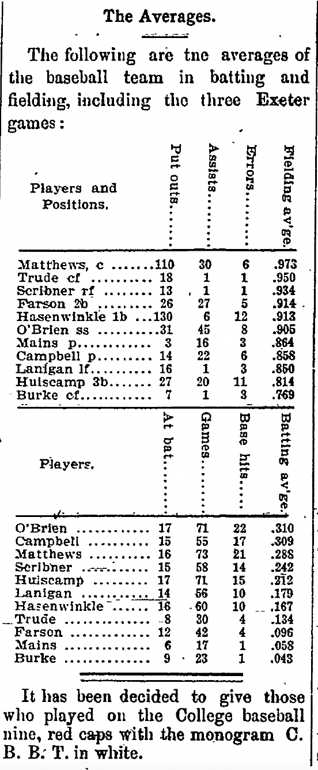
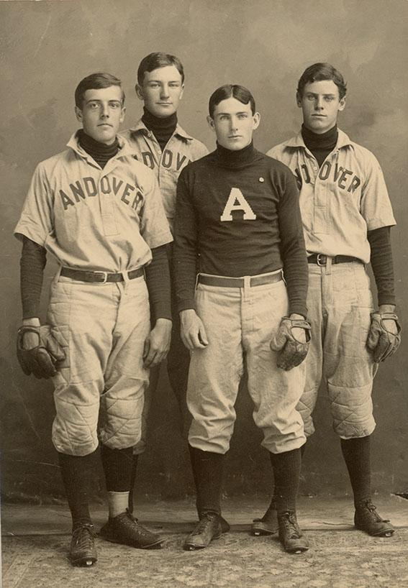
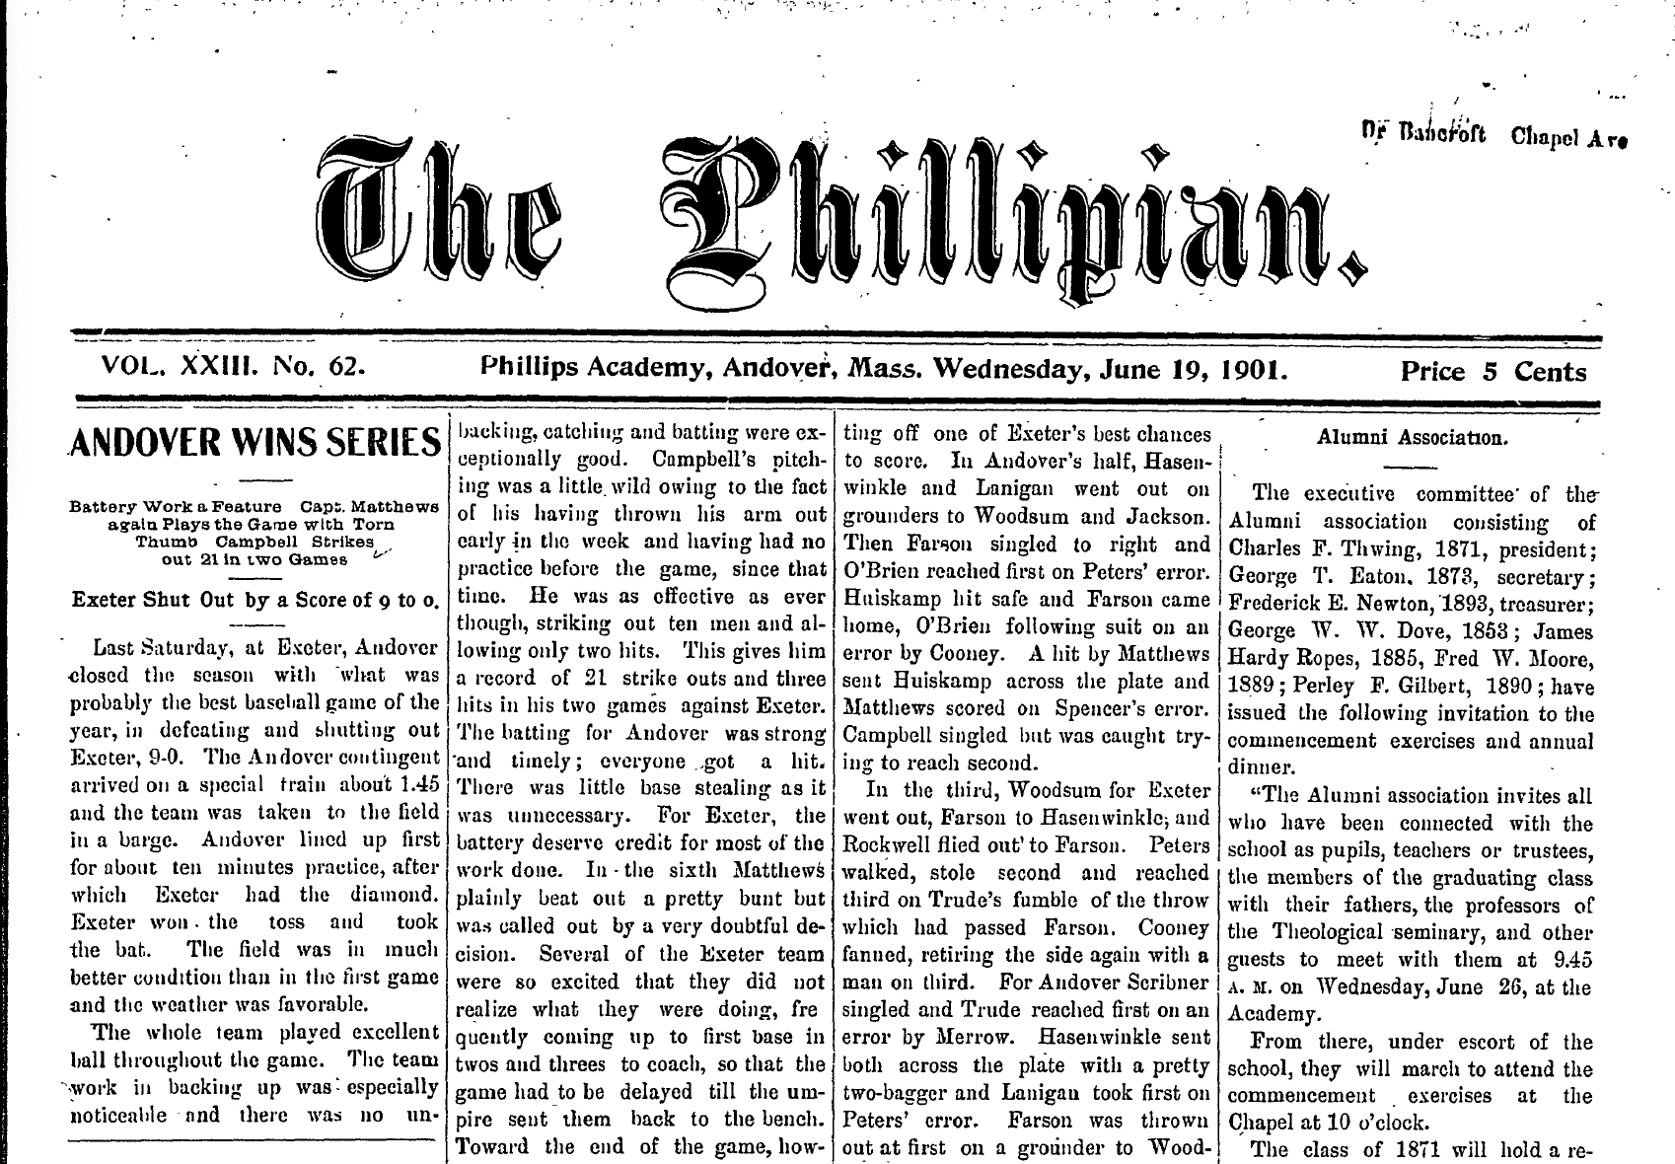
Andover-Exeter, 1901

Slide 31
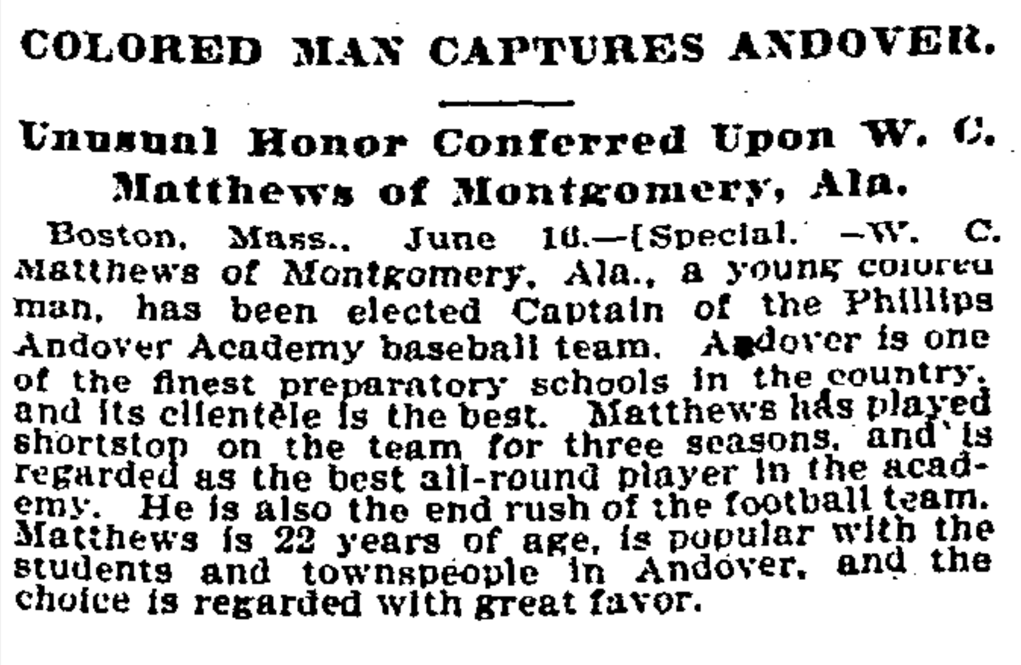
Captain Matthews

Slide 32
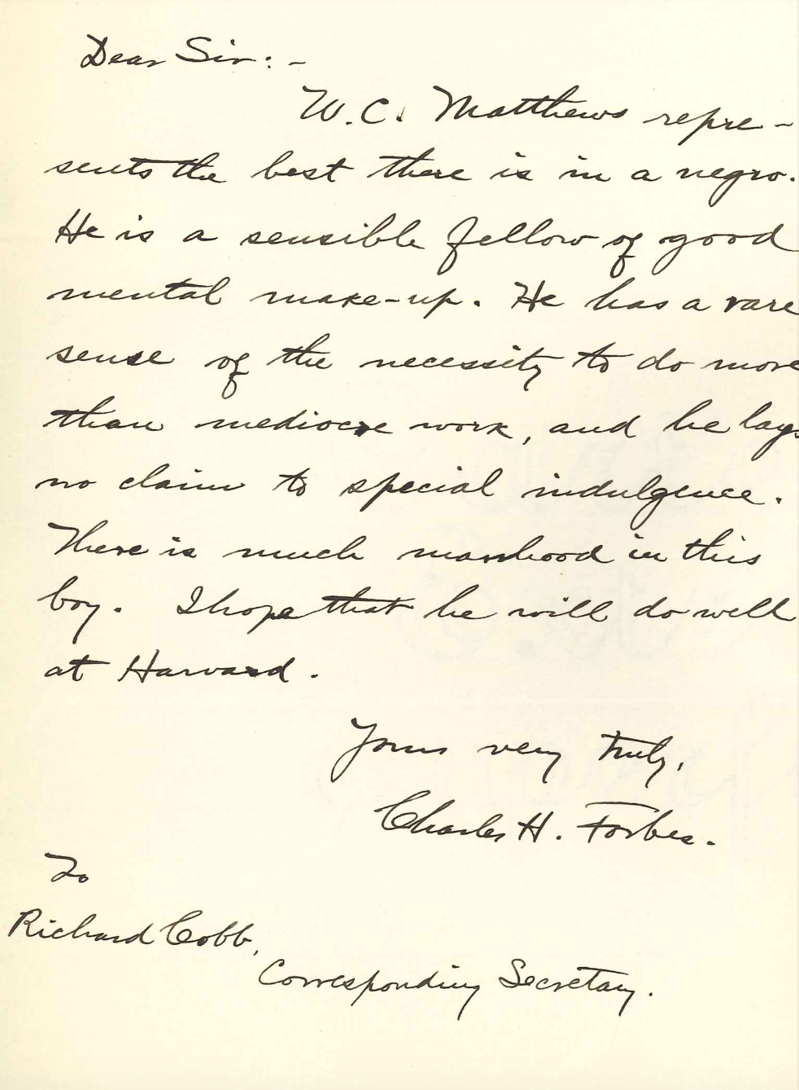
[He] represents the best there is in a negro. He is a sensible fellow of good mental makeup. He has a rare sense of the necessity to do more than mediocre work, and he lays no claim to special indulgence.
Charles Forbes, Latin Teacher to W.C. Matthews

Slide 33
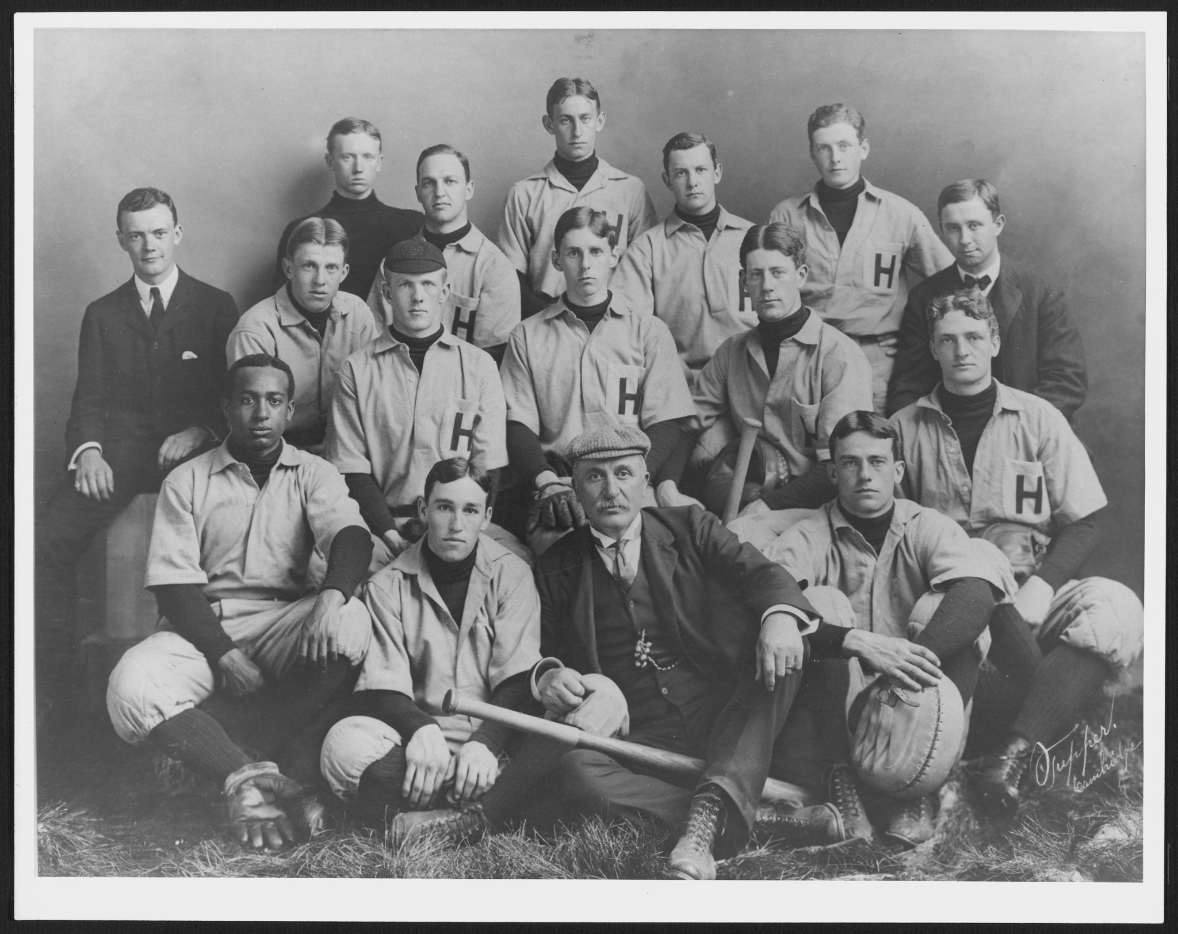
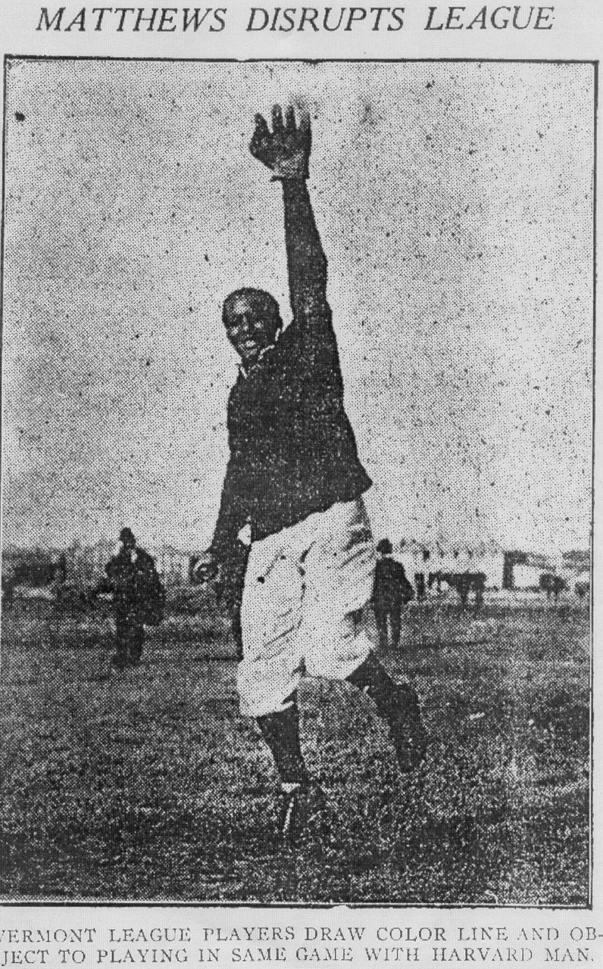
Harvard’s Starting Nine, 1902
Matthews in the Vermont League, 1905

Slide 34
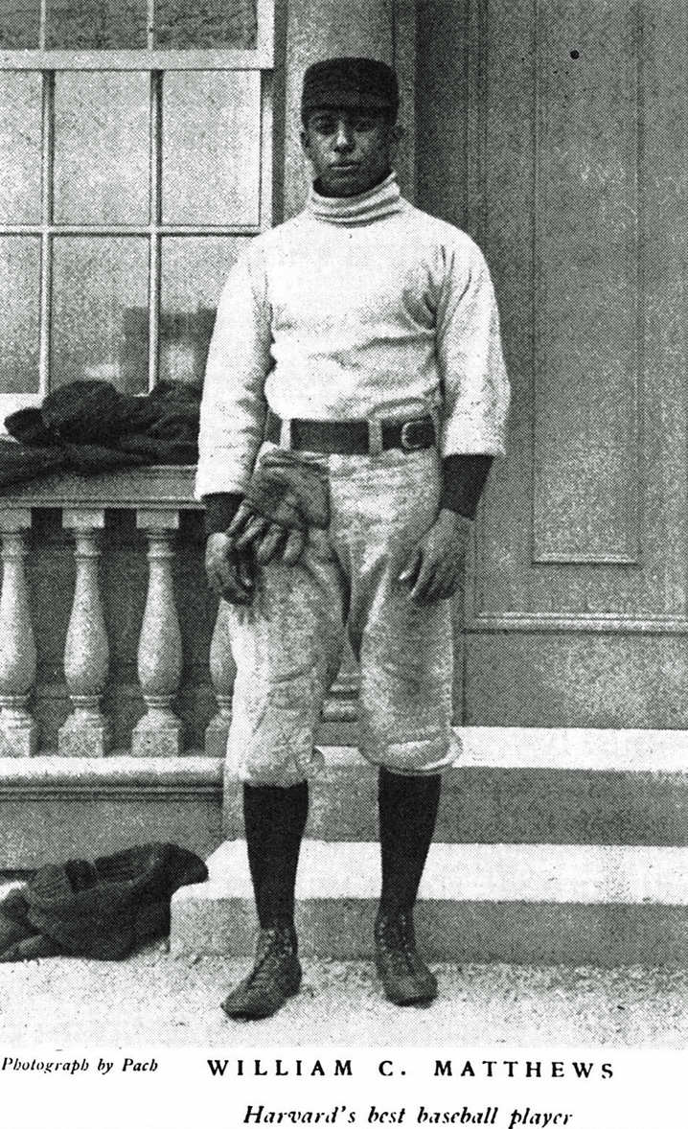
I think it is an outrage that colored men are discriminated against in the big leagues. What a shame it is that black men are barred forever from participating in the national game. I should think that Americans should rise up in revolt against such a condition. Many negroes are brilliant players and should not be shut out because their skin is black. As a Harvard man, I shall devote my life to bettering the condition of the black man, and especially to secure his admittance into organized base ball.
William Clarence Matthews, 1905

Slide 35
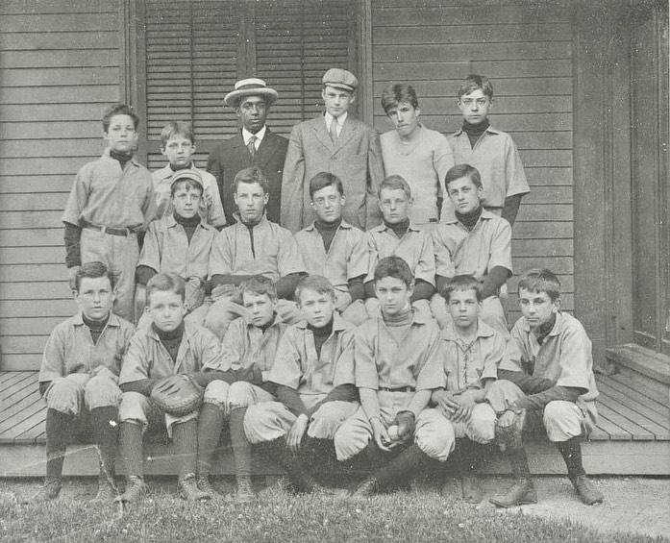
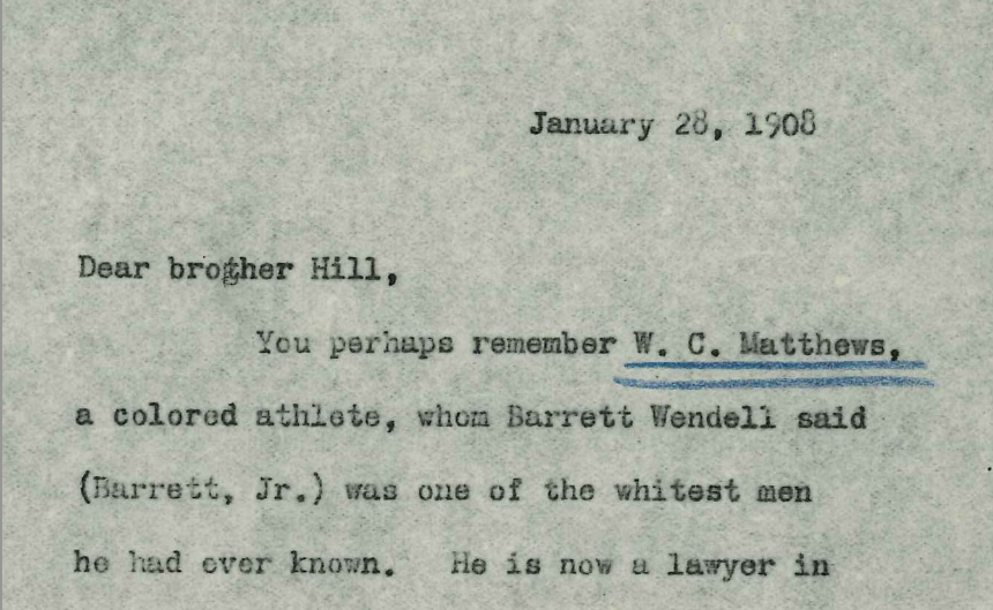
The Dean of Harvard College reflects on Matthews, 1908
Matthews coaching at Nobles, 1905

Slide 36
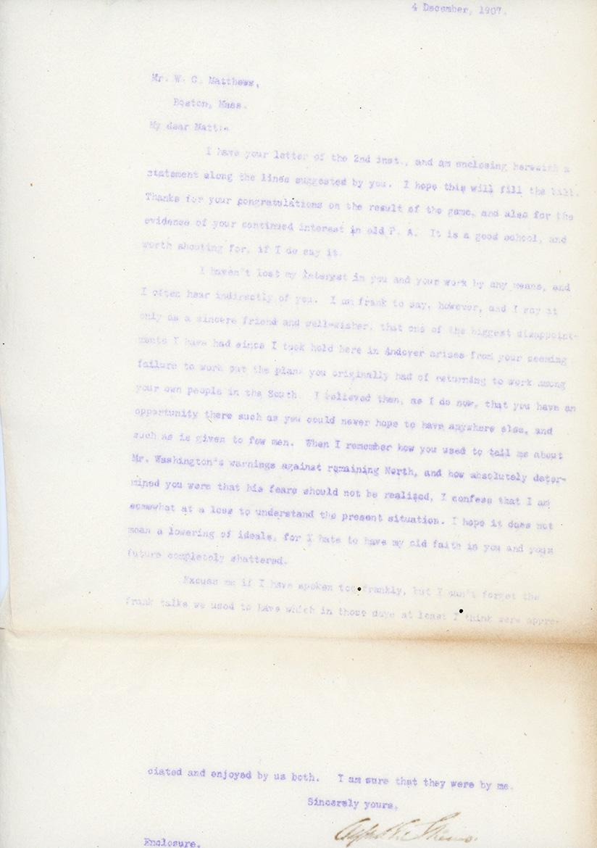
I am frank to say, however, and I say it only as a sincere friend and well-wisher, that one of the biggest disappointments I have had since I took hold here in Andover arises from your seeming failure to work out the plan you originally had of returning to work among your people in the South. I believed then, as I do now, that you have an opportunity there such as you could never hope to have anywhere else, and such as is given to few men…I hope it does not mean a lowering of ideals, for I hate to have my old faith in you and your future completely shattered.
Alfred E. Stearns,
Principal of Phillips Academy 1903-1933
Former Head Baseball Coach

Slide 38
Thanks!
Questions?
edugan@andover.edu
CREDITS: This presentation template was created by Slidesgo, and includes icons by Flaticon, and infographics & images by Freepik
Please keep this slide for attribution

Slide 39
Alternative resources
Here’s an assortment of alternative resources whose style fits the one of this template:
Vectors:
Set of baseball equipment

