Slide 1
The Celebrification of the Game: Examining Player Media Personas from 'What's My Line' to 'Late Night with Jimmy Fallon'
Allison R. Levin, Webster University
Twitter: @consultsnaps
Other Social Media: @arlevin

Slide 2
Key Definitions
Celebrity: Celebrities are not born; they are socially produced in relationship to the audience. Among an audience, a celebrity can be understood as a person who is known for his or her knownness.
Celebrity Capital: The productive value of a celebrity lies in the ability to attract widespread attention; thus, converting well knownness into socialcultural currency.
Parasocial Relationship: One-sided relationships, where one person extends emotional energy, interest and time, and the other party, the persona, is completely unaware of the other’s existence. These relationships create celebrity capital.
Celebrification: The mediated interplays and negotiations between celebrities and various media platforms to reach fans/followers. It is a process, not a status.
Notes:
Help us understand the nuisances of celebrity reach
So looking at the big picture, through celebrification a person can reach the audience who develops a relationship with them. And depending on the strength of the parasocial relationships the celebrity has varying levels of celebrity capital.

Slide 3
What’s My Line Era
Celebrification was gained from on-field play, and newspaper and television accounts
Without social media, celebrity was a binary
What’s My Line was a television show that aired over 800 episodes from 1950-1967 (CBS version) where celebrities were tasked with discovering the occupation of guests.
  Intent was to gauge celebrity and celebrity capital from watching the shows with baseball players
  Set up of the show precluded that
Notes:
Binary - either you were a celebrity, or you were not
What learned-
Known to panel -- big celebrity
Audience recognizes name
There is a strategy to guess the mystery guest. Also, -it is a game and the celebrity panelists know how to play it

Slide 4
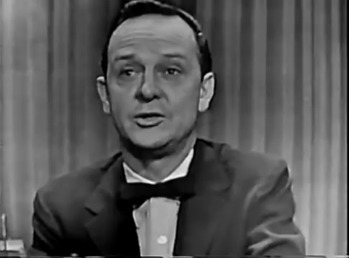
Notes:
Mickey Mantle
May 17, 1953
parasocial relation helps celebrity know that Mantle would be in the paper
expectation that Mickey Mantle would appear on the show eventually- the time and location made sense.
We will see that location plays a big role in using celebrity capital.

Slide 5
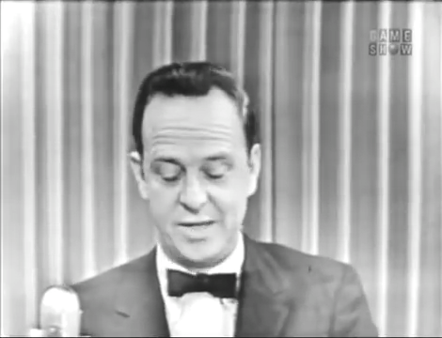
Notes:
Willie Mays
July 11, 1954

Slide 6
Idea of location
Concept of location probably led to the ease of the celebrities guessing the athlete so quickly even when they tried to use fake voices or mislead the panel
One is more likely to recognize the persona from their parasocial relationship if there is a reasonable expectation that they might be seen
  Remains true for celebrities with high celebrity capital
The following video seems to illustrate the validity of this concept
Notes:
Even when change voice and try to fool the panel, the same line of questions occurs and the expectation that a big-name player will appear and the knowledge of who still hasn't been on show makes it easier for the panel to narrow in on the player.
That expectation that the player could be there plays a key role.
But What happens with an average fan in a general location-the celebrity would have need more celebrity capital to be recognized.

Slide 7
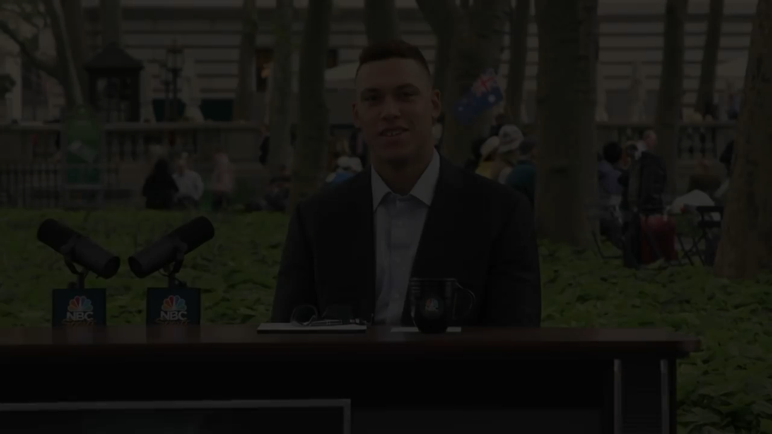
Notes:
May 15, 2017
Rookie Year after having been a September call-up in 2016
Very hot start and talk of New York
Video continues in same way until reveal who he is to the participants
Expectation of being in a location/situation matters when trying to gauge the physical reach of celebrity capital

Slide 8
Celebrification
The mediated process of interplays and negotiations between celebrities and various media platforms to reach fans/followers can help bridge the location barrier.
Develops out of generative practices that initiate the acquisition of celebrity capital, which are inherently based on authenticity
From a conceptual perspective, individual athletes operate as sub-brands that are visibly connected to their teams.
With teams and players becoming social media influencers, physical location is less important. Gen Z and Alpha can be reached through social media platforms and these medias can be used to build celebrity capital that translates to reach and commodification.
Celebrification builds the parasocial relationship beyond what we have seen in the past-- personalities and personal brands develop online
Notes:
- Brings us to concept of celebrification in the social media era
- generative practices --->Develop content that can extend beyond a single platform
Sole platform limits reach; also proves audience portability—
Because of the trickle-down effect, all players have some celebrity capital, but not all of them use social media to expand on it. Celebrity is no longer a binary- there are different levels of fame a player has online.
often outside the baseball fandom.

Slide 9
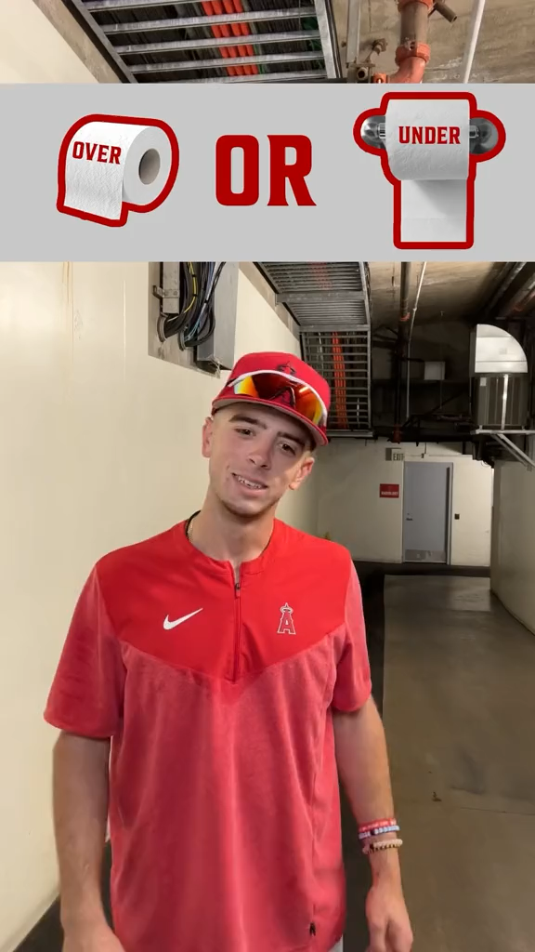
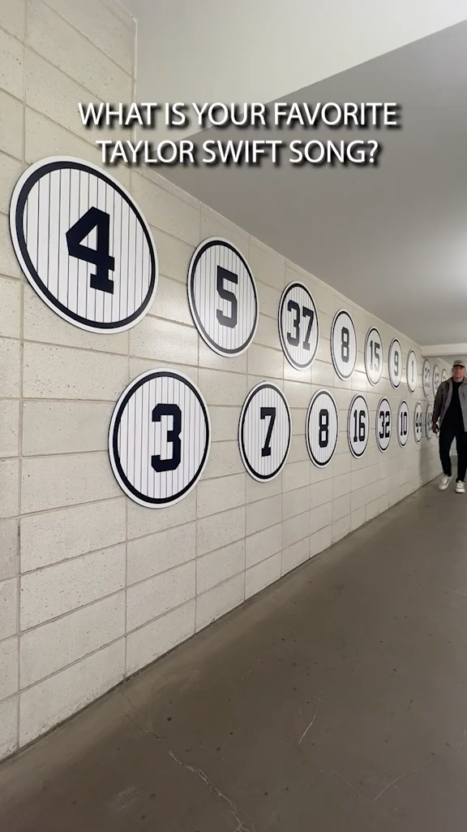
Notes:
we can see this from ask a question videos are popular because they show authenticity
Both TikToks are solid and show the team and players personality.
The Angels video does not help with celebrity capital beyond the team who gains most of the boost in the algorhyms. , we do not learn who the players are– no trickle down. If don’t identify the players, fans have to seek out who they are.
In constrast, through the captioning on the yankees video, we learn who the players are and can easily seek them out for more content to begin building the parasocial relationship.
Videos like these also help build reach that puts the video in front of more eyes. The more followers a team or player has, and the likes, and shares the video receives, the more favorable a platforms algorhytm will be in showing the content to others. This means that somebody who is not a baseball fan but watches a lot of Taylor Swift videos might be shown the yankees video and if they watch it, they might start seeing more Yankees videos, videos of yankees players, and eventually videos from other teams and players. which can start to build a relationship with some or all of that content. This is celebrification. location has changed. somebody who watches these videos can have a parasocial relationship with Aaron Judge enhancing his celebrity capital despite not identifying as a baseball fan. For these fans their only expectation is that they will see him online.

Slide 10
What does this all mean
We need to change how we look at celebrity, especially when identifying what it means for Gen Z and Alpha
  It is about celebrification and the interplay between the parasocial relationship and celebrity capital
  The best players may not be the celebrities whom the younger generations identify
  Meeting the celebrity may be less important than a shout out, follow back, or like on a post
  Most importantly stemming from celebrification, young fans will still go to games, they will just have a different type of fandom and reason for going
Notes:
Its about social media content and platforms and the reach they have for the team or players.
Identify with players with the best generative social media for them as the fan.
They may be going to build their own social media content in hopes of being recognized by a player or team --get that like or shout out.
Players and teams often repost videos from fans who tag them, that is the ultimate response for a young fan--they are not concerned with meting a player in person. These social media interactions are as important to them as an older fan meeting a player or getting an autograph.
celebrity capital has changed because the idea of location has changed. the parasocial relationship is made and often maintained online. This change in how we gauge a players celebrity capital, is the key to understanding the celebrification of players today.

Slide 11
Articles Used
Brooks, G., Drenten, J., & Piskorski, M. J. (2021). Influencer Celebrification: How social media influencers acquire Celebrity Capital. Journal of Advertising, 50(5), 528–547. https://doi.org/10.1080/00913367.2021.1977737
Su, Y., Baker, B. J., Doyle, J. P., & Yan, M. (2020). Fan engagement in 15 seconds: Athletes’ relationship marketing during a pandemic via TikTok. International Journal of Sport Communication, 13(3), 436–446. https://doi.org/10.1123/ijsc.2020-0238
Su, Y., Baker, B., Doyle, J., & Kunkel, T. (2020). The rise of an athlete brand: Factors influencing the social media following of athletes. Sport Marketing Quarterly, 29(1), 33–46. https://doi.org/10.32731/smq.291.302020.03

