Slide 1
Do Pitchers Learn How to Avoid the Third-Time-Through-the-Order Penalty? Rob Mains
SABR Analytics Conference
March 9, 2024

Slide 2
The Third Time Through the Order Penalty
Tango, Lichtman, and Dolphin, The Book, 2007
“As the game goes on, the hitter has a progressively greater advantage over the starting pitcher”
Minimal disadvantage the second time through the order, much greater the third time

Slide 3
Easily Available Today
First time through the order: .727 OPS
Second time: .748
Third time: .782
Source: Baseball-Reference

Slide 4
Two Limitations
Pitchers who face 18 or fewer batters
Don’t face opponents a third time
Typically because of ineffectiveness
Overstates OPS allowed first and second times
May understate third time penalty
Lineup position
Best hitters at top of lineup
Pitcher facing 22 batters faces only top four third time vs. 1-9 the first two
May overstate third time penalty

Slide 5
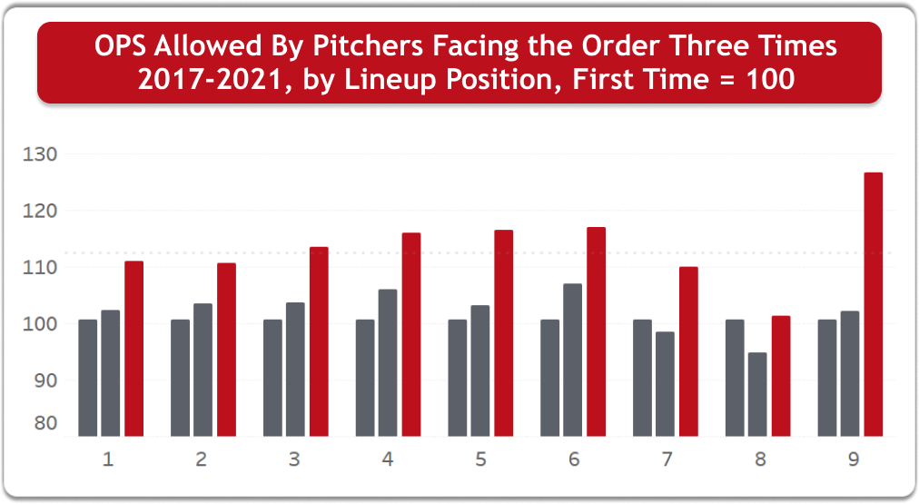
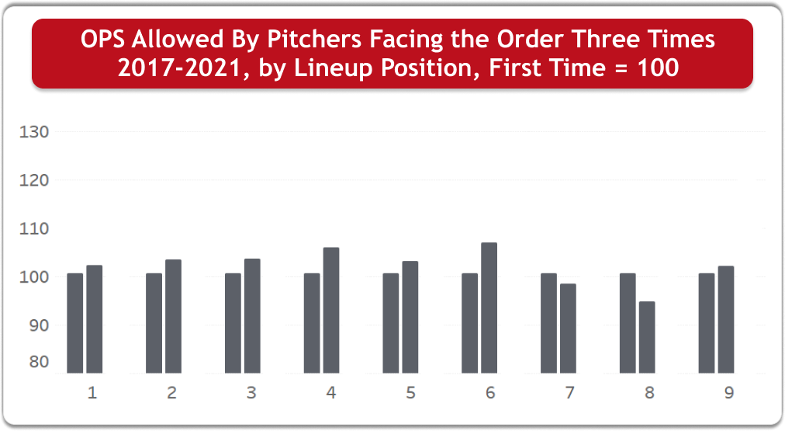
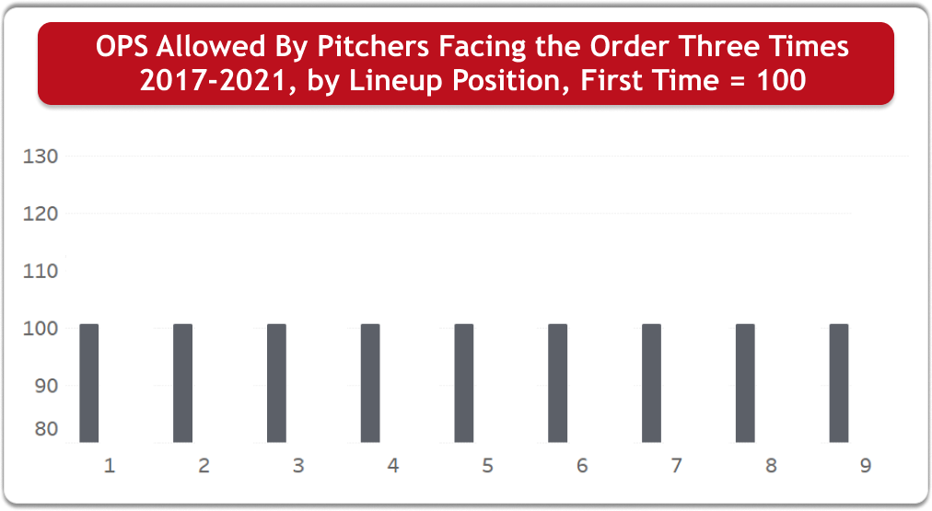
Cumulative Totals, 2017-21

Slide 6
Divisional Era, 1969-2021

Slide 7
Divisional Era, 1969-2021

Slide 8
Divisional Era, 1969-2021

Slide 9
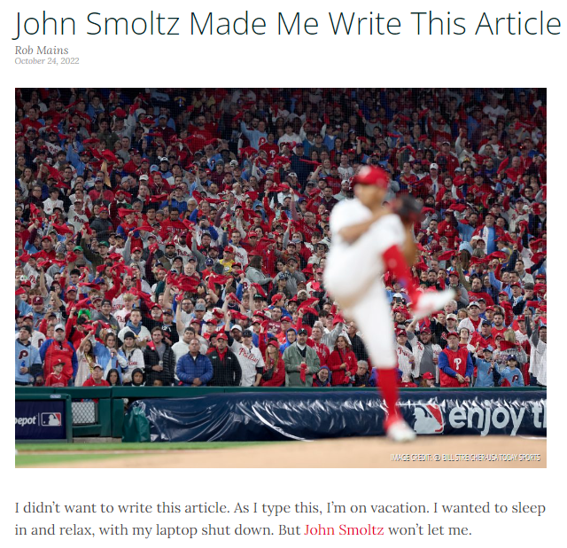

Slide 10
Can Pitchers “Learn” to Face the Order a Third Time?
All starting pitchers from 1969-2014
Minimum 10-year career, 200 starts
Yielded 253 MLB pitchers
Split career
First five years: Learning to pitch a third time
Next five years: Learned to pitch a third time
Years 6-end of career

Slide 11
Parsing the Data
Pitchers facing the order a third time fewer than 50 times in first or second five years (27 pitchers, discarded)
Pitchers facing the order a third time 50-99 times in first and/or second five years (122 pitchers)
Pitchers facing the order a third time 100+ times in first and second five years (104 pitchers)

Slide 12
Limitations of Data
Selection bias
Arbitrary choice of five-year periods
No adjustment for pitcher’s team or opponents
No adjustment for run environment

Slide 13
Example: John Smoltz
 | First Five Years |  |  |  | Next Five Years
# | 1st 2 Times | 3rd Time | Diff |  | 1st 2 Times | 3rd Time | Diff
1 | .631 | .833 | +31.9% |  | .582 | .574 | -1.4%
2 | .652 | .572 | -12.2% |  | .669 | .708 | +5.8%
3 | .687 | 1.032 | +50.1% |  | .739 | .756 | +2.3%
4 | .668 | .870 | +30.1% |  | .610 | .853 | +39.8%
5 | .718 | .568 | -20.8% |  | .601 | .620 | +3.2%
6 | .572 | .611 | +6.8% |  | .661 | .749 | +13.3%
7 | .659 | .518 | -21.4% |  | .569 | .829 | +45.8%
8 | .571 | .592 | +3.6% |  | .540 | .679 | +25.9%
Weighted Average |  |  | +8.9% |  |  |  | +16.3%

Slide 14
Results
Pitchers facing the order a third time 100+ times in first and second five
year
s
Pitchers
Penalty 1
five
Penalty 2
five
Penalty rest of career
st
nd
Better
68
13.0%
4.0%
5.6%
Worse
36
5.2%
12.3%
9.6%
Total
104
10.3%
6.8%
7.0%

Slide 15
Results
Pitchers facing the order a third time 50
-
99 times in first and/or second five years
Pitchers
Penalty 1
five
Penalty 2
five
Penalty rest of career
st
nd
Better
59
14.3%
3.6%
4.6%
Worse
63
6.9%
16.9%
14.5%
Total
122
10.5%
10.5%
9.7%

Slide 16
Results
Pitchers facing the order a third time 50+ times in first and second five years
Pitchers
Penalty 1
five
Penalty 2
five
Penalty rest of career
st
nd
Better
127
13.7%
3.8%
5.1%
Worse
99
6.3%
15.2%
12.7%
Total
226
10.4%
8.8%
8.4%

Slide 17
Difficulty of “Learning”
Only 20 pitchers had no third-time penalty after five seasons
Welch, Drabek, Hooton only three with 150+ career wins
Nine Hall of Famers
Four better after five years (Blyleven, Maddux, Smoltz, Halladay); average improvement 14.9% to 5.3%
Five worse (Glavine, Martinez, Johnson, Morris, Mussina); average decline from 4.3% to 6.9%

Slide 18
Conclusions
Evidence that pitchers do “learn” to face the opposing order a third time
Improvement is limited
Third time through the order penalty remains after “learning”

Slide 19
Acknowledgements
Shawn Brody
Derek Rhoads
SABR and SIS

Slide 20
Do Pitchers Learn How to Avoid the Third-Time-Through-the-Order Penalty? Rob Mains
SABR Analytics Conference
March 9, 2024

