Slide 1
How Did the Pitch Clock Affect Pitcher Performance?
Thomas Stanton
Northwestern University

Slide 2
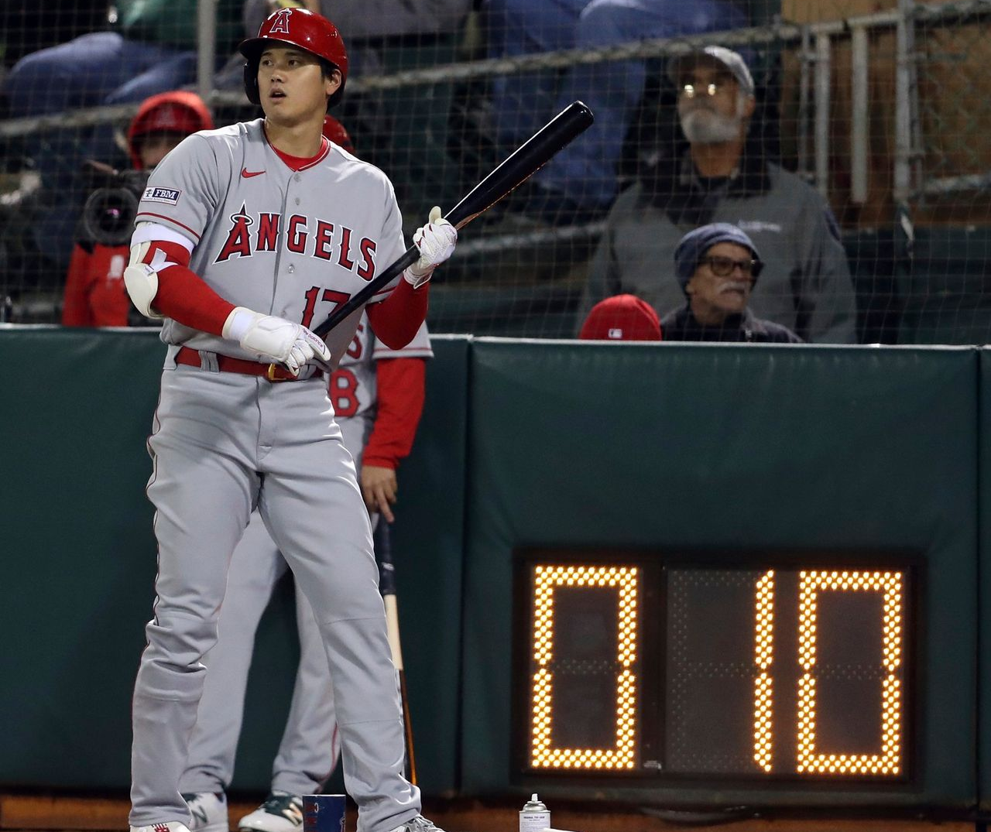
The Pitch Clock - a Refresher
Rules
30 seconds in between batters
15 seconds in between pitches with bases empty
20 seconds in between pitches with runners on base

Slide 3
Pitch Clocks and Fatigue
Sonne and Keir (2016)
The faster game speed caused by pitch clocks increases muscle fatigue in arm muscles, which can lead to injury.
Birfer, Sonne, and Holmes (2019)
Fatigue can cause a decrease in velocity.

Slide 4
Research Question
Did Major League Baseball’s implementation of the pitch clock lead to decreased performance in pitchers as measured by fastball velocity?
Hypothesis: The reduced recovery caused by the pitch clock led to a stronger relationship between fatigue and velocity in 2023 than 2022.

Slide 5
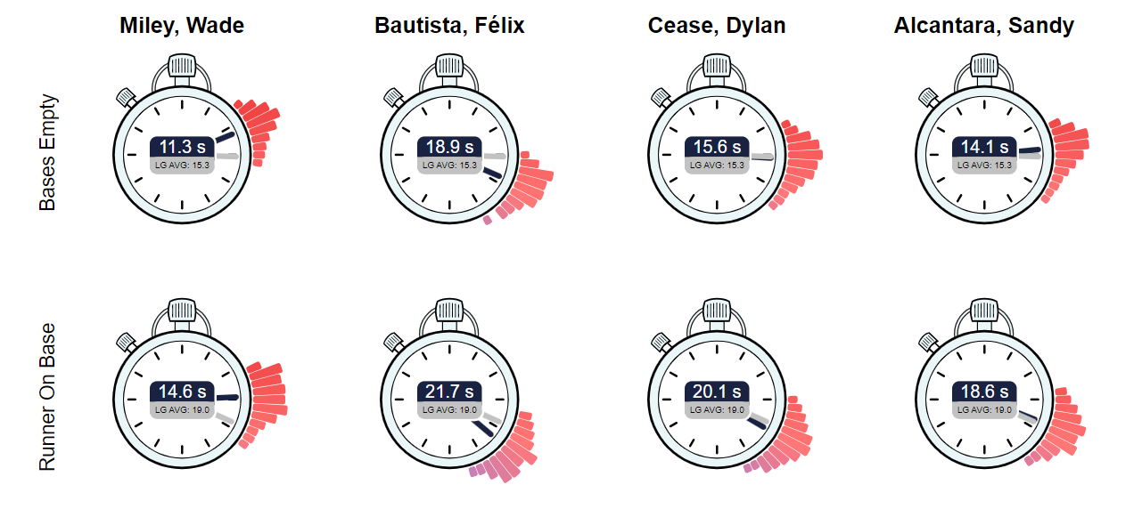
What is Pitch Tempo?
Defined by Baseball Savant as the time between the release of each pitch

Slide 6
Distribution of Pitch Tempo

Slide 7
Scope of Analysis
Target Variable:
Pitch Velocity
Pitch Types Considered:
Four-Seam Fastball
Sinker
Cutter
Splitter
Qualifying Pitchers:
Must have thrown at least 100 pitches of the given pitch type in both 2022 and 2023

Slide 8
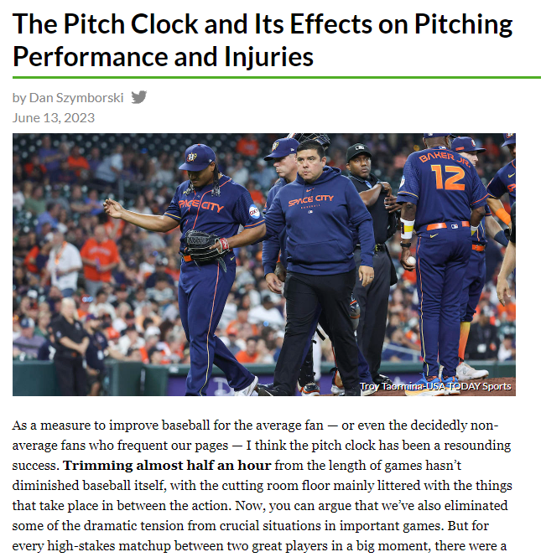

Slide 9
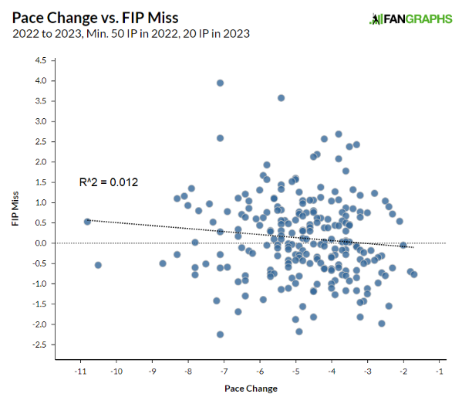
Szymborski
Calculated pace change as the difference between average pitch tempo in 2022 and 2023
Used to identify who was most/least affected by pitch clock
Regressed ERA and FIP misses by Steamer and ZiPS on pace change
No significant results found

Slide 10
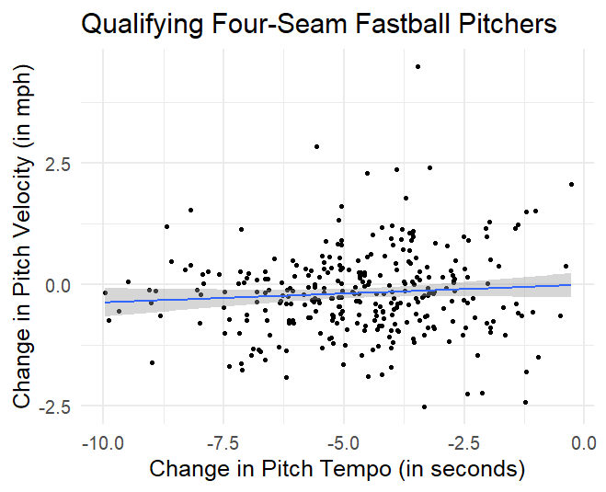
Modifying Szymborski’s Model
Instead of FIP or ERA miss, this model regresses the change in average fastball velocity of each pitcher on his pace change
No significant results found for any pitch type
Limitations:
Each player represents one data point
Small sample size

Slide 11
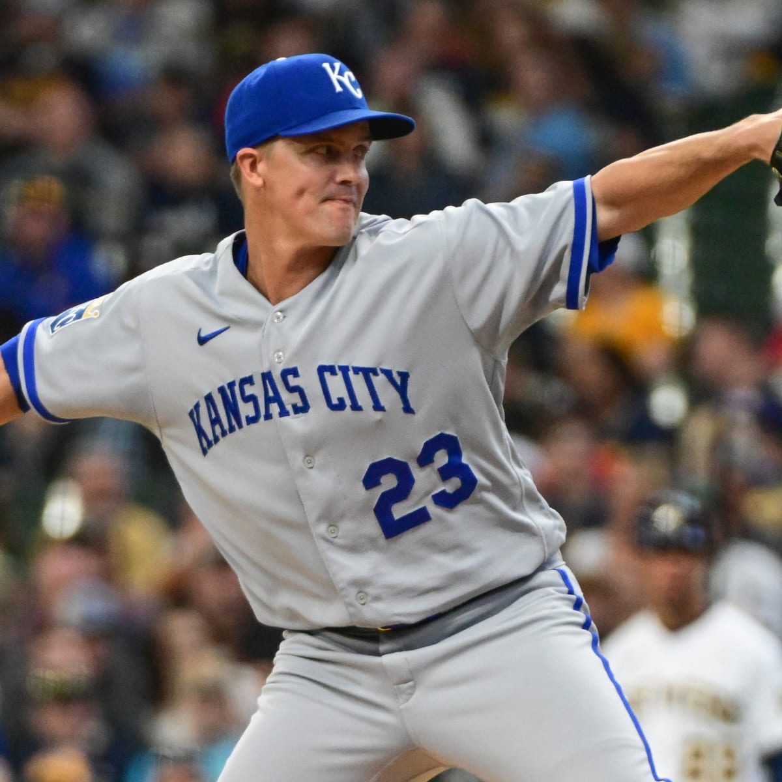
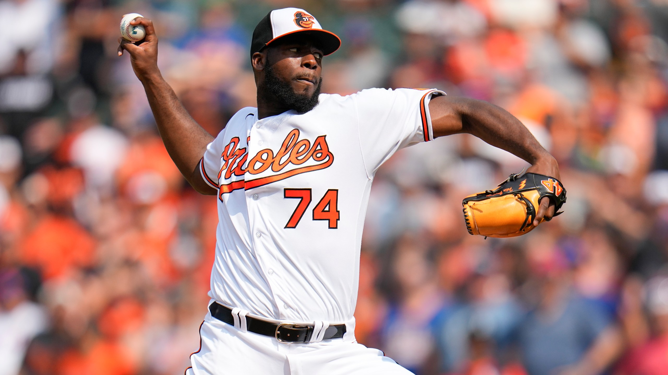
Fixed Effects Linear Regression
Every pitch is its own data point
Controls for unobserved qualities of each pitcher
Measures deviation from the pitcher’s average velocity instead of raw velocity
Allows us to use both of these pitchers in our analysis!
Average Four-Seam Fastball: 89.4 mph
Average Four-Seam Fastball: 99.4 mph

Slide 12
Model 1 Specification
$$velocity= β_{1}year+β_{2}pitch count+β_{3}year×pitch count+pitcher$$
Question
Did pitchers tire more in 2023 due to the pitch clock?
Regressors
In-game pitch count
Binary year variable (0 if 2022, 1 if 2023)
Interaction term between year and pitch count
Pitcher fixed effects

Slide 13
Model 1 Results
$$velocity= β_{1}year+β_{2}pitch count+β_{3}year∗pitch count+pitcher$$
Pitch Type | $$β_{1}$$ | $$β_{2}$$ | $$β_{3}$$ | $$R^{2}$$
Four-Seam | -0.1965*** | -0.014*** | -0.0010* | 0.9964
Sinker | -0.2366*** | -0.0138*** | -0.0009 | 0.9967
Cutter | -0.1449*** | -0.0153*** | -0.0009 | 0.9965
Splitter | 0.1946** | -0.0072*** | -0.0029 | 0.9967
Significance levels:
p < 0.05 = *
p < 0.01 = **
p < 0.001 = ***
Velocity decreased in 2023
Limited evidence that the effect of pitch count on velocity became more negative in 2023

Slide 14
Model 2 Specification
$$velocity= β_{1}\log\left(pitch tempo\right)+pitcher$$
Question
How did the effect of pitch tempo on fastball velocity change between 2022 and 2023?
Regressors
Log of pitch tempo
Pitcher fixed effects

Slide 15
Model 2 Results
The velocity gained with additional rest increased in 2023
$$velocity= β_{1}log⁡(pitch tempo)+pitcher$$
Pitch Type | $β_{1}$ (2022) | $β_{1}$ (2023) | Change in $β_{1}$
Four-Seam | 0.0910*** | 0.4083*** | 0.3173
Sinker | 0.2695*** | 0.4652*** | 0.1957
Cutter | 0.2871*** | 0.4722*** | 0.1851
Splitter | 0.1243*** | 0.2392*** | 0.1150
Every 10% increase in rest between pitches is related to a 0.01-0.05 mph increase in velocity
Significance levels:
p < 0.05 = *
p < 0.01 = **
p < 0.001 = ***

Slide 16
Implications
The pitch clock had a statistically significant effect on pitch velocity during the 2023 season
Limited evidence that pitchers became fatigued quicker due to the reduced rest time between pitches
The value of additional rest on pitch velocity increased between 2022 and 2023

Slide 17
Further Research
Pitch clock’s effect on velocity and spin rate of every pitch type
Other measures of pitch quality: Stuff, Break, Location, etc.
Interaction with age or position (i.e. starter/reliever)

Slide 18
Data
Pitch-by-pitch data from MLB Stats API for 2022 and 2023 regular seasons
Downloaded using BaseballR
After data cleaning, ~1.3 million pitches in the dataset

Slide 19
Questions?

