Slide 1
A Revised Look at Clutch Hitting Pete Palmer Rob Mains
SABR Analytics Conference
March 10, 2018

Slide 2
A Controversial Topic in Sabermetric Research
1977: Dick Cramer, Baseball Research Journal
“Clutch hitting cannot be an important or a general phenomenon.”
2004: Bill James, Baseball Research Journal
“Cramer’s study…may have failed to identify clutch hitters because the method doesn’t work.”

Slide 3
Do Clutch Hitters Exist? Typical Sabermetric Response
YES, some hitters are better in clutch situations than other hitters…
…but they’re hitters who are better, period.
Best OPS since 1988, 1.5+ Leverage Index
Player | OPS
Barry Bonds | 1.091
Joey Votto | 1.075
Mark McGwire | 1.025
Manny Ramírez | 1.018
Albert Pujols | 1.001

Slide 4
Do Clutch Hitters Exit? Typical Sabermetric Response
Not a repeatable skill
Allen Craig, RISP, 2013: .454/.500/.638
Allen Craig, RISP, 2014: .216/.306/.319

Slide 5
David Ortiz, Batting Average with Leverage Index > 2.0
2011: 48 at bats, .229
2012: 19 at bats, .316
2013: 46 at bats, .196
2014: 63 at bats, .397
2015: 48 at bats, .208
2016: 66 at bats, .273

Slide 6
Defining Clutch Hitting
Not simply hitting well in high leverage situations (Bonds, Votto, et al)
“Rising to the occasion,” “stepping up,” “bearing down”
One who does better in higher-leverage situations than others

Slide 7
Running our Simulation
18 equal players over an entire season
Calculate runs produced two ways
Win probability before and after each plate appearance: situation-dependent hitting
Linear weights batting runs: situation-independent hitting
Calculate difference, expressed as runs
Ran 1,000 simulations
Average standard deviation ~10 runs

Slide 8
Using Simulation to Determine Clutch Performance
Every postwar player-season w/500+ PAs (8,963 players in sample)
Calculated a z-score equal to the difference between situation-dependent and situation-independent batting performance

Slide 9
Example: Robin Ventura, 1998
.785 OPS, .267 TAv in 674 PAs
High-leverage PAs: 1.099 OPS
Other PAs: .713 OPS
19 situation-dependent runs
3 situation-independent runs
Z-score = (19 – 3) / (0.4 x 674^{1/2})
Equal to 1.5 (which is pretty good!)

Slide 10
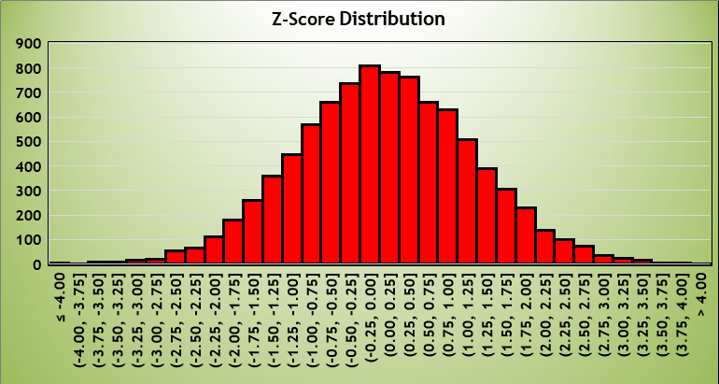
Range of Z-Scores

Slide 11
Four Seasons in Top 5%
Henry Aaron
Sandy Alomar Jr.
Glenn Beckert
José Cardenal
Vince Coleman
Nellie Fox
Steve Garvey
Ken Griffey Sr.
Dick Groat
Tony Gwynn
Enos Slaughter
Billy Williams
Tony Womack

Slide 12
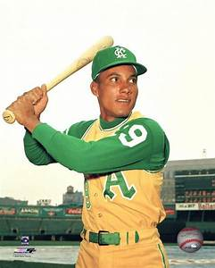
Six Seasons in Top 5%
BERT CAMPANERIS

Slide 13
Three Seasons in Bottom 5%
Jeff Bagwell
Adrián Beltré
Miguel Cabrera
Jermaine Dye
Damion Easley
Edwin Encarnación
Ken Griffey Jr.
Richard Hidalgo
Edgar Martínez
David Ortiz
Albert Pujols
Iván Rodríguez
Benito Santiago
Sammy Sosa
Bernie Williams

Slide 14
Four Seasons in Bottom 5%
Jay Bell
Wade Boggs
Barry Bonds
Robinson Canó
Dwight Evans
Todd Helton
Victor Martinez
Magglio Ordóñez
Frank Robinson
Álex Rodríguez

Slide 15
Five Seasons in Bottom 5%
Torii Hunter
Chet Lemon
Frank Thomas

Slide 16
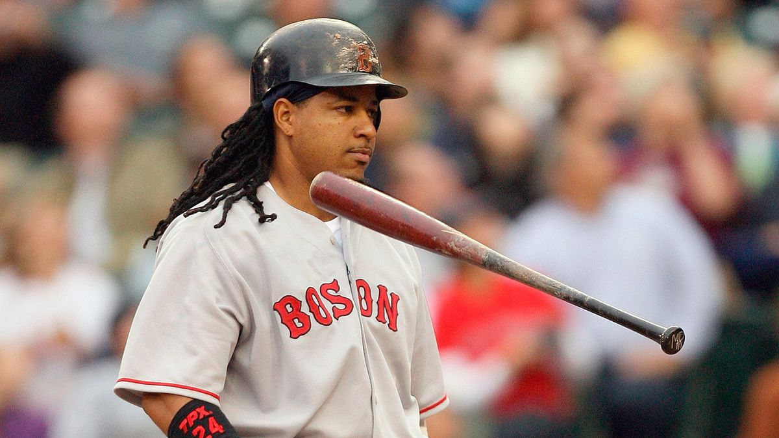
Six Seasons in Bottom 5%
Manny Ramírez
1.018 OPS in 1,992 PA w/LI>1.5

Slide 17
Examples of Top 5% Threshold
Twelve times: Randy Johnson, strikeout rate
Eleven times: Rod Carew, batting average
Nine times: Ted Williams, walk rate
Eight times: Harmon Killebrew, home run rate

Slide 18
Top 5% and Bottom 5% at Least Twice During Career
Garrett Anderson
Dwight Evans
Tony Gwynn
Joe Morgan
David Ortiz
Frank Robinson
Pete Rose
Gary Sheffield
Miguel Tejada
Bobby Thomson
Larry Walker
Carl Yastrzemski

Slide 19
Example: David Ortiz
Season | Z-score | High-Leverage (1.5 LI) OPS | Other OPS
2005 | 2.66 | 1.312 | .928
2006 | 1.48 | 1.100 | 1.037
2007 | -2.25 | 1.019 | 1.079
2011 | -2.70 | .846 | .981
2013 | -2.07 | .867 | .983

Slide 20
Example: David Ortiz
Year | Z-Score
2003 | +0.04
2004 | -1.34
2005 | +2.66
2006 | +1.81
2007 | -2.25
2009 | +0.14
2010 | -0.67
2011 | -2.70
2013 | -2.07
2014 | +0.94
2015 | -1.38
2016 | -1.40

Slide 21
Conclusions
There are, in each season, clutch (and un-clutch) hitters (e.g. 2017: Dansby Swanson, Aaron Judge)
Data are significantly at odds with perception; enough so to question validity
Lack of consistency impugns replicability
Perhaps other clutch measures exist which would support existence of clutch hitters. But this doesn’t.

Slide 22
Special Thanks
Pete Palmer
This conference

Slide 23
Has the Modern Bullpen Destroyed Late-Inning Comebacks?
SABR Analytics Conference
March 11, 2017

Slide 24
A Revised Look at Clutch Hitting Pete Palmer Rob Mains
SABR Analytics Conference
March 10, 2018

