Slide 1
An Empirical Study of
2011 World Series Plate Umpires’ Ball-Strike Judgment and Decision-Making
__________________________________________________________________________
Aaron Baggett
BAYLOR UNIVERSITY

Slide 2
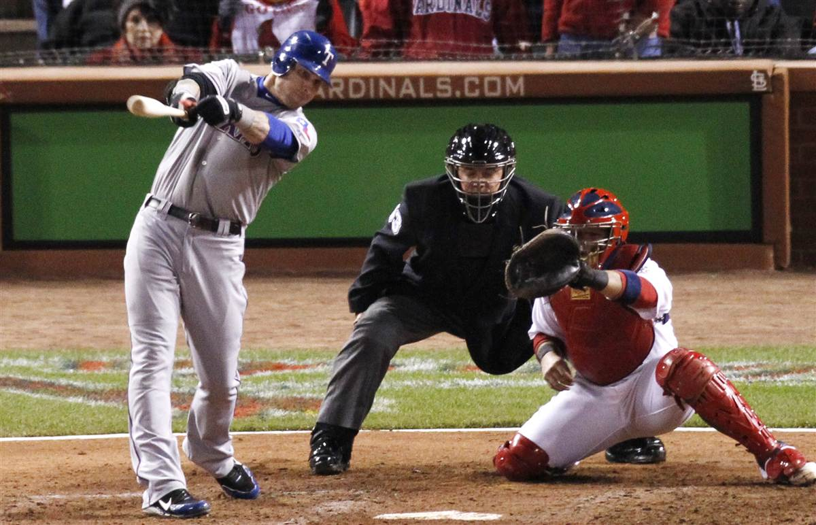
Judgment of Strike Zone
Strike zone as principal parameter of judgment
Perceptual interaction
Bias (Larson, et al., 1991; MacMahon, et al., 2008)
Perceived and experienced stress (Rainey, 1994; Stewart, et al., 2004)
Notes:
How does this relate to umpiring?
The same critical skills are involved in sport competition and performance
Critical skills are called: PERCEPTUAL-COGNITIVE SKILLS
There are three important ones we’ll talk about
Procedural Knowledge
Advance Cue Utilization
Knowledge of Situational Probabilites

Slide 3
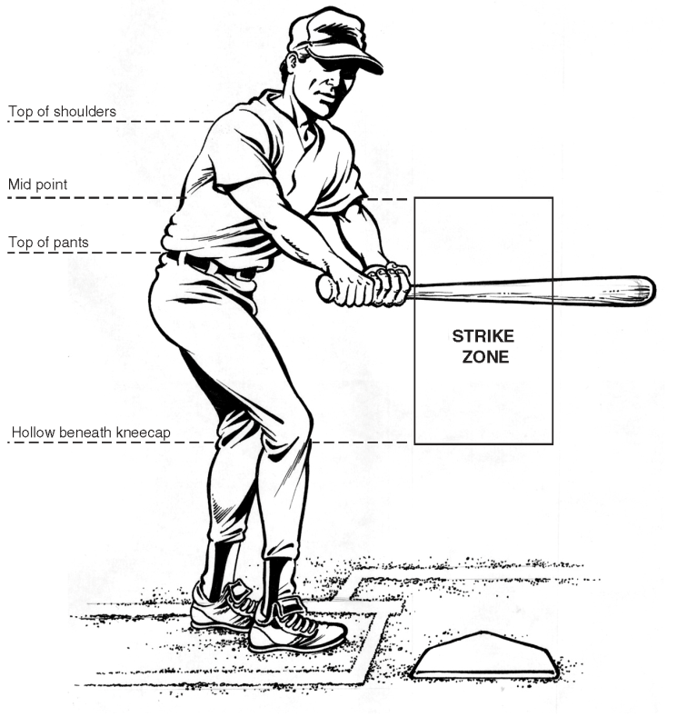
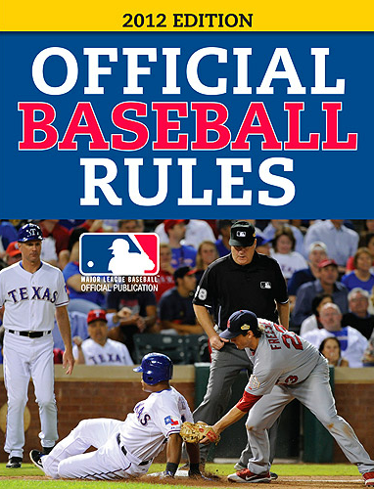
Parameters of the Strike Zone
Upper limit: Horizontal line falling just under the uniform letters
Lower limit: Horizontal line falling at the hollow beneath the knee cap
Determined as batter is prepared to swing (Selig, 2012)
Notes:
How does this relate to umpiring?
The same critical skills are involved in sport competition and performance
Critical skills are called: PERCEPTUAL-COGNITIVE SKILLS
There are three important ones we’ll talk about
Procedural Knowledge
Advance Cue Utilization
Knowledge of Situational Probabilites

Slide 4
Judgment of Strike Zone
Notes:
How does this relate to umpiring?
The same critical skills are involved in sport competition and performance
Critical skills are called: PERCEPTUAL-COGNITIVE SKILLS
There are three important ones we’ll talk about
Procedural Knowledge
Advance Cue Utilization
Knowledge of Situational Probabilites

Slide 5

Expert Judgment & Decision Making
Judgment: Biased observation and consideration of necessary information
  Balls/strikes, safes/outs, balks
  Fair/foul?
Decision making: Process of evaluating judgments toward committed actions (Yates & Tschirhart, 2006)
Born out of early experiments with chess masters (Chase & Simon, 1973)
Notes:
How does this relate to umpiring?
The same critical skills are involved in sport competition and performance
Critical skills are called: PERCEPTUAL-COGNITIVE SKILLS
There are three important ones we’ll talk about
Procedural Knowledge
Advance Cue Utilization
Knowledge of Situational Probabilites

Slide 6
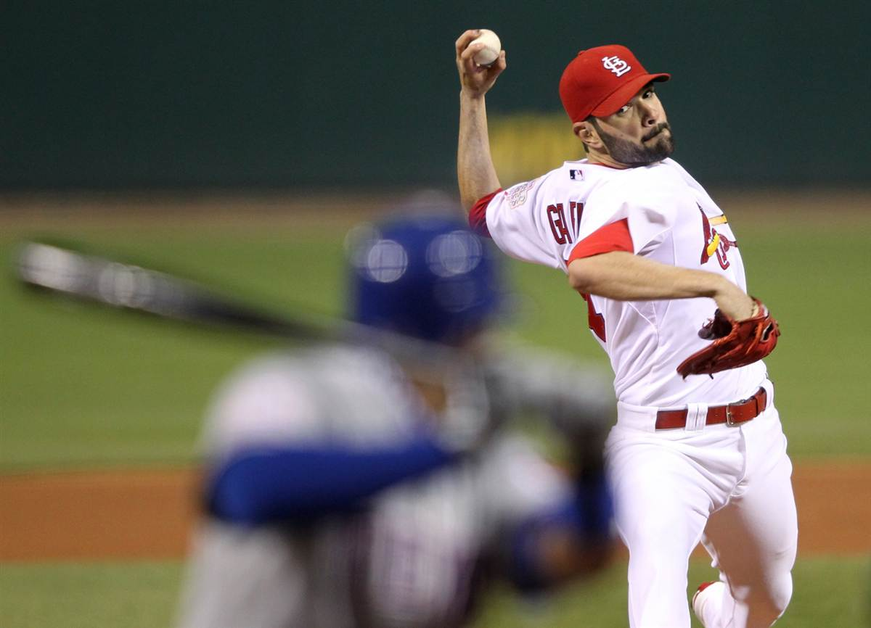
Expertise in MLB Umpires
Lack of research related to the perceptual-cognitive skills of officials in fast-ball sports
The complex integration of visual and mental variables used in judgment and decision making
2011 MLB World Series umpires as a sample
Umpire expertise
  MLB
  Postseason

Slide 7


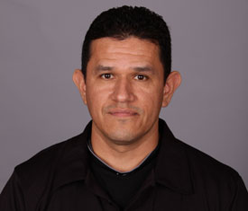



Umpiring Crew
Jerry Layne (CC)
7 DS (1995, 98, 2001-02, 05, 10-11); 4 LCS (1997, 99, 06, 09);
1 WS (2005)
Greg Gibson
8 DS (2001, 03-04, 06-07, 09-11); 1 LCS (2005)
Alfonso Marquez
5 DS (2001-02, 05-06, 11); 2 LCS (2003, 08); 1 WS (2006)
Ron Kulpa
7 DS (2001-02, 06-09, 11); 1 LCS (2005)
Ted Barrett
7 DS (2000-03, 06-07, 11); 4 LCS (2005, 08-10); 1 WS (2007)
Gary Cederstrom
6 DS (2000, 03-05, 10-11); 5 LCS (2001, 06-09); 1 WS (2005)

Slide 8
Ball-Strike Decisions
Game 1: Jerry Layne, 37/92 (9 inn.)
Game 2: Greg Gibson, 41/84 (9 inn.)
Game 3: Alfonso Marquez, 64/132 (9 inn.)
Game 4: Ron Kulpa, 52/103 (9 inn.)
Game 5: Ted Barrett, 53/98 (9 inn.)
Game 6: Gary Cederstrom, 52/136 (11 inn.)
Game 7: Jerry Layne, 58/96 (9 inn.)
Notes:
The Concept of Expertise
A lot of what we know about the concept of expertise comes from early cognitive psychology experiments looking at chess experts
Researchers wanted to know:
What factors do expert players exhibit over novice players?
Experts were able to:
Remember board arrangement better
More quickly describe all available moves
List the most strategic move
And predict subsequent action more accurately
What’s interesting is that there were no differences between experts and novices when the board arrangement was arbitrary or random
This suggests prior knowledge, previous experience were essential

Slide 9
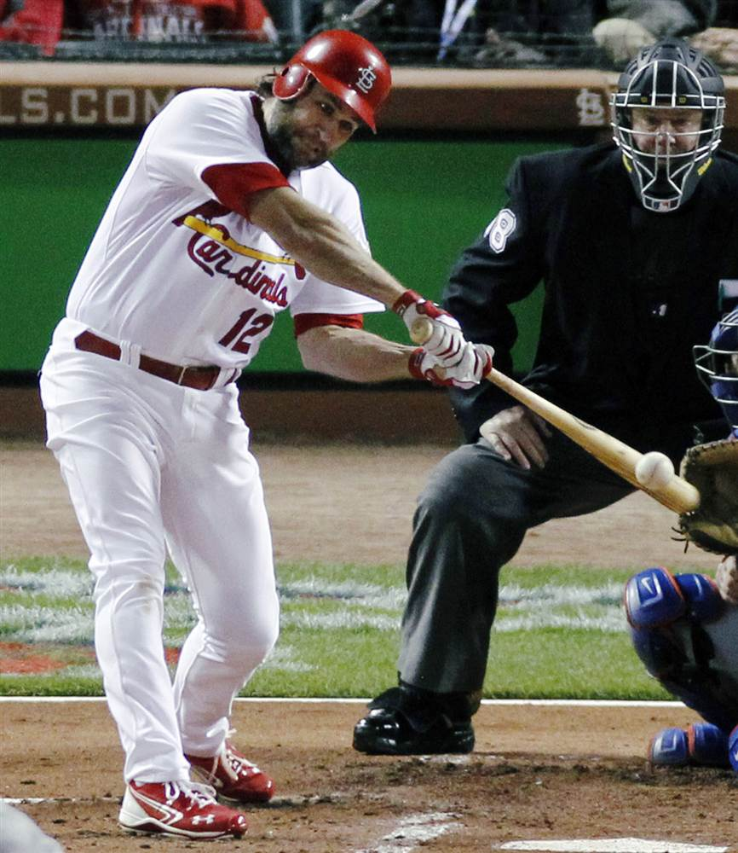
Perceptual Cognitive Skills
Three most important:
Procedural Knowledge
Advance Cue Utilization
Knowledge of Situational Probabilities

Slide 10
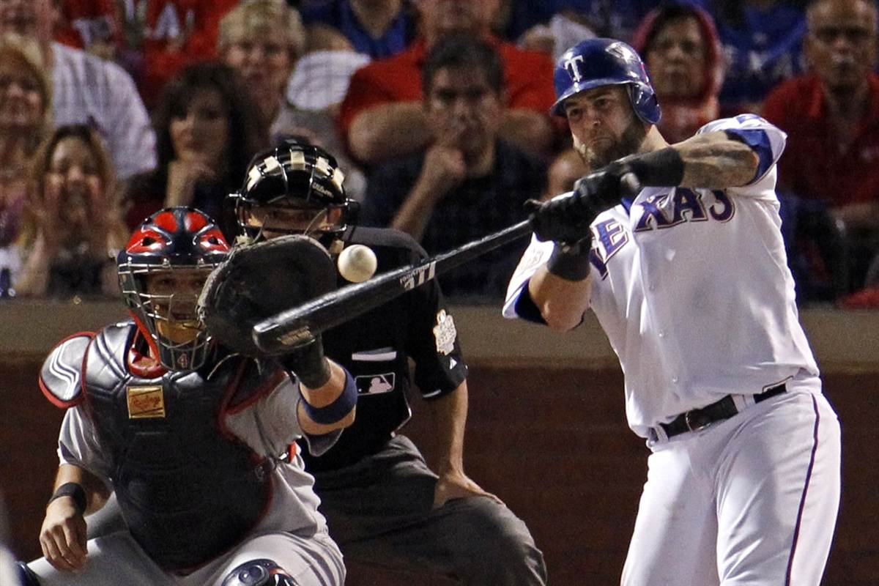
Procedural Knowledge
Most important distinguisher between experts and novices
Think of it as selective attention
Combining separate task-related items to form an output motor response
Complex organization of units of knowledge

Slide 11
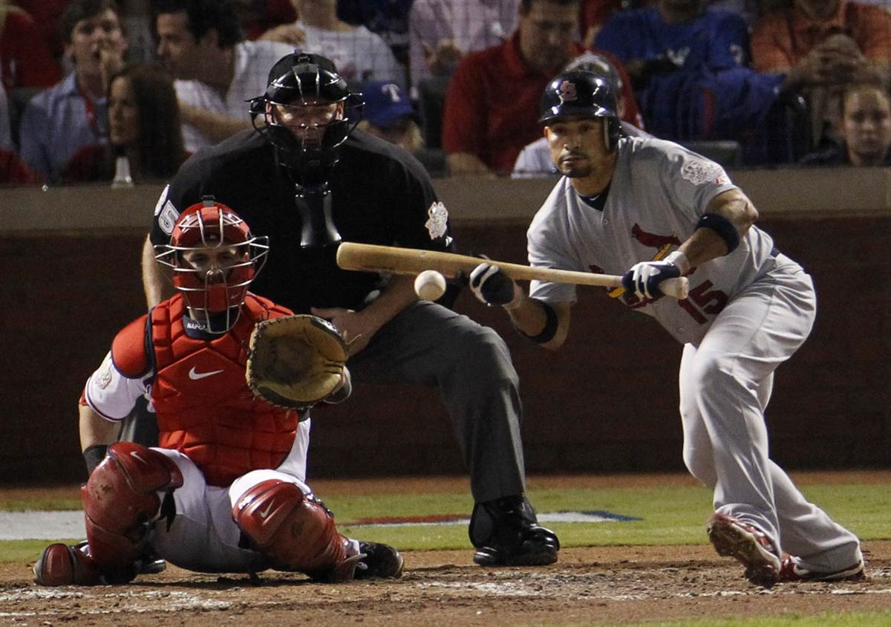
Advance Cue Utilization
Enhanced pattern recognition
Ability to anticipate potential contextual action
Involves:
    Identifying and acquiring environmental information
    Integrating information with what’s already there
    Responding accordingly

Slide 12
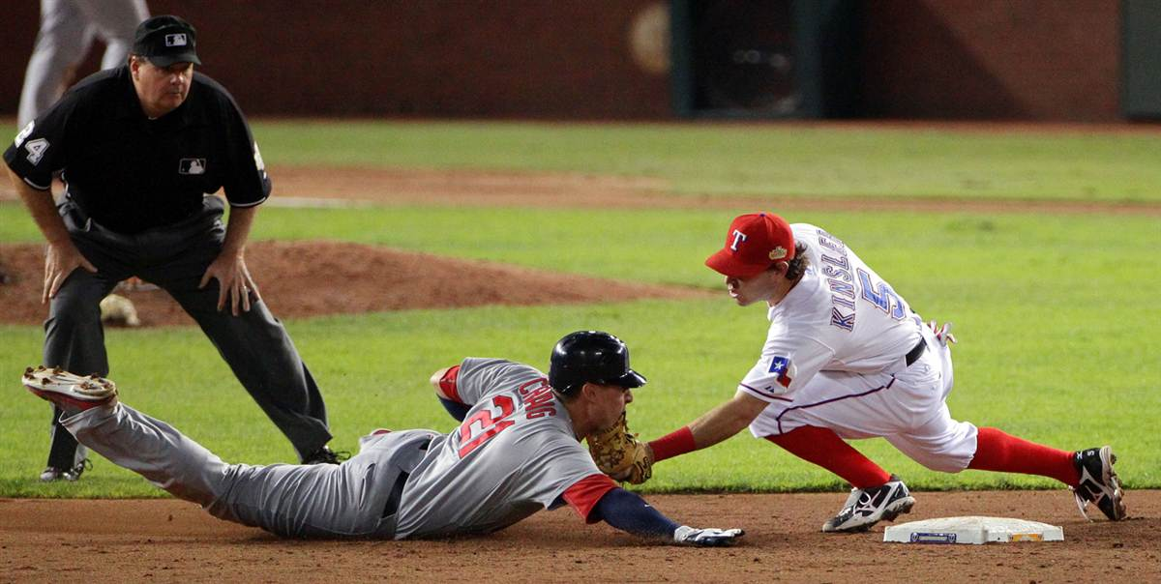
Situational Probabilities
Complex cognitive arrangement of potential outcomes requiring a variety of motor responses
Relevant action often requires flash-bulb judgment

Slide 34
References
Abernethy, B., Maxwell, J.P., Masters, R.S.W., van der Kamp, J., & Jackson, R.C. (2007). Attentional processes in skill learning and expert performance. In Tenenbaum, G. & Eklund, R.C. (Eds.). Handbook of sport psychology. San Francisco: John Wiley & Sons, Inc.
Chase, W.G. & Simon, H.A. (1973; 1988). The mind’s eye in chess. In Collins, A. & Smith, E.E.
(Eds.). Readings in cognitive science: A perspective from psychology and artificial
intelligence. Waltham, MA: Morgan Kaufmann Publishers.
Ericsson, K.A. (2006). The influence of experience and deliberate practice on the development of superior expert performance. In K. A. Ericsson, N. Charness, P. Feltovich, and R. R. Hoffman, R. R. (Eds.). Cambridge handbook of expertise and expert performance (pp. 685-706). Cambridge, UK: Cambridge University Press.
Fadde, P.J. (2006). Interactive video training of perceptual decision-making in the sport of baseball. Technology, Instruction, Cognition, and Learning, 4, 237-255.
Ghasemi, A. Momeni, M., Jafarzadehpur, E., Rezaee, M., & Taheri, H. (2011). Visual skills involved in decision making by expert referees. Perceptual and Motor Skills, 112(1), 161-171.
Moran, A. (2009). Cognitive psychology in sport: Progress and prospects (In press). Psychology of Sport and Exercise, 1-7.
Paull, G. & Glencross, D. (1997). Expert perception and decision making in baseball. International Journal of Sport Psychology, 28(1), 35-56.
Takeuchi, T. & Inomata, K. (2009). Visual search strategies and decision making in baseball batting. Perceptual and Motor Skills, 108(3), 971-980.
Williams, A.M. & Ward, P. (2007). Anticipation and decision making: Exploring new horizons. In Tenenbaum, G. & Eklund, R.C. (Eds.). Handbook of sport psychology. San Francisco: John Wiley & Sons, Inc.
Williams, A.M., Ward, P., & Smeeton, N.J. (2004). Perceptual and cognitive expertise in sport: Implications for skill acquisition and performance enhancement. In Williams, A.M. & Hodges, N.J. (Eds.). Skill acquisition in sport: research, theory and practice. Routledge: London.

