Slide 1
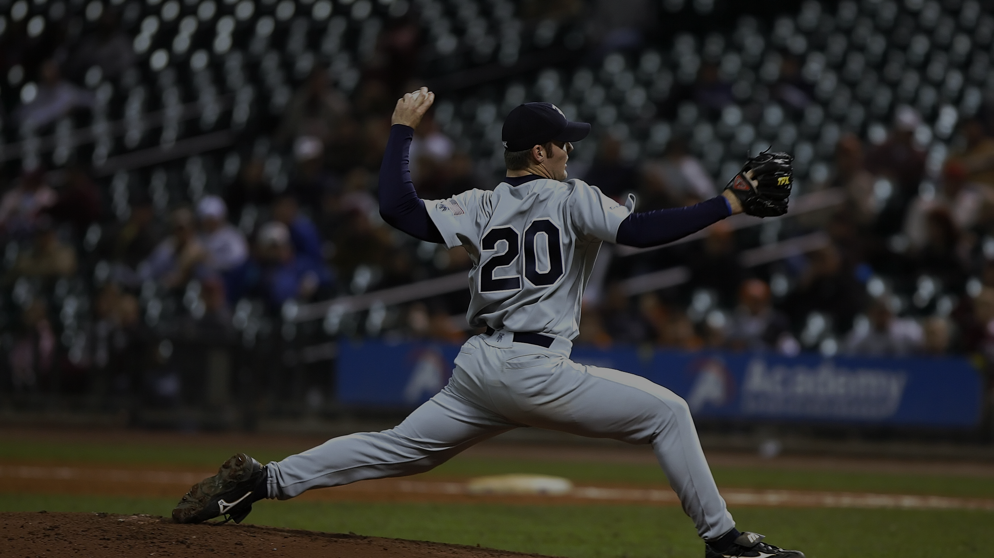
Is Less, More? A Validation Comparing a 4 vs 8 Camera Setup
James Wright (Msci)
wright@simi.com
Notes:
Introduction of me

Slide 2
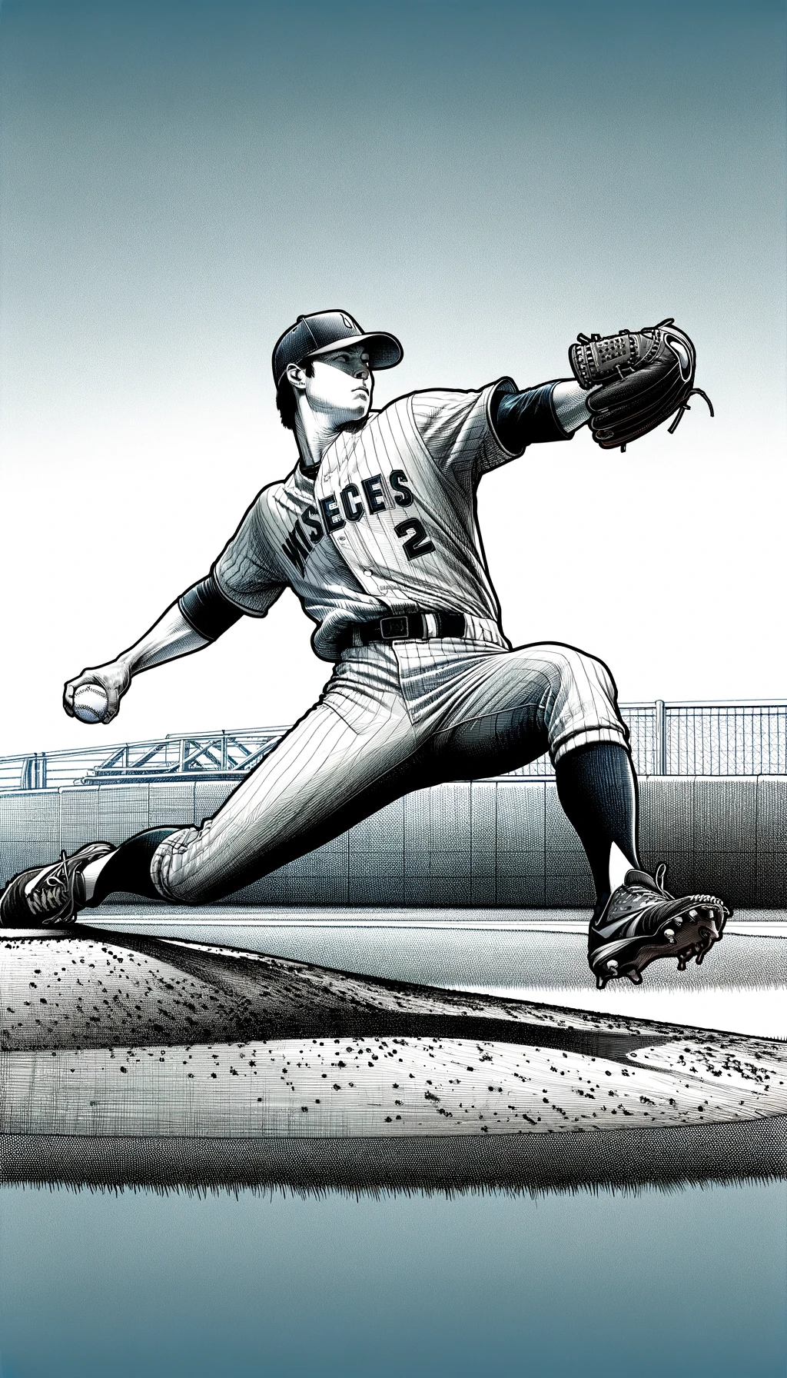
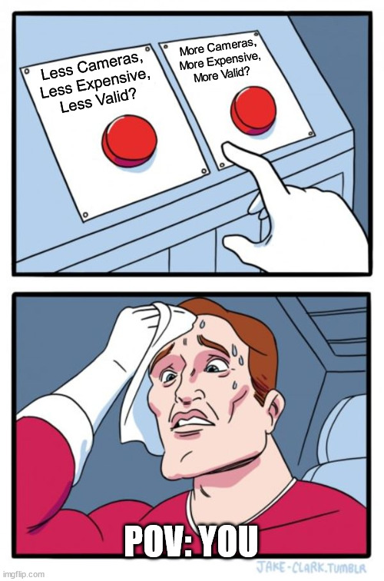
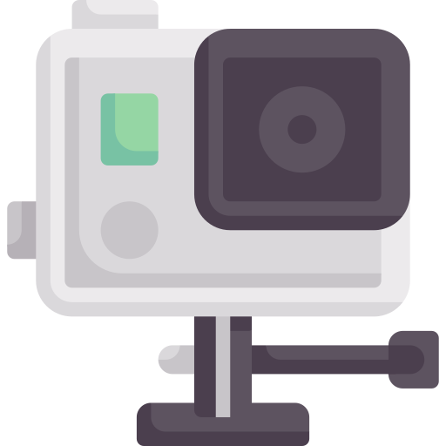
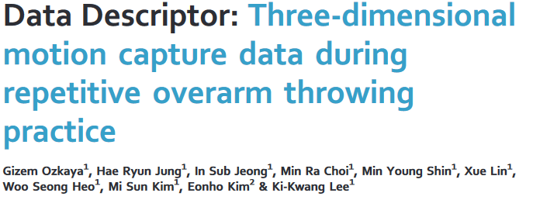
Rationale
Cost/Benefit Ratio for Practitioners
Too Fast for Markers!
Little to No Research
Displaying the advancements in technology
Notes:
Why

Slide 3
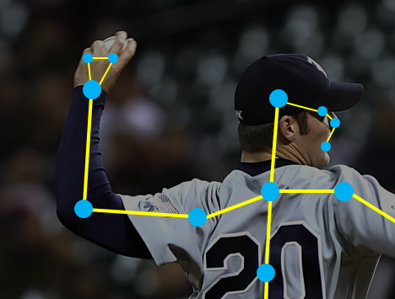
Introduction & Research Questions
Is Less, More? A Validation Comparing a 4 vs 8 Camera Setup
Joint Centre/Rotation Kinematic Differences
4 vs 8 Camera Setup
Simi NeMo
Notes:
Introduction to the topic

Slide 4
Methodology – Pre-Validation
Shape vs NeMo – Key Findings:
No Significant Differences between Joint Centres

Slide 5
Methodology
1 Participant – 10 Pitches each
8 vs 4 Camera Capture
New Technology - Simi NeMo to Track
Calibration differences
X-Direction | 4mm
Y-Direction | 0
Z-Direction | 3mm

Slide 6
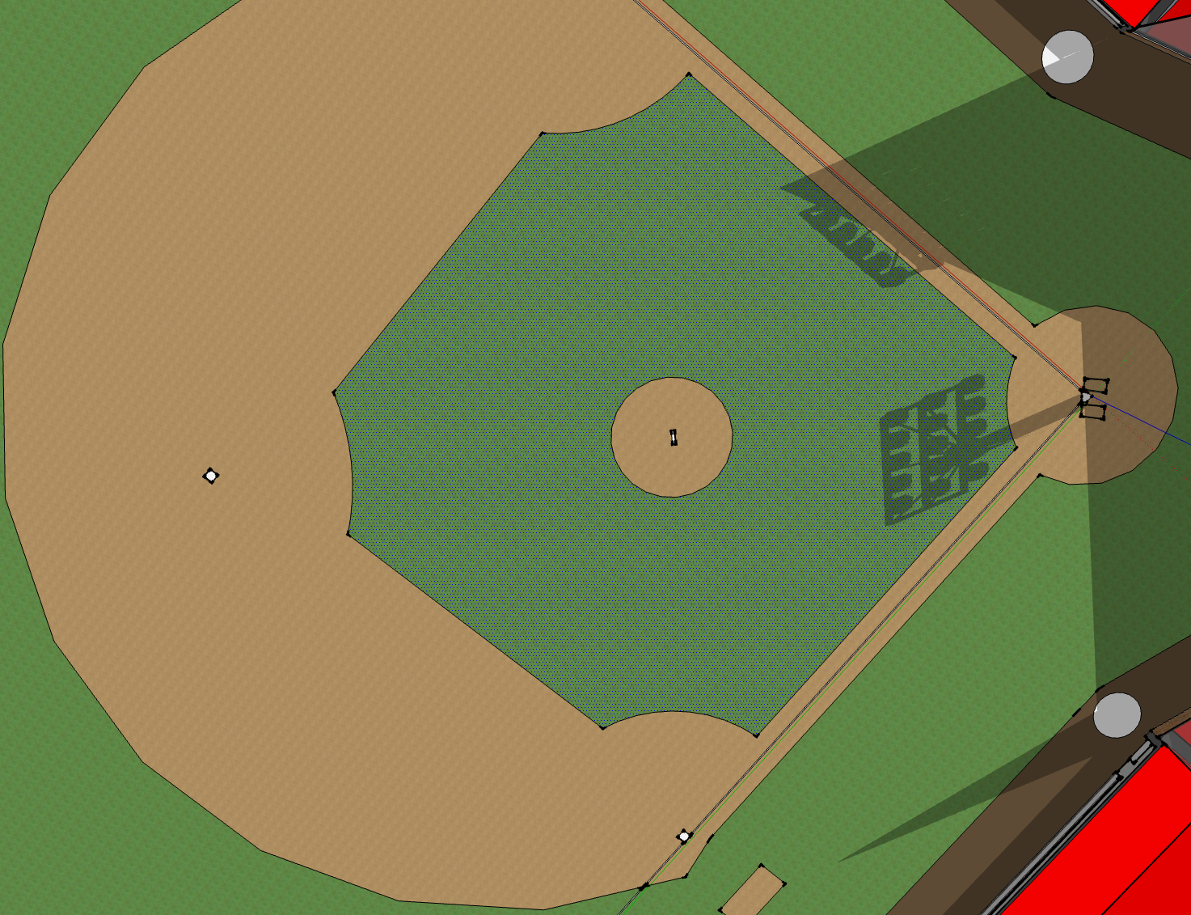

Slide 8
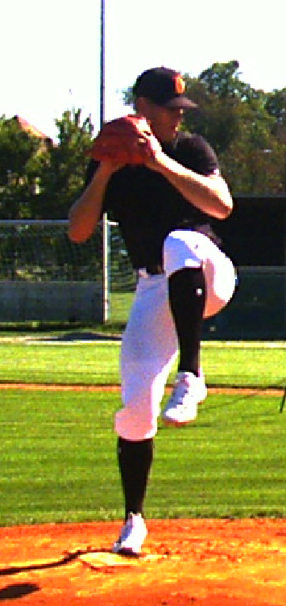
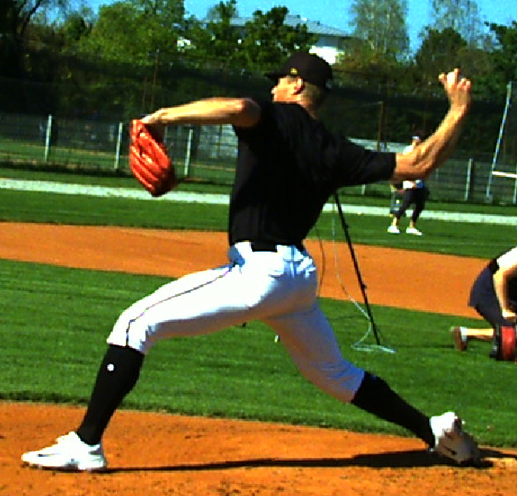
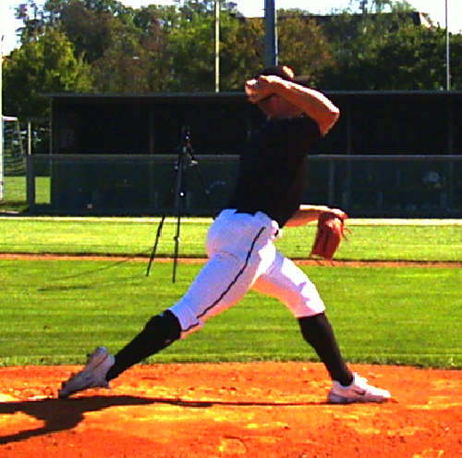
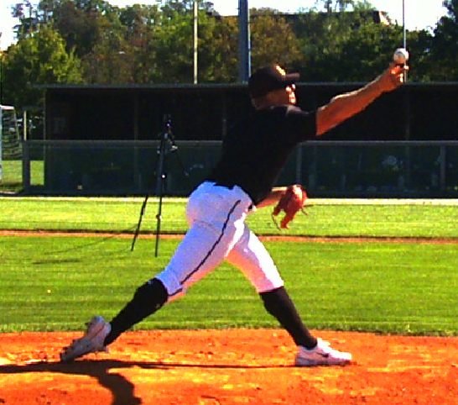
Phases
Wind-Up
Lay-Back
MER
Ball Release

Slide 9
Results
Wilcoxon Summary Table | Value (p)
Mean | 0.002**
Median | 1.168e-09**
Smallest Significance | 0.017*
ICC Summary Table | Value (r)
Mean | 0.941
Median | 0.948
Smallest Correlation | 0.919
* = p < 0.05
** = p < 0.05

Slide 10
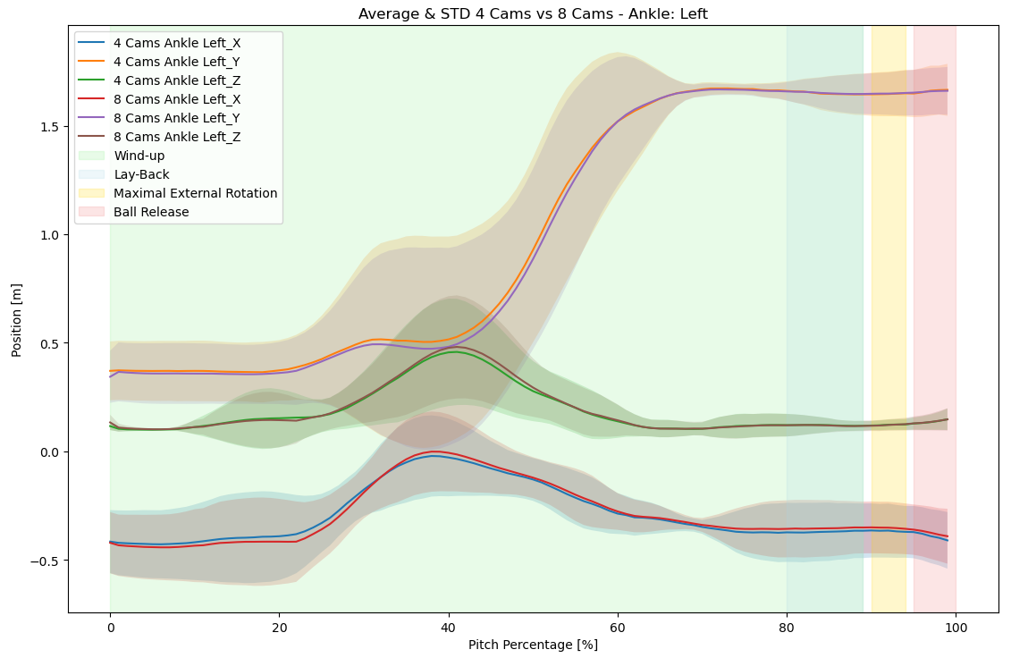
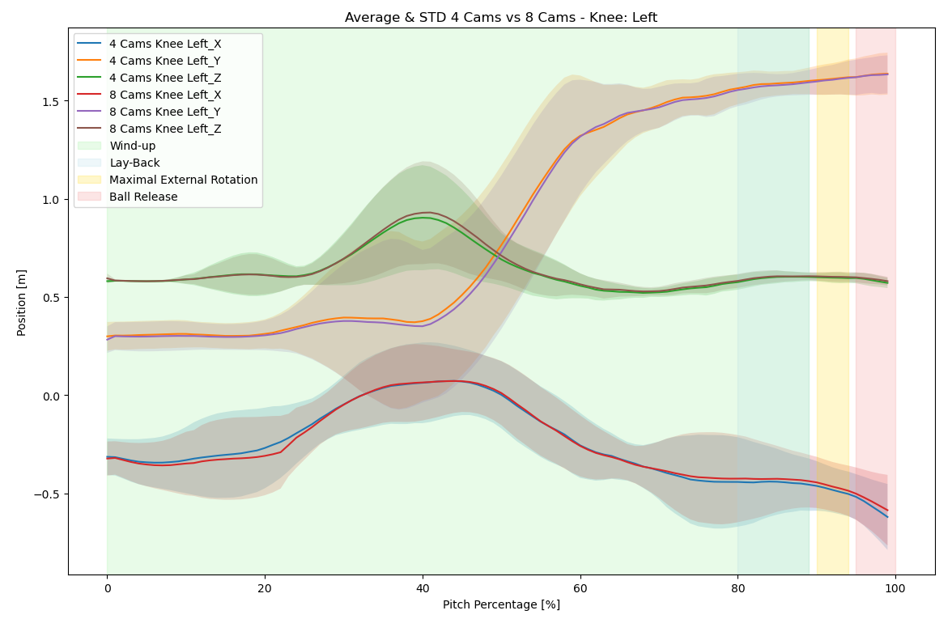
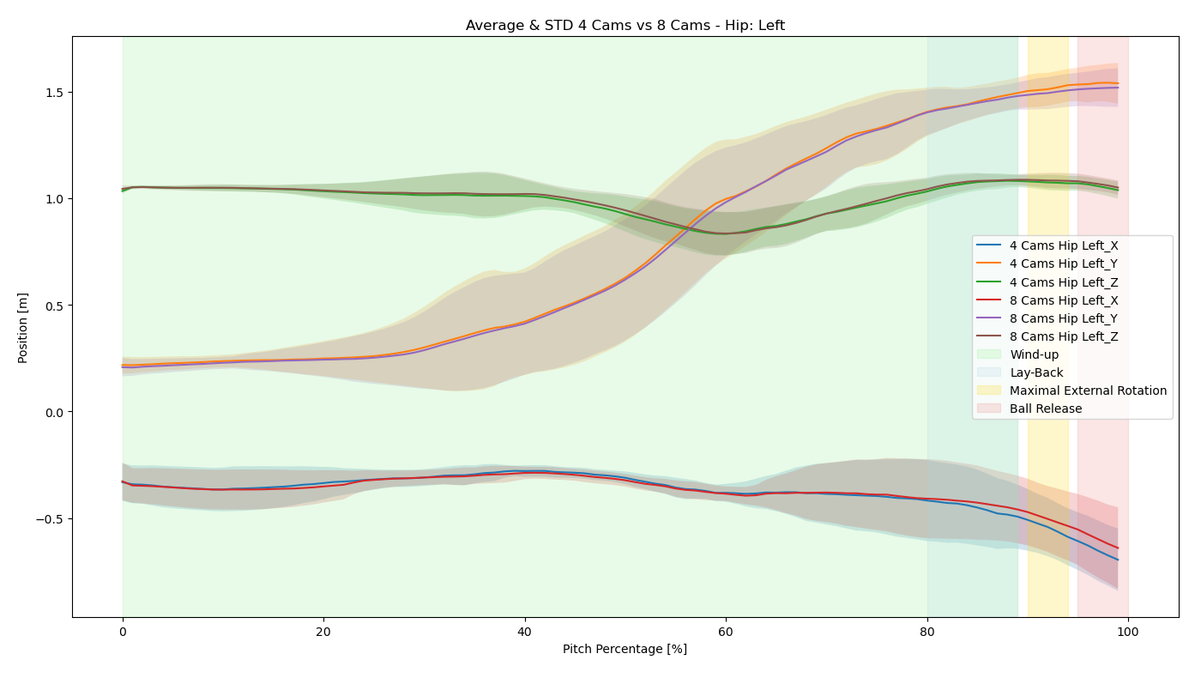
Results – Lead Leg

Slide 11
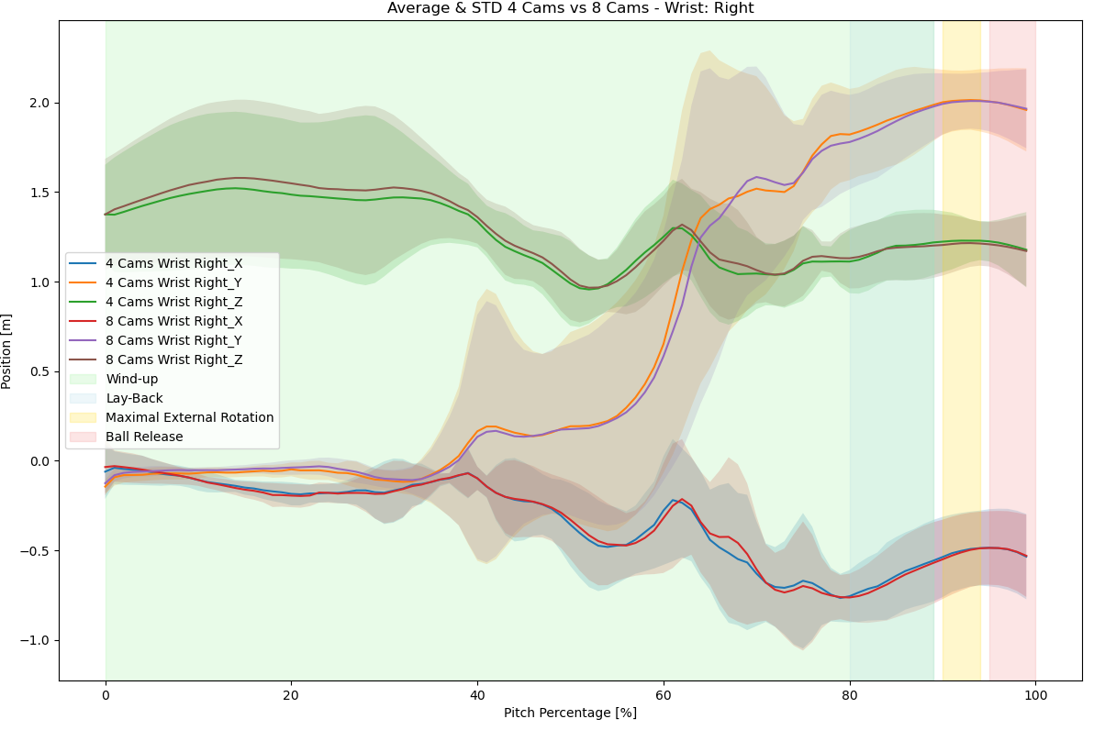
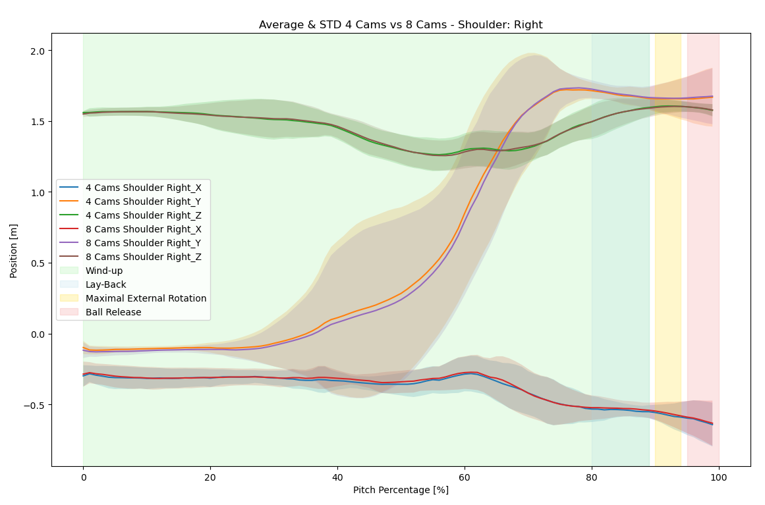
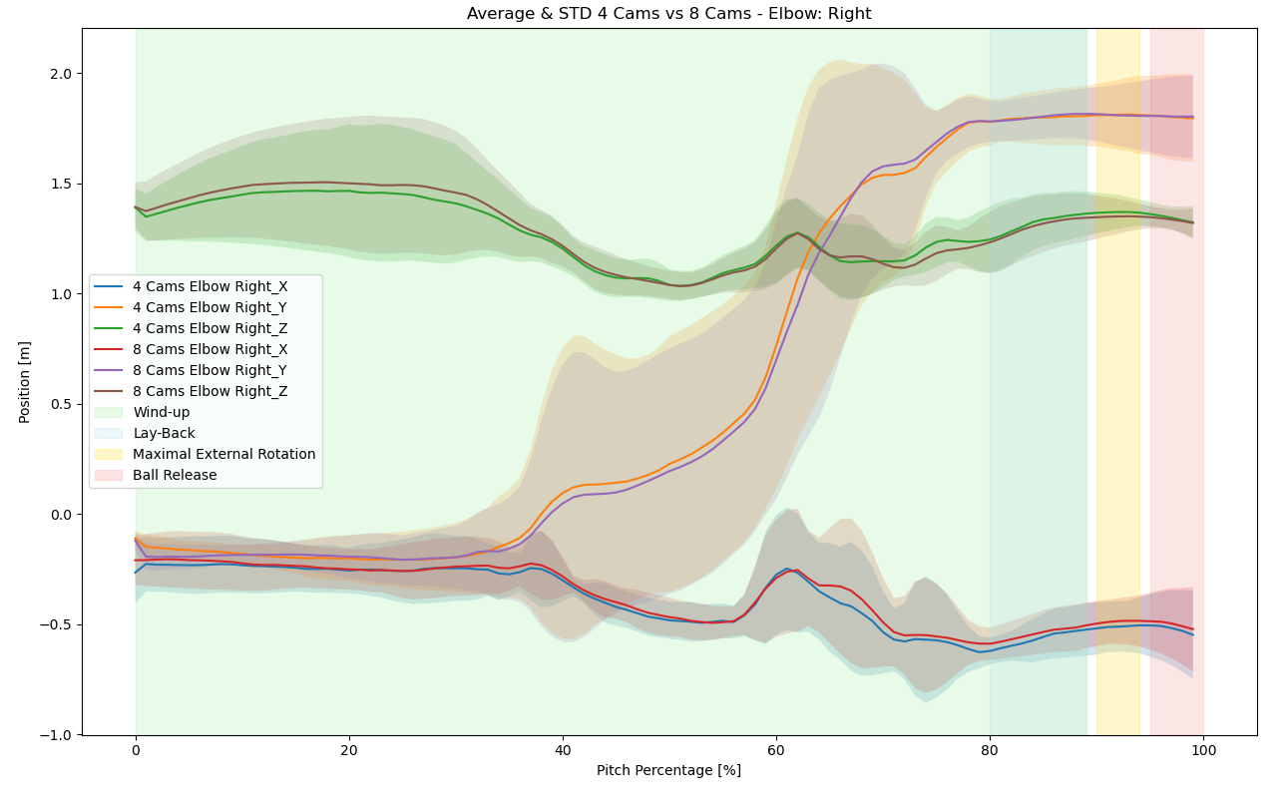
Results – Lead Arm

Slide 12
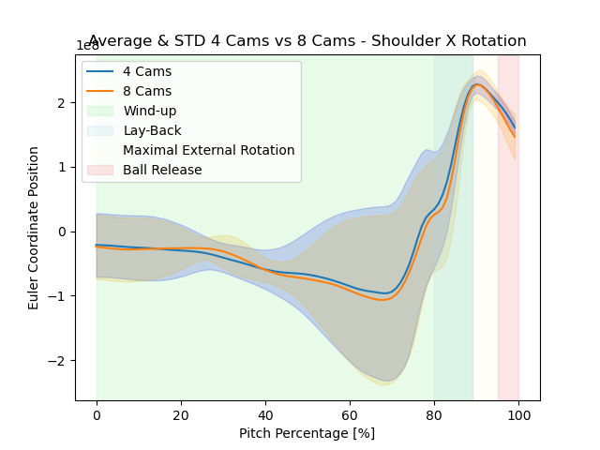
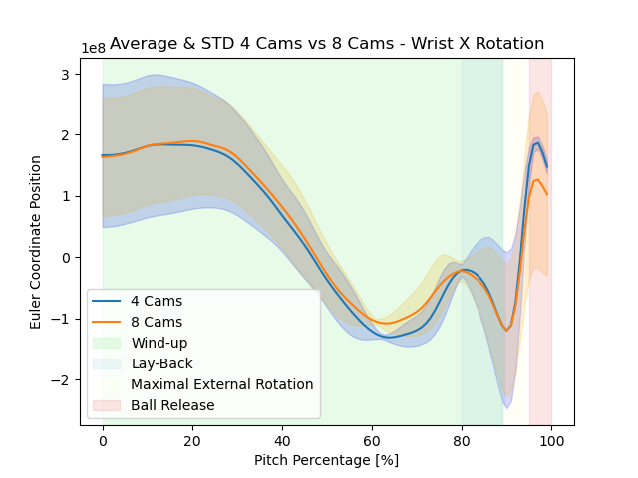
Results – Rotational Centres

Slide 13
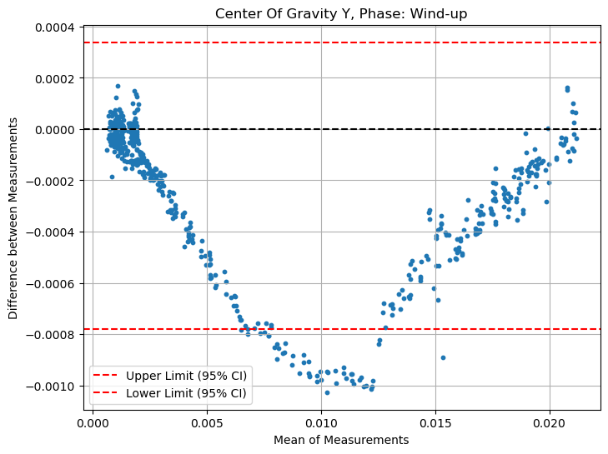
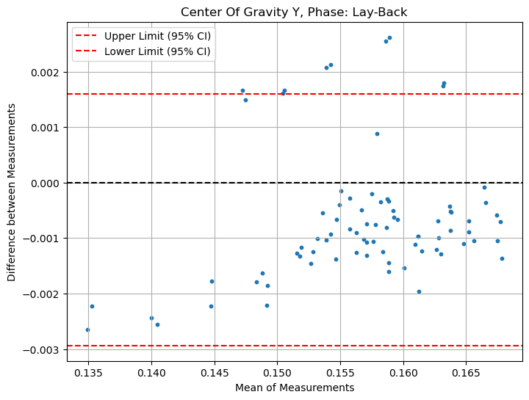
Results – Bland-Altman

Slide 14
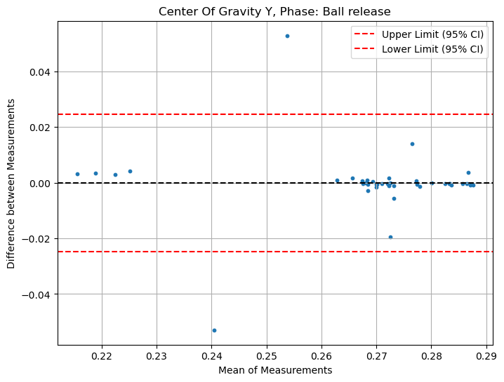
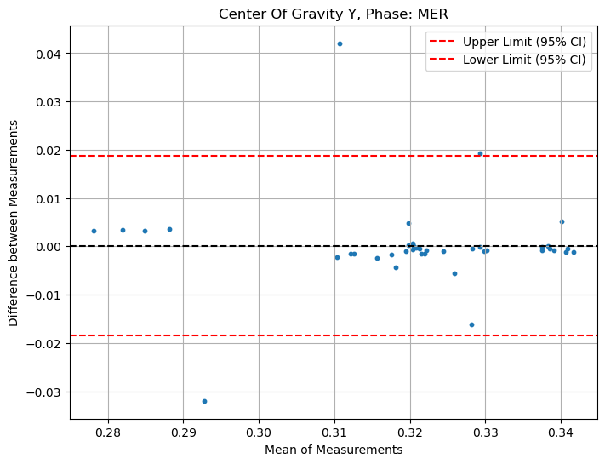
Results – Bland-Altman

Slide 15
Key Take-Away
Main Research Question:
Null Hypothesis (No Significant Difference) between 4 vs 8 Cameras.
Secondary Research Question:
Can 4 Cameras be a replaceable tool for all practitioners?
Seen accurate and valid data to suggest Yes…
Works in a real-world example…
More “data” is required to provide 100%:
Different Pitch Types?
Lefty/Righty?
Lab Settings
Not long to go to ensure 100%

Slide 16
Future Timeline
Marker-Based Comparison (Ongoing)
YOU!
Stage 1
Stage 2
Stage 3
Stage 4
More Environments (Ongoing)
3 Camera Setups
You can also be a monumental assistor in upcoming research!

Slide 17
Is Less, More? A Validation Comparing a 4 vs 8 Camera Setup
James Wright (Msci)
wright@simi.com
Notes:
Introduction of me

