Slide 1
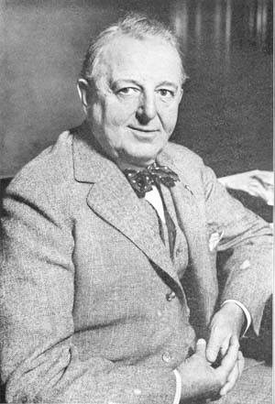
The Ultimate Tear-Down and Rebuild The White Sox 1922-26
Bruce Allardice
SABR 51
Notes:
I’d like to thank __ for his introduction.
I grew up as a Sox fan—on the north side of Chicago, surrounded by Cub fans. I’ve lived, and died—mostly, died—with the Sox my entire life. So in a sense it pains me to talk about a low point in Sox history.
The title of the talk is the ULTIMATE tear-down and rebuild. The themes of this talk is that in the aftermath of the Black Sox scandal, the Chicago White Sox faced a tear-down that was unique in baseball history, a tear-down of a championship team because of actions outside the club’s control. Imagine a club where half of its players die in a plane crash. That’s what White Sox management faced in the 1920s.

Slide 2
What is a Tear-Down?
The phrase tear-down popularized by recent Astros
Notes:
The terms “tear down” and “rebuild” has in recent years become a staple of MLB commentary. The modern popularity of the term is perhaps inspired by the Houston Astros, who in 2010 deliberately tore down their team, traded their best players for minor leaguers of other teams, finished in the cellar, stocked higher draft choices and soon emerged as a dominant team.

Slide 3
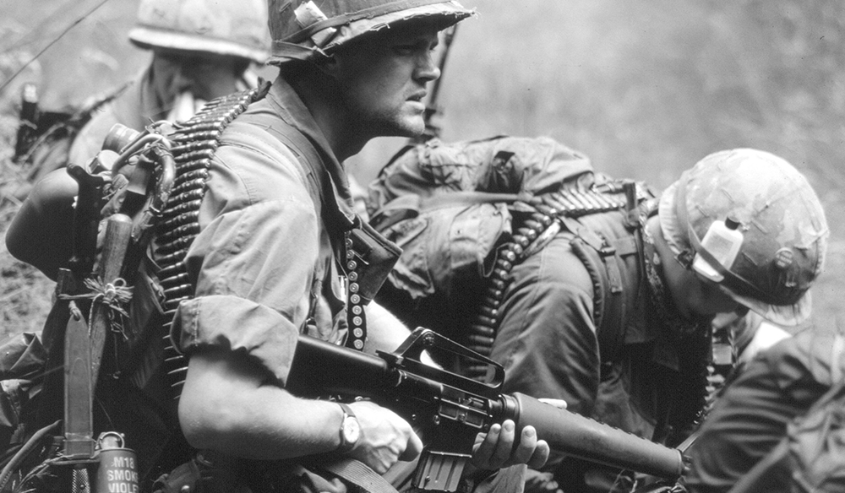
WAR: What’s It Good For?
Notes:
For this presentation I’ll use baseball reference’s Wins Above Replacement (WAR) and Wins Above Average (WAA), unless I specify otherwise.

Slide 4
The Sox—an Involuntary Tear-Down, Compared to the Astros
But Sox after the scandal an Involuntary tear-down, not voluntary
Sox a very good team before the tear-down. Just on WAA, the Black Sox lost players valued at 11.2 WAA (per their 1920 season). Joe Jackson alone, at 5.2 WAA, was worth all the veterans the 2010 Houston discarded.
And unlike today’s rebuilds, the Sox got nothing in return for the loss.
Different rebuilding context in 1920s. No draft to help weaker teams. Free agency today. No International pool.
Rebuild thus much tougher
Notes:
Unlike present day, where a last-place team can at least be assured of a high draft pick that could improve their club over time, there was no baseball draft in that era. Today there is also free agency and international signings, allowing cash-rich clubs to purchase known talent. This should make rebuilding easier today than in the past. The one advantage compared to today that 1910s and 1920s rebuilding had, was that the minor leagues were largely independent and MLB clubs could purchase young talent like Lefty Grove on the more-or-less open market.
With that as context, we can view the White Sox in 1922 and subsequent years as a tear-down and rebuild, albeit a unique, special kind of involuntary tear-down.
During modern tear-downs and rebuilds the Astros and other modern teams were able to acquire young talent in trades for their veterans. Not so the White Sox. From the 1920 team that finished 96-58 (2nd place), even with the Black Sox players arguably tossing games that year as well, the club lost the seven suspended players (including four starting field players and two starting pitchers) and gained no compensation for the loss. Unlike the A’s or Astros, the Sox couldn’t even plan who they let go. This can be considered the ultimate tear-down.
So how well did team owner Charles Comiskey rebuild the 1917-20 White Sox dynasty?

Slide 5
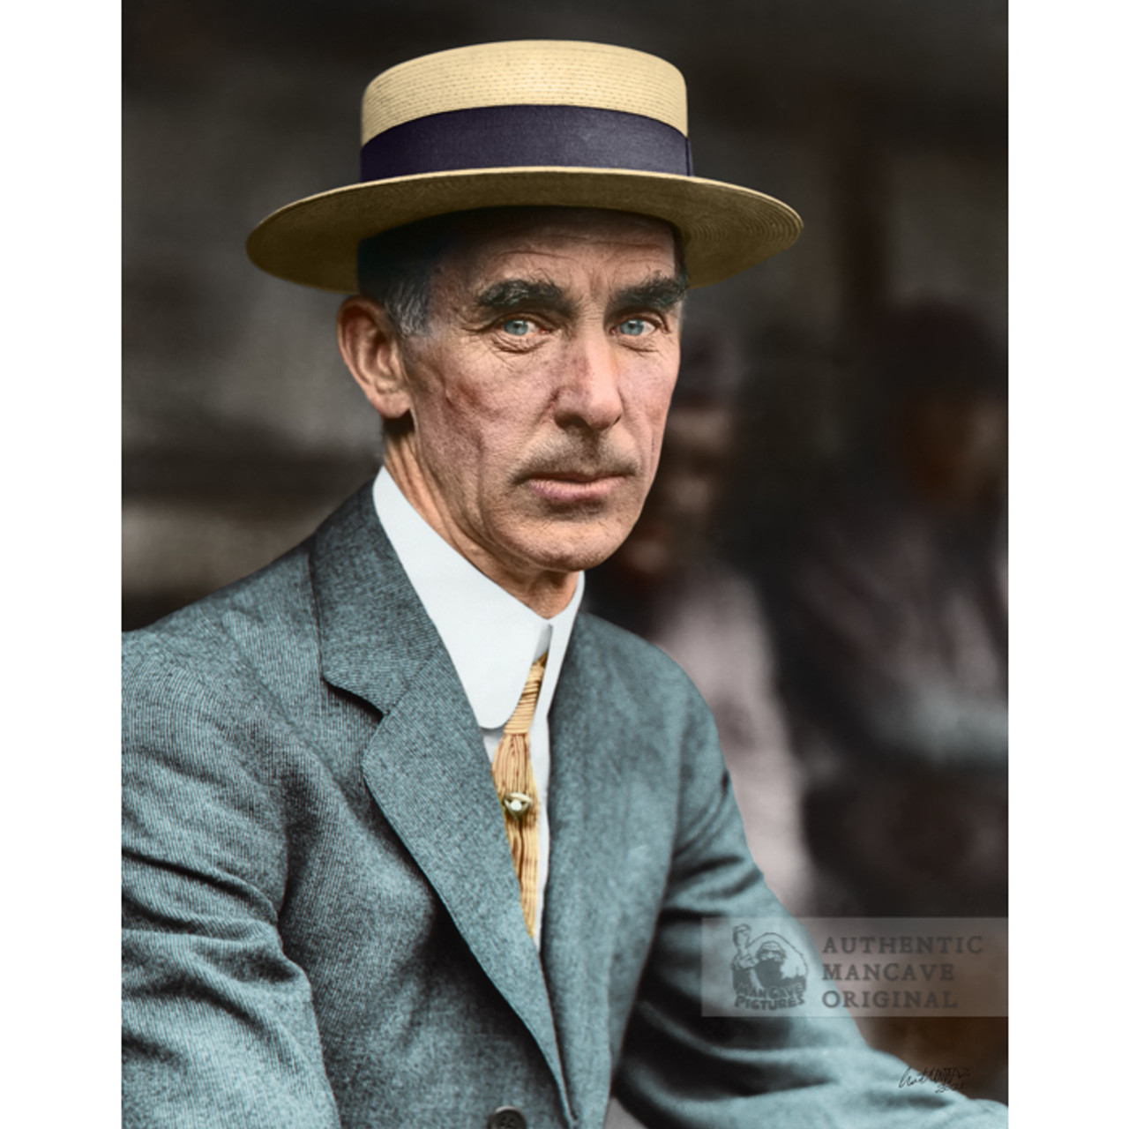
Historic Tear-Downs: the 1914 A’s
Not counting pre-1900 tear-downs due to the franchise
hijinks of that era (e.g., 1898-99 Cleveland Spiders)
Closest post-1900 comparison the 1914 Philadelphia As.
(Reasons why—semi-voluntary)
Lost Collins, Baker, Plank, Bender, Coombs,
four Hall of Famers.
Finished in last place 9 years in a row.
Notes:
I’m not going to compare the Sox’s rebuild to that of teams torn-down in the 19th century because of dual ownership or similar ownership hijinks, such as the 1898-99 Cleveland Spiders.
Perhaps the earliest famous example of a “tear-down and rebuild” was when a cash-starved Connie Mack, faced with aging pitchers and the threat of the new Federal League luring his stars away, dismantled his 1914 pennant winning Philadelphia Athletics. The club shed about the same WAR as did the 1920-21 White Sox. The result was a swift and near-total collapse. The Athletics went from 99–53 and a pennant in 1914 to 43–109 (56 games worse) and last place in 1915, and then to 36–117 (.235, a major league low winning percentage) in 1916. They finished in last place through 1922 and did not achieve a winning record until 1925.
And at least Mack got $50,000 for Collins.
The Sox got nothing in return.

Slide 6
Any Money Saved by Losing the Black Sox?
Not that much money saved. The Black Sox players combined earned $46,600 in 1920.
Notes:
As we’ll see, Comiskey’s rebuild didn’t lack for money anyway. The Sox has been a very profitable franchise throughout the 1910s, annually finishing at or near the top of the American League in attendance.
He paid $100,000 for Willie Kamm, for example, and a record amount for ss Bill Cissell.
And $15,000 for star Baltimore hurler Tommy Thomas
Comiskey had—and spent– money, belying the myth that he was some sort of tightwad. I’m not saying he always spent wisely, but he spent.
Of course, “spending, but not wisely” could also be said about the 2023 White Sox.

Slide 7
Brief Summary of the Rebuild
In 1921-22 the White Sox promoted some players in their “pipeline” and purchased the 1b, ss and 3b from the Salt Lake City PCL team.
1923 purchased 3b Willie Kamm from the PCL for a record $100,000.
By 1925 the new players were maturing, and the team finished with a winning record. They did better in 1926.
However, stars Collins and Schalk were aging.
By 1927 the decline started again.
Notes:
I’ll briefly summarize the rebuild: for 1921 the Sox brought up some young players they had options on such as outfielders Bib Falk and Johnny Mostil, and basically purchased the Salt Lake City trio of infielders (Earl Sheely at 1b, Ernie Johnson at SS and Eddie Mulligan at 3b). There was a fall-off in the field with these young players. The Sox weren’t able to replace starting pitchers Eddie Cicotte and Lefty Williams.
Of the minor league pitchers brought into camp for 1921, one newspaper acidly asked: “Know any of them? Neither do we.” Salt Lake City Tribune, March 30, 1921.
However, 1922 showed improvement—to .500. That was due to the new field players maturing (almost 6 more WAR from basically the same field lineup) plus a marked improvement (11.2 WAR) in the pitching. New starters Dixie Leverett, Charlie Robertson and Ted Blankenship replaced the gaggle of 1921 unknowns, all that Comiskey was able to find for that year. However, the Sox lost World Series hero Dickie Kerr in a contract dispute.
1923 saw the Sox purchase, for a then-record $100,000, Willie Kamm, the star 3rd baseman of the PCL. Kamm went on to have a solid, though not spectacular, Sox career. The field team improved by one WAR, but the pitchers regressed a little, as ace Red Faber started to show his age. 1923 also saw the cup-of-coffee debut of Hall of Famer Ted Lyons.
The pitching staff regressed further in 1924. Young starters Lyons, Ted Blankenship and Sloppy Thurston showed promise, but Faber aged further and none of the other pitchers did much. One suspects that the poor defense (last in the league) contributed to the pitcher’s woes
1925 saw the first fruits of the rebuild, as the Sox posted their first winning record since 1920. The field team players were remarkably healthy, and Lyons emerged as a star hurler. The fielding also improved dramatically. The only fly in the ointment was that their best field players (2b Eddie Collins and c Ray Schalk) were close to retirement.
The club improved more in 1926. OF Johnny Mostil finished 2nd in the MVP voting, and Bib Falk hit a solid .327. The fielding improved even more, and new starter Tommy Thomas (a minor league star purchased from the Baltimore Orioles) solidified the staff (the team ERA was 3rd in the league). The good young starters led at least one newspaper expert to predict that the Sox would be pennant contenders that year. One note of worry was that longtime but aging stars Collins and Schalk played fewer games that year.
1927 and 1928 marked a letdown—not in the pitching staff, so much as in the field team. In 1927 Collins left for Philadelphia, Schalk only played in 16 games, and Sheely was benched for not hitting. The team was not able to find suitable replacements. Even worse, star outfielder Johnny Mostil attempted suicide during Spring Training, for reasons that are obscure even today. He recovered from this tragedy, but was never the same player. 1928 continued this trend, as the Sox simply didn’t replace their aging or slumping players with players of equal value. Schalk retired to become manager, then quit in disgust halfway through the 1928 season.

Slide 8
Sox drew the fans, even in decline AL Rank in Attendance
Year AL Rank Year AL Rank
1919 2nd 1924 3rd
1920 3rd 1925 2nd
1921 4th 1926 3rd
1922 4th 1927 3rd
1923 3rd 1928 3rd
Notes:
Throughout the rebuild, the Sox continued to draw well. They were never first in attendance, but even when the steam was bad, they drew better than average. And since in those days, team revenue was mostly ticket sales, the Sox had enough of a revenue stream to stay competitive.

Slide 9
Sox Won-Loss (ties not counted)
Year W-L Record Pythagorean W-L
1919 88-52 84-56
1920 96-58 89-65
1921 62-92 61-93
1922 77-77 77-77
1923 69-85 72-82
1924 66-87 71-82
1925 79-75 81-73
1926 81-72 83-70
1927 70-83 72-81
1928 72-82 70-84
Notes:
Note that I’ve highlighted 1921.
Basically, uncertainty surrounded the 1921 season. Sox management couldn’t know if the trail of the Black Sox players would even occur that year, given the delays and legal maneuvering. The Sox couldn’t know the verdict of the trial, couldn’t know if the Commissioner would ban or re-instate the players, couldn’t now if the players (if banned) would sue to get reinstated or at a minimum collect their back play.
Comiskey was hamstrung. But once the trial was over, in Aug. 1921, he had more certainty. Comiskey could then start the rebuild in earnest.

Slide 10
------------ .500
Notes:
Here’s the won-loss chart, in visual (graph) form.

Slide 11
Statistics
Why start 1922 rather than 1921?
Runs scored versus Runs given up 22-26
Basically, Sheely and Johnson replaced Gandil and Risberg, Kamm replaced Weaver. Lyons and Thomas replaced Cicotte and Williams
By 1922—within a year of 1921--they’d replaced the WAA of the Black Sox pitchers and infielders.
Notes:
Basically, uncertainty surrounded the Sox in 1921. Comiskey couldn’t know if the trial or the Commissioner would re-instate the players, or that the players would at a minimum get their salaries paid or successfully sue to be reinstated.
He was hamstrung. But after the trial and after Commissioner Landis banned the Black Sox for life, in Aug. 1921, Comiskey could start the rebuild in earnest.

Slide 12
Gandil 1919—1.5 WAR, -0.3 WAA; Earl Sheely 1921, 2.6 WAR, 0.2 WAA
Risberg 1920, 1.5 WAR, -0.4 WAA; Ernie Johnson 1921, 1.7 WAR, -0.7 WAA
Weaver 1920, 3.9 WAR, 1.1 WAA; Kamm 1923, 4.6 WAR, 2.2 WAA
Jackson 1920—7.5 WAR, 5.2 WAA---a star like that couldn’t be easily replaced
Felsch 1920—5.6 WAR, 3.3 WAA—ditto
Notes:
One of the things I’ve discovered in my research is that Swede Risberg and Chick Gandil of the 1919 team simply weren’t that good.
I do a comparison here of Gandil, Risberg, Weaver and their replacements—and as you can see, the Sox replaced them,
It wasn’t until 1925-26 that the White Sox developed outfielders that performed anywhere near the Jackson-Felsch level.

Slide 13
Chart of Team Total WAR and WAA, 1919-27
WAR WAA
1919 41.7 10.3
1920 44.9 10.8
1921 20.6 -13.6 A drop of 24.4 WAA and 24.3 WAR
1922 37.6 1.5
1923 35.9 -0.4
1924 26.2 -9.2
1925 38.2 2.9
1926 44.2 8.5
1927 36.0 1.8
Notes:
Note that the 1926 Sox WAR and WAA are pretty close to the 1919-20 glory years.

Slide 14
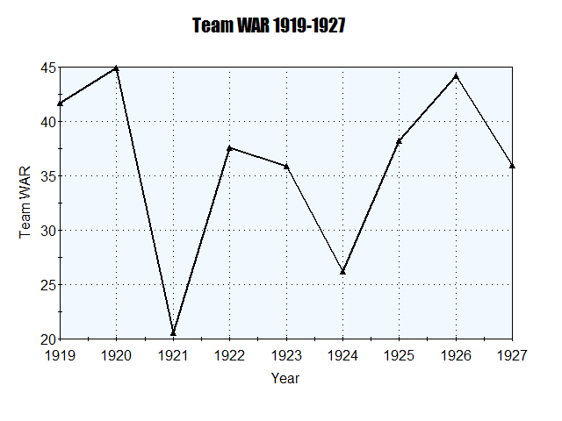
Notes:
As can be seen, by 1926 team WAR approached the 1920 level.

Slide 15
Chart of Field Team WAR, 1919-28
1919 27.5
1920 26.9
1921 13.7
1922 19.5
1923 20.5
1924 20.5
1925 27.1
1926 28.3
1927 19.5
1928 13.8
Notes:
Note that the Field Team combined WAR for 1925 and 1926 are similar to the 1919-20 WAR

Slide 16
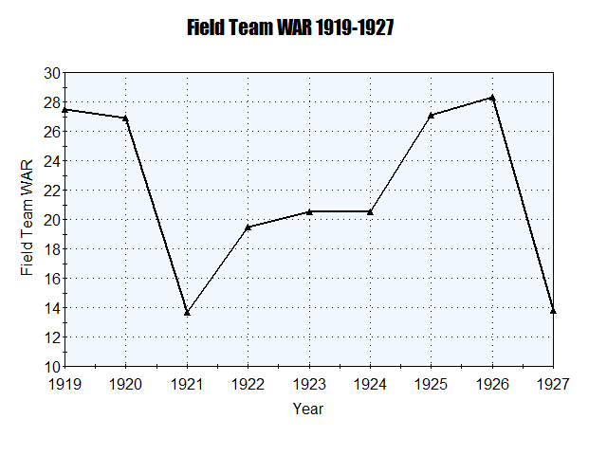
Notes:
Again, here’s the chart in Graph form.

Slide 17
Chart of Team Pitching WAR 1919-28
1919 14.2
1920 18.0
1921 6.9
1922 18.1
1923 15.4
1924 5.7
1925 11.1
1926 15.9
1927 16.5
1928 15.5
Notes:
Note that by 1922 the pitching WAR equaled that of 1920. And the 25-26 pitching WAR was similar to 1919-20.

Slide 18
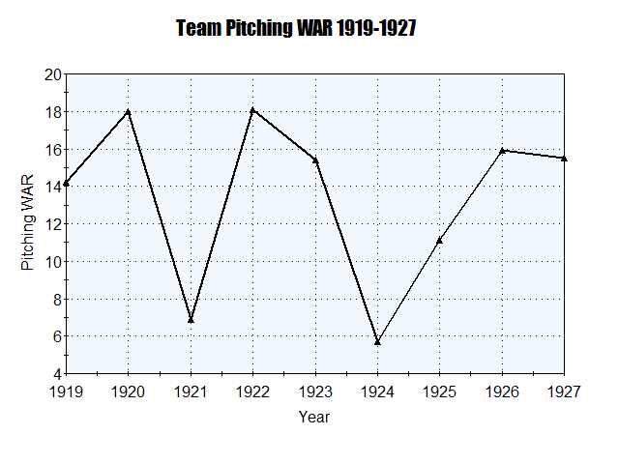

Slide 19
Chart of Team Defensive Efficiency, 1919-28
Year DER League Rank
1919 2
1920 4
1921 2
1922 1
1923 2
1924 8
1925 4
1926 1
1927 1
1928 3
Notes:
The 1921-23 teams, with all their problems, played as good a defense as the 1919-20 teams.
Overall, with the exception of 1924, the Sox were very good on defense this decade.

Slide 20
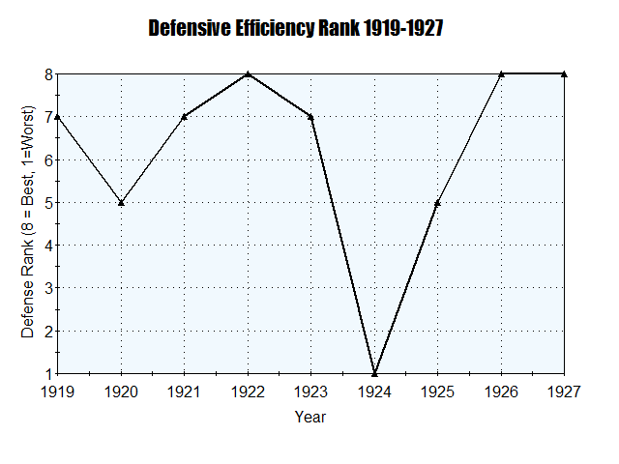

Slide 21
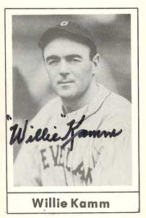
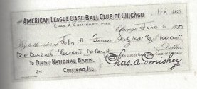
Big Spender Comiskey?
For the years 1918-26, in all but 2 of those years the Sox player payroll was above league average. And the two years were the talent-shy Sox of 23-24.
Kamm contract—$100,000 and three players.
Notes:
Hall-of-Fame pitcher, Chief Bender: “Willie Kamm was the best third baseman I ever saw.”
Bleacher Report—30th best 3b of all time. Ahead of Weaver.
He still holds the American League single-season record for putouts by a third baseman (243).
-Kamm led the league in fielding percentage eight times, including six times in a row; and led the league in putouts seven times.
First minor league player bought for 6 figures--$100,000.
27.1 career WS WAR—14th highest among WS position players. Just behind Joe Jackson (27.8) and well ahead of Buck Weaver (21.2). His peak WAR was also higher than Weaver’s.

Slide 22
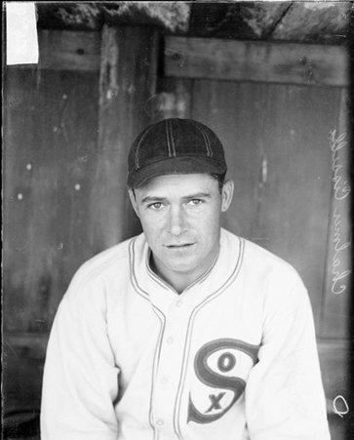
Big Spender Comiskey?
Big Bill Cissell (who?) purchase.
Allegedly,
The BIGGEST Purchase EVER
($100,000 plus two players)
Notes:
Infielder. His big PCL season set the stage for him to become “baseball’s costliest player” in 1927 when the Chicago White Sox sent $75,000 to $100,000 in cash to Portland and two players as well (Ike Boone and Bert Cole). When the value of Boone and Cole (Cole’s contract had cost the White Sox $35,000) was added to the cash sent to Portland, the total the Beavers reaped for their investment was also said to have been a record.
Played in parts of 9 undistinguished seasons 1928-38.

Slide 23
Conclusions
The White Sox management did a pretty good job of rebuilding the team, to the point that by 1926, the Sox were talked of as pennant contenders.
They basically rebuilt the pitching staff and the infield. But they could never replace star outfielders Jackson and Felsch with anyone comparable.
Compared to the 1914 A’s, the Sox did a much better job rebuilding.
And they rebuilt at least as fast as the Astros—under rules that made rebuilds more difficult.
Notes:
Despite the criticisms then and today, it appears that the White Sox did a solid job rebuilding this team, considering all the circumstances. In the 4th year of the rebuild, the Sox were again a winning team. This rebuild is light-years better than the 1914-15 A’s, and comparable to the 2010-15 Astros, and the Sox were rebuilding under much more difficult circumstances (due to the rules of the time).
The Sox’s decline started in 1927, in part by the ill-health of Comiskey, and the aging or retirement of Comiskey’s network of old friends and scouting bird dogs. As Comiskey biographer Tim Hornbaker writes “Throughout 1920, Comiskey suffered from increased health concerns, and it grew in severity to the point in which his doctors advised him to completely refrain from watching any ballgames.” Increasingly, “he relied upon his lawyer Alfred Austrian and team secretary Harry Grabiner to …. essentially manage the team in his absence.” While it is perhaps overstating things to blame the Sox’s downturn in the late 1920s solely on Comiskey’s absence, the illness certainly played a part.
One final point--The Sox’s lean years of 1927-35 (perhaps the low point in the club’s history) cannot be blamed on the Black Sox scandal losses, as by then the 1920 Black Sox stars would not (given the normal aging process) have been stars any more.
Thank YOU.

Slide 25
Black Sox vs. Astros
Compare Sox 1920-21 with Astros. Sox lost the 11.2 WAA of the Black Sox players in just one year, and got nothing in return
In 2010-12 Astros traded away veterans SPs Roy Oswalt, Wandy Rodriguez, Brett Myers, 1B/OF Lance Berkman, OFs Hunter Pence, Michael Bourn and Carlos Lee. In their last year with the Astros, these players combined for 5.3 WAA.
But the Astros got young talent in return

Slide 26
Black Sox vs. Astros Rebuilds (team WAA)
Astros White Sox
2009 -13.0 1919 10.3
2010 -16.6 1920 10.8
2011 -10.3 1921 -13.6 (a drop of 24.4 WAA!)
2012 -19.1 1922 1.5
2013 -25.8* 1923 -0.4
2014 -11.7 1924 -9.2
2015 11.5 1925 2.9
2016 0.9 1926 8.5
2017 16.7 1927 1.8

Slide 27
White Sox outfielders
Johnny Mostil total WS WAR—24.4
Peak WAR—6.3 in 1926 (fangraphs)
Bibb Falk—career WAR—22.7
Peak WAR—5.3
Very comparable to Shoeless Joe Jackson and Happy Felsch’s peak and WS WARs

