Slide 1
Replacement Spring:
Baseball on the Brink in 1995
Matthew J. Prigge

Slide 2
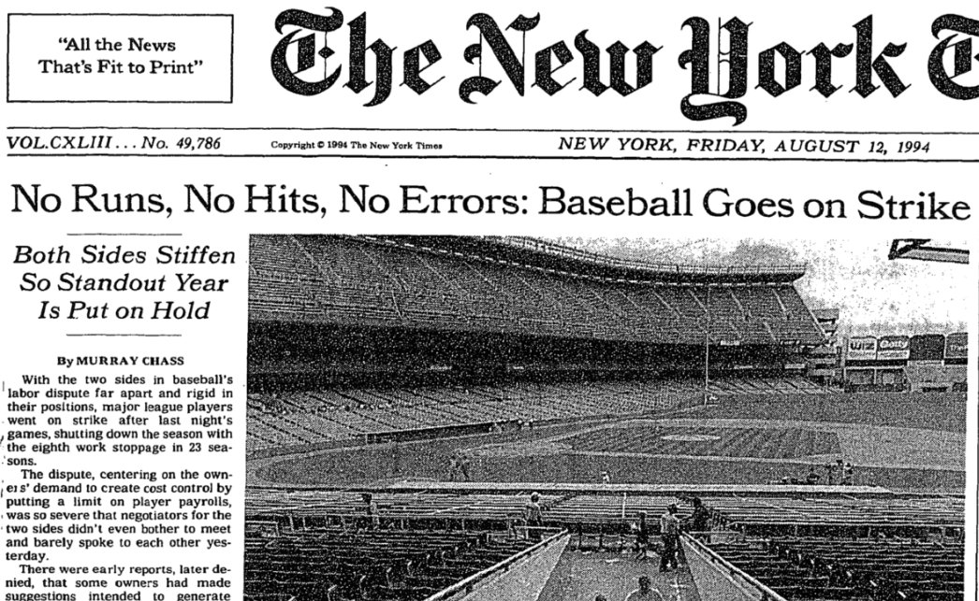

Slide 3
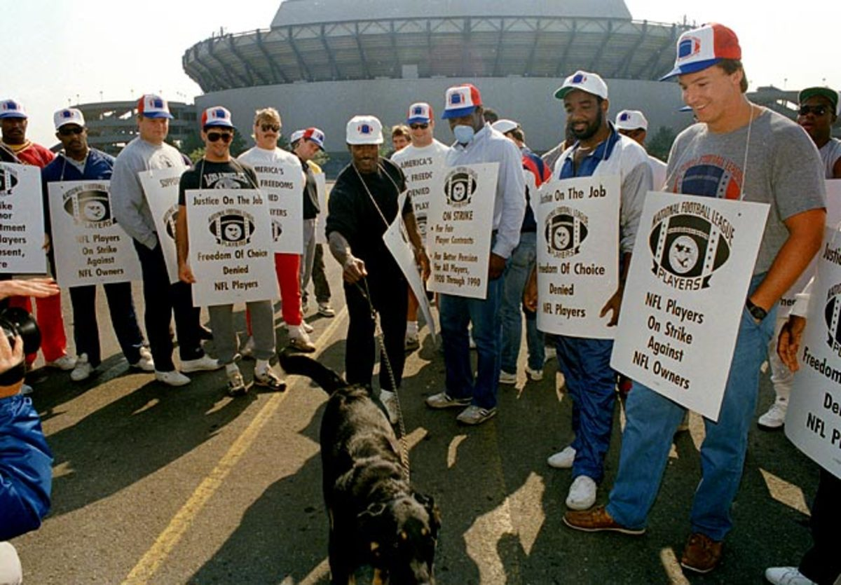

Slide 4
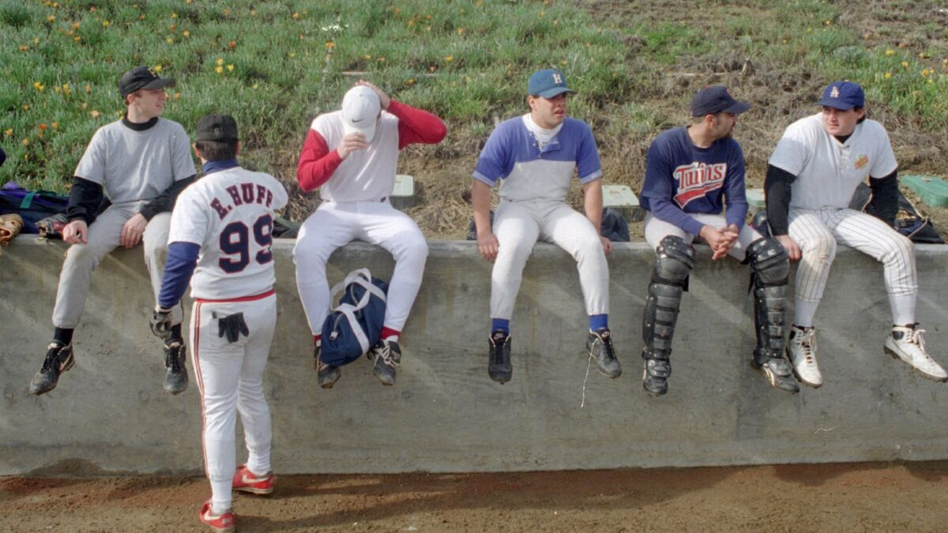

Slide 5
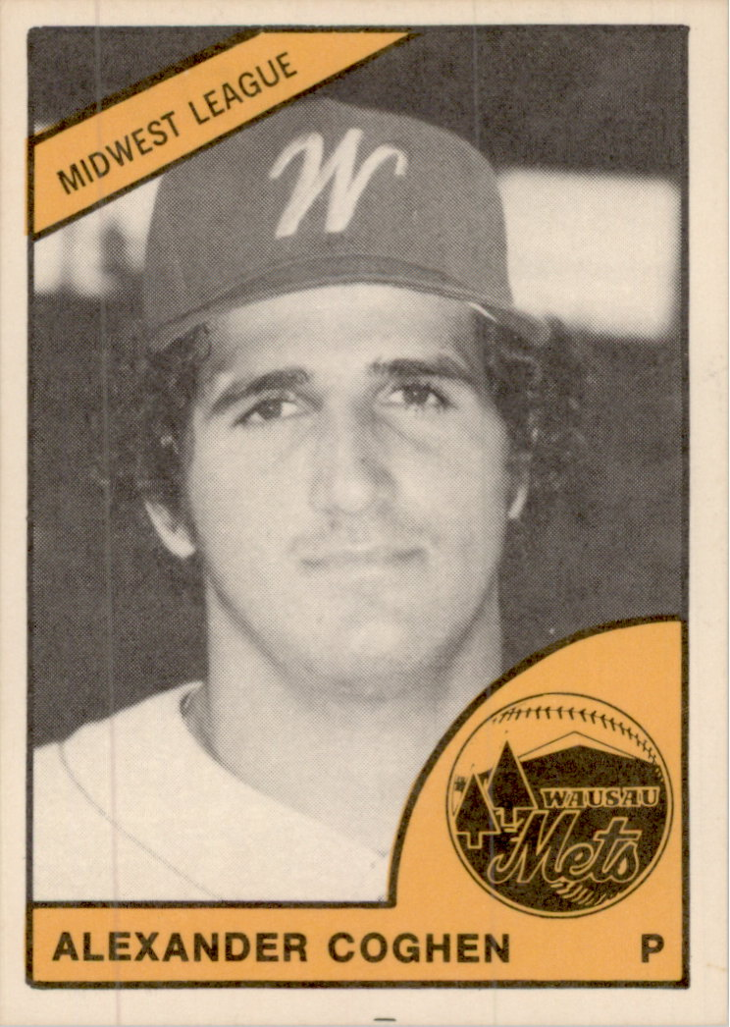

Slide 6
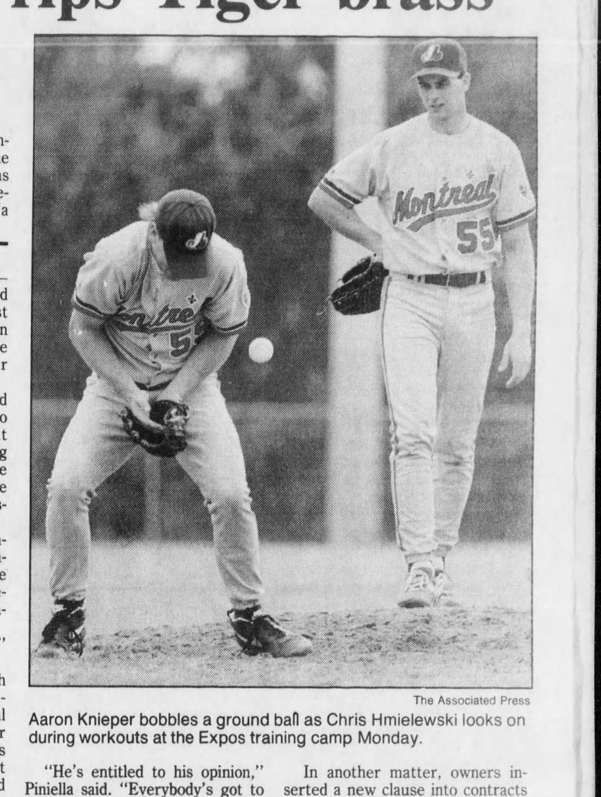

Slide 7
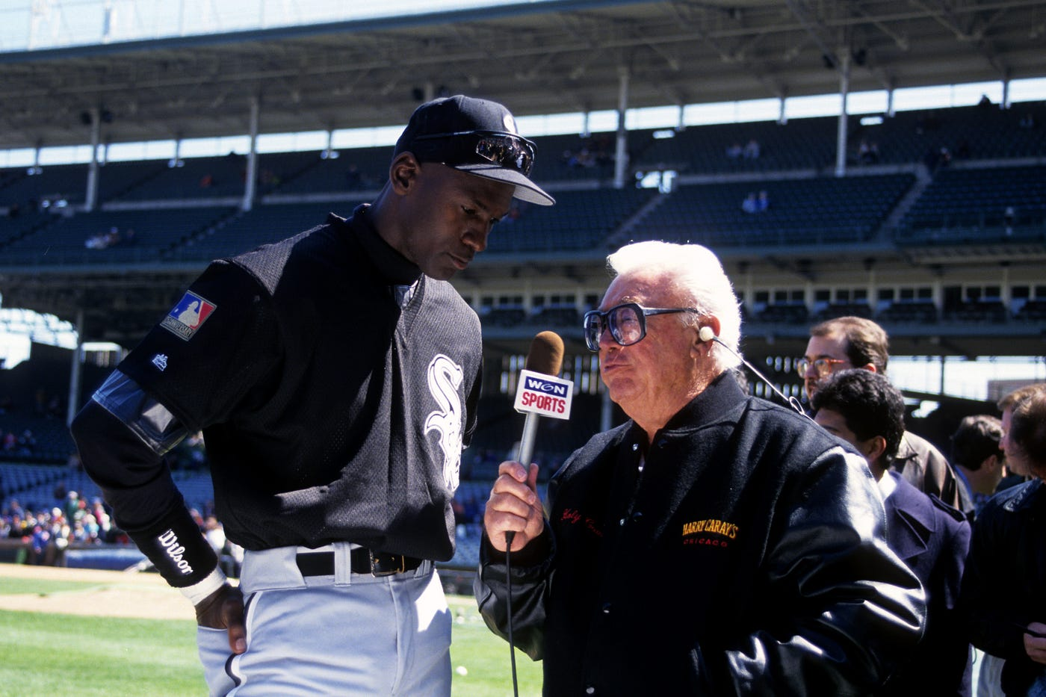

Slide 8
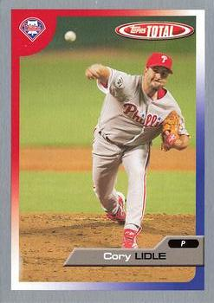
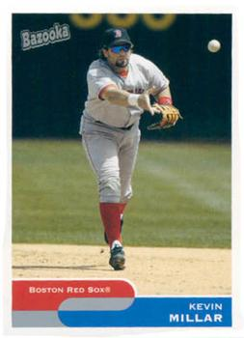
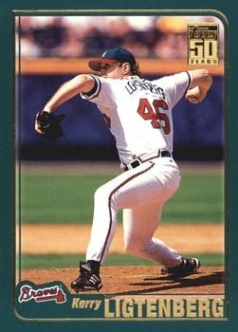
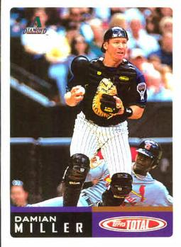

Slide 9
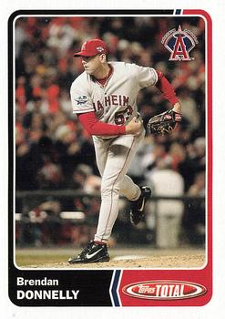
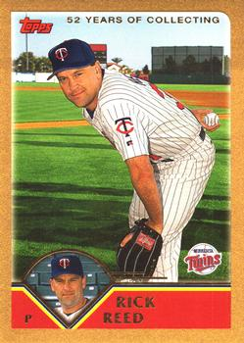

Slide 10
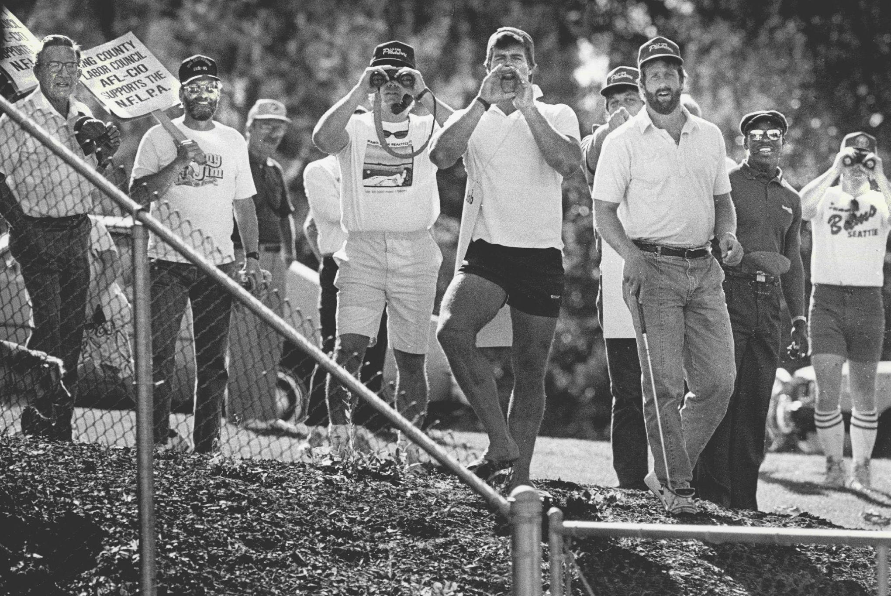

Slide 11
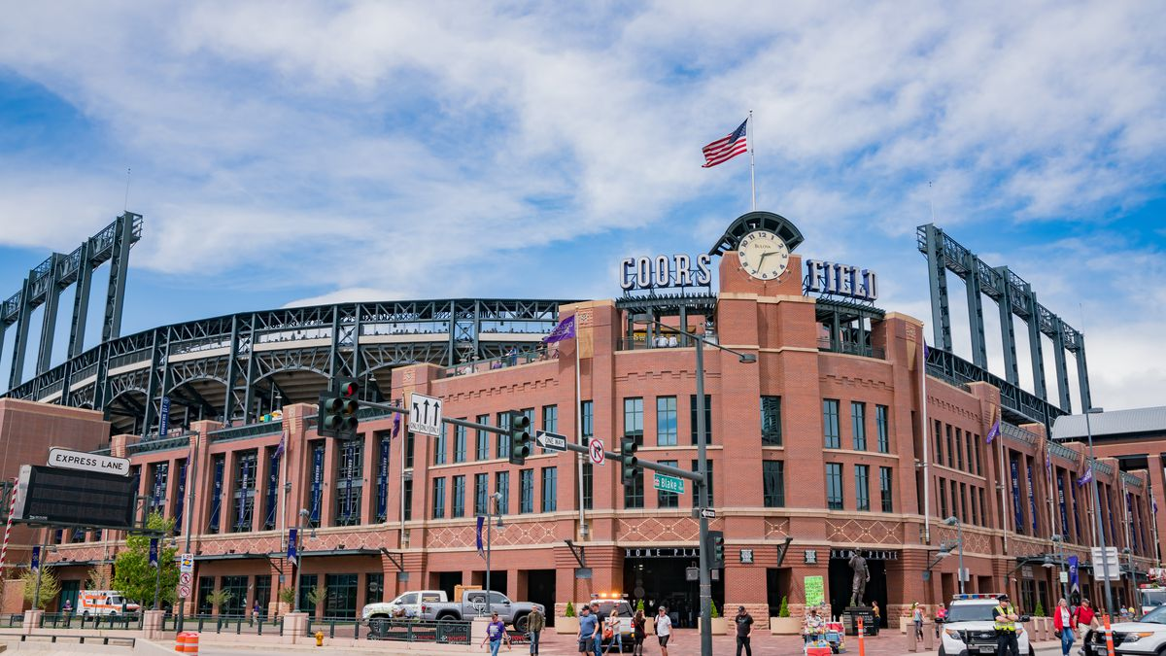

Slide 12
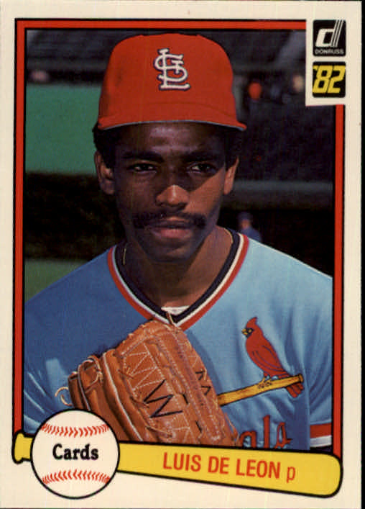

Slide 13
American League |  |  |  |  | National League
East |  |  |  |  | East
Red Sox | 16 | 15 | 0.516 |  | Braves | 14 | 13 | 0.519
Yankees | 11 | 17 | 0.393 |  | Expos | 13 | 13 | 0.500
Tigers | 10 | 18 | 0.357 |  | Phillies | 11 | 14 | 0.440
Blue Jays | 9 | 18 | 0.333 |  | Marlins | 10 | 15 | 0.400
Orioles | 0 | 0 | 0.000 |  | Mets | 7 | 17 | 0.292
Central |  |  |  |  | Central
Brewers | 16 | 13 | 0.552 |  | Astros | 20 | 7 | 0.741
White Sox | 15 | 13 | 0.536 |  | Pirates | 16 | 10 | 0.615
Indians | 16 | 16 | 0.500 |  | Reds | 15 | 12 | 0.556
Twins | 15 | 16 | 0.484 |  | Cubs | 14 | 14 | 0.500
Royals | 11 | 16 | 0.407 |  | Cardinals | 12 | 16 | 0.429
West |  |  |  |  | West
Rangers | 19 | 7 | 0.731 |  | Dodgers | 21 | 8 | 0.724
A's | 15 | 11 | 0.577 |  | Rockies | 21 | 9 | 0.700
Angels | 13 | 12 | 0.520 |  | Padres | 11 | 17 | 0.393
Mariners | 12 | 15 | 0.444 |  | Giants | 8 | 18 | 0.308

