Slide 1
EAGLE
Quantifying Hitter Plate Discipline in Major League Baseball
Joshua Mould
Dr. David Anderson

Slide 2
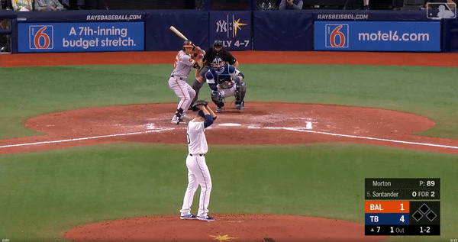
Notes:
Terrible swing that looks incredibly silly, but not a high leverage situation.

Slide 3
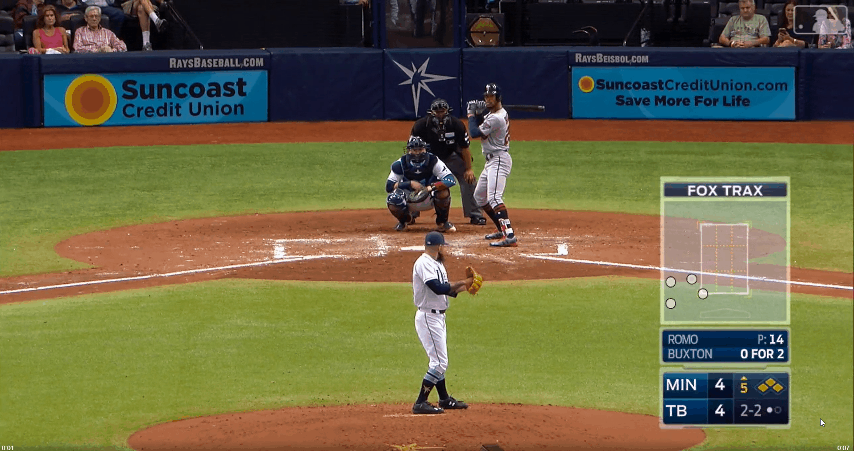
Notes:
This is a terrible swing, and it’s a high leverage situation

Slide 4
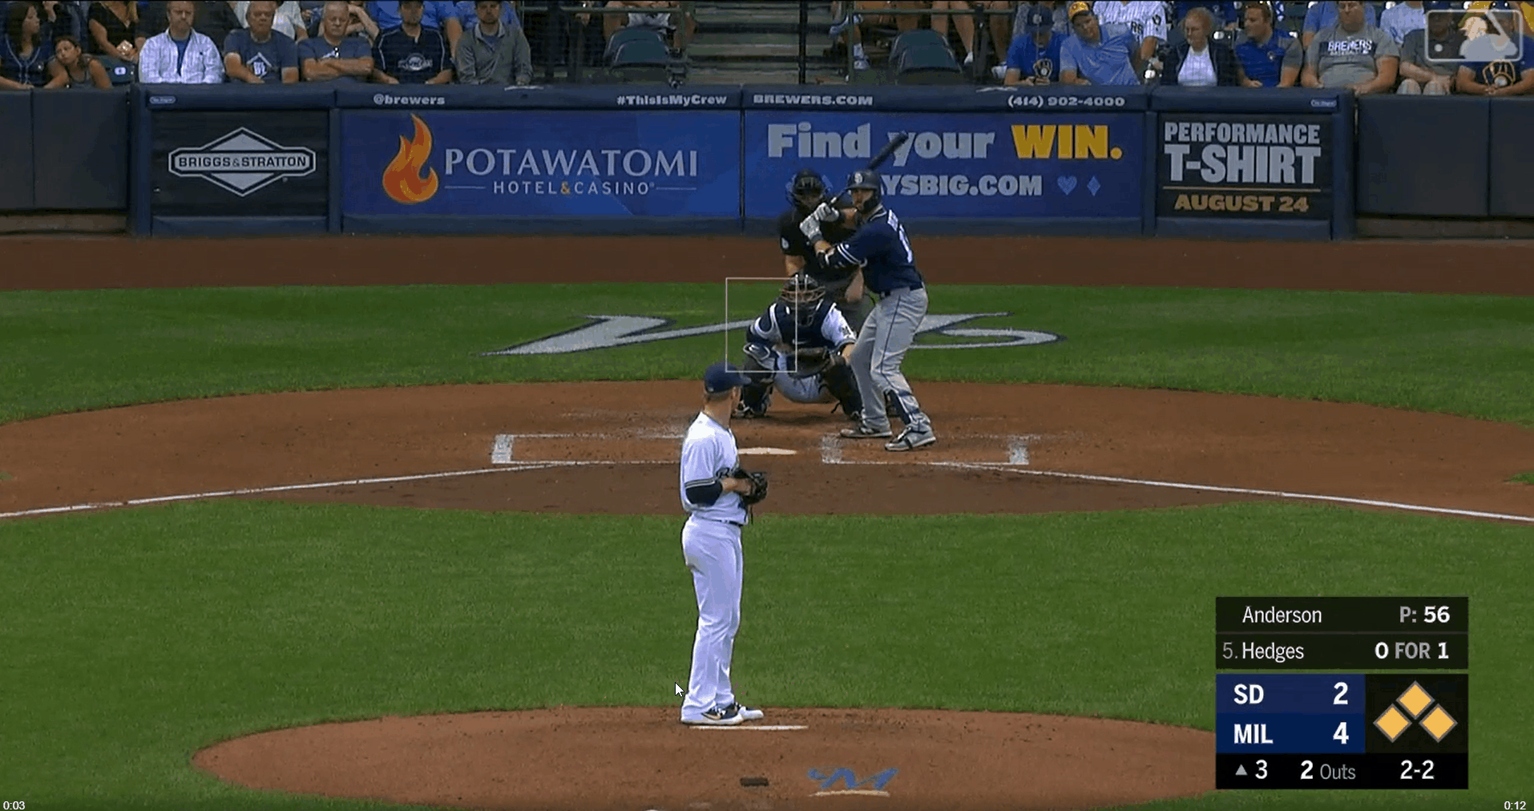

Slide 6
The Question
How can we determine how good a player is at deciding when to swing or when to take a pitch?

Slide 7
The Answer
EAGLE: Expected Additional runs Gained by Looking/swinging Estimate

Slide 8
Delta Run Expectancy as Evaluation Metric
Start of the Inning
Game State: Empty, 0 Outs, RE = .461
Batter hits a double
Game State: _2_, 0 Outs, RE = 1.068
Delta Run Expectancy = RE_final – RE_initial
DRE = 1.068 - .461 = .607
*This can be done similarly using count*

Slide 9
The Decision Analysis Approach

Slide 10
Calculating Delta Run Expectancy
Utilized 2019-2020 Statcast Data from the baseballr package
Calculated the Run Expectancy Matrix
For each pitch:
Determined game state for each outcome
Calculated Run expectancy of the new game states
Calculated new Delta Run Expectancy for each outcome

Slide 11
Adjusting Run Expectancy
Run Expectancy depends on the batter
Mike Trout is more likely to score runs than Freddy Galvis
XGBoost Model predicts Delta Run Expectancy
Using game situation and OPS
Adjusted original run expectancy for outcomes based on predicted values
new_RE = orig_RE + predicted_DRE

Slide 12
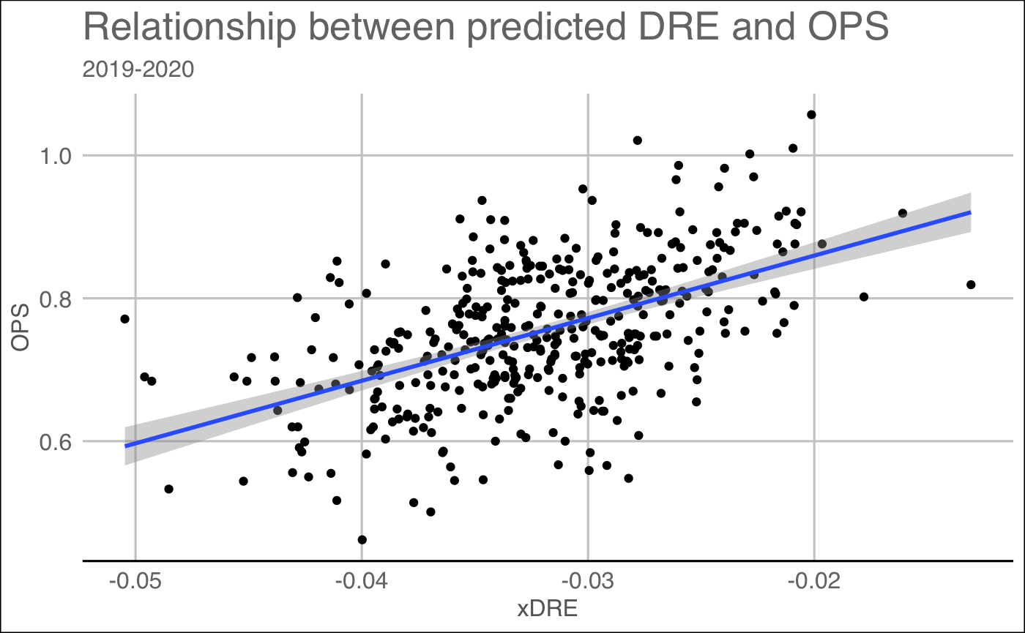
Predicted DRE

Slide 13
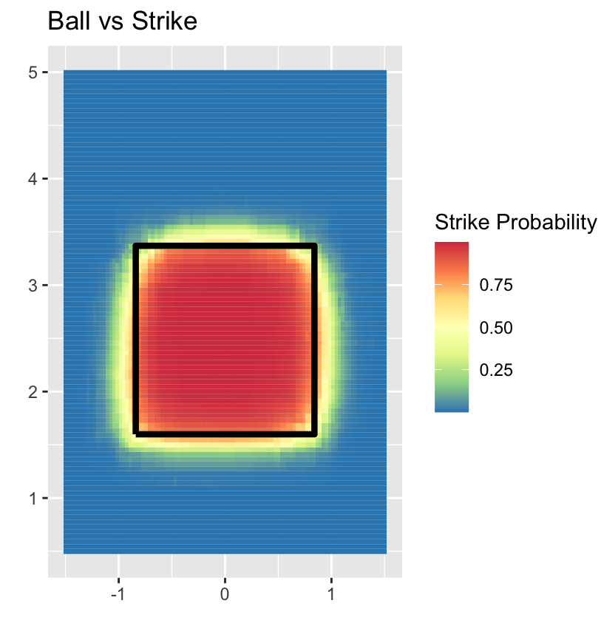
The Takes
Predict outcome (Ball, Strike) probabilities
Use logistic regression model
Features
X location
Z location
Top of strike zone
Bottom of strike zone
Top SZ
Z Location
Bottom SZ
X Location

Slide 14
If the Batter Swings (Part 1)
Predict probability of each swing outcome, considering:
Pitch Information
velocity, spin rate, movement, location, type)
Situational Information
count, outs, pitcher/batter handedness
Statistics & Statcast data
Hitters
Pitchers
PA, AVG, OBP, SLG
EV, LA, xBA, xwOBA, wOBA, ISO
IP, ERA, WHIP, GB/FB, K,BB%
Average Velocity, Average Spin Rate

Slide 15
The Swings (Part 2)
Utilized Cross Validation to optimize several XGBoost Parameters and ended up with these results:
Outcome
Outcome | Miss | Foul | Out | Single | Double | Triple | Homerun
Miss | .410 | .328 | .181 | .053 | .015 | .002 | .011
Foul | .217 | .421 | .243 | .075 | .023 | .002 | .018
Out | .227 | .389 | .265 | .078 | .023 | .002 | .015
Single | .173 | .396 | .272 | .110 | .029 | .003 | .018
Double | .160 | .407 | .266 | .093 | .042 | .004 | .028
Triple | .152 | .412 | .267 | .091 | .040 | .008 | .030
Homerun | .164 | .420 | .247 | .076 | .037 | .004 | .052
Predictions

Slide 16
The Swings (Part 2)
Utilized Cross Validation to optimize several XGBoost Parameters and ended up with these results:
Outcome
Outcome | Miss | Foul | Out | Single | Double | Triple | Homerun
Miss | .410 | .328 | .181 | .053 | .015 | .002 | .011
Foul | .217 | .421 | .243 | .075 | .023 | .002 | .018
Out | .227 | .389 | .265 | .078 | .023 | .002 | .015
Single | .173 | .396 | .272 | .110 | .029 | .003 | .018
Double | .160 | .407 | .266 | .093 | .042 | .004 | .028
Triple | .152 | .412 | .267 | .091 | .040 | .008 | .030
Homerun | .164 | .420 | .247 | .076 | .037 | .004 | .052
Predictions

Slide 17
The Swings (Part 2)
Utilized Cross Validation to optimize several XGBoost Parameters and ended up with these results:
Outcome
Outcome | Miss | Foul | Out | Single | Double | Triple | Homerun
Miss | .410 | .328 | .181 | .053 | .015 | .002 | .011
Foul | .217 | .421 | .243 | .075 | .023 | .002 | .018
Out | .227 | .389 | .265 | .078 | .023 | .002 | .015
Single | .173 | .396 | .272 | .110 | .029 | .003 | .018
Double | .160 | .407 | .266 | .093 | .042 | .004 | .028
Triple | .152 | .412 | .267 | .091 | .040 | .008 | .030
Homerun | .164 | .420 | .247 | .076 | .037 | .004 | .052
Predictions

Slide 18
The Swings (Part 2)
Utilized Cross Validation to optimize several XGBoost Parameters and ended up with these results:
Outcome
Outcome | Miss | Foul | Out | Single | Double | Triple | Homerun
Miss | .410 | .328 | .181 | .053 | .015 | .002 | .011
Foul | .217 | .421 | .243 | .075 | .023 | .002 | .018
Out | .227 | .389 | .265 | .078 | .023 | .002 | .015
Single | .173 | .396 | .272 | .110 | .029 | .003 | .018
Double | .160 | .407 | .266 | .093 | .042 | .004 | .028
Triple | .152 | .412 | .267 | .091 | .040 | .008 | .030
Homerun | .164 | .420 | .247 | .076 | .037 | .004 | .052
Predictions

Slide 19
Bringing It Home
$$RE\left(Take\right)= \sum_{Call}{P\left(Call\right)∗ RE(Call)}$$
$$RE\left(Swing\right)= \sum_{Outcome}{P\left(Outcome\right)∗ RE(Outcome)}$$
P(Miss)
P(HR)
P(Strike)
P(Ball)
…
…
RE(Strike)
RE(Ball)
RE(Miss)
…
…
…
…
…
RE(HR)
$$xRG\left(Swing\right)=RE\left(Swing\right)−RE\left(Take\right)$$
$$xRG\left(Take\right)=RE\left(Take\right)−RE\left(Swing\right)$$
EAGLE = xRG(Decision)

Slide 20
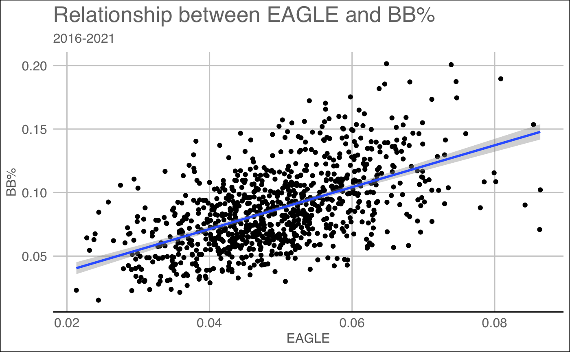
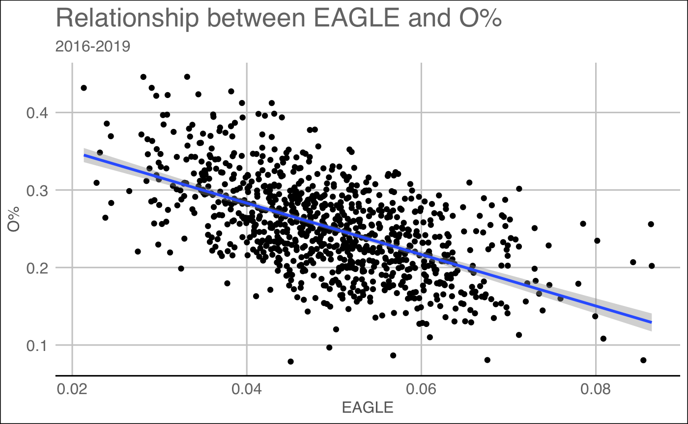
Results: BB% and O%
BB% correlation = .552
O% correlation = .580

Slide 21
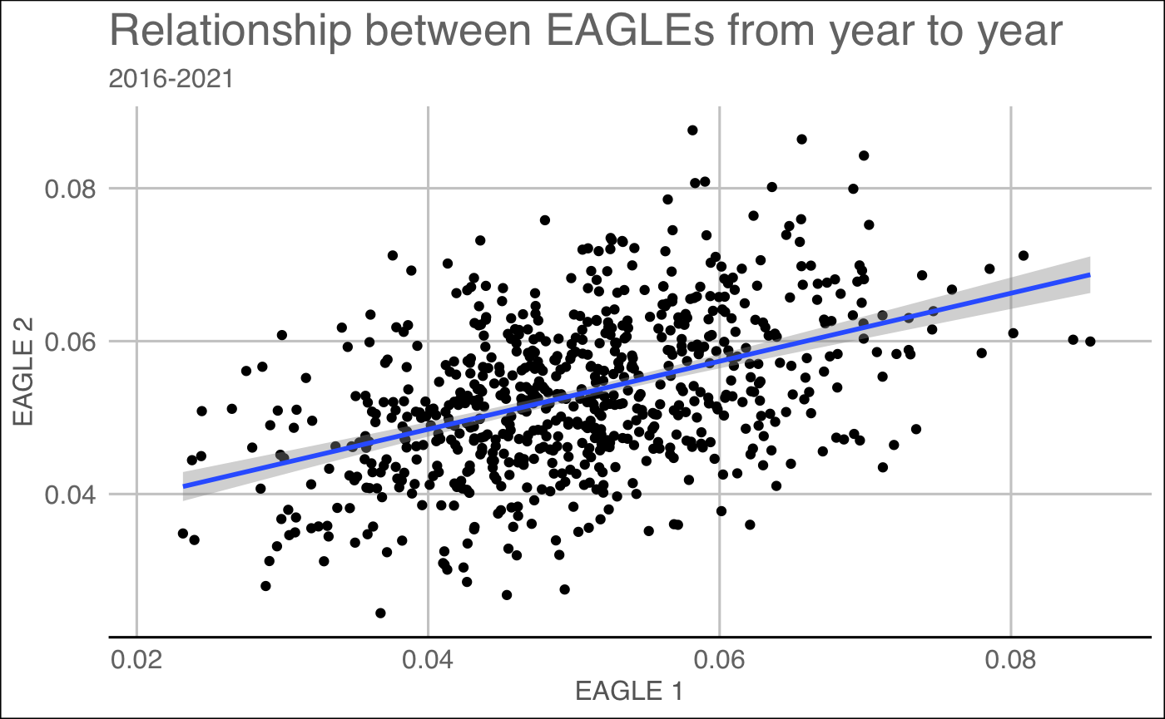
Results: Stable Over Time
Correlation from year to year = .452

Slide 22
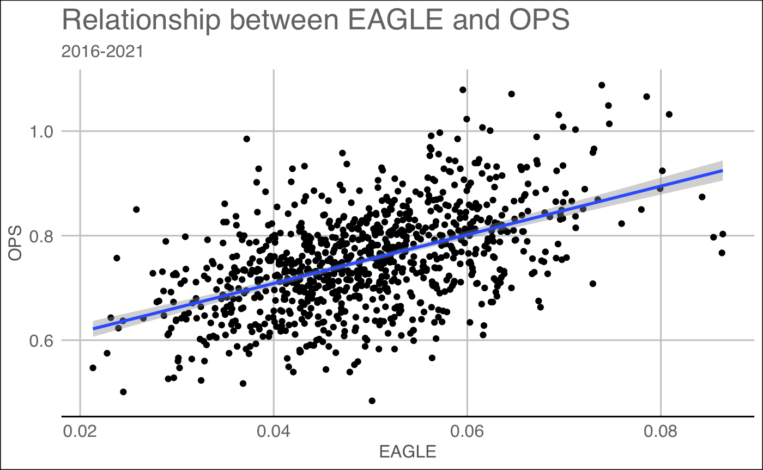
Results: OPS
EAGLE Correlation with OPS = .508
O% Correlation with OPS =
-.104
No other current plate discipline statistic accounts for the slugging aspect of baseball

Slide 23
Predicting OPS
Percentile | EAGLE | OPS
10th | .038 | .701
25th | .044 | .730
75th | .059 | .794
90th | .066 | .825
This Year’s OPS
Percentile | EAGLE | OPS
10th | .038 | .736
25th | .044 | .752
75th | .059 | .787
90th | .066 | .803
Next Year’s OPS

Slide 24
Applying to the Data
Data from 2016-2021
Best
Worst
Rank | Name | Year | EAGLE
1 | Juan Soto | 2019 | .088
2 | Khris Davis | 2018 | .084
3 | Joey Votto | 2017 | .081
4 | George Springer | 2019 | .081
5 | Nelson Cruz | 2017 | .080
6 | Cavan Biggio | 2019 | .079
7 | J.D. Martinez | 2017 | .079
8 | Kyle Tucker | 2021 | .078
9 | Chris Taylor | 2017 | .078
10 | Brandon Crawford | 2021 | .078
Rank | Name | Year | EAGLE
1 | Jose Iglesias | 2021 | .023
2 | Jose Iglesias | 2016 | .023
3 | Harold Castro | 2019 | .023
4 | Erick Aybar | 2016 | .024
5 | Dee Strange-Gordon | 2018 | .024
6 | Ryan Zimmerman | 2016 | .027
7 | Jose Iglesias | 2019 | .028
8 | Freddy Galvis | 2016 | .028
9 | Willi Castro | 2021 | .028
10 | Jeff Francoeur | 2016 | .028

Slide 25
Now We Evaluate 1
1-2 Count, 1 Out, No one on base | 0.00
Strike Probability | 0.00
RE pre pitch | 0.237
Probability of Miss | 0.803
Probability of Foul | 0.133
Probability of Out | 0.036
Probability of Single | 0.022
Probability of Double | 0.002
Probability of Triple | 0.001
Probability of Homerun | 0.001
RE(Take) | 0.264
RE(Swing) | 0.166
EAGLE | -0.098

Slide 26
Now We Evaluate 2
2-2 Count, 1 Out, Bases Loaded | 0.00
Strike Probability | 0.00
RE pre pitch | 1.503
Probability of Miss | 0.857
Probability of Foul | 0.063
Probability of Out | 0.034
Probability of Single | 0.038
Probability of Double | 0.005
Probability of Triple | 0.001
Probability of Homerun | 0.001
RE(Take) | 1.804
RE(Swing) | 0.894
EAGLE | -0.910

Slide 27
Now We Evaluate 3
2-2 Count, 2 Out, Bases Loaded | 0.00
Strike Probability | 0.994
RE pre pitch | 0.688
Probability of Miss | 0.095
Probability of Foul | 0.386
Probability of Out | 0.292
Probability of Single | 0.058
Probability of Double | 0.057
Probability of Triple | 0.009
Probability of Homerun | 0.101
RE(Take) | 0.006
RE(Swing) | 1.665
EAGLE | -1.659

Slide 28
Now We Evaluate 4
0-0 Count, 2 Out, Runner on First | 0.00
Strike Probability | 0.981
RE pre pitch | 0.242
Probability of Miss | 0.076
Probability of Foul | 0.343
Probability of Out | 0.046
Probability of Single | 0.027
Probability of Double | 0.054
Probability of Triple | 0.001
Probability of Homerun | 0.453
RE(Take) | 0.200
RE(Swing) | 1.153
EAGLE | 0.953

Slide 29
What if we turn EAGLE around…
Using EAGLE for pitchers is a way of measuring deceptiveness
New Question
How good are pitchers at causing hitters to make bad decisions?
New Answer
Inverse EAGLE

Slide 30
Inverse EAGLE For Pitchers
Data from 2016-2021
Starters
Relievers
Rank | Name | Year | EAGLE
1 | Jacob deGrom | 2021 | .019
2 | Kenta Maeda | 2020 | .021
3 | Corey Kluber | 2017 | .025
4 | Zach Eflin | 2020 | .025
5 | Shane Bieber | 2020 | .025
6 | Justin Verlander | 2019 | .026
7 | Ryan Yarbrough | 2020 | .027
8 | Clayton Kershaw | 2016 | .027
9 | Aaron Nola | 2020 | .028
10 | Jameson Taillon | 2016 | .028
Rank | Name | Year | EAGLE
1 | Luke Gregerson | 2016 | .017
2 | Andrew Miller | 2016 | .018
3 | Devin Williams | 2020 | .020
4 | Aaron Slegers | 2020 | .020
5 | Kyle Zimmer | 2020 | .021
6 | Brusdar Graterol | 2020 | .023
7 | Giovanny Gallegos | 2019 | .024
8 | Shane Greene | 2020 | .024
9 | Richard Bleier | 2021 | .025
10 | Mark Melancon | 2020 | .025

Slide 31
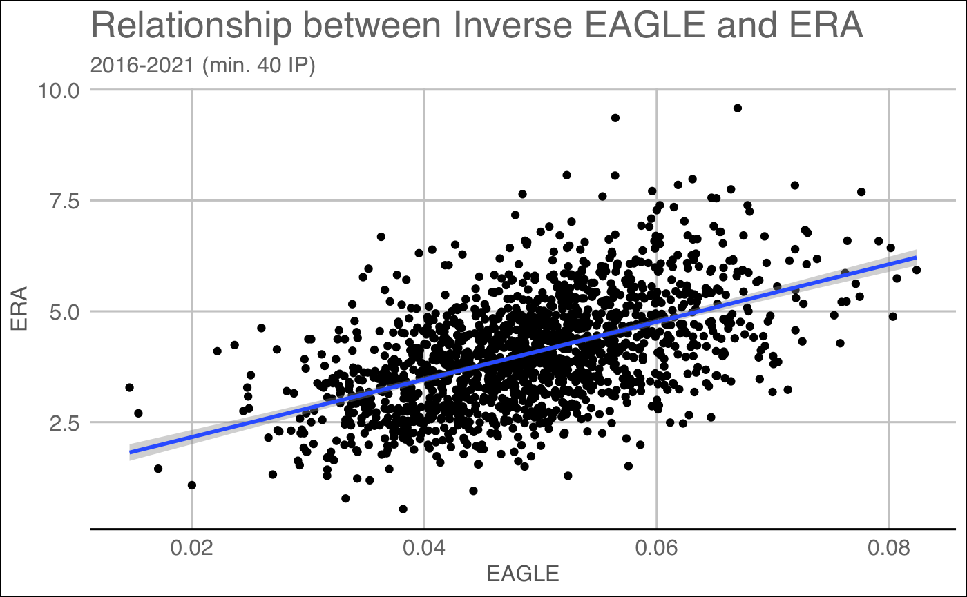
Indicative of ERA?
Correlation with ERA = .5211

Slide 32
Summary 1
EAGLE
A new and innovative statistic that truly evaluates a player’s plate discipline
Takes into account slugging
Shows that you don’t have to be the best at hitting the baseball to be successful
Can be used on a pitch-by-pitch level or aggregate level
Can predict future performance

Slide 33
Summary 2
Inverse EAGLE
Can tell us a lot about a pitcher’s ability
Shows that a lot of a pitcher’s success comes from their ability to deceive the batter
If you can master the art of deception, you might not need very good control/stuff to be a good pitcher

Slide 34
Questions?

