Slide 1
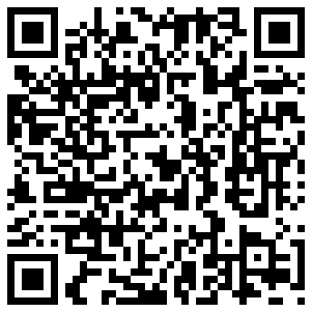
The Fear of Injury: How Risk Aversion Affects Contract Extensions (SABR 42)
William Spaniel
University of Rochester, Department of Political Science
williamspaniel@gmail.com
@gametheory101
(Link to full paper)
Notes:
Hi, I’m William Spaniel. Let’s learn some game theory. Today, we are going to see why there is safety in numbers as we start looking to games with more than just two strategies per player.

Slide 2
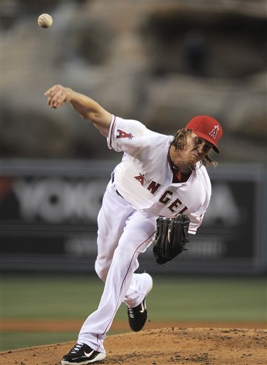
Signed a five year, $85 million contract extension in 2011.

Slide 3
Signed a five year, $85 million contract extension in 2011.
That’s a lot, but…

Slide 4
Jered Weaver as a Free Agent?
Weaver would have made a lot more money on the free agent market.
Johan Santana (2008): Six years, $137 million.
CC Sabathia (2009): Seven years, $161 million.
Cliff Lee (2011): Five years, $120 million.
Puzzle: Why didn’t Weaver pursue free agency?

Slide 5
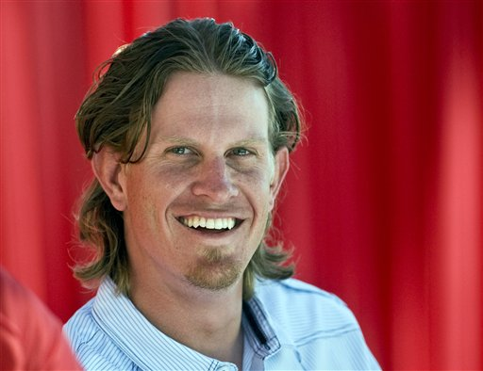
How much more money do you need?

Slide 6
Risk Aversion
Playing games risks catastrophic injury.

Slide 7
Risk Aversion
Playing games risks catastrophic injury.
Would you prefer $85 million guaranteed, or $100 million with probability .9 and $0 with probability .1?

Slide 8
Risk Aversion
Playing games risks catastrophic injury.
Would you prefer $85 million guaranteed, or $100 million with probability .9 and $0 with probability .1?
Risk averse individuals are willing to pay a premium to ensure decent outcomes.

Slide 9
Big Questions
How does risk aversion impact contract extension negotiations?

Slide 10
Big Questions
How does risk aversion impact contract extension negotiations?
Why do some players pursue free agency?

Slide 11
Big Questions
How does risk aversion impact contract extension negotiations?
Why do some players pursue free agency?
Why do players sign contract extensions when they do?

Slide 12
Methodology
We have a strategic situation (contract negotiations) that could get convoluted.
Game theory will sort out the logic.

Slide 13
Results
Teams will always re-sign a player if he is sufficiently risk averse.
Delay in agreement is a result of the team’s uncertainty of how risk averse the player is.
Negotiations should not be suspended in-season.
Perfect player safety is suboptimal for the team in contract extension negotiations.

Slide 14
Results
Teams will always re-sign a player if he is sufficiently risk averse.
Delay in agreement is a result of the team’s uncertainty of how risk averse the player is.
Negotiations should not be suspended in-season.
Perfect player safety is suboptimal for the team in contract extension negotiations.

Slide 15
The Model
Two periods: preseason and offseason.
Paper allows for midseason bargaining.
Each period, the team makes a contract offer to the player.
The player accepts or rejects. Accepting ends the game. Rejecting ends the period.
In between periods, the player does not suffer an injury with probability p.

Slide 16
Payoffs
The team values the player worth V > 0.
If the player reaches the free agent market, he will sign a contract worth n > 0.
The team is risk neutral. It maximizes the value of the player times the probability he remains uninjured minus the cost of the contract.
Results only require team to be less risk averse than the player.

Slide 17
Payoffs
Player is risk averse.
Expected utility function: x^{1/α}
The parameter α > 1 is the player’s level of risk aversion. Greater values of α represent greater levels of risk aversion.
Assume α is common knowledge.

Slide 18
Solution Concept
Sequential game + complete information = backward induction.
What’s optimal tomorrow determines what’s optimal today. Backward induction allows us to get at that.

Slide 19
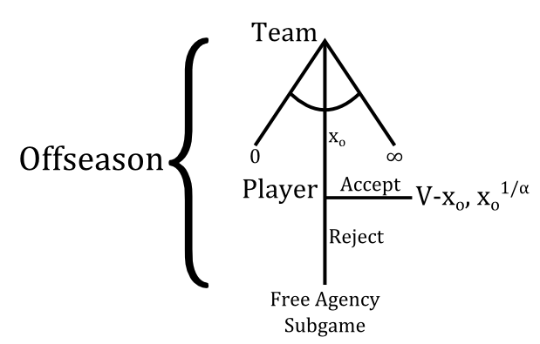

Slide 20
Offseason
The player accepts the team’s offer x_{o} if it is greater than or equal to n, the amount he would receive if he pursued free agency.
The team earns V – x_{o} if the player signs and 0 otherwise.
Therefore, the team offers x_{o} = n if V ≥ n to induce the player to sign. If V < n, the team does not sign the player.

Slide 21
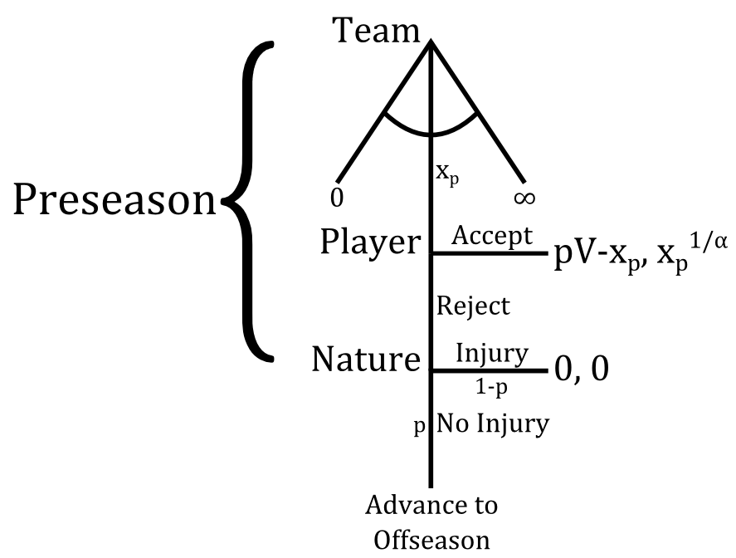

Slide 22
Preseason
Suppose the player re-signs in the offseason.
If the player rejects x_{p}, he earns n^{1/α} with probability p and 0 with probability 1 – p.

Slide 23
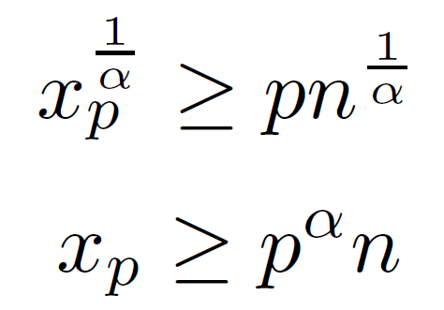
Preseason
Suppose the player re-signs in the offseason.
If the player rejects x_{p}, he earns n^{1/α} with probability p and 0 with probability 1 – p.
Thus, he accepts if:

Slide 24
Preseason
Suppose the player re-signs in the offseason.
If the team offers x_{p} = p^{α}n, the player signs, and the team earns pV – p^{α}n.
If the team fails to sign the player at preseason, it earns p(V – n) + (1 – p)(0)

Slide 25
Preseason
Suppose the player re-signs in the offseason.
If the team offers x_{p} = p^{α}n, the player signs, and the team earns pV – p^{α}n.
If the team fails to sign the player at preseason, it earns p(V – n) + (1 – p)(0)
Team resigns at preseason if:

Slide 26
Preseason
Suppose the player does not re-sign in the offseason.
If the player rejects x_{p}, he still earns n^{1/α} with probability p and 0 with probability 1 – p.

Slide 27
Preseason
Suppose the player does not re-sign in the offseason.
If the player rejects x_{p}, he still earns n^{1/α} with probability p and 0 with probability 1 – p.
Thus, he still accepts if:

Slide 28
Preseason
Suppose the player does not re-sign in the offseason.
If the team offers x_{p} = p^{α}n, the player signs, and the team earns pV – p^{α}n.
If the team fails to sign the player during the preseason, it earns 0.

Slide 29
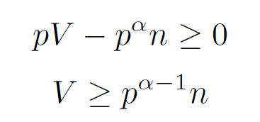
Preseason
Suppose the player does not re-sign in the offseason.
If the team offers x_{p} = p^{α}n, the player signs, and the team earns pV – p^{α}n.
If the team fails to sign the player during the preseason, it earns 0.
Team re-signs the player if:

Slide 30
Preseason versus Offseason
The team is willing to re-sign the player in the offseason if and only if V ≥ n.
The team is willing to re-sign the player at preseason if and only if V ≥ p^{α-1}n.

Slide 31
Preseason versus Offseason
The team is willing to re-sign the player in the offseason if and only if V ≥ n.
The team is willing to re-sign the player at preseason if and only if V ≥ p^{α-1}n.
Note that n > p^{α-1}n.
The team is willing to re-sign players during the preseason it is not willing to re-sign during the offseason!

Slide 32
Important Result
The team re-signs the player if:

Slide 33
Important Result
The team re-signs the player if:
Solving for α yields:

Slide 34
Important Result
Regardless of how much more money the player would make if he became a free agent, if he is sufficiently risk averse, he still re-signs with his team.

Slide 36
Important Result
Regardless of how much more money the player would make if he became a free agent, if he is sufficiently risk averse, he still re-signs with his team.
The larger α is, the greater risk premium the player is willing to pay to sign earlier. This drives down contract prices early in the season, allowing the team to re-sign the player at lower prices.

Slide 37
Results
Teams will always re-sign a player if he is sufficiently risk averse.
Delay in agreement is a result of the team’s uncertainty of how risk averse the player is.
Negotiations should not be suspended in-season.
Perfect player safety is suboptimal for the team in contract extension negotiations.

Slide 38
Explaining Delay
When the team knows the player’s level of risk aversion, bargaining has a “no-delay” property.
But if the team isn’t sure of the player’s α, it increases its offers over the course of the season until he accepts.

Slide 39
Explaining Delay
When the team knows the player’s level of risk aversion, bargaining has a “no-delay” property.
But if the team isn’t sure of the player’s α, it increases its offers over the course of the season until he accepts.
Proof is in the paper.

Slide 40
Results
Teams will always re-sign a player if he is sufficiently risk averse.
Delay in agreement is a result of the team’s uncertainty of how risk averse the player is.
Negotiations should not be suspended in-season.
Perfect player safety is suboptimal for the team in contract extension negotiations.

Slide 41
Don’t Stop!
Suspending negotiations midseason kills this learning process.
The only reason to suspend midseason negotiations is if you know you won’t re-sign with the team.

Slide 42
Don’t Stop!
Suspending negotiations midseason kills this learning process.
The only reason to suspend midseason negotiations is if you know you won’t re-sign with the team.
Pujols. Reyes.

Slide 43
Don’t Stop!
Suspending negotiations midseason kills this learning process.
The only reason to suspend midseason negotiations is if you know you won’t re-sign with the team.
Pujols. Reyes. Molina? Wright?

Slide 44
Results
Teams will always re-sign a player if he is sufficiently risk averse.
Delay in agreement is a result of the team’s uncertainty of how risk averse the player is.
Negotiations should not be suspended in-season.
Perfect player safety is suboptimal for the team in contract extension negotiations.

Slide 45
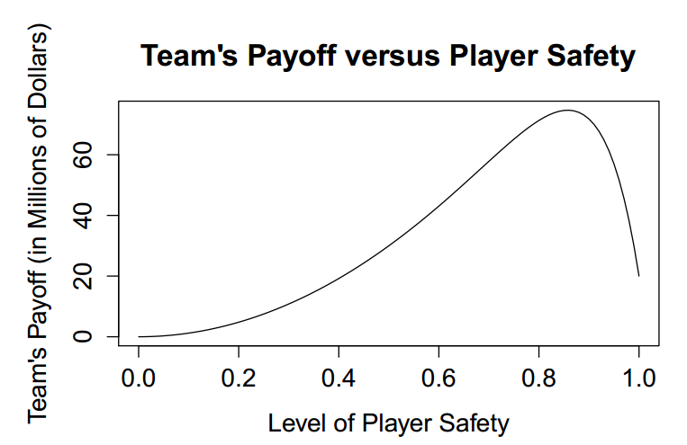

Slide 46
Safety Is Good…to a Point
Moral note: this is only a model of contract extensions.
Teams have incentive to keep games safe to protect their previous investments.
But sports carry some inherent risk, and the teams benefit from it here.

Slide 47
Thanks!
William Spaniel
University of Rochester
Department of Political Science
williamspaniel@gmail.com
@gametheory101
(Link to full paper)
Notes:
Hi, I’m William Spaniel. Let’s learn some game theory. Today, we are going to see why there is safety in numbers as we start looking to games with more than just two strategies per player.

