Slide 1

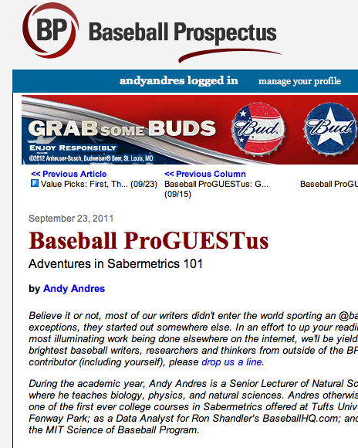

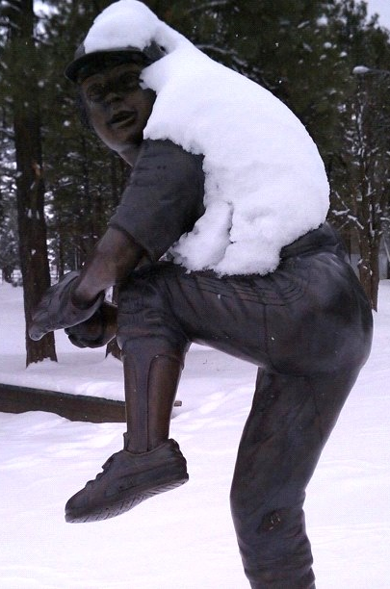
Pitching Up A Storm:
The Impact of Temperature and Humidity on Pitch Effectiveness
Lisa Lebovici, Matt McGrath, Steve Miller, Kim Miner, Peter Travers, Rory Kirchner, and Andy Andres
June 30, 2012
SABR National Convention 42
Minneapolis, MN
Contact Andy Andres at Andy.Andres@Gmail.com or LAndres@BU.edu

Slide 2
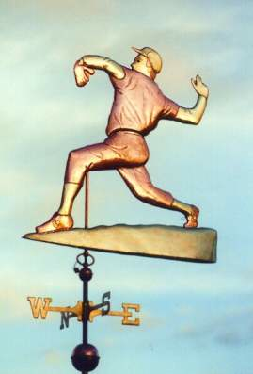
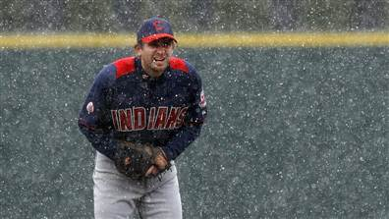
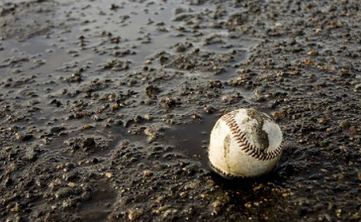
The Big Question
Is there a relationship between weather (temperature and humidity) and the effectiveness of different types of pitches (movement)?
Andy Andres, Boston SABR Chapter

Slide 3
Conventional Wisdom
Pitchers have the advantage in cold weather
  April usually the lowest scoring month
  Batters have more difficulty in the cold
Warm and humid air is less dense
  Fastballs are faster, but other pitches have less drag, and so less movement
  More humidity causes the ball to expand, worsening a pitcher’s grip
Andy Andres, Boston SABR Chapter

Slide 4
Past Research
Fastball velocity studied previously
  Higher velocity correlates with higher temperature
Hardball Times researched specific outcomes
  More strike-outs and walks, but fewer home runs, in colder weather
Research and conventional wisdom on wind and air pressure (especially at Coors)
Andy Andres, Boston SABR Chapter

Slide 5
Our Hypotheses
The velocity, movement, and general effectiveness of pitches will be affected by temperature and humidity.
  Specifically: low temperature and humidity will result in more movement but lower velocities
  Higher temperature will correlate with higher velocities, but less movement
  Overall, pitchers will be most effective in cooler weather.
Andy Andres, Boston SABR Chapter

Slide 6
The First Study Methods (Spring 2011)
Select pitchers
Examine individual game logs
Gather Pitch F/X statistics for each game
Gather weather data from each game
Analyze the relationship between weather and Pitch F/X data
Andy Andres, Boston SABR Chapter

Slide 7
Methods: Gathering the First Pitchers to Analyze
25+ starts for the same team every season 2008-2010
40% 4-seam fastball, 8% curveball, 8% changeup thrown
15 pitchers in all:
  Paul Maholm, Wandy Rodriguez (indoor), James Shields (indoor), Bronson Arroyo, Ubaldo Jimenez, Mark Buerhle, Tim Lincecum, Barry Zito, Matt Cain, Justin Verlander, Felix Hernandez, Cole Hamels, Zach Duke, Zach Greinke, Jered Weaver
Andy Andres, Boston SABR Chapter

Slide 8
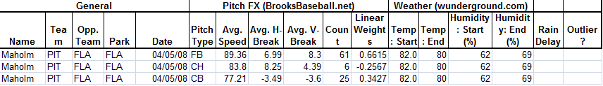
Methods: Data Collection
BrooksBaseball: Pitch F/X tool
  Avg. velocity, V-break, H-break, linear weights and count
  3 pitches for every start: Fastball, Curveball, Changeup
WeatherUnderground
  Temperature and humidity at start of the game
  Data at end of game to qualify outliers
  Rain delays
Andy Andres, Boston SABR Chapter

Slide 9
Overall Trends
Linear Weights vs. Humidity, FB
Linear Weights vs. Humidity, CH
Linear Weights vs. Humidity, CB
Andy Andres, Boston SABR Chapter

Slide 10
Overall Trends
Linear Weights vs. Temp, FB
Linear Weights vs. Temp, CH
Linear Weights vs. Temp, CB
Andy Andres, Boston SABR Chapter

Slide 11
Discussion and Conclusions
There seems to be an optimal range for pitchers between 70-80 degrees (F) and 60% humidity levels.
Andy Andres, Boston SABR Chapter

Slide 12
Hypothesis Revisited
Prelim data suggested that pitchers are most effective in a cooler temperatures, not in the extremes
  However, higher temperatures and humidity levels seem to correlate with decreased velocities (surprising result!)
  And lower temperatures and humidity levels actually result in less movement
Some Limitations on first study:
Small Sample Size (n=12)
Temp changes during game
Andy Andres, Boston SABR Chapter

Slide 13
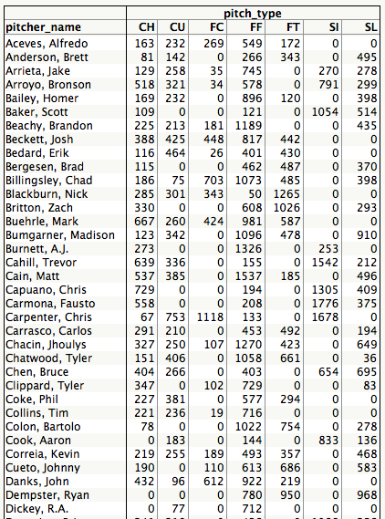
Tufts Weather Study 2.0
Pitch F/X for all of 2011
No Domes
Using time stamp in database we scraped weather data from airport located nearest to home ballpark
Left 574440 pitches in 2011
Selection of 2011 pitcher/pitches
  Top 150 by pitch count (min number pitches was 1190)
  7 pitch types: Changeup, Curveball, Cut FB, 4-Seam FB, 2-Seam FB, Sinker, Slider (now 329K to analyze)
Andy Andres, Boston SABR Chapter

Slide 14
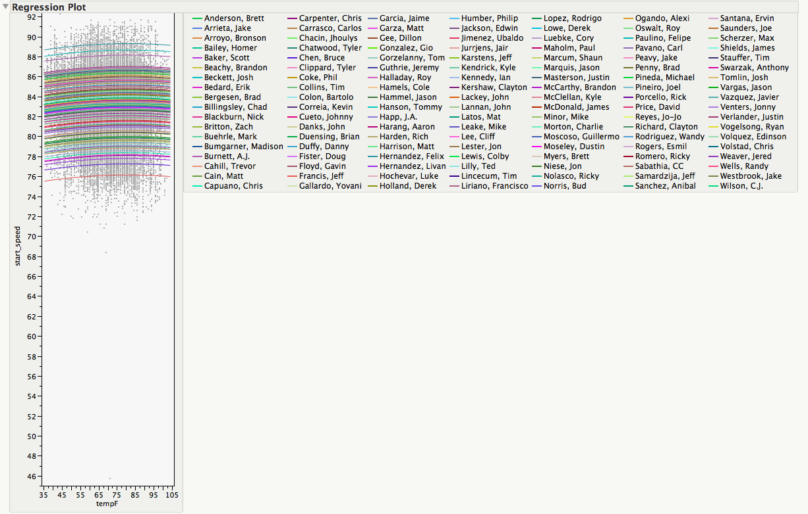
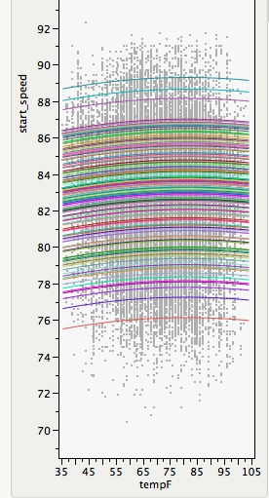
Temp v. Velocity: Changeup
137/150 Pitchers
Mean: 82.6 mph
R²: 75%
Linear Slope: .06 mph/
10 degrees F
Andy Andres, Boston SABR Chapter

Slide 15
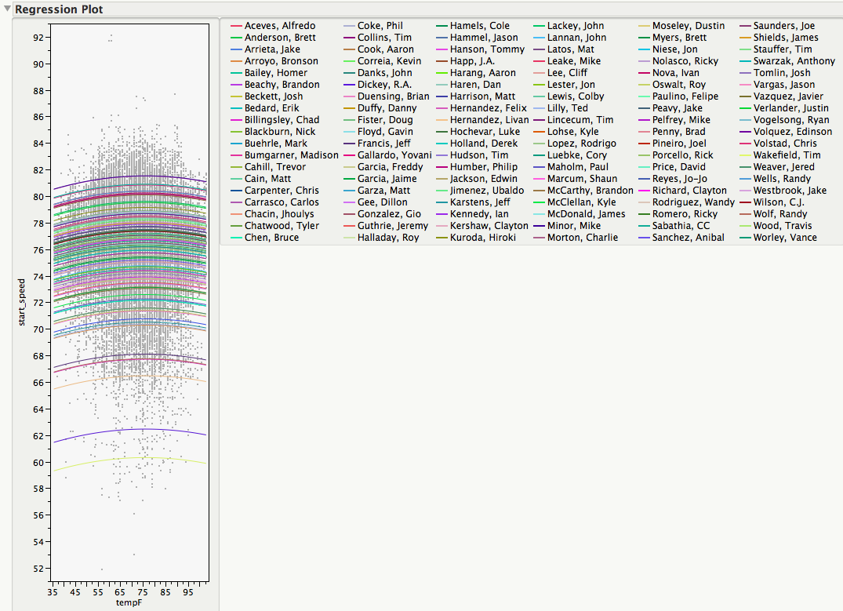
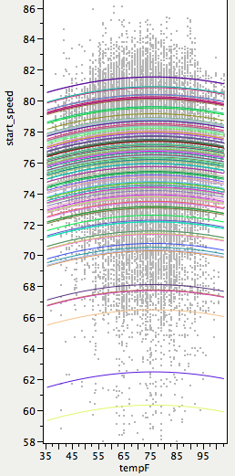
Temp v. Velocity: Curveball
116/150 Pitchers
Mean: 76.2 mph
R²: 77%
Linear Slope: .06 mph/
10 degrees F
136/150 Pitchers
Mean: 82.6 mph
R²: 75%
Andy Andres, Boston SABR Chapter

Slide 16
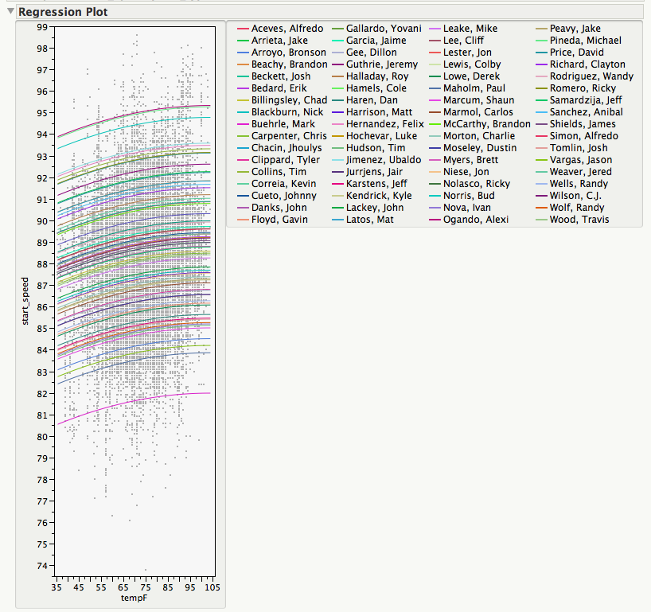
Temp v. Velocity: Cut Fastball
70/150 Pitchers
Mean: 87.9 mph
R²: 73%
Linear Slope: .12 mph/10 degrees F
Andy Andres, Boston SABR Chapter

Slide 17
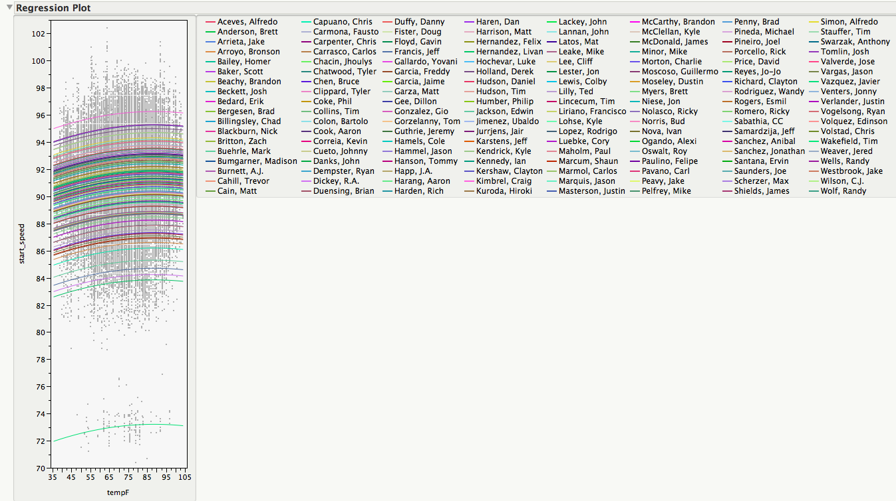
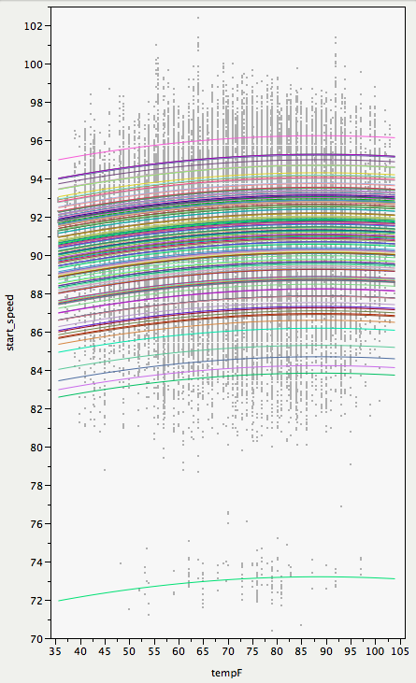
Temp v. Velocity: 4-Seam Fastball
148/150 Pitchers
Mean: 91.6 mph
R²: 71%
Linear Slope: .16 mph/10 degrees F
Andy Andres, Boston SABR Chapter

Slide 18
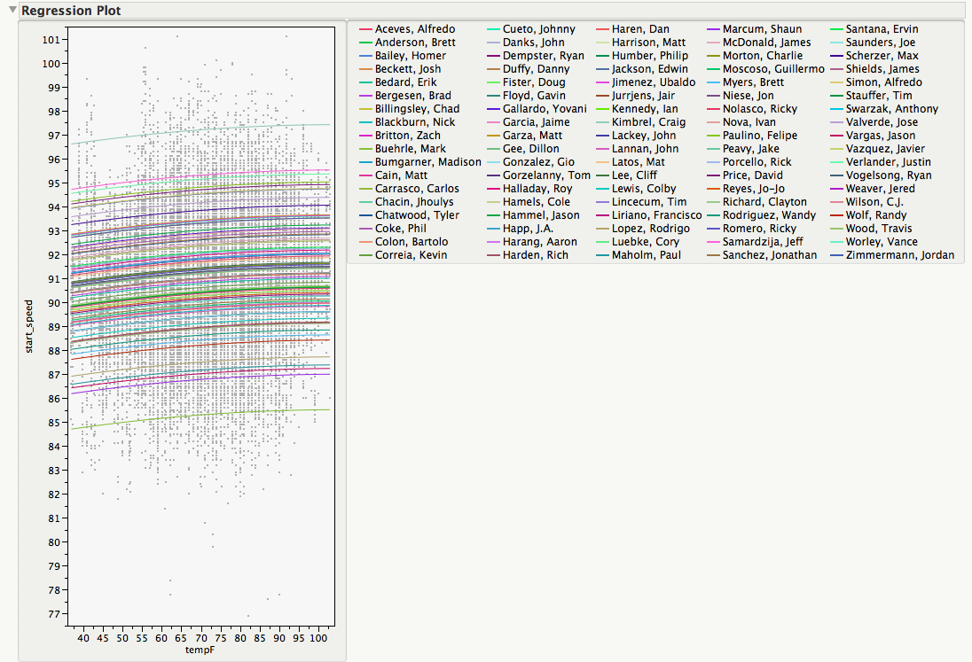
Temp v. Velocity: 2-Seam Fastball
90/150 Pitchers
Mean: 90.9 mph
R²: 61%
Linear Slope: .12 mph/10 degrees F
Andy Andres, Boston SABR Chapter

Slide 19
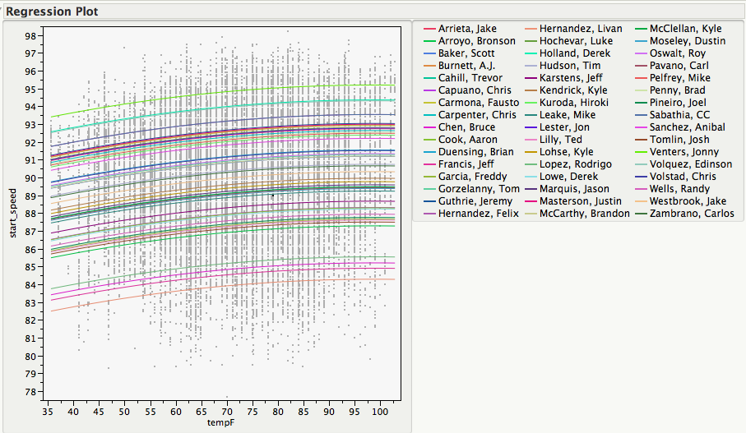
Temp v. Velocity: Sinking Fastball
48/150 Pitchers
Mean: 90.2 mph
R²: 77%
Linear Slope: .25 mph/10 degrees F
Andy Andres, Boston SABR Chapter

Slide 20
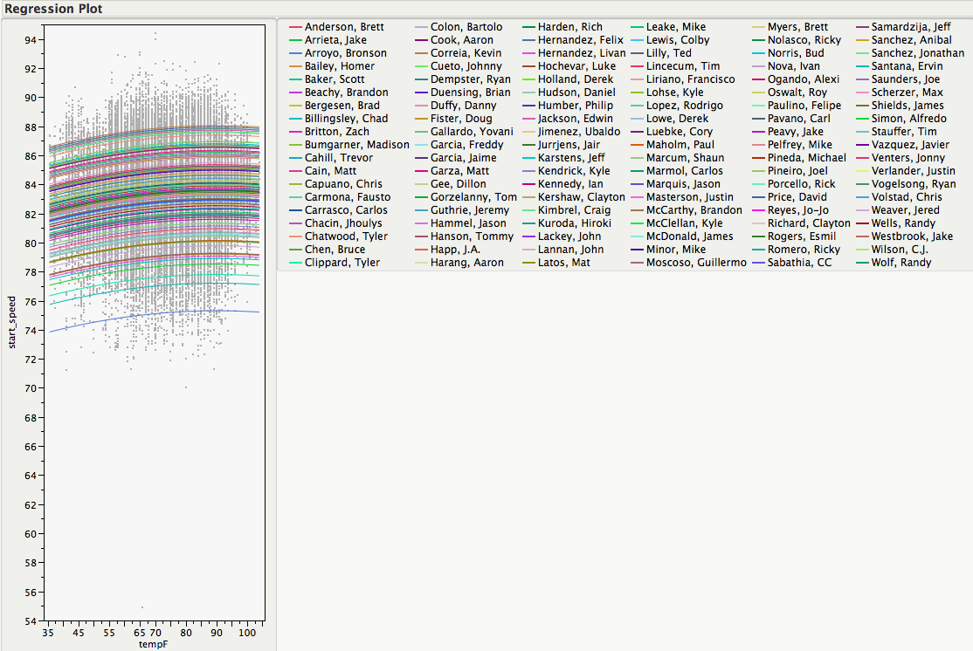
Temp v. Velocity: Slider
118/150 Pitchers
Mean: 83.5 mph
R²: 66%
Linear Slope: .19 mph/10 degrees F
Andy Andres, Boston SABR Chapter

Slide 21
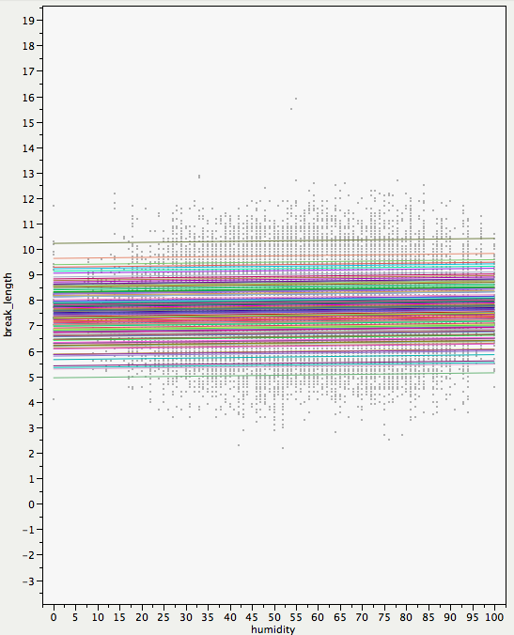
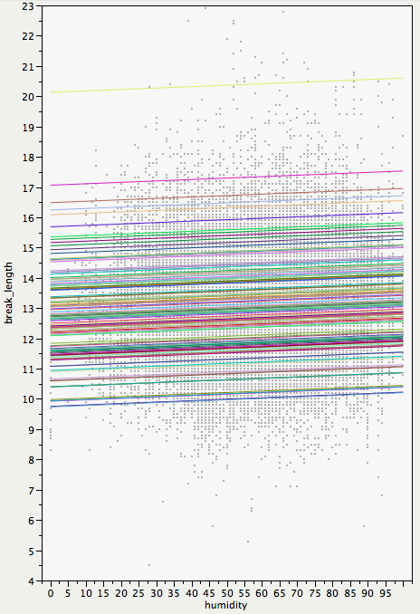
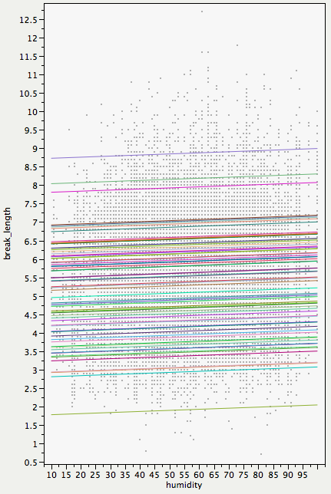
Humidity, Break, and Pitch Type, Linear not Polynomial
FC
CH
CU

Slide 22
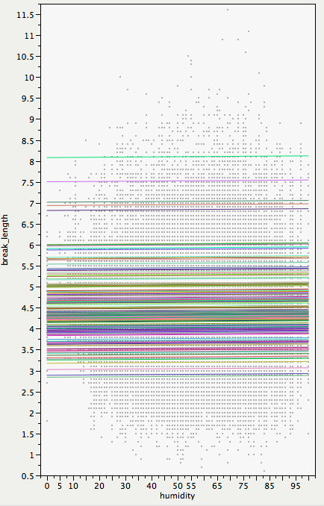
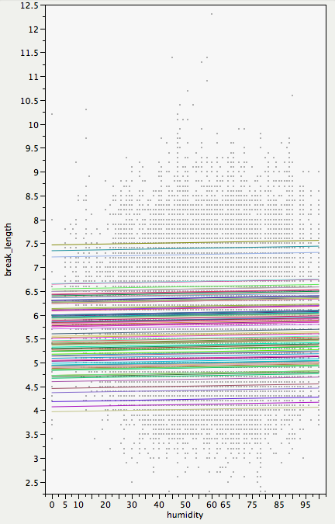
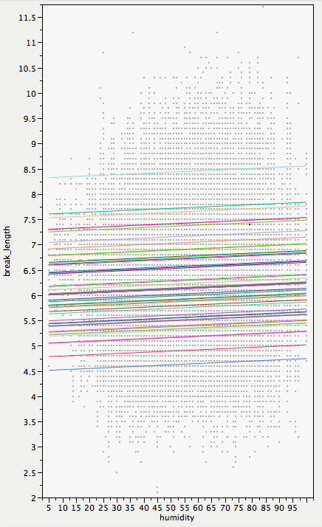
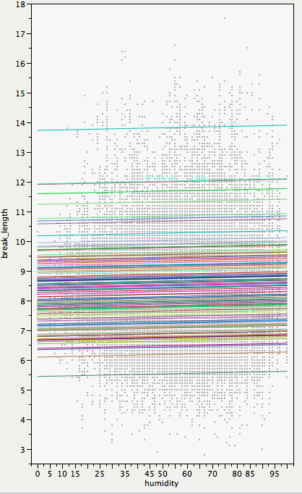
Humidity, Break, and Pitch Type
FF
FT
SI
SL

Slide 23
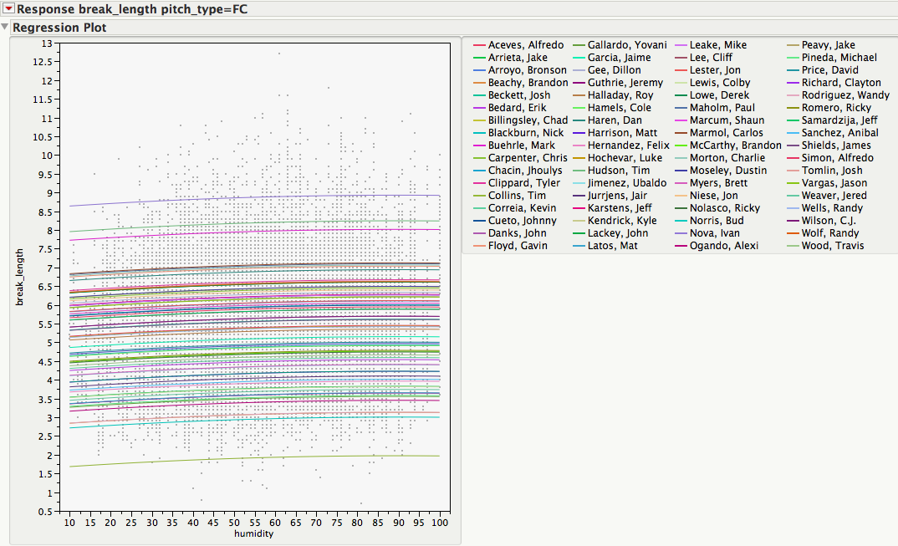
Break and Humidity, Polynomial

Slide 24
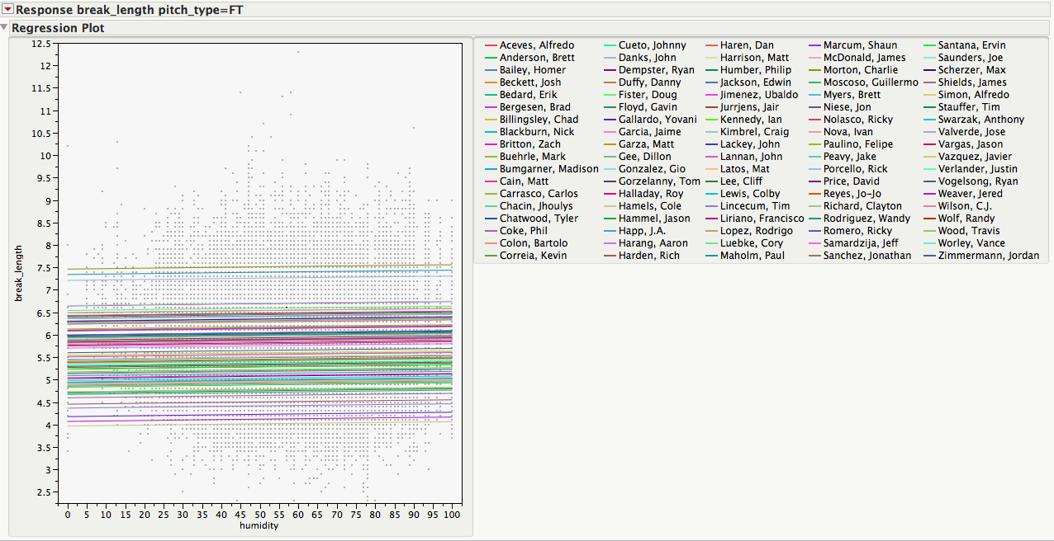
Break and Humidity, Polynomial

Slide 25
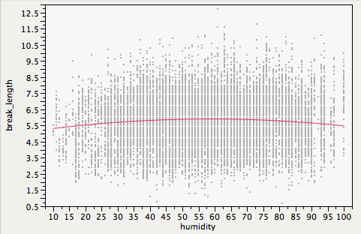
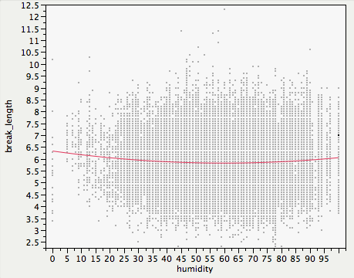
Break and Humidity, Polynomial
FC
FT

Slide 26




Acknowledgements:
Lisa Lebovici, Matt McGrath, Steve Miller, Kim Miner, Peter Travers, Rory Kirchner
Contact Andy Andres at Andy.Andres@Gmail.com or LAndres@BU.edu

Slide 27
Sources
Brooks Baseball for Pitch F/X data
  http://brooksbaseball.net/pfxVB/pfx.php
ESPN and Baseball Reference for individual player’s game data
  http://espn.go.com/mlb/players
  http://www.baseball-reference.com/players/
Weather Underground for site specific historical weather data
  http://www.wunderground.com/history/
Constancio, Chris, “Temperature Effects,” Hardball Times (October 23, 2006) http://www.hardballtimes.com/main/article/temperature-effects/
Merritt, Cam, “The Effects of Humidity on Baseballs,” Livestrong.com (June 22, 2010) http://www.livestrong.com/article/155931-the-effects-of-humidity-on-baseballs/
Fast, Mike, “Spinning Yarn: Do Spring Speeds Matter?” Baseball Prospectus (March 30, 2011) http://www.baseballprospectus.com/article.php?articleid=13380
Weber, Bruce, “Yankees Bracing for Cold in Opener and in April,” The New York Times (March 30, 2011) http://www.nytimes.com/2011/03/31/sports/baseball/31yankees.html?_r=2
Null, Jan, “Weather Corner,” San Jose Mercury News (May 9, 2000) http://ggweather.com/archive/weacornermay09.htm
Cameron, Dave “Runs A Plenty,” Fangraphs.com (April 17, 2009) http://www.fangraphs.com/blogs/index.php/runs-a-plenty/
Andy Andres, Boston SABR Chapter

Slide 28
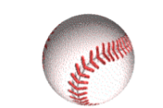

Contact Information:
Andy Andres, Ph.D.
Senior Lecturer of Natural Sciences and Mathematics at Boston University
MLB Datacaster/Stringer for Fenway Park, MLBAM
Visiting Lecturer in Sabermetrics at Tufts University
Head Coach, MIT Science of Baseball Program
Data Analyst, BaseballHQ.com
Boston University College of General Studies
871 Commonwealth Ave.
Boston, MA 02215 voxmail: 617.575.9853 fax: 815.361.1365 or 617.353.5868
LAndres@BU.edu or Andy.Andres@GMail.com
“I believe in the Church of Baseball. I've tried all the major religions and most of the minor ones. And the only church that truly feeds the soul, day-in day-out, is the Church of Baseball.” Annie Savoy
Andy Andres, Boston SABR Chapter

Slide 29

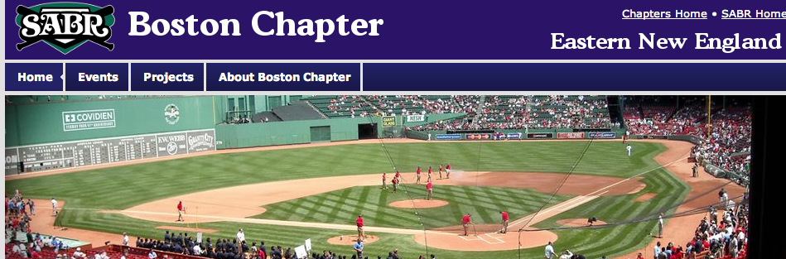









Andy Andres, Boston SABR Chapter

Slide 30
Limitations
Indoor/retractable roofs
Temperature changes during game
Not enough samples (especially at extremes)
Pitchers and hitters continually adapt
Weather collection location vs actual stadium
Andy Andres, Boston SABR Chapter

Slide 31
Future Research
Expand sample size
Relievers
Expand pitches: slider, sinker, 2-seam vs 4-seam
Other weather- rain, barometric pressure, wind
Factors beyond linear weights
Consider park factors
Indoor stadiums
Andy Andres, Boston SABR Chapter

Slide 33
Data
3,284 Pitch Sample Points (86,887 pitches)
Measures of Weather:
- temperature
- humidity
Measures of Pitch Effectiveness:
- vertical break
- horizontal break
- average velocity
Andy Andres, Boston SABR Chapter

Slide 34
Multiple Linear Regression
GOAL: to find the marginal effect of weather on pitch effectiveness
Model Features:
  quadratic transformations
  month dummy variables
  absolute value of Horizontal Break
Andy Andres, Boston SABR Chapter

Slide 35
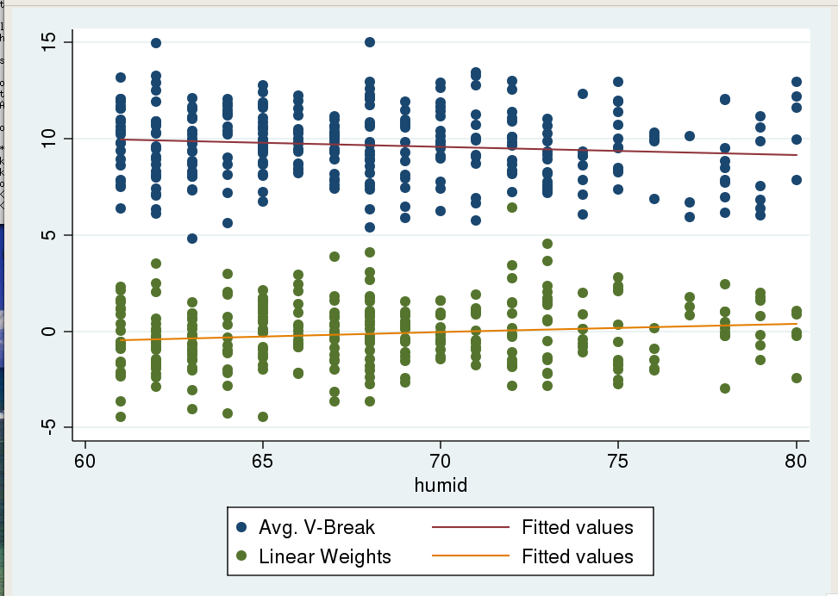
Fastball: 60-80% Humidity
Vertical Break = -0.0437Humidity + 12.649
R² = 1.5%
#Obs = 309
% change = 0.50%
Linear Weight = 0.0454Humidity – 3.23
R² = 2.05%
#Obs = 309
% change = 30.78%
Andy Andres, Boston SABR Chapter

Slide 36
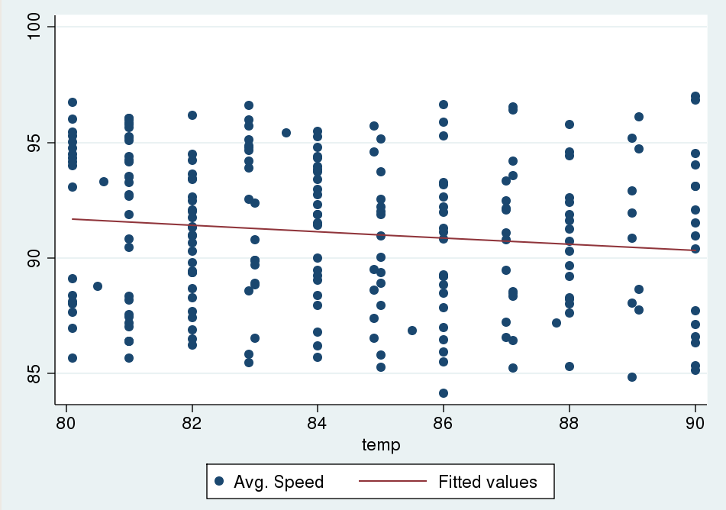
Fastball: 80-90° Temperature
Average Speed = -0.138Temp + 102.749
R² = 1.57%
#Obs = 230
% change = 0.15%
Andy Andres, Boston SABR Chapter

Slide 37
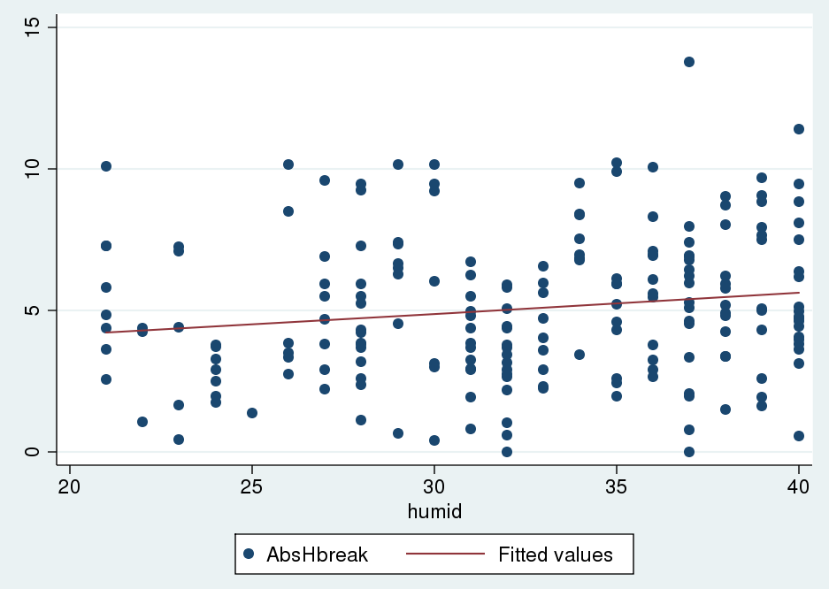
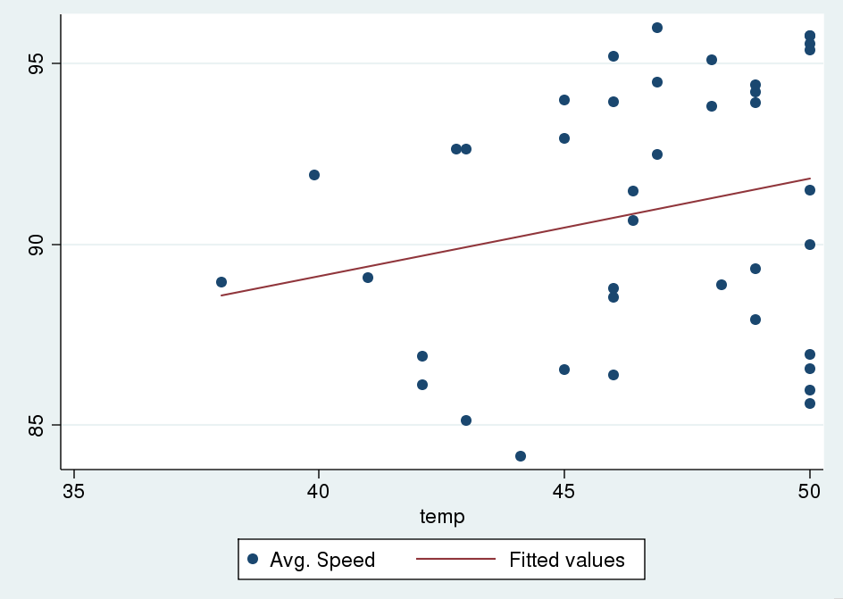
Extreme Conditions
Fastball: 20-40% Humidity
|Horizontal Break| = 0.0738Humidity + 2.665
R² = 2.48%
#Obs = 199
% change = 2.35%
Fastball: 38-50° Temperature
Average Speed = 0.268Temp + 78.404
R² = 5.52%
#Obs = 40
% change = 0.29%
Andy Andres, Boston SABR Chapter

Slide 38
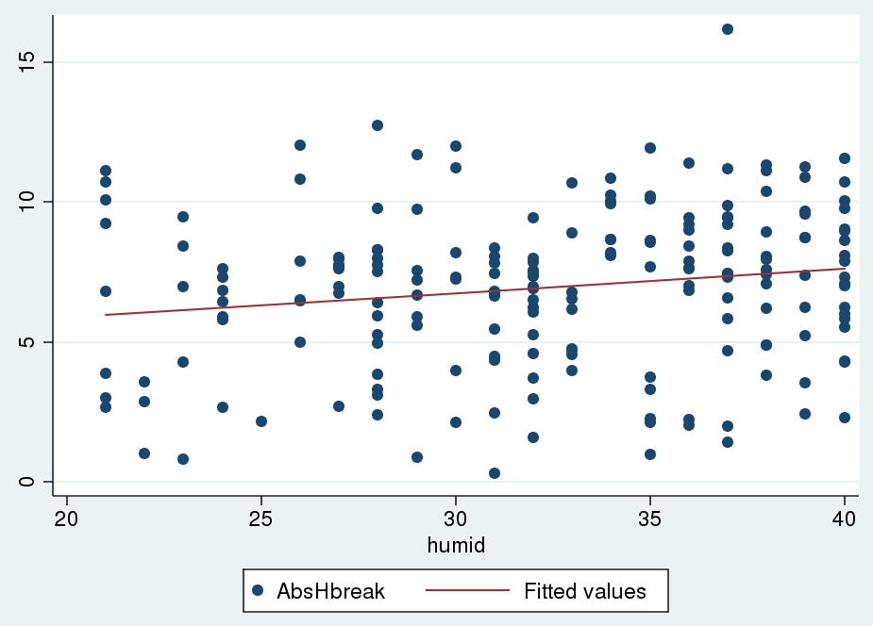
Change Up: 20-40% Humidity
|Horizontal Break| = 0.0876Humidity + 4.119
R² = 2.92%
#Obs = 197
% change = 4.19%
Andy Andres, Boston SABR Chapter

Slide 39
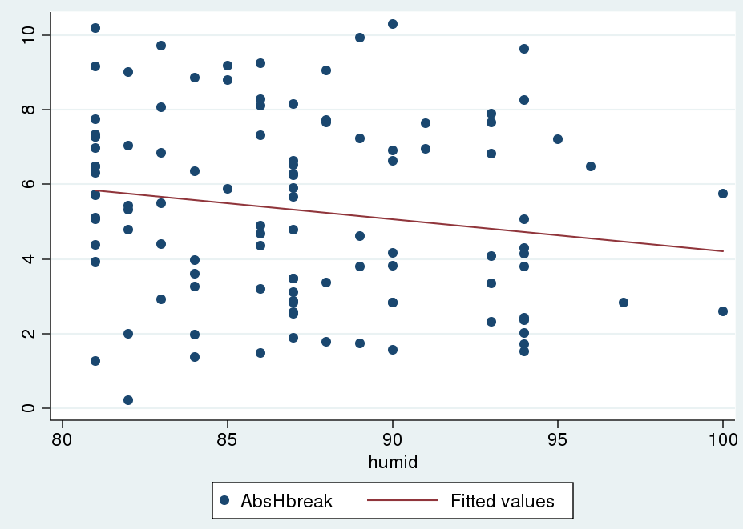
Curveball: 80-100% Humidity
|Horizontal Break| = -0.0853Humidity + 12.744
R² = 2.71%
#Obs = 107
% change = 2.31%
Andy Andres, Boston SABR Chapter

Slide 40
Discussion and Conclusions
There seems to be an optimal range for pitchers between 50-60 degrees (F) and 40-50% humidity levels.
Going below or above these levels towards the extremes reduces pitch effectiveness
  Reduces break, velocity, and increases linear weights
There are more statistically significant results in humidity than in temperature.
The most significant results involve fastballs
Andy Andres, Boston SABR Chapter

Slide 41
Hypothesis Revisited
Evidence suggests that pitchers are indeed most effective in a cooler temperature range, but not in the extremes
  However, higher temperatures and humidity levels seem to correlate with decreased velocities
  And lower temperatures and humidity levels actually result in less movement
How to explain this?
  Fatigue, grip, seasonal progression
Andy Andres, Boston SABR Chapter

