Slide 1
Snoopy: Baseball’s Top Dog
Melissa (Missy) Booker
SABR 51
July 8, 2023

Slide 2
A Little Background
SABR Member (2012)
Interested in the person behind the player
In a relationship with Snoopy since 1978
Wanted to know about the dog behind the statistic

Slide 3
Snoopy the Dog

Slide 4
About Peanuts
Comic strip created by Charles M. Schulz
Dates
Oct. 2, 1950 until Feb. 13, 2000
17,897 total strips
1,794 about baseball
716 about Snoopy and Baseball

Slide 5
A Humble Debut
October 4, 1952

Slide 6
Learns to Walk
June 28, 1957
Practiced Standing in November 1955

Slide 7
Renaissance Dog
Exudes confidence
Believes everything can be solved with a SMAK
Believes he can do anything
Famous characters: the Red Baron, Attorney, Joe Cool, Beagle Scout, Zamboni Driver, Hockey Player, Tennis Player, Chef, Novelist
The “World Famous” at everything

Slide 8
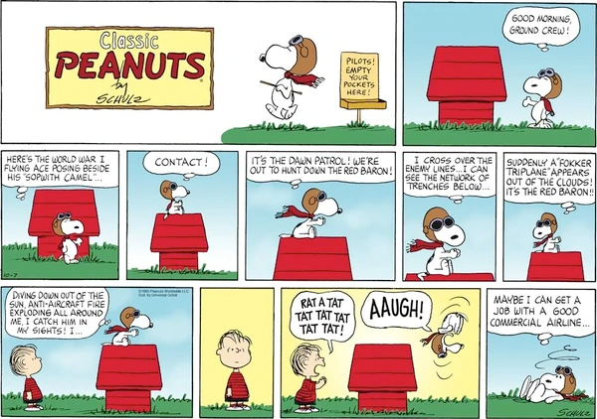
World War I Flying Ace
October 10, 1965
Notes:
It was a dark and stormy night

Slide 9
World Famous Attorney
May 5, 1992
Notes:
It was a dark and stormy night

Slide 10
Joe Cool
May 27, 1971
Notes:
It was a dark and stormy night

Slide 11
Not Really “World Famous” At Everything
April 1973
Notes:
It was a dark and stormy night

Slide 12
Charles M. Schulz on Snoopy
"Snoopy’s whole personality is a little bittersweet. But he’s a very strong character. He can win or lose, be a disaster, a hero, or anything, and yet it all works out. I like the fact that when he’s in real trouble, he can retreat into a fantasy and thereby escape.“

Slide 13
Snoopy the Player

Slide 14
Scouting Report
Best player on Charlie Brown’s team
Shortstop and Groundskeeper
Power hitter
Decent fielder who fields with his mouth
Terrible at throwing
Very confident in his abilities
Notes:
Decent fielder (often fields with his mouth)
Terrible at throwing
Power Hitter
Very confident in his abilities

Slide 15
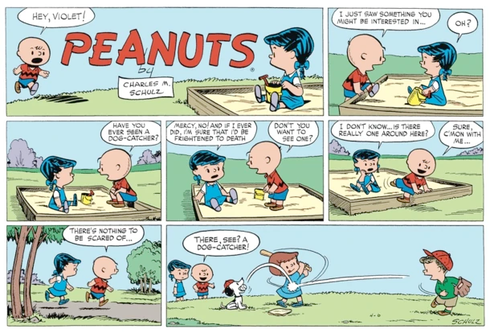
Baseball Debut
August 6, 1952
April 6, 1952

Slide 16
Snoopy the Shortstop
April 12, 1957
Did not learn to walk until June 1957

Slide 17
Double Play Partners
August 24, 1960
August 24, 1960
Notes:
It was a dark and stormy night

Slide 18
High Maintenance
Knows he is the best player on the team
Not always nice
Refers to Charlie Brown as “the round headed kid”
Doesn’t always pay attention

Slide 19
Falling Asleep
April 12, 1967

Slide 20
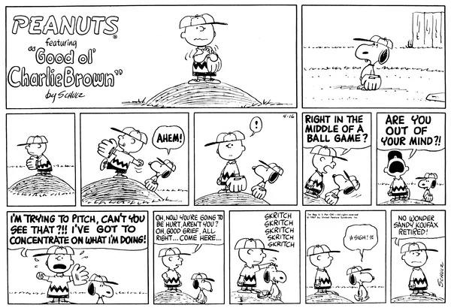
Needs a “Skritch”
April 16, 1967
Notes:
It was a dark and stormy night

Slide 21
Still Worth Protecting

Slide 22
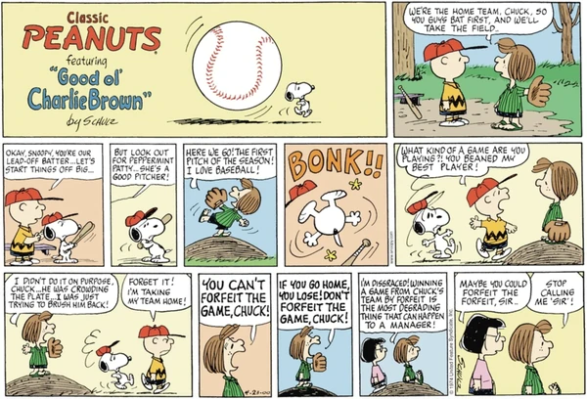
“What kind of game are you playing? You beaned my best player!” – Charlie Brown
April 21, 1974
Notes:
It was a dark and stormy night

Slide 23
Babe Ruth, Hank Aaron and Snoopy?

Slide 24
August 1973
Babe Ruth
Hank Aaron
Notes:
It was a dark and stormy night

Slide 25
Snoopy Also Chasing Ruth
August 1973
Series of strips about Snoopy chasing Babe Ruth’s home run record
Shed light on the plight of Aaron’s real chase of Ruth’s record
August 1973
Notes:
It was a dark and stormy night

Slide 26
1973: Snoopy Can Tie Babe Ruth
August 11, 1973
Notes:
It was a dark and stormy night

Slide 27
1973: “You’re Not Even Human”
August 11, 1973
Notes:
It was a dark and stormy night

Slide 28
1973: Pressure
August 14, 1973
Notes:
It was a dark and stormy night

Slide 29
1973: Letters
August 15, 1973
Notes:
It was a dark and stormy night

Slide 30
1973: Final At-Bat
August 20, 1973
Notes:
It was a dark and stormy night

Slide 31
1973: No Forgiveness
August 22, 1973
Notes:
It was a dark and stormy night

Slide 32
Cal Ripken, Jr. or Snoopy?

Slide 33
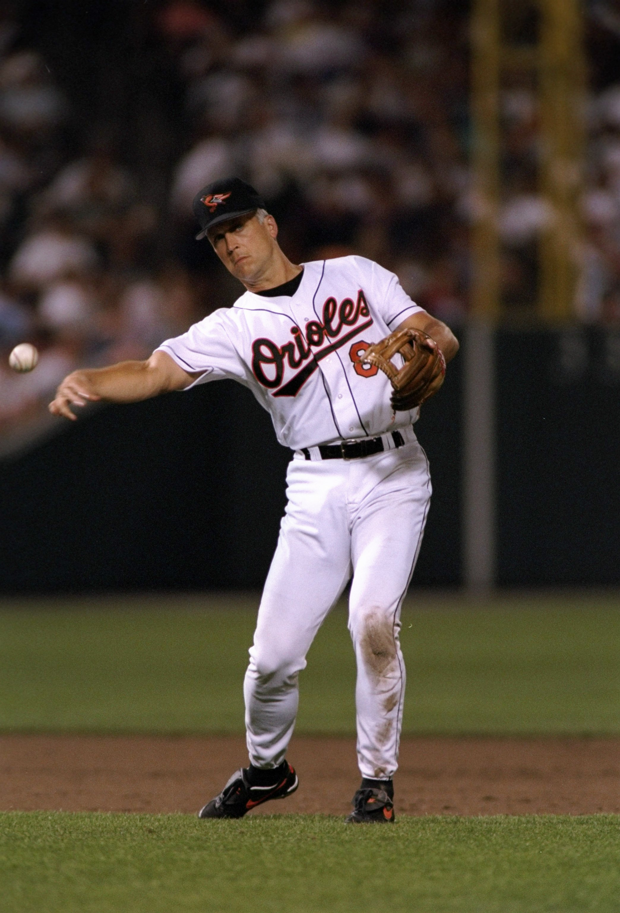
Is Snoopy the prototype for the modern shortstop?
Cal Ripken, Jr.
Snoopy
Notes:
It was a dark and stormy night

Slide 34
Snoopy the Manager

Slide 35
A Frustrated Player Leads to…
Management!
March 13, 1968

Slide 36
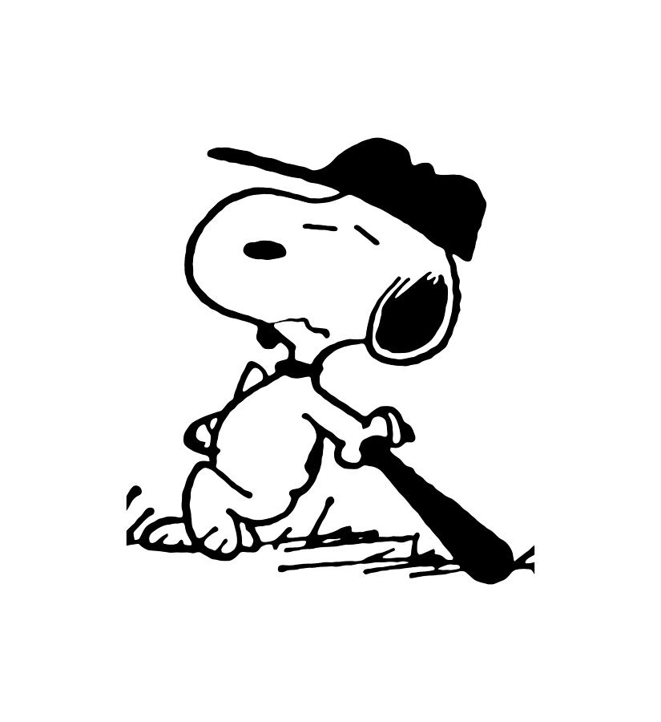
High Expectations
Demanding
No patience
No understanding about mistakes
Poor performers get “the boot"

Slide 37
The “Boot”
March 15, 1968
March 19, 1968

Slide 38
A Smak
March 23, 1968

Slide 39
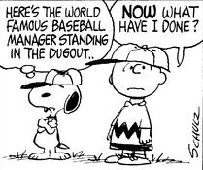
Charlie Brown With An Ego

Slide 40
Snoopy the Marketer

Slide 41
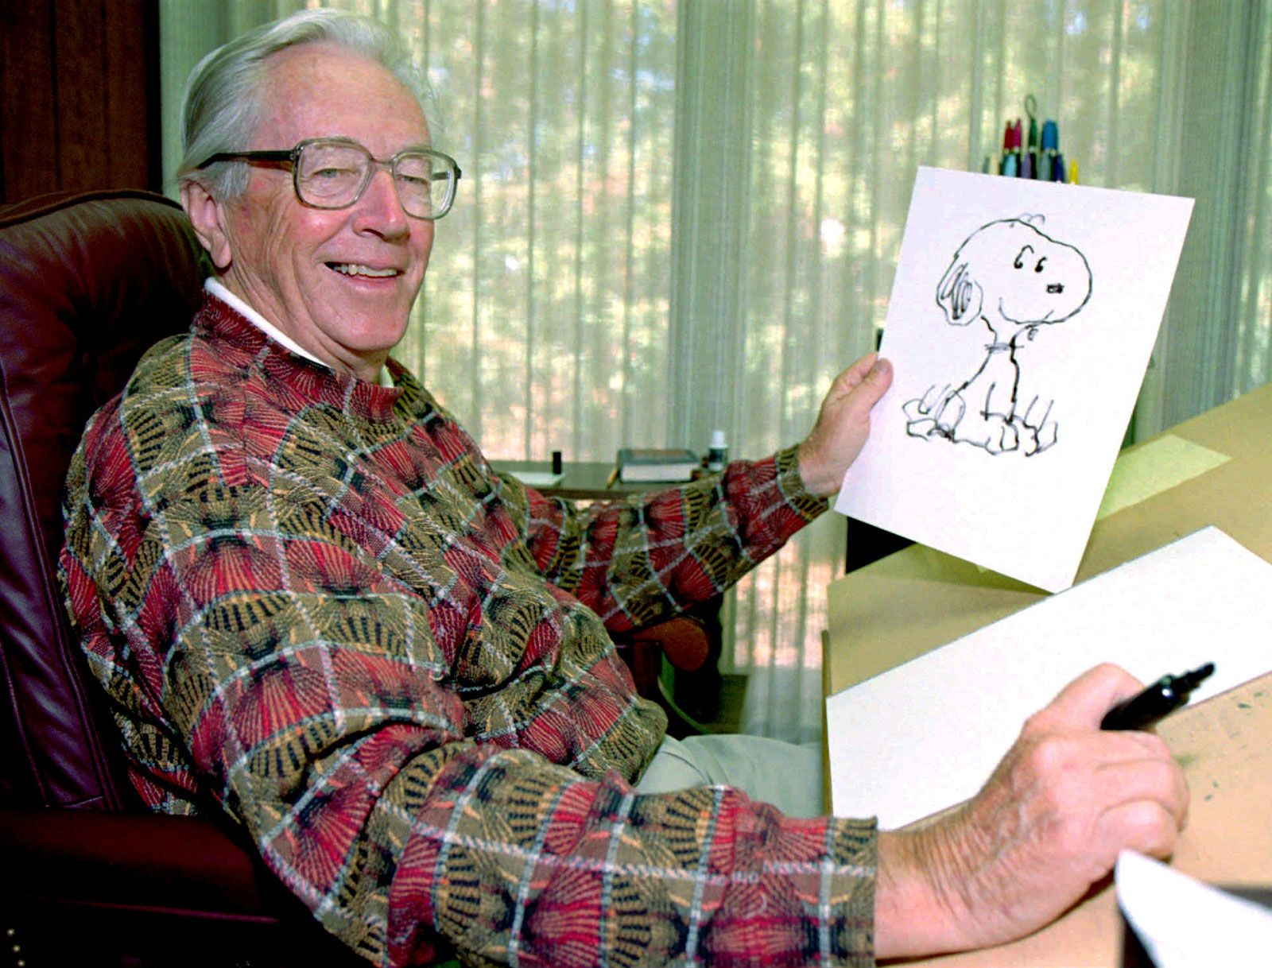
Still A Hit
Peanuts is 71+ years of age
Charles M. Schulz’s estate earned 32.5M (2020)
700+ licensing agreements
Snoopy has become the face of Peanuts

Slide 42
The Peanuts Movie
Film from 2015
Also known as “Snoopy and Charlie Brown: A Peanuts Movie”
US Gross
$130,178,411
World Gross
$246,233,113

Slide 43
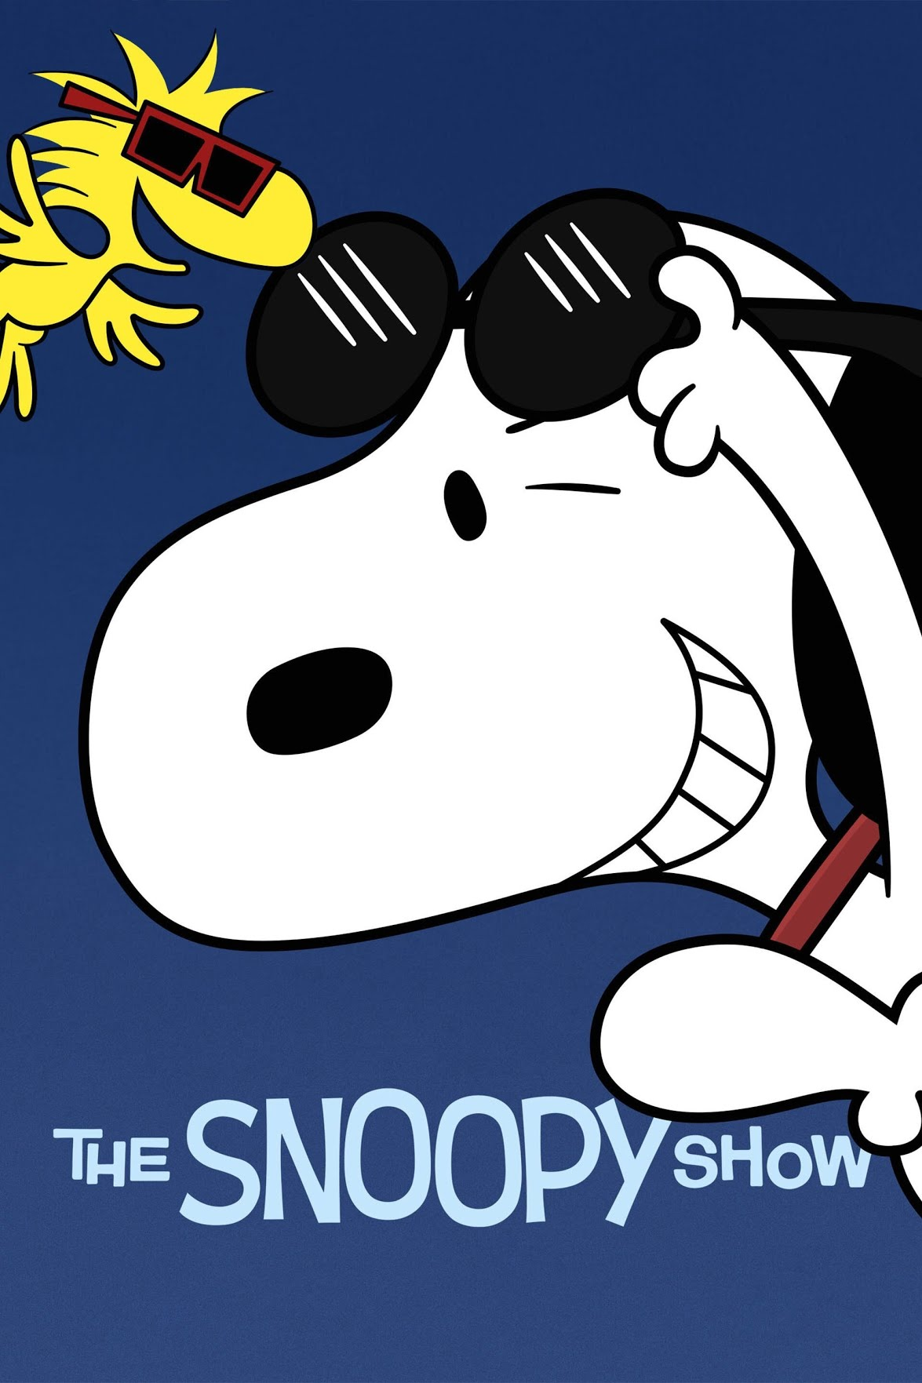
The Snoopy Show
Streaming series on Apple TV+
Season 1: 13 Episodes
Season 2: 13 Episodes
Season 3: In process

Slide 44
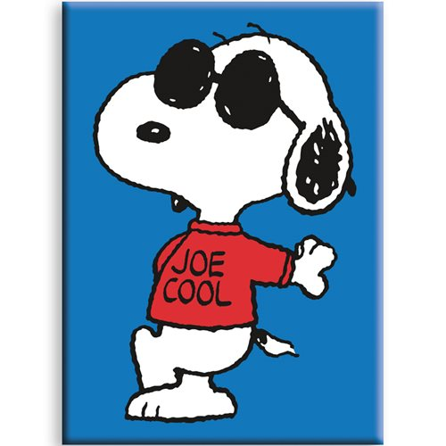
Social Media Star
Instagram: @snoopygrams
Twitter: @snoopy
TikTok: Snoopy
Snapchat: Snoopysnaps
Facebook: Snoopy

Slide 45
The Face of MetLife
Peanuts characters had year relationship with MetLife
The “Snoop Blimp”
Snoopy in his baseball uniform
Now the face of their pet insurance

Slide 46
Baseball Collectibles King

Slide 47
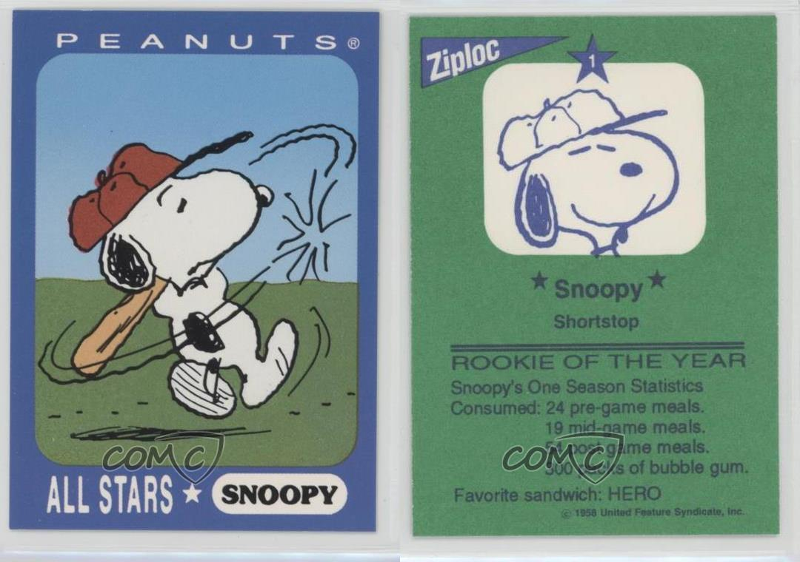
Baseball Cards

Slide 48
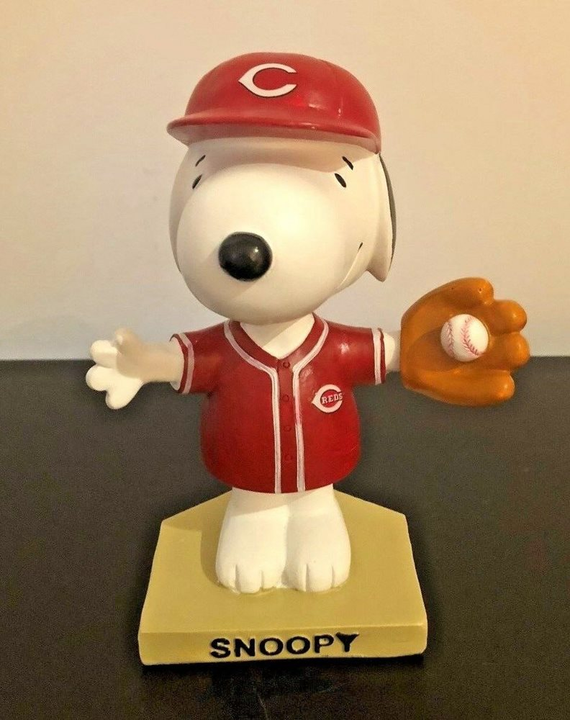
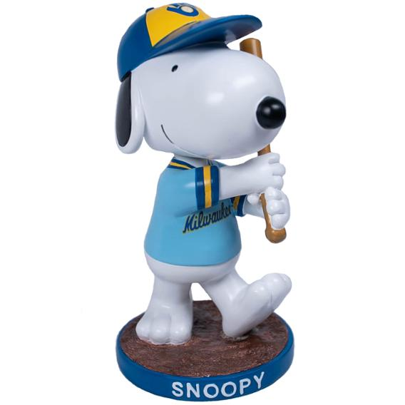
Bobbleheads
Cincinnati Reds
Milwaukee Brewers

Slide 49
What Makes Snoopy Great
“Snoopy figured that since no one will ever see you the way you see yourself, you might as well build your world around fantasy, create the person you want to be, and live it out, live it up. Part of Snoopy’s Walter Mitty–esque charm lay in his implicit rejection of society’s view of him. Most of the kids saw him as just a dog, but he knew he was way more than that.” – Sarah Boxer, The Atlantic (November 2015)

Slide 50
In Conclusion

Slide 51
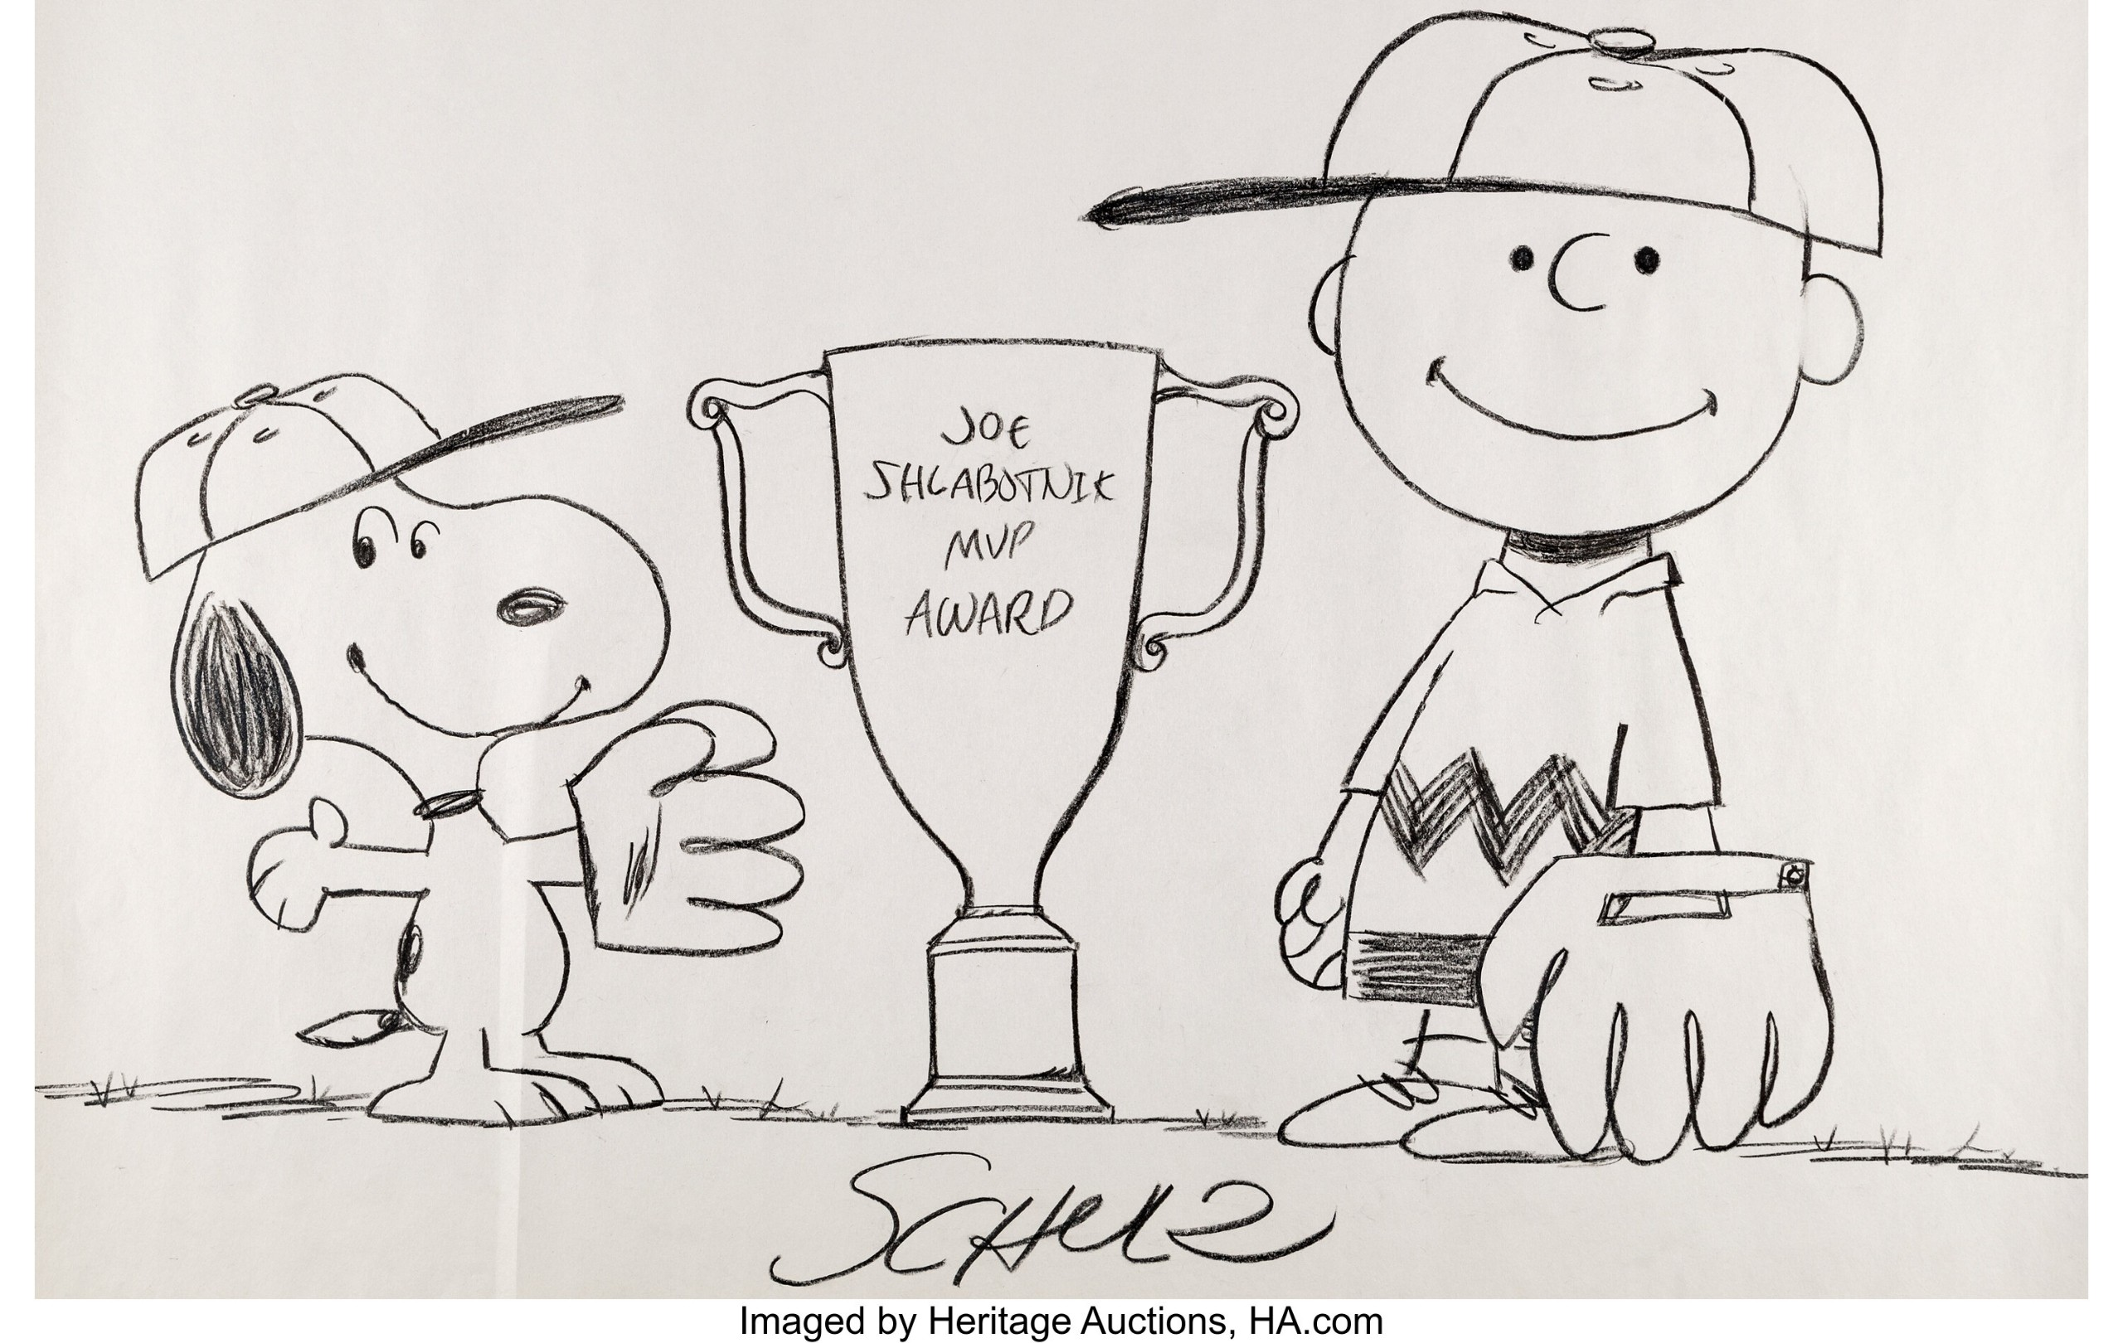
Snoopy: Baseball’s World Famous Top Dog
Notes:
I believe Snoopy is Baseball’s Top Dog because of his skill as a player, his tenacity as a manager and his marketing skills.

Slide 52
Thank You! Melissa (Missy) Booker #Snoopy #BaseballsTopDog

Slide 53
Thank You
James Booker, JoAnn Booker, Molly Dole, Steve Dole, Sam Dole, Alecia Dole, Harper Dole, Hannah Dole, Alyssa Whiteof, Zach Witeof, Linda Gemmell, Bo Gemmell, Teri Dickson, Terry Dickson, Jamie Olson, Mike Olson, Mason Olson, Kaden Olson, Caitlin Olson, Trevor Dickson, Travis Dickson, Meghan Dickson, Lucas Dickson, Charlotte Dickson, Joey Boston, Mike Boston, Michael Boston, Jim Booker, Shelby Booker, Joey Booker, Mike Davis, Cory Piana, John Piana, Kathy Martinez, Eric Martinez, Joshua Martinez, Kerri Barnhart, Lindsay Bedford Warner, Mary Collins, Laura Evankovich, Andy Yerman, Tom Sutton, Todd Werkhoven, Kelly Smotherman, Mrs. Anne Springs Close, Rayne McEnery, Mya Barbatsoulis, Dakota Barbatsoulis, Ed Devney, Bob Tonozzi, Richard Ciccarello, the Tavenner Family the Steigerwald Family, George Hill, Randy Mobley, Gene McArtor, Bob Todd, Izzy Volpe, Joe Francisco, Chris Carroll, Kirk Collier, Eric Petty, Laura Albertson, Joelle Poe, Max Arbow, Antoine Juhel, Starbuck the Dog, Kristen Erbes, Suhas Riggs, Brian Lynd, Mike Nutter, SABR, Mark Armour, Larry Lester, Leslie Heaphy, Phil Ross, Larry Lester, Mike O’Meara, Robb Spewak, Oscar Santana, TMOS Zoomers, Rob Maher, Joe Robinson, Justin Schlegel, Robby Robinson, Dan Rea, Ron Barr, Joe Castellano, Leroy “Satchel” Paige, Tommy John, Russ Morman, Hoyt Wilhelm, Wilbur Wood, Phil Niekro, Joe Niekro, Lance Niekro, Melissa Hill, Shawn Pender, the Corby Family, Cincinnati Reds Baseball Operations, Snoopy, Coco the Cat, Niekro the Cat, the Hall of Fame Symposium crew

