Slide 1
Behind the Numbers:
The Untold History of Official Scorers
Christopher J. Phillips
Carnegie Mellon University
cjp1@cmu.edu

Slide 2
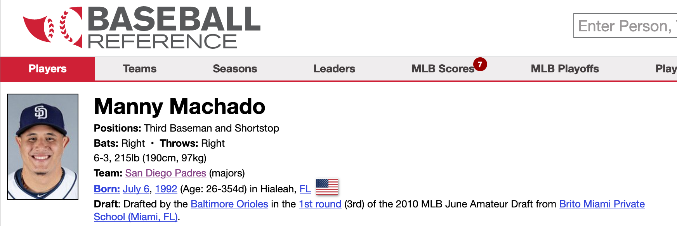
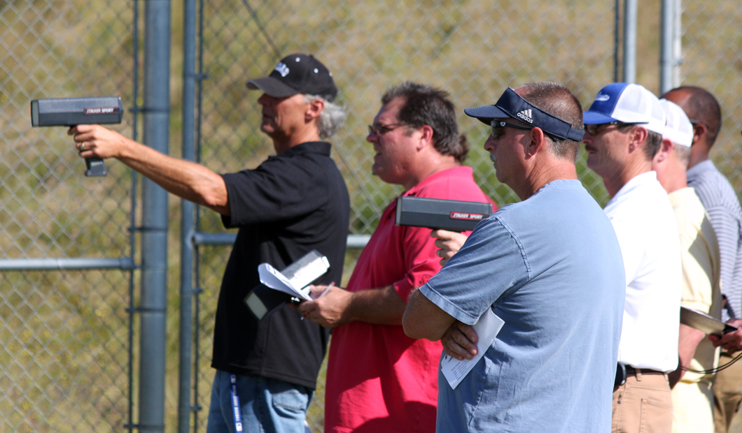
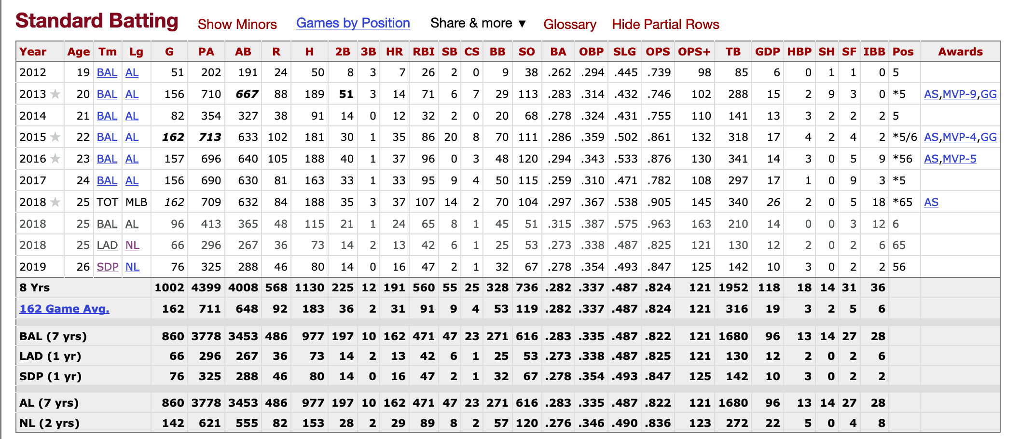
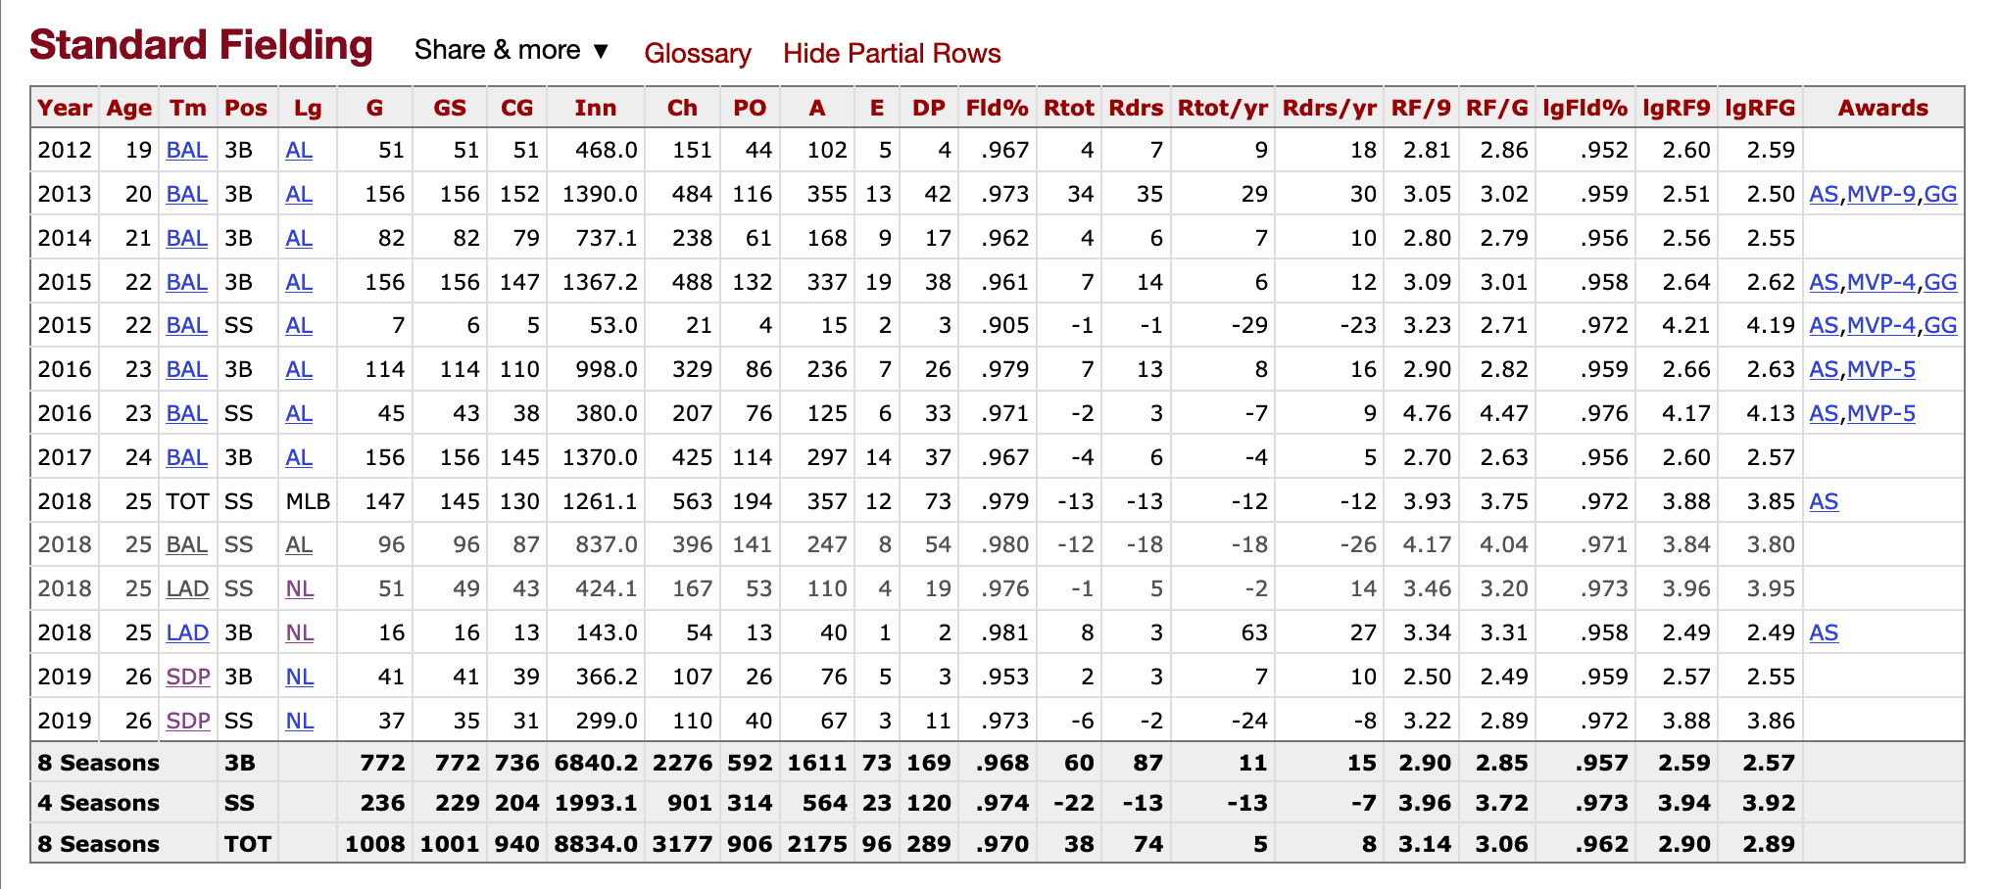

Slide 3
H & E

Slide 4
“The people who determine players’ earned runs, hits and errors are unregulated, unsupervised, and, in some cases, unqualified.”
—Bill Plaschke, 1993

Slide 5
1873:
a “Boston Reader” complained about a ruling on a “hot line ball”

Slide 6
1877:
AB, H, R, TB, PO, E
and
bases made by runners
Official Report from 2015

Slide 7
Strategies for Turning Subjective Judgments into Objective Statistics:
1. Control who scores

Slide 8
a “thorough gentleman” is required as scorer, one whose “gentlemanly conduct will render him acceptable to all who are liable to make inquiries of him”
—Henry Chadwick, 1866

Slide 9
“thorough gentleman”
A man…
(cf. Elisa Green Williams, Martha Boynton Reynolds, Susan Fornoff, and Marie-Claude Pelland-Marcotte, among others)
…but crucially, a gentle-man
(e.g., English natural philosophers: cannot be influenced)

Slide 10
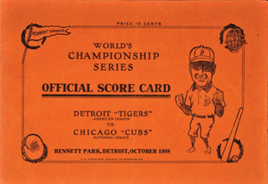
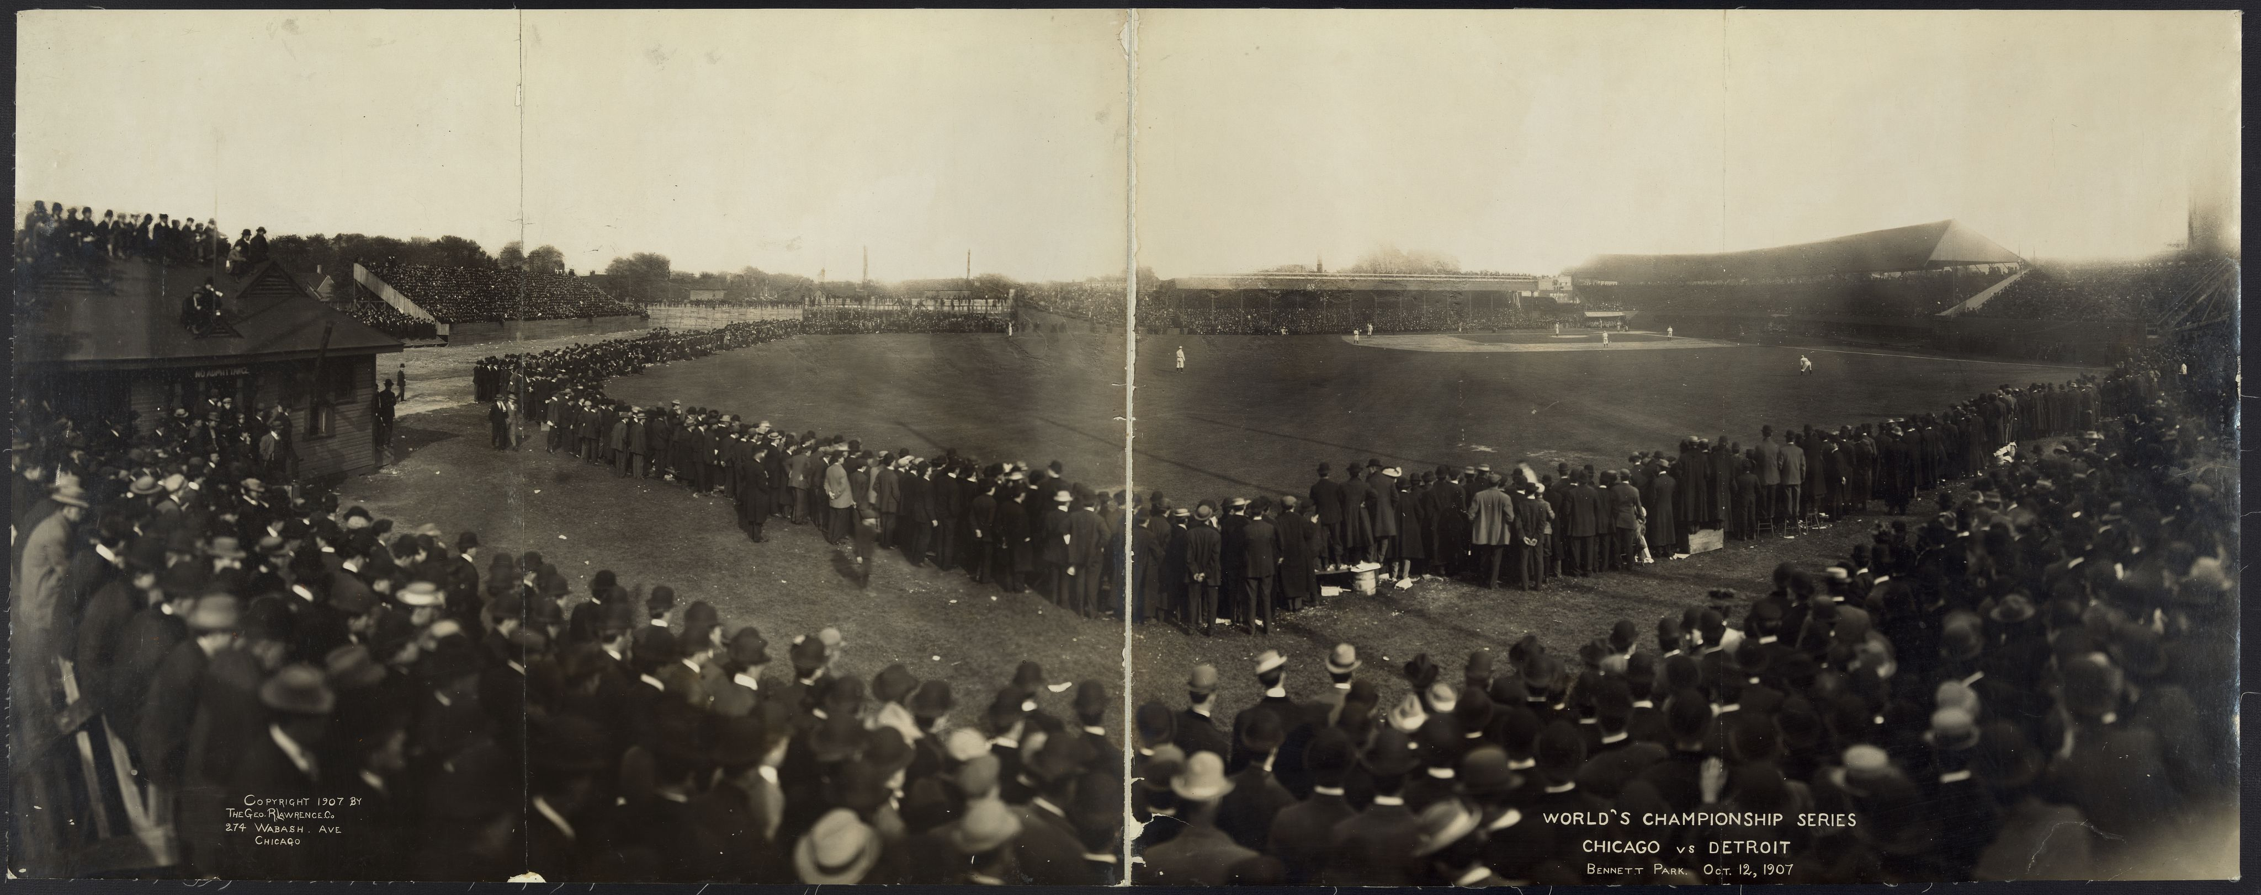
From Gentlemen to Newspaper Reporters
1908 World Series and formation of Base Ball Writers’ Association of America (BBWAA)

Slide 11
BBWAA as Official Scorers
“Cincinnati Hit”
and
Ty Cobb controversy in 1922
but
cheap, available, and knowledgable
Formalized circa 1929: leagues appointed BBWAA-recommended scorers

Slide 12
Controlling Who Scored Ultimately Not Successful:
by 1979, BBWAA could no longer guarantee scorers as newspapers revolted
by 1980, 15 official scorers were not reporters
and so the
modern system of “outside consultants” on annual contracts

Slide 13
Strategies for Turning Subjective Judgments into Objective Statistics:
1. Control who scores
2. Manage how they score

Slide 14
1873:
a “Boston Reader” complained about a ruling on a “hot line ball”

Slide 15
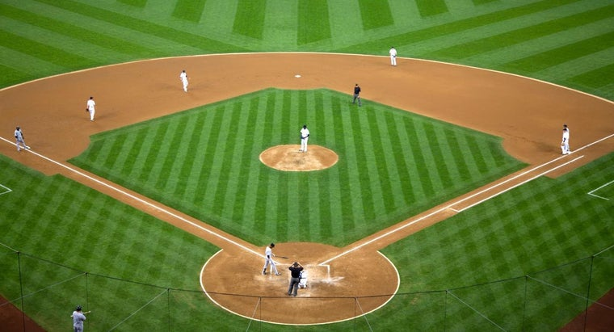
Chadwick’s Response:
Rules for Hit versus Error
Normal versus Exceptional
Normal as Statistical
of 30-odd times, 4 were hits…

Slide 16
1873: Chadwick, Normal v Exceptional on basis of statistics
1877: National League, obvious v non-obvious (in case of doubt, don’t give an error)
1908: Murnane, “rules of thumb” (e.g., short hop -> hit)
1911: Cummings, act like a machine “as though the players were inanimate objects he had never before seen”
1912: Sanborn, judgment of “ordinary skill” (e.g., an experienced reporter who know what’s “ordinary”)

Slide 17
1925: Fisher, divide everything into cases and specify rulings for each
1943: Sporting News, exercise “common sense”
1971: Young, figure out who to blame because blame was the “essence of scoring”
Rule Book from 1949: “ordinary effort”

Slide 18
1925: Fisher, divide everything into cases and specify rulings for each
1943: Sporting News, exercise “common sense”
1971: Young, figure out who to blame because blame was the “essence of scoring”
Rule Book from 1949: “ordinary effort”
1887, National League Secretary, in charge of scorers:
too much variation in scoring
2015, Phyllis Merhige, in charge of scorers:
“Scoring is not only different city to city. It’s different scorer to scorer.”

Slide 19
Strategies for Turning Subjective Judgments into Objective Statistics:
1. Control who scores
2. Manage how they score
3. Systematize the score

Slide 20
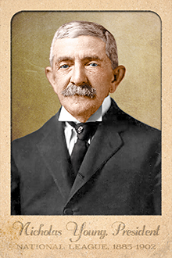
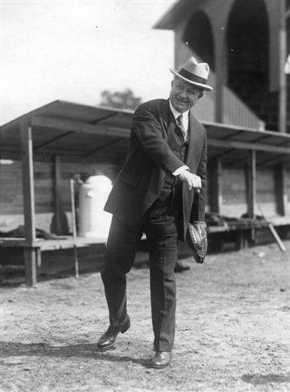
National League’s Management of Scoring
Nicholas Young (Secretary; President)
arslongaartcards.com
John Heydler (Secretary; President)
SABR Bio Project

Slide 21
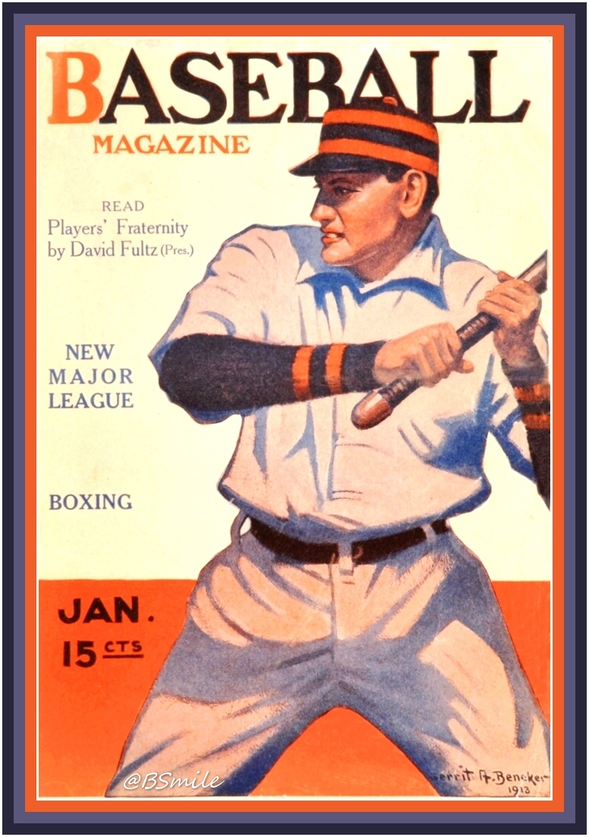
Step 1: Make Scores “Official”
F.C. Lane, “Behind the Scenes in Organized Baseball”:
Heydler’s records “are complete in every detail to mathematical perfection”
1913

Slide 22
Step 2: Make Scorers “Official”
1949 rule book: “the scorer is an actual official of the game he is scoring, is an accredited representative of the League, is entitled to the respect and dignity of his office and shall be accorded full protection by the President of the League.”

Slide 23
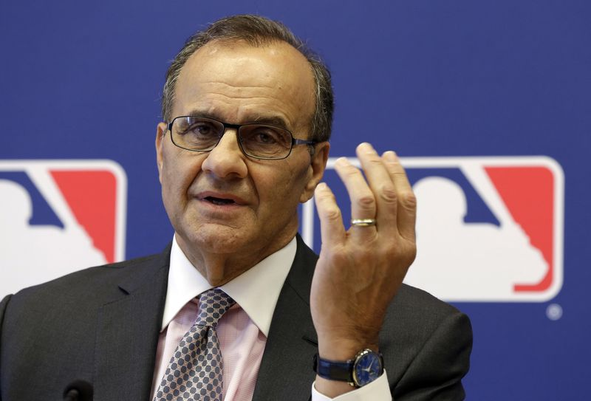
Step 3: Make Scoring Itself “Official”
Appeal Process for Scorers’ Judgment:
authoritarian
no need for justification
makes all judgments ”official” = “of the office”
Executive Vice President for Baseball Operations
currently Joe Torre
(Richard Drew / Associated Press)
Credibility remains essential…

Slide 24
Step 3: Make Scoring Itself “Official”
Phyllis Merhige:
Official Scorers Seminar
Online Presence
Casebook (SABR’s Stew Thornley, among others)
Bringing people into conversation to standardize scoring

Slide 25
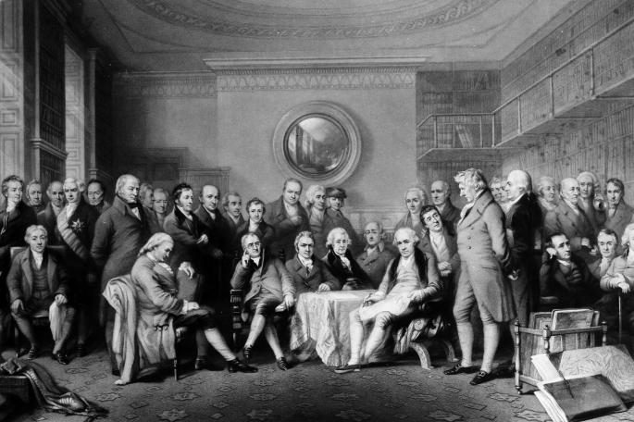
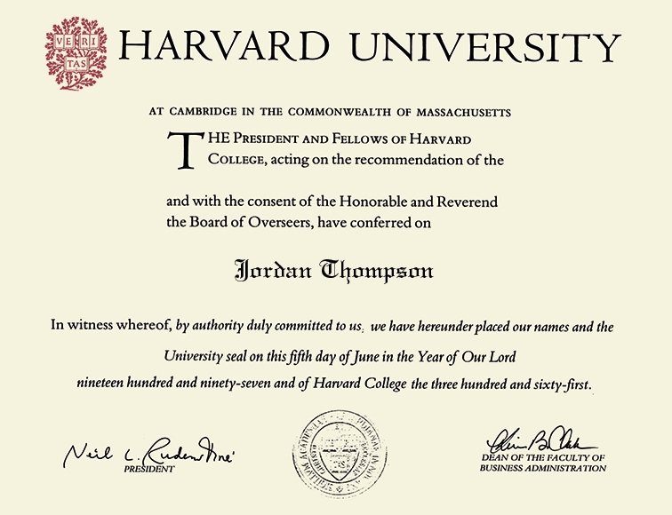
Strategies for Turning Subjective Judgments into Objective Statistics:
1. Control who scores
2. Manage how they score
3. Systematize the score

Slide 26
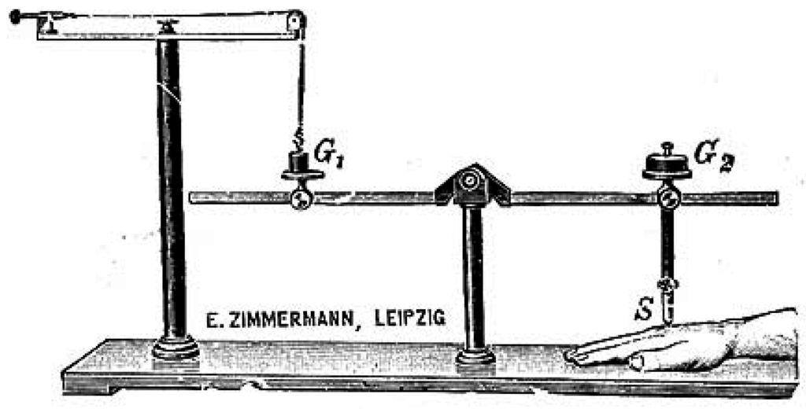
Strategies for Turning Subjective Judgments into Objective Statistics:
1. Control who scores
2. Manage how they score
3. Systematize the score

Slide 27
Strategies for Turning Subjective Judgments into Objective Statistics:
1. Control who scores
2. Manage how they score
3. Systematize the score

Slide 28
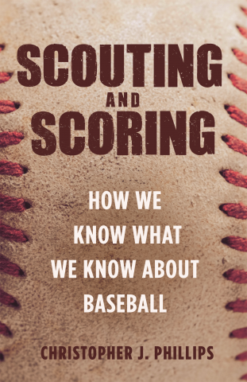
March 2019 (Princeton)

Slide 29
Behind the Numbers:
The Untold History of Official Scorers
Christopher J. Phillips
Carnegie Mellon University
cjp1@cmu.edu

