Slide 1
OPTIMIZING LINEUP SIMULATORS WITH BALL TRACKING DATA
By Reece Calvin
Notes:
Hello Everyone,
My name is Reece Calvin
Third-year data science and economics major at NEU
Thank you to Scott and SABR for allowing me to speak in front of you all.
Now, I am excited to share with you, my research in leveraging ball-tracking data when building lineup simulators

Slide 2
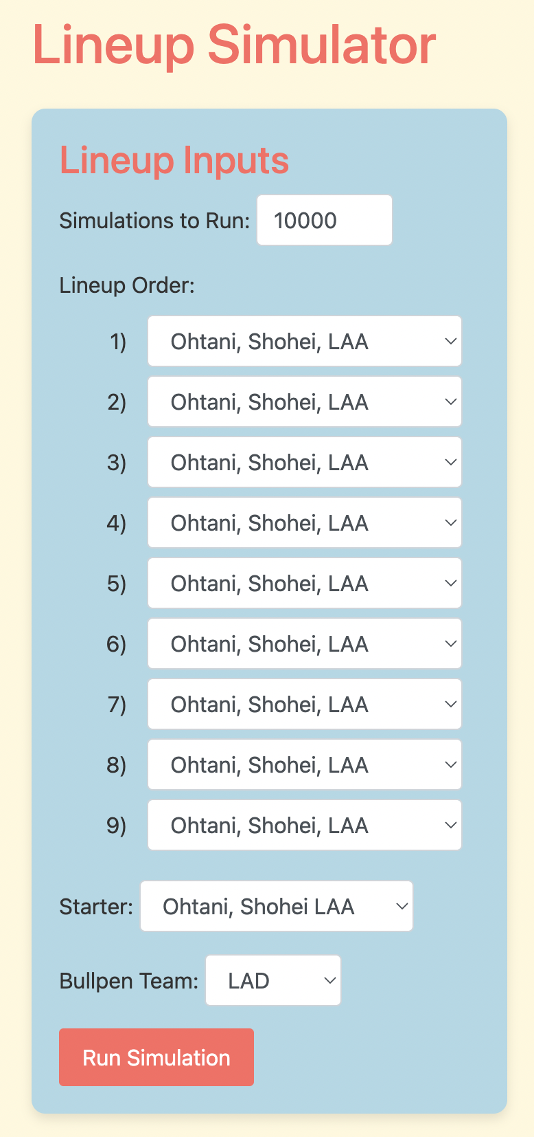
Notes:
Now I know most of you are only here to find out what a lineup of
Shohei's would score against Dodgers pitcher Ohtani.
Unfortunately, the results for that are at the end.
So bare with me

Slide 3
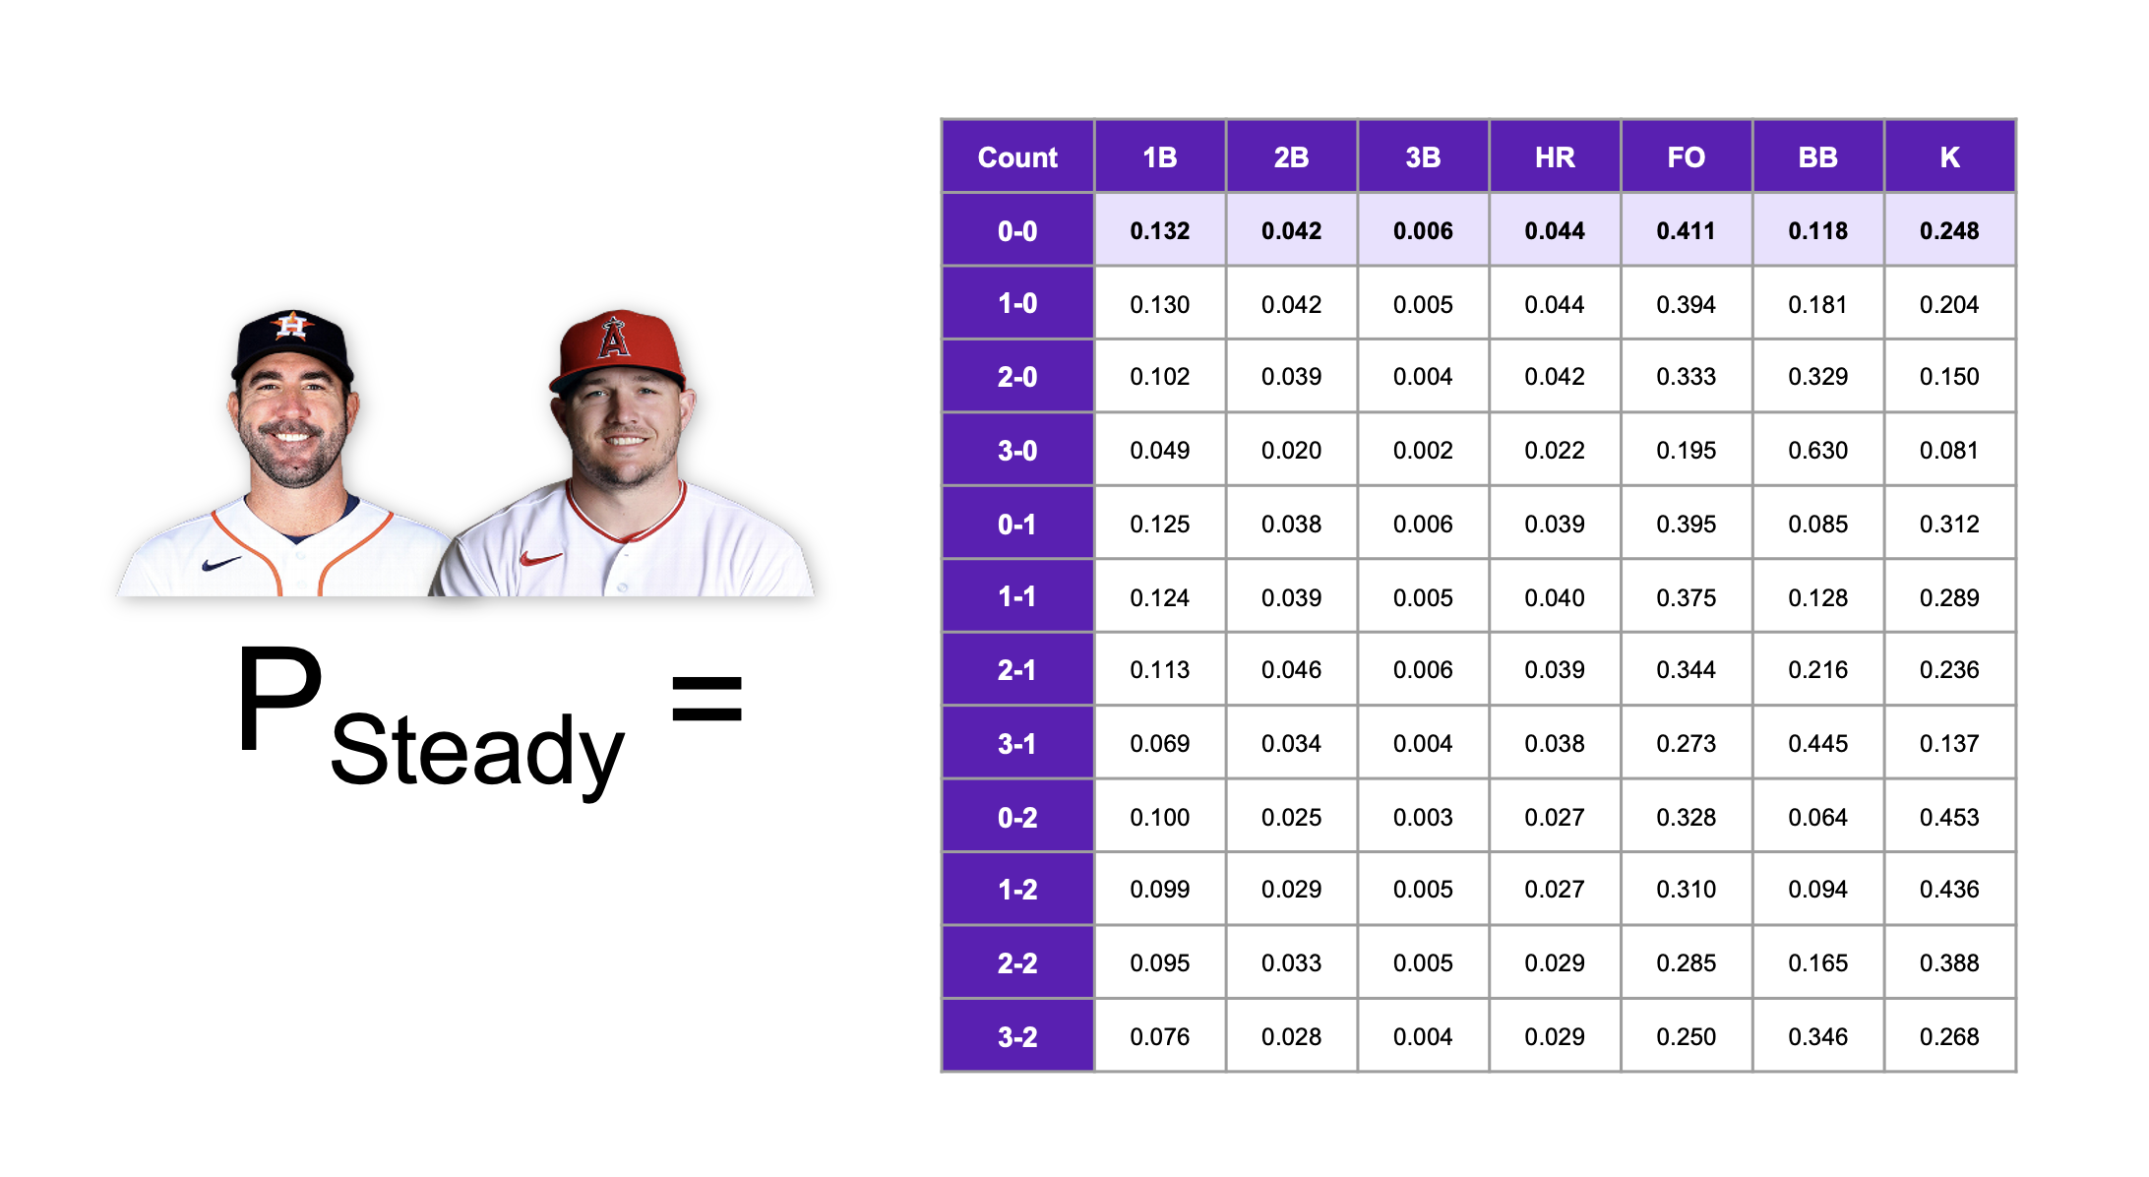
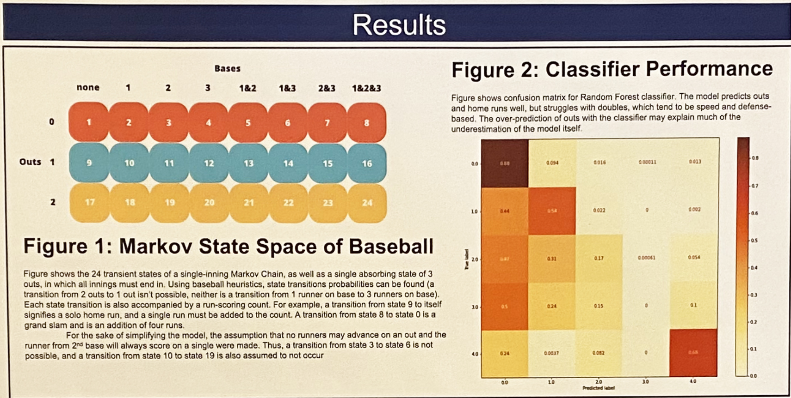
Previous Works
Notes:
In previous conferences, we have seen Connor Turner of The Diamond present his solution to what he called the “Pitch hitter problem”.
He sought out an effective way to predict the results of different pitcher and batter matchups.
His solution was to build matrices of each player’s PA outcome distribution according to the count.
For example, in 2019, after getting to a 1-0 count, Mike Trout hit a single 11% of the time and struck out 16%.
For Cy Young Pitcher Justin Verlander, a 1-0 count resulted in a single 6% of the time and he struck out the batter 32% of the time.
To predict the outcome, Connor averaged the two matrices and predicted the outcome.
A 1-0 count with Verlander pitching and Trout hitting resulted in a single a predicted 9% of the time and a strikeout 24% of the time.
Last year, NYU students Jeff Jin and Chris Chen took this method a step further
Instead of assuming equal value to the pitcher and batter distributions, they used multi-categorical Brier Score to find the optimal weights when determining the matchup outcomes.
They found that 34% of the outcome is determined by the pitcher while 66% is dictated by the batter.
Also, Johns Hopkins student Ashwin Pah-Soo-Pah-Thee presented his own research in lineup optimization using Markov Chains.

Slide 4
MARKOV CHAIN PRIMER
Notes:
Markov chains are going to be a recurring topic today
So, I wanted to first give a brief primer to ensure every is on the same page.

Slide 5
What Does This Look Like?
100/0
003/2
120/0
020/0
Notes:
Essentially, a Markov chain allows us to look at a system at a current place in time and see what may happen next.
An individual position in a Markov Chain is called a state.
In baseball, we can define a state as the position of runners on base and the number of out.
In state 1, we see 100/0.
This represents a runner on 1st base with 0 outs.
If we move forward 1 plate appearance, we get to 1200, or, runners on 1st and second with 0 outs.
Maybe a walk happened, maybe a single. It does not matter how we got here; all the Markov chain takes into account is end results.
Next, we got to 003/2. You may have to use your imagination a bit more for this one. Maybe the batter grounded into a double play, but the lead runner still advanced to third.
Every half inning can be summarized in this manner. Do you want to calculate how many runs were scored from 1 state to the next? Well, add up the number of base runners, and the outs, add 1 to represent the current batter, and from that total subtract the sum of the next state's total runners and outs.
So, when we moved from state 1, we had 1 runner on base and 1 batter, so we got a value of 2. State 2 had 2 runners and 0 outs, also a value of two. 2 subtracted from 2 is … 0. So we know no runs were scored.
If state 2 instead was 020/0,
*Click*
we would instead only subtract 1 from 2, leaving us with 1 run scored.

Slide 6
How do we calculate transition prob?
020/1
Single
Strikeout
…
100/1
103/1
020/2
020/2
103/2
40%
37%
10%
94%
5%
Notes:
Here is another way to visualize a subsection of the Markov Chain.
With a runner on second and 1 out, a single results in the next state being 100/1 40% of the time, and 101/1 37% of the time.
We know in the first outcome, 1 run was scored while in the second, 0 runs were scored.
In the full Markov Chain, you would see every state, with every possible plate appearance outcome.

Slide 7
WHAT DO WE FEED INTO THE MODEL?
Notes:
So we spent the last few minutes talking about how to predict the state change, given the plate appearance result.
The issue now is, how do we predict the result?

Slide 8
5% HR
2B
5%
12%
FO
LO
5%
19%
GO
2% 3B
12% 1B
Corbin Carroll vs RHP
10% BB
22% K
Notes:
Well, this is the 2023 NL rookie of the year Corbin Carroll. Versus right-handed pitching,
From the visual, you can see Carroll grounded out 19%, homered 5%, struck out 22% of the time

Slide 9
1% HR
2B
2%
11%
FO
LO
4%
22%
GO
0% 3B
13% 1B
Kodai Senga vs LHB
13% BB
29% K
Notes:
Now, here are the pitching results vs left-handed batters for the 2023 NL Rookie of the Year runner-up, Kodai Senga
He allowed ground outs 22% of the time, home runs 1% of the time, and struck out 29% of the batters he faced.

Slide 10
How do we predict matchup outcomes?
Grid Search
Minimize multi-class Brier score
Find the optimal batter weight and regression weight
What percent of the outcome is dictated by the pitcher?
Should we regress the batter/pitcher distribution towards the league average?
Notes:
At this point, I removed 25% of the games from the data set. Those games are to be used later in the simulation process but were not included in anything prior.
So, I split the remaining 75% of the data into further training and testing sets. I used the training set to create each player outcome distribution, and I used the testing set to score the data.
I used a grid search method to test every different batter and pitcher weight to find what was most optimal in predicting a matchup outcome

Slide 11
Hit% | Out% | Walk% | Hit | Out | Walk | Sum Squared Errors
33% | 33% | 33% | 0 | 0 | 1 | .66
33% | 33% | 33% | 0 | 1 | 0 | .66
 |  |  |  |  | Mean | .66
Notes:
Here is a simplified version of the data.
In reality, I used specific hit-and-out types. But for the sake of readability, let’s walk through this example used by Jin and Chen in their presentation.
Pretend we multiply the two matrices with x weight for the pitcher and 1-x weight for the hitter and we get a 33% chance of a hit, 33% chance of an out, and 33% chance of a walk,
If the actual result of the at-bat was a walk, the errors are 33% wrong for hit%, 33% wrong for out%, and 66% wrong for walk%.
When you sum up the square of those numbers, you get .66. I did this for every plate appearance in the training set and tried to minimize the error.
Also, I added a regression number of N league average results to add to the hitters and pitchers.
0 would represent their true distributions, and 50 would mean I added 50 plate appearances of the hitter or pitcher getting league-average results.

Slide 12
Grid Search Results
43% of the weight towards the pitcher
Do not regress towards the league average
Notes:
The outcome was a 43% weight to the pitcher and a 57% weight to the hitter.
I mentioned at the start of my presentation that Jin and Chen got a weight of 34%.
I was able to replicate this result, but when I added pitcher and batter splits, the weight shifter to the aforementioned 43%.
I also saw the best results when I added 0 regression for the batter and pitcher.

Slide 13
3% HR
2B
4%
11%
FO
LO
4%
Senga vs Carroll
21%
GO
1% 3B
13% 1B
12% BB
25% K
Notes:
Here is what I would predict for a matchup between Kodai Senga and Corbin Carroll,
Using 43% weight to the pitcher and a 57% for the batter.

Slide 14
HOW DO WE SIMULATE?
Notes:
Let’s do a quick recap
We talked about how to use Markov chains to move from 1 state to the next
We talked about how I used brier score to find the best combination of hitter and pitcher stats to predict the outcome.
Now how do we use this to predict an MLB game?

Slide 15
Let’s Simulate
Trained on 75% of the 2023 MLB season
Created transition probabilities and batter/pitcher distributions off these games
Simulated the remaining 25% of the season
Input batter/pitcher distributions, team reliever distributions, team lineups, and starting pitchers
43% weight towards the pitcher
Replace a pitcher after 7 innings, or if they allow 5 runs
Use team average reliever stats
Choses LHP/RHP based on current pitcher at bat
Simulates each game 1,500 times
Notes:
We created the Markov chain and the player distribution stats based on the 75% subset of the data.
We then took the separated 25% of the data, 600 games, and simulated each game 1,500 times.
A starting pitcher was replaced once they allowed 5 runs or after pitching 7 innings.
5 runs were chosen as the cap because when a pitcher allows 5 runs in the first 4-innings, they are typically removed that inning.
Pitchers who allowed 4 runs usually stayed at least 1 more inning.
Also, when looking at pitchers who allowed fewer than 5 runs, they pitched between 5 and 7 innings.
I opted to go with the more extreme 7-inning cap due to how reliever distributions were calculated as I had more confidence in the reliability of using starting pitchers.
The way I did relievers was I calculated each team's average stats for their relievers.
Remember what I did for Kodai Senga? Well now imagine that but for one every left-handed reliever for the Mets and one for every right-handed reliever.
When making a pitching change, I would choose left-handed vs right-handed based on the platoon advantage.
Keep in mind, that these assumptions I made were only due to simulating over 600 games 1,500 times all at once. When simulating one game, one could create different thresholds for each pitcher, and create an order to use relievers.

Slide 16
Results
10.4% correlated with game scores
Correctly picked the O/U 52% of the time
Notes:
When I simulated the games, I got a 10.4% correlation with real scores
When comparing with betting lines, I was able to correctly pick the over-under 52% of the time.

Slide 17
HOW CAN WE LEVERAGE BALL TRACKING DATA?
Notes:
These results are promising, but I think we can do better.
The prevalence of ball tracking data opens the door for a lot of improvements to the previous method.

Slide 18
Predicting 2nd Half Results From the 1st Half
 | 2nd Half wOBA Correlation for Batter
1st Half wOBA | 29%
1st Half xwOBA | 38%
Notes:
Weighted on-base average, or wOBA, is commonly accepted as the best stat for summarizing a hitter's value at the plate.
But when looking at the first half of the season compared to the second half wOBA, first-half xwOBA is more predictive of future wOBA than wOBA itself.
xwOBA only looks at the launch angle and exit velocity of a pitch to predict the batted ball outcome.
It attempts to filter out luck and defensive impacts.

Slide 19
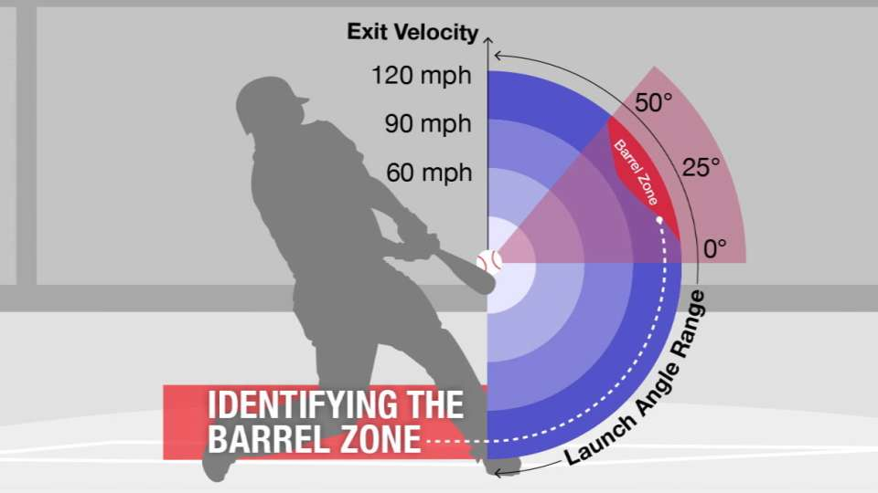
So How Can We Use This?
Classify results not only by outcome but by barrel zone
Re-simulate each PA with an XGBoost Classifier
We now go from 11 possible outcomes to 41
E.g. Single 1, Single 3.
Single 3 is more likely to move runner's extra bases
Notes:
Also, we have something called barrel zone.
The barrel zone is the range of exit velocity and launch angle where hitters have the most success.
There are also 4 other zones of varying levels of power. 1 is weakest, 4 is hardest and 5 is the barrel zone.
I used this to create new results. A weak single would be Single-1, while a harder-hit single may be called Single-3.
This is useful because Single-3 is much more likely to move runners already on base extra bases.
Now instead of 11 possible PA results, we have 41
This means are Markov chain looks a little different, also it can be a lot more confident in its results.
Results have a lot less nuance when we break it up by how hard the ball was hit.
Next, I re-ran every plate appearance with the ML model, xgboost classifier.
I predicted the probability of each result of each PA, as opposed to seeing the real result, and used the outcomes to create new player distributions.

Slide 20
Let’s Re-Run Our Grid-Search
Batter weight jumps to 72%
Regress batting stats by 50 at-bats to league average
Why does the batter weight increase?
Pitchers have less control over the type of hit
Notes:
When I re-ran the grid search, we found that 72% of the results were dictated by the batter and also regressed the batting stats by 50 plate appearances.
If you are wondering why the jump in hitter weight, I point to the common belief that pitchers have less control over the ball once it’s put in play.
Now that we are looking more into the specific type of ball in play, more weight is shifted towards the batter.

Slide 21
Results
 | Correlation to Real Score | O/U Accuracy
Basic Stats | 10% | 52%
Stats + Barrel Zone | 17% | 56%
Notes:
So here are the simulation results
correlation jumps to 17%
O/U accuracy increases to 56%

Slide 22
Uses
Showing to be more accurate than using traditional stats
Applicable for collegiate teams with Trackman, Yakkertech, or other ball tracking technology
It also is great for Twitter arguments
Notes:
This is exciting because we see tangible evidence that using these ball-tracking metrics can help in predicting scores
This is something that can be applied to different levels of the game.
Any program with access to yakker tech, trackman, or similar tech can now better utilize their data.

Slide 23
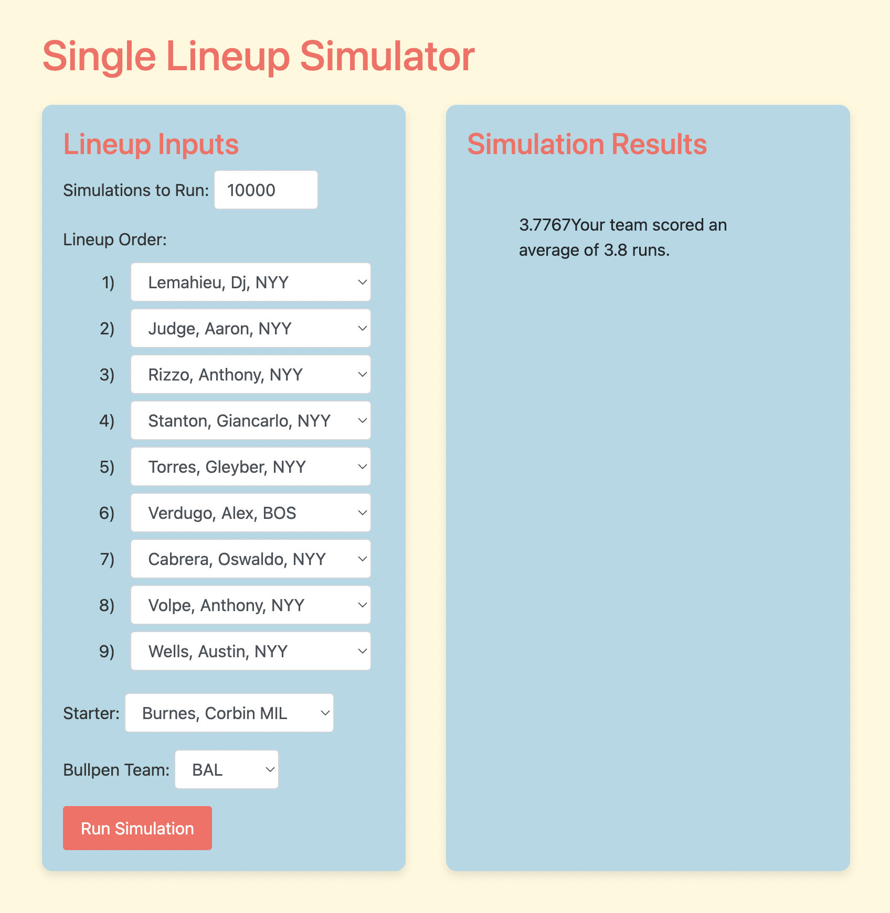
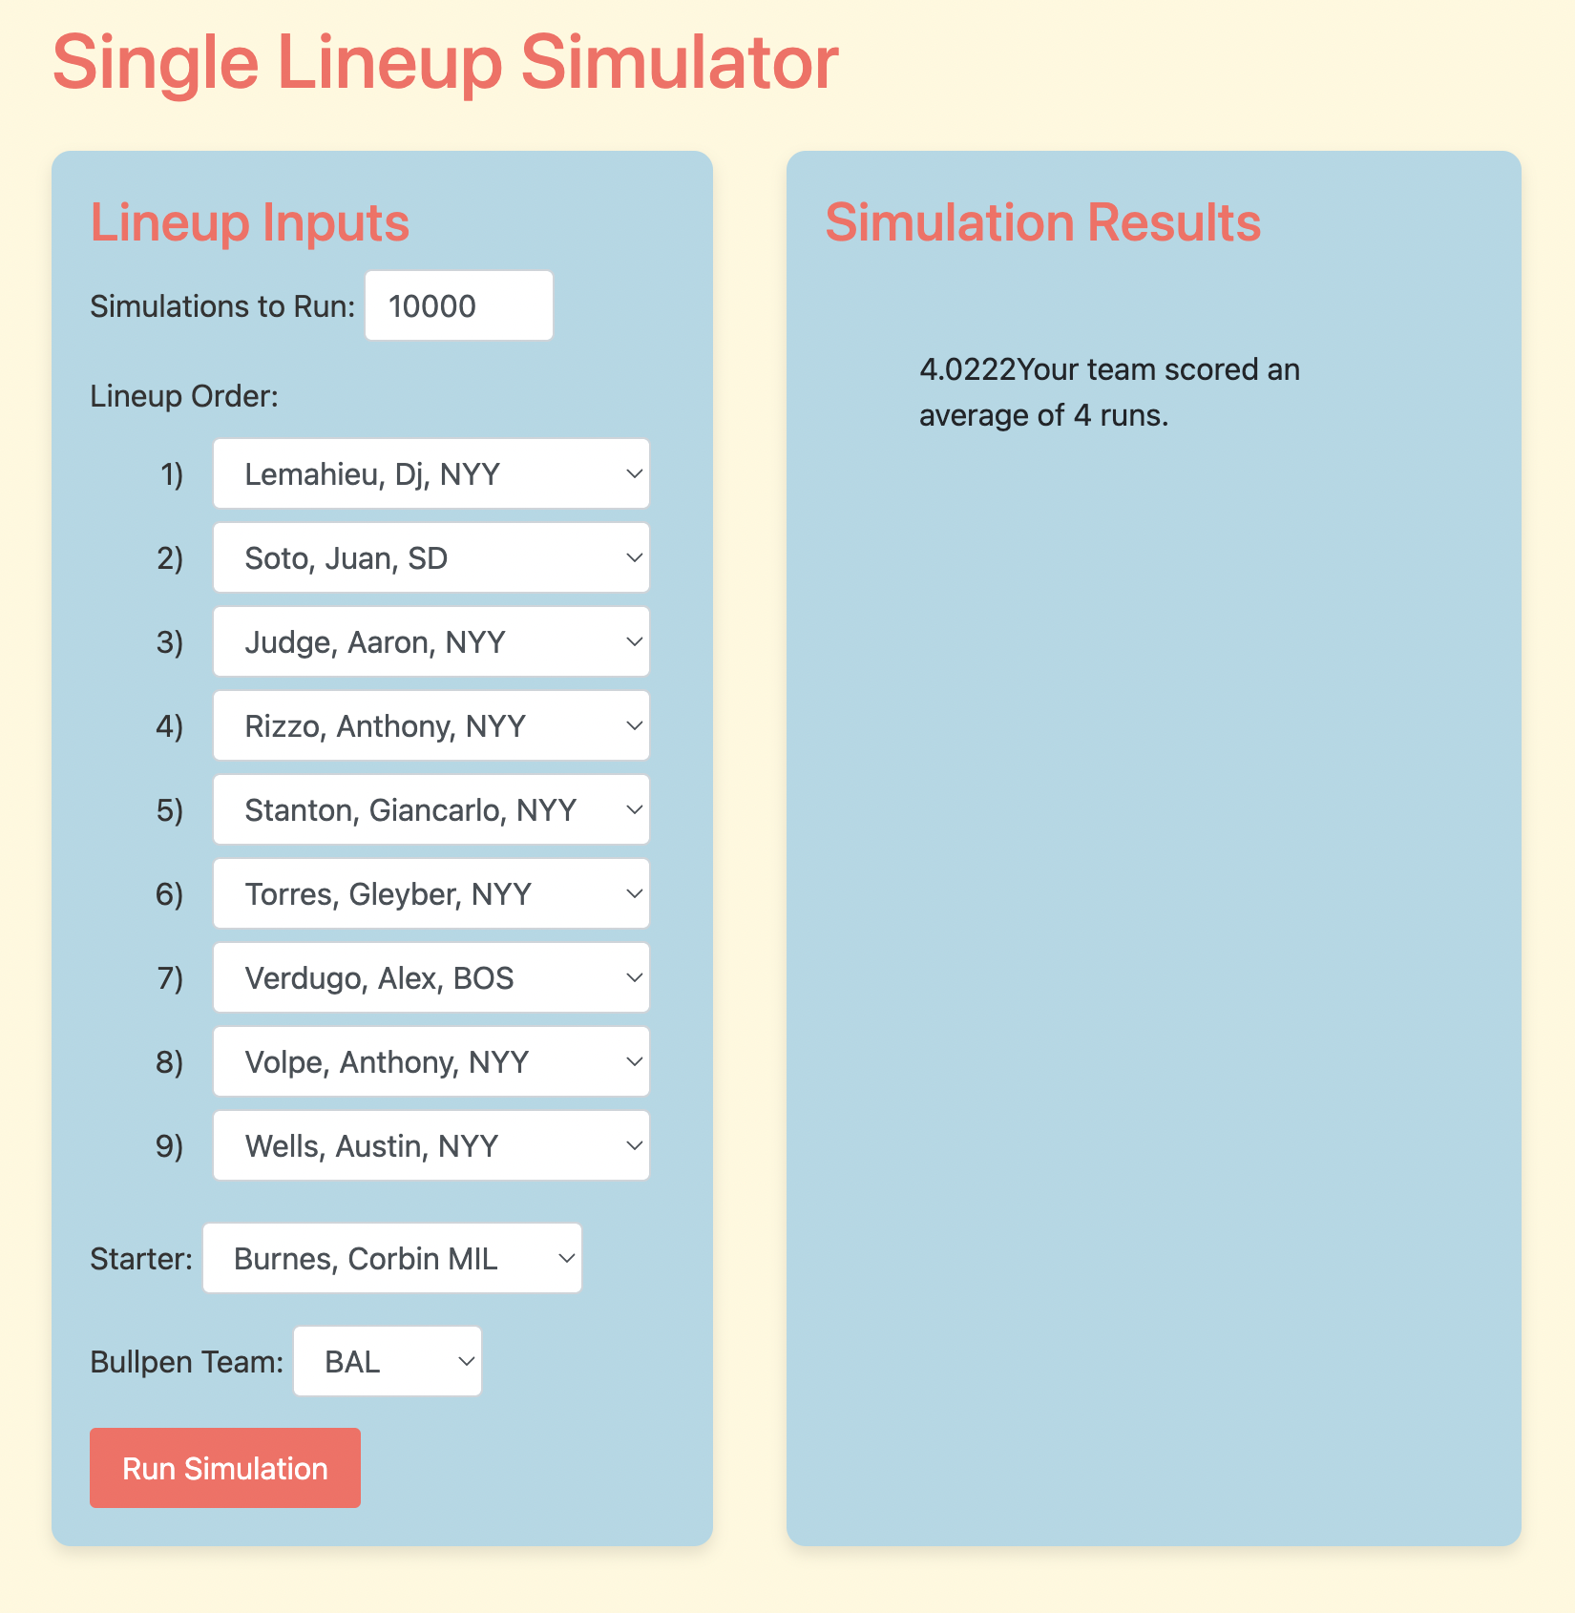
Your team scored an average of 3.7 runs.
Your team scored an average of 4.0 runs.
Notes:
This offseason, the division rivals Baltimore Orioles added Corbin Burnes and New York Yankees added Juan Soto
Prior to Soto, I simulated the Yankees scoring 3.7 runs per game against Burnes and the O’s
With Soto, that increases to 4 runs.
That comes out to .3 runs per game, 49 runs per season, and about 5 extra wins.

Slide 24
Future Development
Incorporate relievers and better predict usage
Include weather data
Bunting Thresholds
Consider defenses and ballpark factors
Break down result into parts
Do Pitchers/Hitters have more/less impact on if the ball was hit and the inverse on the type of hit?
Notes:
Some things I would like to improve include:
Better incorporating reliever usage
Possibly implementing logistic regression to predict if a pitcher will be pulled
Import weather data and how that affects the run-scoring environment
Implement Bunting thresholds
calculate when a sacrifice bunt is better than the batter hitting away by way of expected run value
Consider defenses and ballpark factors
Some teams may be better at turning weak signals into ground out and vice versa
Break down results into parts
I said earlier how batters have more results in the outcome of the ball hit into play
But would that mean that I could predict strike, walk, HR, and bip with different weights? Maybe more shifted to pitchers,
Then if it is a ball in play, use more extreme weights toward the hitters.

Slide 25
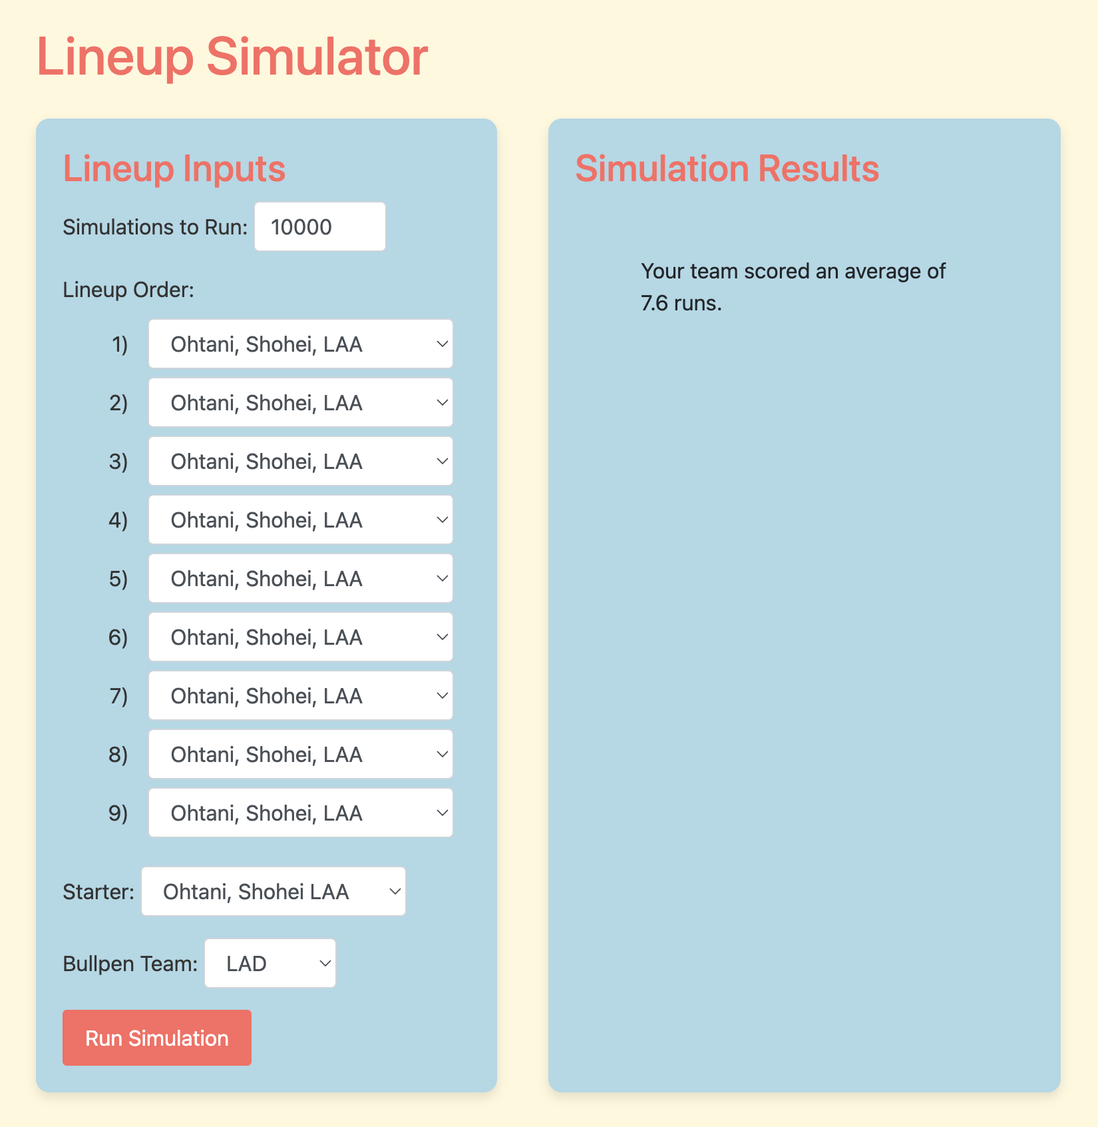
Thank You!
Email:
Reece Calvin:
calvin.r@northeastern.edu
Your team scored an average of 7.6 runs.
Email:
Reece Calvin: calvin.r@northeastern.edu
Notes:
Now, with all of that out of the way, here are my Shohei Ohtani results and does anyone have questions?
With that, thank you for giving me your time and feel free to reach out over email

