Slide 1
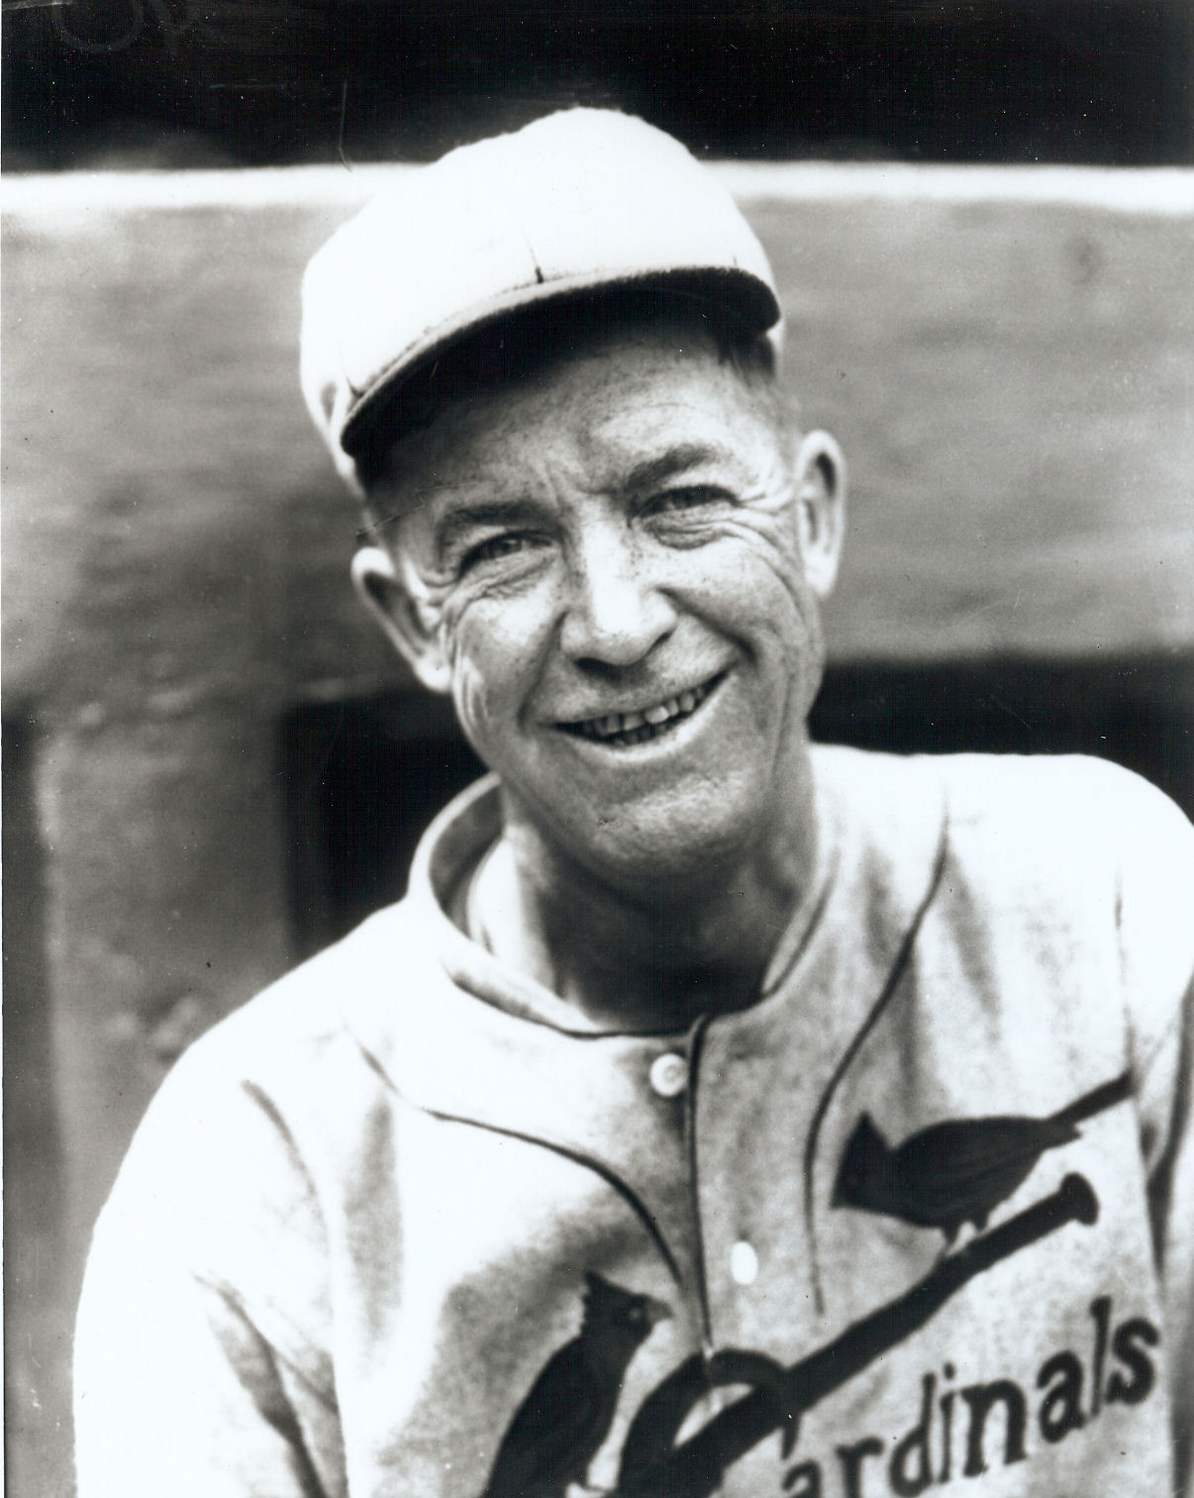
Heroes, Goats, and Myths: 1926 World Series, Game Seven
Presented by Steve Steinberg
SABR 47, New York City
June 29, 2017
Allied Photocolor

Slide 2
Dennis Goldstein Collection
“Above all the crowd found the main melodrama in
the ancient right arm of an old-time pitcher marvel
who figured in his third triumph. … They [the fans]
were all for the pitcher who was still defying the
beckoning finger of Time as he moved upon his
winning way. The Chicago discard of two months
ago had suddenly become the crowning figure in
baseball’s greatest drama, and he had even the
Yankee crowd openly and loudly exulting in his
third and final triumph.”
Grantland Rice, New York Herald Tribune

Slide 3
Steve Steinberg Collection
Waite Hoyt
Final Game, 1921 World Series:
1—0 loss on unearned run
Final Game, 1926 World Series:
Again gave up NO earned runs.
Again tagged with the loss.
“Hoyt pitched like a master, perhaps
the best game of his career, but luck
was against him.”
Richards Vidmer, New York Times

Slide 4
Cleveland Public Library Photograph Collection
“The Red Birds of Hornsby are
champions today because they
skillfully dodged the issue to the big
hitter. Then are the ducking champions
of 1926, and these tactics in pitching
to him only makes him look the
bigger.”
George Daley, New York World

Slide 5
Grantland Rice, New York Herald Tribune
“It was through an open breach in the left wing of the Yankee defense,
through a complete cave-in of the Yankee levee where Mark Koenig
and Bob Meusel both crashed together . . .”

Slide 6
Dennis Goldstein Collection
“I couldn’t get the damned ball out of my
mitt.” Koenig bemoaned his small hands
and added, “I was never the player I
should have been. I was too hard on
myself.”
Mark Koenig

Slide 7
Steve Steinberg Collection
“Koenig’s fumble was a crusher but his
interference with Meusel on Hafey’s fly on the
next play was a worse blunder. Meusel could
have caught the ball, but Koenig bluffed him
away, and the ball dropped for a bogus
single.”
Sid Mercer, New York Evening Journal

Slide 8
Steve Steinberg Collection
“The white pill hit his outstretched hands
and popped out again like the rabbit from
the magician’s hat. … There is only one
explanation for Meusel’s muff. He tried to
throw the ball before he got it and thereby
made himself the greatest world’s series
‘goat’ since Fred Snodgrass of Giant
fame.”
James Harrison, New York Times

Slide 9
Steve Steinberg Collection

Slide 10
Steve Steinberg Collection

Slide 11
Cleveland Public Library Photograph Collection
“A lot will be written about that
error, no doubt—and perhaps
Mark will be elected to that select
society of baseball ‘goats’ whose
names have been inscribed in
mud paneling in many other
world series. Somehow the term
‘$50,000 bobble’ has an
appealing sort of sound to those
who dally with pretty phrasing.”
Ford Frick, New York Evening Journal

Slide 12
Steve Steinberg Collection
“Some of the fans properly may believe
that Bob Meusel’s miss of a fly ball
later in the inning was more disastrous
than Koenig’s error, but Meusel is an
easy-going ball player, while Koenig
feels things deeply. It was his
conviction that he alone was
responsible for the Cardinals’ victory.”
Sporting News, “Scribbled by Scribes”

Slide 13
Aimee Alexander and Ronald Reagan
Ballplayers who appeared in the 1952 movie included Bob Lemon, Gene Mauch, and Hank Sauer.

Slide 14
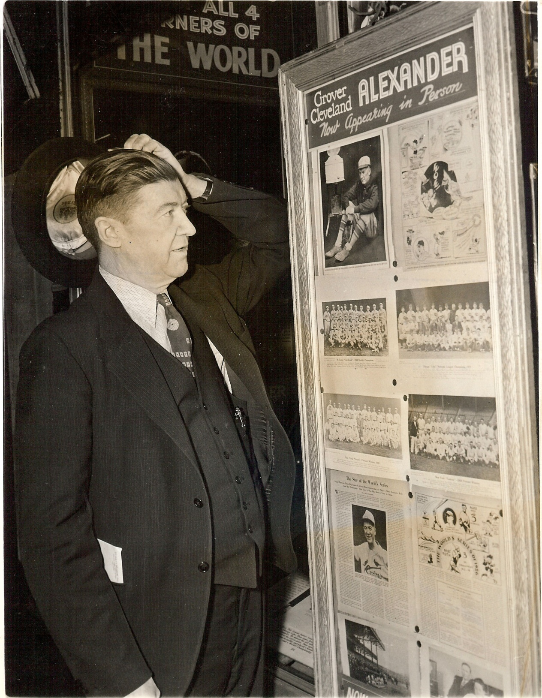
Steve Steinberg Collection Times Square, New York City: The Legend Lives On Steve Steinberg Collection

Slide 15
Cleveland Public Library Photograph Collection
“Now, for fifty years, that ball has
been traveling. It has been foul
anywhere from an inch to twenty
feet, depending on who you are
listening to or what you’re
reading. But I was standing on
third base, and I’ll tell you—it was
foul all the way. All the way.”
Les Bell, Cardinals Third Baseman

Slide 16
Steve Steinberg Collection
“There isn’t a night goes by but
what some guy leans across
the bar, or comes up behind
me at a table in this joint, and
brings up the old question.
Never a night.”
Tony Lazzeri

Slide 17
Alexander and mother, St. Paul, Nebraska, October 1926 Steve Steinberg Collection
“You weren’t doing Alex any favor by
buying him a drink, because he just
couldn’t stop. … So in the seventh
inning of the seventh game, Alex is
tight asleep in the bullpen, sleeping off
the night before when trouble comes.”
Bob O’Farrell, Cardinals Catcher
Alexander had “a nice drink of
stimulant in the bullpen before being
called that day.”
Bozeman Bulger, New York Evening World

Slide 18
Urban Archives, Walter P. Reuther Library, Wayne State University
“Babe the Mighty went down
fighting. Alone he fought the
overwhelming tide of defeat and
single handed he came within
inches of pushing it back. … At
bat he reached first base five
times again. … A moment later
he tried to steal and failed, out
gloriously but nevertheless out
for a series that has marked his
brilliance as it never had been
marked before.”
Norman W. Baxter, Washington Post

Slide 19
Washington Post, October 11, 1926
“The world’s series worked
itself down to four short words:
Koenig’s fumble, Meusel’s
muff. … Everything was
incidental to those two errors.
… If Meusel and Koenig had
held onto the ball, Alex would
have been merely a gallant,
old pitcher on a losing ball
team. Fate made a hero of
Alexander and a victim of
Hoyt.”
James R. Harrison, New York Times

Slide 20
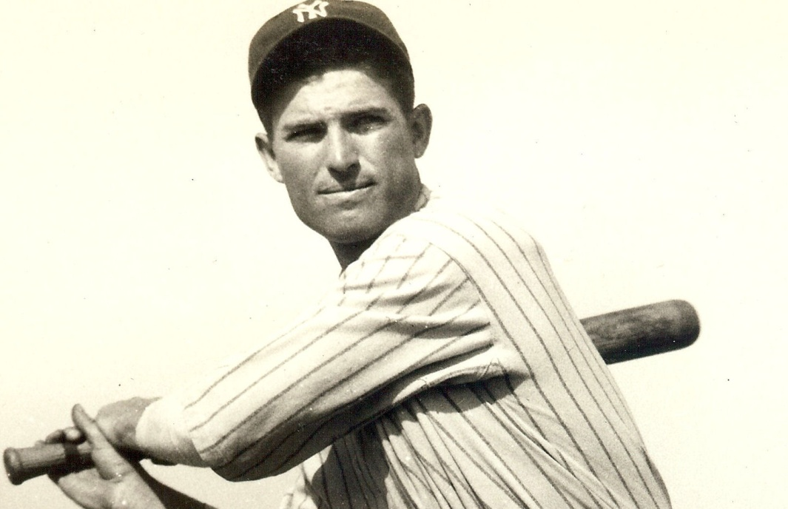
Steve Steinberg Collection Michael Mumby Collection
“Perhaps it will not last so long
because of the brightness of the
crown that Alexander wears. …Time
had taught him that all men are but
mortal and nothing to be feared. He
is, moreover, an artist, with none of
the tight-drawn nerves nor
temperament that genius often
brings.”
Norman W. Baxter, Washington Post

Slide 21
Bob Meusel Obit, Nov. 30, 1977 Mark Koenig, April 25, 1993

