Slide 1
Regression Based Approach
for Predicting Ground Reaction Forces
in Pitching
Tim Niiler, PhD, Ari Gordon, BA,
Rob Hulbert, MS, Scott Coleman, MS
March 8, 2024
01

Slide 2
Background
Why Predict GRFs?
02

Slide 3
Background
03

Slide 4
Background
Take-aways:
6 collegiate RHPs
High correlations between maximum linear wrist velocities and peak GRFs
Force | r²
Rear A/P | 0.82
Rear Vert | 0.74
Front A/P | 0.86
Front Vert | 0.70
04

Slide 5
Background
More recent work:
* Peak drive leg AP forces are significantly correlated with throwing velocity
Kageyama et al., 2014, McNally et al., 2015, Wasserberger et al., 2023
*Drive leg M/L forces are a significant predictor of external rotation torque in the throwing shoulder and may have implications regarding injury risk
Nicholson et al., 2019
05

Slide 6
Motivation
In season, a large proportion of pitches are thrown in-game and GRFs from these are not generally being measured.
Not all teams have labs with force plates and using kinematic data to predict forces can help:
1) Assess injury risk
2) Accelerate player development
06

Slide 7
Modeling
Strategy
1
Model every frame
Instead of modeling time series via short-cuts like shape fitting or FFT models, frame-by-frame modeling allows for more nuance in results
07

Slide 8
Modeling
Strategy
1
Model every frame
Instead of modeling time series via short-cuts like shape fitting or FFT models, frame-by-frame modeling allows for more nuance in results
2
Use regression
While neural networks have their draw, often they function as black boxes and it can be difficult to do anything other than predict – standardized regression variables can tell us which variables are most important
08

Slide 9
Modeling
Strategy
1
Model every frame
3
Avoid overfitting
Instead of modeling time series via short-cuts like shape fitting or FFT models, frame-by-frame modeling allows for more nuance in results
Use strategies including k-means cross-validation, kernel density weighting, and AIC to keep models generalizable
2
Use regression
While neural networks have their draw, often they function as black boxes and it can be difficult to do anything other than predict – standardized regression variables can tell us which variables are most important
09

Slide 10
Modeling
Strategy
1
Model every frame
3
Avoid overfitting
Instead of modeling time series via short-cuts like shape fitting or FFT models, frame-by-frame modeling allows for more nuance in results
Use strategies including k-means cross-validation, kernel density weighting, and AIC to keep models generalizable
2
Use regression
4
Fill the data subspace
While neural networks have their draw, often they function as black boxes and it can be difficult to do anything other than predict – standardized regression variables can tell us which variables are most important
Get as many examples as possible of as many pitchers and pitches so that the models have “seen” similar data and are mostly interpolating rather than extrapolating.
10

Slide 11
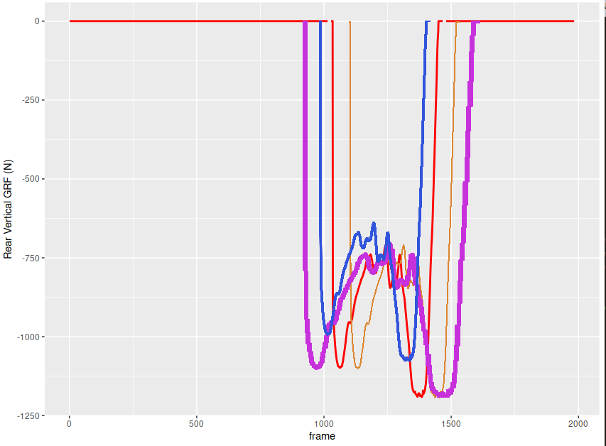
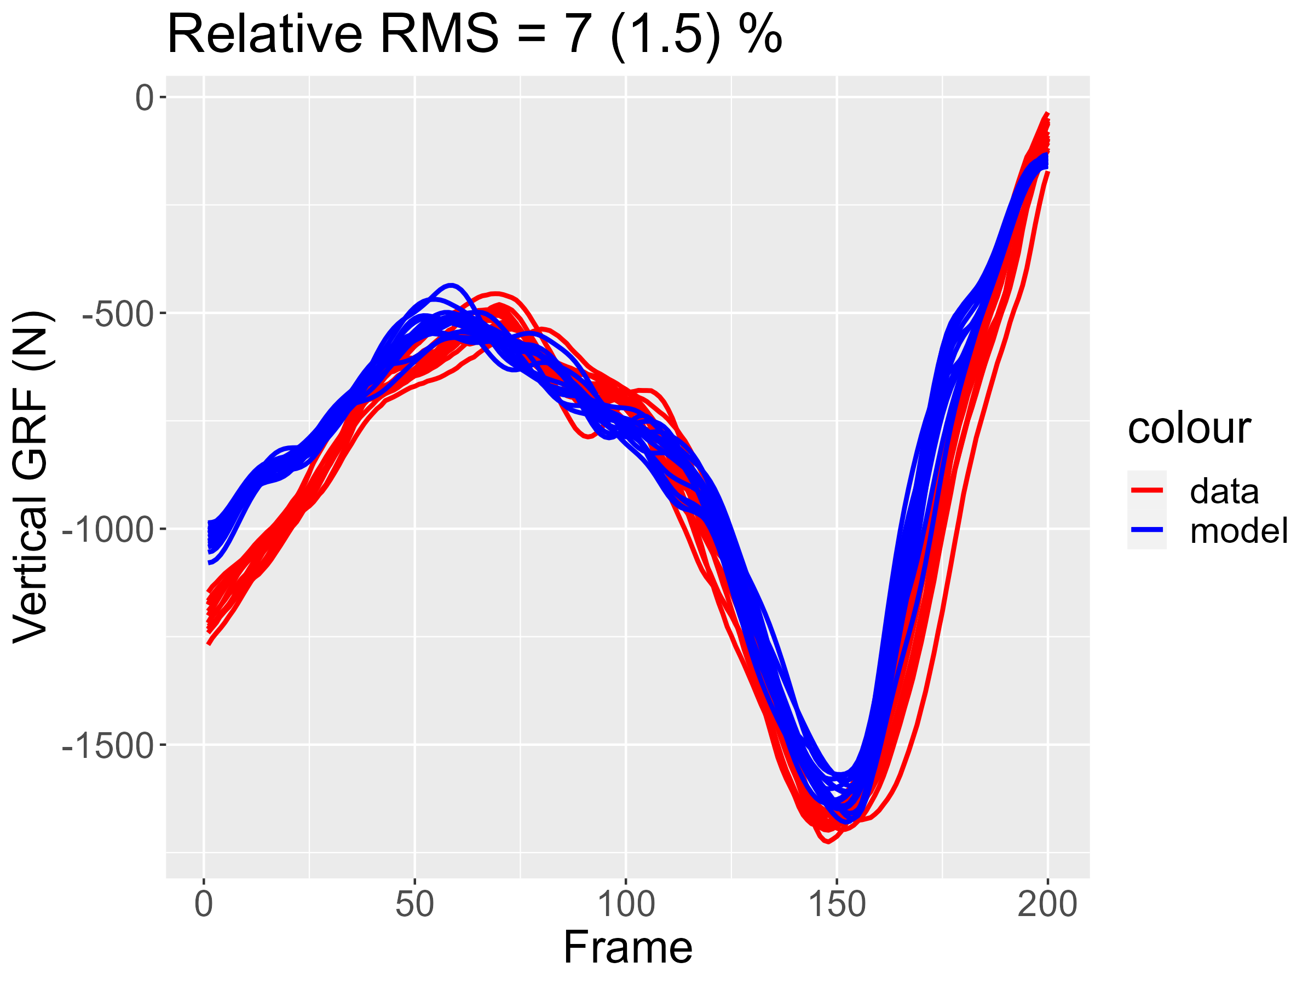
Modeling
Strategy
Density
Weighting
Data
Registration
PREDICTION
k-fold CV
AIC
Avoiding Overfitting
11

Slide 12
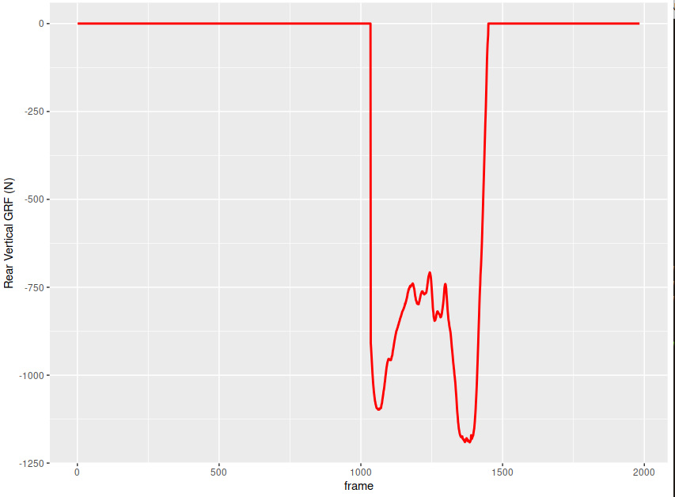
Methods
Data registration
Data
Registration
Rear Vertical Ground Reaction Force (single pitch)
12

Slide 13
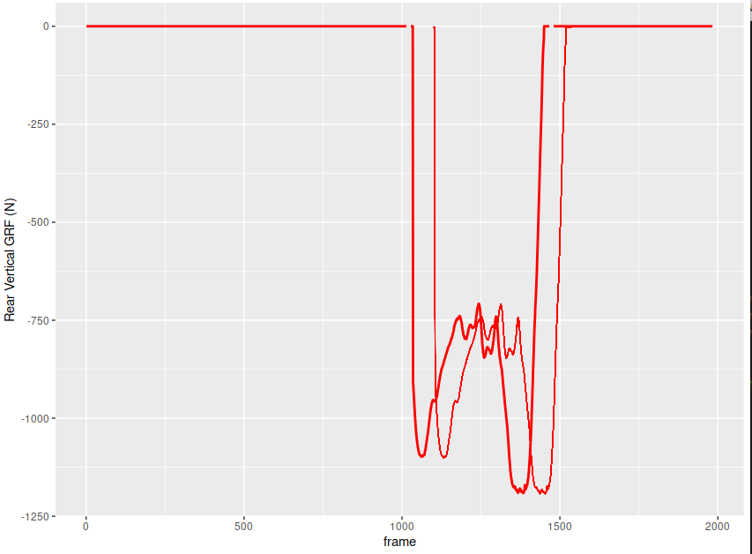
Methods
Data registration
Data
Registration
With multiple pitches, data may be time shifted
13

Slide 14
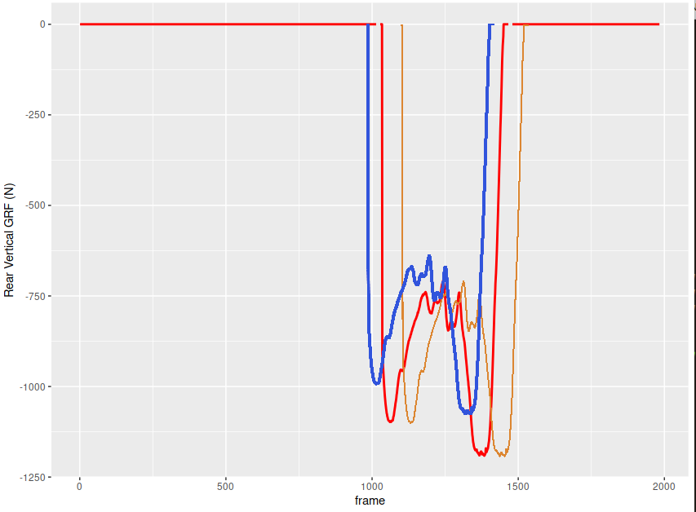
Methods
Data registration
Data
Registration
With multiple pitches, data may be time shifted
-or not of the same magnitude AND shifted
14

Slide 15
Methods
Data registration
Data
Registration
With multiple pitches, data may be time shifted
-or not of the same magnitude AND shifted
-or stretched out and shifted.
How to predict such variation?
15

Slide 16
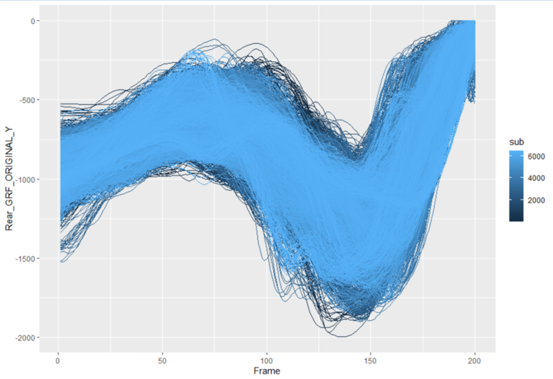
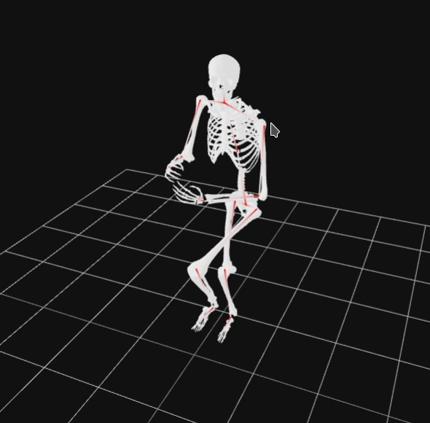
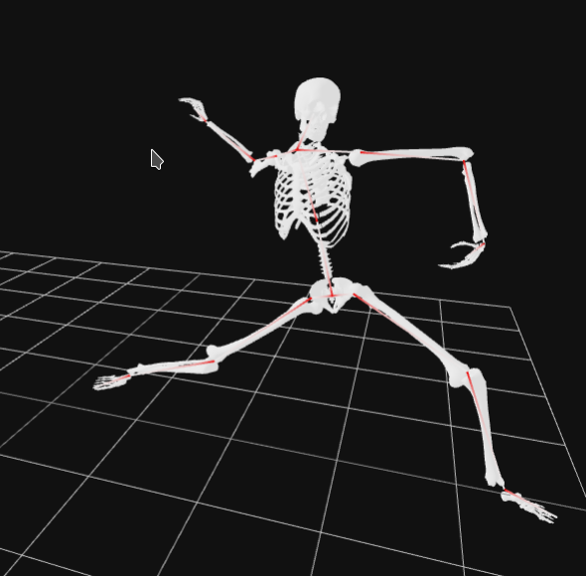
Methods
Data registration – REAR FP
Data
Registration
Cut from where front foot COM crosses rear leg shank COM vertically
… To toe off using a kinematic criterion – when the toe has moved a certain minimum distance vertically and forward from the rubber
16

Slide 17
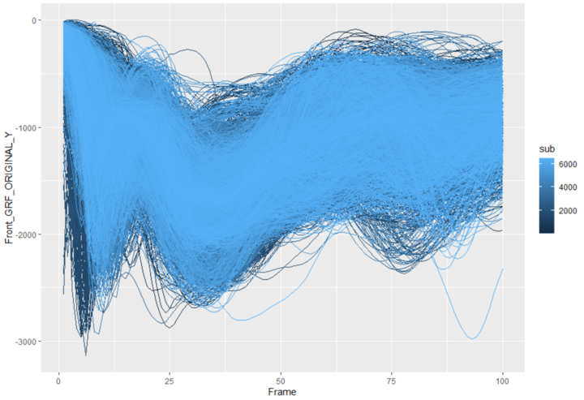
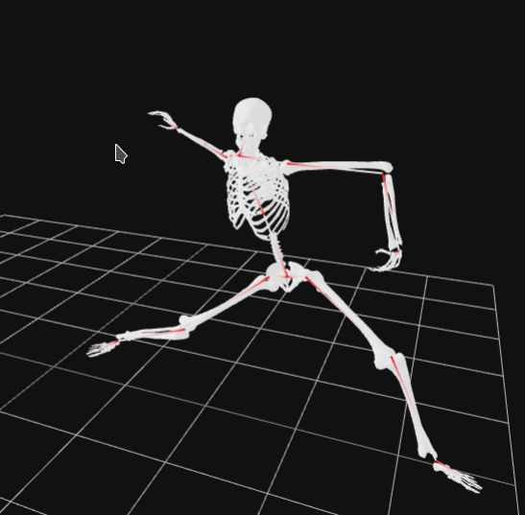
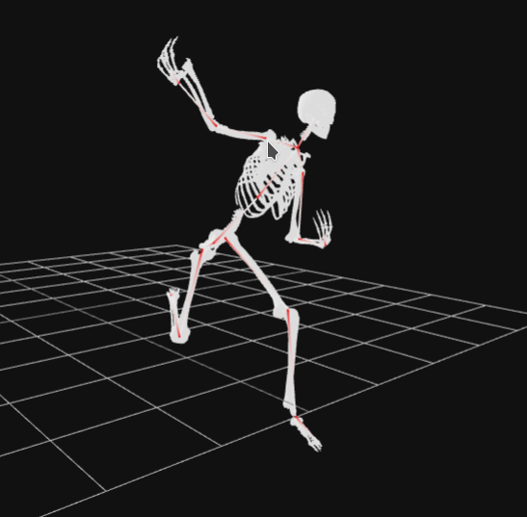
Methods
Data registration – Front FP
Data
Registration
Cut from where kinematically determined foot contact on front force plate
… To 65 frames past release
17

Slide 18
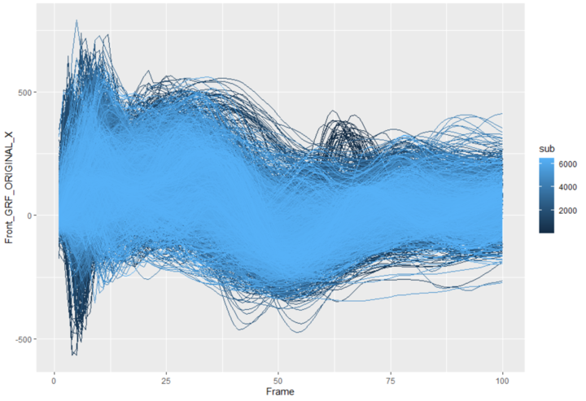
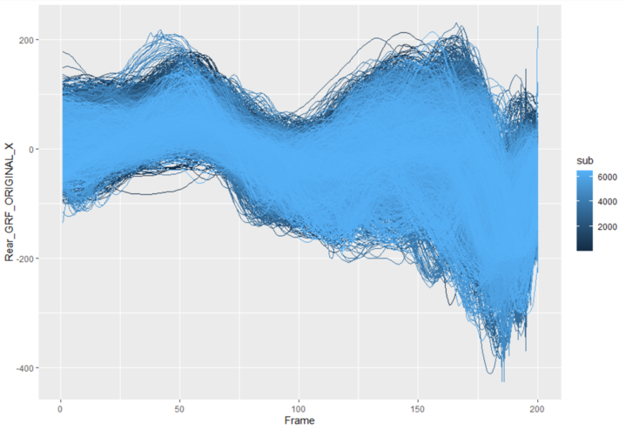
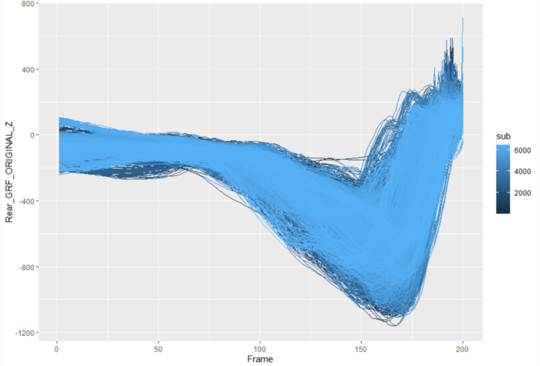
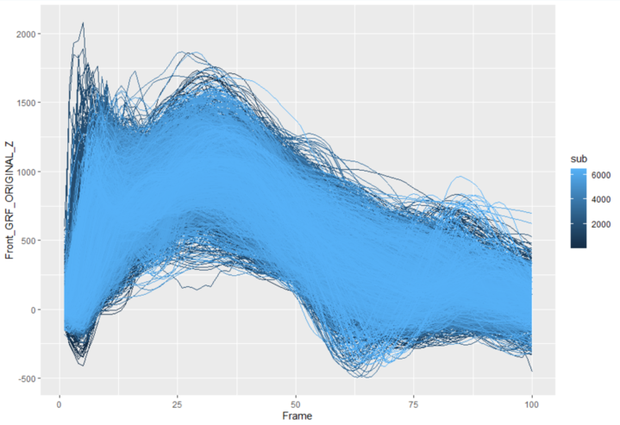
Methods
6488 individual pitches!
Data
Registration
Front M/L
Rear M/L
Rear Vert
Front Vert
Rear A/P
Front A/P
Rear A/P
18

Slide 19
Data
Used
6488
201
4
76.1%
Pitches
Pitchers
Labs
%RHP
19

Slide 20
Methods
Density Weighting
Regression type models are better at modeling data they see more frequently.
How to deal with outliers (real data) to give them a fighting chance?
Remember, each frame of data has its own model
Density
Weighting
20

Slide 21
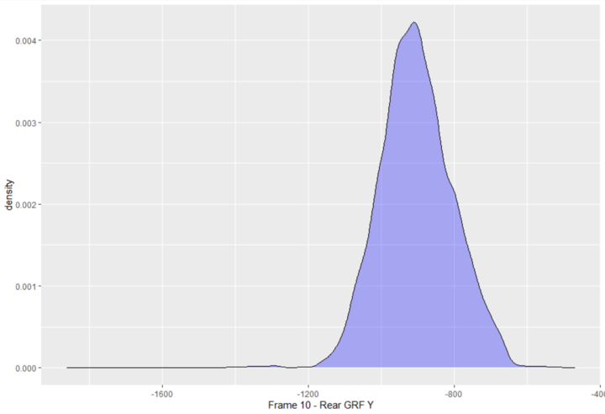
Methods
Density Weighting
Frame 10
Density
Weighting
21

Slide 22
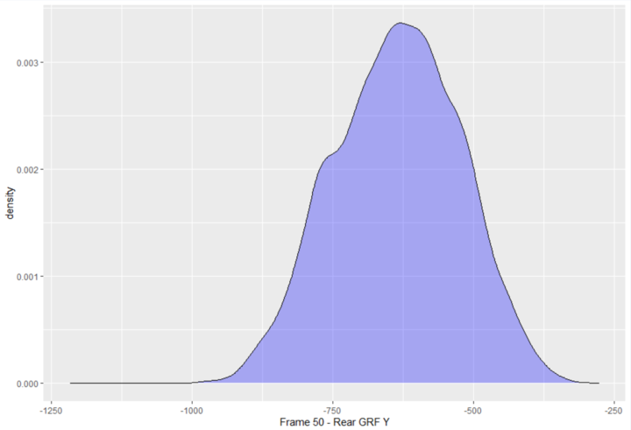
Methods
Density Weighting
Frame 10
Frame 50
Density
Weighting
22

Slide 23
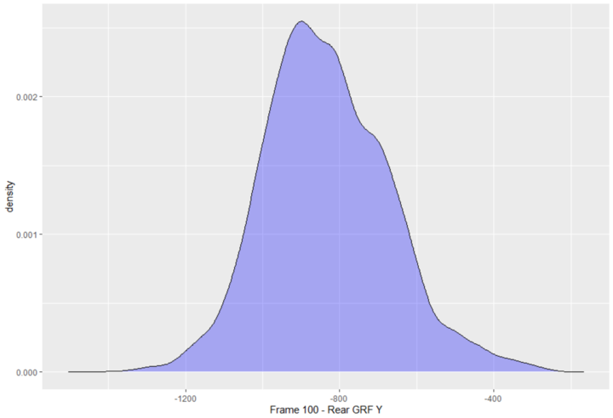
Methods
Density Weighting
Frame 10
Frame 50
Frame 100
Density
Weighting
23

Slide 24
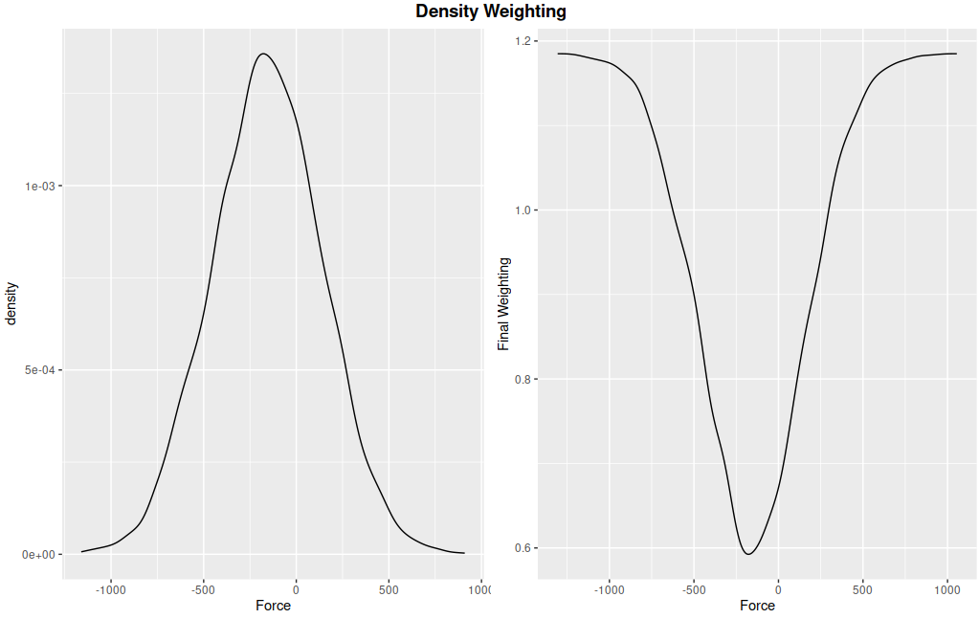
Methods
Density Weighting
Regression type models are better at modeling data they see more frequently.
How to deal with outliers (real data) to give them a fighting chance?
For each frame of data we use an inverse function of the density to create a weighting for each pitch so that pitches with less common patterns of GRFs get more weight in the model.
Density
Weighting
24

Slide 25
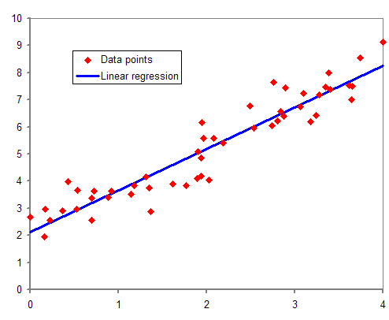
Methods
Basic Regression
Given independent data x
and dependent data y
Try to find slope (m) and intercept (b).
y
$$y=mx+b$$
AIC
x
https://en.wikipedia.org/wiki/Regression_analysis#/media/File:Normdist_regression.png
25

Slide 26
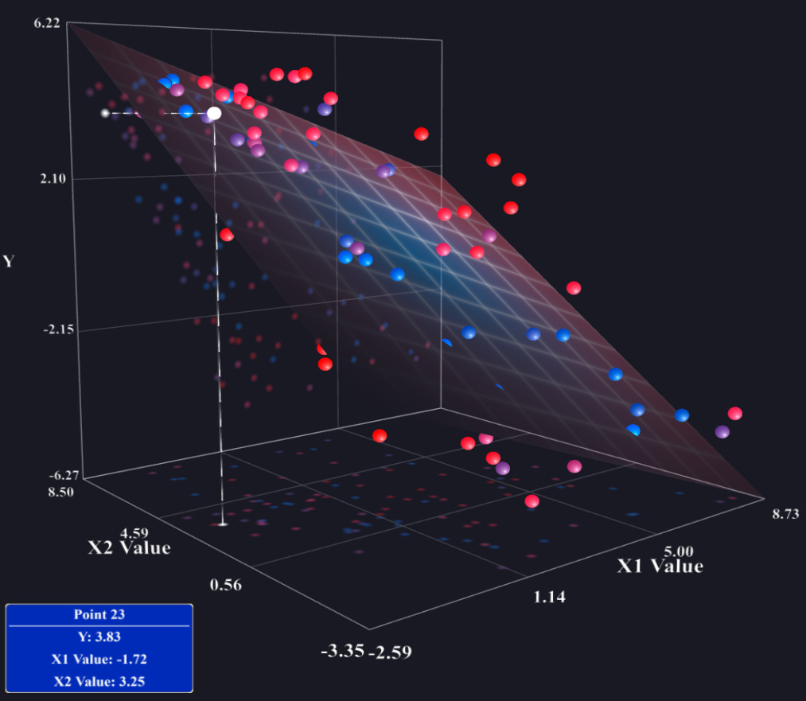
Methods
Multiple Regression
$$y={Ax}_{1}+{Bx}_{2}+C$$
Given independent data x1 and x2
and dependent data y
Try to find coefficients of fit
A, B, and C
AIC
26
https://stats.stackexchange.com/q/82396

Slide 27
Methods
Multiple Regression with > 2 ind vars
Given independent data xi
and dependent data y
Try to find coefficients of fit
A, B, C, … Z
$$y={Ax}_{1}+{Bx}_{2}+{Cx}_{3}+⋯+{Zx}_{N}$$
AIC
27

Slide 28
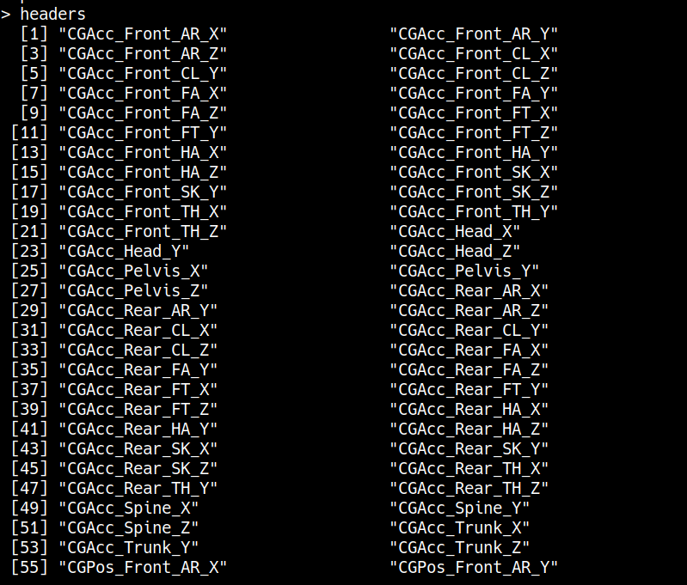
Methods
AIC Regression
$$y={Ax}_{1}+{Bx}_{2}+{Cx}_{3}+⋯+{Zx}_{N}$$
We have MANY more variables which could go into the model
Per Force Plate and Direction
18 – COM Accelerations
18 – COM Velocities
18 – COM Positions
AIC
28

Slide 29
Methods
AIC Regression
$$y={Ax}_{1}+{Bx}_{2}+{Cx}_{3}+⋯+{Zx}_{N}$$
AIC uses maximum likelihood estimate deleting variables to select a final model which explains the greatest variability in the y-variable using the fewest x-variables.
Per Force Plate and Direction
18 – COM Accelerations → 13 ?
18 – COM Velocities → 10 ?
18 – COM Positions → 12 ?
AIC
29

Slide 30
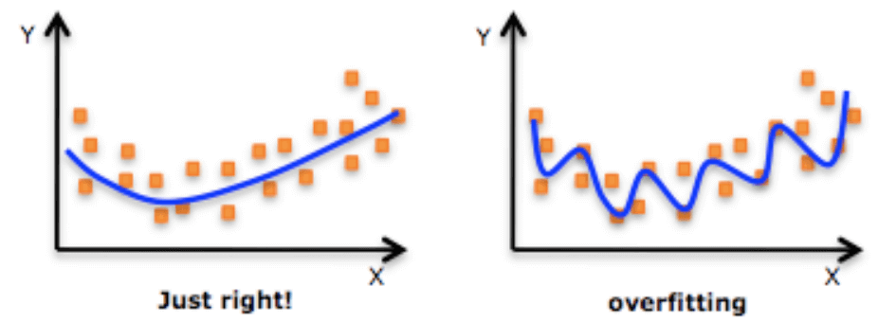
Methods
AIC Regression
$$y={Ax}_{1}+{Bx}_{2}+{Cx}_{3}+⋯+{Zx}_{N}$$
Ultimately used to avoid overfitting
AIC
https://www.datarobot.com/wiki/overfitting/
30

Slide 31
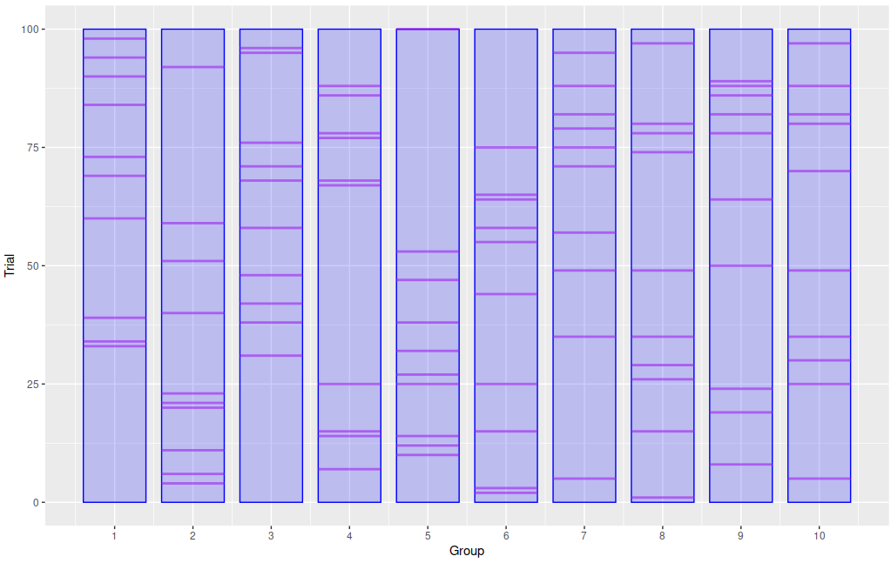
Methods
k-fold CV
Split data into 10 groups 648 pitches per group.
Train data on 9 out of those 10 groups, then test on the one that was left out.
Rise-wash-repeat 9 more times.
This gives a sense of error on data that was not used in training.
However, such data is from the same pitchers...
k-fold CV
31

Slide 32
Methods
k-fold CV
$$y_{1}=A_{1}x_{1}+B_{1}x_{2}+C_{1}x_{3}+⋯+Z_{1}x_{N}$$
Each group will have its own model which may have different variables due to AIC. (Generally few, if any, variables changed between folds).
Average model coefficients using weighted averages
Final model will be slightly less accurate even on training data, but should be more generalizable
$$y_{2}=A_{2}x_{1}+B_{2}x_{2}+C_{2}x_{3}+⋯+Z_{2}x_{N}$$
$$⋮$$
$$y_{10}=A_{10}x_{1}+B_{10}x_{2}+C_{10}x_{3}+⋯+Z_{10}x_{N}$$
k-fold CV
32

Slide 33
Methods
Summary: From the lab to in-game GRFs
1
Gather data
Data were gathered from 4 sites with KinaTrax systems in lab settings. Inspect for errors.
33

Slide 34
Methods
Summary: From the lab to in-game GRFs
1
Gather data
Data were gathered from 4 sites with KinaTrax systems in lab settings. Inspect for errors.
2
Condition data
Load data into R
* Cut data to appropriate size -based on kinematics using interpolation (registration)
* Determine front/rear based on handedness
* Flip M/L data for left handers
34

Slide 35
Methods
Summary: From the lab to in-game GRFs
1
Gather data
Data were gathered from 4 sites with KinaTrax systems in lab settings. Inspect for errors.
2
Condition data
Load data into R
* Cut data to appropriate size -based on kinematics using interpolation (registration)
* Determine front/rear based on handedness
* Flip M/L data for left handers
3
Build Models
Use AIC regression with kernel density weighting and k-fold cross-validation
35

Slide 36
Methods
Summary: From the lab to in-game GRFs
1
Gather data
Data were gathered from 4 sites with KinaTrax systems in lab settings. Inspect for errors.
2
Condition data
Load data into R
* Cut data to appropriate size -based on kinematics using interpolation (registration)
* Determine front/rear based on handedness
* Flip M/L data for left handers
4
Validate models
Validation on training set, test set and independent data set
3
Build Models
Use AIC regression with kernel density weighting and k-fold cross-validation
36

Slide 37
Methods
Summary: From the lab to in-game GRFs
1
Gather data
Data were gathered from 4 sites with KinaTrax systems in lab settings. Inspect for errors.
2
Condition data
Load data into R
* Cut data to appropriate size -based on kinematics using interpolation (registration)
* Determine front/rear based on handedness
* Flip M/L data for left handers
4
Validate models
Validation on training set, test set and independent data set
5
3
Build Models
Dugout pipeline
Use AIC regression with kernel density weighting and k-fold cross-validation
Bring ability to predict in-game GRFs into Dugout
37

Slide 38
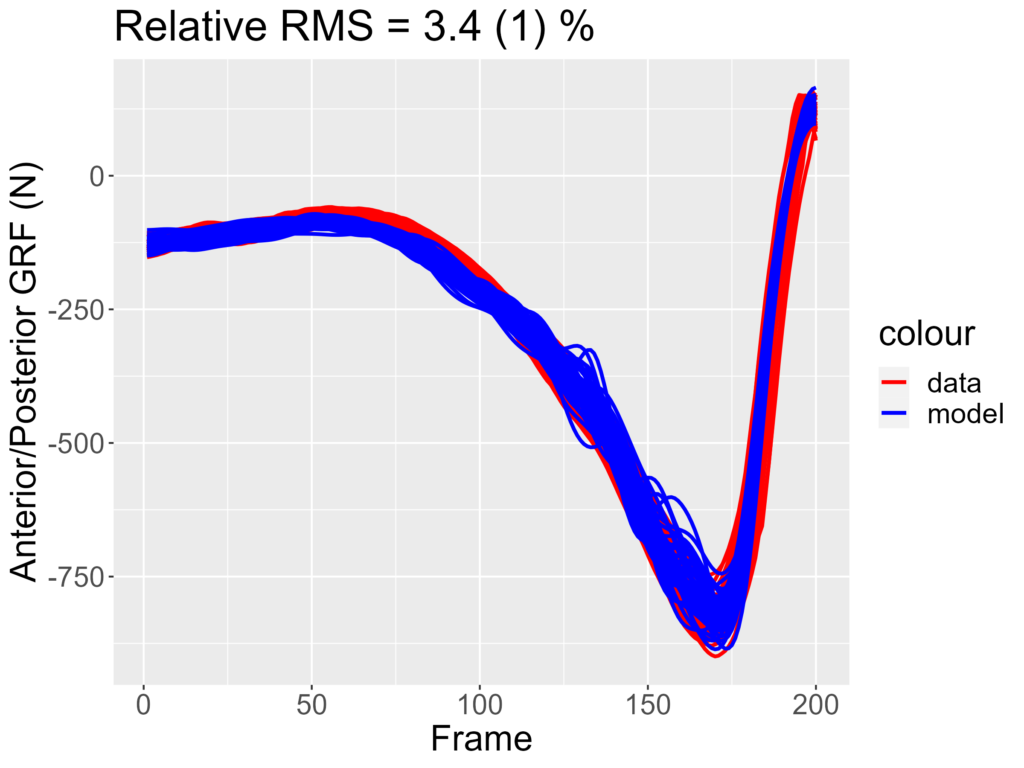
GRF
Results
Results shown in subsequent slides are per pitcher predictions (model) compared with real data from that pitcher
Results near the mean %RMS are shown
However results can be very much better →
38

Slide 39
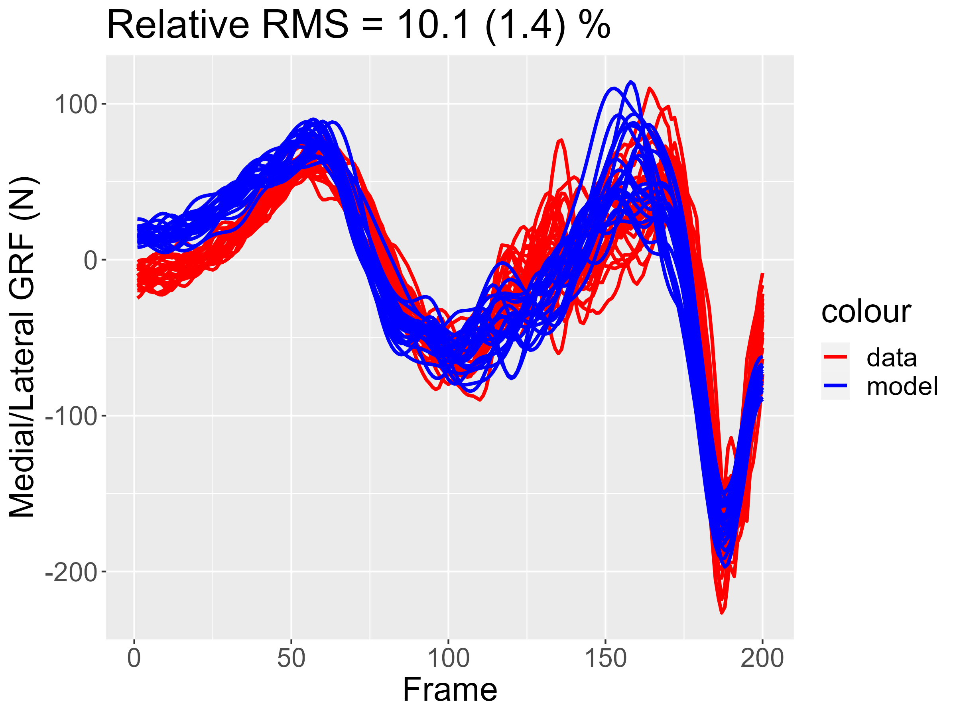
GRF
Results
M/L Rear
 | %RMS
Training | 10.3 ± 3.3
Test | 10.3 ± 3.4
Combined Model | 10.4 ± 4.9
10th %-ile | 6.5
90th %-ile | 15
Mean PPV | 2.1 ± 2.6
39

Slide 40
GRF
Results
Vertical Rear
 | %RMS
Training | 6.8 ± 2.8
Test | 6.9 ± 2.8
Combined Model | 6.9 ± 3.4
10th %-ile | 4.2
90th %-ile | 10.4
Mean PPV | 1.5 ± 2.1
40

Slide 41
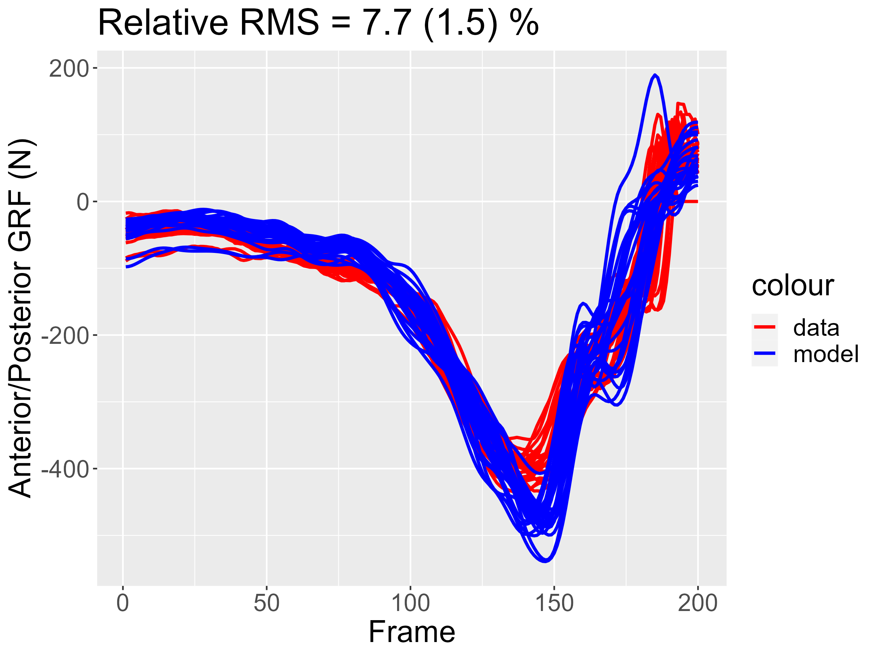
GRF
Results
A/P Rear
 | %RMS
Training | 6.1 ± 3.0
Test | 6.2 ± 3.0
Combined Model | 6.2 ± 6.3
10th %-ile | 3.5
90th %-ile | 9.2
Mean PPV | 1.9 ± 4.7
41

Slide 42
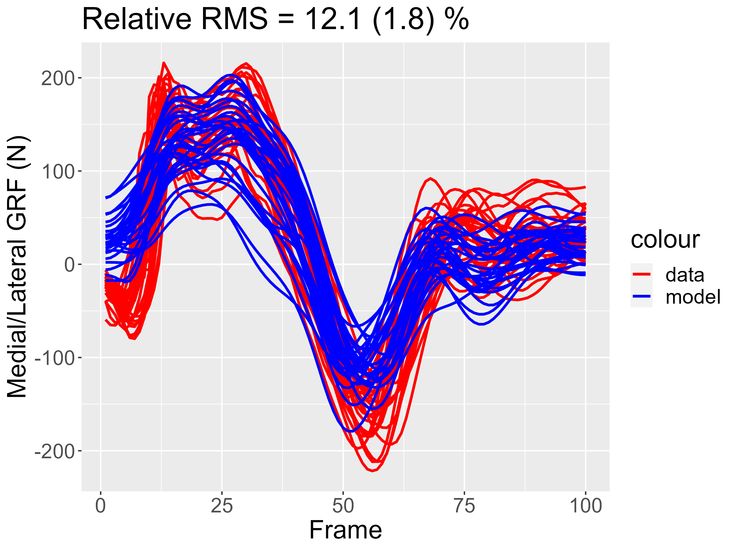
GRF
Results
M/L Front
 | %RMS
Training | 14.8 ± 6.8
Test | 14.9 ± 6.9
Combined Model | 15.1 ± 6.9
10th %-ile | 9.5
90th %-ile | 22.1
Mean PPV | 3.8 ± 3.2
42

Slide 43
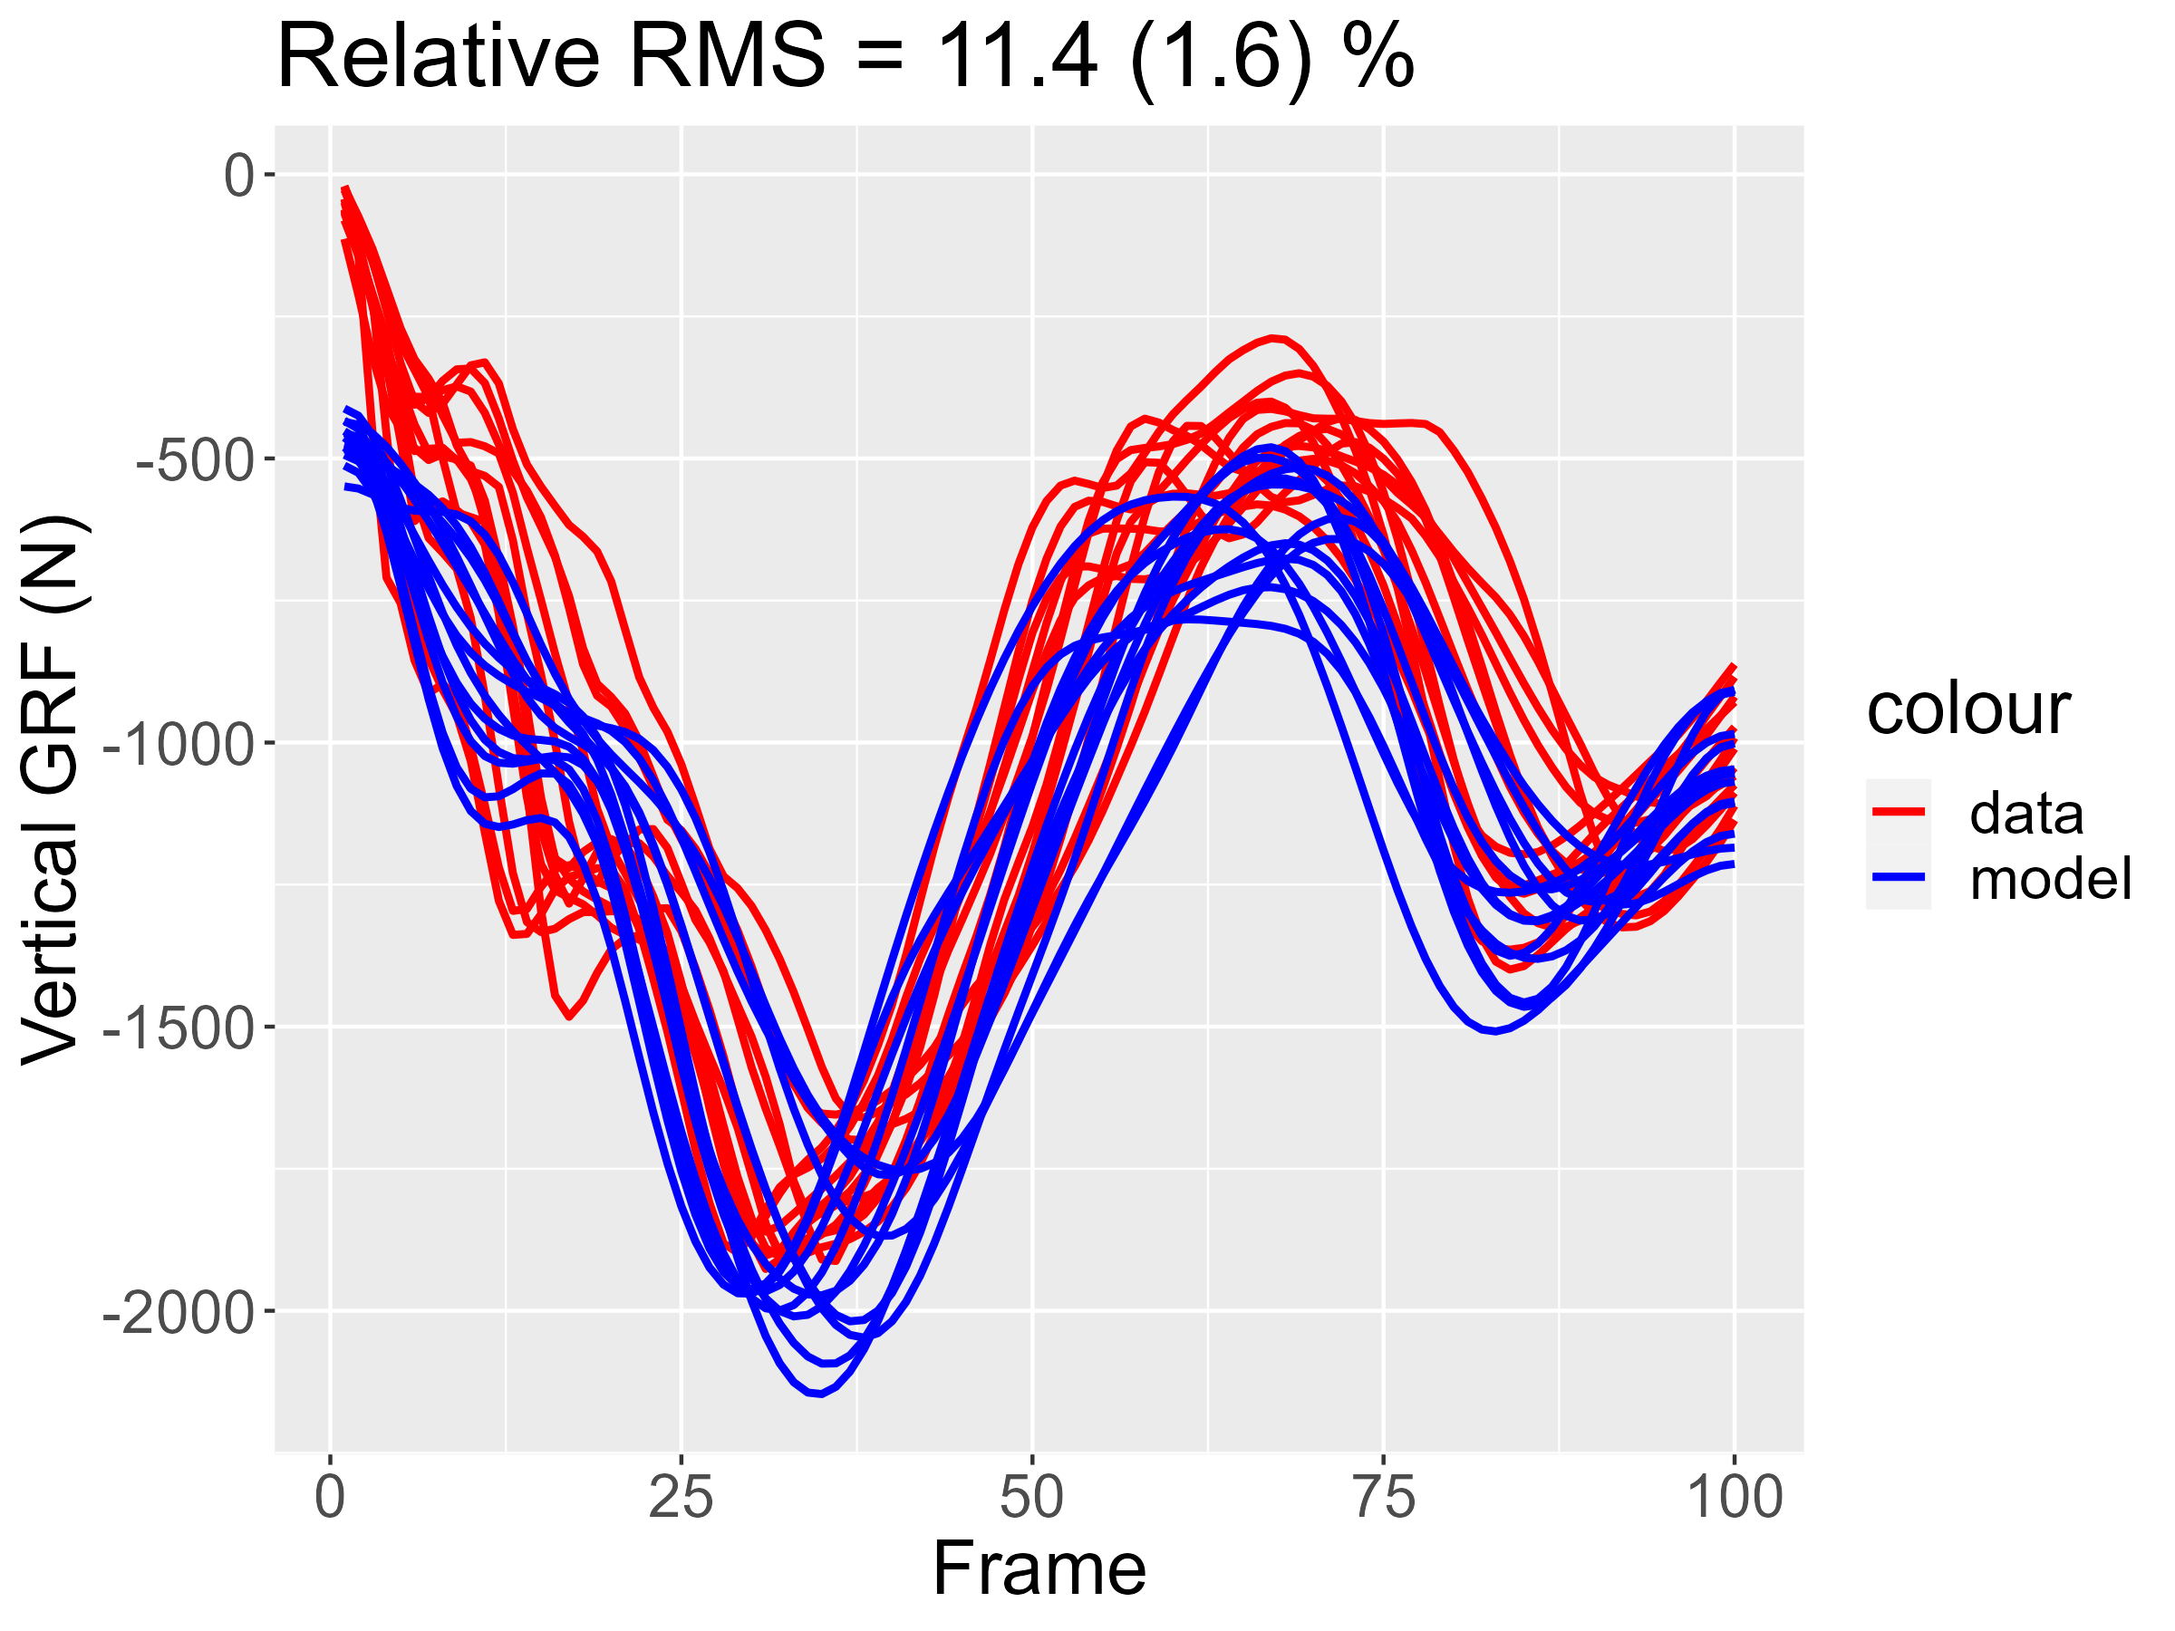
GRF
Results
Vertical Front
 | %RMS
Training | 11.5 ± 5.9
Test | 11.6 ± 6.0
Combined Model | 11.7 ± 6.1
10th %-ile | 7.0
90th %-ile | 16.8
Mean PPV | 2.8 ± 2.5
43

Slide 44
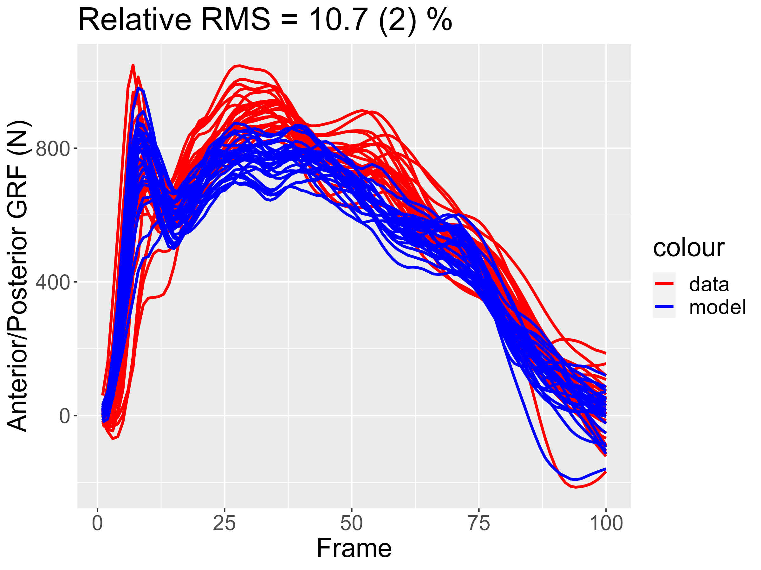
GRF
Results
Vertical Front
 | %RMS
Training | 10.6 ± 5.1
Test | 10.7 ± 5.1
Combined Model | 10.8 ± 5.4
10th %-ile | 6.6
90th %-ile | 15.0
Mean PPV | 2.8 ± 2.9
44

Slide 45
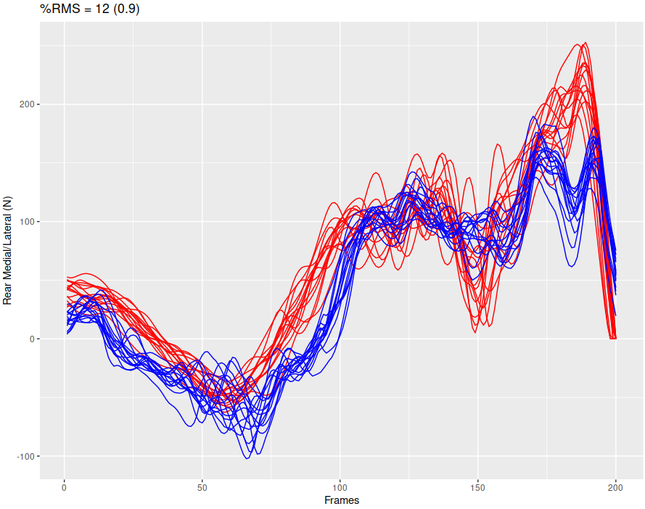
Results
Rear M/L
CV/Training vs Independent
M/L Rear | Independent Data (592) | Training/CV Set (6488)
Combined Model | 11.5 ± 7.1 | 10.4 ± 4.9
10th %-ile | 1.5 | 6.5
90th %-ile | 20.4 | 15
Mean PPV | 2.2 ± 1.2 | 2.1 ± 2.6
45

Slide 46
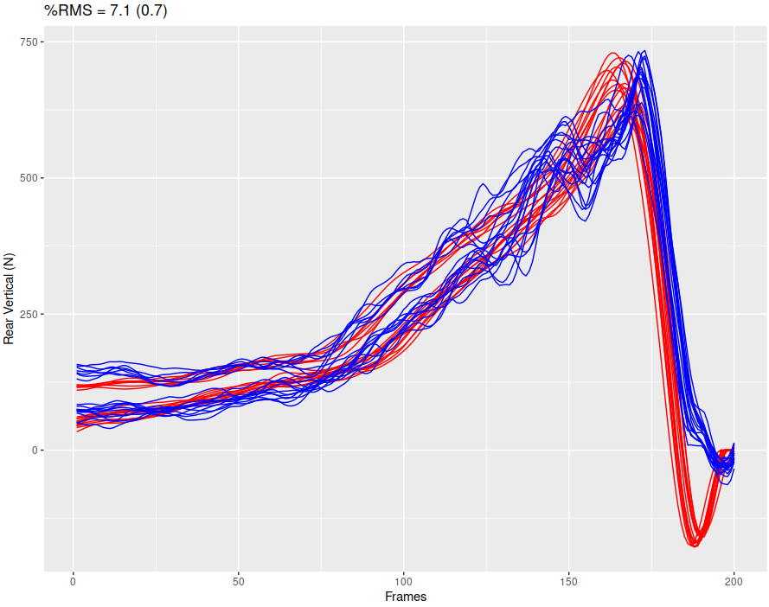
Results
Rear Vertical
CV/Training vs Independent
M/L Rear | Independent Data (592) | Training/CV Set (6488)
Combined Model | 8.2 ± 7.5 | 6.9 ± 3.4
10th %-ile | 1.1 | 4.2
90th %-ile | 13.6 | 10.4
Mean PPV | 1.4 ± 0.6 | 1.5 ± 2.1
46

Slide 47
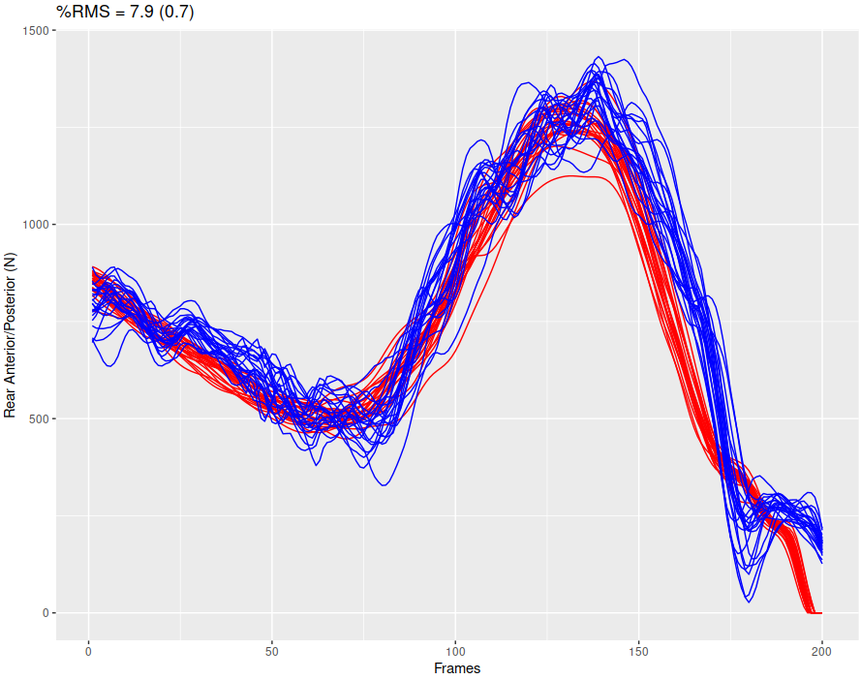
Results
Rear A/P
CV/Training vs Independent
M/L Rear | Independent Data (592) | Training/CV Set (6488)
Combined Model | 10.6 ± 9.5 | 6.2 ± 6.3
10th %-ile | 1.3 | 3.5
90th %-ile | 16.1 | 9.2
Mean PPV | 1.5 ± 0.8 | 1.9 ± 4.7
47

Slide 48
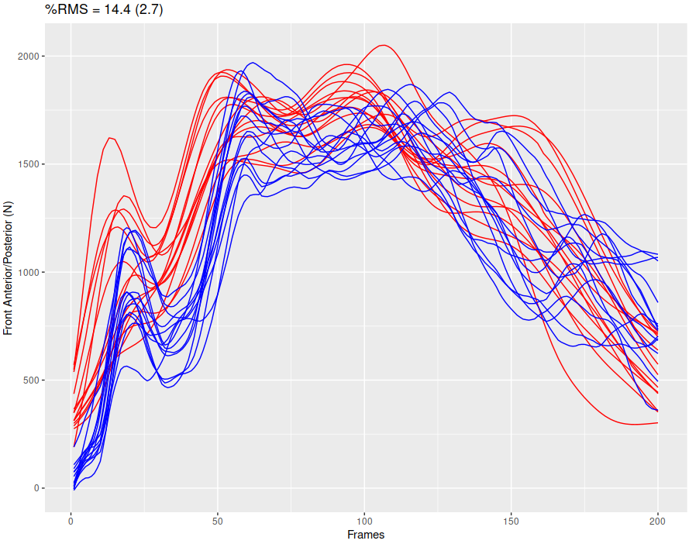
Results
Front M/L
CV/Training vs Independent
M/L Rear | Independent Data (592) | Training/CV Set (6488)
Combined Model | 12.8 ± 9.3 | 15.1 ± 6.
10th %-ile | 2.0 | 9.5
90th %-ile | 21.2 | 22.1
Mean PPV | 2.6 ± 0.9 | 3.8 ± 3.2
48

Slide 49
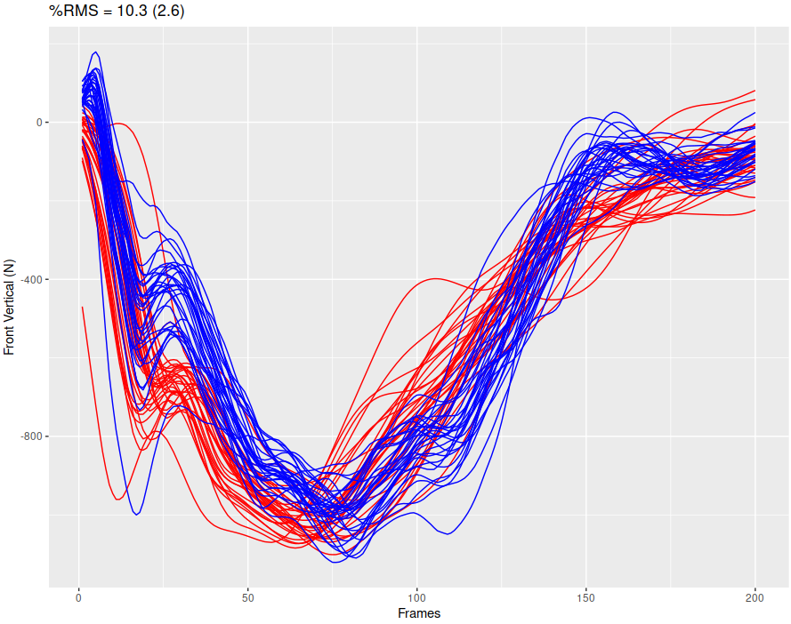
Results
Front Vertical
CV/Training vs Independent
M/L Rear | Independent Data (592) | Training/CV Set (6488)
Combined Model | 12.6 ± 9.7 | 11.7 ± 6.1
10th %-ile | 2.1 | 7.0
90th %-ile | 21.2 | 16.8
Mean PPV | 2.3 ± 0.8 | 2.8 ± 2.5
49

Slide 50
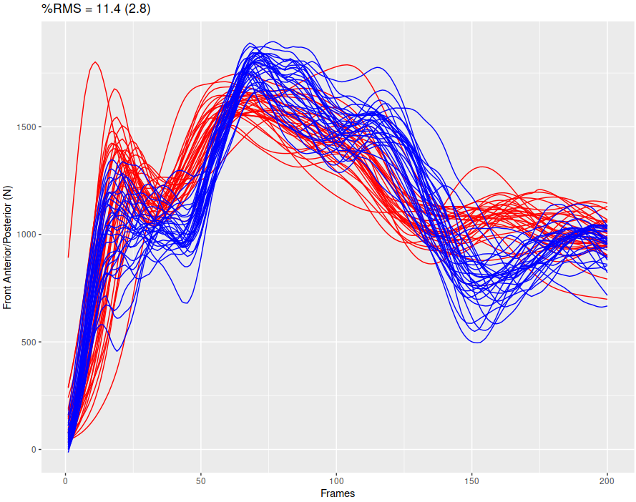
Results
Front A/P
CV/Training vs Independent
M/L Rear | Independent Data (592) | Training/CV Set (6488)
Combined Model | 14.4 ± 9.5 | 10.8 ± 5.4
10th %-ile | 2.3 | 6.6
90th %-ile | 26.1 | 15.0
Mean PPV | 2.7 ± 0.8 | 2.8 ± 2.9
50

Slide 51
Discussion
1
Mean Results
These were within 8-15% in independent data testing, but VERY consistent within each player
51

Slide 52
Discussion
1
Mean Results
These were within 8-15% in independent data testing, but VERY consistent within each player
2
Rear forces were better
Generally, the rear data were less chaotic than the front data. This seemed to have consequences for the model. Front data may be more inconsistent due to the increased variability post release.
52

Slide 53
Discussion
1
Mean Results
3
M/L forces are worse
These were within 8-15% in independent data testing, but VERY consistent within each player
This goes along with the idea that more chaotic data sets lead to worse results.
2
Rear forces were better
Generally, the rear data were less chaotic than the front data. This seemed to have consequences for the model. Front data may be more inconsistent due to the increased variability post release.
53

Slide 54
Discussion
1
Mean Results
3
M/L forces are worse
These were within 8-15% in independent data testing, but VERY consistent within each player
This goes along with the idea that more chaotic data sets lead to worse results.
2
Rear forces were better
4
Where we missed
Generally, the rear data were less chaotic than the front data. This seemed to have consequences for the model. Front data may be more inconsistent due to the increased variability post release.
* Sometimes it was due to a new pattern in data
* Sometimes it was due to incorrectly identified kinematic events.
54

Slide 55
GRF
* Better registration via shape or Procrustes type methods may lead to improvements in our models.
* Identify key 3-4 variables at various pitching phases to determine what most affects GRFs
* Using CART (Classification & Regression Trees) to identify pitch types/styles that need their own models
* BATTING! - it doesn’t get enough love!
FUTURE WORK
55

Slide 56
Thank
YOU
For a whitepaper on this topic, please email me at:
tniiler@kinatrax.com
Tim Niiler
Senior Software Developer
KinaTrax
56

