Slide 1
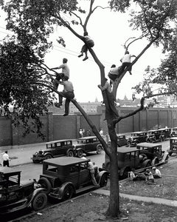
Baseball and Gambling 1935-1950

Slide 2
ATOR’S GAMBLING’S ANNUAL REPORT 1935
TURNOVER
Legal betting at race courses $465,000,000
Horse bets with handbooks 3,132,000,000
Lotteries (including numbers, policy, sports pools 200,000,000
Gambling houses 275,000,000
Slot machines 180.000,000
Pin ball or bagatelle games 195,000,000
“Corn Games,” aka keno, lotto 60,000,000
Dog racing 100,000,000
Commission bets on sports and elections 110,000,000
Sweepstakes (of which 80 percent is crooked) 150,000,000
Petty gambling (dice, nickel-dime games in cigar stores or saloons 150,000,000
Total $5,017,000,000
GROSS INCOME
Legal racetrack gambling $37,660,000
Handbooks 253,690.000
Lotteries 100.000,000
Gambling houses 53,000,000
Slot machines 72,000,000
Pin ball 130,000,000
Keno, etc. 22,000,000
Dog races 20,000,000
Commission betting 6,000,000
Sweepstakes* 12,000,000
Punchboards, etc. 75,000,000
Total $781,350,000
Joseph Ator, “’We Bet 5 Billion’: America on Gambling Spree. Here’s What is Behind It All.” Chicago Tribune, 4 October 1936, F1-1.

Slide 3
