Slide 1
Luke Appling
vs the White Sox
R. J. Lesch
SABR 51
July 7, 2023
Notes:
On August 21, 1967, the Chicago White Sox are tied with the Twins for first place in the American League. The Red Sox and the Tigers are close behind. The White Sox are in pursuit of what would be only their second pennant since 1919. The same day, the tenth-place Kansas City Athletics take the field under their new manager, legendary White Sox shortstop Luke Appling, who took over from the fired Alvin Dark. The ambitions of Appling and his former team collide on September 27 as the White Sox play a doubleheader in Kansas City. The Athletics seem to be merely a speed bump on the way to a possible White Sox flag. Lesch brings together the dramatic 1967 pennant race, the last days of the Athletics sojourn in Kansas City, and the brightest moment in Luke Appling’s sole campaign as a major-league manager.

Slide 2
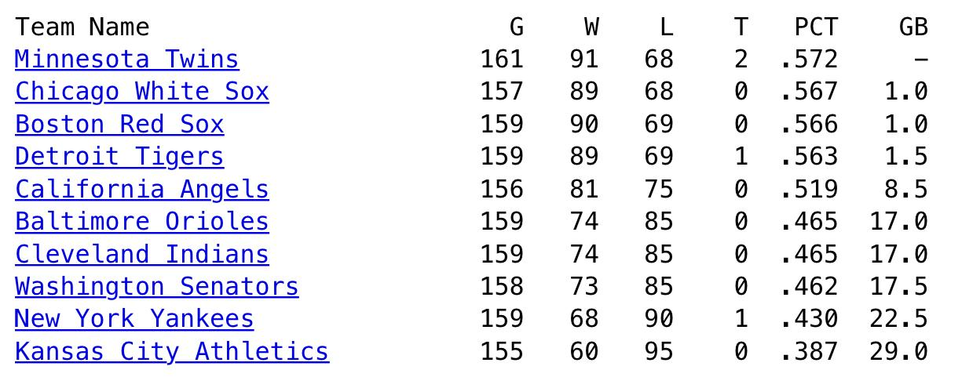
AL standings, morning of September 27, 1967
courtesy Retrosheet

Slide 3
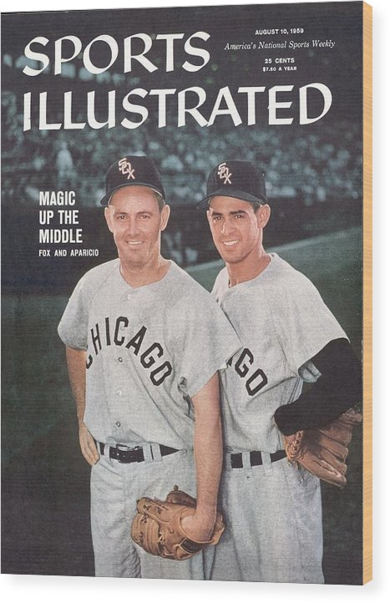
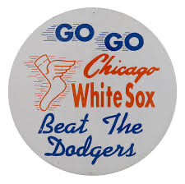
How the Chicago White Sox got here
17 straight years of winning records, going back to 1951
One World Series appearance: 1959
Five second-place finishes: 1957, 1958, 1963, 1964, 1965
Seven 90-win seasons

Slide 4
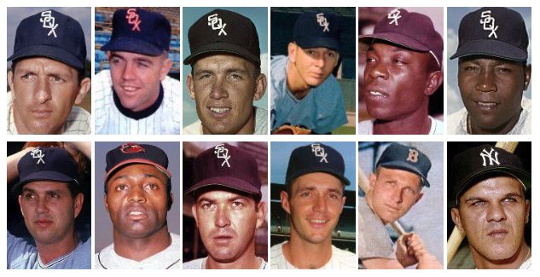
1964: 98-64, second place, one game out
Ron Hansen, ss:
7.7 bWAR
20-68-.261/.347/.419
MVP-16th
Pete Ward, 3b
6.3 bWAR,
23-94-.282/.348/.473
MVP-6th
Gary Peters, p
5.1 bWAR
20-8, 2.50
MVP-7th
Floyd Robinson, of
4.3 bWAR
11-59-.301/.388/.408
MVP-15th
courtesy Baseball Reference

Slide 5
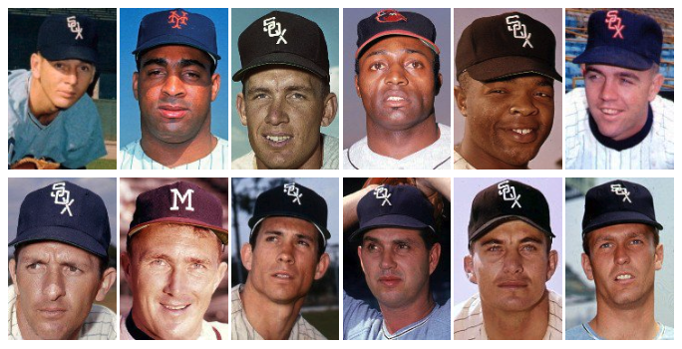
1967: 17th Straight Winning Season
Joe Horlen, p
5.6 bWAR
19-7, 2.06
MVP-4th
Tommie Agee, of
4.6 bWAR
14-52-.234/.302/.371
Gary Peters, p
4.5 bWAR
16-11, 2.28
MVP-9th
Ron Hansen, ss
2.4 bWAR
8-51-.233/.317/.321
MVP-14th
courtesy Baseball Reference

Slide 6
1967: 17th Straight Winning Season
Held 1st place, June 11 through August 12, by as much as 5.5 games (last time on July 1).
The others kept pace, though.
White Sox hitting: 10th in the league in OPS, 9th in OPS+
They got here with pitching
courtesy Baseball Reference

Slide 7
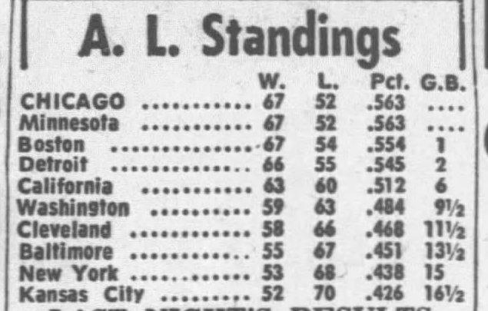
AL standings, morning of August 22, 1967
''Those other teams should be embarrassed.” — Eddie Stanky, August 25

Slide 8
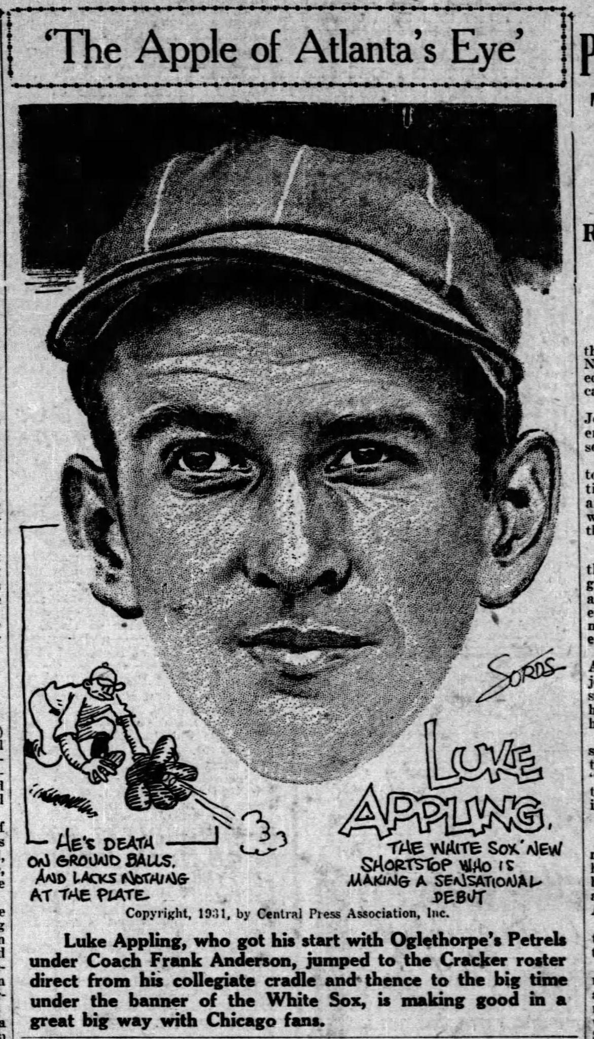
How Luke Appling got here
Played for the White Sox 1930-1950
Only 6 seasons .500 or better: 1936, 1937, 1939, 1940, 1941, 1943
Nearest finish to first: 1940 (4th place, 8.0 games from first place)
Two distant third-place finishes, 1937 and 1941.
Best record: 1937, 86-68

Slide 9
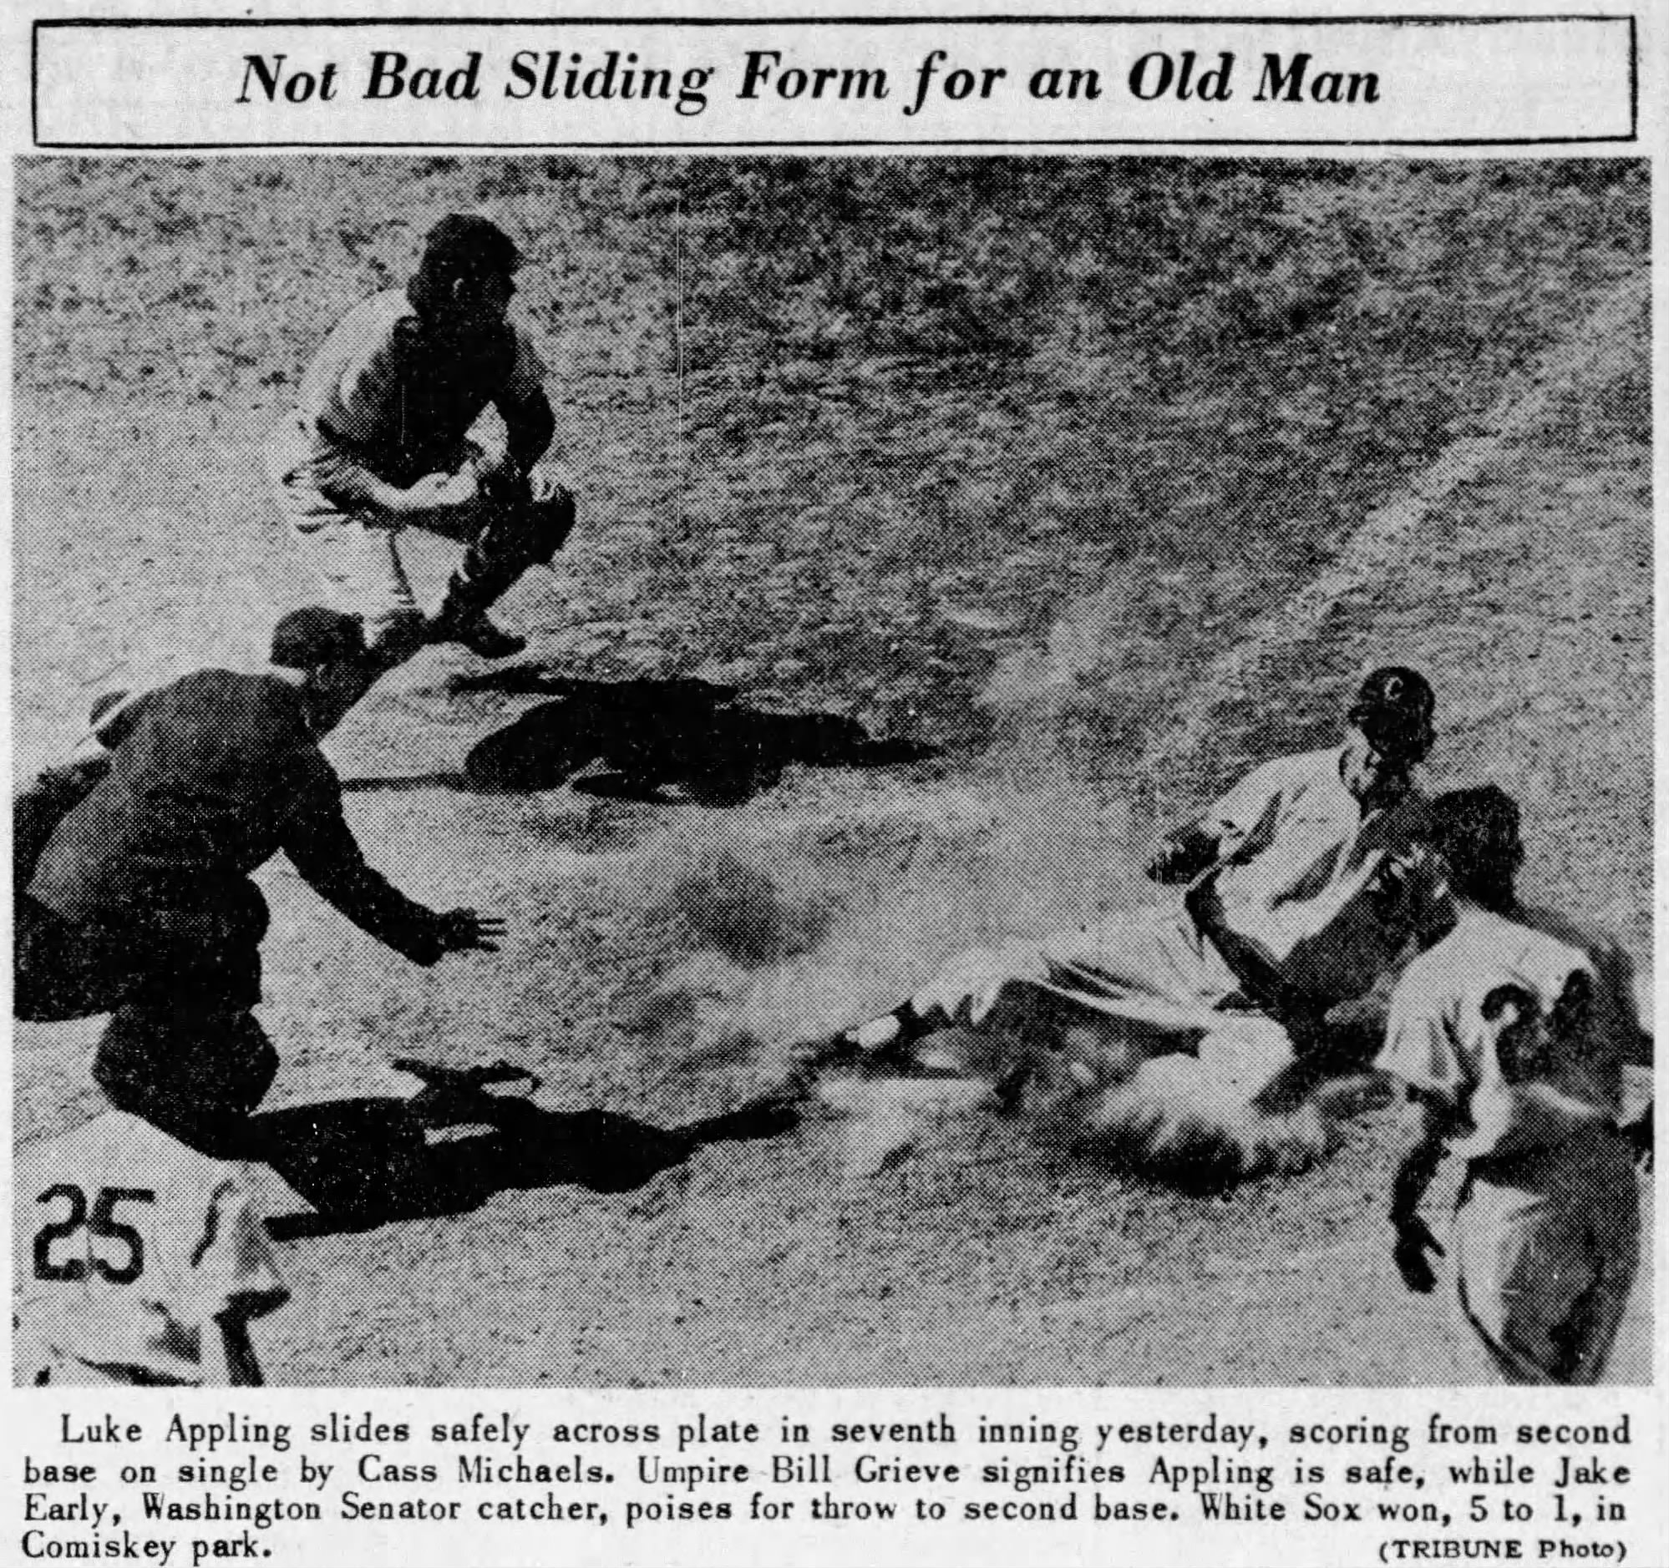
How Luke Appling got here
Chicago White Sox mainstay 1930-1950
White Sox career leader:
bWAR for position players: 77.5
(45th all-time, 6th among shortstops)
Games played: 2,422
Hits, 2,749
Times on Base: 4,062
Among all Shortstops
Games at Shortstop: 2,218 (8th)
Top 10 in putouts, assists, double plays
Hall of Fame, 1964

Slide 10
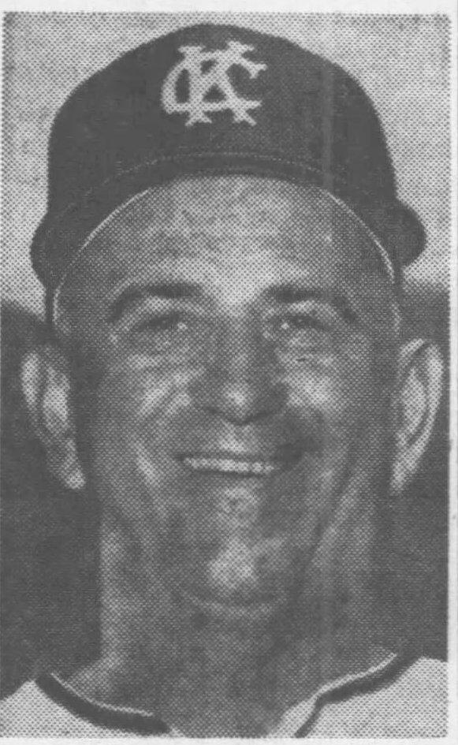
How Luke Appling got here
Minor league manager
Pennant: Memphis, Southern Association, 1952
Minor League Manager of the Year, 1952
1st place: Memphis, Southern Association, 1953
1st place, Indianapolis, American Association, 1962
Major league coach
Detroit, 1960
Traded to Cleveland for coach Jo-Jo White, August 8, one week after Dykes-Gordon swap
Cleveland, 1961
Baltimore, 1963
Kansas City, 1964-66
With Gabby Hartnett
1967: Appling a special assignment scout with Athletics

Slide 11
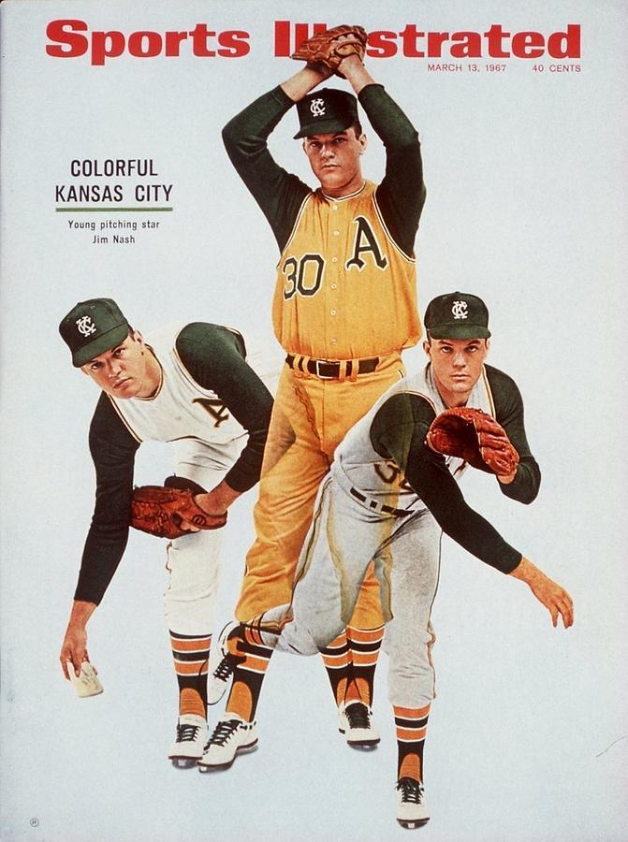
How the Kansas City Athletics got here
1967: manager Al Dark
Athletics are building with young players …
… except when they aren’t
Finley interfering with player development
Move from Kansas City looming
Charlie gonna Charlie
Allan Lewis, first designated runner
Peterson, John E. The Kansas City Athletics. McFarland, 2003

Slide 12
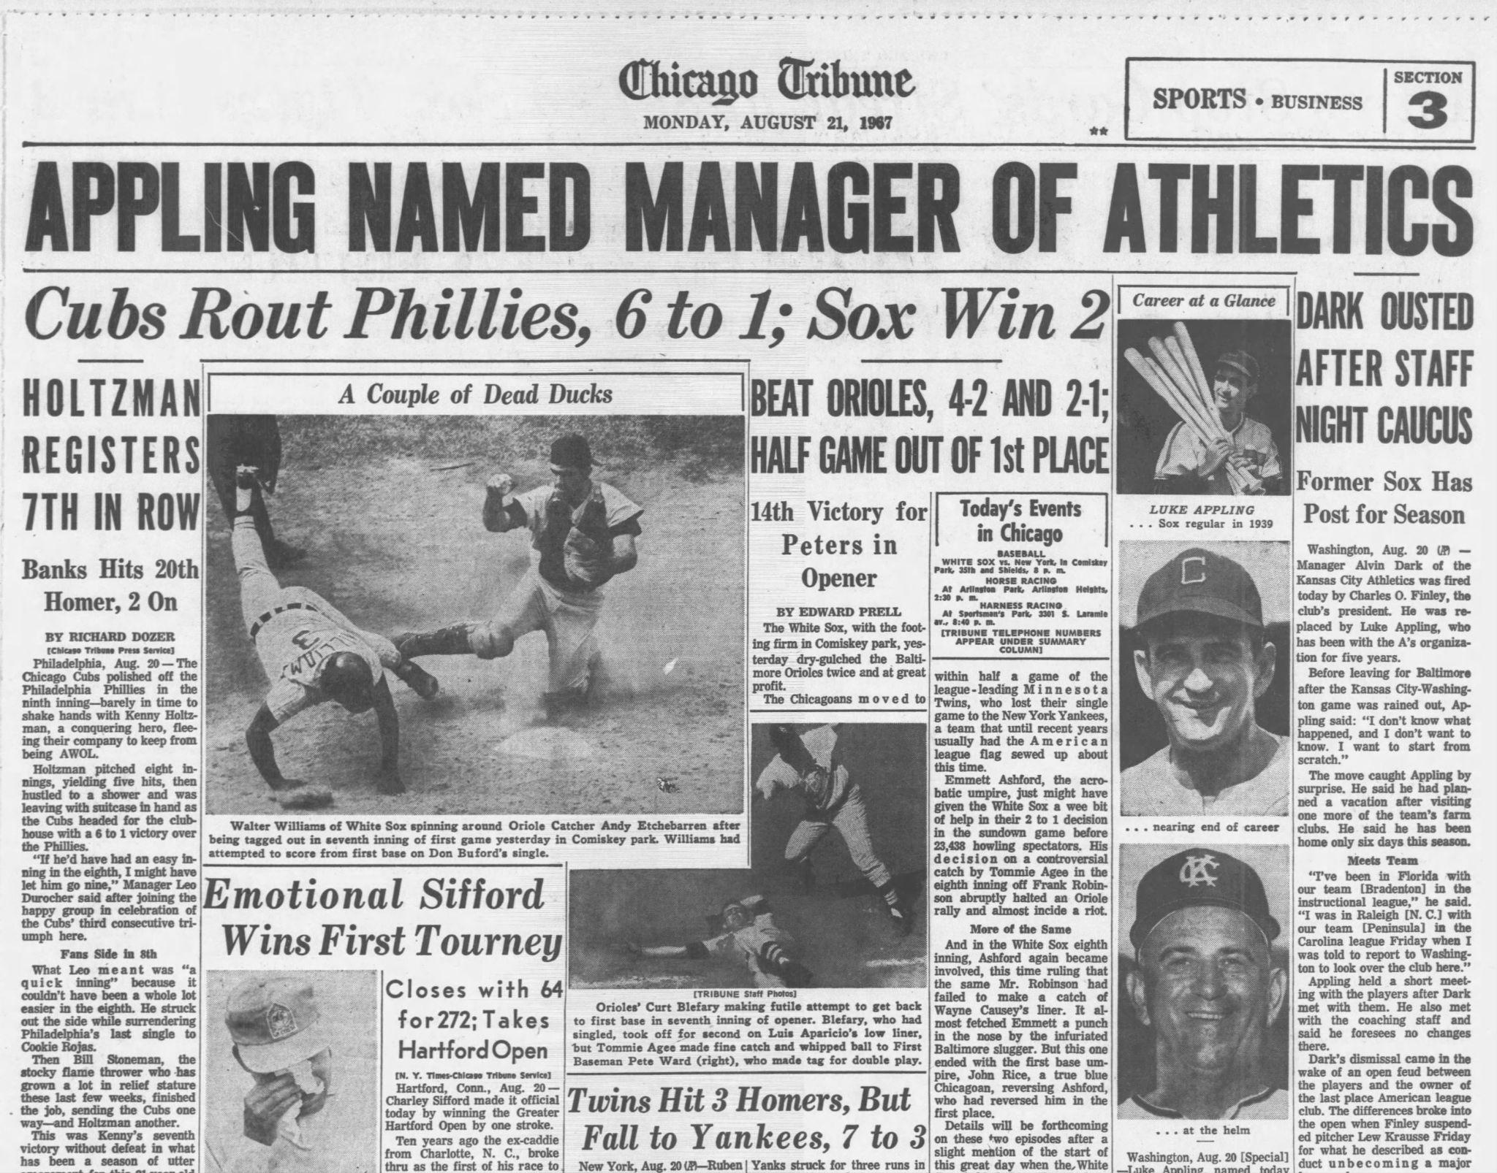
August 20: Dark is out, Appling is in
Finley and Dark clash over Lew Krausse incident
Appling named manager
“I don’t know what happened and I don’t want to know. I want to start from scratch.”

Slide 13
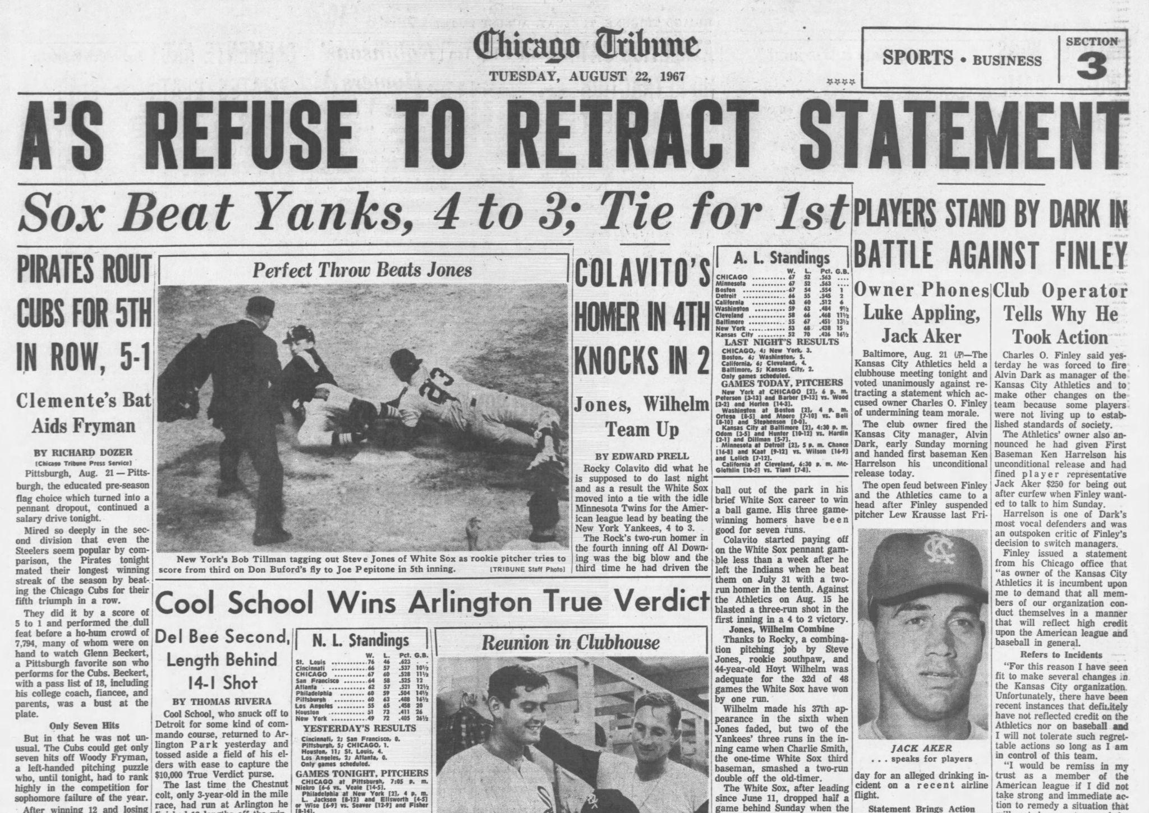
Athletics players side with Dark
Players issue a statement critical of Finley.
Finley rehires, refires Dark
Ken Harrelson is released unconditionally.
Appling caught in crossfire
Athletics decline
Meanwhile …

Slide 14
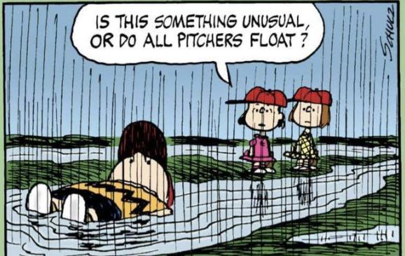
August 21-27
White Sox 5-5
(3 doubleheaders, 2 due to rainouts earlier in the season.)
Drop to 3rd, 1 game out
3-2 versus New York at home
2-3 versus Boston at home
Stanky gonna Stanky
courtesy Retrosheet

Slide 15
Dark and Appling, 1967 managerial tendencies
Dark
Appling
thanks, Baseball Reference

Slide 16
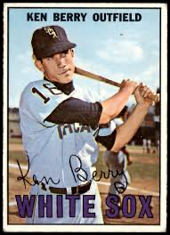
August 28 - September 3
White Sox 4-3, 3rd, 1.0 game out
1-2 at Washington
3-1 at Boston
courtesy Retrosheet

Slide 17
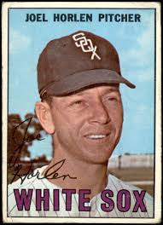
September 4-10
White Sox 5-3, 3rd, 1.5 games out
2-1 at New York
1-0 vs California (see SABR Games Project: https://sabr.org/gamesproj/game/september-6-1967-white-sox-walk-off-creates-four-way-tie-for-first-place/)
2-2 vs Detroit: Horlen no-hitter
is Retrosheet great or what?

Slide 18
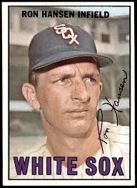
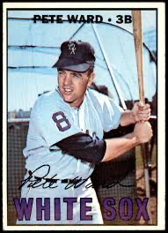
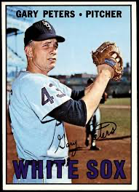
September 11-17
White Sox 5-3, 2nd, 0.5 games out
0-1 vs. Baltimore
2-2 vs. Cleveland
3-0 vs. Minnesota
Retrosheet is a national treasure

Slide 19
September 18-24
White Sox 4-2, 3rd, 1.0 game out
2-1 at California
2-1 at Cleveland
Retrosheet, right?!

Slide 20
AL standings, morning of September 27, 1967
Monday September 25: off day for the White Sox
Tuesday September 26: rain, forcing a doubleheader September 27.
courtesy Retrosheet

Slide 21
White Sox vs Athletics, 1967 to date
They're even at 8-8
A’s take a series with Chicago at home, May 19-21. The White Sox went into KC at 19-8, beat KC in the first game to make it 12 of their last 13., and then drop the next two.
A’s take a series in Chicago, June 3-4, two games to one

Slide 22
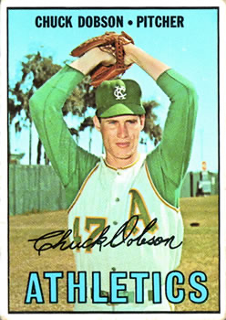
September 27, 1967, Game 1, 5:00 pm
see SABR Games Project account by Thomas M. Knosby
Gary Peters: 5 ⅔ innings, 4 hits, 1 walk, 3 runs
Chuck Dobson: 8 ⅓ innings, 3 hits, two walks, two runs
“I wanted to get a shutout, but I got those ninth-inning jitters again.”
Paul Lindblad puts out the fire in the 9th
Appling: two pitching changes in the 9th, no other noticeable
Kansas City 5, Chicago 2

Slide 23
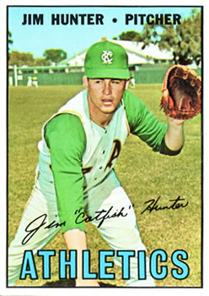
September 27, 1967, Game 2
see SABR Games Project by Thomas M. Knosby
Catfish Hunter shuts out the Sox, and takes out Les Josephson in a home plate collision
Joe Horlen two hits through 5
Then the sixth: keep the line moving
Five singles, a walk, an error, and a passed ball
Kansas City 4, Chicago 0

Slide 24
AL standings, morning of September 28, 1967
Remaining:
White Sox: three games vs. Washington
Minnesota vs Boston, two games
Detroit: two doubleheaders against California
Bless you, Retrosheet

Slide 25
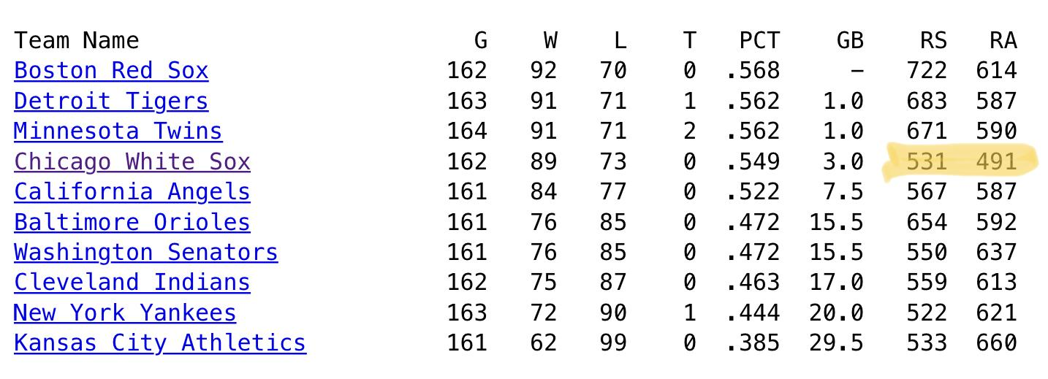
AL standings, end of 1967
Retrosheet, taking us home

Slide 26
KC Athletics Record against Opponents, 1967
Opponent | W | L | RS | RA | W-L%
BAL | 8 | 10 | 67 | 80 | .444
BOS | 6 | 12 | 62 | 87 | .333
CAL | 4 | 14 | 40 | 64 | .222
CHW | 10 | 8 | 70 | 72 | .556
CLE | 7 | 11 | 67 | 68 | .389
DET | 6 | 12 | 62 | 94 | .333
MIN | 8 | 10 | 50 | 66 | .444
NYY | 7 | 11 | 61 | 67 | .389
WSA | 6 | 11 | 54 | 62 | .353
Baseball Reference also rocks

Slide 27
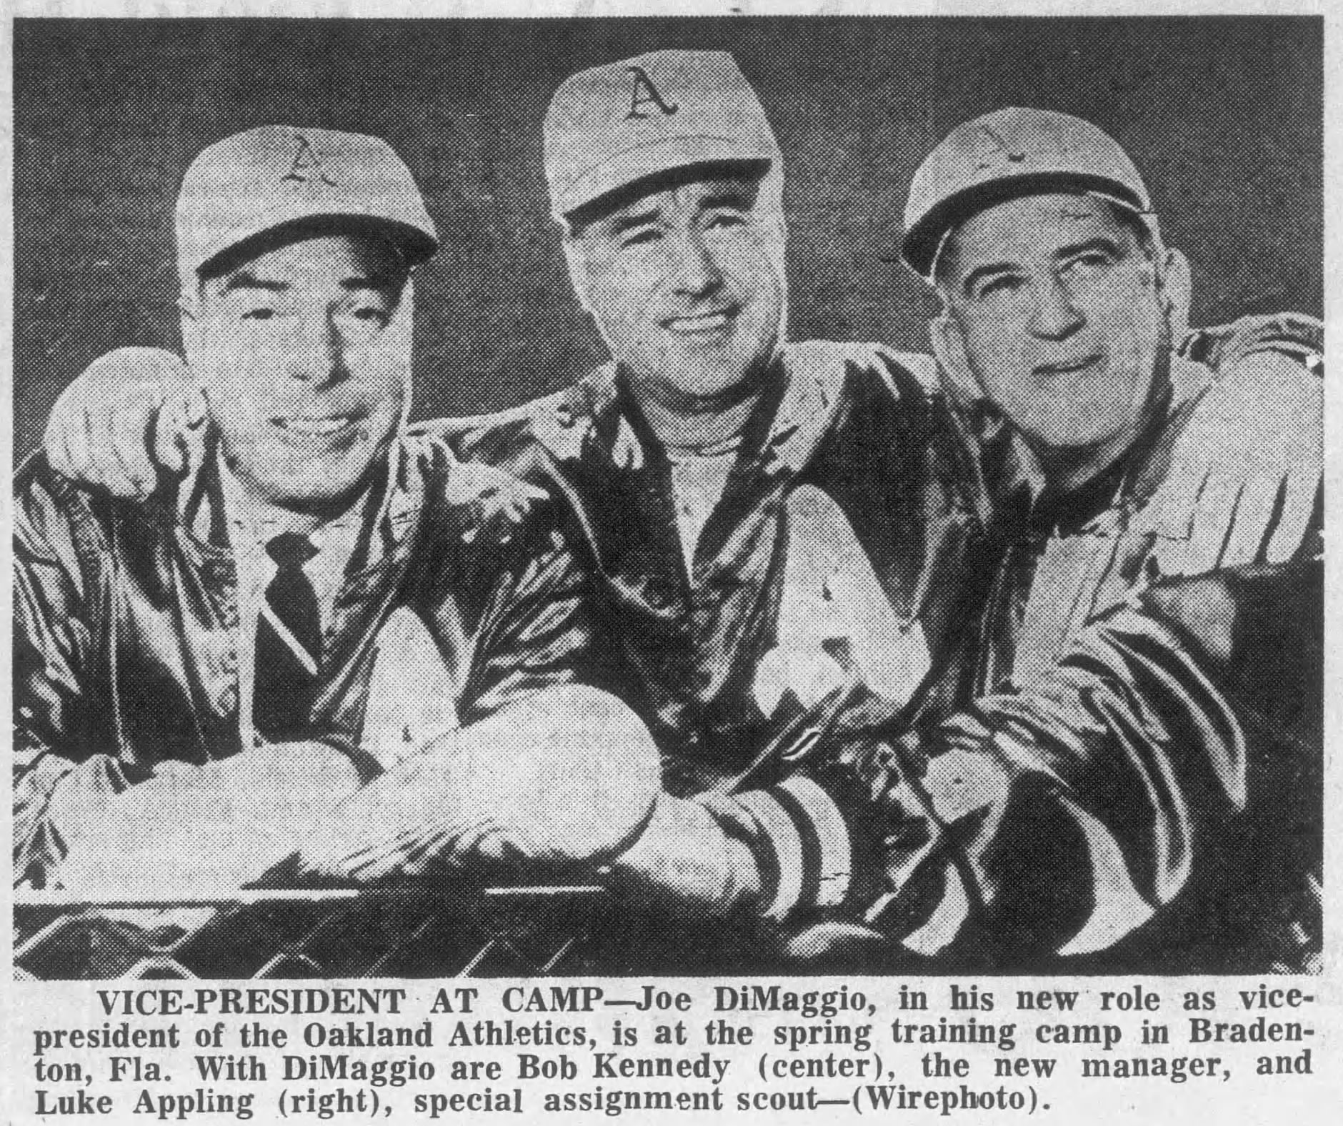
Luke goes back undercover
Fired as manager after the season.
Returns to special assignment for the Athletics, now in Oakland
Returns to coaching
Chicago AL, 1970-71
Atlanta, 1976-1990
in the dugout 1981 and 1984
Hitting instructor until his death

Slide 28
Online Sources
Baseball Reference
https://www.baseball-reference.com/leagues/AL/1967.shtml
https://www.baseball-reference.com/teams/split.cgi?t=p&team=CHW&year=1967
SABR Games Project
https://sabr.org/gamesproj/game/september-27-1967-as-take-first-game-of-doubleheader-on-their-last-day-in-kansas-city/
https://sabr.org/gamesproj/game/september-27-1967-catfish-hunter-shuts-out-white-sox-in-as-final-home-game-in-kansas-city/
Retrosheet
https://www.retrosheet.org/boxesetc/1967/B09272KC11967.htm
https://www.retrosheet.org/boxesetc/1967/UPKC101967.htm
https://www.retrosheet.org/boxesetc/1967/B09271KC119676.htm

Slide 29
Newspapers
Chicago Tribune
Kansas City Star
Atlanta Constitution
The Sporting News

Slide 30
Luke Appling 2, White Sox 0
R. J. Lesch
SABR 51
July 7, 2023
Notes:
On August 21, 1967, the Chicago White Sox are tied with the Twins for first place in the American League. The Red Sox and the Tigers are close behind. The White Sox are in pursuit of what would be only their second pennant since 1919. The same day, the tenth-place Kansas City Athletics take the field under their new manager, legendary White Sox shortstop Luke Appling, who took over from the fired Alvin Dark. The ambitions of Appling and his former team collide on September 27 as the White Sox play a doubleheader in Kansas City. The Athletics seem to be merely a speed bump on the way to a possible White Sox flag. Lesch brings together the dramatic 1967 pennant race, the last days of the Athletics sojourn in Kansas City, and the brightest moment in Luke Appling’s sole campaign as a major-league manager.

