Slide 1
Jacks (and Césars, and Shanes, and Martíns, and ...) of All Trades
Neal D. Traven
SABR 51
July 7, 2023

Slide 2
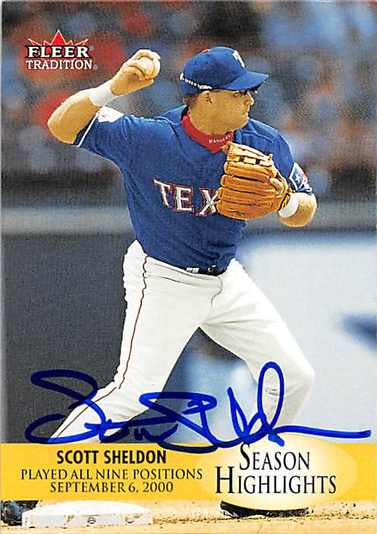
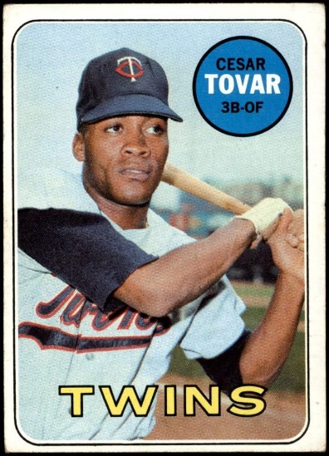
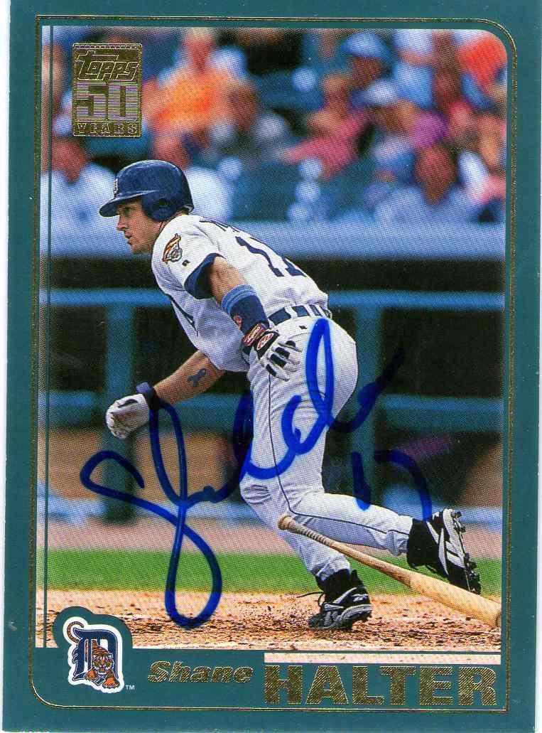
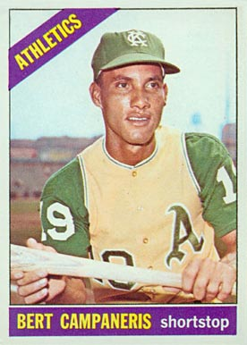
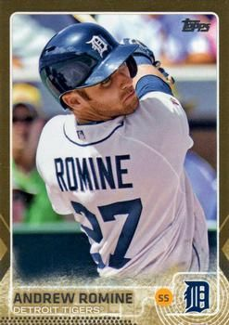
Investigating players who played all nine fielding positions in their careers
All positions in a single game
Bert Campaneris (September 8, 1965)
César Tovar (September 22, 1968)
Scott Sheldon (September 6, 2000)
Shane Halter (October 1, 2000)
Andrew Romine (September 30, 2017)
All positions in a career
Very little research:
Baseball Almanac’s list is out-of-date, incomplete, combines LF/CF/RF into one “OF” position
A blog post on T-Bones Baseball (December 9, 2022) is hilariously inaccurate and contradictory
Notes:
Let’s call them “Circuits”.
That T-Bones site is so weird that it might really be a ChatGPT fantasy.

Slide 3
Methodology
Database query using Baseball-Reference.com’s Stathead
All major leagues, 1871-2023
Appeared at least once at every fielding position
For each player identified by the query:
Debut, Final Game
Total Games, Defensive Games*, Appearances at each Position
Date of first game at each position
No Game Logs before 1901 and for Negro Leagues, so collect the Year he first played each position
* Estimated before 1901 and for the Negro Leagues
Notes:
Basically, used all seasons available in B-R. So the National Association, Players League, Union Association, American Association, and Negro Leagues are here in addition to the usual NL, AL, and Federal League.
Appearances table displays Defensive Games in NL/AL/FL from 1901 onward, but had to be estimated for all others.
Similarly, could only obtain the year of positional debuts before 1901 and in the Negro Leagues.
Will show what I did to generate estimates in a later slide.

Slide 4
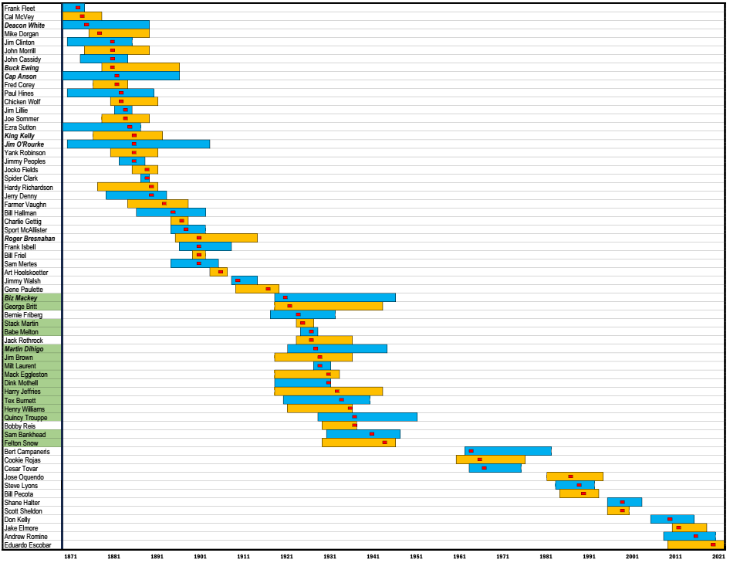
All Nine-position Players (1871-2023) by Circuit Completion Date
Lively ball / Negro Leagues
(1917-1960)
N = 19
Expansion Era
(1961- )
N = 12
19th C/Deadball
(1871-1916)
N = 33
Notes:
Bars are careers, alternating colors only for contrast. Red blocks indicate the year of Circuit completion.
64 players, 15 of them Negro Leaguers (green).
Gene Paulette, Bernie Friberg, Jack Rothrock, Bobby Reis the only white guys in the middle period (between 1911 and 1965).
Low!! 4 times that many players in the Hall of Fame! Eight HOFers – Deacon White, Ewing, Anson, King Kelly, O’Rourke, Bresnahan, Biz Mackey, Dihigo
64th in hits – Gehrig, 2721 64th in HR – Bench, 389
64th in wins – W Ford, 236
20 years between Felton Snow in 1945 and the Campaneris stunt in 1965.
7 years between Jimmy Walsh (1911) and Gene Paulette (1918), longest gap in that segment

Slide 5
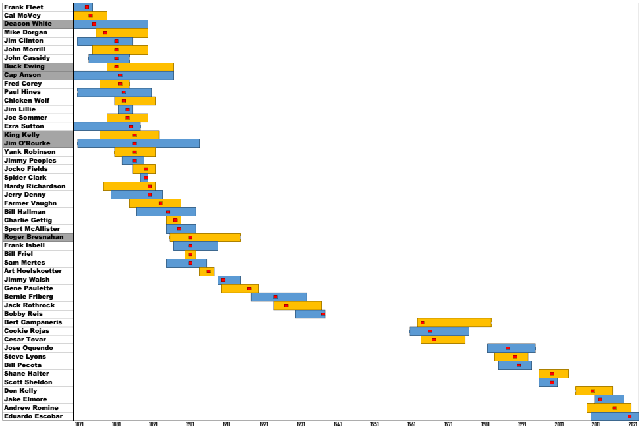
NL/AL/FL Nine-position Players (1871-2023) by Circuit Completion Date
Notes:
In NL/AL/FL, it was 27 years between Bobby Reis (1938) and Campy.

Slide 6
Prevalence Rate: Circuits by Era
Era | Time Period | Field Players | Circuits | % Players with Circuit
19th C/Deadball | 1871-1916 | 4520 | 33 | 0.73%
Lively ball / Negro Leagues | 1917-1960 | 7585 | 19 | 0.25%
Lively ball | 1917-1960 | 5296 | 4 | 0.08%
Negro Leagues | 1920-1948 | 2336 | 15 | 0.64%
Expansion Era | 1961-2022 | 11,562 | 12 | 0.10%
Total |  | 21,654 | 64 | 0.30%
Notes:
Huge difference between Negro Leagues (they’re like Deadball) and their contemporaries (they’re like Expansion)
Possibly due to roster size(?)
As I read Cliff Blau’s work on operating rules, the 25-man playing roster was first defined in 1910.

Slide 7
Primary Position by Era
Primary Position | 19th C / Deadball |  | Lively Ball / Negro Leagues |  | Expansion Era |  | Total
 | Count | Percent | Count | Percent | Count | Percent | Count | Percent
P | 1 | 3.0% | 2 | 10.5% | 0 | --- | 3 | 4.7%
C | 4 | 12.1% | 6 | 31.6% | 0 | --- | 10 | 15.6%
1B | 4 | 12.1% | 2 | 10.5% | 0 | --- | 6 | 9.4%
2B | 5 | 15.2% | 2 | 10.5% | 2 | 16.7% | 9 | 14.1%
3B | 6 | 18.2% | 3 | 15.8% | 3 | 25.0% | 12 | 18.8%
SS | 0 | --- | 2 | 10.5% | 4 | 33.3% | 6 | 9.4%
LF | 4 | 12.1% | 0 | --- | 1 | 8.3% | 5 | 7.8%
CF | 2 | 6.1% | 1 | 5.3% | 2 | 16.7% | 5 | 7.8%
RF | 7 | 21.2% | 1 | 5.3% | 0 | --- | 8 | 12.5%
Total | 33 |  | 19 |  | 12 |  | 64
χ² (16) = 27.92
p = 0.032
Notes:
Cells with largest contribution to the significant difference are:
[SS-Expansion – expected value = 1.125] (biggest by a lot)
[C-Lively/Negro – expected value = 2.97]

Slide 8
Position of Last Debut by Era
Position of Last Debut | 19th C / Deadball |  | Lively Ball / Negro Leagues |  | Expansion Era |  | Total
 | Count | Percent | Count | Percent | Count | Percent | Count | Percent
P | 10 | 22.2% | 6 | 22.2% | 6 | 28.6% | 22 | 23.7%
C | 4 | 8.9% | 6 | 22.2% | 6 | 28.6% | 16 | 17.2%
1B | 9 | 20.0% | 4 | 14.8% | 3 | 14.3% | 16 | 17.2%
2B | 4 | 8.9% | 1 | 3.7% | 1 | 4.8% | 6 | 6.5%
3B | 3 | 6.7% | 3 | 11.1% | 0 | --- | 6 | 6.5%
SS | 3 | 6.7% | 3 | 11.1% | 0 | --- | 6 | 6.5%
LF | 6 | 13.3% | 1 | 3.7% | 1 | 4.8% | 8 | 8.6%
CF | 3 | 6.7% | 1 | 3.7% | 2 | 9.5% | 6 | 6.5%
RF | 3 | 6.7% | 2 | 7.4% | 2 | 9.5% | 7 | 7.5%
Total | 45 |  | 27 |  | 21 |  | 93
χ² (16) = 12.88
p = 0.682
Notes:
Note that there can be multiple last-debuts for a player – as many as five:
Campaneris at P/C/1B/2B/RF – except for 2B, never played those again
Babe Melton at 1B/2B/3B/SS/RF – but that’s in a year, not a day
Overall, no significant difference.
But still some patterns. I’d expect P and C to be the last ones to debut, but 1B??

Slide 9
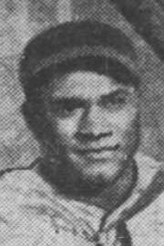
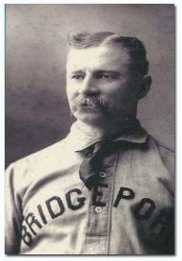
How Many Games to Complete the Circuit?
Mean = 397 ± 312 Median = 275
Fewest: Frank Fleet (1871-1875) – 52/88 games, 1874
Babe Melton (1926-1929) – 63/114 games, 1928
Most: Jim O’Rourke (1872-1904) – 1246/1999 games, 1887
Jim Brown (1920-1937) – 656/701 games, 1930
Estimation procedure, pre-1901 and Negro Leagues
Frank Fleet’s Appearances table
Year | G | Bat | Def | P | C | 1B | 2B | 3B | SS | LF | CF | RF
1871 | 1 | 1 |  | 1 | 0 | 0 | 0 | 0 | 0 | 0 | 0 | 0
1872 | 13 | 13 |  | 0 | 0 | 0 | 2 | 10 | 0 | 0 | 1 | 1
1873 | 22 | 22 |  | 3 | 0 | 1 | 8 | 3 | 9 | 0 | 0 | 0
1874 | 22 | 22 |  | 0 | 13 | 0 | 11 | 0 | 0 | 1 | 0 | 0
1875 | 26 | 26 |  | 2 | 11 | 0 | 10 | 1 | 9 | 0 | 0 | 0
1875 | 4 | 4 |  | 3 | 0 | 0 | 0 | 1 | 0 | 0 | 1 | 0
 | 88 | 88 |  | 9 | 24 | 1 | 31 | 15 | 18 | 1 | 2 | 1
Prim Pos
P
3B
SS
C
C
P
2B
Def App
1
14
24
25
33
5
102
Circuit
1
13
22
16.5
52.5
DA/DG
1.000
1.077
1.091
1.136
1.269
1.250
1.159
Determine Primary Position by season and career
Sum Defensive Appearances across all positions
Estimate Defensive Games as minimum of Games and Defensive Appearances
Estimate Games to Complete Circuit as sum of all previous season games + 75% of target season
Appearances per Defensive Game is defined as (Defensive Appearances / Defensive Games)
1
13
22
22
26
4
88
Notes:
Note that the most games played in the Negro Leagues by anyone was 1202 by Cool Papa Bell. Willie Wells (1039) only other over 1000.
Biz Mackey – 900
Jim Brown – 701
Babe Melton – 114
Quincy Trouppe – 158
Estimated DefG can be an overestimate:
If DA>G, assumes he fielded in every game; if DA<G, assumes he played one position per game

Slide 10
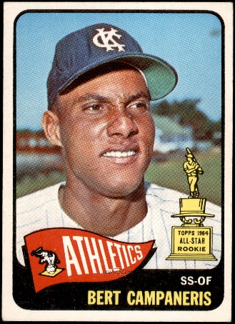
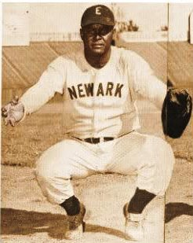
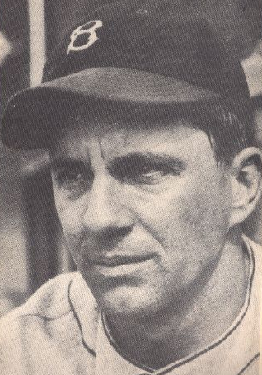
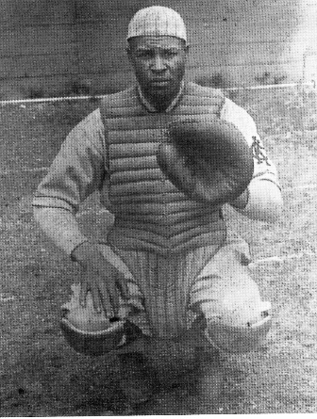
What Proportion of Career to Complete the Circuit?
Mean = 54.9% ± 25.3% Median = 52.7%
Smallest: Bert Campaneris (1964-1983) – 200/2328 games = 8.6%, 9/8/1965
Biz Mackey (1920-1947) – 210/900 games = 23.3%, 1922
Largest: Dink Mothell (1920-1932) – 542/545 games = 99.4%, 1932 [played only 15 games in 1932]
NL/AL/FL: Bobby Reis (1931-1938) – 173/175 games = 98.9%, 9/11/1938) [3 innings at C, last fielding appearance in career]
Notes:
Reis pinch-ran twice after his stint at C.
18/31 Bioproject essays mention the Circuit.

Slide 11
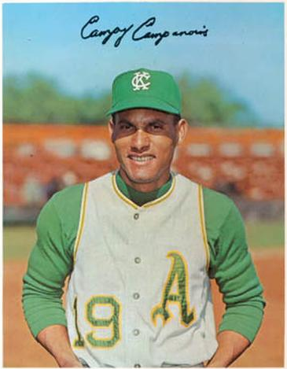
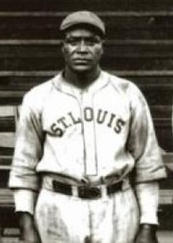
What Proportion of Career at Primary Position?
Mean = 54.5% ± 18.0% Median = 53.4%
Lowest: Stack Martin (1925-1928), 60/227 defensive games at 1B = 26.4%, 1926
NL/AL/FL: Art Hoelskoetter (1905-1908), 78/281 defensive games at 2B = 27.8%, 5/11/1907
Highest: Bert Campaneris (1964-1983), 2097/2264 defensive games at SS = 92.6%, 9/8/1965
Henry Williams (1923-1937), 248/296 defensive games at C = 83.8%, 1937
Notes:
So although Campaneris was the first to do the one-game stunt, he was actually the least “multi” guy in the entire group.

Slide 12
Positional Minima and Maxima
Player’s minimum number of games at a Position
Lowest: 1 (42 players) [so 22 played ≥ 2 games at every position]
Most 1-game Positions: 4 (Bert Campaneris P/C/1B/RF, Eduardo Escobar P/C/CF/RF)
Highest: 9 (Buck Ewing), 8 (Roger Bresnahan)
Most Games by Position (Primary, Non-Primary)
Position | Primary Position |  | Non-Primary Position |  | Median Games (Non-Primary)
 | Player | Games | Player | Games
P | George Britt | 126 † | Fred Corey (3B) | 93 | 2
C | Roger Bresnahan | 972 | King Kelly (RF) | 584 | 3
1B | Cap Anson | 2152 | Jim Brown (C) | 257 ‡ | 22
2B | Cookie Rojas | 1445 | Bernie Friberg (3B) | 429 | 24
3B | Jerry Denny | 1109 | Shane Halter (SS) | 262 | 31
SS | Bert Campaneris | 2097 | José Oquendo (2B) | 364 | 17
LF | Jim O'Rourke | 770 | César Tovar (CF) | 394 | 18
CF | Paul Hines | 1303 | Jim O'Rourke (LF) | 463 | 10
RF | Chicken Wolf | 1024 | Jim O'Rourke (LF) | 217 | 24
NL/AL/FL Leader
† Bobby Reis (69)
‡ Buck Ewing,
Farmer Vaughn (253)
Notes:
Only Expansion Era players >1 at every position –
Steve Lyons (lowest was 2 at P),
Shane Halter (lowest was 2 at P and C). Also, Halter had already completed Circuit a couple of months before his stunt.
The only player in the entire dataset who pitched more games than Corey is Britt. Not even the other primary P players (Charlie Gettig 42, Bobby Reis 69) .
Halter played as many games at 3B as at SS (his Primary) … more innings at SS than 3B

Slide 13
The Baseball Almanac Conundrum
Ignoring some leagues (NA, Negro) may be justifiable
Reporting a single “OF” position is not justifiable
Pre-1901 fielding stats combine them, but Appearances specify positions
Validity check – (LF+CF+RF) Appearances never less than OF Appearances
Surprisingly, it makes very little difference
A mere 14 men played P/C/1B/2B/3B/SS and one or two OF positions
8 Deadball, 3 Negro Leagues, 3 Expansion
Bob “Death To Flying Things” Ferguson (never played LF)
Greg Litton (never played CF)
Marty Martínez and Kyle Farmer (played neither CF nor RF)
Notes:
Deadball includes Bob Ferguson (Death to Flying Things, not WA’s Attorney General), who never played LF
The only active player in this group is Kyle Farmer, who has played LF but not CF/RF

Slide 14
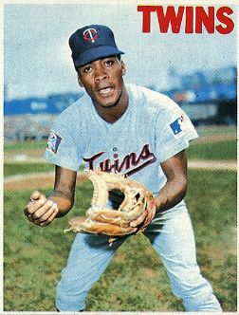
Defensive Appearances per Defensive Game
Measure of in-game position changes (?)
Likely underestimating DefA/DefG pre-1901 and Negro Leagues
8 players recorded ≥ 1.100 DefA/DefG
Highest: César Tovar (1965-1976), 1599/1335 = 1.198 DefA/DefG
Others: Frank Fleet 1.159, Bill Pecota 1.149, Cal McVey 1.143, Don Kelly 1.113, Andrew Romine 1.112, King Kelly 1.109, Scott Sheldon 1.105
How does this compare with other known multi-position players?
B Zobrist 1.202 | F Santangelo 1.133 | J Youngblood 1.112 | I Happ 1.221 | C Taylor 1.148
D Williams 1.164 | C Hinton 1.127 | D Demeter 1.112 | B Donovan 1.193 | M Muncy 1.133
T Phillips 1.153 | C Candaele 1.125 | B Holt 1.110 | K Hernández 1.167 | L Urías 1.130
M Gonzalez 1.148 | B Bailor 1.122 | C Salmon 1.103 | T Edman 1.166 | R Urías 1.115
S Rodríguez 1.136 | D Thomas 1.120 | L Harris 1.102 | J Berti 1.150 | B Drury 1.114
Notes:
Underestimates are because we’re possibly overestimating the denominator (Def Games) – if sum(DefA) is greater than total G, we always assume that he played in the field for every game he played at all.
OTOH –
Circuit Campaneris 1.009
Rojas 1.047
Oquendo 1.061
Lyons 1.070
Multi-pos C Biggio 1.008
P Rose 1.016
R Mulliniks 1.020
P Polanco 1.030
B Surhoff 1.043

Slide 15
Close, But No Cigar
193 players appeared at eight positions in their careers
No surprise that nearly all missed P or C
Watch for these potential Circuit-completing appearances!
SS – Willians Astudillo (Japan)
1B – Isiah Kiner-Falefa
Tzu-Wei Lin (Atlantic League)
C – Ehire Adrianza
Harold Castro
Marwin Gonzalez (Japan)
Josh Harrison
Kiké Hernández
Dylan Moore
Hernán Pérez (AAA)
Jace Peterson
Chad Pinder (AAA)
Matt Reynolds
Luke Williams
Notes:
My money’s on IKF to be the first of them to complete the career Circuit.
Maybe the only one…
Changing here from the Big Picture to the Small, from careers to a single game.

Slide 16
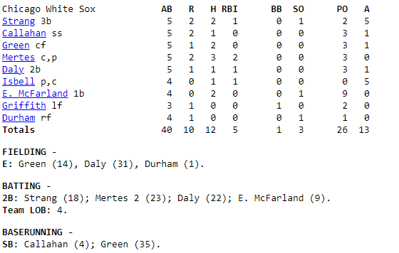
Game Played on Sunday, September 28, 1902 (D) at Sportsman's Park II CHI A 0 2 0 0 4 0 4 0 0 - 10 12 3 STL A 2 1 0 1 0 0 0 0 0 - 4 9 7
From the Retrosheet boxscore
Notes:
2nd game of doubleheader, final game for both clubs.
Three players completed their career circuit in the game (Isbell at C, Mertes and Friel at P).
No one who pitched was an actual pitcher. It was the only time any of them pitched in 1902. Only mound appearance of career for Mertes, Friel, Heidrick, Sugden. Last career pitching for Wallace and Burkett.
First boxscore ever with someone playing four positions … and two did it. Played the same 4 positions. Except for the Campy/Tovar stunts, no one played 4 positions again for 86 years (Jeff Kunkel 8/31/1988).
Looked for contemporary discussion of the 9/28/1902 game, found stuff in Sporting Life …

Slide 17
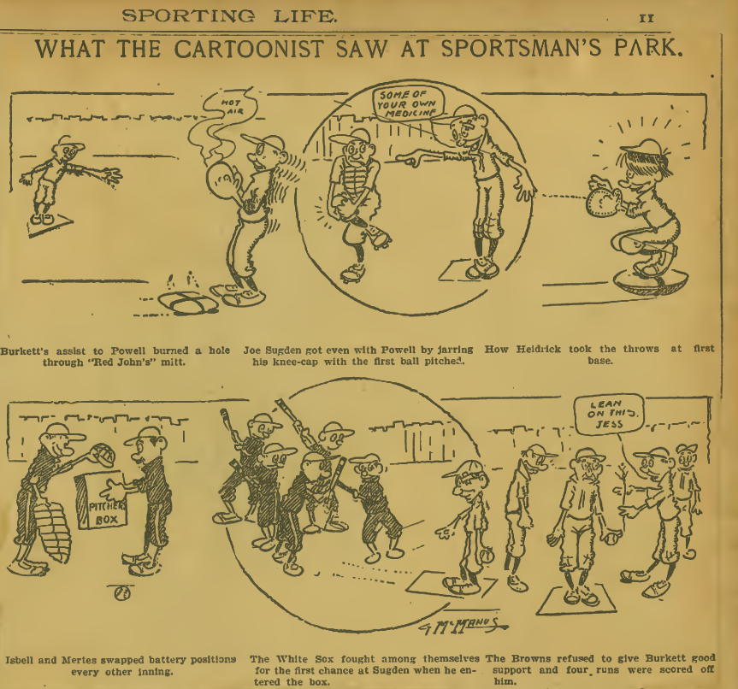
Commentaries in Sporting Life
October 4, 1902, p. 9
“The second game was turned into a burlesque by the local team players exchanging positions at will.”
October 11, 1902, p. 11
G. McManus, cartoonist
Notes:
The quote was part of the “header” for the boxscore.

Slide 18
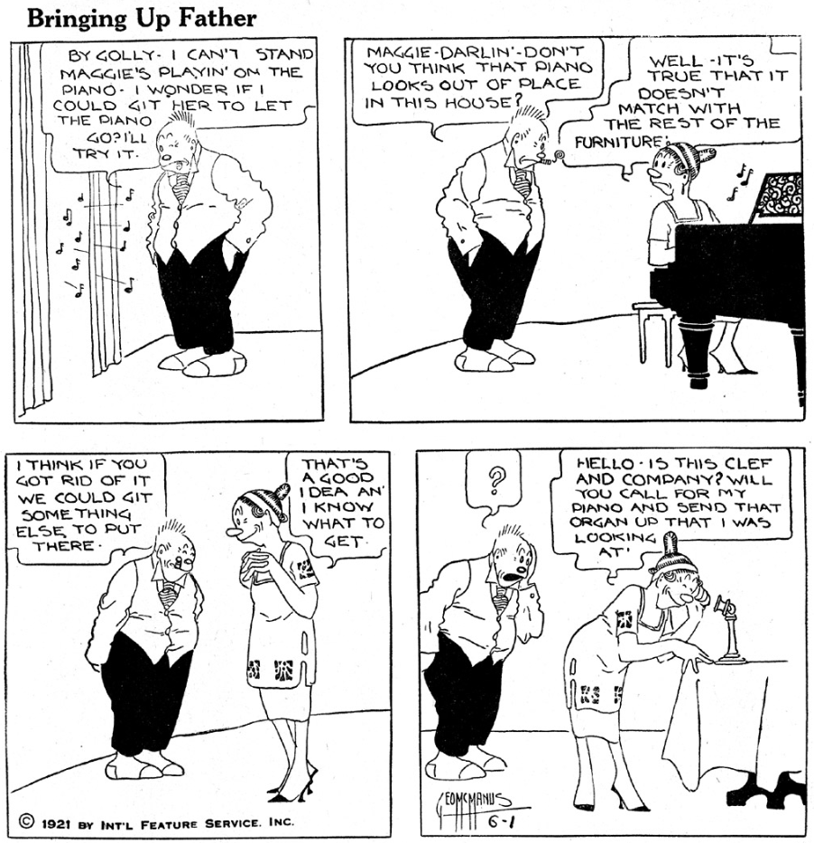
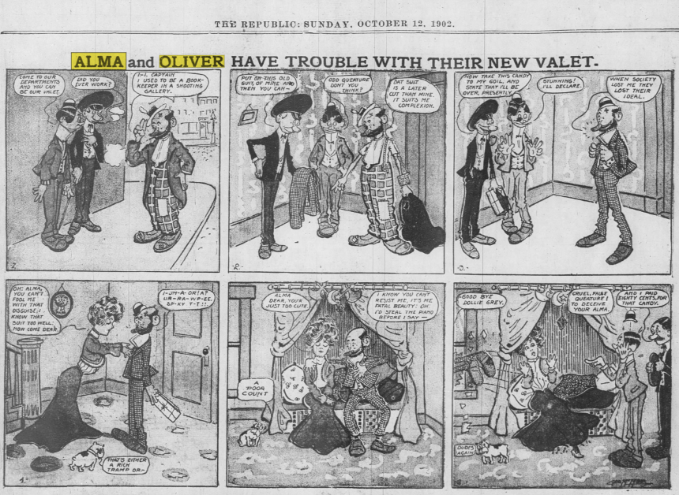
Sleuthing on the side…
so who was that cartoonist?
I’m convinced that it’s 18-year-old George McManus, more than ten years before he started Bringing Up Father (AKA Maggie and Jiggs), the first nationally- and internationally-syndicated newspaper comic strip.
McManus (1884-1954) was born and raised in St. Louis
At 15, started working in the art department of the St. Louis Republic
Created his first strip, Alma and Oliver, at the Republic in 1900. He was still only 16.
This Alma and Oliver strip ran on 10/12/1902, the day after the cartoon in Sporting Life.
Source: Saved From the Paper Drive, 5/4/2013
Notes:
McManus turned 15 in 1899
19 years between Sporting Life and this panel of Bringing Up Father. He’s 37, not 18.

Slide 19
In summary …
The nine-position Circuit has been completed by only 64 players since 1871
Circuits are much more frequent when rosters are small
A majority of Circuits occurred in the 19th century and deadball era
Nearly half of all Circuits since 19thC/deadball were in the Negro Leagues
Patterns of primary position have changed over time
Last position debut is at P, C, or 1B in over half of all Circuits
(Defensive Appearances/Defensive Games), a measure of in-game maneuvering, may be worthy of further study

Slide 20
Thank you!
My email (info/questions): beisbol@alumni.pitt.edu
Stathead query output: https://stathead.com/tiny/ITY9C

