Slide 1
Getting to the Money in Moneyball: Better Understanding Revenue per Win Across Different Baseball Markets Presented at the 47th Annual SABR Conference New York, NY July 1st, 2017
James Goldstein, Ph.D.
Associate Professor of Accounting
Paul Sauer, Ph.D.
Professor of Marketing
Canisius College – Buffalo, NY

Slide 2
Introduction
The prime inspiration for this work is Gennaro’s excellent “Diamond Dollars” (2007), in which he examines the relationship between the number of games a team wins and revenue earned
Some of Gennaro’s (2007) main findings:
All teams show a significant relationship between number of wins and revenue earned
Post-season appearances have significant effect on the amount of revenue earned
Revenue sharing weakens the relationship between the number of wins and revenue earned
The above relationships vary by team

Slide 3
Previous Studies – Baseball Revenue
Examples:
Ahn and Lee (2014) – Factors of MLB attendance
Cebula et al. (2013) – Factors of Minor League revenue
Denaux et al. (2011) – Factors of MLB attendance
Beck (2009) – External factors of MLB attendance
Davis (2008) – Attendance and winning percentage
Horowitz (2007) – Attendance and winning percentage
Alexander (2001) – Ticket price setting
Majority of previous studies have focused on the determinants of attendance

Slide 4
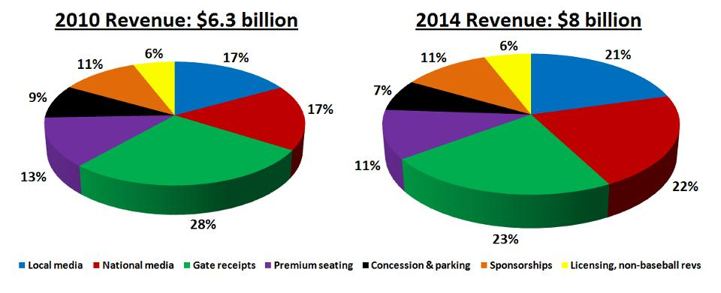
MLB Revenue (Forbes 2015)
https://www.forbes.com/sites/kurtbadenhausen/2015/04/06/opening-day-graphic-mlb-revenue-today-vs-2010/#7ddf1fb67dbf

Slide 5
Our Research Questions
How much variation in revenue earned is explained by variation in wins? How does this vary across different baseball markets?
How has the above relationship changed due to the introduction of revenue sharing?
What other factors could explain the remaining variation in revenue earned? Do these factors have a different effect on teams in different markets?

Slide 6
Methodology
Categorize baseball teams into markets, as defined by Al Streit of “Baseball Almanac” (population)
Regress team revenue (RevREAL) on wins (WINS) during the time periods represented by the different collective bargaining agreements
Revenue figures from 1990-2015 obtained from “Financial World” and “Forbes” (adjusted for inflation)
Same sources represented on SABR Business of Baseball Committee website
Regress team revenue on wins and other factors during the same time periods and compare results.

Slide 7
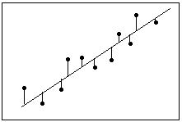
Ordinary Least Squares (OLS) Regression
Line of least squares = best fit

Slide 8
Baseball Markets (based on Pop.)
Mega-Market
Angels, Dodgers, Mets, Yankees
Large Market
Athletics, Cubs, Giants, Orioles, Phillies, Rangers, Red Sox, Tigers, White Sox
Medium Market
Astros, Blue Jays, Braves, Mariners
Small Market
Brewers, Cardinals, Indians, Padres, Pirates, Reds, Royals, Twins

Slide 9
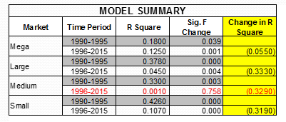
Results: Pre and Post Revenue Sharing
OLS Regression
Criterion Variable: Real Revenue
Predictor Variable: Wins
Note: Red font indicates not significant at the 5% or 10% level

Slide 10
Results: Pre and Post Revenue Sharing
Pre Rev Share | Constant | B (Slope)
Mega | 10.836 | 0.752
Large | 7.308 | 0.610
Medium | -2.832 | 0.669
Small | 4.503 | 0.089
Post Rev Share | Constant | B (Slope)
Mega | -40.224 | 2.078
Large | 51.716 | 0.706
Medium | 100.454 | -0.073
Small | 22.067 | 0.214
Note: Red font indicates not significant at the 5% or 10% level

Slide 11
Results: CBA Time Periods
Criterion Variable: Real Revenue Predictor Variable: Wins
Note: Red font indicates not statistically significant change in R-square at the 5% or 10% level

Slide 12
What is a “Market”?
Recently, there have been challenges to the criteria that have been used to define baseball markets
For example:
Blog Posting (12/13/16) – “There’s no such thing as a small-market team”, Henry Druschel
“Being a small-market team is not a badge of inferiority that certain teams have to carry throughout life like a scarlet letter; it’s the product of choices, usually made by the owner, to scrimp and save, to not sign free agents, and not to try as hard as possible to win. That’s what makes a small-market team, not where they happen to play.”

Slide 13
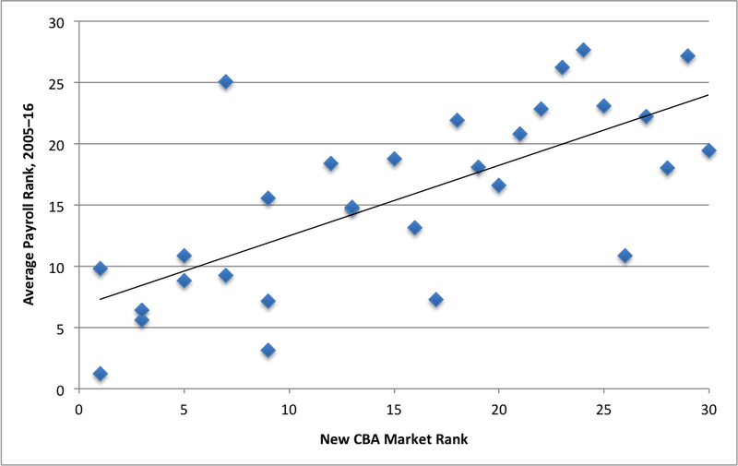
Team Payroll and Market
Team’s average payroll rank since 2005 vs. market size ranking under previous CBA
Source: http://www.beyondtheboxscore.com/2016/12/13/13904532/small-market-teams-mlb-athletics-economics-the-long-cons-of-lew-wolff-and-many-many-others

Slide 14
Team by Average Payroll Quartile
Some change a great
deal
Some are consistent

Slide 15
Results: Pre and Post Revenue Sharing by Payroll Quartile
OLS Regression: Criterion Variable=Real Revenue, Predictor Variable= WINS
Note: Red font indicates not significant at the 5% or 10% level

Slide 16
Results: CBA Time Periods by Payroll Quartile
Criterion Variable: Real Revenue Predictor Variable: Wins
Note: Red font indicates non-significance

Slide 17
Results: Pre and Post Revenue Sharing
Pre Rev Share | Constant | B (Slope)
Quartile 4 | 31.341 | 0.383
Quartile 3 | 1.472 | 0.657
Quartile 2 | 5.560 | 0.573
Quartile 1 | 5.091 | 0.446
Post Rev Share | Constant | B (Slope)
Quartile 4 | 89.333 | 0.552
Quartile 3 | 77.085 | 0.350
Quartile 2 | 91.165 | 0.038
Quartile 1 | 39.453 | 0.556
Note: Red font indicates not significant at the 5% or 10% level

Slide 18
Results: CBA Time Periods Population vs. Payroll Quartiles

Slide 19
Summary of Findings: Pre and Post Revenue Sharing
Prior to revenue sharing, the largest market teams were dependent on wins to generate revenue.
However, largest market teams were less dependent than the three other markets
All markets were less dependent on wins to generate revenue once revenue sharing was introduced.
Regardless of our market classification method, the smallest market teams still show a significant relationship (albeit smaller) between wins and revenue
For markets based on demographics, the largest and smallest markets had the greatest relationship between wins and revenue after revenue sharing
For markets based on payroll, only the smallest market showed a significant relationship between wins and revenue

Slide 20
Summary of Findings: CBA Time Periods
The largest market teams actually became more dependent on wins to generate revenue until the 2012-2015 CBA
Under all CBAs, the three smaller markets became less dependent on wins to generate revenue
Under the 2012-2015 CBA, all markets are less dependent on wins to generate revenue
After revenue sharing, there were fewer time periods where significant relationships between wins and revenue were noted for the payroll classification than the demographic classification

Slide 21
Resulting Research Question
What other factors could explain the remaining variance in revenue earned? Do these factors have a different effect across markets?
Factors tested:
Post-season appearances
World series wins
Chronic win streaks
Chronic loss streaks
Total payroll

Slide 22
Analysis with Additional Factors

Slide 23
Next Steps
Expand the existing analysis:
Include 2016 data and six teams that had incomplete records
Further explore the concept and operational definition of “market” through techniques such as cluster analysis
Build economic baseball model
Incorporate factors that could influence team revenue

Slide 24
Defining, Measuring, and Comparing Market Potential (MPI) of each Market
MPI Dimension | Weight | Possible Measure
Market Size | 35% | Population
Market Intensity | 20% | Entertainment Options
Market Growth Rate | 25% | Entertainment $$ Spent
Market Consumption Capacity | 20% | Disposable Personal Income

Slide 25
Questions/Comments?

Slide 26
Thank You!

Slide 27
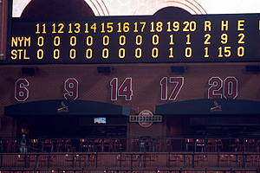
Extra Innings

Slide 28
Pre and Post: All Teams
Dependent Variable: Real Revenue
Independent Variable: Wins

Slide 29
CBA Time Periods: All Teams
Dependent Variable: Real Revenue
Independent Variable: Wins

Slide 30
Pre and Post: Payroll and Wins
Dependent Variable: Wins
Independent Variable: Total Payroll
Note: Red font indicates non-significance

Slide 31
CBA Time Periods: Payroll and Wins
Dependent Variable: Wins
Independent Variable: Total Payroll
Note: Red font indicates non-significance

Slide 32
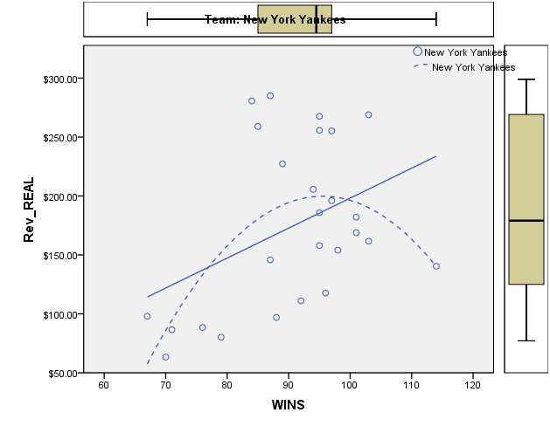
Example – Wins vs. Revenue Mega-Market Team

Slide 33
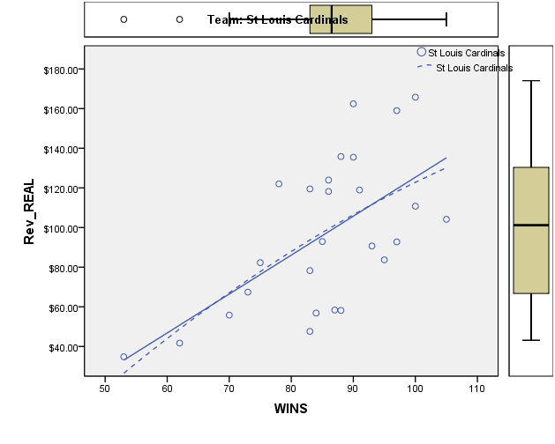
Example – Wins vs. Revenue Small Market Team

