Slide 1
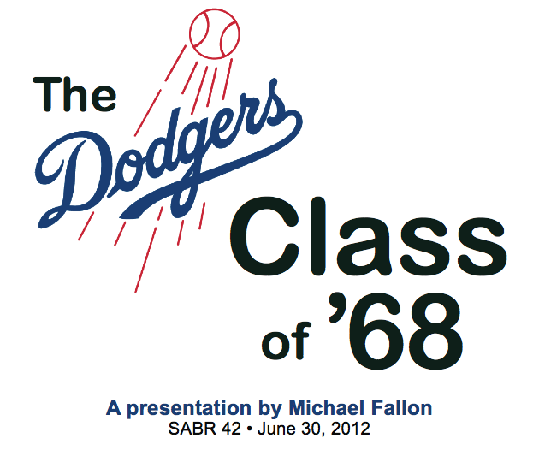

Slide 2
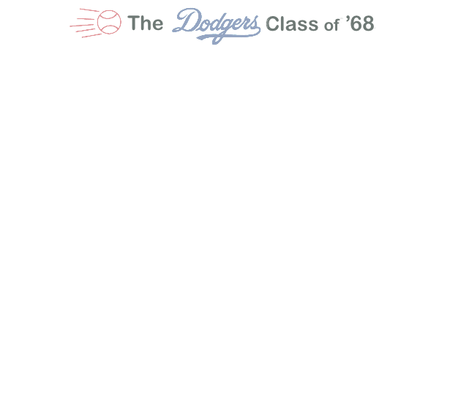
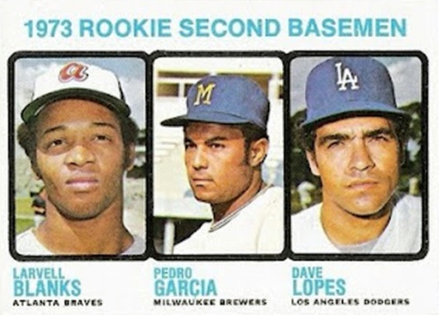
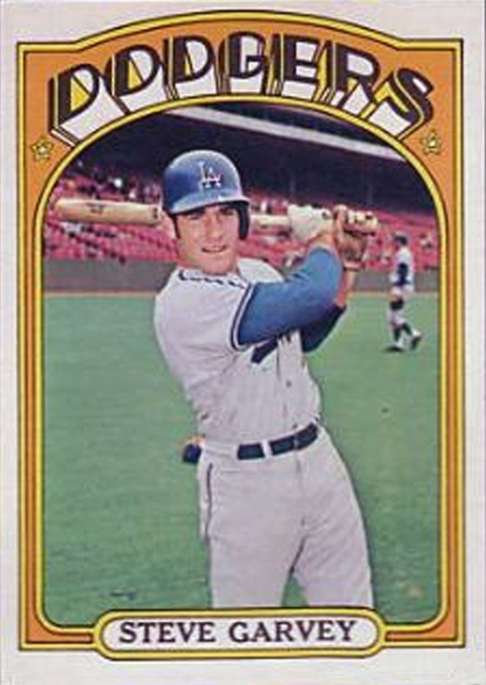
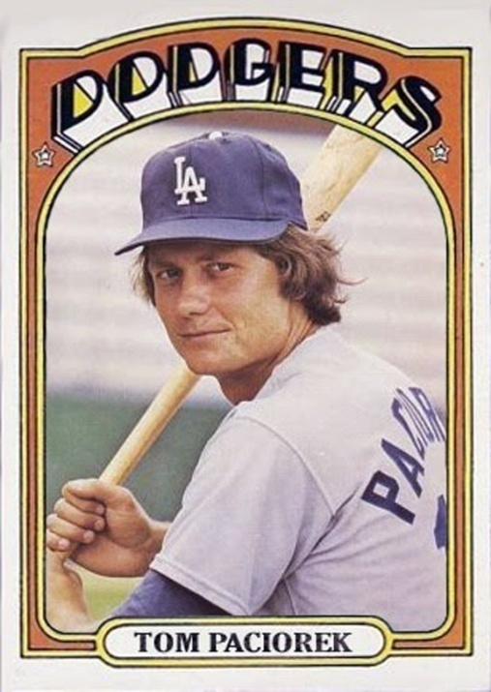
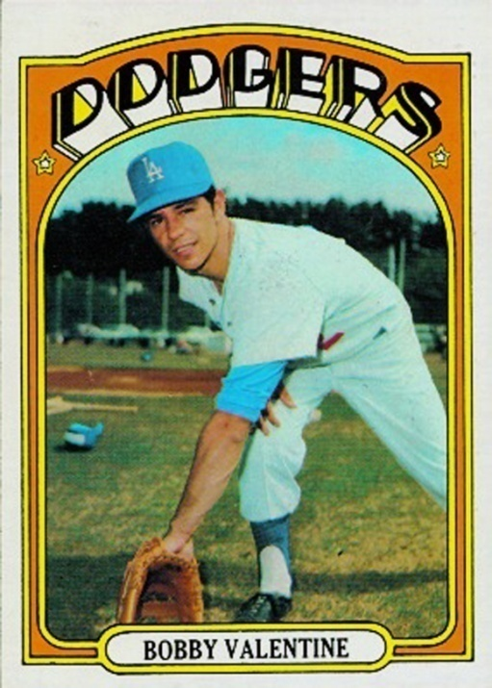
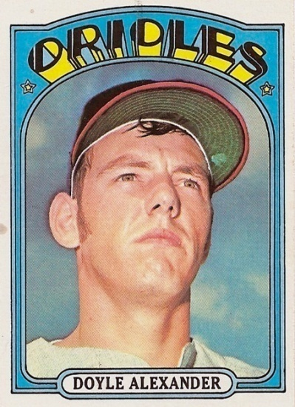
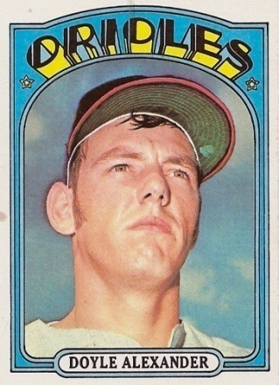
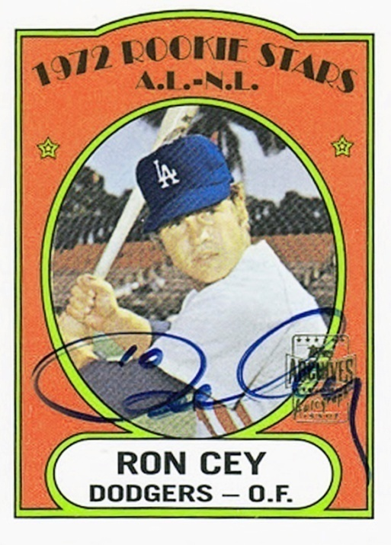
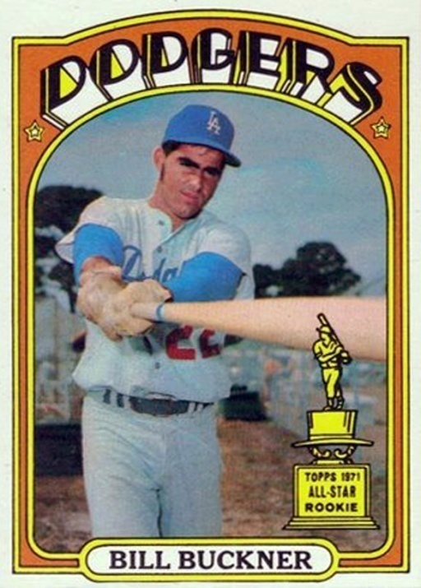
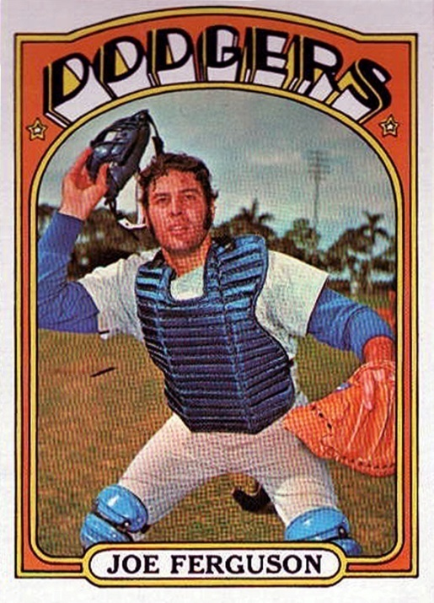
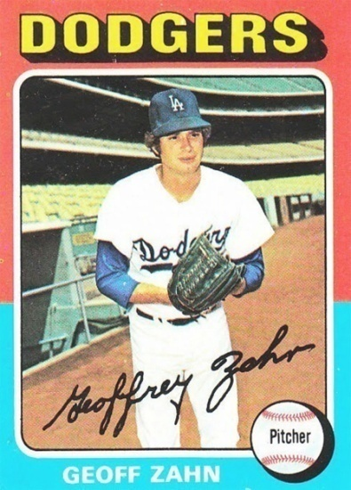

Slide 3
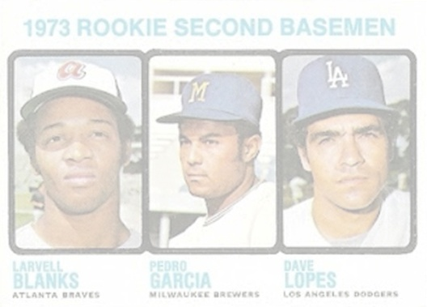
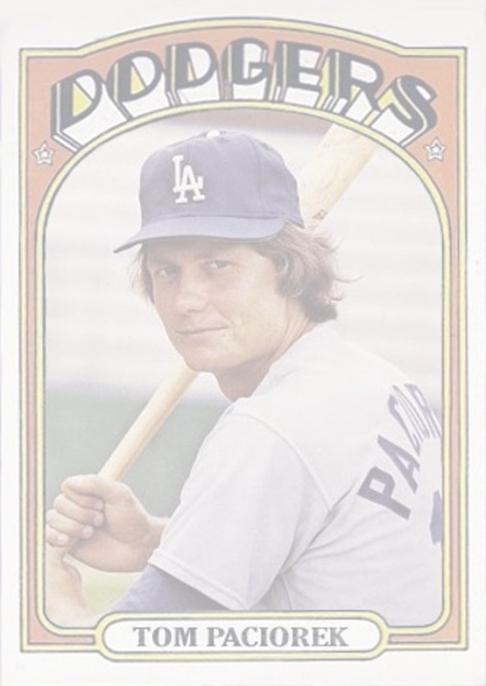
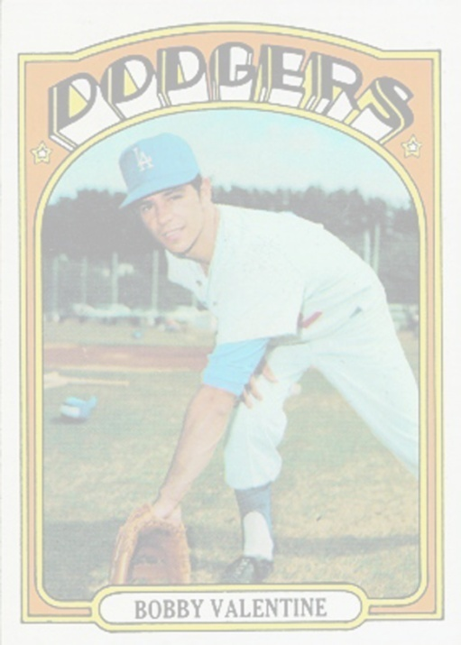
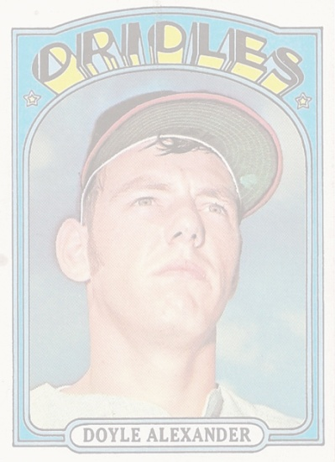
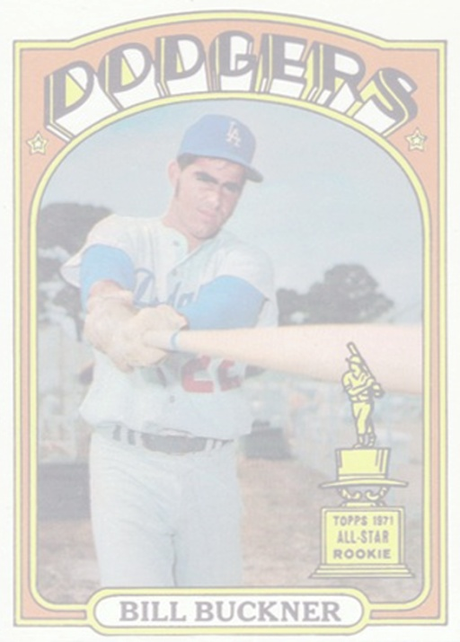
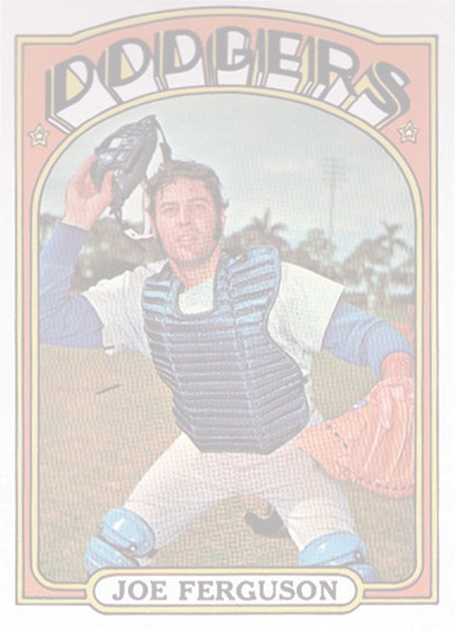
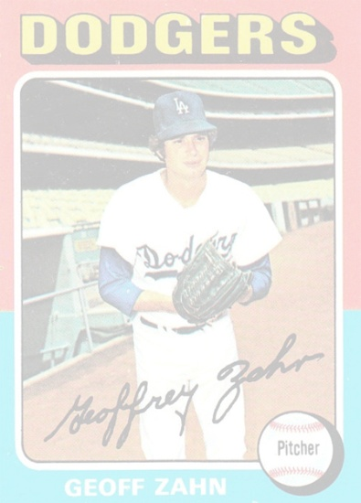
June Regular Draft (Dodgers choose 71 players)
^{Rd. Pick Player}
^{1. (5) Bobby Valentine}
^{2. (25) Bill Buckner}
^{5. (89) Tom Paciorek}
^{8. (137) Joe Ferguson}
^{9. (185) Doyle Alexander}

Slide 4
June Regular Draft (Dodgers choose 71 players)
^{Rd. Pick Player}
^{1. (5) Bobby Valentine}
^{2. (25) Bill Buckner}
^{5. (89) Tom Paciorek}
^{8. (137) Joe Ferguson}
^{9. (185) Doyle Alexander}
June Secondary Draft (Dodgers choose 7 players)
^{Rd. Pick Player}
^{1. (13) Steve Garvey}
^{3. (53) Ron Cey}

Slide 5
June Regular Draft (Dodgers choose 71 players)
^{Rd. Pick Player}
^{1. (5) Bobby Valentine}
^{2. (25) Bill Buckner}
^{5. (89) Tom Paciorek}
^{8. (137) Joe Ferguson}
^{9. (185) Doyle Alexander}
June Secondary Draft (Dodgers choose 7 players)
^{Rd. Pick Player}
^{1. (13) Steve Garvey}
^{3. (53) Ron Cey}
January Regular Draft (Dodgers choose 10 players)
^{Rd. Pick Player}
^{No players of note}
January Secondary Draft (Dodgers choose 13 players)
^{Rd. Pick Player}
^{2. (26) Dave Lopes}
^{5. (86) Geoff Zahn}

Slide 6
Average annual # of ML players in team draft classes, 1965-2006
Number of future major leaguers in Dodgers’ Class of 1968: 9

Slide 7
Average annual # of ML players in team draft classes, 1965-2006
Number of future major leaguers in Dodgers’ Class of 1968: 9
Historical average, 1965-2006: 4.874 major leaguers per class

Slide 8
Accomplishments of the Class of ’68
• Garvey, Cey, Lopes, & Russell = June, 1973 to Oct., 1981 (8.5 seasons)

Slide 9
Accomplishments of the Class of ’68
• Garvey, Cey, Lopes, & Russell = June, 1973 to Oct., 1981 (8.5 seasons)
• Average career of Class of ’68 = 16.4 seasons (vs. historic ave. 5.6 seasons*)
* Source: Sam Roberts, “Just How Long Does a Baseball Career Last?” New York Times, June 15, 2007

Slide 10
Accomplishments of the Class of ’68
• Garvey, Cey, Lopes, & Russell = June, 1973 to Oct., 1981 (8.5 seasons)
• Average career of Class of ’68 = 16.4 seasons (vs. historic ave. 5.6 seasons*)
• Steve Garvey = 1974 National League MVP
• Garvey, Cey, Lopes, Buckner, Alexander, & Paciorek = 23 All-Star Game appearances
* Source: Sam Roberts, “Just How Long Does a Baseball Career Last?” New York Times, June 15, 2007

Slide 11
Accomplishments of the Class of ’68
• Garvey, Cey, Lopes, & Russell = June, 1973 to Oct., 1981 (8.5 seasons)
• Average career of Class of ’68 = 16.4 seasons (vs. historic ave. 5.6 seasons*)
• Steve Garvey = 1974 National League MVP
• Garvey, Cey, Lopes, Buckner, Alexander, & Paciorek = 23 All-Star Game appearances
• World Series appearances in 1974 (vs. A’s), 1977 and 1978 (vs. Yankees)
• World Championship in 1981 (over Yankees)
* Source: Sam Roberts, “Just How Long Does a Baseball Career Last?” New York Times, June 15, 2007

Slide 12
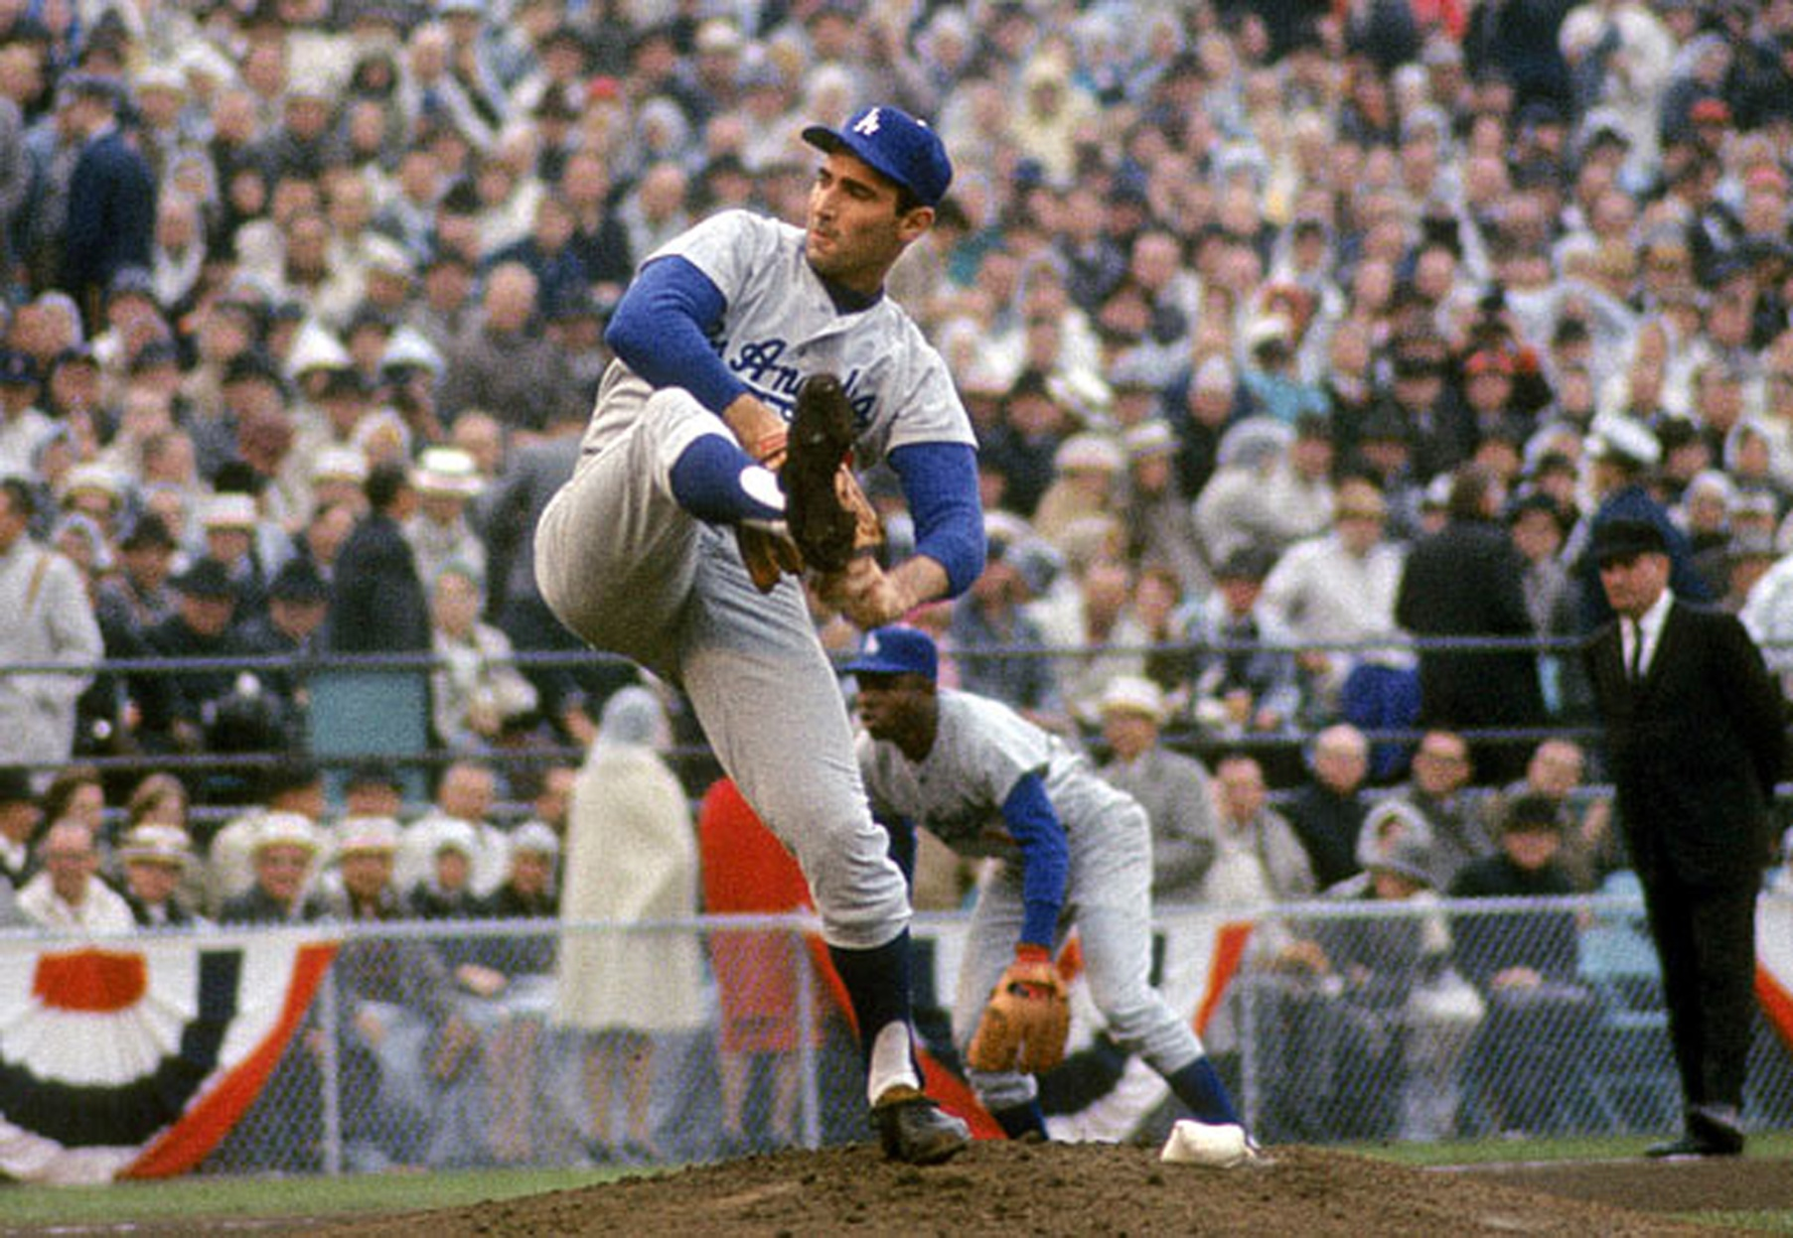
October 14, 1965 (Bloomington, Minnesota)

Slide 13
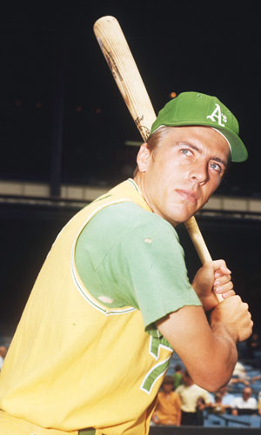
June 8, 1965
• MLB establishes First-Year Player (a.k.a “Rule
4”) Draft
• Primarily goals: More evenly distribute talent
and curtail spiraling bonus payments*
* Source: Allan Simpson, ed. The Baseball Draft: The First 25 Years (1965–1989). American Sports Pub., 1990.

Slide 14
June 8, 1965
• MLB establishes First-Year Player (a.k.a “Rule
4”) Draft
• Primarily goals: More evenly distribute talent
and curtail spiraling bonus payments*
• Opposed by four teams: The Yankees, Cardinals,
Mets, and Dodgers
• Dodger GM Buzzie Bavasi:*
1. Clubs will continue making same personnel
mistakes under this new system as under old;
2. It won’t save money;
3. It’s a form of socialism;
4. It penalizes the “industrious.”
* Source: Allan Simpson, ed. The Baseball Draft: The First 25 Years (1965–1989). American Sports Pub., 1990.

Slide 15
June 8, 1965
• Kansas City A’s in 1965: Monday, Bando, Tenace
(A’s in 1966: Reggie Jackson; 1967: Vida Blue)
• A’s W-L record, 1955-1964 = 634–936 (.403 %)
A’s W-L record, 1967-1976 = 884–726 (.549 %)
Rick Monday – Number one draft pick, 1965

Slide 16
June 8, 1965
• Kansas City A’s in 1965: Monday, Bando, Tenace
(A’s in 1966: Reggie Jackson; in 1967: Vida Blue)
• A’s W-L record, 1955-1964 = 634–936 (.403 %)
A’s W-L record, 1967-1976 = 884–726 (.549 %)
• Dodgers’ in 1965: Alan Foster, Leon Everitt, Gary
Moore
• Dodgers’ W-L record, 1965-1966: 192–132 (.593 %)
Dodgers’ W-L record, 1967-1968: 149–175 (.459 %)
• Dodgers’ hitting, 1967: .236 BA (10th), 519 runs (9th)
Dodgers’ hitting, May 1968: One run or less in 20 of
49 games
Rick Monday – Number one draft pick, 1965

Slide 17
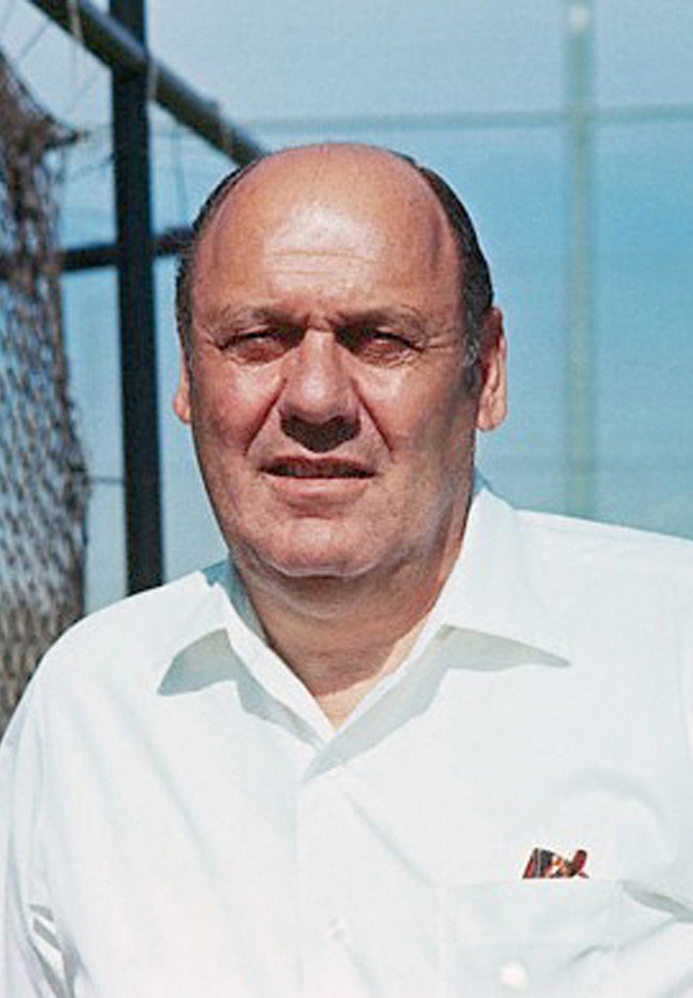
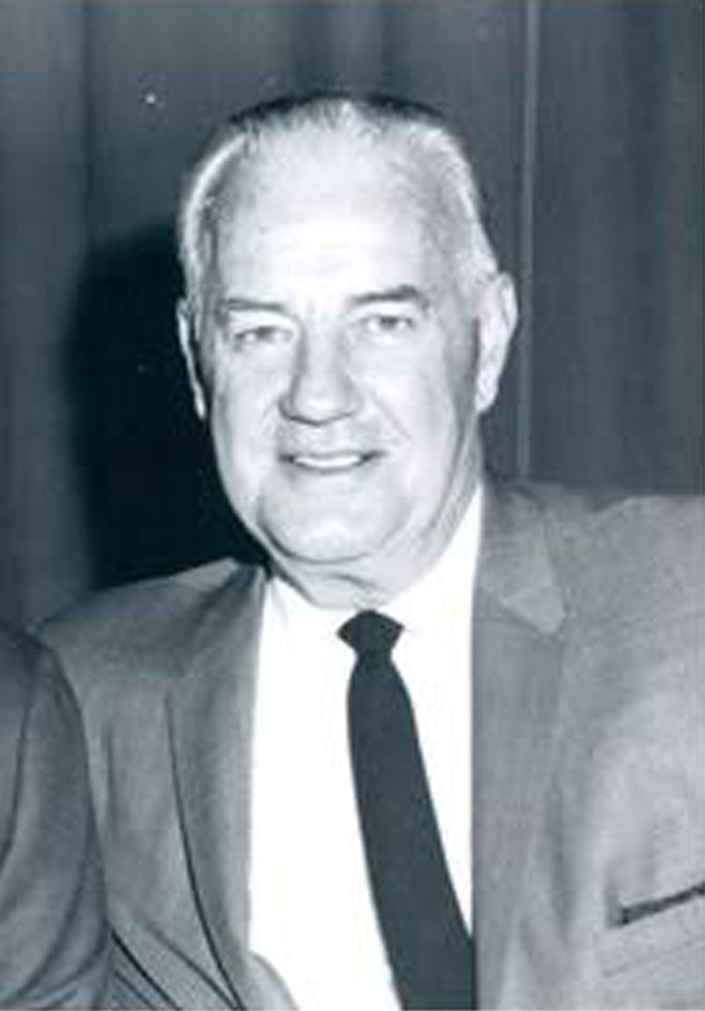
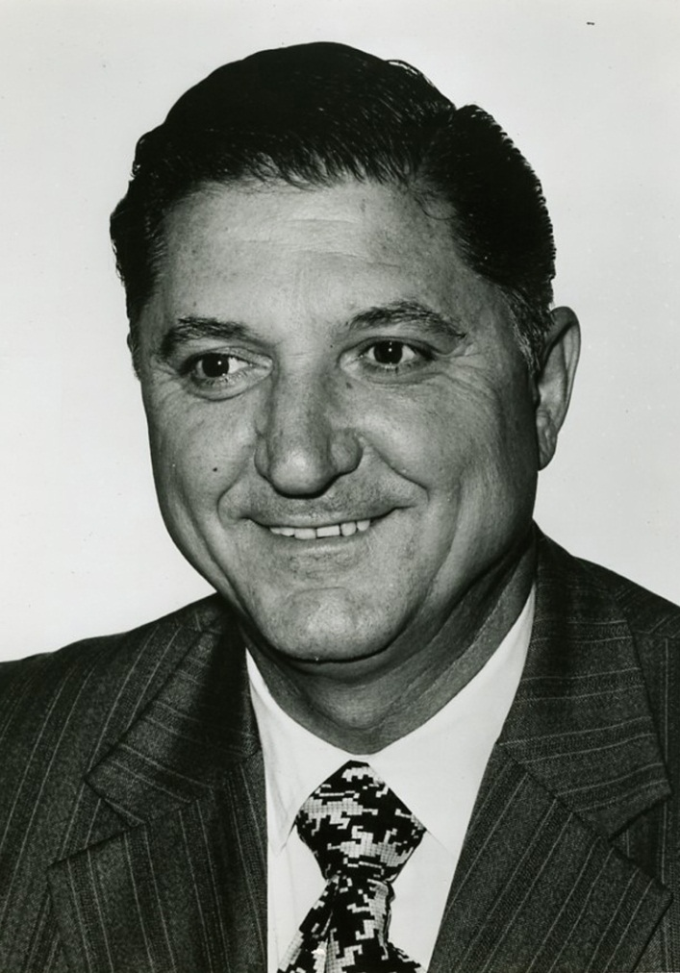
Dodger Brain Trust in 1968

Slide 18
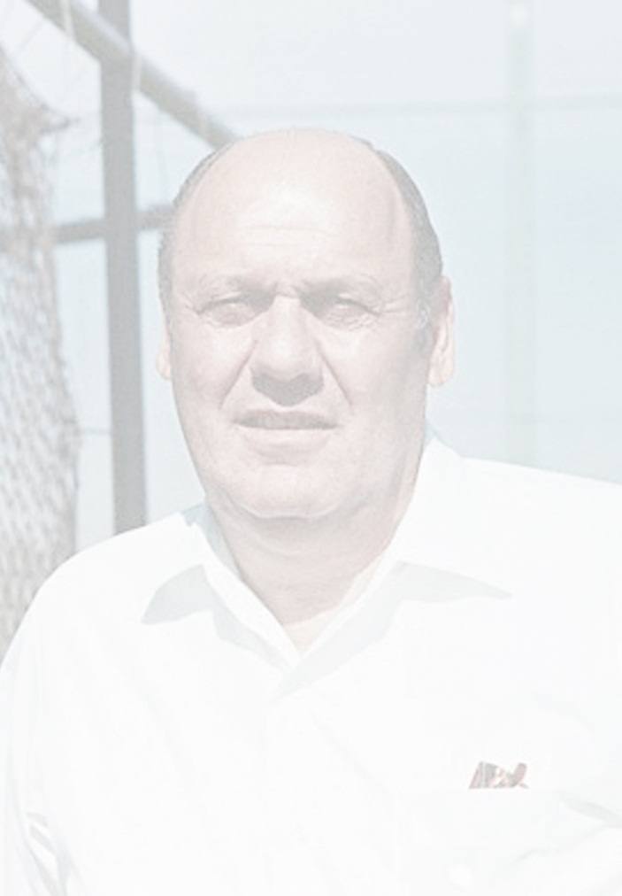
Dodger Brain Trust in 1968

Slide 19
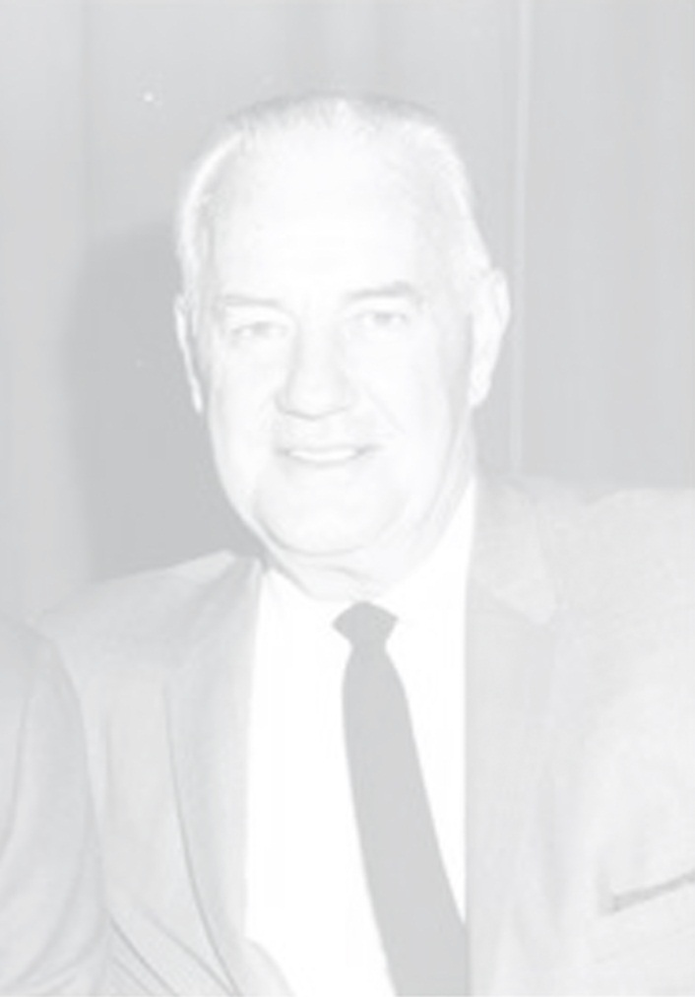
Dodger Brain Trust in 1968

Slide 20
The Campanis Strategy

Slide 21
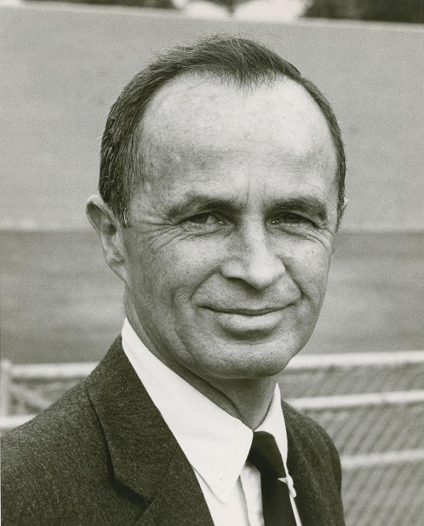
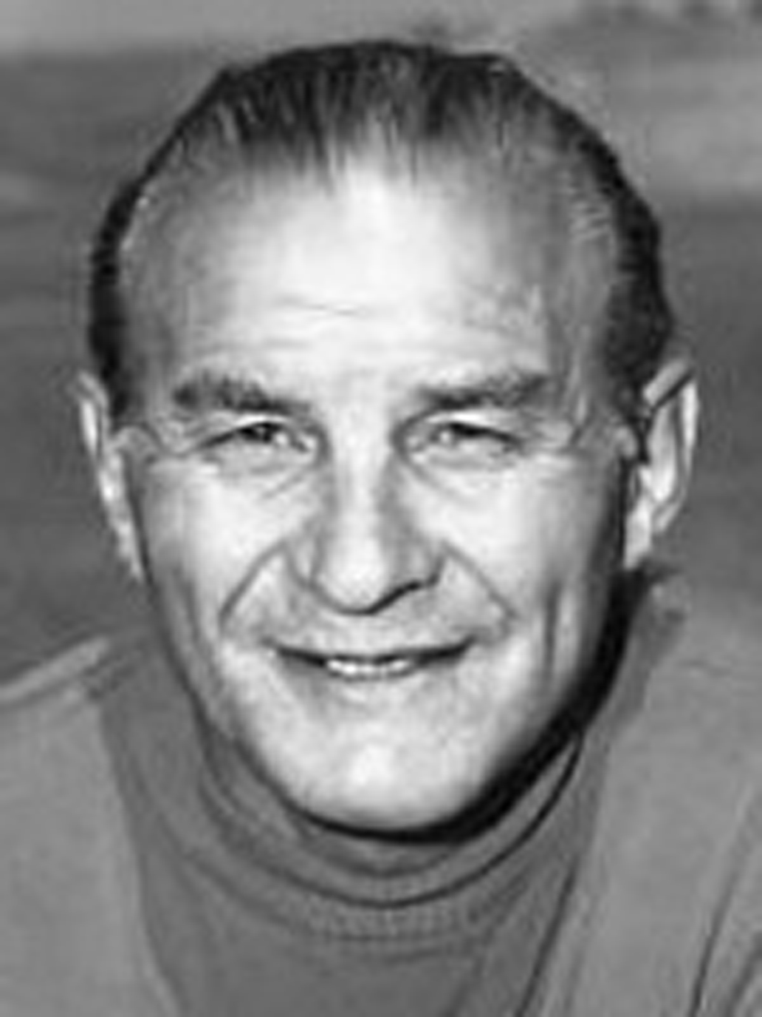
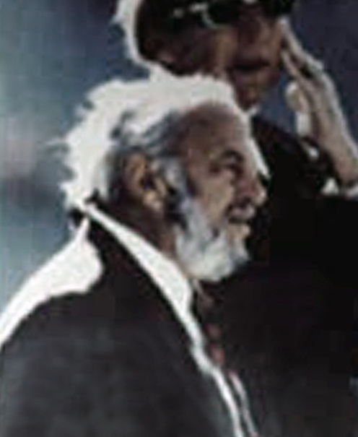
The Campanis Strategy

Slide 22
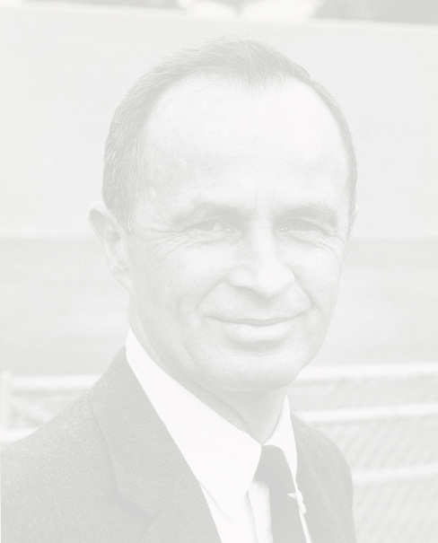


The Campanis Strategy
• Numbers—Schweppe: “The thought was that you
didn't know how well you would do signing these
players, so you better draft as many as you can.”*
(Dodgers in 1968 = 101 players in 50 rounds)
* Source: Tom Singer. “The Greatest Draft in Baseball History,” Mlb.com, May 8, 2008.

Slide 23
The Campanis Strategy
• Numbers—Schweppe: “The thought was that you
didn't know how well you would do signing these
players, so you better draft as many as you can.”*
(Dodgers in 1968 = 101 players in 50 rounds)
• Paperwork—LoCasale: “We spent a lot of time
talking about organization and preparing paperwork…
• Evaluation standards—“…How do you evaluate your
evaluators? You have to know what weight to assign
various people, how to break personnel down.”**
* Source: Tom Singer. “The Greatest Draft in Baseball History,” Mlb.com, May 8, 2008.
** Source: Allan Simpson, ed. The Baseball Draft: The First 25 Years...

Slide 24
The Campanis Strategy
• Numbers—Schweppe: “The thought was that you
didn't know how well you would do signing these
players, so you better draft as many as you can.”*
(Dodgers in 1968 = 101 players in 50 rounds)
• Paperwork—LoCasale: “We spent a lot of time
talking about organization and preparing paperwork…
• Evaluation standards—“…How do you evaluate your
evaluators? You have to know what weight to assign
various people, how to break personnel down.”**
• Best available talent—Campanis: “We told our scouts
to look for the cream…”
* Source: Tom Singer. “The Greatest Draft in Baseball History,” Mlb.com, May 8, 2008.
** Source: Allan Simpson, ed. The Baseball Draft: The First 25 Years...

Slide 25
Was the Dodgers’ Class of ’68 the Best Ever?
Was the Dodgers’ Class of ’68 the Best Ever?

Slide 26
Was the Dodgers’ Class of ’68 the Best Ever?
Was the Dodgers’ Class of ’68 the Best Ever?
^{Player} ^{Seasons played Career WAR}
Bobby Valentine 10 1.2
^{Bill Buckner 22} ^{19.7}
^{Tom Paciorek 18 6}
Joe Ferguson 14 19.7
Doyle Alexander 19 30
Steve Garvey 19 34.4
Ron Cey 17 50.4
Dave Lopes 16 40.3
Geoff Zahn 13 18.6
Total 148 212.4
Player ave. 16.44 23.6

Slide 27
Top Draft Classes 1965-1991 (Total Career WAR)
Top Draft Classes 1965-1991 (Total Career WAR)

Slide 28
Top Draft Classes 1965-1999 (Draft Team WAR)
Top Draft Classes 1965-1999 (Draft Team WAR)

Slide 29
Top Draft Classes 1965-2006 (Draft Team WAR)
Top Draft Classes 1965-2006 (Draft Team WAR)

Slide 30
