Slide 1
The 1890 Philadelphia Athletics
How a Pennant Contender Became the Worst Team of All Time
Justin Mckinney

Slide 2
The Philadelphia Athletics 1882-1889
Inaugural member of the American Association in 1882
First major league team in Philadelphia since 1876
Philadelphia gets an NL club in 1883, going 17-81
A’s won 1883 AA pennant and set attendance record – clear nearly $80,000
One of strongest clubs in AA, but never wins another pennant
Phillies improve throughout the decade and eventually overtake A’s in attendance
1889 A’s club finish third - reputation as lushers and some think it cost them the pennant

Slide 3
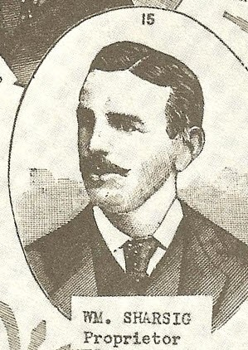
Billy Sharsig
Born 1855 in Philadelphia
Semi-pro player in late 1870s
Helped found Athletics in 1880
Joined with Lew Simmons, Charlie Mason to bring team into AA
1887 – Sharsig buys out other owners - partners with H.C. Pennypacker and William Whittaker
Acted as manager 1888-1890

Slide 4
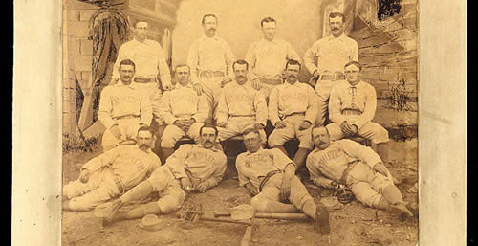

Slide 6
1890 – The Players’ League forms
Players’ League forms as a third major league
Numerous players defect to the new league
A’s lose 5 regulars including top hitter Harry Stovey and top pitcher Gus Weyhing
More concerningly, Philadelphia will have PL team, so the city will have 3 major league teams
1884 had proven that city could not support three teams – one would be left in the dust

Slide 7
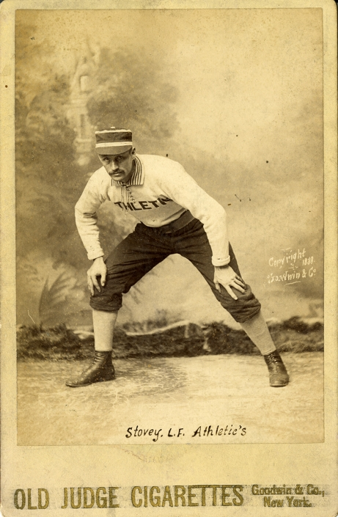
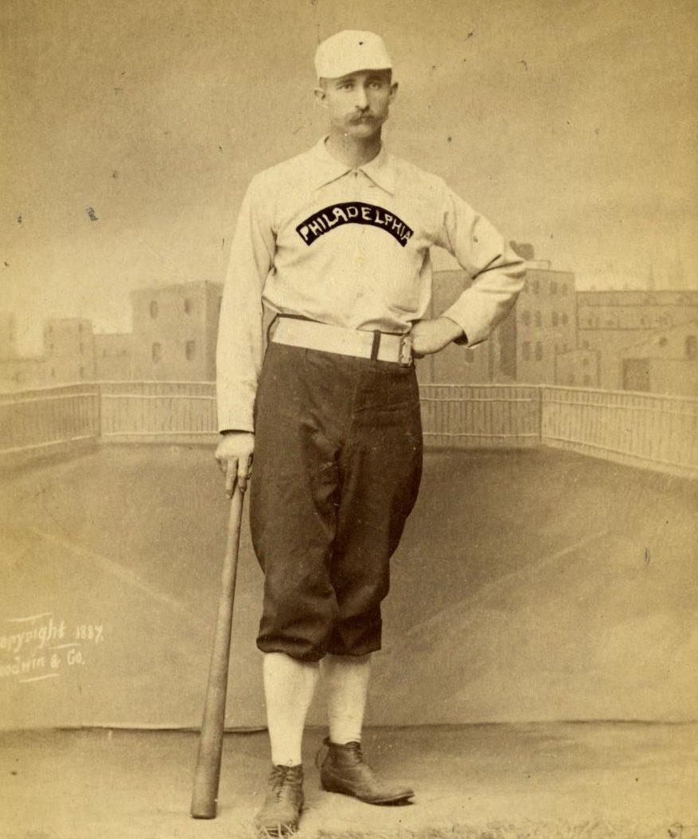

Slide 8
A Promising Bunch
A’s were less hard hit than other clubs
Were expected to contend in a weakened AA
Managed by Billy Sharsig
Opening day roster featured: C Wilbert Robinson, 1B Jack O’Brien, 2B Taylor Shafer, SS Ben Conroy, 3B Denny Lyons, OF Blondie Purcell, OF Orator Shafer, OF Curt Welch, P Sadie McMahon, P Ed Seward
Conroy and Shafer were inexperienced middle infield, but rest of team was solid

Slide 9
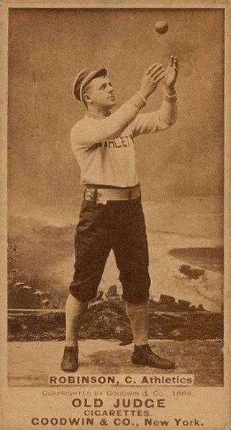
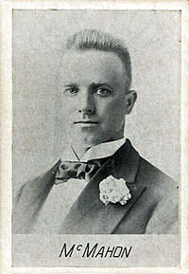

Slide 10
A Fast Start
The A’s start the season strong, jumping out to a 17-8 record and taking over first place on May 23
Attendance proving to be a struggle – PL making a huge dent
Home opener attendance for three clubs – PL 17,119, NL 6,952, AA 2,040
PL club has benefit of novelty, as well as fact that the new league is likely the strongest in baseball.
AA the weakest circuit

Slide 11
Into the Summer
A’s strong play continues and club remains in first place into July
Attendance improves, with a season high of 7,241 attending doubleheader sweep that puts club 20 games above .500 and a 6 game lead
Some red flags though – Ed Seward who had won 56 games in 1888-1889 struggles with injuries and ineffectiveness
Young Sadie McMahon starts to lag due to overwork, and Sharsig has trouble finding a replacement for Seward

Slide 12
Dog Days
Rumors of poor training habits plague team
McMahon struggles, Seward bad, and every new pitcher they try flames out
Louisville goes on a tear, while A’s collapse
Denny Lyons in middle of MVP quality campaign hitting .354/461/.531 with 193 OPS+
August 28 it all falls apart - Lyons shows up drunk to park and makes four errors at third base in demoralizing 21-8 loss to Columbus

Slide 13
Financial Peril
Sharsig and company are losing money on the year
Rumors of financial mismanagement by co-owner and treasurer William Whittaker
Attendance hindered by competition:
28 home games played in opposition – 13 where all three teams played
PL games averaged 3263 fans, NL - 2980, AA - 1476 in head to head competition
Attendance sunk as club fell out of race

Slide 14
Losing it all
Sharsig releases Lyons for drunkenness, though it was also a cost-cutting measure
Team was losing money and had fallen out of race
Reportedly $17,000 in debt and over a month left to play with costly western road trip upcoming

Slide 15
Losing it all
On September 16 – Sharsig makes a proposal to the team
Play out rest of season for share of gate receipts
Or be granted your release
Every veteran player is given their release
Curt Welch, Sadie McMahon, and Wilbert Robinson sign with Baltimore and will form nucleus of budding Orioles dynasty

Slide 16
Sharsig searches the scrap heap
What next for Sharsig’s Athletics?
Rumors that club would disband, but Sharsig had an idea
Sign new players to replace the departed and finish out the season
New club is disdainfully christened “Sharsig’s Amateurs”
He signs players from local sandlots and a few minor leaguers from the area
Begin road trip on September 18

Slide 17
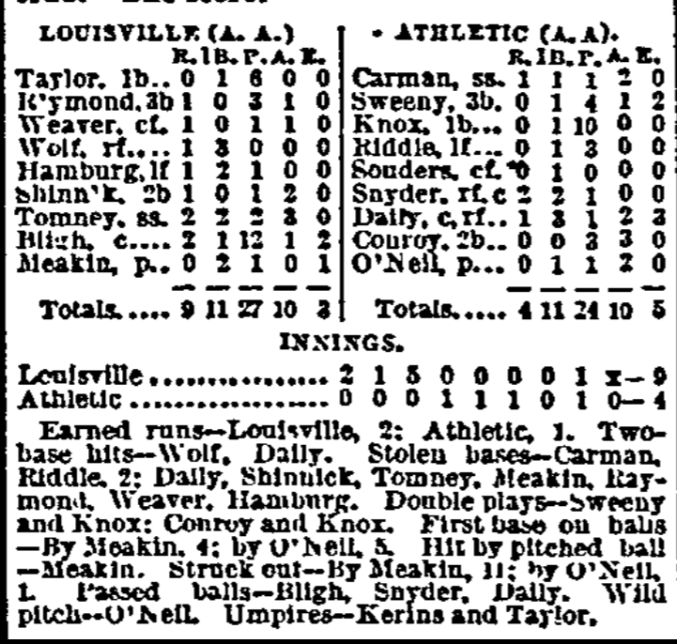
September 18, 1890 - A new club debuts
Don Carman, SS
Pete Sweeney, 3B
Andy Knox, 1B
John Riddle, LF
Al Sauters, CF
Charles Snyder, RF/C
Joe Daly, C/RF
Ben Conroy, 2B
Ed O’Neil, P
Ed Green, P
William Stecher, P

Slide 18
Sharsig’s Amateurs
Debut with a 9-4 loss on September 19 in Louisville
Ed Green, one of the holdovers, pitches game of a double header on September 20 and is torched by Louisville for 22 runs in 22-4 loss
William Stecher, another of the holdovers, loses 10-0 in game two
Another doubleheader in Louisville on September 21 sees Ed O’Neil fall 12-4 and Stecher lose 16-3
They then lose three more games in St. Louis by scores of 21-2, 15-3, and 7-3
Pick up a local player, Ed Pabst, to play left field

Slide 19
Ohio Blues
Next series was in Toledo, the AA’s fourth place club
Lose three games on September 27-28: 15-3, 11-9, 15-1
Teams took to scheduling doubleheaders when hosting the Amateurs
Off to visit Columbus, who would finish second for three game set
Fall 14-2, 14-0, and 9-2
In Columbus, they try a local battery late in final game with no success
William Lackey and a catcher known only as Macey

Slide 20
Running out of Syracuse
Final games on their road trip are a doubleheader in Syracuse on October 4
Ed Pabst who had been one of the only players with a pulse, hitting .400 in 8 games with 3 SB, leaves club and signs with his home town St. Louis
Syracuse was one of weaker clubs in league
The Amateurs almost win game one, falling 7-6, and then dropping game 2 by score of 6-1
A’s head back to Philly for final homestand

Slide 21
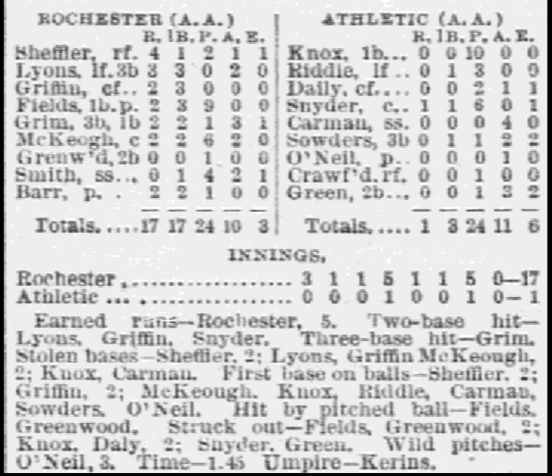
Not so triumphant return
Club returns to Philly for game on October 8 against Rochester
Lose 17-1 in front of 50 fans
Lose second game on October 9 – 10-4
Swept by Syracuse in doubleheader on October 11 – 16-1 and 15-4
Final game of the season on October 12

Slide 22
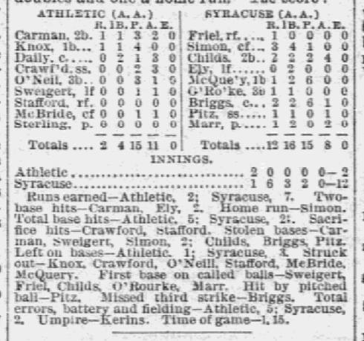
October 12, 1890
Sunday game in Gloucester, 20 people estimated to be in attendance
12-2 shellacking in five innings by visiting Syracuse
Four members of the A’s lineup that day remain unidentified – Crawford, Sweigert, McBride, Stafford
Starting pitcher, John Sterling, was only firmly ID’d earlier this year

Slide 23
Any Diamonds?
Of Sharsig’s misfits, only catcher Joe Daly appeared in the majors post-1890
A few had at least a modicum of ability:
Charles Snyder, 17-year-old catcher, hit .273 in his stint – had minor league career destroyed by alcoholism, and was dead before age 30
Crawford, IF/OF, of unknown origin but received praise for defense and Sharsig used him on several of his minor league and semi-pro teams in later years
Andy Knox, giant first baseman, posted .333 OBP in his A’s stint with 5 steals, 8 RBI, 9 BB – had minor league career afterward

Slide 24
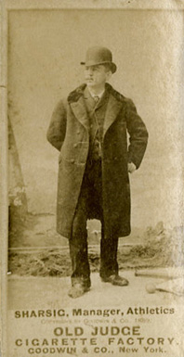
Aftermath
The club disbands immediately after the season
Players’ League collapses in off-season
PL Quakers join the AA to replace the departed Athletics and assume the same name
Sharsig named manager of the 1891 club, but is dismissed after 6-11 start
Despite the 1890 debacle, Sharsig remains a respected figure in the city
Later manages several minor league clubs and is hired by Connie Mack in 1901 as A’s business manager
Died February 1, 1902

Slide 25
Worst Team of All Time: By the Numbers
Sharsig’s Amateurs are the worst baseball team in major league history
0-21 record with 59 runs scored and 273 runs allowed
No team in major league history ever allowed more runs or posted a worse run differential (-214) over a 21-game stretch
20th century record is 202 runs allowed over 21 games by 1930 Phillies

Slide 26
Team | First Game | Last Game | Runs Scored | Runs Allowed
Philadelphia (AA) | September 19, 1890 | October 12, 1890 | 59 | 273
Pittsburgh (NL) | July 11, 1890 | August 17, 1890 | 100 | 265
Brooklyn (NA)* | July 9, 1875 | October 9, 1875 | 60 | 227
Louisville (AA) | May 22, 1889 | June 17, 1889 | 100 | 201
Cleveland (NL) | September 13, 1899 | October 15, 1899 | 58 | 199

Slide 27
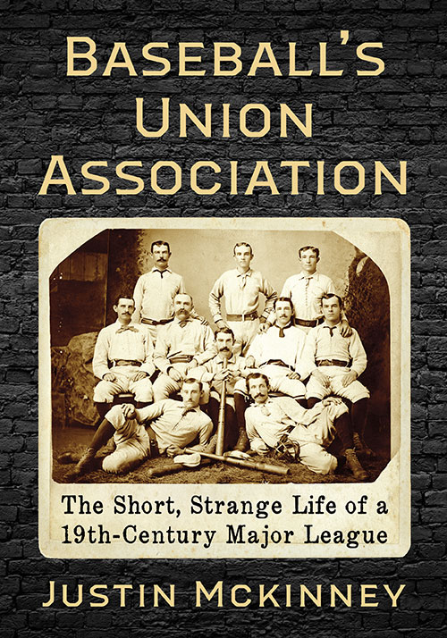
Baseball’s Union Association
Available now
https://mcfarlandbooks.com/product/baseballs-union-association/
Winner of 2023 SABR Baseball Research Award
Questions? Comments?
Twitter: @just_mckinney
Email: just.mckinney@gmail.com

