Slide 1
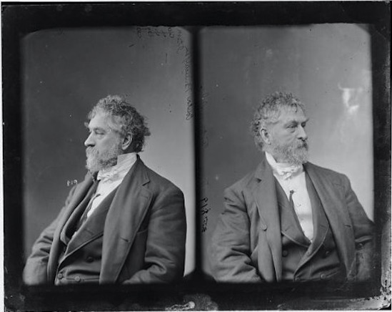
Colonel Thomas Fitzgerald,
Philadelphia publisher, baseball man, playwright
and lecturer on mozart

Slide 2
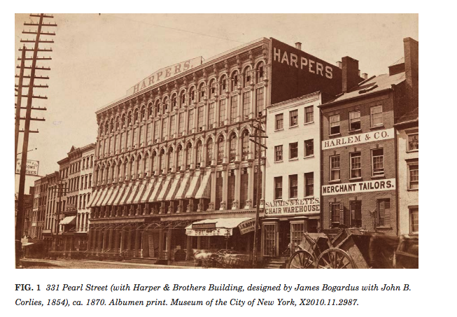
Harper Brothers’ printing
house on NYC’s
franklin square

Slide 3
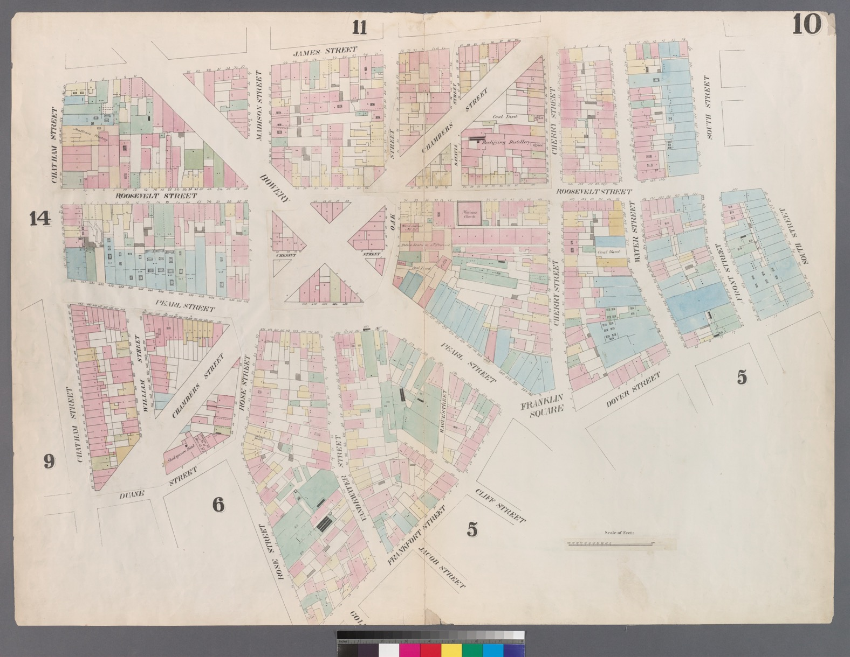
NYC’s 4th ward, where
Thomas Fitzgerald was
born and raised

Slide 4
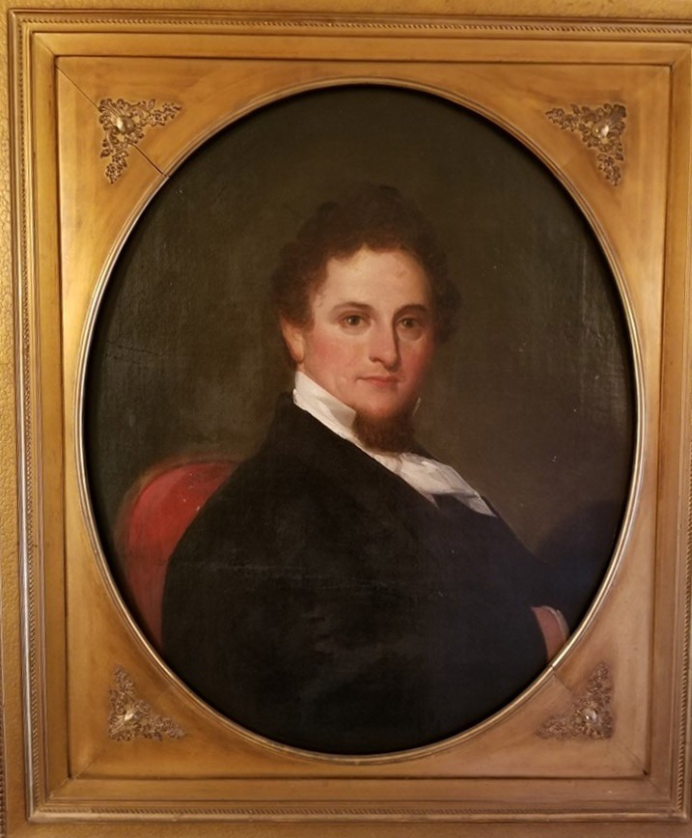
The young and newly
reinvented Fitzgerald,
c. 1850

Slide 5
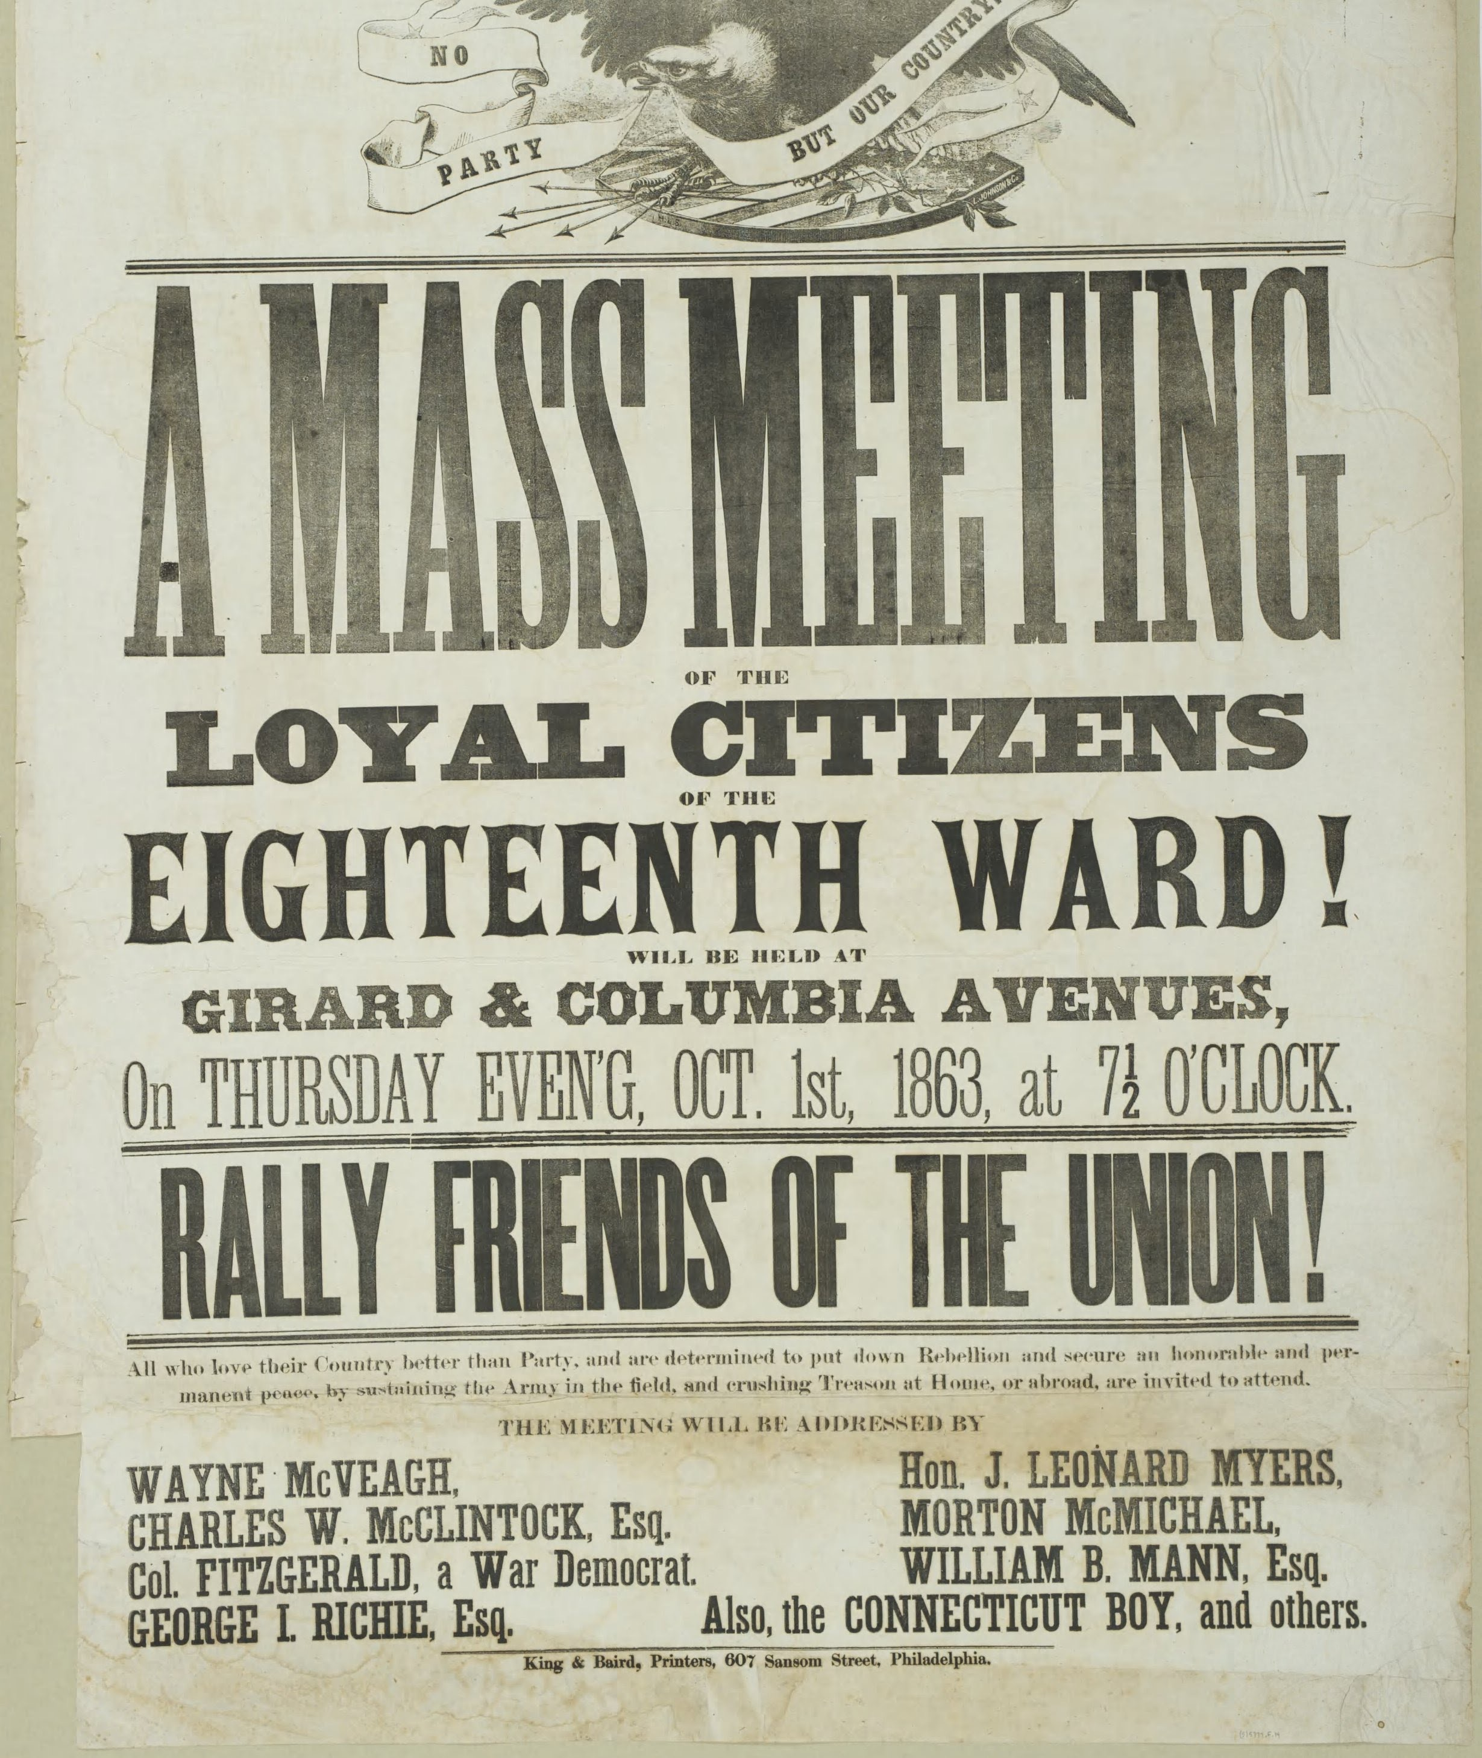
Fitzgerald campaigned
with Abraham Lincoln as
An abolitionist and
war democrat

Slide 6
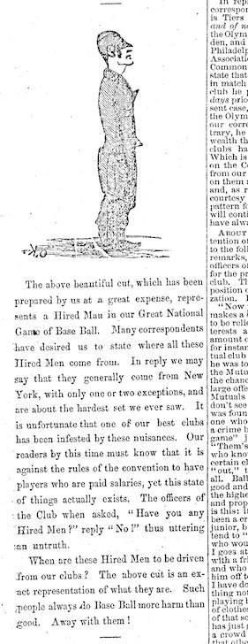
A caricature of a baseball
“hired man” that ran in Fitzgerald’s
City Item newspaper in 1866

Slide 7
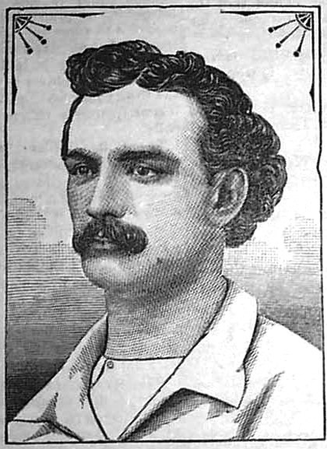
Lipman Pike, a genuine “hired man” who played in Brooklyn, Philadelphia, Irvington NJ,
Troy NY, New York City, Baltimore,
Hartford CT, St. Louis, Cincinnati,
Providence & Worcester, MA

Slide 8
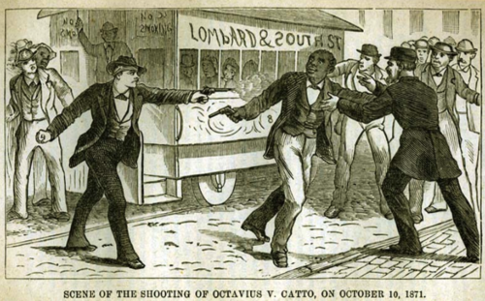
The 1871 assassination of
civil rights activist and baseball
man Octavius Catto

Slide 9
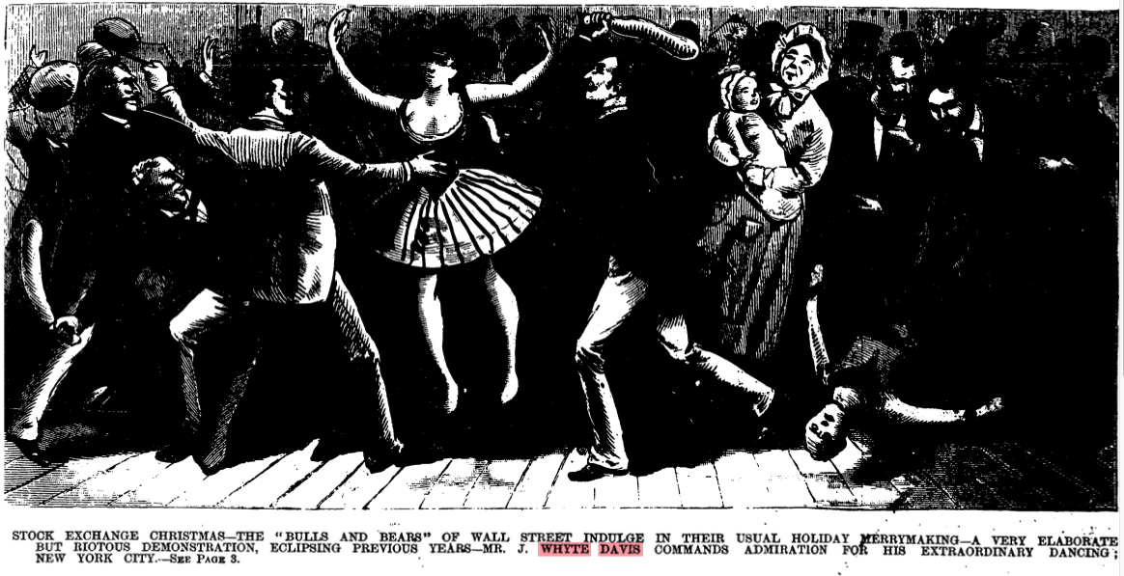
JJAMJAMES W. DAVIS DANCE CHAMPION

Slide 10
