Slide 1
Can An Across-the-Board Increase in Minor League Pay Reduce PED Use?
Scott Brave
Economic Research
Federal Reserve Bank of Chicago
March 15, 2020
Co-authors: Daniel Aaronson
Ross Cole
Olivia Zhao
*The views expressed herein are those of the authors and not those of the Federal Reserve Bank of Chicago or the Federal Reserve System.

Slide 2
Is there a connection between MiLB pay and PED use?
Large literature in economics on cheating to appeal to for answers
Key Takeaway: The larger the (net) reward, the more likely cheating occurs
PEDs can be costly (suspensions/fines)…but are they worth the risk?
Question a player might ask: Can PED use get me over the hump?
Off the bench and onto the field
Moved up in the lineup or rotation
Or to a bigger paycheck

Slide 3
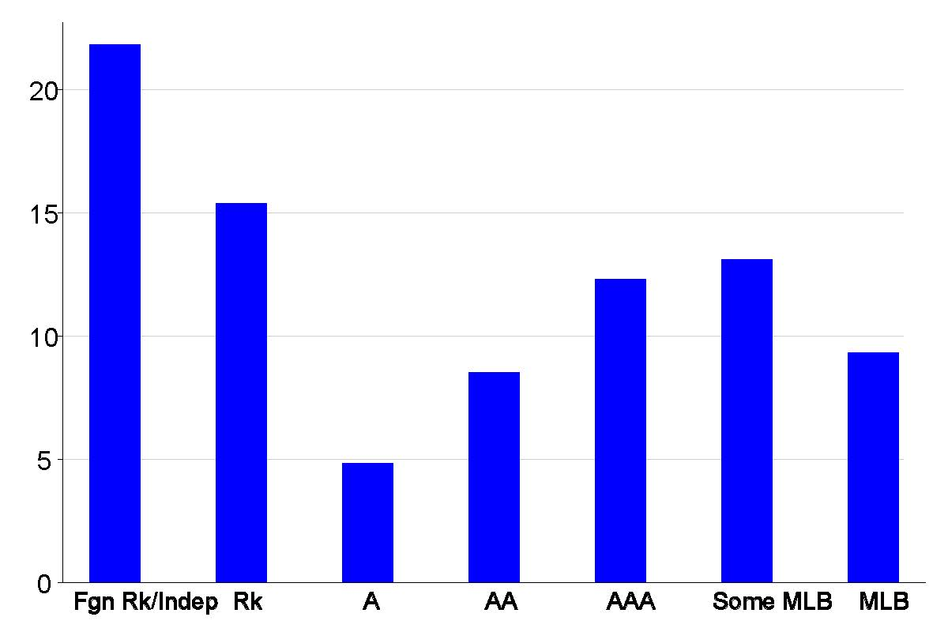
Who uses PEDs?
All PED Suspensions, 2005-2019 seasons
* Shown as % of total roster size. Some MLB is MiLB players on 40-man rosters.
Based on suspension data from MLB.com and MiLB.com and rosters from Baseball Reference.

Slide 4
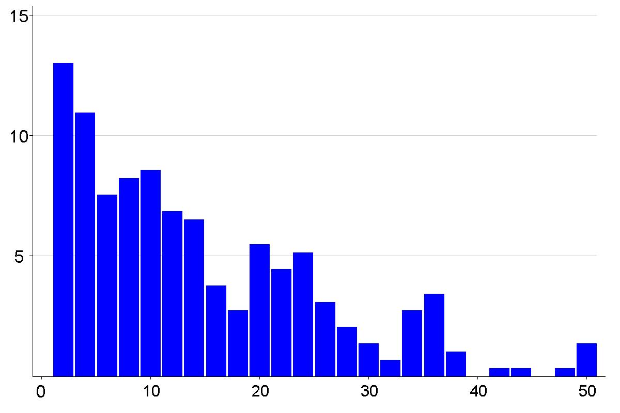
Who uses PEDs?
Suspensions by Player’s Draft Round
* Shown as % of draft round size. Undrafted players treated as round 51 (not shown).
Based on suspension data from MLB.com and MiLB.com and rosters from Baseball Reference.

Slide 5
Our Model
Calculates distances to promotion/demotion thresholds
that define pay changes for MiLB players to identify an “At-Risk” zone for PED use
Ordered probit model with endogenous Performance and PED suspensions
Next Season Level Assignment (Out, Fgn Rk/Indep, Rk, A, AA, AAA, MLB)
Current Season Performance (WHIP/wOBA normalized to level average)
Current Season PED Suspension Status (0=False, 1=True)
Pay is included in each equation with marginal impacts that vary by base wage levels
Inferred based on level (Rk/A-, A, A+, AA, AAA), experience, and 40-man roster status
Coefficients on Current Season PED Suspension Status are of primary interest
Additional controls: Age, Experience, Draft Round, Birthplace, MLB debut indicator, Previous Season Performance, Current Season Teammate Performance, Current Level interacted with Times Repeated and PED Suspension indicator, Previous Season Level, PED Suspension Fine Structure, and Position, Season, League and Affiliate indicators
Assumes model errors are jointly normally distributed and estimates their correlations

Slide 6
Sample includes the 2005-2018 seasons
Only MLB-affiliated minor league teams
Excludes Winter, Fall, and Summer Leagues
Only the highest level attained in each season through 2019 is recorded
Performance is appearance-weighted across all levels in a season
77,965 player-season observations, 26,488 players, and 315 PED suspensions
Aims to explain the player transitions recorded by Baseball Reference
 | Next Season Level
Current Level | Out | Fgn Rk/Indep | Rk | A | AA | AAA | MLB
Rk | 27.8 | 5.2 | 26.4 | 38.1 | 1.2 | 1.2 | 0.1
A | 21.5 | 7.1 | 1.7 | 43.5 | 19.7 | 5.1 | 1.3
AA | 15.7 | 9.4 | 0.5 | 5.4 | 29.8 | 27.8 | 11.6
AAA | 17.0 | 11.3 | 0.3 | 3.2 | 11.6 | 40.5 | 16.1

Slide 7
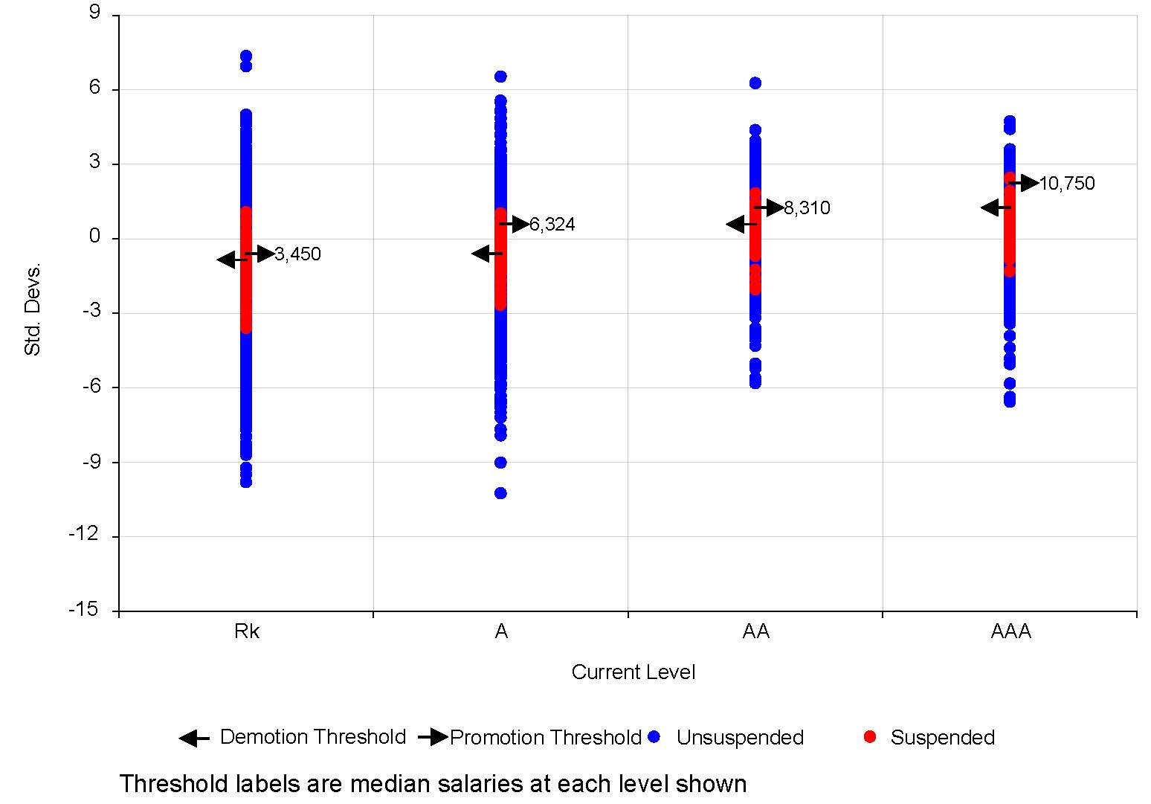
Model translates player characteristics into an index
And defines corresponding thresholds for transitions
Thresholds mirror the pay structure across levels
Suspended players tend to cluster in the “At-Risk” zone between the thresholds
Size of this region varies across levels, but generally increases as the player gets closer to MLB

Slide 8
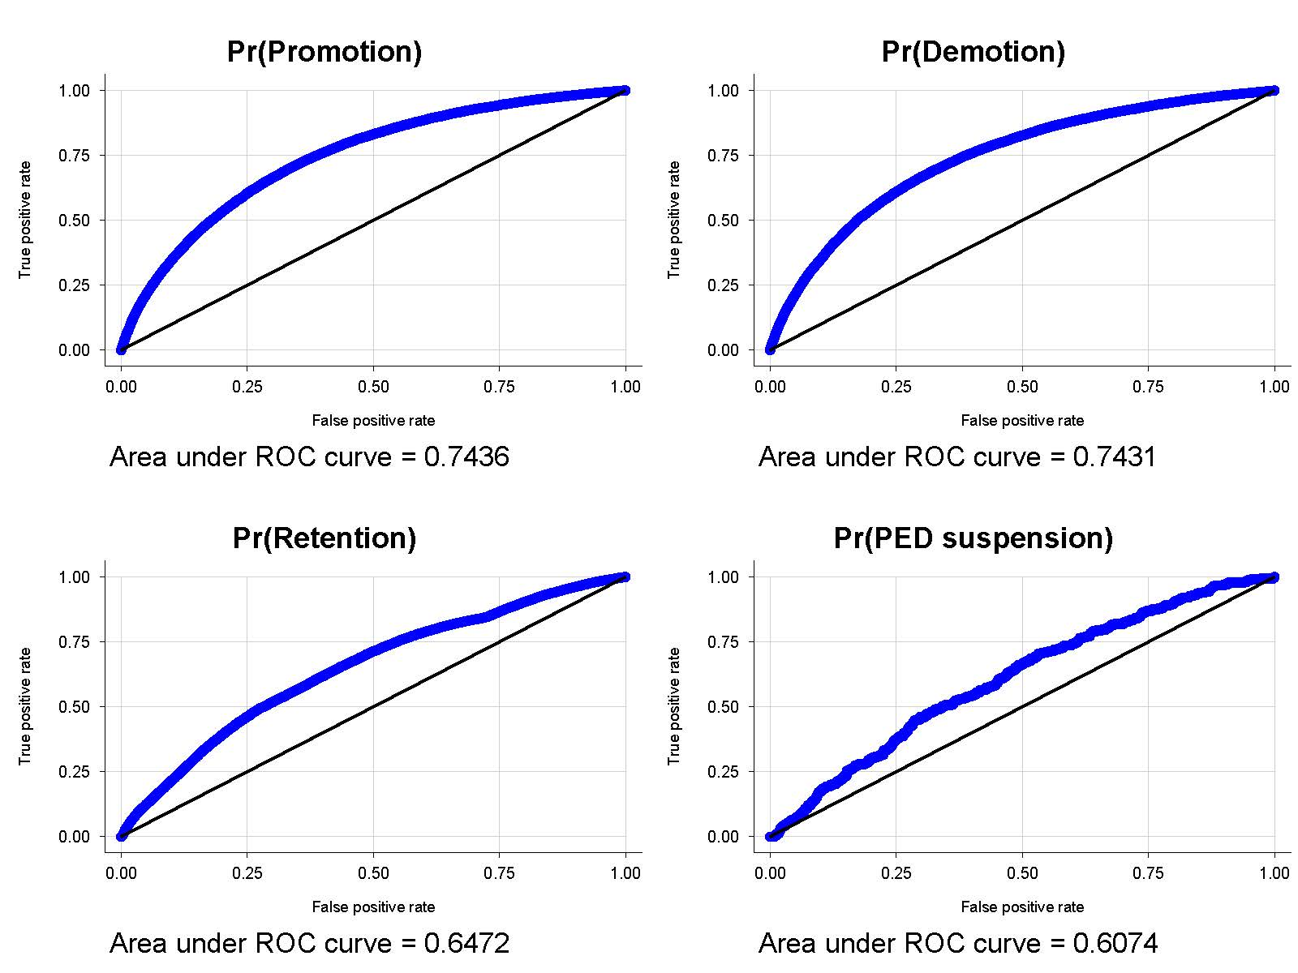
Caveats: Still a work in progress to define these zones
Model implies more transitions than actually exist
Pay must be inferred (variation over time may be missing)
But selection bias well accounted for currently
+ correlation between PED use & performance and level
- correlation between performance & level

Slide 9
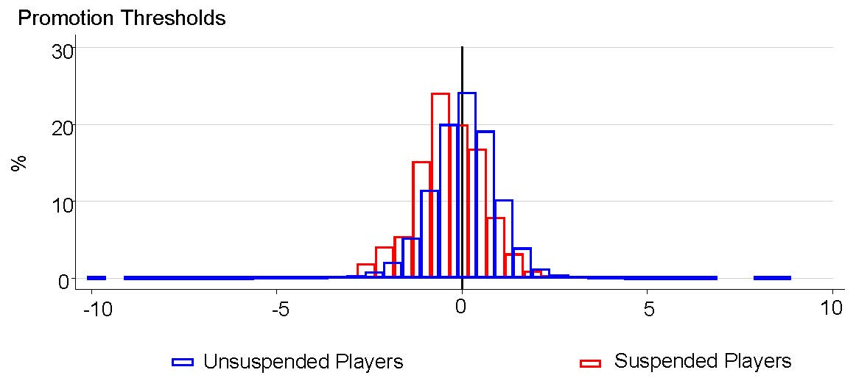
Who uses PEDs?
Can now appeal to our distance measures from the nearest thresholds
PED users are more likely to fall just below the promotion threshold for their level

Slide 10
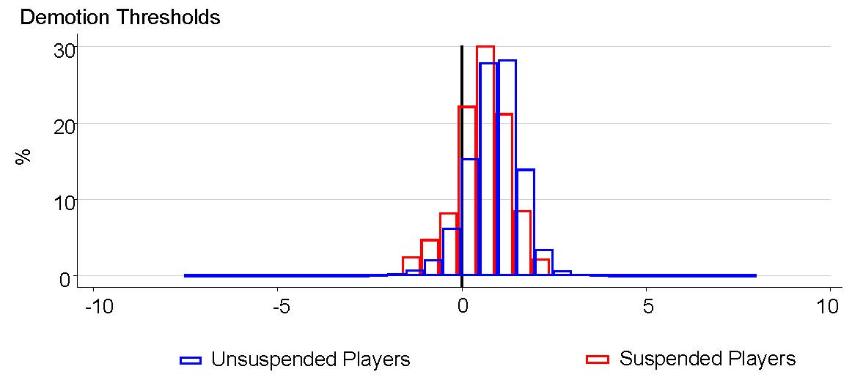
Who uses PEDs?
Can now appeal to our distance measures from the nearest thresholds
And also are more likely to fall just above the demotion threshold for their level

Slide 11
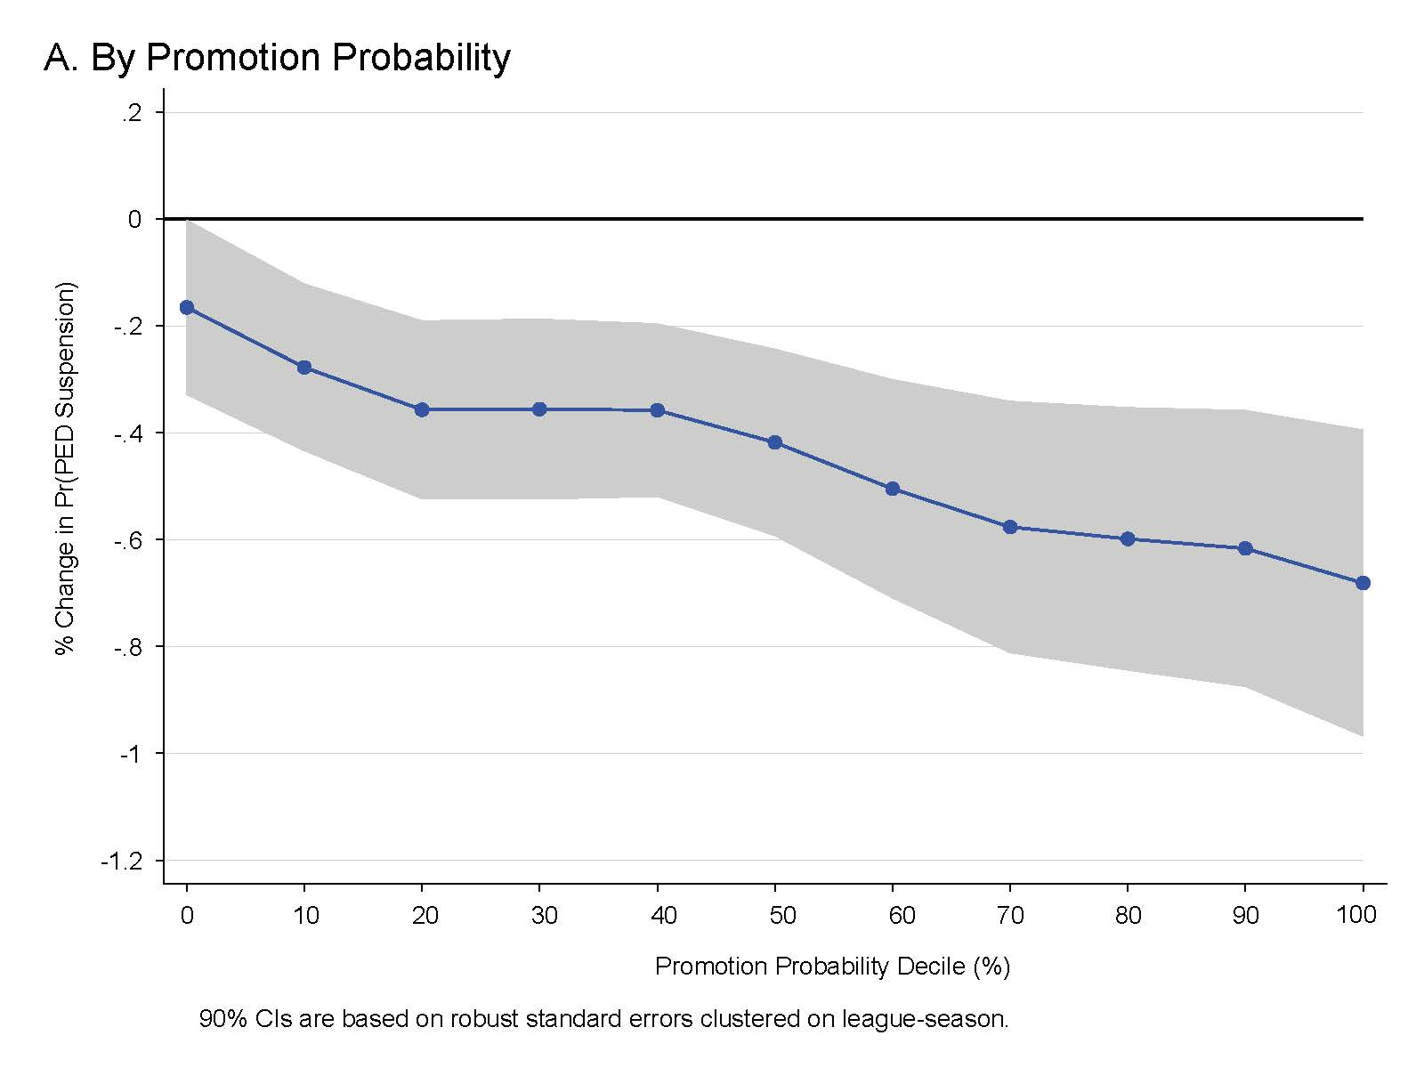
Who uses PEDs?
Average marginal effects for 1% pay increase
Those players with the most to gain.

Slide 12
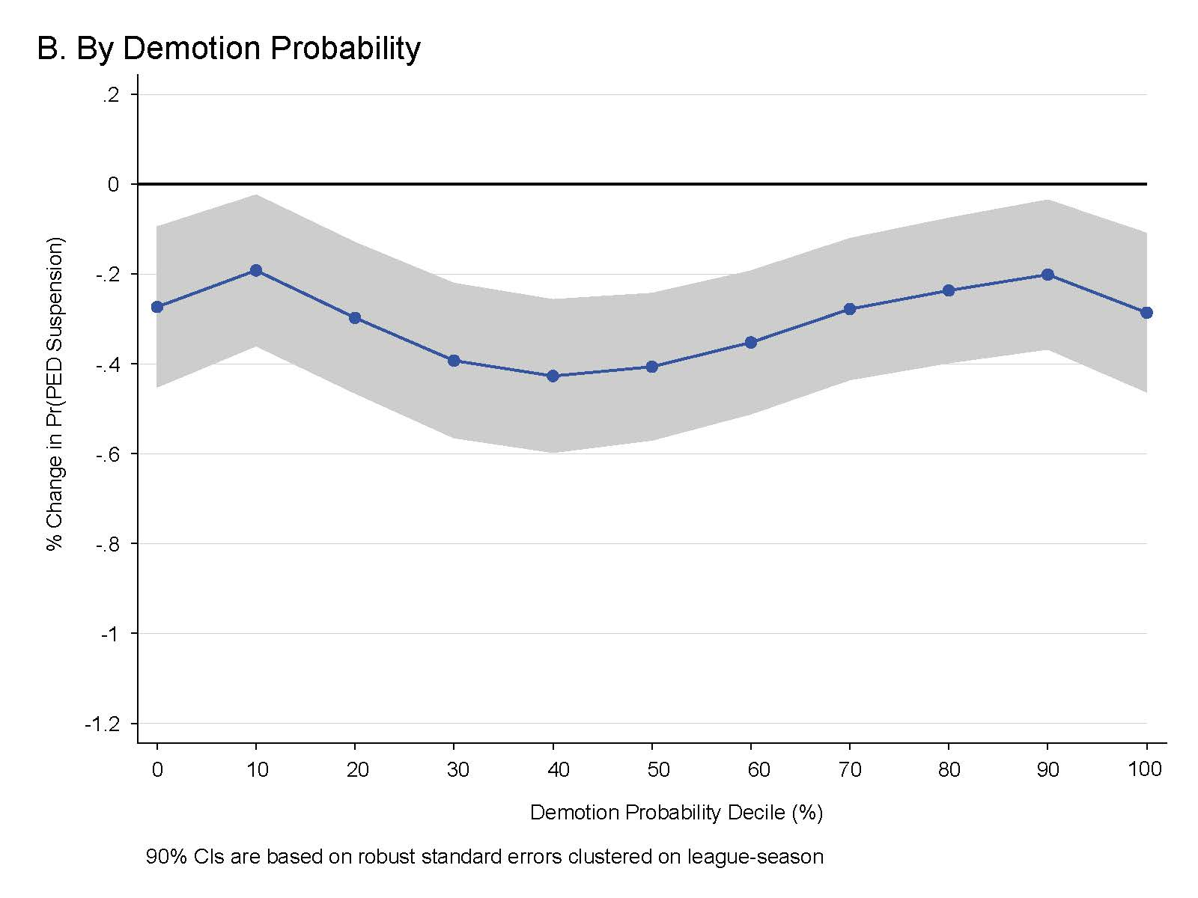
Who uses PEDs?
Average marginal effects for 1% pay increase
And those with something to lose

Slide 13
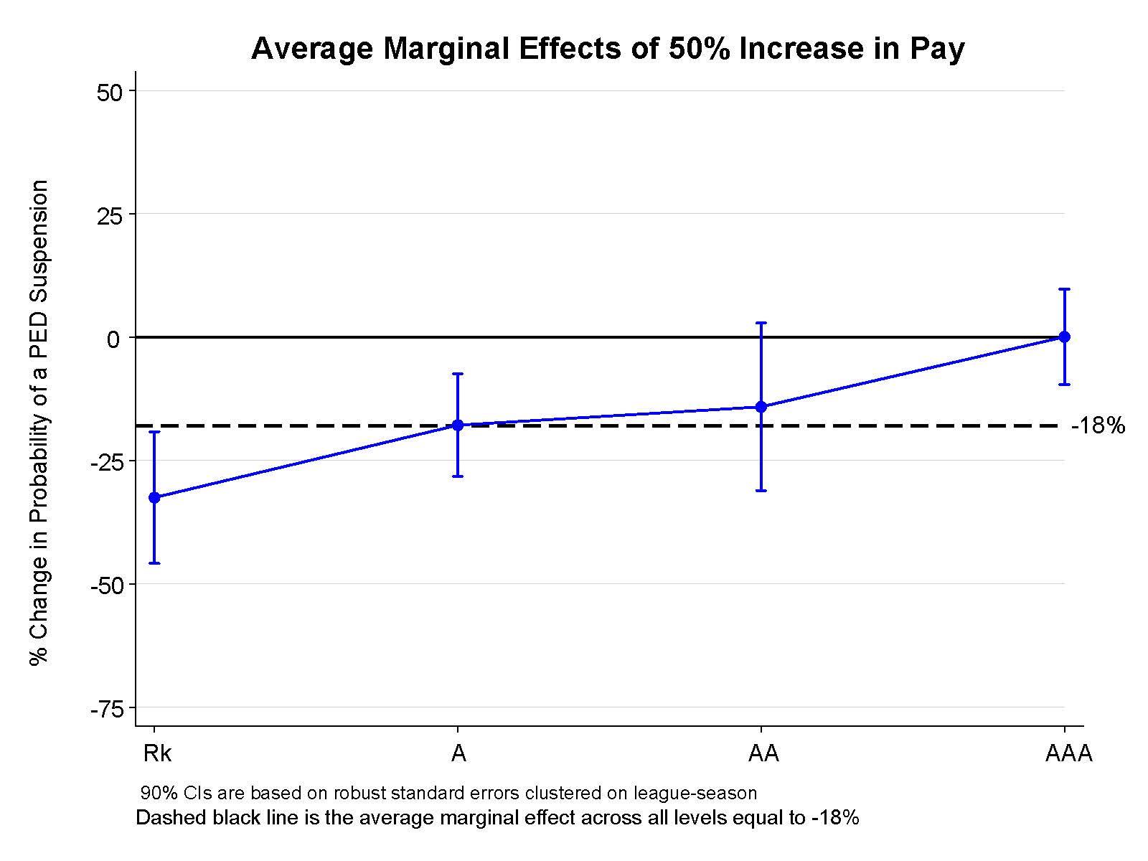
The Toronto Experiment
Prior to 2019 season, the Blue Jays implemented an across-the-board pay increase of roughly 50% for MiLB players

Slide 14
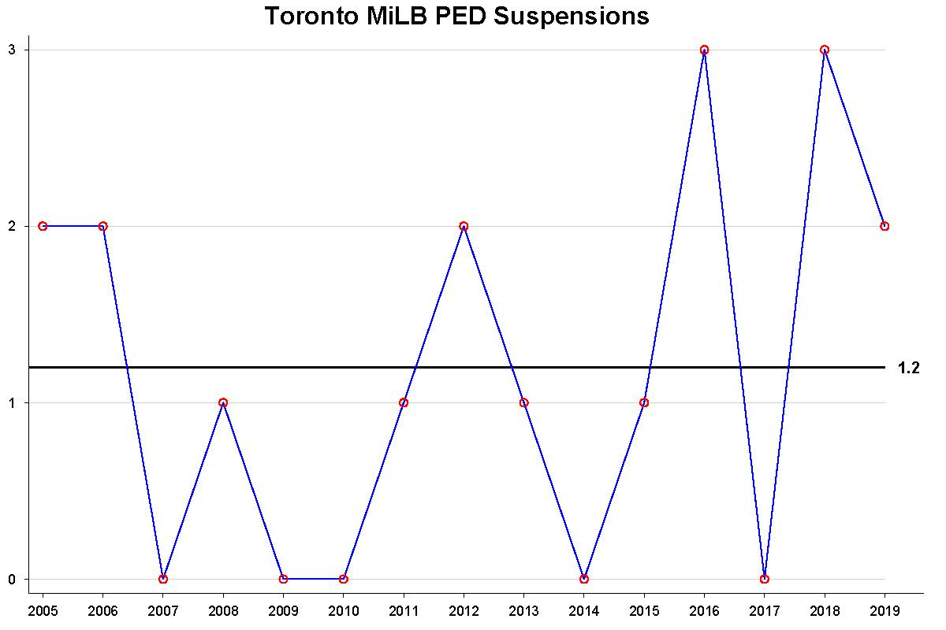
Why should Toronto (and all MLB teams) care?
Brave and Roberts (JSE, 2019):
MiLB PED suspensions >1 for a team in a season on average reduces their Forbes franchise value estimate by about $6 million per suspension

Slide 15
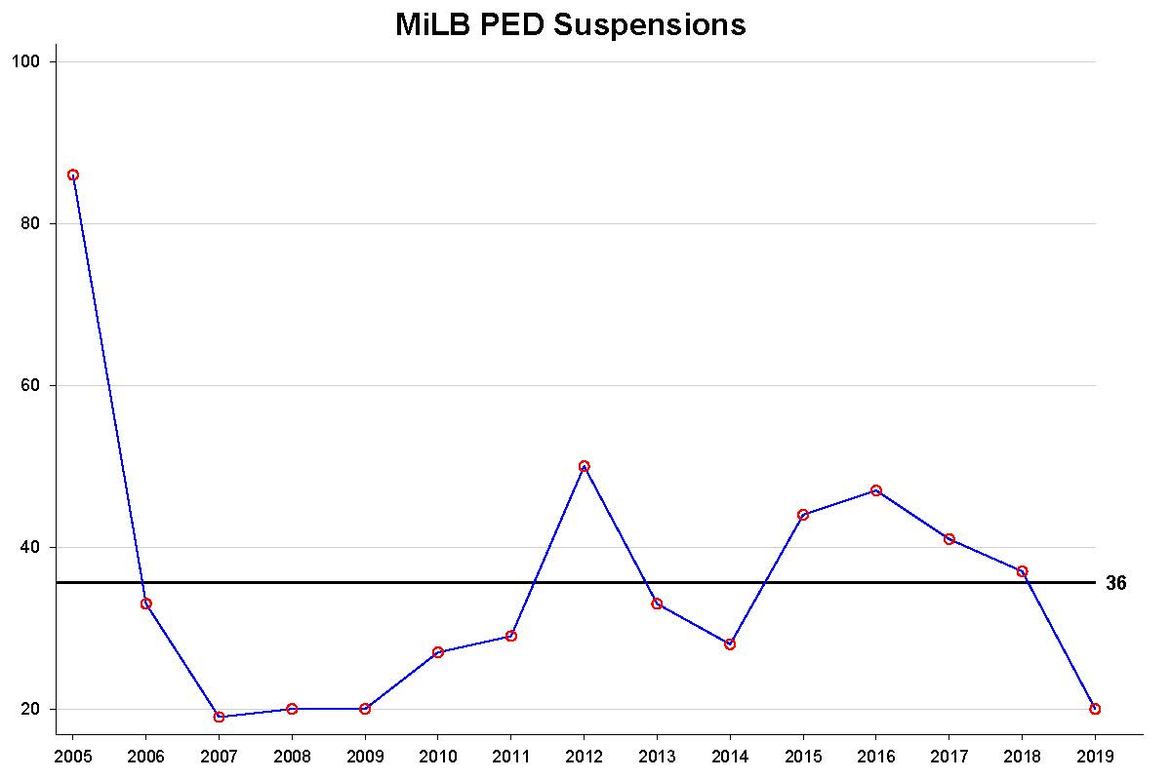
MiLB PED suspensions averaged 36 per season
Our experiment implies 6 fewer suspensions
This would result in a gain of about $3 million for MLB franchise value (Brave and Roberts, JSE 2019)
Compares favorably to a cost of about $4 million if MiLB players were paid the federal minimum wage (NPR, May 2 2017)

Slide 16
What Happens Next?
Lawsuit seeking minimum wage and overtime pay is still working its way through the courts
Federal laws were pre-empted by Congressional approval of Saving America’s Pastime Act
But the current case is targeted to state laws (Arizona, Florida, and California)
Cubs and Giants have both reportedly increased MiLB player pay prior to this season
And MLB has announced league-wide increases in 2021 (Avg=55%)
Rk/A-: 38% increase
A: 72% increase
AA: 71% increase
AAA: 39% increase
There has also been talk about a contraction in MiLB teams (mostly at the lower levels)
Our results imply that the smaller increase in pay combined with contraction at the lowest levels is likely to produce a smaller reduction in MiLB player PED use

