Slide 1
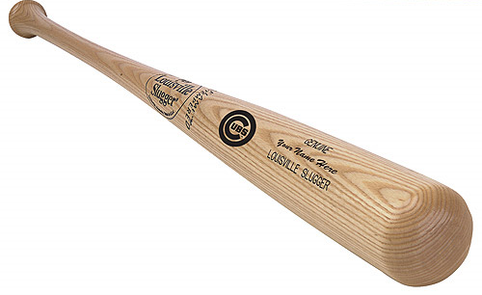
Political & Economic Realities Associated With Major League Baseball in Portland, Oregon
The Soft Underbelly of Major League Baseball Exposed

Slide 2

Donald G. Frank
Professor Emeritus
Portland State University
Portland, Oregon

Slide 3
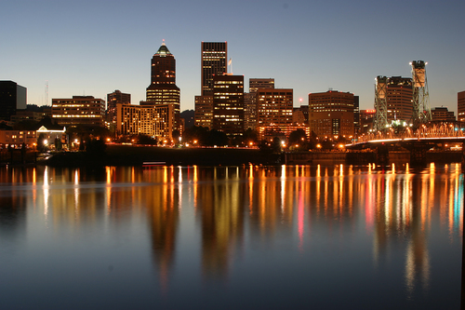
Notes:
Rationale for Major League Baseball in Portland, Oregon
2.3 million in the metropolitan area.
Progressive, vibrant community.

Slide 4
The Portland Market
355 companies with a minimum of 350 employees
Population increased nearly 500,000 from 1990 to 2000
Significant degree of “affluent residents”
Significant degree of “single college-educated residents”

Slide 5
Market …
Excellent public transportation system
Selected as the “most livable city” in the nation by Money Magazine
Television ratings for MLB in Portland are better than the ratings in most cities with MLB teams

Slide 6
Market …
Support for the professional basketball team is substantial, with annual sellouts

Slide 7
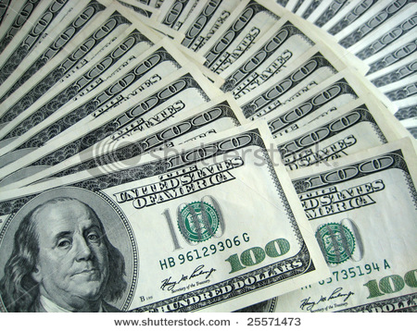
Money???

Slide 8
The Financial Plan
$115 Million: Payroll Income Tax [Oregon Legislature Approved Up to $150 Million]
$85 Million: Ticket Fees
$56 Million: Business License Fees (Stadium District)
$29 Million: Concessions/Merchandise Tax

Slide 9
Financial Plan …
$25 Million: Charter Seats
$12 Million: Team Lease
$322+ Million: TOTAL
Need $350 Million for Stadium

Slide 10
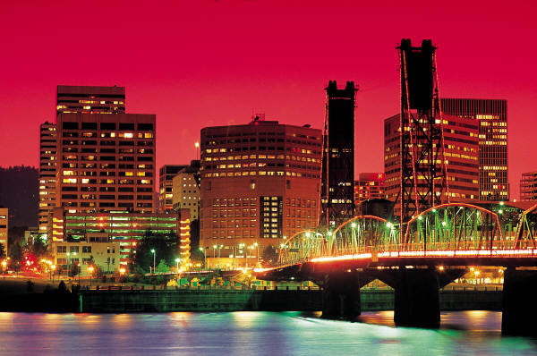
Getting Organized …

Slide 11
Key Partners
City of Portland
State of Oregon
Oregon Stadium Campaign (Oregon Sports Authority, Portland Baseball Group, & Oregon Baseball Campaign)

Slide 12
Oregon Sports Authority
Private, non-profit organization composed of public/corporate leaders in Oregon
Define Oregon as the preferred location for professional teams/franchises
Recruited five professional teams/franchises with an annual economic impact of $90 million

Slide 13
Portland Baseball Group
Coalition of local civic/private leaders (volunteers)
Contributes time/money to obtain a MLB team
Focus on communication or public relations

Slide 14
Oregon Baseball Campaign
David Kahn, Executive Director
Grassroots organization (volunteers) dedicated to obtaining a MLB team (10,000+ supporters)
Assisted by Sports Management Worldwide, the “Global Leader in Sports Business Education.”

Slide 15
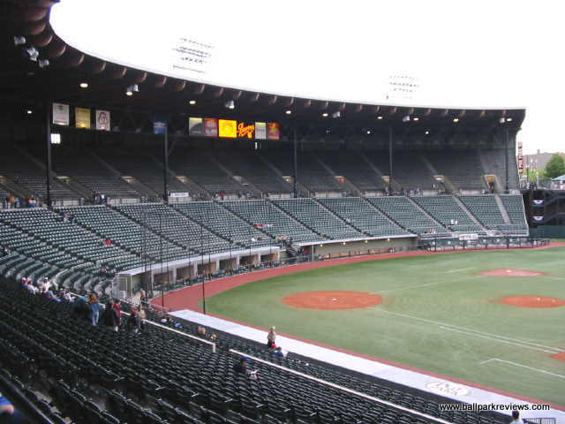
PGE Park (Portland)

Slide 16
Need for the Ballpark
HOK Sports Facilities Group identified possible ballpark locations
HOK designed Coors Field (Denver), Jacobs Field (Cleveland), Oriole Park (Camden Yards), & Pacific Bell Park (San Francisco)
Proposed Stadium: 38,000 Seats & 975,000 Square Feet

Slide 17

What Worked Well …

Slide 18
What Worked Well
Civic leaders supported the initiative
State legislature supported the initiative
Reports prepared for MLB were accurate, comprehensive, and timely
Presentation to MLB was received positively
Several ideal locations for the ballpark

Slide 19
What Worked Well …
Funds for the ballpark were likely to be available
Ties to and support of the professional basketball team provided an essential base of operations
Key organizations provided essential assistance (HOK & SMW)

Slide 20
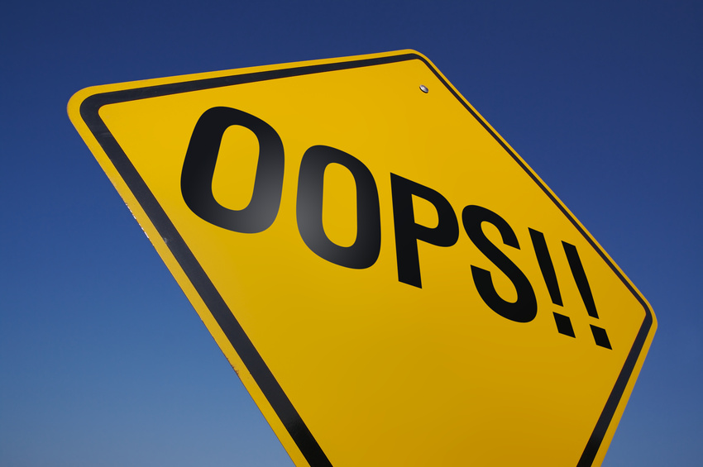
What Did Not Work Well …

Slide 21
What Did Not Work Well
Support for the AAA team was reasonable, but sellouts were rare
Were the citizens of Portland informed and key participants in important processes?
City Manager refused to support the initiative
Viable Ownership Group not identified

Slide 22
What Did Not Work Well …
Education, books, arts, & food tend to dominate the culture of the area
Proximity to the Mariners?
Competition via other local professional teams (basketball, soccer, rugby, lacrosse, & hockey)?

Slide 23
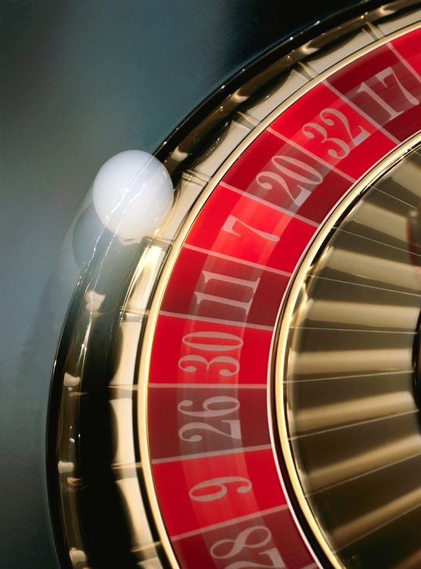
Key Contenders …

Slide 24
Key Contenders: Dulles, VA
Near Dulles International Airport
$442 million for the stadium ($360 million via public taxes)
Proximity to a large media market
Possibly the “runner up in the Expos sweepstakes”
Viable Ownership Group identified

Slide 25
Key Contenders: Norfolk, VA
Use Harbor Park as the interim stadium, home of the Norfolk Tides (NYM AAA team)
New stadium to be constructed near Harbor Park
$306 million for the new stadium (via municipal bonds)
Viable Ownership Group identified

Slide 26
Key Contenders: Las Vegas
No appropriate interim stadium
Rumor: Stadium in San Antonio as the interim option
$420 for the stadium ($400 million from the private sector)

Slide 27
Monterrey, Mexico & San Juan, Puerto Rico
Discussed, but no definitive plans

Slide 28
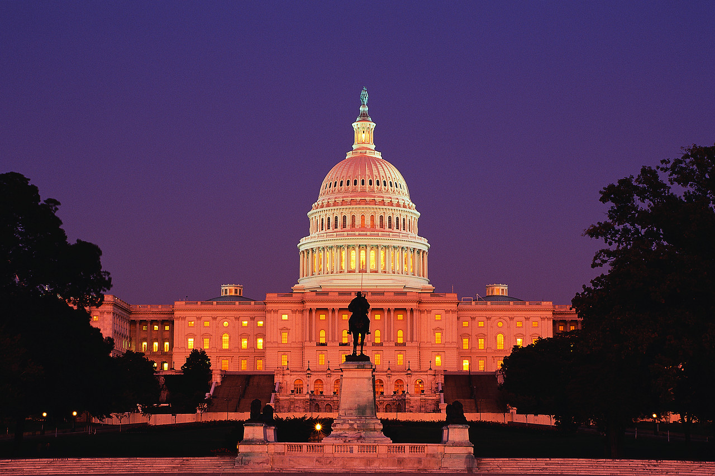
Another Key Contender …

Slide 29
Washington, D.C.
Use RFK Stadium as the interim option
New stadium near the Anacostia River for $383 million
Key reality: Mayor Anthony Williams promised a completely publicly funded stadium, the preference of Commissioner Selig (less uncertainty)
Viable Ownership Group identified

Slide 30
And the Decision …

Slide 31
Decision: Washington, D.C.
Politically, it’s difficult to compete with the forces supporting professional baseball in Washington, D.C.
Portland, Oregon, does not dominate the national news
Viable Ownership Group?
Oregon’s inconsistent economy
Larger interim ballpark in Washington, D.C.

Slide 32
Decision: The Nationals …
Washington D.C.’s mayor’s promise of a publicly funded stadium
Incidentally, Peter Angelos (Orioles) was the “lone dissenter”
And have Dulles & Norfolk been eliminated as viable options in the future?
If so, will Portland be a realistic option?

Slide 33
Lessons Learned …

Slide 34
Lessons …
Key decisions are usually made within a dynamic, political context
Politics & Baseball’s “legal monopoly” (TWM)
Supportive President (TWM)
Supportive Congress (TWM)

Slide 35
More Lessons …
Need for effective advocates
Relevance of a community’s culture(s)
Relative priorities: Baseball & public education
Articulation of social & economic benefits is a complex process
Malek & others

Slide 36
Finally …
“Oregon Takes Lead in Race for Expos” (The Washington Times, 08/26/2003)
“Portland Prepared for the Next Team That Moves” (AP, 08/26/2004)
“Major League Baseball in Portland? Some Still Have Hope” (Oregonian, 08/31/2009)

Slide 37
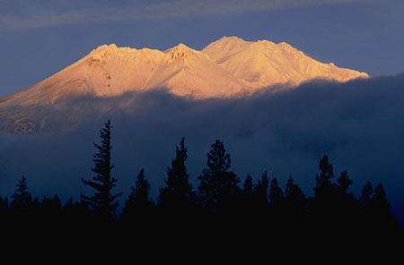
Questions?

