Slide 1
The Scandal of Candlestick
Or
Charles Harney’s Revenge
Robert F. Garratt
University of Puget Sound

Slide 2
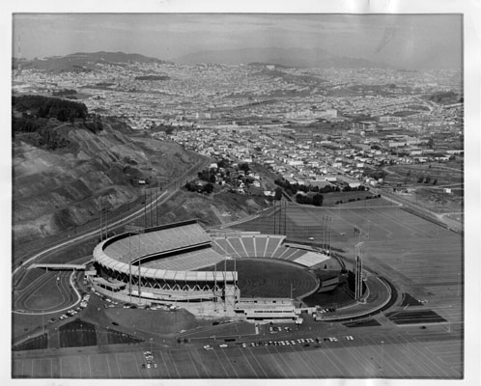

Slide 4
“If you were to write the definitive history of the San Francisco Giants, long before the mention of Willie Mays, Willie McCovey, Juan Marichal or anyone else, there would be Candlestick. There is no way of calculating exactly how damaging Candlestick Park was to the Giants franchise, and to the city, but some things are obvious.”
Hank Greenwald, Giants’ broadcaster for 17 seasons

Slide 5
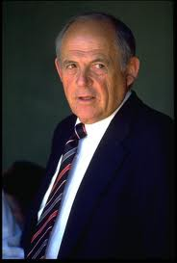

Slide 6
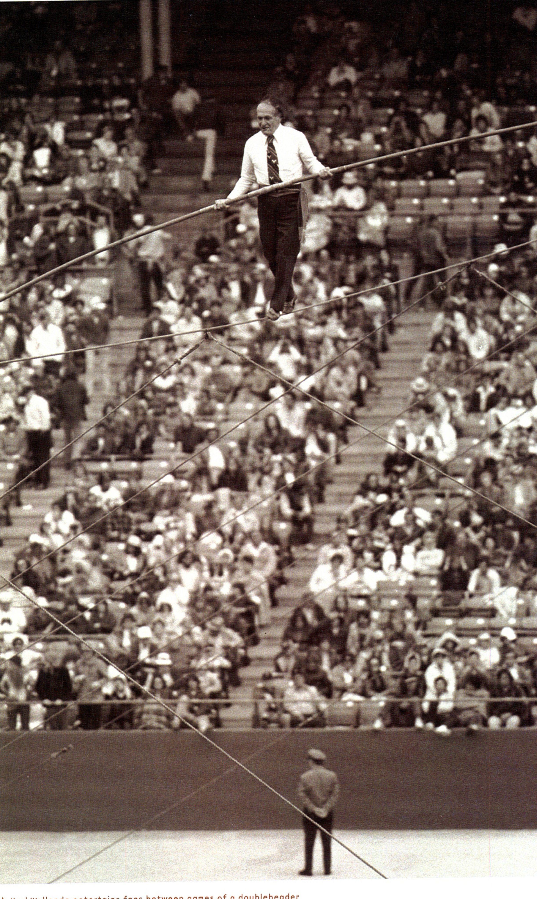

Slide 7
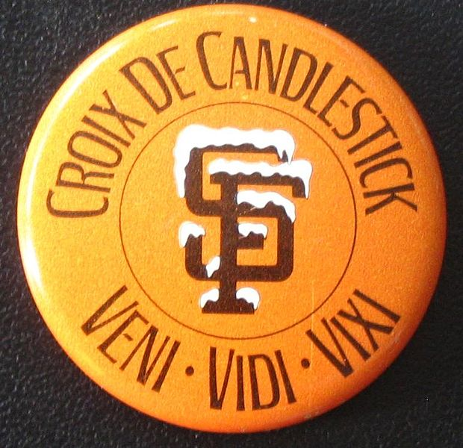

Slide 8
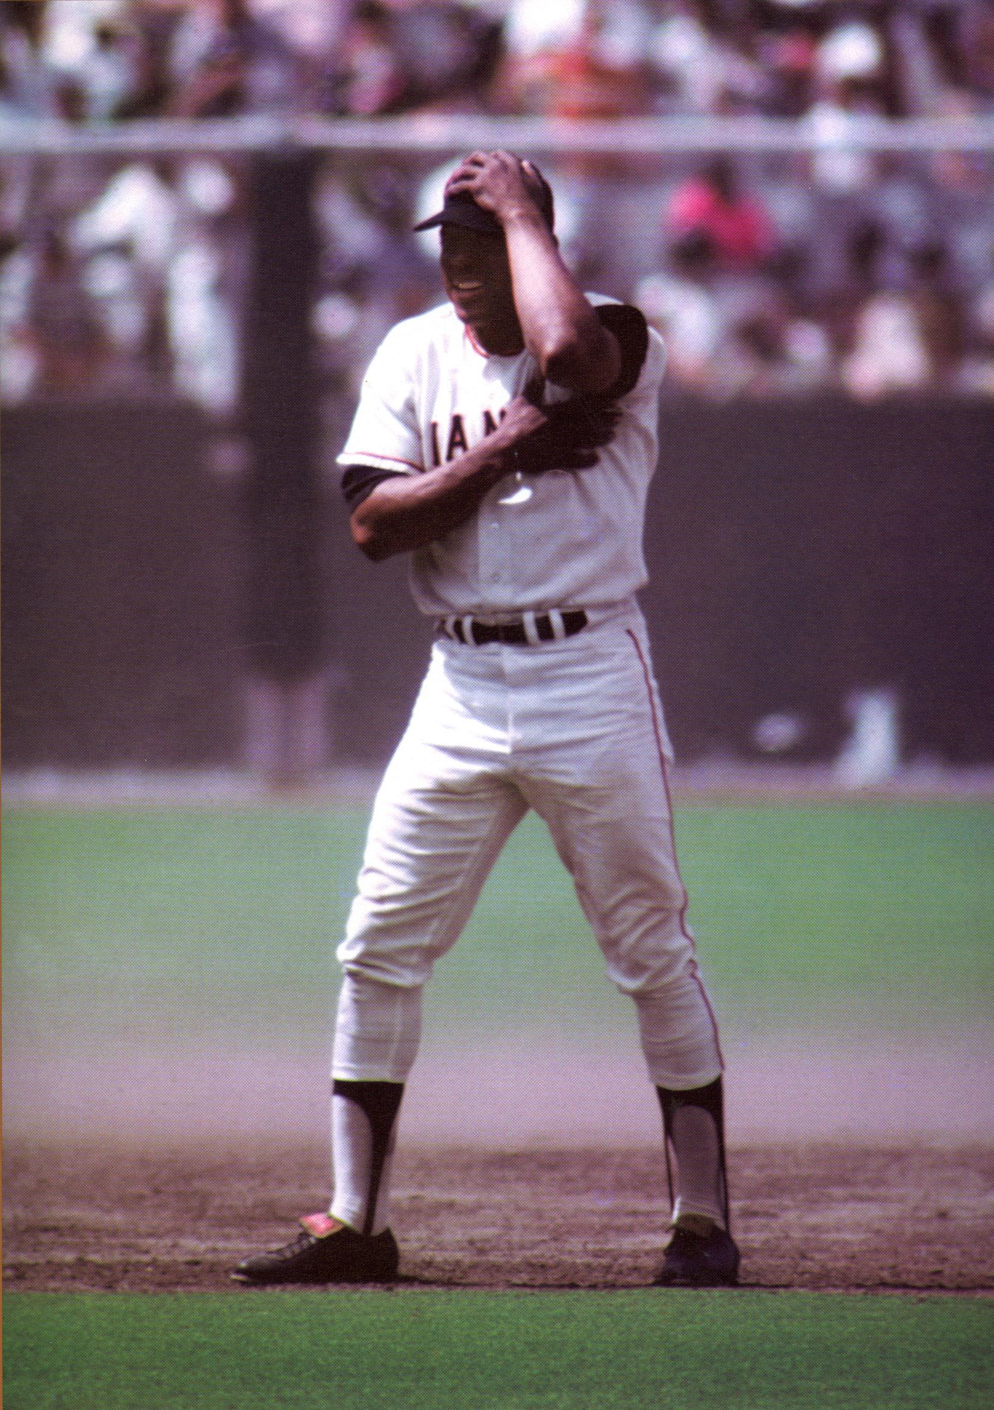

Slide 9
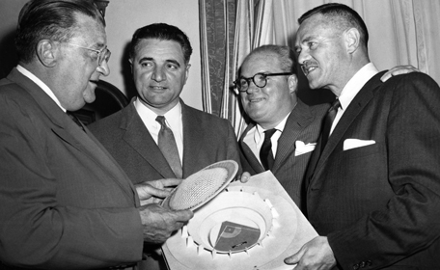

Slide 10
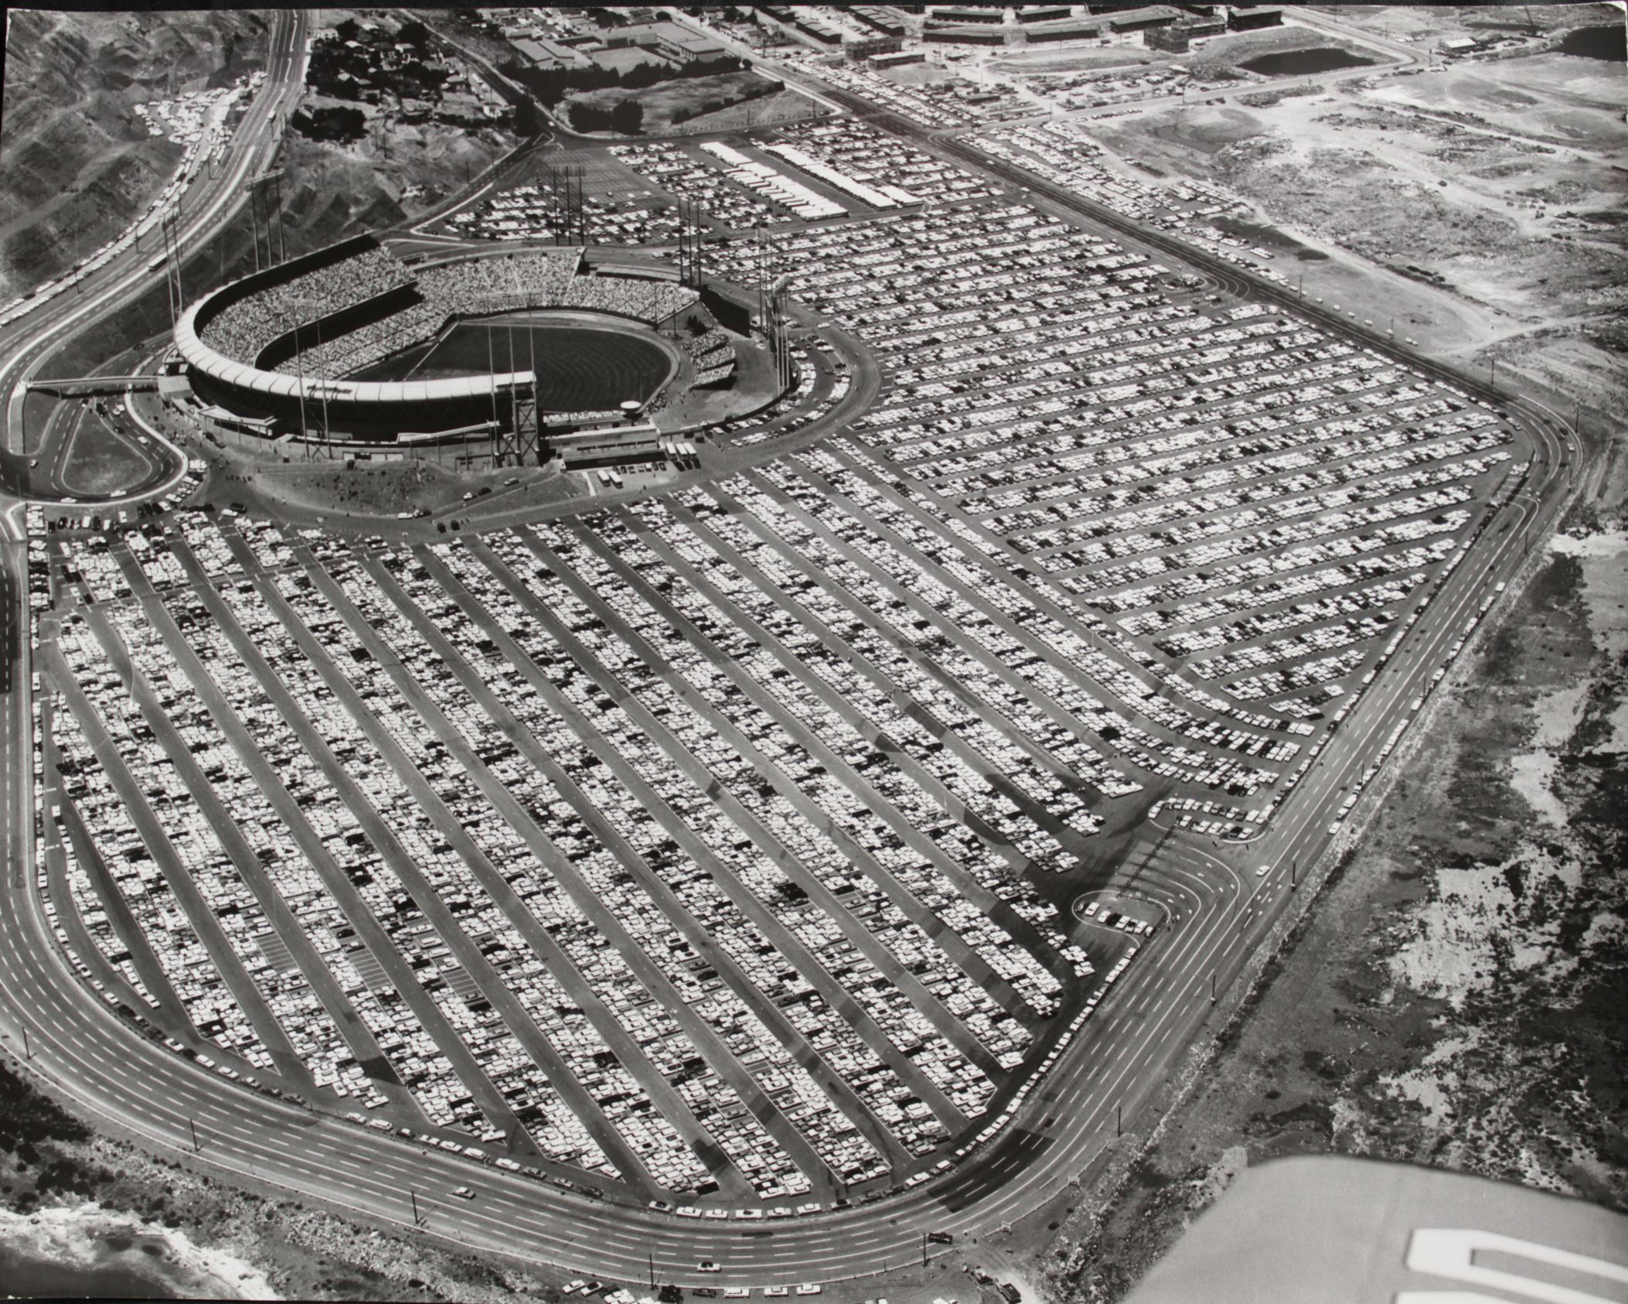

Slide 11
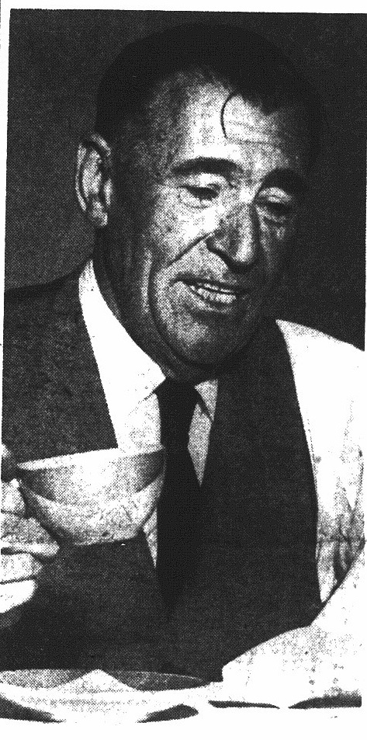

Slide 12
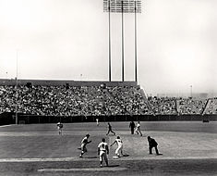

Slide 13
