Slide 1
I NEVER THOUGHT I’D
MISS TRICKY NICK
And you should, too.

Slide 2

Con - “Razzle Dazzle” - “Hoop Skirt” Murphy

Slide 3
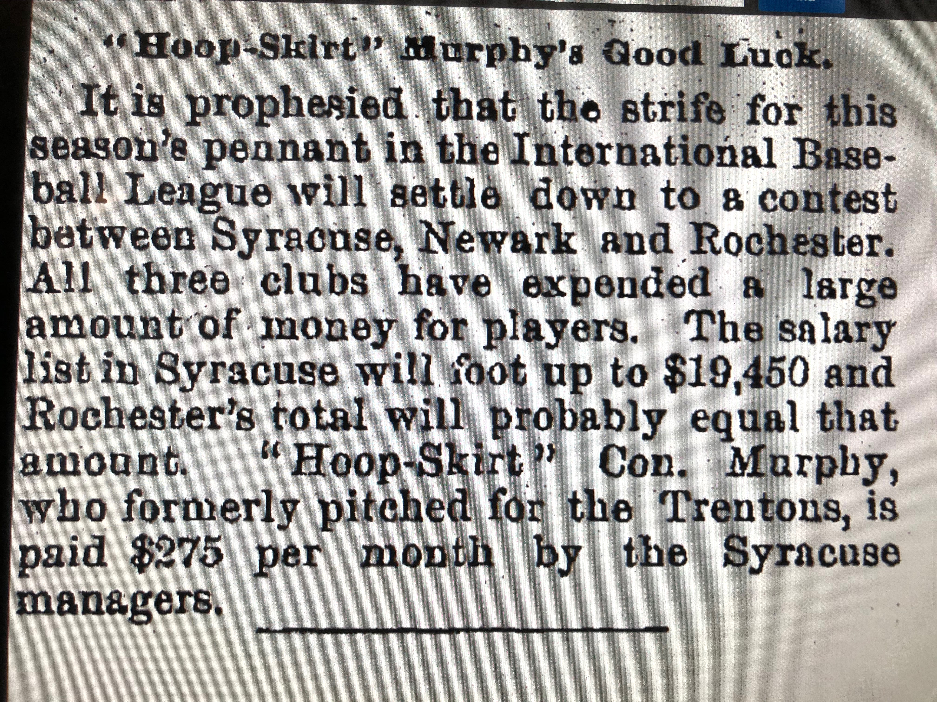

Slide 4
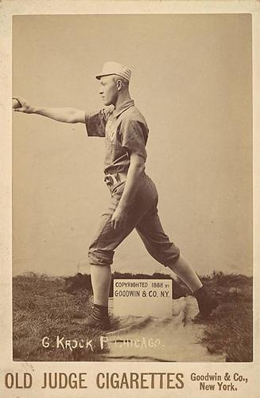
Gus “Kinnikinnick” Krock

Slide 5
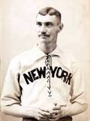
“Long John” – “Carmencita” - Ewing

Slide 6
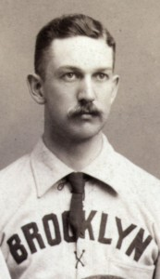
Adonis Terry
Notes:
William H. Terry is rightly called “Adonis.” He has the form of an Apollo, the bearing of a Roman senator and is “as graceful as a young gazelle.” If he had been a female Venus he would have had to hunt for another job.

Slide 7
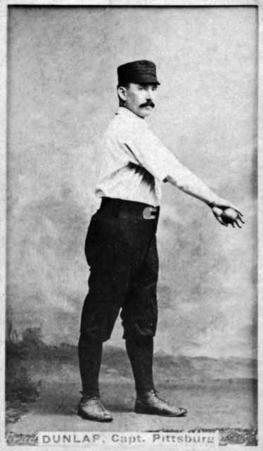
Fred “Sure Shot” Dunlap
Notes:
Cleveland, 1880-1883, several other teams after that. Played for Pittsburgh in 1890. “When Dunlap took his base for the third time on balls, he lifted up his right arm pathetically to “Peek-a-Boo” Veach, saying in his best April voice ”Lame arm. Don’t want to hit the ball. ‘Fraid of fracturing my humerus. See.” Fred really had quite a lame arm, and there was a notable swelling above the elbow.”

Slide 8
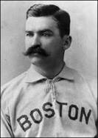
King Kelly – the $10,000 Baby

Slide 9
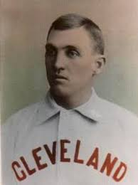
Buttons Burkett – “Don’t git Ketched”

Slide 10
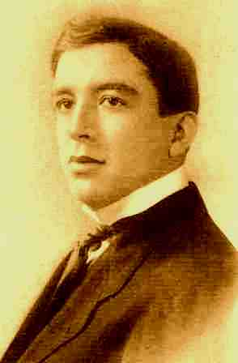
George Tebeau
“White Wings” – “Hard Gall”
– and for a time in 1887 “Tin Can” and “Tea Pot”

Slide 11
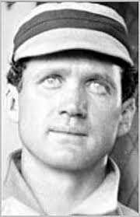
Oliver Wendell “Patsy” Tebeau
Notes:
A party of minstrels in Boston, had a performance in which they presented the scene of a country school. There was a little fellow named Patsy Bolivar, who sat in the corner, who was inoffensive, quiet, and generally well-behaved. The older boys took occasion to annoy the master in many ways; and when the master asked, in a rage, “Who did that?” the boys would answer, “Patsy Bolivar!”

Slide 12
Another Tebeau
And there was another Tebeau - from Worcester Massachusetts:
Charles Alston “Pussy” Tebeau:
1895, Cle-N, 2 games, 6 at bats, 3 runs, 3 hits
Notes:
. . . . Two games, six at bats, three runs, . . . . . What a pussy.

Slide 13
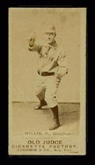
Charles “Tit” Willis
Notes:
Outfielder and Pitcher. Bats right, Throws Right. Debut: Brockton, Eastern New England League, 1885. Played on 20 teams, including Omaha, 1889-90, Pawtucket, Albany, Minneapolis, Lawrence, Haverhill. He got around! Ended his career back at Brockton. His luck at getting on a National League team was a complete bust.

Slide 14
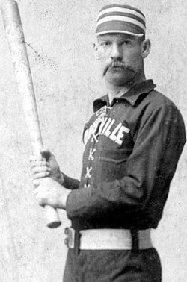
Louis Rogers “Pete”
“The Louisville Slugger” “The Gladiator” Browning

Slide 15
***
Baseball writers just now are suffering for want of a nickname for Duluth. Every club has its name. Omaha – Omahogs. Milwaukee – Brewers. Minneapolis – Millers. Sioux City – Corn Huskers. Kansas City – Cow Boys. Lincoln – Farmers. Denver – Mountaineers, and now for Duluth. Will some ingenious sporting writer come to the rescue? – Omaha World Herald, June 28, 1891.

Slide 16
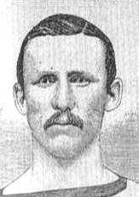
George Washington “Grin” Bradley
Notes:
Probably nothing better could be said of Bradley’s conduct than to quote the following from yesterday’s Enquirer: “Did you ever see a great, overgrown, uncouth, ungainly, semi-idiotic country lout pitch onto a small boy scarcely to his knee, especially when he knew there was nobody in hailing distance to prevent him? Such was the case yesterday of Bradley, the pitcher of the Clevelands, who disgraces the name of the Father of our country by having it in front of his own.” Cincinnati Daily Gazette, April 17, 1882.

Slide 17
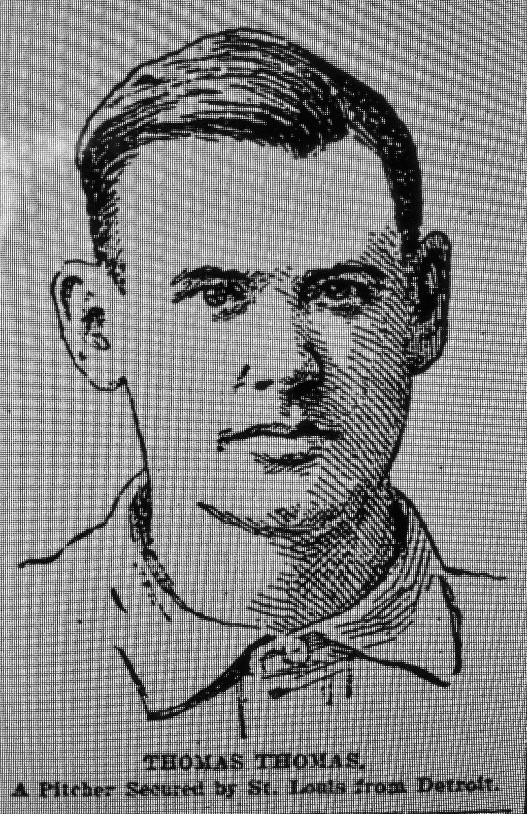
“Savage” Tom Thomas
Notes:
If anyone needed a nickname, a pet name or a cognomen, it was Thomas Thomas. “Savage”? Was it because he was from Shawnee, Ohio? No clear explanation has been found.

Slide 18

Tricky Nick
Notes:
Fred Nichols, known as “Tricky Nick,” a native of Bridgeport, Connecticut, was the first pitcher to introduce the drop ball. He did it much the same as a man would jerk a stone, and he bothered some of the best batsmen with his tricky pitch along about 1875 for the first time.

