Slide 1
A Return to Greatness: The Tumultuous History of the Bullpen Cart
Allison R. Levin
Webster University
Presented at SABR 49
Twitter @ConsultSnaps

Slide 2
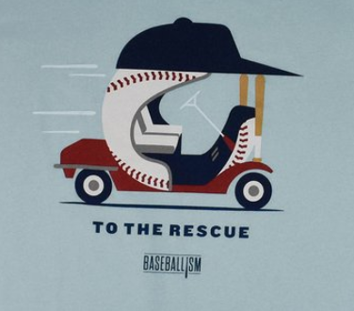
Methodology
A rhetorical content analysis of the evolution of bullpen carts
Global understanding of the rise, fall, and potential rise again of the bullpen cart
Notes:
This project started when Arizona announced in 2018 they were bringing back the cart and my generation rejoiced. But when I stopped to think about it, how much did I really know about the bullpen cart? I know I must have seen games where one was used, but I have no memory of it. My students were super excited and they weren’t even alive the last time a cart was used. Yet, many of us have a perverse love and need for the return of the bullpen cart. The premade nostalgia is mostly in the heads of people probably thanks to hugely popular movies like Major league which came out in 1989 and us being in the era of throwback uniforms and promotions. Due to my own love of the cart I wanted to learn the history. As I started researching I found that, they really were not a big deal and were mentioned for 1 or 2 games, then generally ignored and so texts and pictures are very hard to find and I quickly realized the carts were a cult phenomenon.
So what was going to be a simple overview of the rise and fall of the bullpen cart has turned into a much more detailed analysis . Due to time constraints I’ll give you can just give you a surface analysis of what I am finding… so lets dive in.

Slide 3

1950s
Notes:
The “Little Red Wagon” was a proto-cart that was used in 1950 by the Indians to escort players to the mound…. The impetuous for the cart was the size of the stadium.
Although it existed in 1950, it is not considered to be the first bullpen car, that honor goes to

Slide 4
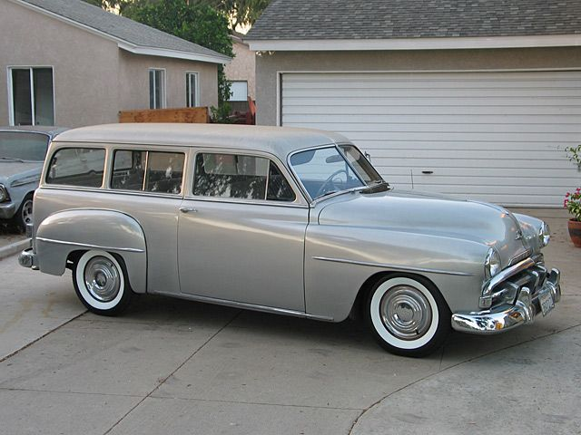
1951 White Sox Bullpen Car
Notes:
The Chicago White Sox.
Marv Roblatt entered the game by car on June 9, 1951 in a game against the Yankees. The car was the model pictured here.
What is maybe most memorable from that game is the Yankees reaction, which led to what could be described as the first bullpen car feud.
As was reported, when the car passed the Yankee dugout all the Yanks came out, led by Stengel, and tipped their cap with mock politeness.
________________
Segment from New York Times June 10, 1951
The New York Media did not appreciate the car at all writing that the “White Sox were going Bush”,

Slide 5
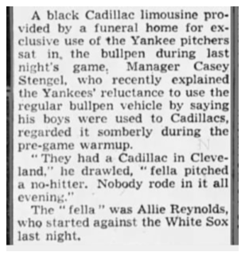
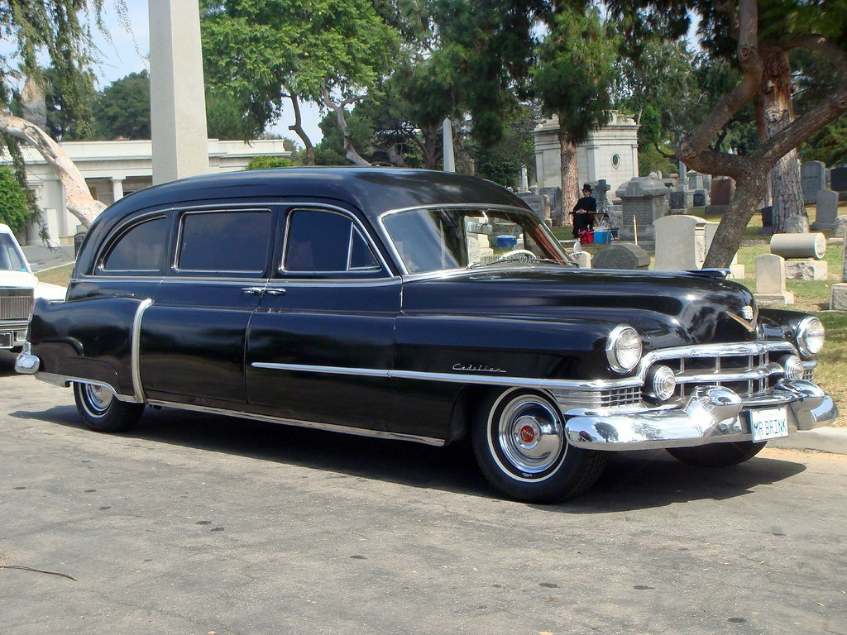
The Yankees Respond
Notes:
The next time the Yankees played the Sox in Chicago again Stengel decided to commission his own bullpen car -- a black Cadillac hearse of the type shown here from a South side funeral home as he did not want to be shown up by the White Sox.
He “explained the Yankees reluctance to use the regular bullpen vehicle by saying his boys were used to Cadillacs” you can take that at face value or use the more superstitious answer that “they had a Cadillac in Cleveland… [Allie Reynolds] pitched a no-hitter. Nobody rode in it all evening.
____________________
Chicago Tribune 7/18/51

Slide 6
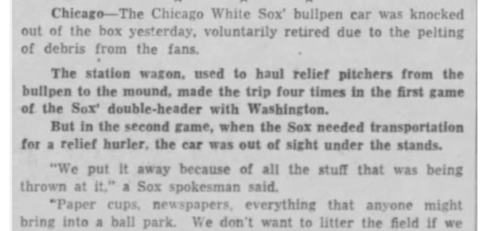

Bye for now
Notes:
These bullpen cars of the 1950s where not a craze with only the Indians, White Sox and A’s adopting them. In fact they were abandoned by the end of the decade.
In 1954 the Bingham Press and News wrote about the White Sox car--- the station wagon was put away for the second game of a double header because of all the stuff that was being thrown at it. Paper cups, newspapers, everything that anyone might bring into a ball park. We don’t want to litter the field.”
_____________________
Woodsy Owl
made the trop 4 times in the first game of the Sox double-header with Washington. But in the second game, when the Sox needed transportation for a relief hurler, the car was out of sight under the stands.

Slide 7
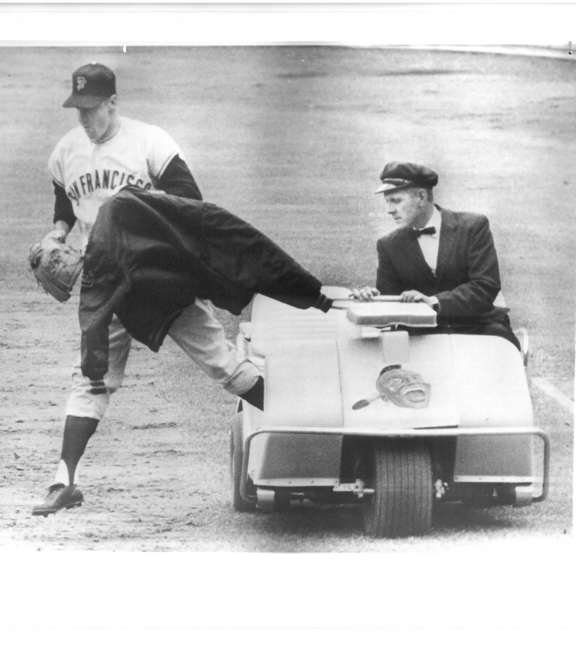
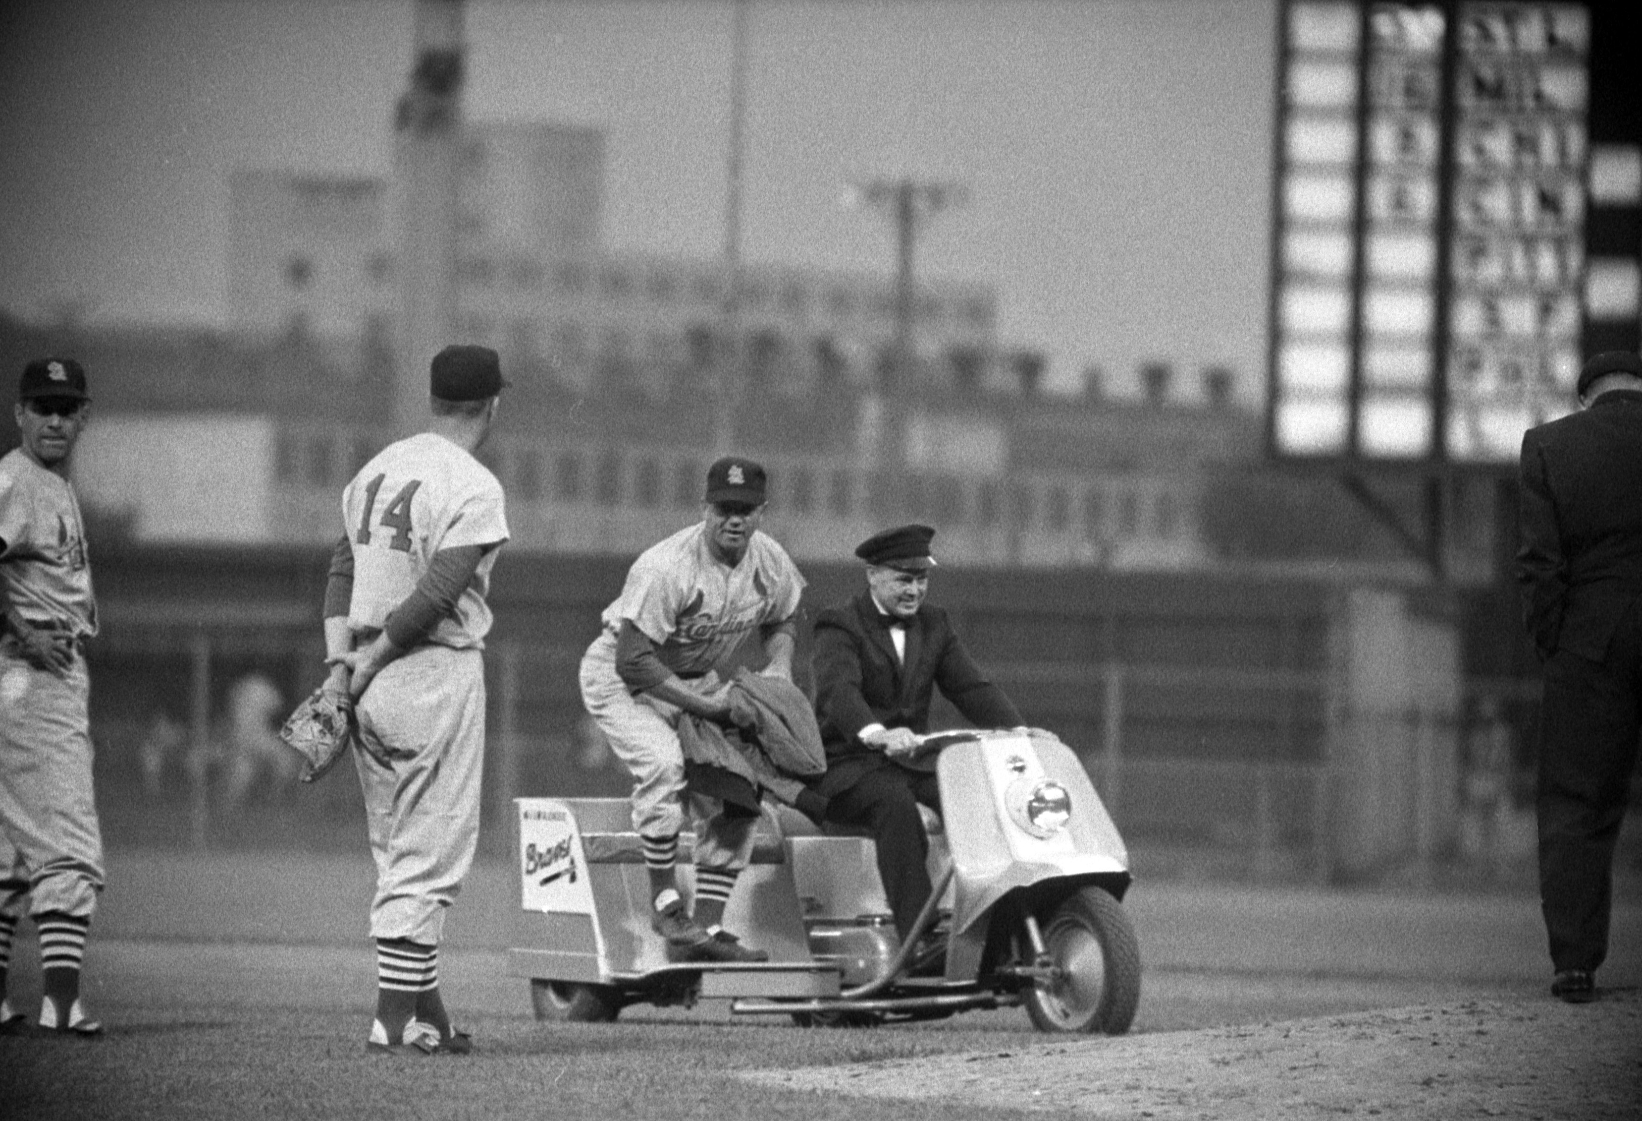
1960s
Notes:
Bullpen transportation starts to spring up again in the 1960s. Starting with the Milwaukee Braves with a Harley Davidson Topper Scooter which was preferred because it’s light weight meant it could ride directly over the grass to the mound. This lower impact style cart remained favorable until the late 1970s.
The Angels in 1963 were the first to use a golf cart like what is shown in the picture., The Braves replaced the scooter with this model in 1964. This was the start of what could be called the era of the bullpen cart which would last until the 1980s.
So when did the all so familiar bullpen cart come into existence? We just don’t know.
There is a gap in the literature between teams using an ordinary golf cart and an oversized baseball, complete with bat-shaped supports. When did teams make that leap? In 1967 the Angels added a roof with a cap but it had no baseball shape. We also know the recognizable baseball design appeared with the Mets in 1967.
Were the Mets the first? Did the rest of the league immediately fall into line with these giant baseball carts once they saw it in action? It seems unthinkable in today's era for there to be a missing link, and yet, here we are:
Nobody knows.

Slide 8
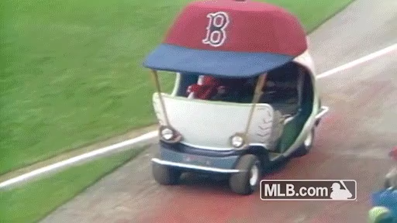
The 70s Cart
Notes:
Team historians are stumped, fans don't know, even the Hall of Fame lacks documentation -- a tiny moment in baseball history that has totally been lost to time. Somehow it happened, though. With a grand leap in design evolution, the giant carts took a spot as a defining feature of '70s baseball.
We actually don’t even know how many teams had carts as reporters simply didn’t write many stories saying “the pitcher arrived via bullpen cart” and it wasn’t a feature of radio and television broadcasts. What we can say is it seems as if most clubs with Astroturf and/or domes did.
The typical cart was an AMF golf cart that featured a baseball like cab, with red stitching to represent the seams. The A-pillars were baseball bats and the headlights were baseball gloves.

Slide 9
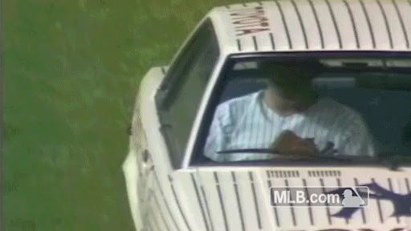
The 70s become the 80s
Notes:
The cart's demise started as teams began to experiment too wildly with design in the late 1970s and quite simply baseball changed.
The Yankees opted for a Datsun which was later replaced with a Toyota Celica -- hardly the kind of thing that excites fans. The White Sox added a Chrysler LeBaron. Which historian Josh Cohen recalls that no one ever used it. If the pitcher opted out the LeBaron still had to do a full lap around the warning track while the pitching change took place. The beer shower it received had to be seen to be believed– imagine beer flying out of the upper deck
To understand why carts might not work now, we must understand why they rose to prominence and also why the players eventually refused to use them
.They became commonplace because of entrepreneurs like Charlie Finley, and Bill Veeck. They were into it. They weren't afraid to be showboats. They weren't afraid to be wacky. And the other teams would follow suit because those guys were doing it, and they were at the cutting edge of entrepreneurship.
And It likely isn’t coincidental that as the carts die out in the '70s and '80s … the ballplayers – now with free agency -- weren't beholden to the owners like they used to be. Players began thinking, I want respect I can jog a couple dozen yards.
_______________________________________________
Mike Flannigan said of the Yankees car that the first time hegot into the car and they told me to lock the doors.

Slide 10
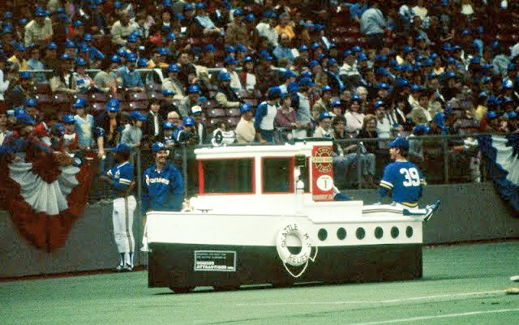
The breaking point
Notes:
As we are seeing players refuse to use the cars and carts, there is one episode that can be pointed to as the absolute breaking point where the players said nope, you are not embarrassing us anymore.
It was 1982 when the Mariners introduced this beauty formally named the MS Seattle Relief and referred to by many simply as the Tugboat. As Jerry Crasnick stated this went from kitch to catastrophe.
All the reports indicate the relief pitchers loathed it. In fact, Bill Caudill spoke for all his teammates when he stole the keys on Opening Day and left the MS Seattle Relief stranded on the field, delaying the start of the game. With a reception of like that, it is not surprising that the Tugboat quickly disappeared.
While this was the unofficial end to the bullpen cart, the official end actually came much later, as the Brewers continued to use a Harley with a sidecar for pitchers to ride in on that remained available through the 1995 season, though it was rarely used.
So the question is where the carts a fad that rightly went the way of the pet rock when ”relief pitchers, as a way of loosening up and appearing menacing, began stalking their way in from the bullpen instead of riding in relative luxury” [mcguire and Micheal Sean Gormley] What we do know is even with their auspicious end in what I’ve termed the era of bullpen cart
for some teams and fans these carts had and in some cases still have enough popularity to live on in the public consciousness.
The Red Sox cart resides on their concourse and still makes public appearances
The Dodgers cart lives near the luxury suites,
And the Mets cart sold in 2015 for over 112 thousand dollars. For reference you could have your own bullpen cart to the same specs as the Diamondbacks and Nationals cart made for 20,000.
And it is likely because of this public remembrance that the topic of the bullpen cart even returned in the 2010s when

Slide 11
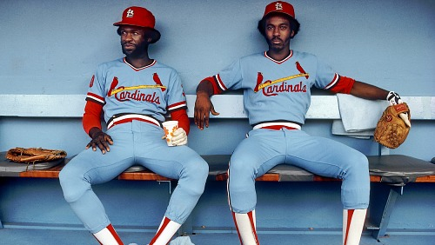
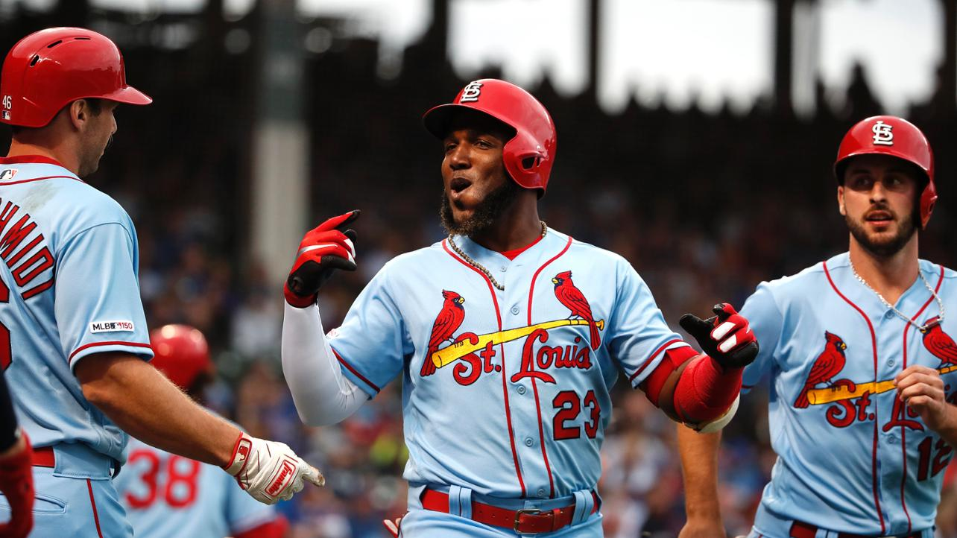
What’s old is new again
Notes:
In this era throwbacks are all the rage and fans want to relive the not so distant past. One where thanks to nostalgia, selective memory, or in many cases, only having seen glamorized movie and television footage, some fans started clamoring for the return of the bullpen cart.
____________________________________________________
The Sugarland Skeeters of the Independent League requisitioned a cart in 2012 leading in the new revolution, but Houston’s house of sound who made the new cart had to refuse other teams seeking out carts for themselves because the costs of making one simply could not be recouped because it is so much more than cutting and pasting onto a golf cart
Mark Sofia the founder of SportsKartz a huge proponent of bringing back the bullpen cart believes who worked with the Rochester Red Wings, the AAA affiliate of the Twins, in 2015 believes that making them is feasible if you package them as a marketing tool. His premonition that the way they will come back is through marketing and sponsorship possibilities, but the remaining question is, will sponsors pay if nobody uses them. But first, why are teams having this conversation now.

Slide 12
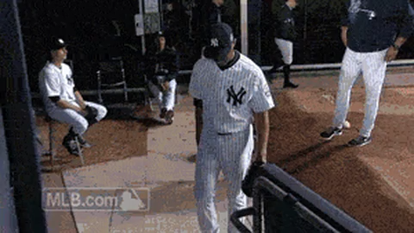
Times have changed
Notes:
But so much had changed since cars and carts were last used.
Teams no longer play in sterile cavernous multisport saucers. The new Stadiums are significantly smaller so the bullpen is closer to field and there is also less room to store the carts
Further, The majority of teams have moved to grass fields and As trevor Hoffman explained, no groundkeeper is going to let a cart go across the diamond. As a result carts don’t go to the mound, it’s a trip from the bullpen around the track to the dugout, the pitcher still has to go to the mound. Because of this many pitchers believe they can ”steal” more warm-up time by actually running in
And perhaps most importantly entrance music , prominent since the late 1990s added an intimidation factor, pitchers are reluctant to give up. There is no doubt that when the doors opened at Yankee stadium and everyone heard enter sandman before Marino Rivera even appeared, dread had to enter the minds of the opposing team and excitement brewed for the fans. A little plug here, if you want to hear more about walk-up and entrance music check out my poster in the foryay.
What do the players have to say about a potential new bullpen cart era?
__________________________________
Players are healthier ” Dick Stigman said I don’t think we could have made it in the 1960s
. While entrance music might have been a new concept, the idea of intimidation was not. Al Hrabososky turned closer intimidation into a sensation as the Mad Hungarian. He was known for working himself to a lather on the jog from the bullpen to the mound. He said he preferred jogging in to riding in the carts because he was able to be by himself and had his thoughts to get prepared.
And with the rise in salaries, especially for top relievers, it is even more important to pitchers that they be viewed as athletes, They want to be taken serious as talent and riding in on an awesome albeit ridiculous cart might take away from that image.

Slide 13
There is probably a reason it hasn’t been used in so long
I want to hate it but I want to love it. I don’t know if I’m wrong for loving it.
It’s good from the standpoint of advertising and the almighty dollar for teams. Who cares if it looks like NASCAR with all the stickers on the side? It could be cool. Fans would love it.
I think it is a lot more pressure to go in and pitch well if you are cruising in on a bullpen cart
Do you tip the driver? ’Here is a bag of sunflower seeds.’ Or ‘have some Double Bubble gum.’
Why would I not conserve energy before going into a game in the biggest moment?
It would feel a little weird warming up and getting all pumped up then getting in a cart and sitting down for a ride. You get your blood going and the last thin you want is to relax and sit down.
I would consider riding in it if it got me a couple extra warmup pitches or if I could drive it.
I think a Billy the Marlin theme would be classic. You could have a huge marlin bill out the side and joust with other teams’ carts-– like in medieval times.
Do you hug him? Do you shake his hand? Do you fist bump? Do you say, ‘Talk to you later?’ It’s just awkward.
Notes:
Same think they are good for the pitcher and baseball – definitely the minority and focus on fandom
Others are unsure or think it might be awkward. These players are often very dry and sarcastic, so it is likely they would never ride in the cart and just know how to give a good quote
Others are down right opposed and the comments all run to the same few thoughts.

Slide 14
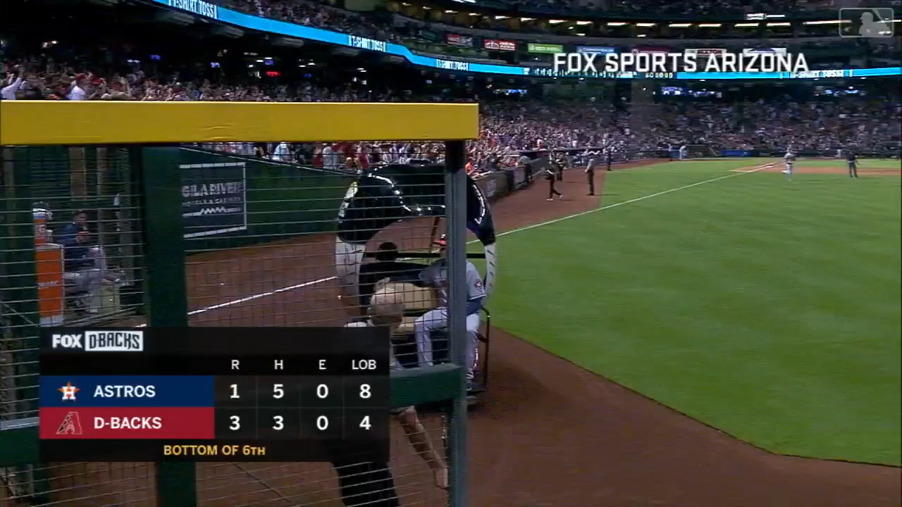
The Rebirth!
Notes:
Despite all of the reluctance-– on May 5, 2018 we saw the formal return of the bullpen cart when Astros pitcher Colin McHugh rode out on the Diamondbacks cart. Unlike the carts we have seen before it has heavy advertising on it and thus the costs are offset, but to keep the partnership going it also has to be used– something that we are not really seeing. Despite the hoopla and excitement from a certain branch of fans, only 2 other teams have introduced them– the tigers and Nationals, with the Nationals cart being the most popular thanks to Sean Doolittle's love of the cart.. In 2019 we saw no new carts it does not seem like the craze is catching on.
Where it arguably is catching on is in the minors where we see a need for more entrepreneurship and have always seen more varied promotions much like Veeck and Finley brought into the majors– just think asparagus night- which the Stockton Ports the Class A affiliate of the A’s host every year- so it is possible younger pitchers will jump onboard the trend and be excited to ride on carts when they reach the majors and these three teams are just a little ahead of the curve. Or perhaps without the support to start the revolution at the major league level and the isolated fan support, within a few years as the carts sit unused in the bullpens the sponsors, not seeing a return on investment will end their sponsorship and bullpen carts will die out again.
It is hard to know, but right now anybody using the cart is news, and teams and companies are making money off of giveaways and selling t-shirts based solely off of nostalgia.
And no matter what, As younger generations talk about the cart, both positively and negatively, there is one positive, they are talking about baseball.
__________________________
After the Diamondbacks introduced theirs on opening day the Tigers introduced one on April 13, 2018 and the Nationals introduced theirs on August 17,2018. The nationals cart is arguably the most popular because closer Sean Doolittle has been a proponent of the cart since his days with Oakland and uses it every time he pitchers.

Slide 15

No matter what-- we will always have Japan
Notes:
Yakult Swallows closer Yasuaki Yamazaki comes in from the bullpen on a sports car.
The time might have passed in the US, but the bullpen car is alive an well in Japan– with convertibles, glorified golf carts and literal limousines.

Slide 16

Questions?
Notes:
And while I am I answering questions I’ll leave you with this thought

