Slide 1
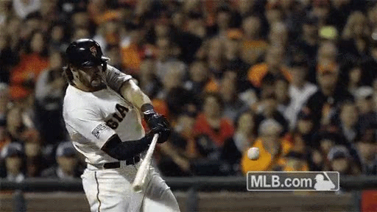
Do All Wood Bats Perform Identically?
(and if not, why not?)
Alan Nathan, Dan Russell, Patrick Drane
and Blake Campshure

Slide 2
The Focus of this Talk
Suppose we have two nominally identical bats
  Same length, weight, weight distribution, balance pt, shape
Will these bats perform identically?
If not, why not?
Is there a simple way to select the better bat?

Slide 3
Preliminaries:
Quantifying Bat Performance
How do we define performance?
  Exit velocity (EV), under some standard game-like conditions
  High EV is the characteristic of a well-hit ball
    Whether line drive single or long home run

Slide 4
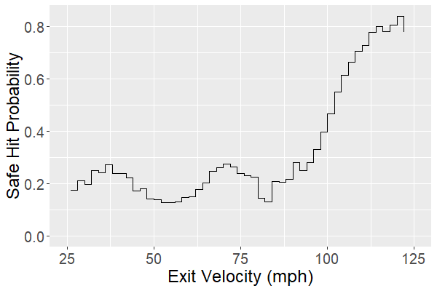
Hit Probability vs. EV

Slide 5
Factors Contributing to EV
Pitch Speed
  A little
Bat Speed
  A lot
“collision efficiency”
  A joint property of ball and bat
Exit Velocity (EV) = q v_{pitch} + (1+q) v_{bat}

Slide 6
Factors Contributing to q
“Static” properties of bat
  Weight, “swing weight”, length, shape
  Affects “feel” of bat, swing speed, q
“Bounciness” of ball
  “coefficient of restitution” (COR)
  More bouncy (superball)→higher q

Slide 7
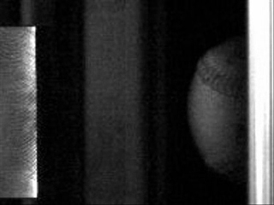
Coefficient of Restitution (COR)
“Bounciness” of ball
  Energy dissipated in ball
  Bat matters also
    Bat not rigid: It can vibrate
    Ball-Bat COR, or BBCOR
120 mph on steel plate
7
Notes:
7
Bounce some balls: superball, sad ball, baseball (in between)

Slide 8
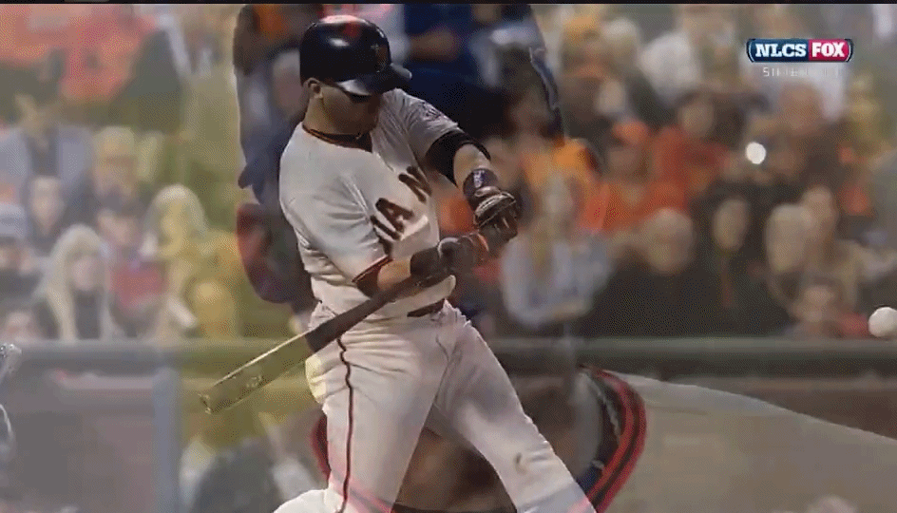
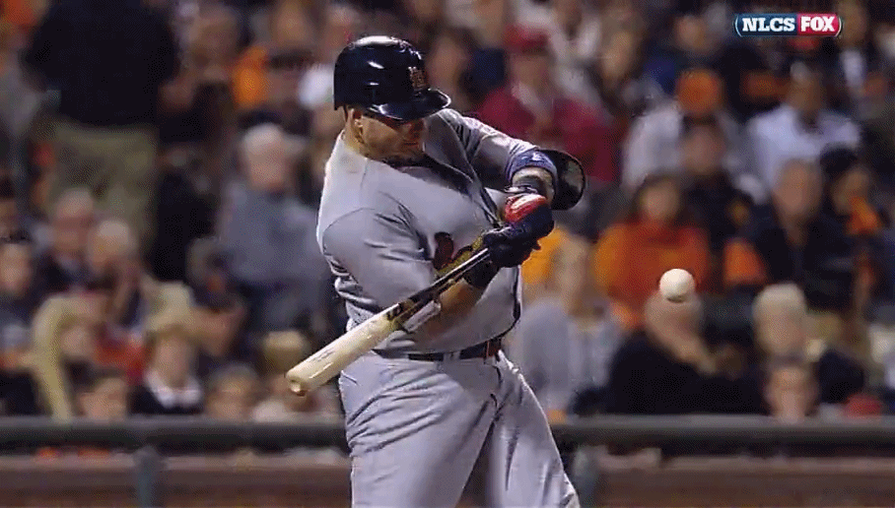
Dynamics: The Bat Matters Also
Vibrations and the Sweet Spot!
“sweet spot”
inside
outside

Slide 9
Summary Thus Far….
EV determined by pitch speed, bat speed, q
  Bat speed determined by static properties
q determined by static properties + BBCOR
EV of bats with identical static properties distinguished only by BBCOR
  Vibrations reduce BBCOR

Slide 10
Outline of Research
Obtained 18 nearly identical bats—
  Thank you, Rawlings!
  33.5”, 31.5 oz
  6 each ash, maple, birch
Measure static properties to verify identical
  Length, weight, shape, etc.
Measure vibrational properties via modal analysis
  Dan Russell, Penn State
Measure BBCOR via 100 mph impacts
  Patrick Drane, UML
Predict EV w/computer simulation
  Me, UIUC

Slide 11
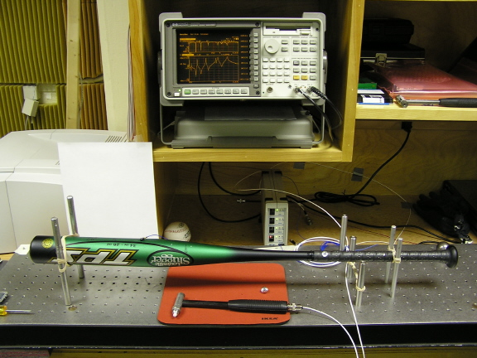




“Modal Analysis” Studies
https://www.acs.psu.edu/drussell/bats.html
179 Hz
582 Hz
1181 Hz
1830 Hz
frequency
time
Demo
Notes:
Note: nodes stack up at barrel end-->”sweet spot zone”

Slide 12
Modeling The Collision
Model the ball
  Laboratory measurements of COR, stiffness
Model the bat
  Static properties: length, weight, shape, etc.
  Modal analysis: vibrational frequencies
Specify the pitch and swing speeds
  Typical fastball and swing speed
  Same for all bats
Model the collision
  Predict BBCOR and exit velocity

Slide 13
Some Physics
Collision time is short, <1/1000 sec
Therefore only low frequency modes absorb energy
Stiffer bat means
  Higher vibrational frequencies
  Less energy absorbed in vibrations
  Therefore higher BBCOR and EV

Slide 14

More Physics
AJP 45, 979 (2000)
+
e
v_{f}
BBCOR max when
vibrational energy min
E_{vib}
14
Notes:
14
Demo: ball on stick, bat with cup on knob
Demo: ball on stick, rubber bat

Slide 15
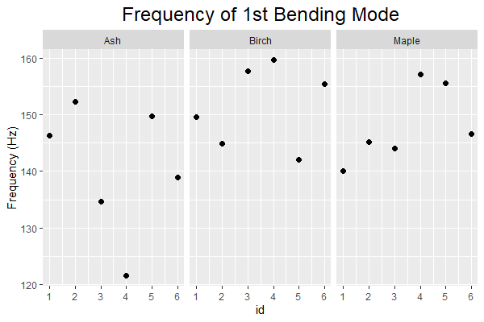
Results:
Lowest Bending Vibration

Slide 16
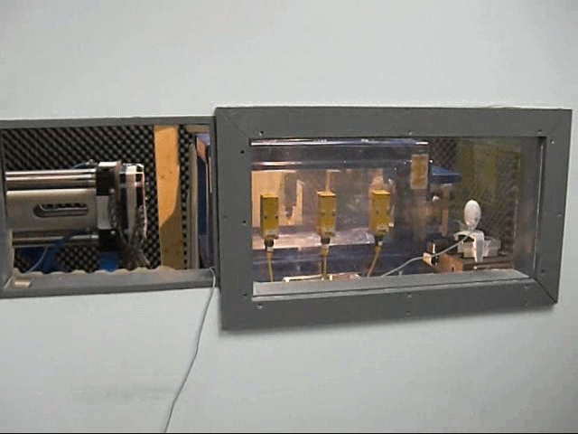
100 mph Impacts in Lab
q = (rebound speed)/(incident speed)
BBCOR inferred from q

Slide 17
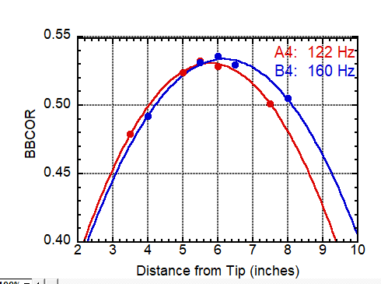
First Results: 100 mph Impact
Δ(BBCOR)=0.01⇒ Δ(EV)~2 mph

Slide 18
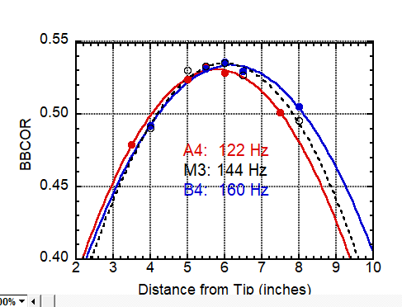
First Results: 100 mph Impact
Δ(BBCOR)=0.01⇒ Δ(EV)~2 mph

Slide 19
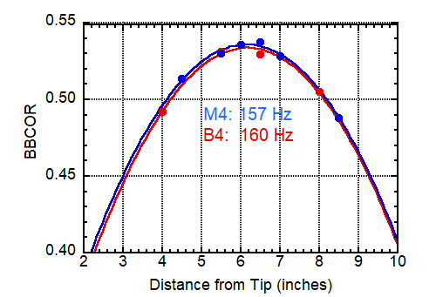
First Results: 100 mph Impact
Δ(BBCOR)=0.01⇒ Δ(EV)~2 mph

Slide 20
Tentative Conclusions
(work still in progress)
Nominally identical wood bats do not perform identically
Body of evidence suggests differences in bending stiffness as primary reason for differences in performance
Frequency of lowest bending mode is likely good predictor of relative bat stiffness
  Tap and listen
  Smart phone apps for frequency analysis of sound
Thanks for listening. Questions?

