Slide 1
The 1949 Project
The Negro Leagues After 1948

Slide 2
The Negro Leagues Died in 1948
The Last Negro League World Series was contested between the Homestead Grays and Birmingham Black Barons.
Statistics in Seamheads and other sources only go through 1948.
SABR’s Book Bittersweet Goodbye was about the 1948 Homestead Grays and Birmingham Black Barons.
AL/NL Baseball had been integrated beginning with Jackie Robinson on April 15, 1947.
Was there life in the Negro Leagues after 1948, and why should we care?

Slide 3
So, Why Pose the Question?
Willie Mays played for the Birmingham Black Barons in 1948 at the age of 17.
He next appears, per Baseball-Reference, with Trenton in 1950.
What happened in the interim?
Ernie Banks never played a day in the minors. Where, really, was he before his debut with the Cubs in September 1953?
Henry Aaron began his career in the minor leagues with Eau Claire, Wisconsin in 1952. They even have a plaque saying that he played his first professional game there. Did he?
And what happened to the hundreds of men who played on the 12 Negro League teams in 1948?
Let us try to find some answers.

Slide 4
The Negro Leagues Didn’t Die – They Just Faded Away and took a while to do So!
Let’s begin with the Negro League Structure in 1948.
Two Leagues – Each with Six Teams.
Most of those teams were located in Northern Urban centers.
Half of the teams were in cities with AL/NL major league teams.

Slide 5
Negro League Baseball - 1948
Negro National League
Negro American League
Homestead Grays
Baltimore Elite Giants
Newark Eagles
Philadelphia Stars
New York Cubans
New York Black Yankees
Birmingham Black Barons
Kansas City Monarchs
Cleveland Buckeyes
Chicago American Giants
Memphis Red Sox
Indianapolis Clowns

Slide 6
Before 1949, Two Teams Dropped Out of the Negro National League
Homestead Grays
New York Black Yankees
Owner Cumberland Posey had died in March 1946.
Headliner Josh Gibson had died in January 1947.
Luke Easter was en route to the Cleveland Indians.
Money was short.
Team chose to barnstorm and joined the Negro American Association, a minor Negro league.
Clearly the worst of the Negro League franchises.
Had relocated to Rochester, NY for several games during 1948 season.
Few quality players.
Became a travel team in 1949, barnstorming in various parts of the country.

Slide 7
Two Teams Relocated
Newark Eagles
Cleveland Buckeyes
The Eagles, who started out as the Brooklyn Eagles in 1935, had enjoyed great success in Newark from 1936 through 1948.
They had won the Negro League World Series in 1946.
Abe and Effa Manley decided to sell their interest in the team.
The team moved to Houston.
But the core players from their great teams, including Monte Irvin, did not relocate.
The Buckeyes had won the Negro League World Series in 1947.
Their star player was Sam Jethroe, but he was signed by the Dodger organization in 1948 and was NL Rookie of the Year with the Braves in 1950 .
A young Al Smith was signed by the Cleveland organization, slated for Wilkes-Barre, PA in 1949.
The team moved to Louisville in 1949.
Or Did They?

Slide 8
Negro American League – 1949:
The Negro American League in 1949 had more of a Southern focus.
Eastern Division
Western Division
Baltimore Elite Giants
New York Cubans
Philadelphia Stars
Louisville Buckeyes
Indianapolis Clowns
Kansas City Monarchs
Chicago American Giants
Birmingham Black Barons
Memphis Red Sox
Houston Eagles

Slide 9
Where did the Black Players Go in 1949?
A handful went to the AL/NL major leagues in 1949.
Minnie Minoso, Don Newcombe, Monte Irvin, and Luke Easter were newcomers to the majors in 1949. Hank Thompson, who had played briefly with the Browns in 1947, returned to stay, breaking the color line (along with Irvin) with the New York Giants.
Artie Wilson led a small group of six Black players in the PCL. Sam Jethroe was one of a similarly small group in the International League.
With few exceptions, the lower minor leagues remained segregated in 1949.
Most players from the Negro Leagues of 1948 were still in the Negro American League in 1949.

Slide 10
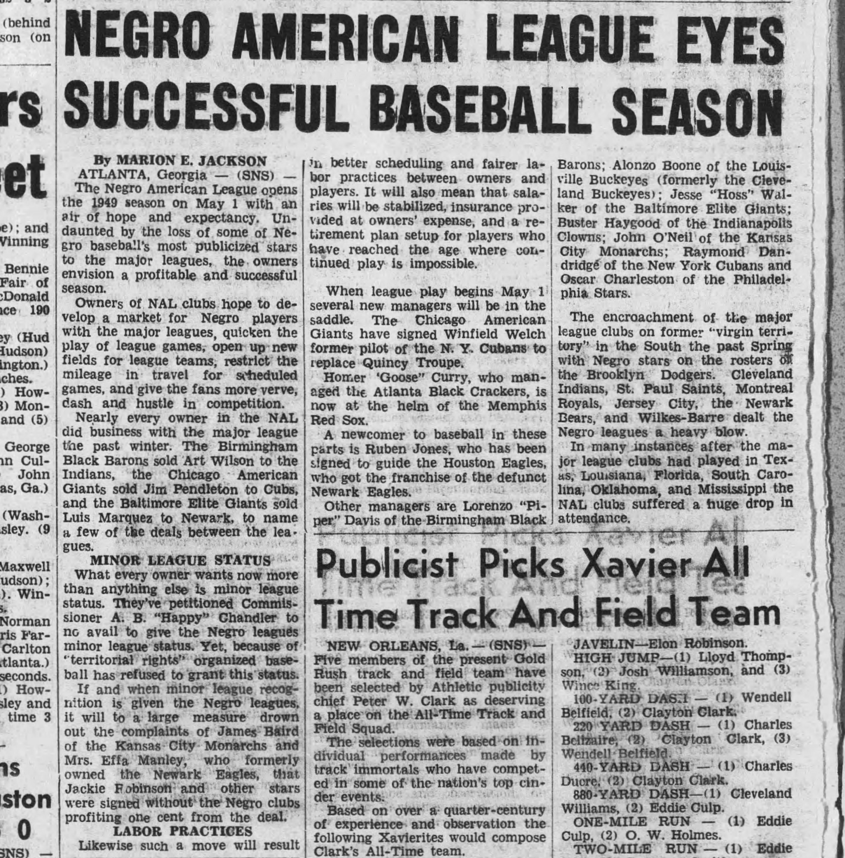
The Season Begins

Slide 11
The Kansas City Monarchs
Powerhouse lineup with major talent.
Pitching staff led by Connie Johnson.
Versatile Elston Howard split time between outfield and catcher.
Keystone combination of Curt Roberts and Gene Baker.
Willard Brown had returned to Monarchs after a short-time in 1947 with the St. Louis Browns.
Pitcher/Outfielder Bob Thurman was acquired from Homestead Grays.
Pitcher Frank Barnes who would advance to the AL/NL majors with the the St. Louis Cardinals.
And the first baseman – Buck O’Neil.
The Monarchs would remain a viable franchise through 1962.

Slide 12
The Birmingham Black Barons
The longtime Negro American League team had lost the Negro League World Series in 1948.
They had lost their top player Artie Wilson, who, after a contentious dispute, wound up with Oakland of the PCL in 1949. He played briefly with the New York Giants in 1951.
Manager/second baseman Piper Davis was one of four members of the team to play in the 1949 East-West Game.
High school junior Willie Mays did not accompany the team on road trips until his school year ended.
In the home opener on May 8, Mays had gunned down Chicago’s Jesse Douglas at home plate as Birmingham swept a doubleheader.
Pitcher Bill Greason, who later pitched for the St. Louis Cardinals, is now Baseball’s second oldest living player.

Slide 13
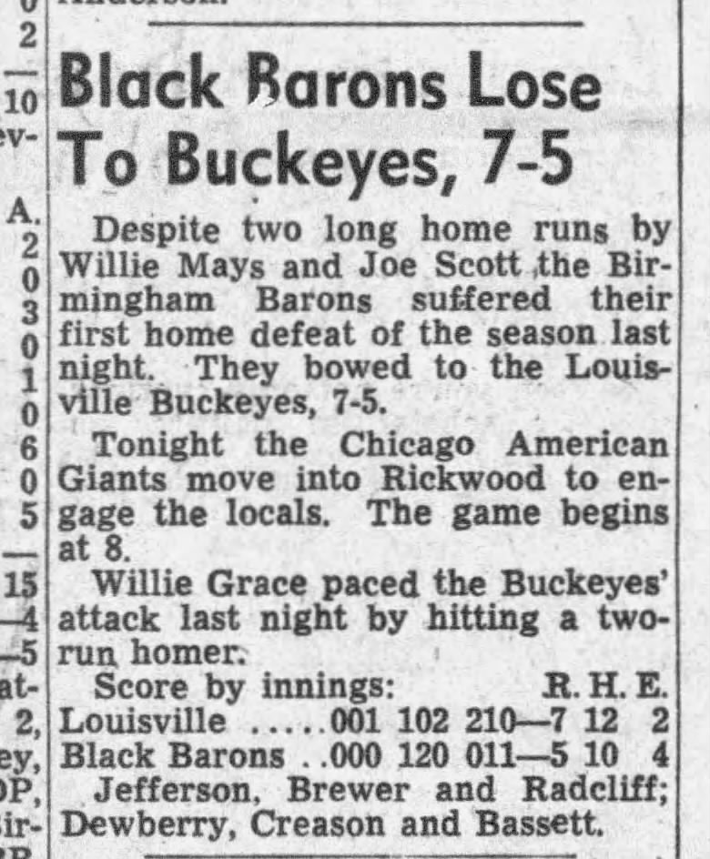
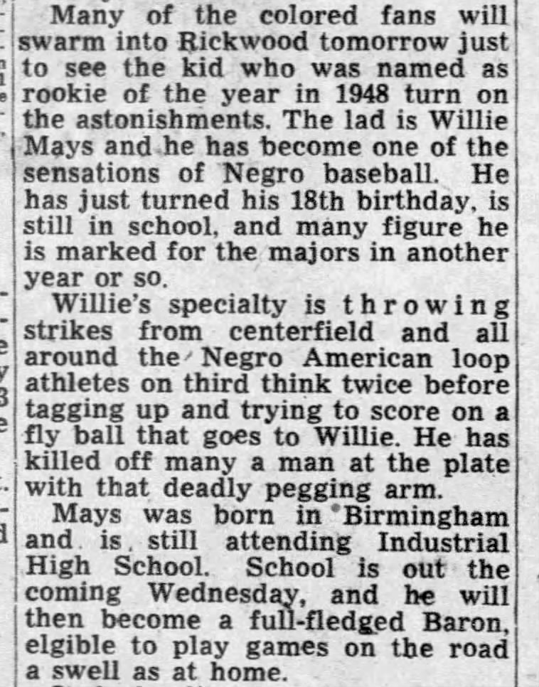
May 10, 1949 – Willie’s first home run of season
From May 11, 1949 Birmingham News
From May 22, 1949 Birmingham News

Slide 14
Baltimore Elite Giants Rule Eastern Division
The Baltimore Elite Giants won the first half Eastern Division title.
Here are the standings;
Eastern Division W L Pct. GB
Baltimore Elite Giants 33 16 0.673
New York Cubans 17 15 0.531 7.5
Philadelphia Stars 17 24 0.415 12
Indianapolis Clowns 20 30 0.400 15
Louisville-Cleveland Buckeyes 12 38 0.240 21.5

Slide 15
Baltimore’s Leaders
The pitching staff was led by Joe Black, in his seventh season with Baltimore.
Black remained with Baltimore in 1950 and joined the Brooklyn Dodger organization in 1951.
In 1952, he went 15-4 with Brooklyn and won the NL Rookie of the Year award.
Junior Gilliam was only 20 years old in 1949 but, in his fourth season with Baltimore, showed greatness in the infield and outfield.
In 1951, he joined Joe Black with the Montreal Royals and advanced to the Dodgers in 1953, winning the NL Rookie of the Year Award.

Slide 16
New York Cubans
Owned by Alex Pompez, the Cubans played their home games at the Polo Grounds in New York.
They had a great “Hundred Thousand Dollar” infield with Lorenzo Cabrera, Ray Dandridge, Armando Yvanez, and Howard Easterling.
None of these infielders made it to the AL/NL major leagues, but five men who played for the 1949 Cubans (Rafael Noble, Pat Scantleburry, George Crowe, Lino Dinoso, and Quincy Trouppe) did advance.
The scouts were out in force when the Cubans played their first home games of the season on May 29.
They won the opener against Birmingham, 8-4 behind Scantlebury’s 10 strikeouts. Scantlebury made it to the AL/NL majors for six games with Cincinnati in 1956.
But, from their perch in the center field clubhouse, the Giants scouts saw something else.

Slide 17
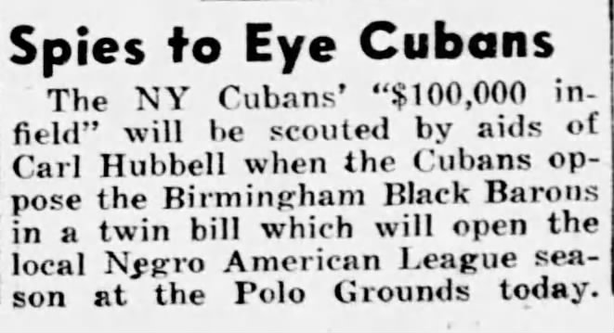
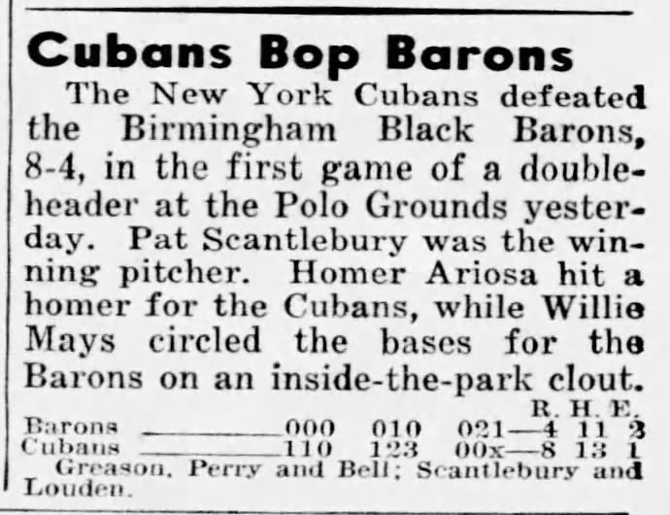
What a Difference a Day Makes!
New York Daily News – May 29, 1949
New York Daily News – May 30, 1949

Slide 18
Philadelphia Stars
The Stars were a long-standing franchise in the Negro National League, but had not, in general, faired particularly well.
They had won the League Championship in 1934, but generally played below .500.
The 1949 team featured All-Stars Bus Clarkson, Bill Cash, and Bob Griffith.
Clarkson was signed by the Boston Braves in 1950 and made it to the AL/NL majors with Boston in 1952 – playing in 14 games at age 37.
Milt Smith was a 20-year-old rookie with the 1949 Stars. He was with the team through 1951 and made it to the AL/NL majors with the Cincinnati Reds for 36 games in 1955.

Slide 19
Kansas City Triumphs in First Half of Season
The Kansas City Monarchs won the first half Western Division title.
Here are the standings;
Western Division W L Pct. GB
Kansas City Monarchs 31 20 0.608
Birmingham Black Barons 29 20 0.592 1.0
Chicago American Giants 32 23 0.582 1.0
Houston Eagles 19 20 0.487 6.0
Memphis Red Sox 20 24 0.455 7.5

Slide 20
What were the Stats?
Detailed statistics were not shown in newspapers.
At midway point, batting Leaders, shown in the Baltimore Afro-American, were.
Player Team AB R H Pct.
Piper Davis Birmingham 175 39 71 0.406
Lennie Pearson Baltimore 176 32 67 0.381
Leonard Pigg Indianapolis 122 8 45 0.380
Butch Davis Baltimore 172 36 63 0.366
Lyman Bostock Chicago 225 40 79 0.351
Willard Brown Kansas City 189 42 66 0.349
Ed Steele Birmingham 169 46 59 0.349
Bob Boyd Memphis 159 31 54 0.342
Rernando Diaz New York 138 26 47 0.341
Art Pennington Chicago 189 37 66 0.340

Slide 21
The East-West Game
1949 East-West Game was played at Comiskey Park on August 14.
The West squad did not include Birmingham’s Willie Mays. After a spectacular start, Mays had slumped badly, and his batting average, in early July, stood at .274 (per the Atlanta Daily World – 7/6/49). Five of his Black Baron teammates were well above .300.
The East won the game, 4-0. Attendance was 31,097. Of the seven pitchers in the game, only two (Pat Scantlebury and Bill Greason) played in the AL/NL major leagues.
The East-West games continued through 1962.

Slide 22
The Chicago American Giants Make a Charge
During the second half of the season, Baltimore continued its winning ways and once again led the East.
In the West, the Chicago American Giants put on a belated rush to win the Division.
By this point, media coverage was limited, and it is unclear why Kansas City and Chicago did not have a playoff.
Chicago advanced to the Negro League World Series and faced Baltimore.

Slide 23
The Chicago American Giants
Chicago was the oldest established member of the Negro Leagues.
They were Champions of the original Negro National League in 1920.
They were in the first Negro National League until it folded after the 1931 season. In 1932, they were in the Negro Southern League, and they joined the new Negro National League in 1933. They joined the Negro American League in 1937.
The 1949 team included 15 newcomers, six of whom were in the starting lineup. However, the roster included few players under the age of 30. Only three starters were under 30.
Art Pennington was selected for the East-West Game but was acquired by the Portland Beavers of the Pacific Coast League on July 15. He was replaced by teammate Lloyd Davenport.

Slide 24
1949 Negro League World Series
Baltimore won the Negro League World Series in four straight games.
Only the first two games were scheduled for Baltimore, as their ballpark, Bugle Field, was scheduled for demolition.
Box Scores not available for the final two games, played in Norfolk and Chicago.

Slide 25
1949 Negro American League Players That Played in the AL/NL Majors
Gene Baker
Frank Barnes
Joe Black
Bob Boyd
Willard Brown
Bus Clarkson
George Crowe
Lino Donoso
Junior Gilliam
Bill Greason
Sam Hairston
Jehosie Heard
Dave Hoskins
Elston Howard
Connie Johnson
Sam Jones
Willie Mays
Rafael Noble
Curt Roberts
Pat Scantlebury
Milt Smith
Joe Taylor
Bob Thurman
Quincy Trouppe
Bob Wilson

Slide 26
1950 – Some Departures – Some Arrivals
Willie Mays graduated from high school on May 25, 1950. He played in 35 games before departing for Trenton in June. He had three home runs with the Black Barons in 1950.
The Kansas City Monarchs still had much of their lineup intact – and there was one notable addition. Ernie Banks arrived from Dallas, Texas.
Banks roomed with Elston Howard during his first weeks with the Monarchs, but Howard, like Mays of Birmingham, was on his way to New York. Howard’s first stop in the Yankee organization was at Muskegon, Michigan in the Central League. One of Howard’s teammates in Muskegon was Monarchs’ teammate Frank Barnes.
The New York Cubans added Sandy Amoros who went on to make a World Series savings catch with the Brooklyn Dodgers in 1955.

Slide 27
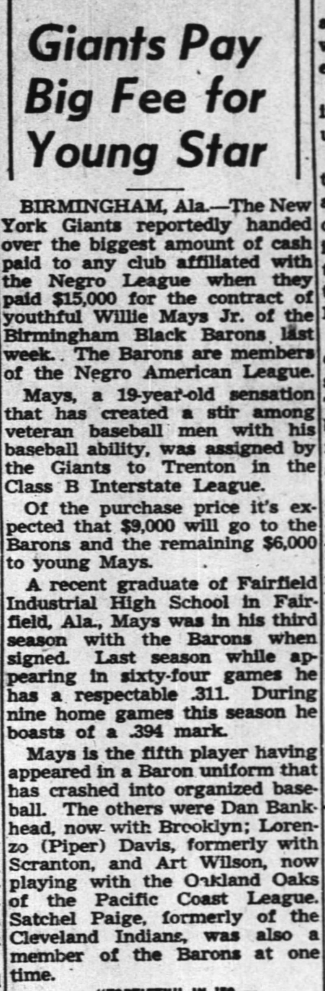
The Signing of Mays

Slide 28
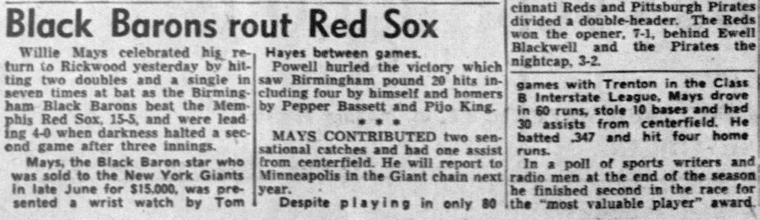
Willie Mays Day in Birmingham
On September 24, Mays after finishing his first minor league season with Trenton, was honored by the Black Barons.
He played in the doubleheader that day.
During the two games he had two doubles and a single in seven at-bats against Memphis.
He was only 19 years old.

Slide 29
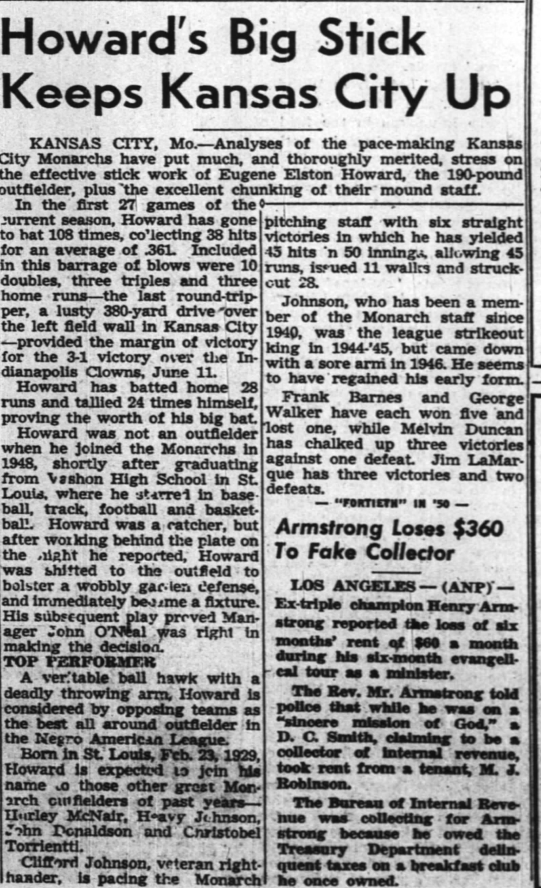
Elston Howard Ready to Move On
Elston Howard was on a home run binge with the Monarchs in June 1950, topped off by his game winner on June 11.
On July 18, his contract was obtained by the Yankees organization.
In 1955, he became the Yankees’ first Black player.

Slide 30
Ernie Banks in 1950
Banks first appearance was in doubleheader on June 4. He was 1-for-4 and 2-for-3.
Per statistics released by the Howe News Bureau, he batted .255 in 53 games with 11 doubles, one triple, one homer, and 20 RBIs. He stole three bases.
Two of those doubles came in a 14-inning Labor Day marathon against Indianapolis. The game was scoreless when halted by darkness.

Slide 31
Others move on
Ray Dandridge, who was scouted by the Giants in May 1949, signed with the team (he was 35) but made it no further than Triple-A Minneapolis, winning the American Association MVP Award in 1950.
Lennie Pearson, longtime first baseman for the Newark Eagles, was with the Baltimore Elite Giants in 1950. During the season, at age 32, he went to the Braves organization.
With the Triple A Milwaukee Brewers, he batted .305 in 63 games.
In 1951, Pearson was demoted to Single A Hartford.
The Brewers had George Crowe at first base in 1951. He had been in the New England League in 1949 and the Eastern League in 1950.
Some lower-level minor leagues, such as the New England League, the Canadian-American League, the Colonial League, the Provincial League, the Eastern League, and the Mississippi-Ohio Valley League welcomed Black players as early as 1946.

Slide 32
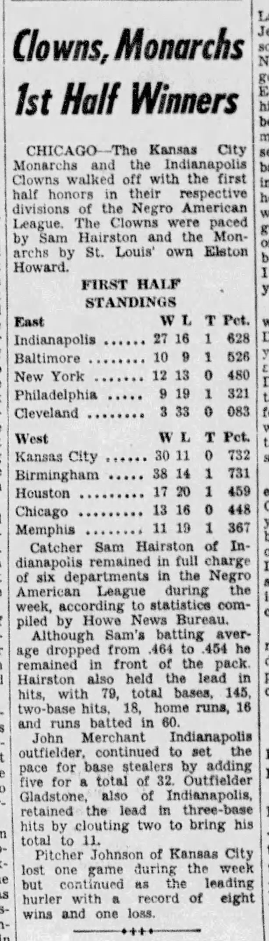
First Half of the 1950 Season
The Kansas City Monarchs won the West, and the Indianapolis Clowns won the East.
Archie Ware and Sam Hairston were the big stars for Indianapolis.
Elston Howard and newcomer Ernie Banks were the big stars for Kansas City.
Howard and Hairston were among the many who would depart the NAL, along with Mays, during the 1950 season.

Slide 33
Not Clowning Around
The Indianapolis Clowns were best known for the antics and Goose Tatum (of basketball fame), King Tut, Eddie “Nyassis” Davis, and the others put on a show.
But they had some good ballplayers.
Sam Hairston had first joined the Clowns in 1946 and was consistently over .300. He won the Triple Crown with the Clowns in 1950 before signing with the White Sox organization.
Hairston had a cup of coffee with the White Sox in 1952, appearing in four games and going 2-for-5.
Other Clowns of note included Henry “Speed” Merchant, Sherwood Brewer, Raul Galata, and Archie Ware.
Hairston was the only member of the 1950 Clowns to make it to the AL/NL major leagues.

Slide 34
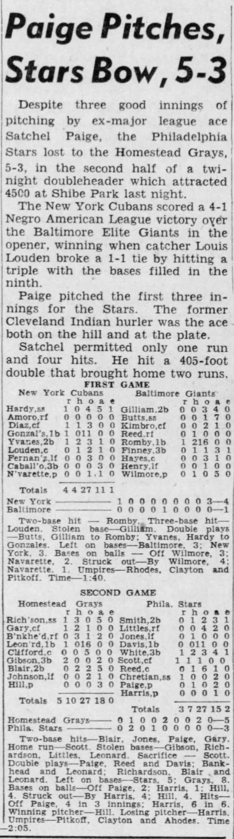
July 24, 1950
Satchel Paige returned to the Negro Leagues, pitching for the Philadelphia Stars. He pitched three innings and doubled in a pair of runs.
The Homestead Grays, not in a league at the time, were the opposition. The Grays disbanded after the season.
Buck Leonard was age 42. His slugging days were coming to an end.
Playing for the Grays at third base was Josh Gibson, Jr.
In the first game, Sandy Amoros played for the Cubans and Junior Gilliam played for Baltimore.

Slide 35
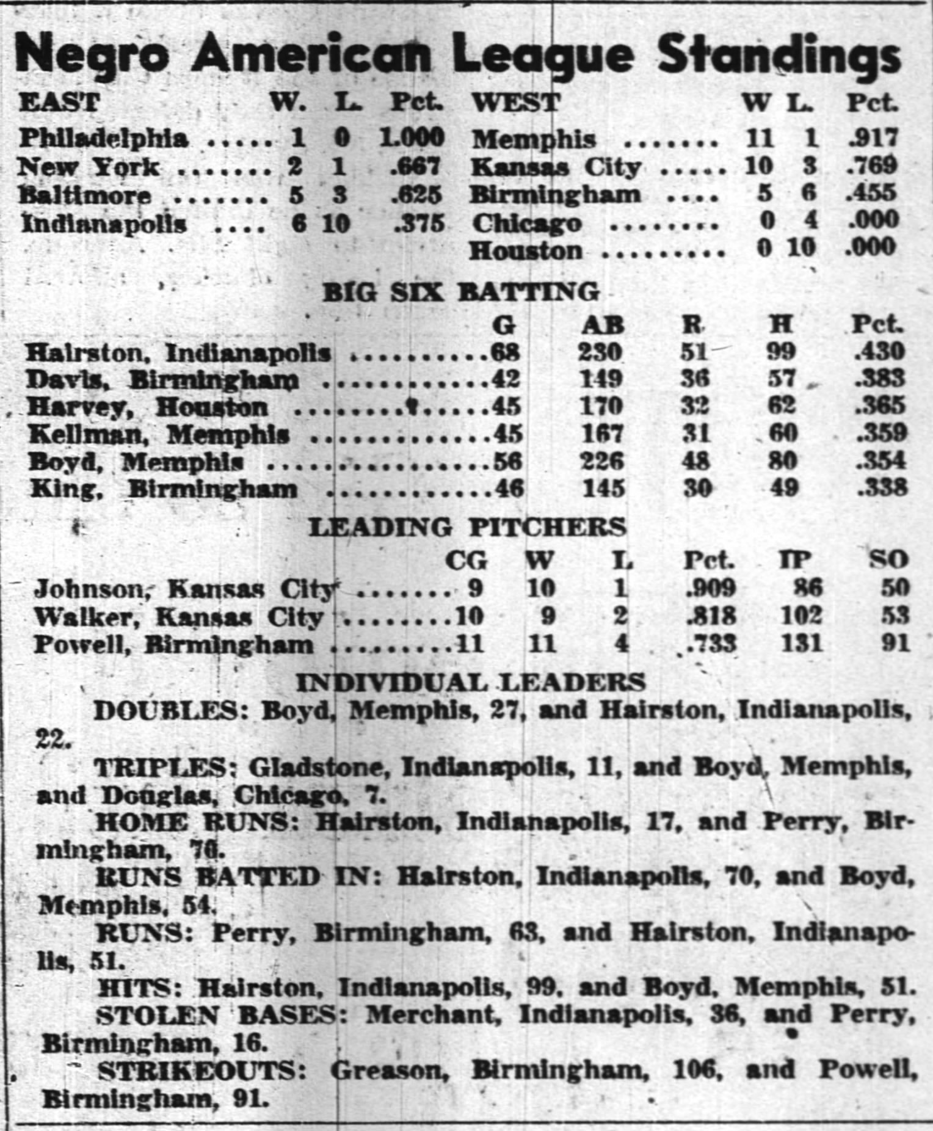
Per Pittsburgh Courier –August 12, 1950
The second half of the 1950 season showed only four teams in the East. The Buckeyes were gone.
Memphis contended for the West, but Kansas City won.
Elston Howard was gone from the Monarchs.
By the time these standings were published, Hairston was in the White Sox organization.
No clear-cut winner in the East. Indianapolis won more games but had sub .500 record.

Slide 36
The Eagles were Homeless
The Newark Eagles were the champions in 1946.
They became the Houston Eagles in 1949.
They played rarely in Houston. The only players from the 1949 and 1950 Eagles to make it to the AL/NL majors were Jehosie Heard and Bob Wilson.
Wilson began his tour of the minors in late 1950, after signing with Brooklyn. After returning to the Negro American League with the Monarchs in 1957, he made it to the majors with the Dodgers in 1958.
The Eagles relocated once more – becoming the New Orleans Eagles in the 1951 season, but there was no hope for survival beyond 1951.
Heard was with that last team and made it to the majors with the Orioles in 1954. He was Baltimore’s first Black player.

Slide 37
Bye-Bye Buckeyes
The Cleveland Buckeyes had started the 1949 season in Louisville, but, by July, they were back in Cleveland.
Before the 1950 season, two of their players, pitcher Sam Jones and pitcher-outfielder Dave Hoskins, departed, each joining the Cleveland Indians organization.
The Buckeyes’ 1950 season was horrific.
They finished the first half with a 3-37 record and failed to complete the season, dropping out after starting the second half 0-2.
Roster changes were frequent, and sources indicate that more than 60 men played for the team in 1950.
One of them, Joe Caffie, signed with the Cleveland organization in 1951 and played with the Indians in 1956 and 1958.

Slide 38
1951 Contraction
In 1951, as the Buckeyes and Cubans dropped out, there were only eight teams in the Negro American League.
Marshall Bridges, who advanced to the AL/NL majors in 1959, began his professional career in 1951, at age 20, with the Memphis Red Sox and was with them through 1954.
Overall, however, only 12 players who played in the NAL in 1951 played in the AL/NL majors, down from 25 in 1949 and 1950. The number would shrink to eight 1952 and four in 1953 before increasing to six in 1954.
Three of those players in 1951 were with the Chicago American Giants.
Larry Raines and Joe Taylor had short AL/NL stints.
Satchel Paige had returned to the Negro Leagues the prior season but was signed by the St. Louis Browns in July 1951.

Slide 39
Whatever Became of Willard Brown
At the end of the 1950 season, Willard Brown was acquired by the Ottawa Senators of the Border League.
He was 35 years old.
He was the only Black player in the League.
In his month with the team, he batted .352 and led his team to the championship.
He continued to play in the minor leagues (mostly in the Texas League) until he was 42.
He was one of 22 Kansas City Monarchs to play in the AL/NL majors.
He was elected to the Hall-of-Fame in 2006.

Slide 40
Further Contraction
The NAL shrank to six teams in 1952 as Baltimore and New Orleans dropped out.
1952 marked the end of divisional play.
The NAL further shrank to four teams in 1953. Only Kansas City, Indianapolis, Birmingham, and Memphis remained.
During this time of decline, two players of note took the field - one for the Indianapolis Clowns in 1952 and the other for the Kansas City Monarchs in 1953.

Slide 41
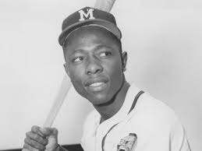
Henry Aaron
Henry Aaron joined the Indianapolis Clowns in 1952.
4/30/52 – 13 chances at shortstop without an error.
5/3/52 – participated in seven double plays.
5/18/52 – first two homers in Game Two of doubleheader at Baltimore’s Memorial Stadium.
6/10/52 – Last Game with Clowns before joining Braves organization.

Slide 42
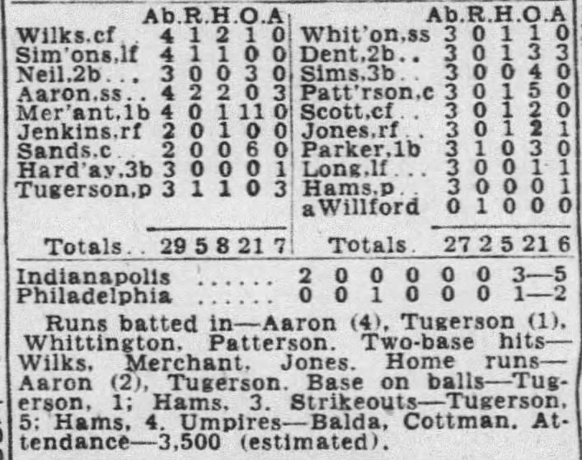
Hank Aaron’s first two homers – Box Score

Slide 43
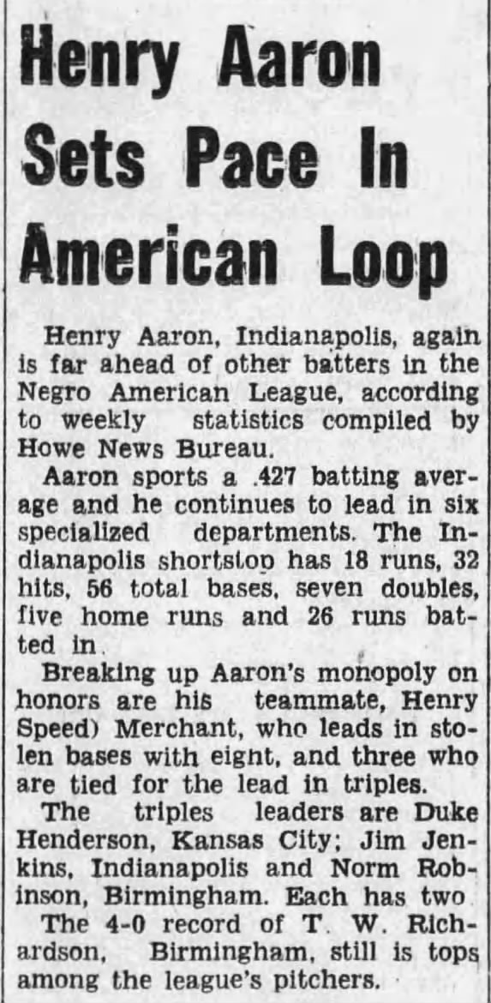
Aaron Leads League in Early June
Just before leaving the Monarchs, Aaron was batting .427 with five homers and 26 RBIs.
The article is from the Alabama Tribune – June 13, 1952.

Slide 44
Indianapolis Wins First Half in 1952
Five members of the Clowns were named to play for the East team in the East-West Game:
They were Jimmy Wilkes, Henry “Speed” Merchant, Ted Richardson, Jim Cohen, and catcher/manager Buster Haywood. Their careers eould not take them beyond the Negro Leagues.
The West won the game 7-3. The announced attendance was 18,279.
Indianapolis won the first half. Birmingham won the second half.
The teams then barnstormed their way through 12 (perhaps more) games with Indianapolis winning the championship – Seven Games to Five.

Slide 45
The Post Season in 1952
Birmingham won five of the first eight games per major Black weeklies. The next four games were as follows.
Game Nine: Indianapolis 3, Birmingham 1 at Columbus, Georgia
Game Ten: Indianapolis 3, Birmingham 2 (10 inn) at Mobile, Alabama
Game Eleven (9/27): Indianapolis 5, Birmingham 3 at Biloxi, MS
Game Twelve: (9/28): Indianapolis 5, Birmingham 0 at New Orleans.
The MVP was Hank Aaron who rejoined the Clowns for the series and had five home runs and batted .402.

Slide 46
Other 1952 “World Series” Games
Before September 28
After September 28
September 14 – Birmingham – Rained out in second inning
September 15 – Memphis - Indianapolis 4, Birmingham 3
September 16 - Little Rock – Birmingham 5, Indianapolis 3
September 18 – Nashville – Birmingham 12, Indianapolis 0
September 19 – Knoxville – Indianapolis 16, Birmingham 10
September 20 – Welsh, West Virginia
September 21 – Bluefield, West Virginia
September 22 – Newport News, Virginia
September 23 – Norfolk, Virginia
September 29 – New Orleans – Indianapolis 7, Birmingham 4
October 2 – Memphis – Birmingham 6, Indianapolis 5
October 3 - Birmingham
October 4 – Greenwood, Mississippi
October 5 – Birmingham
October 6 – Chattanooga, Tennessee – Indianapolis 4, Birmingham 2
October 7 – Johnson City, Tennessee
October 8 – Knoxville, Tennessee – Birmingham 11, Indianapolis 7

Slide 47
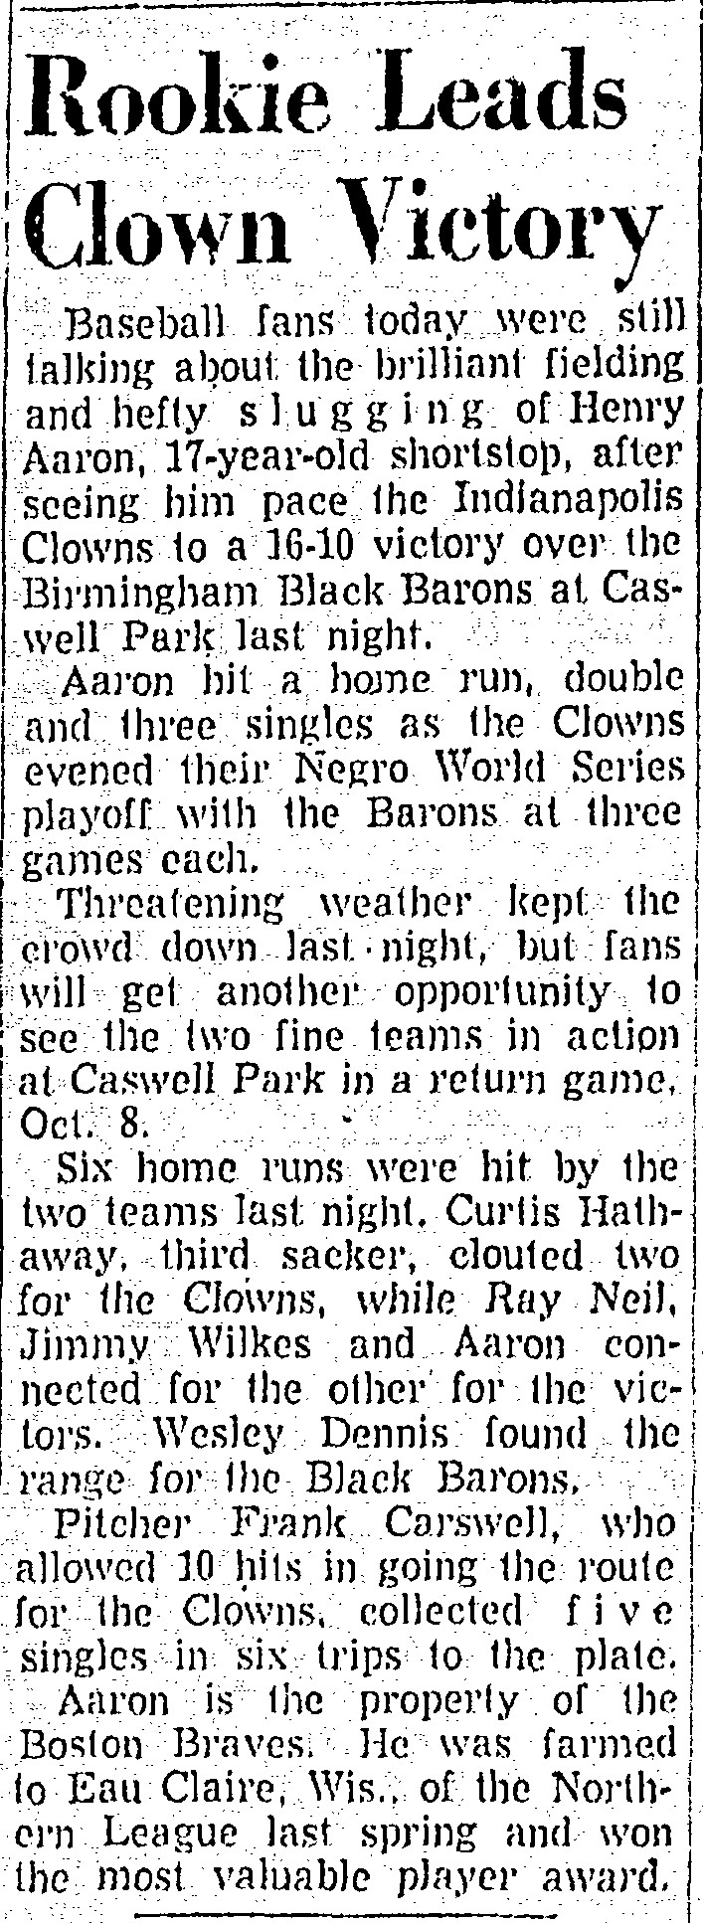
Hank Aaron Breaks Out
On September 18, Hank Aaron homered, doubled and had three singles to lead the Clowns to a 16-10 win.
As noted in the article, he had been selected the MVP in the Northern League.
He had batted .346 at Eau Claire, Wisconsin.

Slide 48
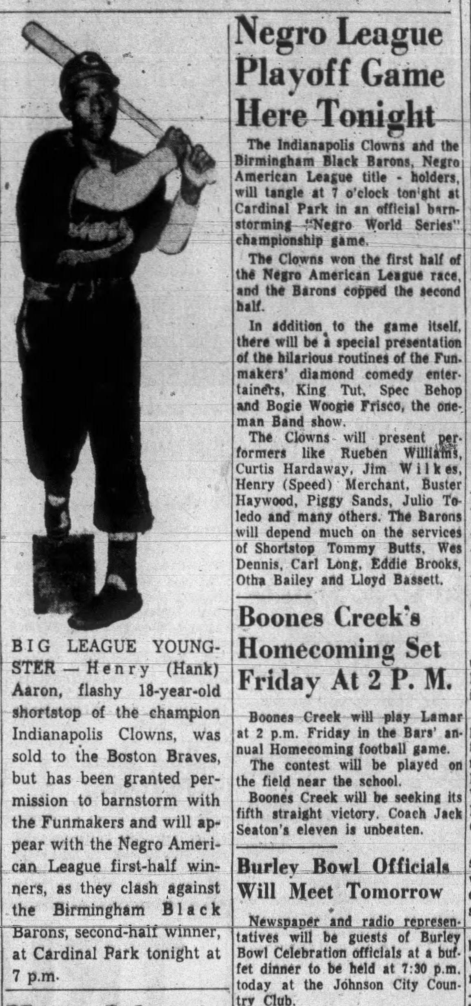
Henry Aaron in Post-Season
This article is from the Johnson City Tennessee newspaper on October 7, 1952.
The series continued long after the “final game” in New Orleans.
They played in Memphis on October 2, Johnson City on October 7, and Chattanooga on October 8.

Slide 49
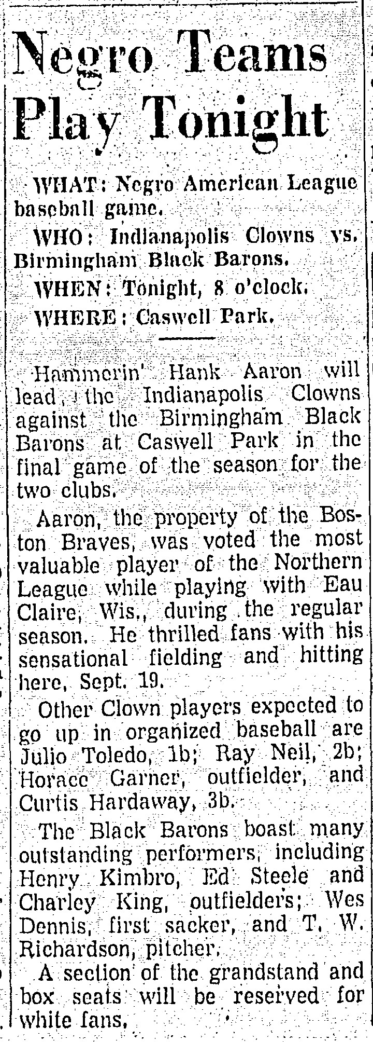
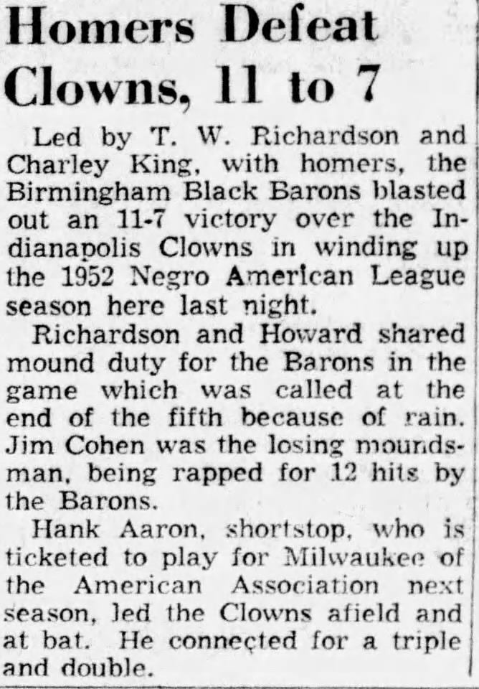
They started to call him “Hammerin’ Hank”
From Knoxville News-Sentinel 10/8/52 Game Preview calls him Hammerin‘ Hank
From Knoxville News-Sentinel 10/9/52 Hank Aaron’s Last Negro League Game

Slide 50
Hank Aaron’s Last Game with the Clowns
Hank Aaron doubled and tripled in the loss to Birmingham at Knoxville on October 8.
The article stated that he was headed for Milwaukee in the American Association in 1953.
But the Braves moved to Milwaukee and Aaron spent 1953 with Jacksonville, breaking the color line in the South Atlantic League.
He and Felix Mantilla were the only Black players on the team and in the League.
Jacksonville went 93-44 for manager Ben Geraghty.

Slide 51
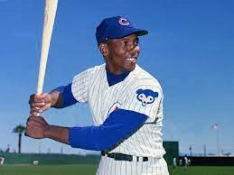
Ernie Banks Returns to Monarchs in 1953
Banks was in the Army in 1951-1952.
He rejoined the Monarchs in 1953 and slugged his first homer on May 10 against the Clowns.
He played in the East-West game on August 16, but went hitless.
His last homer with the Monarchs, a Grand Slam, came on September 4. He last played with the Monarchs on September 13.
For the year, per the 9/29/53 Phila Tribune, he batted .347 with 60 hits, 16 doubles, seven homers, and 47 RBIs.
His first game with the Cubs was on September 17.

Slide 52
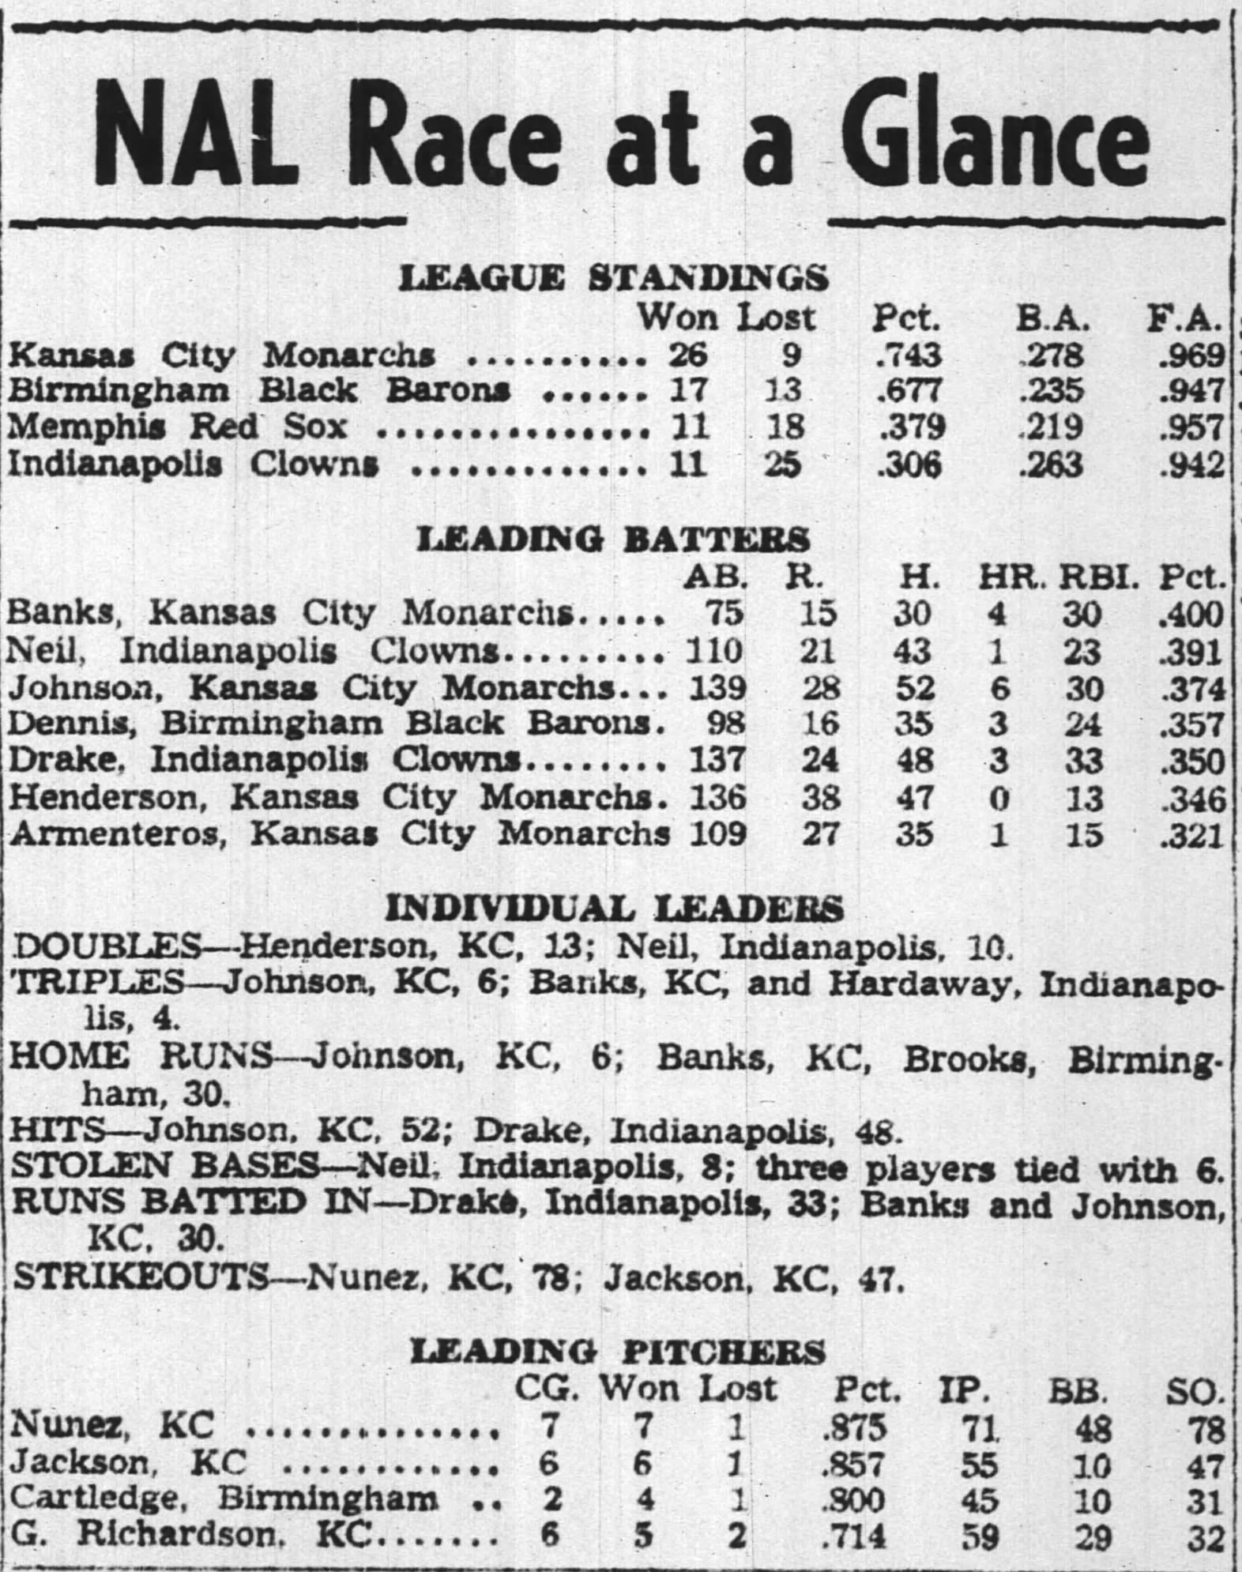
Banks and Monarchs Take Command – from Pittsburgh Courier – 7/18/1953
At the midway point, Banks led league in batting with .400 average.
Monarchs won first-half championship.
Banks’ last game with the Monarchs was at Forbes Field in Pittsburgh. He singled, stole second base, and scored the winning run.
The Monarchs won the second half as well and were the only team in the league with a better than .500 record.
Banks’ .347 average was good for third in the league behind Ray Neil and Doc Dennis.

Slide 53
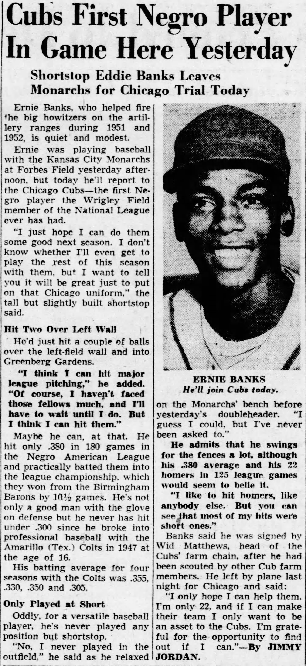
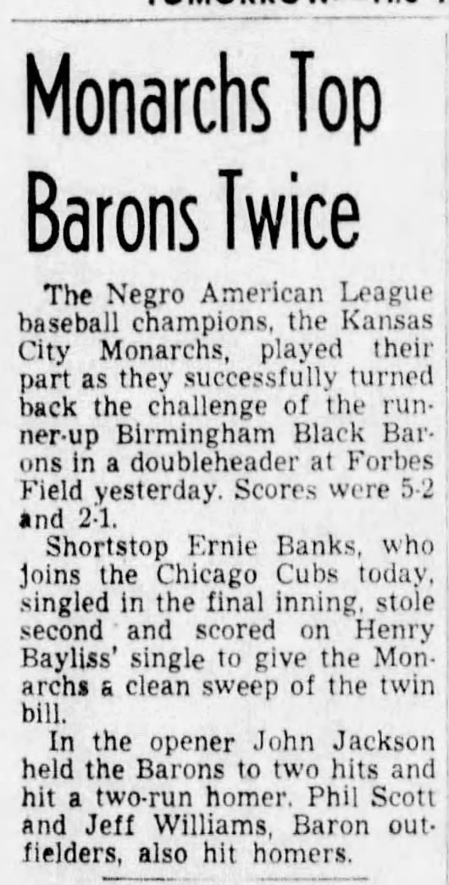
Ernie Moves On!

Slide 54
After 1953 – New Teams and a Barrier Breaker
The Negro American league expanded to six teams in 1954 with the addition of the Detroit Stars and the Louisville Black Colonels.
John Kennedy joined the Birmingham Black Barons in 1954. By 1956, he was with the Kansas City Monarchs.
In 1956, with the Monarchs, he batted .356, third best in the league.
He became the Phillies’ first Afro-American player in 1957. He was hitless in five National League games.

Slide 55
The Indianapolis Clowns Post 1954
The Indianapolis Clowns last played in the Negro American League in 1954.
John Wyatt was the last Indianapolis player from the NAL days to make it to the AL/NL majors.
Through 1989, they were exclusively a traveling barnstorming team.
Little in the way of detailed results are available about the team after 1954.
However, some of their players moved on to bigger things. They include:
George Smith was signed by the Detroit organization after the 1957 season. He made it to Detroit in 1963.
Choo-Choo Coleman, who played with the Clowns from 1955 through 1957, also played with Orlando in the Florida State League beginning in 1955 and made it to the majors with Philadelphia in 1961. He is best known as a member of the 1962 Mets.
Hal King, who played with the Clowns from 1962 through 1964, made it to the majors in 1967 with Houston.

Slide 56
The Monarchs Continue to Produce Quality Players
In 1952, Pancho Herrera joined the Monarchs. He was in two East-West games, homering in the game on August 22, 1954.
Herrera signed with Phillies organization in 1955 and made it to the National League Phillies on April 15, 1958, becoming the team’s fourth player of color.
Walter Bond was on the 1956 Monarchs, batting .308. He was selected for the East-West Game. He was signed by Cleveland and made it to the American League in 1960.
And four players from the 1955 Monarchs made it to the “Show.”

Slide 57
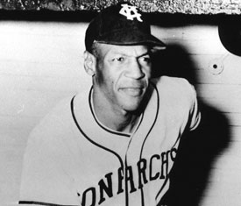
Buck O’Neil Leaves Monarchs
On May 15, 1955, in the season opener at Kansas City, 44-year-old Buck O’Neil hit a pinch-hit home run.
He had been with the team as a player since 1938. He took over as manager in 1948.
At season’s end, Lou Johnson, George Altman, and J. C. Hartman went to Cubs organization. Hal Jones went to the Cleveland organization. Each made it to the AL/NL majors.
O’Neil joined the Cubs as a scout and never forgot his roots in the Negro Leagues.

Slide 58
Minor Leagues Welcome Black Players – Some more than Others
Sammy Gee broke the color line in the Canadian-American League. When he was signed by the Brooklyn Dodger organization, he became the first player signed who had not played in the Negro Leagues.
Chuck Harmon was the second Black player in the Canadian-American League in 1947 after playing briefly in July - only four games , under an assumed name (Charlie Fine) - with the Indianapolis Clowns.
He played with the Gloversville-Johnstown (New York) Glovers. He was the only player of color on the team.
No other former Negro League players were in the Can-Am League, which ceased operations after the 1951 season.
Walter McCoy of the Chicago American Giants, broke the color line in the California League in 1949. He was the only Black in the league.

Slide 59
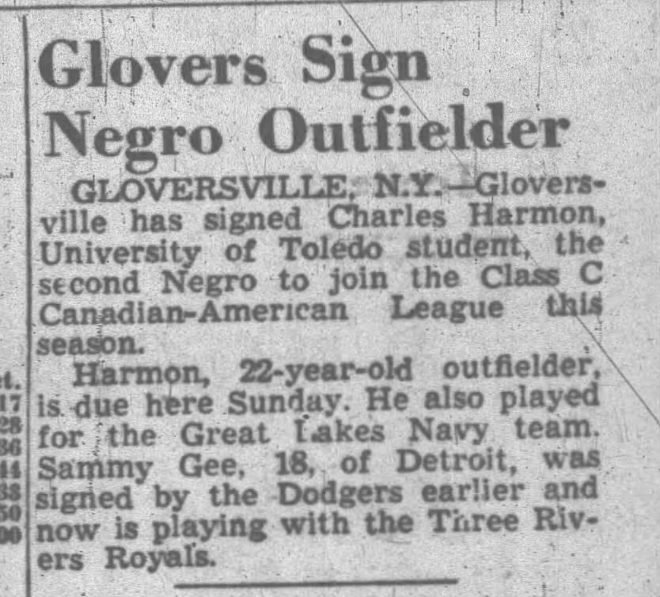
From the Berkshire Eagle – July 19, 1947

Slide 60
Strange Doings in the PONY (Pennsylvania-Ontario-New York) League
Sammy Gee, one year after breaking the color line in the Can-Am League, broke the barrier in the PONY League when the Dodgers sent him to Olean, NY.
He and Ron Teasley were the only Black players on the team, and they were both released by the team on June 5. Gee was batting .321 at the time, and Teasley was batting .267. Both players joined the New York Cubans.
The next Black player with Olean was Chuck Harmon in 1949.
The PONY League, like the Can-Am League, was slow to integrate. Through 1949, only three Blacks had played in the league.

Slide 61
The Provincial League
The Provincial League became a haven for Black players in 1948.
Former Negro League player Bus Clarkson led the league in homers with 31 and batted .408.
There were five former Negro League players in the top-20 batters.
Terris McDuffie batted .342 and pitched to a 19-8 record.
Pancho Coimbre, playing with Sherbook at age 39, batted .312. Former Cuban teammate Claro Duany batted .337 for Sherbrook as the led the league with a 61-37 record.
Hall of famer Ray Brown played with Sherbrooke in 1950 and 1951, and 21-year-old Hector Lopez was in the early days of his career with St. Hyacinthe in 1951.
The league continued through 1953.

Slide 62
The Eastern League
Al Smith broke the color line in the league in 1948 with Wilkes-Barre, batting .316. The next season, he was joined by Harry Simpson.
Piper Davis joined the Red Sox affiliate in Scranton in 1950 but was only with them briefly, being released after 15 games. In 1952, Curley Williams, Leon Day, Frank Barnes, and Jose Colas integrated the team (no longer a Red Sox affiliate) for real.
Hartford broke its color line with Schoolboy Johnny Taylor in 1949.
In 1950, Hartford added George Crowe and Stanley Glenn.
Lennie Pearson, Stanley Glenn, and Julie Bowers were with the Hartford Chiefs in 1951.
In their last year in the 20th century, 1952, Hartford had only one Black player – Stanley Glenn.

Slide 63
The Manitoba-Dakota League 1950-1955
The Manitoba Dakota League began operations in 1950 and became the first minor league with a significant Black presence.
The 1950 Winnipeg Buffaloes had 14 veterans of Negro League play and a shortstop, John Kennedy, who would be the first Afro-American with the Philadelphia Phillies.
Butch Davis, formerly of the Baltimore Elite Giants, led the league in batting with a .456 average.
Gentry Jessup (9-4) had the most wins by a pitcher in the league.
The impact was felt in the United States as some Negro League teams became far less competitive. Many of those who played in the Negro American League in 1950 had never played professionally prior to that year and did not return after 1950.

Slide 64
The Western Canada League - 1951
The Western Canada League was only around for one season with six teams.
Few players of note played in the league, but there were several Black players in the league.
Two became barrier breakers.
Tom Alston, who had been at North Carolina A&T in 1949, began his professional career with Indian Head in 1951. In 1954, he was the first Black player for the St. Louis Cardinals.
Pumpsie Green, at age 17, started his professional career at Medicine Hat in 1951. In 1959, he was the first Black player with the Red Sox.
And Bobby Prescott was beginning a journey that took him from Indian Head in 1951 to Kansas City in the American League in 1961. His one big-league hit came on June 27, 1961.

Slide 65
Southwest-International League 1951-1952
Opened doors to Black players including:
Les Witherspoon, formerly of the Indianapolis Clowns
John Sanderson, formerly of the Kansas City Monarchs
Chet Brewer, at age 45, whose career started with the Monarchs in 1925.

Slide 66
Western International League
Integrated in 1951
Former Negro Leaguers included:
John Ritchey (1951-1952) with Vancouver, British Columbia.
Orinthal Anderson (1952) with Salem, Oregon.
Milt Smith with Lewiston, Idaho (1952) with Salem, Oregon (1953).
Archie Ware (1952) with Lewiston, Idaho.
Jehosie Heard (1952) and Nap Gulley (1953) with Victoria, British Columbia.
Herb Souell (1952) with Spokane, Washington.
Bonnie Serrell (1952) with Yakima, Washington.
Leon Day (1953) with Edmonton, Alberta.
Lonnie Summers (1954) with Yakima, Washington.
Marvin Williams (1954) with Vancouver, British Columbia.

Slide 67
What happened in 1956?
After the 1955 season, with the departure of Buck O’Neil and four future AL/NL players, the Monarchs faced an uncertain future.
The Detroit Stars finished in first place during the first half of the 1956 season, with the Monarchs lagging far behind.
W L Pct. GB
Detroit Stars 17 8 0.680
Memphis Stars 11 11 0.500 4.5
Birmingham Black Barons 12 15 0.444 6.0
Kansas City Monarchs 6 12 0.333 7.5

Slide 68
Rebuilding the Monarchs - Slowly
Ted Rasberry bought the Monarchs from Tom Baird after Baird had disposed of most of the quality players after the 1955 season.
The 1956 Monarchs, after finishing in last place in the first half, didn’t do any better in the second half. Memphis had the best winning percentage in the second half, but Detroit with the best overall record, was designated the league champion.
Despite their poor performance the new Monarchs had three players that would go on to the AL/NL majors: John Kennedy, Walter Bond, and Hal Jones.
The next year, the Monarchs were back on top.

Slide 69
1957 – Six Team League
Kansas City
Memphis
New Orleans
Detroit
Birmingham
Mobile
Jim Banks of Memphis batted .443. His only experience in the minor leagues was in the Man-Dak League in 1953.
Kansas City won the league championship with a 34-9 record.

Slide 70
1958 – More Barnstorming Less of a League
The League was a four-team league with not much in the way of prospects.
The Detroit Clowns had Goose Tatum, then age 40, as owner-manager. He was also the team’s first baseman.
The teams were Birmingham, Detroit, Kansas City, and Memphis.
The teams were essentially travel teams with few games being played in Detroit and Kansas City.
Kansas City’s Jesse Townsend struck out 23 batters in a game, per the Indianapolis Star. It wasn’t noticed by any big-league scouts.
Charlie Pride was 7-3 for Memphis, but he was destined for another Hall of Fame.

Slide 71
1959: Waning interest and Less Stats
The 1959 was the first of the Comiskey Park E-W games without a box score.
We do know that the West won the game, 8-7, and that Willie Smith of the Birmingham Black Barons, playing for the West team, homered. He made it to the AL/NL majors in 1963, but none of his 46 Big-League homers came at Comiskey Park.
Smith was the only participant in the 1959 E-W Game to make it to the major leagues. Only one other player from the 1959 season, George Spriggs of Kansas City, made it to the majors.
Detroit finished in first place in the five-team league and Isaac Barnes of Memphis led the league in batting.

Slide 72
By 1960 – Little Evidence
Season began in late May and there was little in the way of standings information or detailed statistics.
Four teams competed.
Future Big-leaguer Ike Brown joined the Monarchs.
George Spriggs played for the Detroit-New Orleans Stars.
Bill Greason was back for a last hurrah with the Raleigh Tigers.
Willie Smith was in his last season with the Birmingham Black Barons.
Comiskey Park hosted its last East-West Game.

Slide 73
A Playoff in 1961
Although tabs were not kept on results during the 1961 season, a playoff was held at the end of the season between Birmingham and Kansas City.
Game One: Birmingham 4; Kansas City 1.
Beyond that, little is known.
The East-West game was played in New York’s Yankee Stadium.
Satchel Paige was the winning pitcher in the 7-1 contest.

Slide 74
As the Years went on
1962 marked the last year of the East West Game.
By then, there were three “Negro American League” teams.
They did not play in a league.
They barnstormed and, in that year, played the East-West Game in Kansas City. There is no box score from that game or, for that matter, any of the East-West Games after 1958.
But some players from those latter years went on to the Big Leagues.

Slide 75
From the Negro Leagues to the AL/NL Majors
A Summary
73 Negro League players, including more than fifty players who played in the post-1948 Negro Leagues, advanced to the majors.
Mays, Banks, Aaron, and Howard lead the post-1948 list.
Eleven players did not make it to the AL/NL majors until the 1960s.
Here are a couple.
Wonderful Willie Smith was a pitcher/outfielder with the Birmingham Black Barons from 1957 through 1960. He made his debut with the Los Angeles Angels in 1963.
John “Blue Moon” Odom pitched for the Raleigh Tigers in 1962. He made his debut with the Kansas City Athletics in 1964.

Slide 76
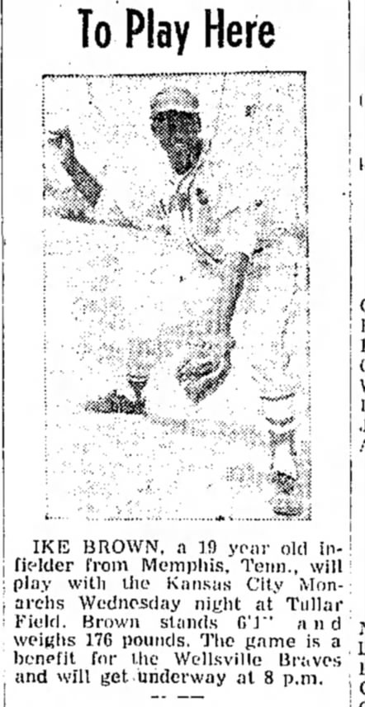
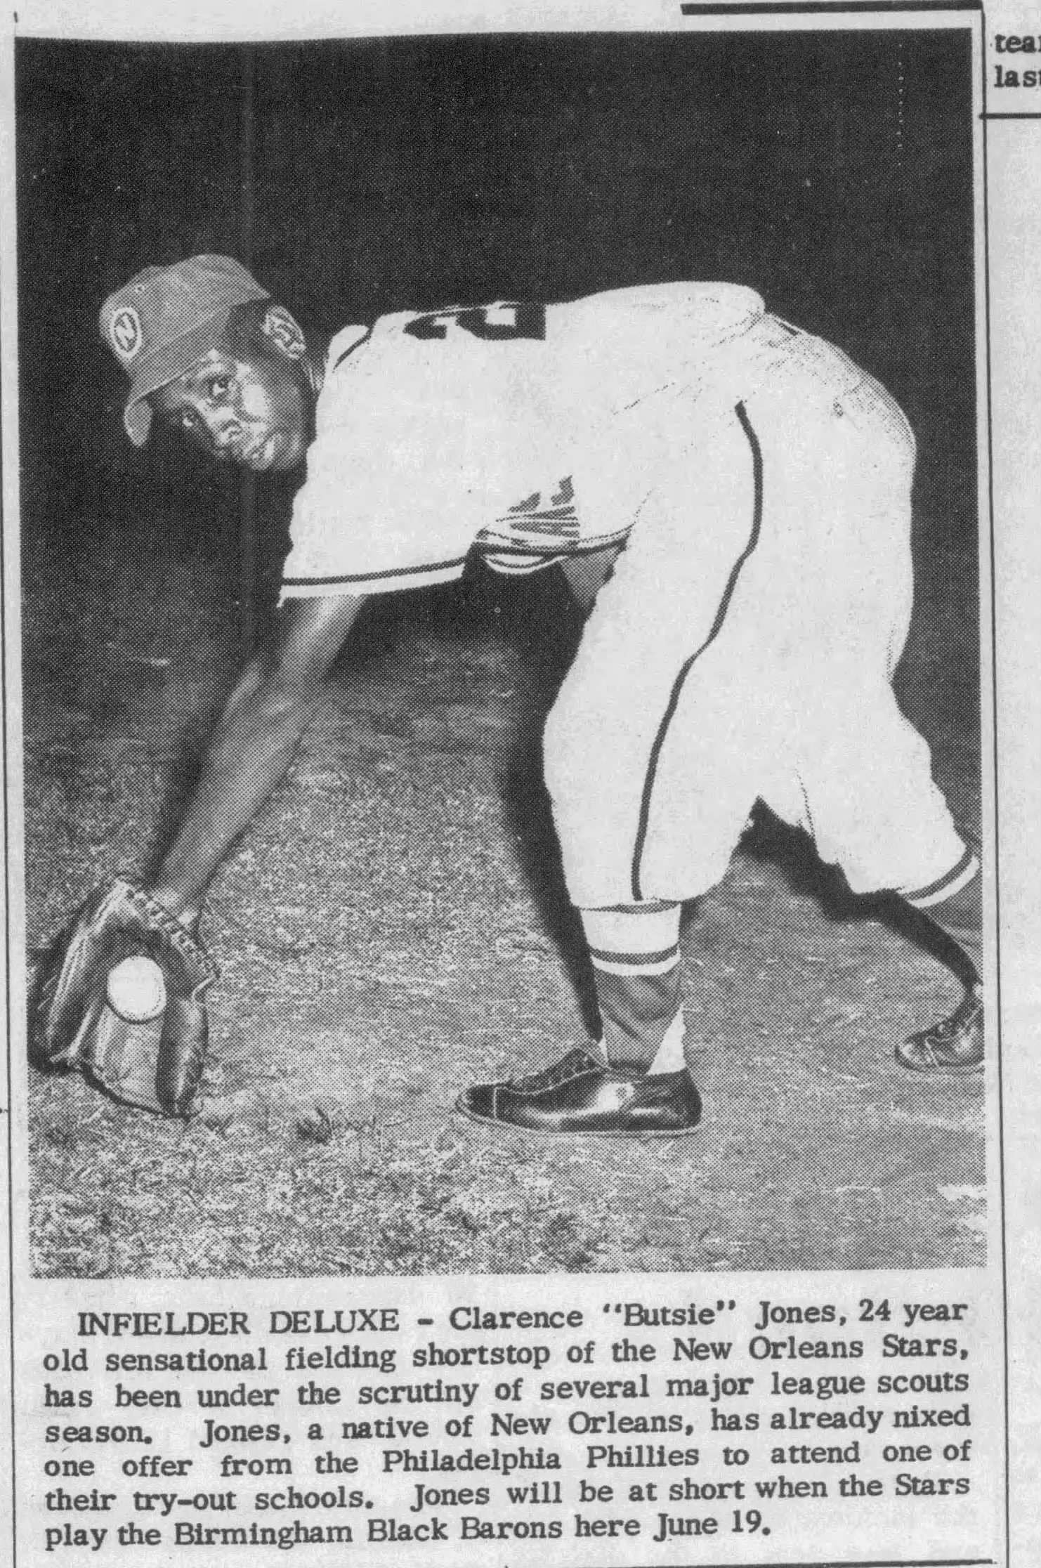
The Last Negro Leaguers to Enter AL/NL Ball
Ike Brown played with the Monarchs in 1960 and 1961. He made his debut with the Detroit Tigers in 1969.
Clarence Jones joined the Chicago Cubs in 1967. Had played with New Orleans Stars in 1960

