Slide 1
A Story Told By the Pioneers of Sabermetrics
When Big Data Was Small
Presented By: Brian Hall

Slide 2
About the Speaker

Slide 3
SABR Oral History Project
About the SABR Oral History Collection
The SABR Oral History Collection includes MP3 audio files from interviews conducted with ballplayers (Major Leagues, Minor Leagues, Negro Leagues, AAGPBL), executives, scouts, authors, writers, broadcasters, and other figures of historical baseball significance. These interviews, some of which date back more than 50 years, were conducted by members of SABR’s Oral History Research Committee and were digitized through a collaboration with the National Baseball Hall of Fame Library.
Founded in 1986, the SABR Oral History Committee has recorded lengthy interviews with well-known and lesser-known players, helping to preserve the historical record and to provide for recollections of baseball history which exist in no other place. Interviews with so called cup-of-coffee players can be as illuminating as interviews with baseball’s biggest names. Such interviews typically explore a player’s biography and involvement in notable games in depth, thus allowing for some of the most probing and authoritative accounts in existence. In many cases, the Oral History Committee recording may be the most comprehensive account of a player’s career in existence.
The committee also offers guidelines for conducting effective oral history interviews; many SABR members use Oral History interviews as a launching point to write that person’s biography for the SABR BioProject.

Slide 4
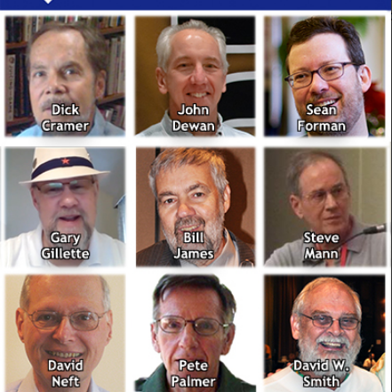
Interviews With:
Dick Cramer, co-founder of STATS, Inc.
John Dewan, principal owner of Sports Info Solutions
Sean Forman, founder of Baseball-Reference.com
Gary Gillette, former SABR Director and contributor to baseball encyclopedias
Bill James, author, historian, and former Boston Red Sox executive
Steve Mann, former Houston Astros executive and fantasy baseball author
David Neft, driving force behind Macmillan’s The Baseball Encyclopedia
Pete Palmer, co-editor of Total Baseball and co-author of The Hidden Game of Baseball
David W. Smith, founder and president of Retrosheet.org

Slide 5
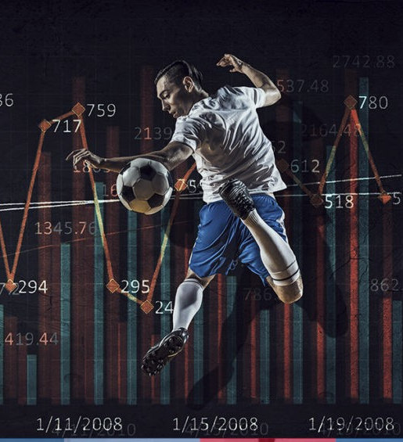
Their Story is a Decades-Long Effort to Help Create “Sports Analytics” Field/Industry

Slide 6
Question For You
Sabermetrics started to develop in the late 1970s and 1980s.
What did sabermetrics need in order to take off and develop?

Slide 7
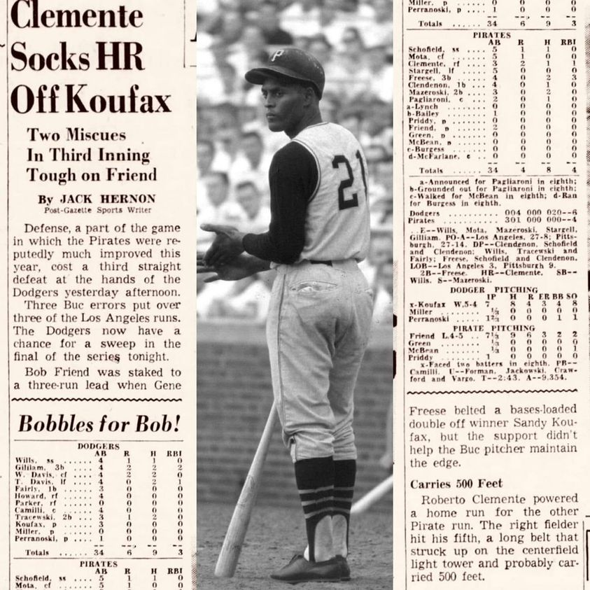
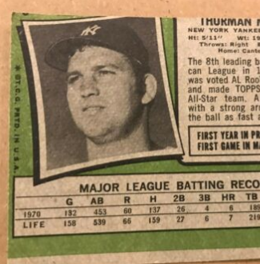
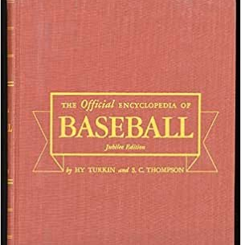
The Problem: Baseball Data was “Small”
Until the 1970s baseball stats were limited:
Newspapers
Baseball Cards
Encyclopedias

Slide 8
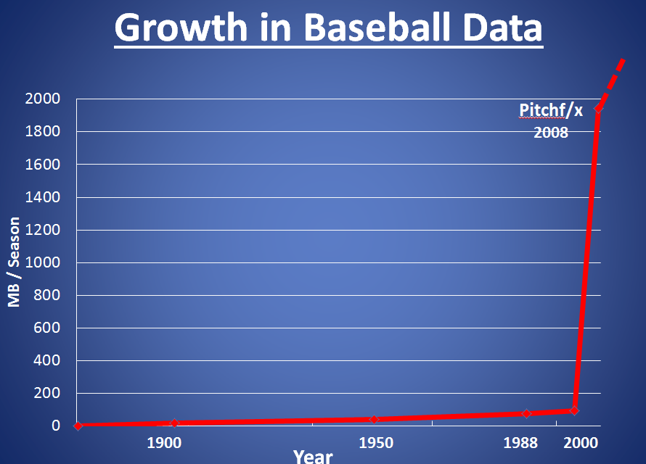
Solution: Collect and Digitize “Missing” Baseball Data

Slide 9
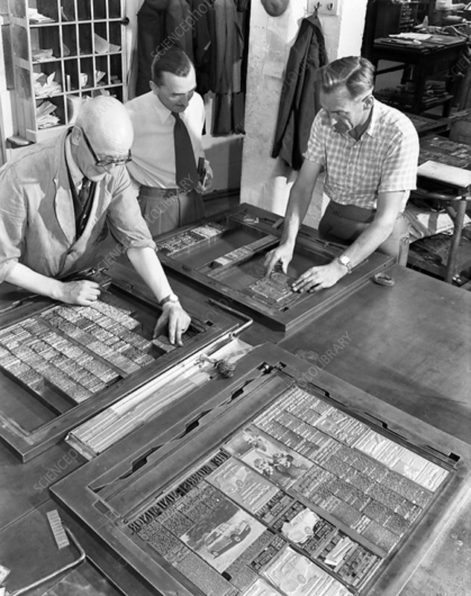
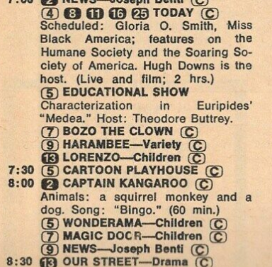
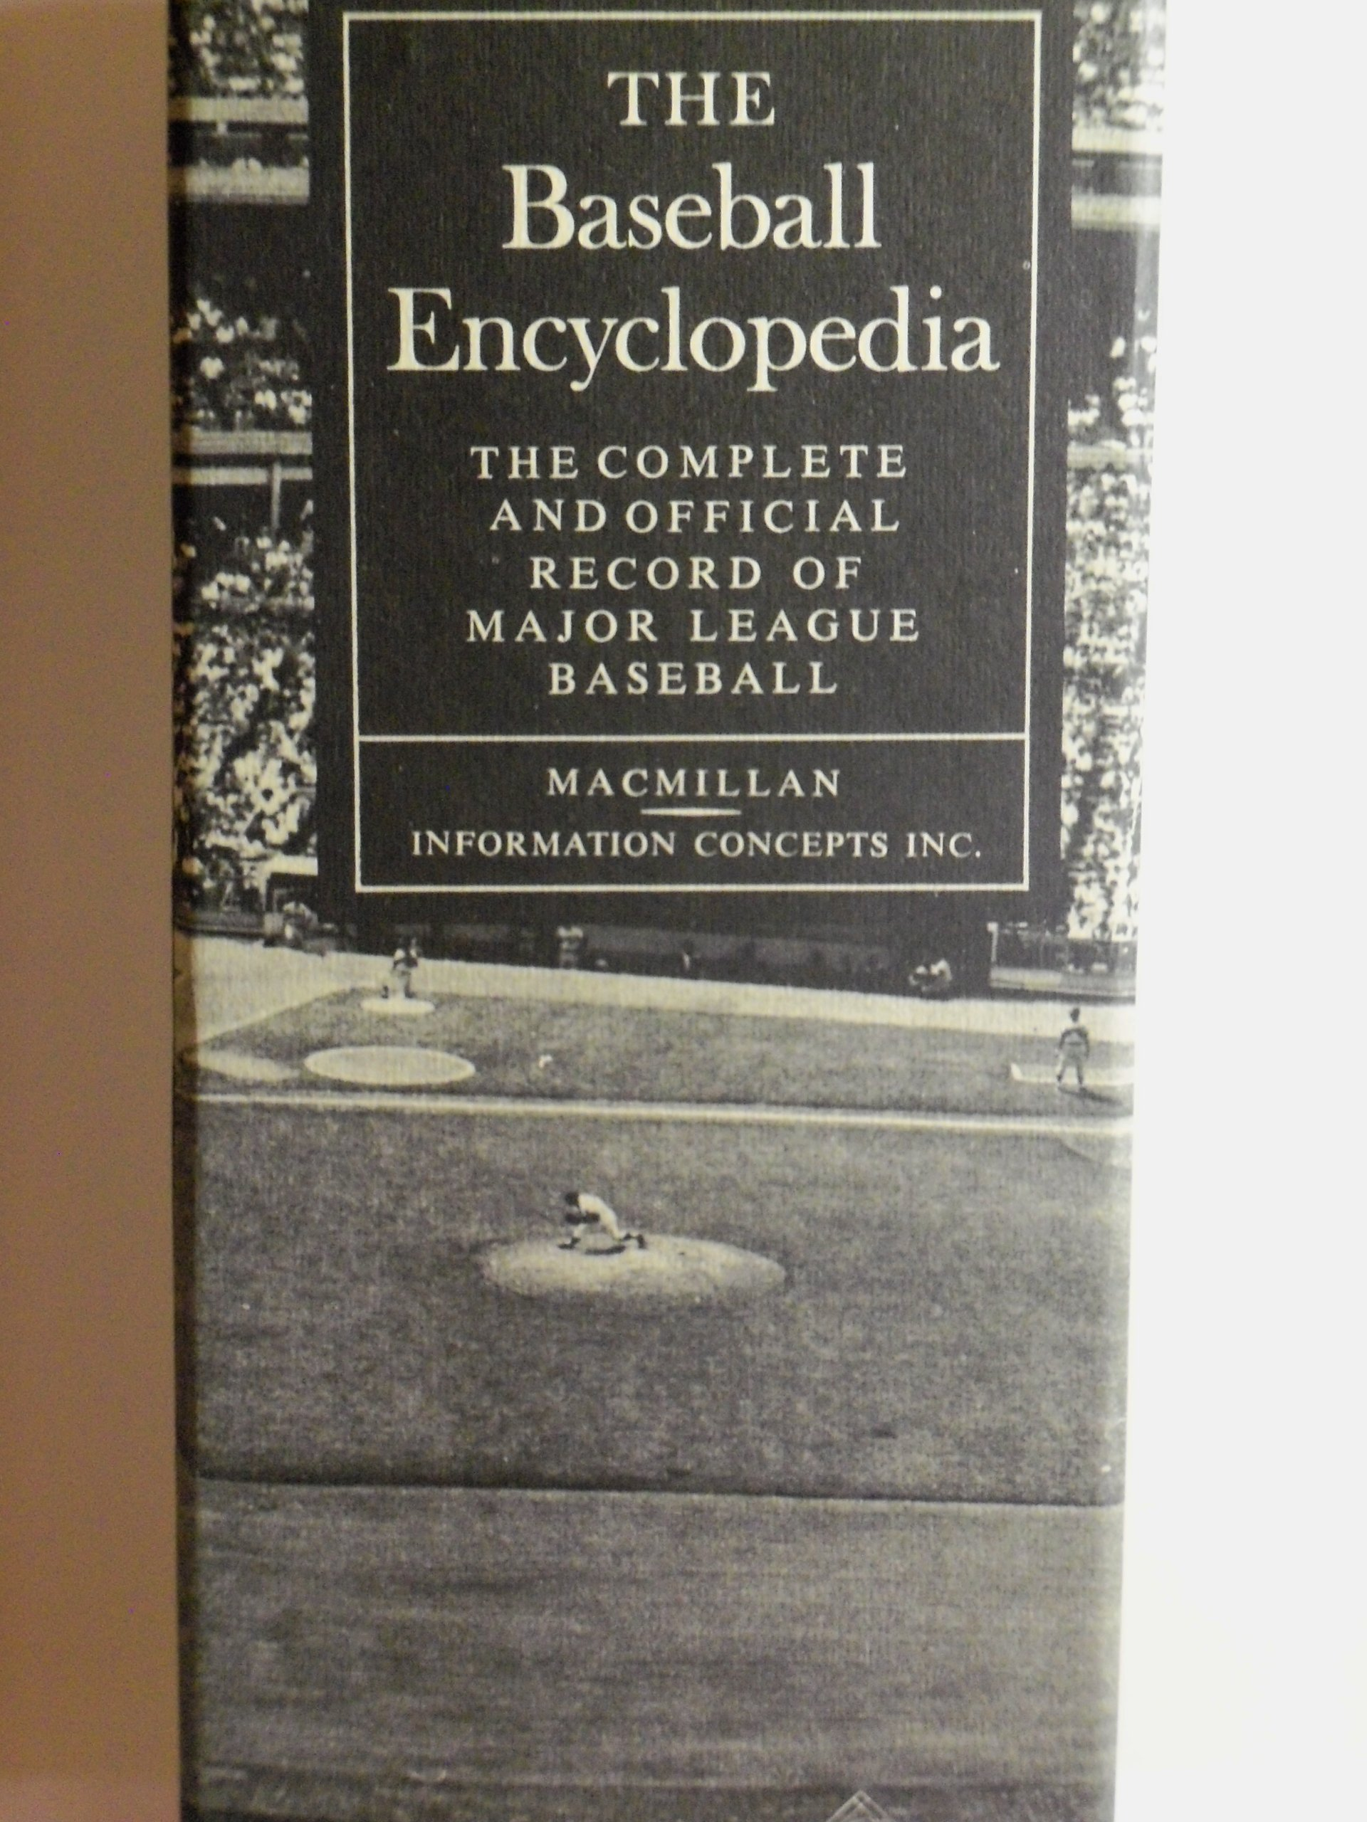
Creating the Golden MLB Dataset
Before 1969, very little information on players in baseball encyclopedia
IBM developed software to replace the manual typesetting of printed TV Guides
“The 1969 Baseball Encyclopedia was the first book of any kind to be typeset electronically in the United States.” – David Neft
The baseball encyclopedia in 1969 had 2,300 pages of 6-point type.
More than 30 people working on the project. An MLB committee would approve statistics before being used, so the book became the official MLB dataset.
Book was a blockbuster hit – not just in bookstores, but department stores like SEARS and in the MLB

Slide 10
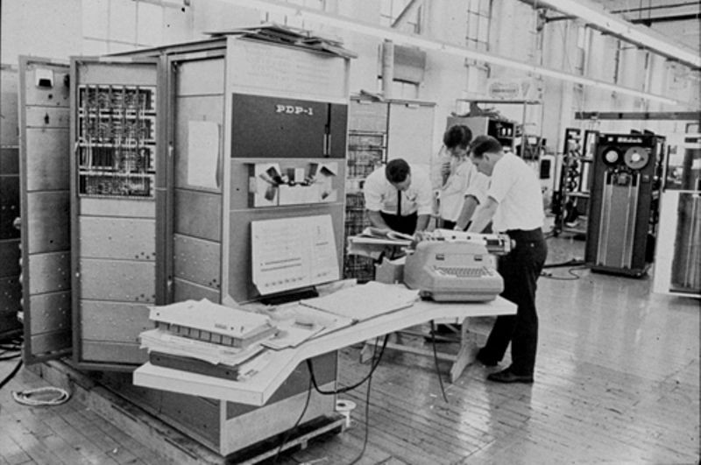
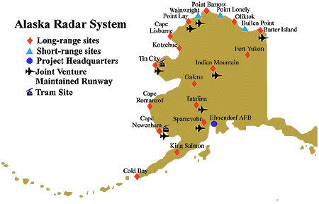
MLB Stats + Computers
In the 1960s-70s computers rare and expensive. Dick Cramer and Pete Palmer were rare baseball in the sense they had access to these computers and could program. This allowed them to:
Digitized the MLB data
Ran Simulations
Tested Theories (i.e., Clutch Hitting)
Created New Statistics (i.e., OPS)

Slide 11
SABR: A Place to Encourage and Exchange Ideas
No longer working in isolation, which increased the pace of advances in baseball analytics
Statistical Analysis Research Committee founded in 1975
Pete Palmer, Bill James and Dick Cramer initial members

Slide 12
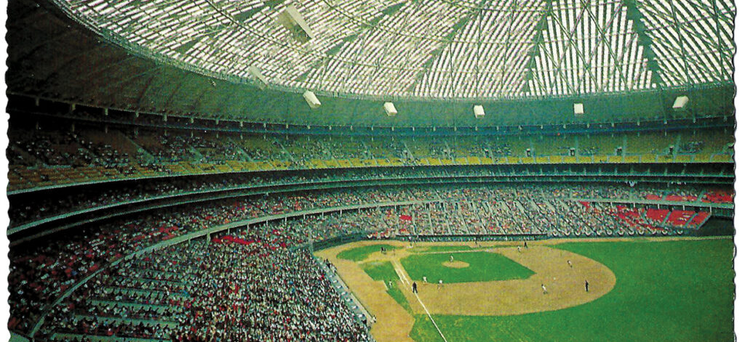
Beginning of Sabermetrics in the MLB Front Office
Steve Mann – Assistant GM of Houston Astros (1979-1980)
Astros GM Tal Smith wanted Steve to study how his players were doing on road compared to home, as the Astrodome a hard place to hit home runs.
Problem: Limited data so difficult for sabermetrics to propose practical solutions . Clubs only had their own play-by-play and batted ball data.
Solution: Pete Palmer introduced Steve Mann to Dick Cramer. They propose and plan to dramatically expanding the available MLB data by collecting play-by-play data.

Slide 13
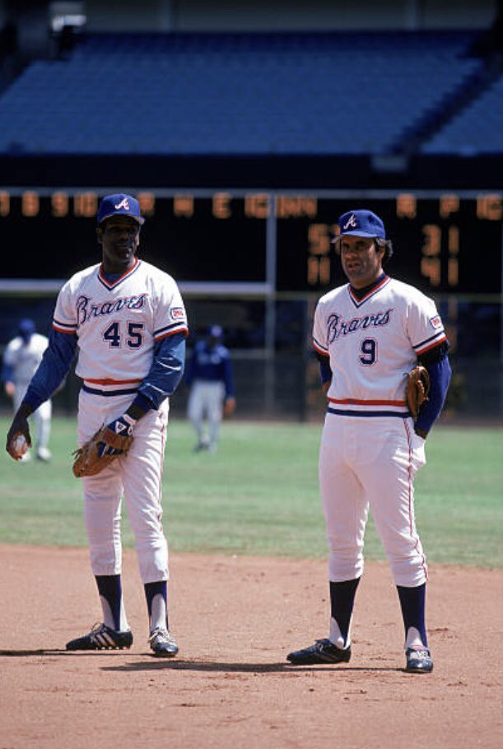
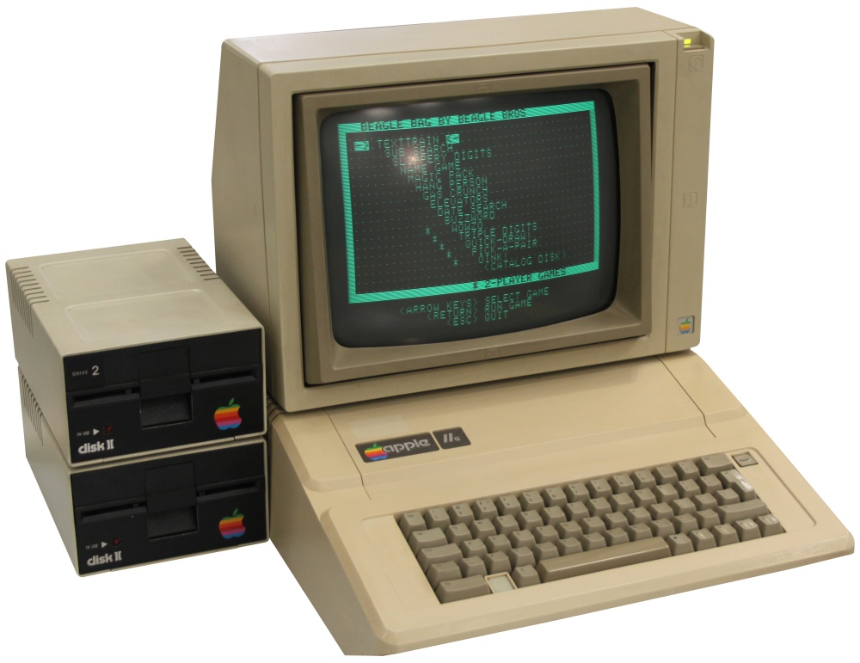
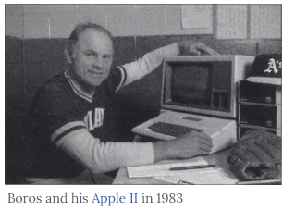
Play-By-Play Data
In early 1980s, Cramer developed EDGE 1,000, play-by-play system that charted batted balls that was used by A’s manager Scor. Used to generate statistical notes for announcers such as lefty/righty batting splits for announcers.
Palmer and Mann also developed a play-by-play system used by the Phillies and the Braves. Manager Joe Torre and Pitching Coach Bob Gibson liked the strike zone and batted ball data.

Slide 14
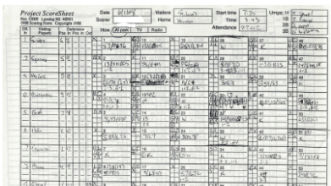
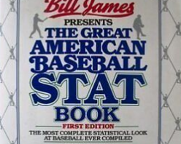
Create MLB Data: Project Scoresheet
Problem: Fans did not have access to MLB play-by-play data.
Founded in 1984 by Bill James. Run by Gary Gillette, John Dewan and many other volunteers.
Data used for baseball research and to create better publications

Slide 15
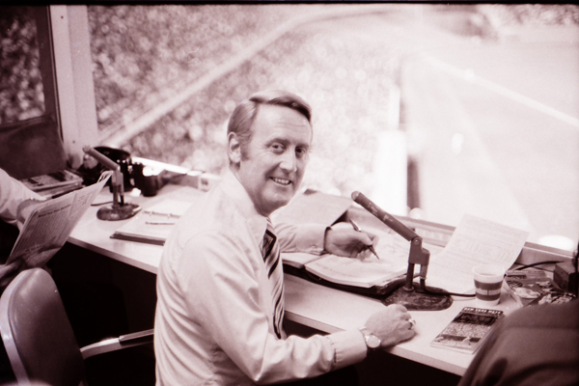
STATS, Inc.
John Dewan and Bill James joined Dick Cramer in 1988 to work together in STATS, Inc.
Created a custom box score for USA Today - programmed by Dick Cramer - 3 minutes after the game sent by phone modem.
Stats were provided to announcers (such as Vin Scully) were just what Dick and John thought were interested (pitch count, lefty vs righty data, ground ball/ fly ball data, individual batter splits). A big one was by count as no one had taken count data before.
Bill James Fantasy Baseball
Created AOL’s baseball stats site, first box score that live updates by pitch. One of AOL’s most popular sites

Slide 16
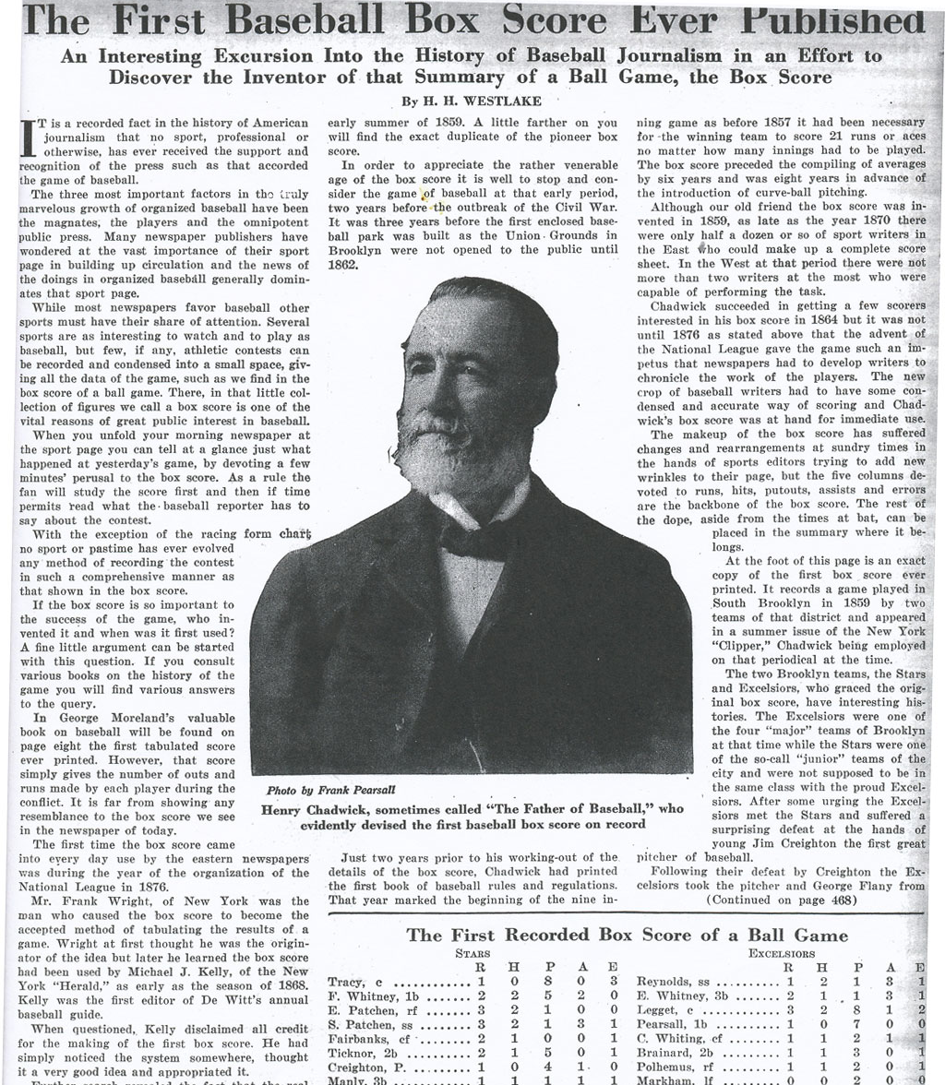
Democratizing MLB Data: Retrosheet
Founded: By Dave Smith in 1989 and all-volunteer organization
Mission: to create a historical dataset of play-by-play information and make it freely available to the public
Went to teams – a decade to get their play-by-play.
Newspapers used to have detail of the games as people had not seen the game on TV or may not have listened to it in the radio
“Baseball sudoku” to create deduced account of game

Slide 17
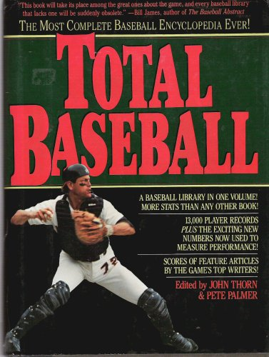
Democratizing MLB Data: Baseball Reference
Founded: By Sean Forman in 2000
Inspiration: Gathered and Programmed with MLB data to win his Fantasy Baseball
Data Sources: Retrosheet and Total Baseball (the work of John Thorn, Pete Palmer and Gary Gillette) in late 90s included a CD rom so you can look up information on your personal computer.
“First” Online Sports Dataset: Sean used mySQL and Pearl to code to create a website for any baseball fan. Now sports-reference viewed over billion times a month by sports fans.

Slide 18
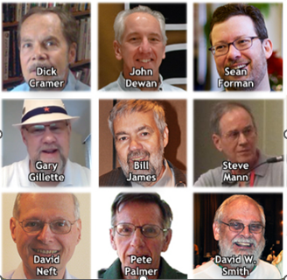
Their Stories are a Decades Long Effort to Create Better Sports Data for Media, Teams and Fans
A lot of blood, sweat and tears from these wonderful folks and others in order to create the culture of freely available real-time data that fans consume and love.
This data was used to initially create an industry that we now call sports analytics.
Their interesting stories told in their own words are available at https://sabr.org/latest/interviews-with-sabermetric-pioneers-added-to-sabr-oral-history-collection/
If you have time, think about volunteering as an interviewer or transcriber to add to the SABR Oral History Collection

