Slide 1
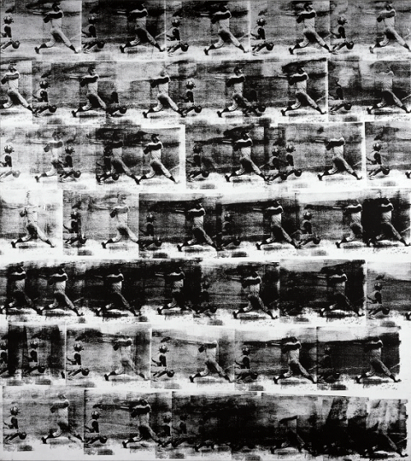
Andy Warhol SABR
TEST TEST TEST TEST
Source: The Nelson-Atkins Museum of Art

Slide 2
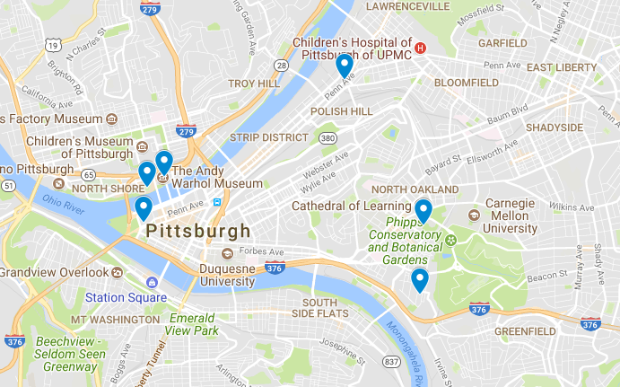
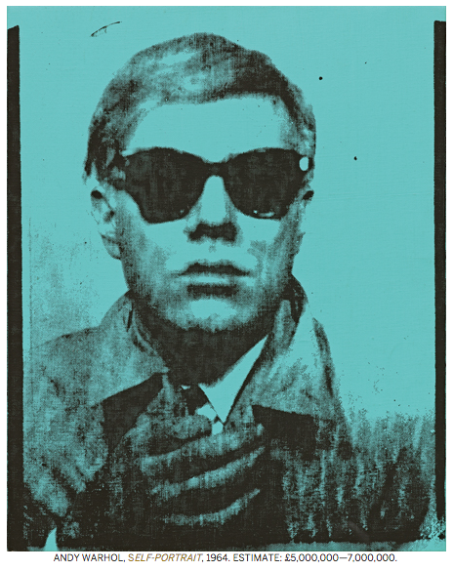
Andy Warhol Triple Play
Pop Art is: Popular (designed for a mass audience), Transient (short-term solution), Expendable (easily forgotten), Low cost, Mass produced, Young (aimed at youth), Witty, Sexy, Gimmicky, Glamorous, Big business
Richard Hamilton (1922 - 2011)
Clemente Museum
PNC
Forbes Field
Wyndham
Warhol
Boyhood Home
Source:Andy Warhol Family Album - The Warhola House, Google Maps, Tate Museum http://www.sothebys.com/en/news-video/blogs/all-blogs/contemporary/2017/06/warhol-self-control.html
Notes:
I am Paul Ember from the SABR Connie Mack Chapter in Philadelphia.
Why we are talking about Andy Warhol at a Baseball Conference?
We are talking about Andy Warhol because we are in his neighborhood, He grew up in the OAKLAND section of Pittsburgh just south of Forbes Field) and
He produced artworks of three baseball legends
_____________

Slide 3
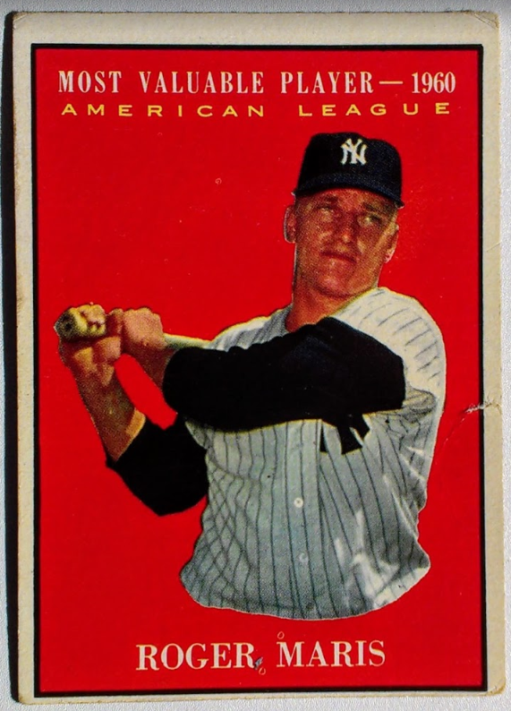
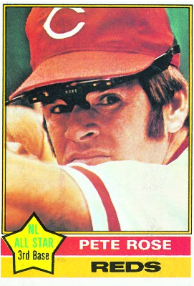
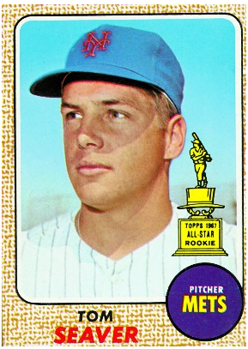
Andy Warhol Triple Play
Notes:
The subjects of these paintings are Roger Maris Pete Rose and Tom Seaver were all captured at significant moments of their careers.
Roger Maris was featured in the 1962 Painting titled “Baseball” Maris was at his career Height. At the age of 28 He was a two time World Champion, 2 Time MVP and he had recently set the Single Season Home Run Record.
The Cincinnati Art Museum commissioned a portrait of Pete Rose in 1985 as he became the Major League Hit King surpassing Ty Cobb.
Andy Warhol captured Tom Seaver in 1977 which happened to be a critical juncture in the Hall of Fame pitchers career.
I have elected to present the three paintings in non-chronological order, placing them in order of Subject/Artist proximity. This essentially means that we are going to Examine the Seaver painting last because he was the ballplayer with whom Warhol became the mosts familiar
--------------
SABR CONNIE MACK PHILADELPHIA
WARHOL MARIS ROSE SEAVER
WHY ANDY
http://www.sothebys.com/en/news-video/blogs/all-blogs/contemporary/2017/06/warhol-self-control.html

Slide 4
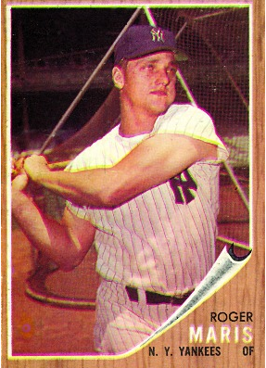
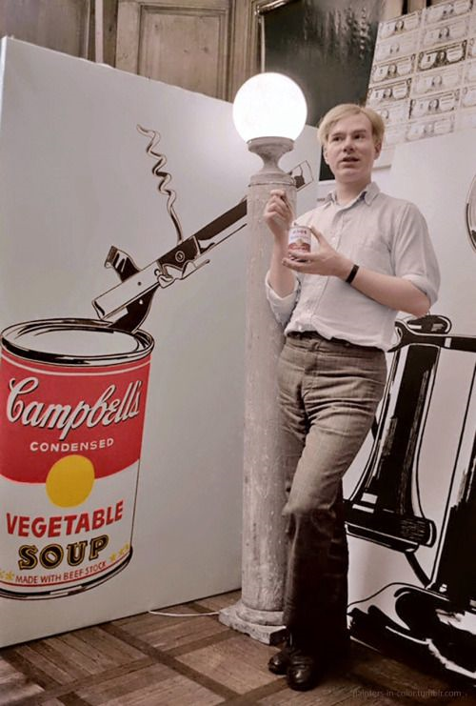
Roger Maris: Baseball (1962)
Andy Warhol: b. 1928 Aug 6 Age: 34
1962: 2nd solo exhibition, 13 years in NY, 2nd year as an independent artist.
Roger Maris: b. 1934 Sep 10 Age: 28
1962: 2 World Championships (1961, 1962), 2 MVP (60, 61), 7 ASG, Single Season HR Record holder (61 in 1961), 6 MLB Seasons, 3 with NYY
Source: Baseball-Ref, imdb.com, Sotheby’s, “The Wahrol Effect” - Rebecca Lowery (Met Museum), Tate Museum, MOMA, Time, Revolver Gallery
Notes:
After a decade of being a successful commercial artist in 1960 Andy Warhol made the move to becoming an independent artist.
IN July of 1962 he introduced his now Famous Soup cans at the Ferus Gallery in Los Angeles. The Tomato Soup Can painting sold for $100.
https://www.smithsonianmag.com/smart-news/andy-warhols-first-self-portrait-headed-auction-180963714/ 64 Selfie

Slide 5
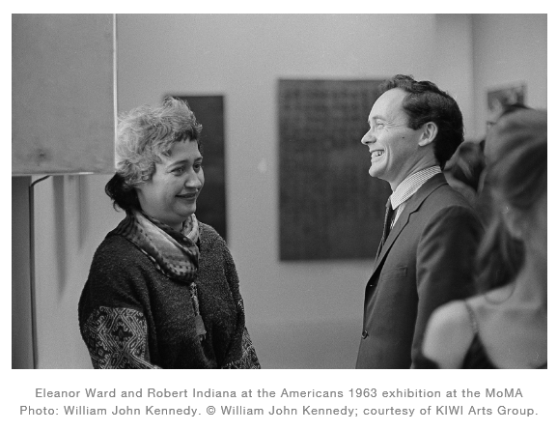
Baseball (1962)
Eleanor Ward Stable Gallery (NYC)
One of 12 pieces in Andy Warhol’s first New York Solo Exhibition
1962 November 6-24
Source: ArtNet News, KIWI Arts Group, William John Kennedy
Notes:
Our first artwork is the only one not named for the player.
Andy Warhol’s 1962 painting featuring Roger Maris is simply titled BASEBALL.
In addition to the artists and the subject there is a third important person who is responsible for getting the artwork in the public eye. This is the Gallery Owner, Art Dealer or Collector
For BASEBALL this person is Eleanor Ward
Ward’s influence on the art world cannot be OVERstated.
The artist She is responsible for supporting, or discovering include Robert Raushenberg, Jasper Johns, Jackson Pollock, and Robert Indiana.
She was also instrumental in Andy Warhol’s career
In Novermber 1962 She gave Andy Warhol his first solo exhibition in New York City.
It was during this exhibition that the BASEBALL was purchased for $1800.
The Next slide features the BASEBALL painting. Each time we unveil a painting I will pause briefly to give you the vibe of seeing the artwork in a museum setting before resuming the presentation.

Slide 6
Notes:
Now we see why the Painting Is titled “BASEBALL” rather than Roger Maris.
Warhol intends to capture the action of the game and not a particular person.
Yes if we look closely we recognize that the individual images are of a baseball player swinging a bat. The original image was likely drawn from a newspaper or magazine photo of Roger Maris.
At it’s simplest the painting is described as Black ink on White canvas Silkscreen. measures approximately 7.5 ft tall by 7 wide.
Drilling down
We find a painting that is somewhat atypical of WARHOL’s best known work, however it captures 3 techniques that he would use throughout his career:
Seriagraph (repeating a single image),
Silkscreen
Appropriation of a Photograph.
These are all techniques that Warhol pioneered.

Slide 7
Baseball (1962)
Photo-Silkscreen
Source: “Modern Myths: Andy Warhol” Barry Blinderman Arts Magazine interview. 1981 October (interview 1981 Aug 11) from “I'll be your mirror : the selected Andy Warhol interviews : 1962-1987” Kenneth Goldsmith
Notes:
I mentioned before that the painting is a SILKSCREEN, more specifically it is a PHOTO-SILKSCREEN, why is this important?

Slide 8
Baseball (1962)
Photo-Silkscreen
Source: “Modern Myths: Andy Warhol” Barry Blinderman Arts Magazine interview. 1981 October (interview 1981 Aug 11) from “I'll be your mirror : the selected Andy Warhol interviews : 1962-1987” Kenneth Goldsmith
Notes:
In a 1981 Interview Warhol discussed this
Warhol had already made prior Silkscreens but they were from drawings.
THATS HOW IT ALL STARTED. THE BASEBALL PAINTING was the first to use the PHOTO-SILKSCREEN
“THAT’S HOW IT ALL STARTED” this is pioneering technique, it is an ART FIRST. And for Andy Warhol it is a career changer. It is akin to Hall of Fame pitcher Candy Cummings developing the first Curveball.

Slide 9
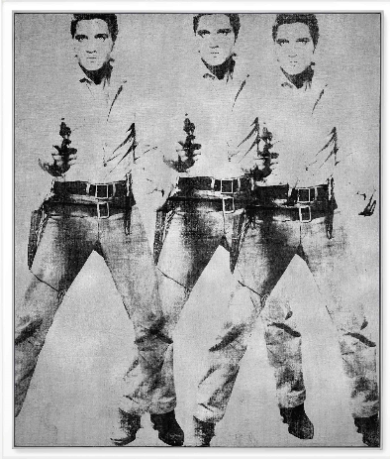
Triple Elvis (1963)
Auction 2014 November 12
Sold for $81,925,000
Baseball 1962 = $1,800 (2017: $14,560) Triple Elvis 2014 = $81.9+ MM
Source:Christies
Notes:
A year later The photo-silkscreen is essentially the same idea Warhol used to create his 1963 painting Triple Elvis.
Triple Elvis sold for $80 Million dollars in 2014.
So yes an 80MM painting started with a Baseball Artwork featuring Roger Maris.
http://www.imdb.com/title/tt0053825/mediaviewer/rm1661143040
https://www.christies.com/lotfinder/Lot/andy-warhol-1928-1987-triple-elvis-ferus-type-5846064-details.aspx

Slide 10
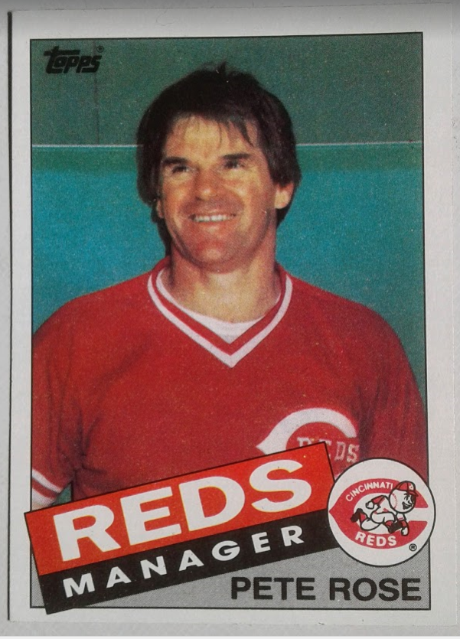
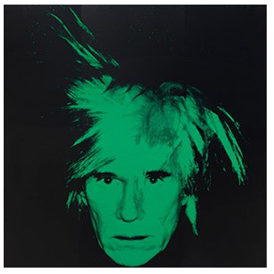
Pete Rose (1985)
Warhol: b. 1928 Aug 6 Age: 57
Career: 25 Years as Independent Artist, Interview Magazine, MTV
Pete Rose: b. 1941 Apr 14 Age: 44
1985: 3 World Championships (1975-CIN, 1976-CIN/MVP, 1980 - PHL), NL MVP (‘73), 17 ASG, return to CIN as Manager/Player 1984
Self-Portrait (1986)
Source: Baseball-Ref, imdb.com, Guggenheim, MOMA, Personal Collection
Notes:
We now skip ahead to 1985 for Part 2 of our Triple Play, the polarizing figure Pete Rose.
In 1985 - Andy is 57 years old and well established.
He has moved well beyond painting. His career accomplishments include producing films and records, publishing books and magazines and hosting a talk show on MTV.
http://www.tate.org.uk/art/artworks/warhol-self-portrait-t07146
https://www.guggenheim.org/artwork/4183

Slide 11
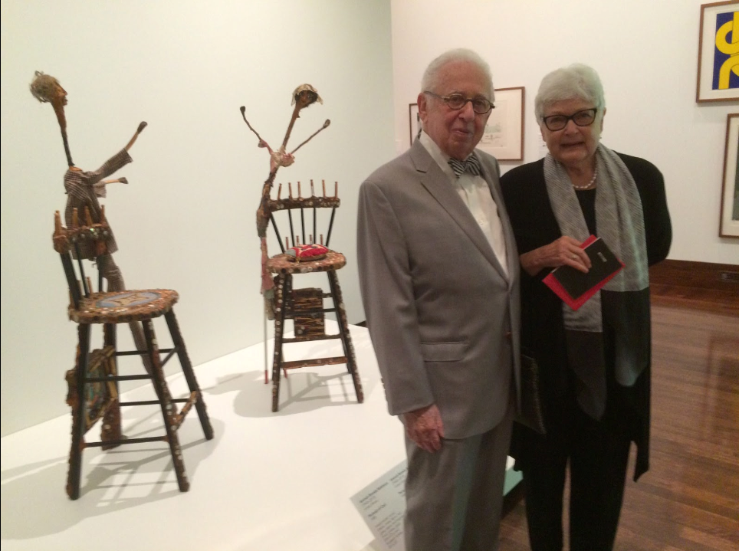
Carl Solway:
“It would be so cool if the art community could do something about that, instead of just the jocks and the sports people”
Source: CityBeat 2010 Aug 24 “Warhol’s Pete Rose Portrait Turns 25” - Steven Rosen
Notes:
Pete Rose starts with a self taught art dealer named Carl Solway.
IN April 1985 the Cincinnati based Art dealer was listening to a game on the radio and former Reds Pitcher JOE NUXHALL notes that Rose will likely break Ty Cobbs record that September.
“It would be so cool if the art community could do something about that, instead of just the jocks and the sports people”
Talks to Cincinnati Art Museum who agrees it’s a great idea.
WARHOL Sets the commision at $100,000.
PERMISSION of the subject.
1 QUESTION
http://blog.solwaygallery.com/2016/04/the-exhibition-not-in-new-york-carl.html

Slide 12
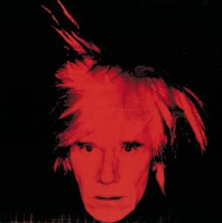
Carl Solway:
“It would be so cool if the art community could do something about that, instead of just the jocks and the sports people”
Andy Warhol:
Who is Pete Rose ???
Source: CityBeat 2010 Aug 24 “Warhol’s Pete Rose Portrait Turns 25” - Steven Rosen
Notes:
For what it’s worth this OBLIVIOUSNESS was MUTUAL.
http://blog.solwaygallery.com/2016/04/the-exhibition-not-in-new-york-carl.html http://blog.solwaygallery.com/2016/04/the-exhibition-not-in-new-york-carl.html

Slide 13
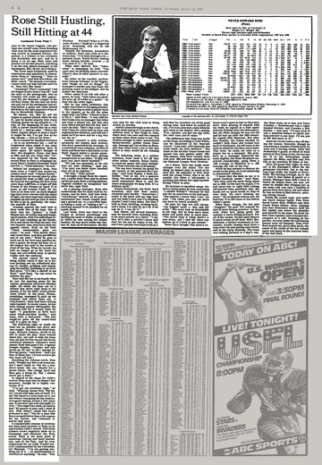
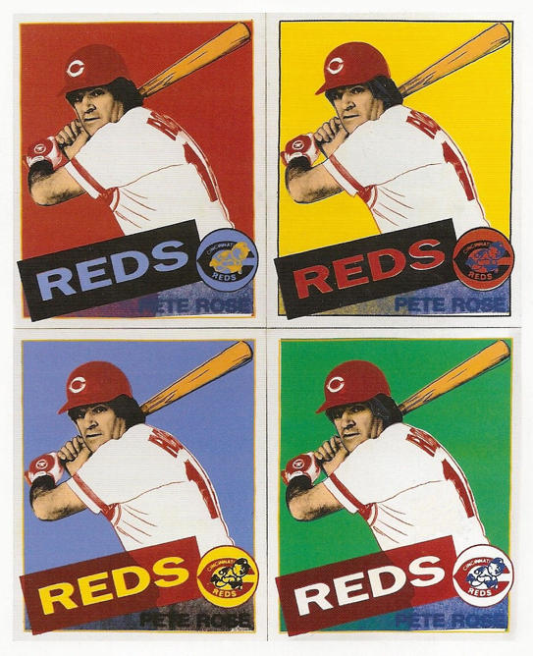
Pete Rose (1985)
New York Times: Ira Berkow
''I'm not getting anything out of it - no endorsements or royalties or anything,'' he said. ''This Warhaw . . . Warhall? What is it? Oh, yeah, Warhol. I think he's a respected artist. Somebody told me he did Muhammad Ali.''
Source: New York Times 1985 Jul 14 “Rose Still Hustling, Still Hitting at 44” Ira Berkow
Notes:
When asked about the painting later that summer
The first thing Rose mentions is MONEY. No Royalties Nothing.
Then he goes on to say This Warshaw, what is it oh Yeah Warhol, I think he is a respected artist. Somebody told me he did Muhammad Ali.
UNFORTUNATELY Solway was unable to set up a meeting between Rose and Warhol.
Warhol agreed to do the painting from photographs.
Our next slide features this painting.

Slide 14
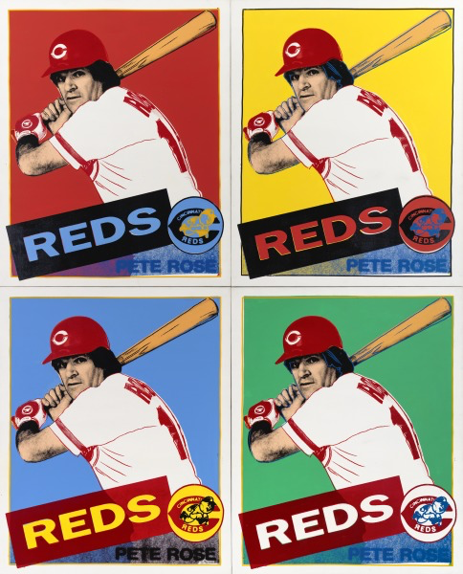
Notes:
In a case of excellent timing, the painting was UNVEILED @ the Cincinnati Art Museum on September 10 1985, one day before Rose Broke TY Cobbs Record.
1985 is Two Decades after the Maris Baseball painting and we have a SIGNIFICANTLY different work which is much more indicative of WARHOL Style.
1st we can instantly tell this is PETE ROSE
The painting features BOLD Colors - Similar to Pete Rose’s personality
However we do still have a SERIAGRAPH (4 repetitions)
APPROPRIATION is also found here, this time the usage of the 1985 Topps Card design.

Slide 15
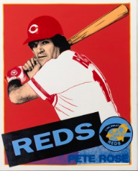
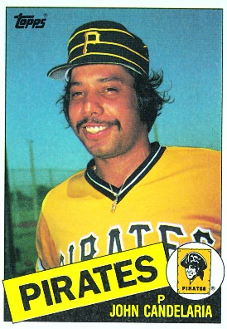
Pete Rose (1985)
4 Panels 54x44” each
Typical Baseball Card 3.5 x 2.5”
Source: Cincinnati Art Museum
Notes:
Warhol kept the design similar with slight variations. Warhol had a preferencence for a square canvas so He changed the aspect ratio. .Notice Pete Rose is a bit wider than a typical baseball card..

Slide 16
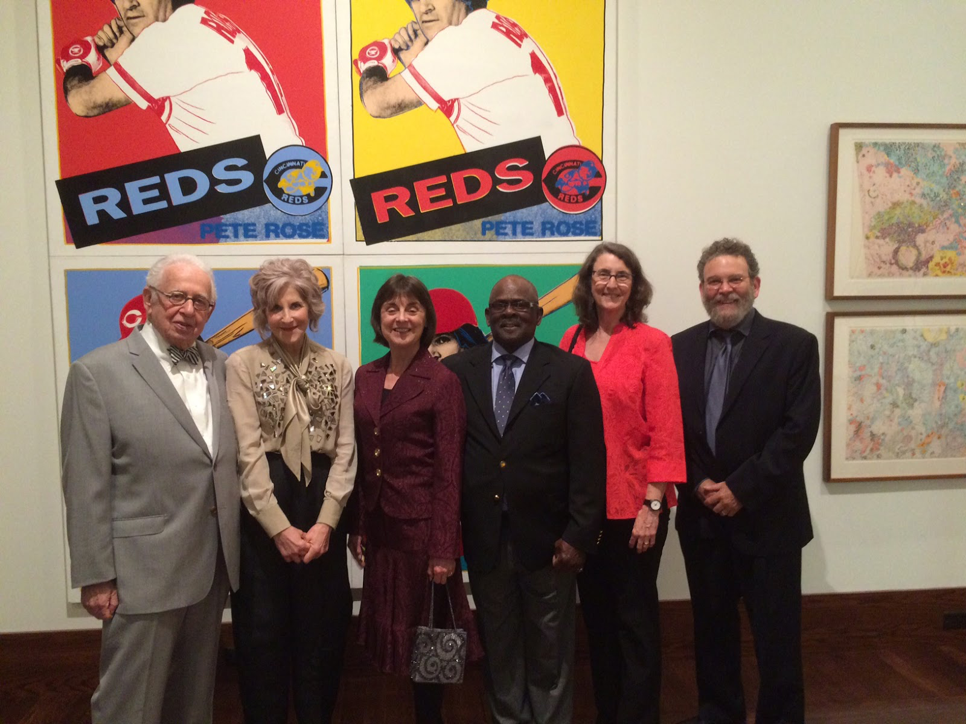
Pete Rose (1985)
4 Panels 54x44” each
108x88” total (approx 9x7’)
Carl Solway (left, 2016)
Source: Solway Gallery
Notes:
The overall dimension of the 4 panel Pete Rose is 9 feet hight by 7 feet wide. This photo of Carl Solway and some colleagues gives you an idea of the size of the painting.
http://blog.solwaygallery.com/2016/04/the-exhibition-not-in-new-york-carl.html

Slide 17
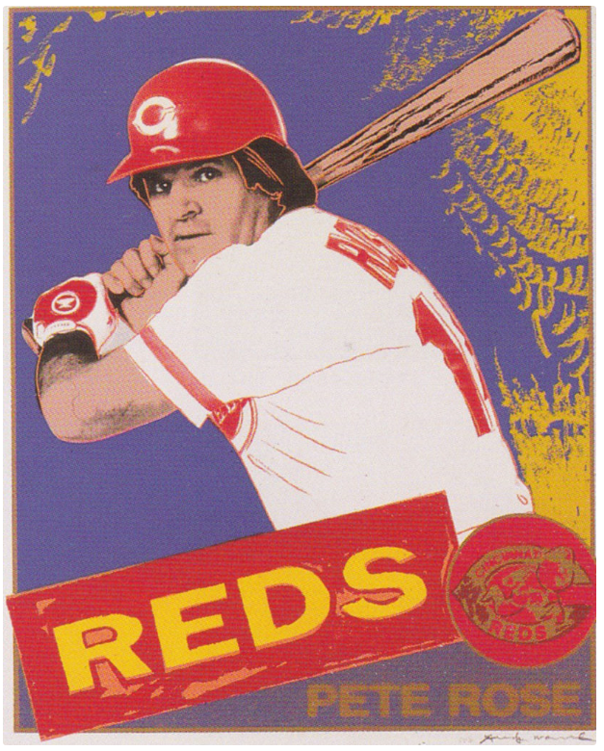
Warhol Signed Print
$2500
2017: $5,700
Source: Cincinnati Art Museum, PBS Antiques Roadshow 2013 Jun 29 Boise ID Air Date 2014 Jan 6
, https://www.citybeat.com/arts-culture/big-picture/article/13002811/warhols-baseball-art-is-a-hit-at-cam
Notes:
How does the Cincinnati Art Museum finance a $100,000 commision
CROWDFUND
Warhol agreed to create 50 signed Lithographs for the project.
SOLD OUT @ $2,500 each - Cincinnati Art Museum turned a profit on the commission.
INTERESTING as print is different than the Original Artwork, Single rather than 4 panel w/ a Lavender field.
SUN
STITCHING
GLARE
Size = Approx 40 x 32”
RECENT Antiques Roadshow Valued the print at $30,000
https://hamiltonselway.com/portfolio-item/andy-warhol-pete-rose-ii-360b-1985/ Source: CityBeat 2015 Apr 07, Cincinnati Art Museum, Hamilton Selway
https://www.citybeat.com/arts-culture/big-picture/article/13013692/warhols-pete-rose-portrait-turns-25
http://npg.si.edu/object/npg_NPG.2002.72?destination=portraits/search%3Fedan_q%3Dpete%2520rose%26edan_local%3D1%26op%3DSearch

Slide 18
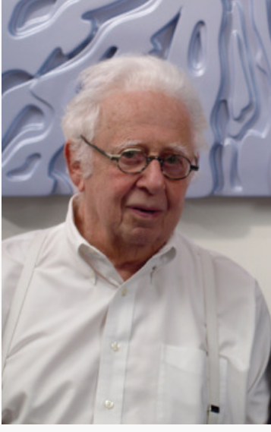
''The idea was completely Warhol's idea...and was brilliant since baseball cards are collected and traded just like artworks are similarly collected and traded. It is a clever comment by Warhol of the art market and the commercialization of it.''
Source: Carl Solway 2018 E-mail Interview
Notes:
SOLWAY is Fond of this painting
And was happy to bring it to his HOMETOWN.
''The idea was completely Warhol's idea...and was brilliant since baseball cards are collected and traded just like artworks are similarly collected and traded. It is a clever comment by Warhol of the art market and the commercialization of it.''
When we started discussing the Pete Rose Painting Carl Solway was looking for a way to connect the baseball and arts world.
Here Warhol has absolutely done so.
Art connoisseurs collect artwork, baseball fans collect baseball cards,
Baseball Cards are essentially miniature works of art.
https://www.citybeat.com/arts-culture/big-picture/article/13013692/warhols-pete-rose-portrait-turns-25

Slide 19
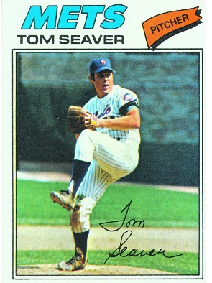
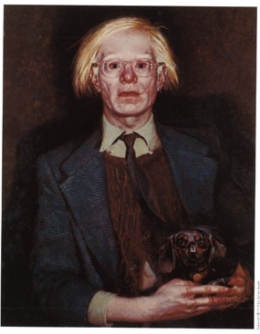
The Athletes Series: Tom Seaver (1977)
Warhol: b. 1928 Aug 6 Age: 49
Career: 17 years as an independent artist, Interview Magazine, “The Philosophy of Andy Warhol”
Tom Seaver: b. 1944 Nov 17 Age: 33
1985: 1 World Championships (1969-NYM), 3 NL CY (‘69,‘73, ‘75), 10 ASG
Andy Warhol by Jamie Wyeth (1976)
Source: Baseball-Ref, imdb.com, Smithsonian Libraries / Cheekwood Estate & Gardens, Baseball Card Database
Notes:
This brings us to our FINAL CHAPTER Tom Seaver.
We are now going Backwards to 1977: Warhol is at age 49, much of his work is on commision portraits. He is heavily involved in publishing Interview Magazine and he has a book out.
http://www.tate.org.uk/art/artworks/warhol-self-portrait-t07146
https://www.guggenheim.org/artwork/4183

Slide 20
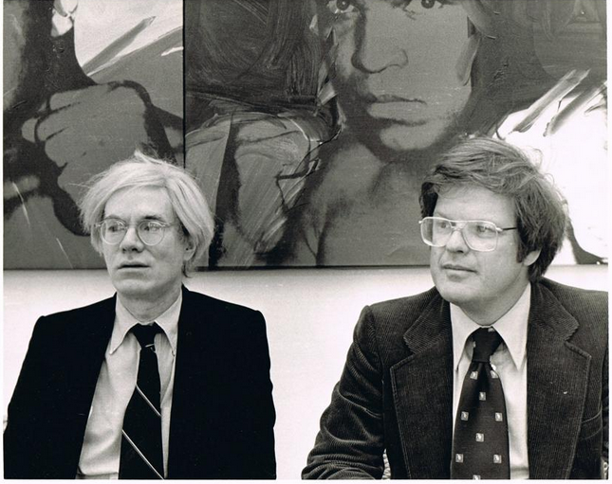
The Athletes Series: Tom Seaver (1977)
Richard Weisman
10 Athlete Portraits
$1 Million
2017: $4MM
Source: Dayton Daily News 2013 Jun22
Notes:
The Tom Seaver idea get started from Art Collector Richard Weisman
Weisman Investment Investment Banker & Art Collector
Friend of Warhol. Idea WARHOL do a project he dubbed the ATHLETES SERIES
$1Million Commision Warhol produces original works of 10 athletes.
https://www.mydaytondailynews.com/entertainment/arts--theater/dayton-art-museum-new-exhibit-combines-art-and-sports/5DTuo8jmvy8t68fGHEyEBL/

Slide 21
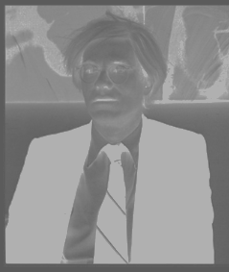
The Athletes Series: Tom Seaver (1977)
Richard Weisman
Tom Seaver
Rod Gilbert
Muhammad Ali
Pele
Chris Everett
Kareem Abdul-Jabaar
OJ Simpson
Jack Nicklaus
Dorothy Hamill
Willie Shoemaker
Source: Dayton Daily News 2013 Jun22
Notes:
Since In the words of SABRs Tom SCHIEBER “Andy Warhol didn’t know the difference between first base and a first down”
The Task of selecting the subjects fell to Richard Weisman
These are the athletes Weisman picked.
Among the first people Richard Weisman reached out to was Tom Seaver
https://www.mydaytondailynews.com/entertainment/arts--theater/dayton-art-museum-new-exhibit-combines-art-and-sports/5DTuo8jmvy8t68fGHEyEBL/

Slide 22
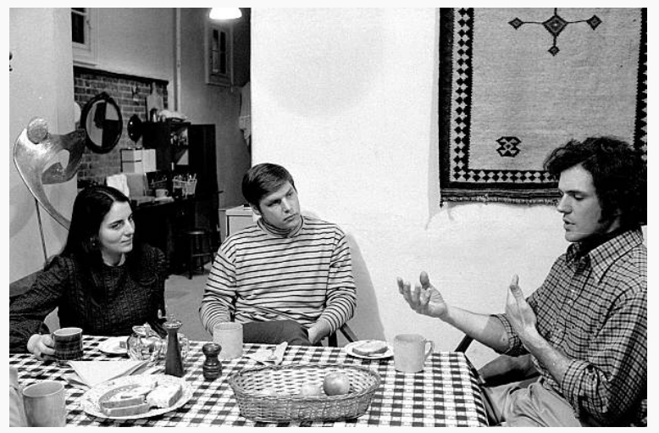
The Athletes Series: Tom Seaver (1977)
Juliet Seaver
Tom Seaver
Charles Seaver
NYC - East Village
1971 Feb 11
Source: Getty Images / Gene Kappock/NY Daily News Archive
Notes:
WEISMANN Knew Seaver and felt he would be Open to Idea
2) Tom Brother CHARLES Sculptor, Tom was familiar with the arts and comfortable around artists.
3) Proxiimity NYC WEISMAN
JUNE 15th 1977
MIDNIGHT MASSACRE
https://www.gettyimages.com/license/97321462

Slide 23
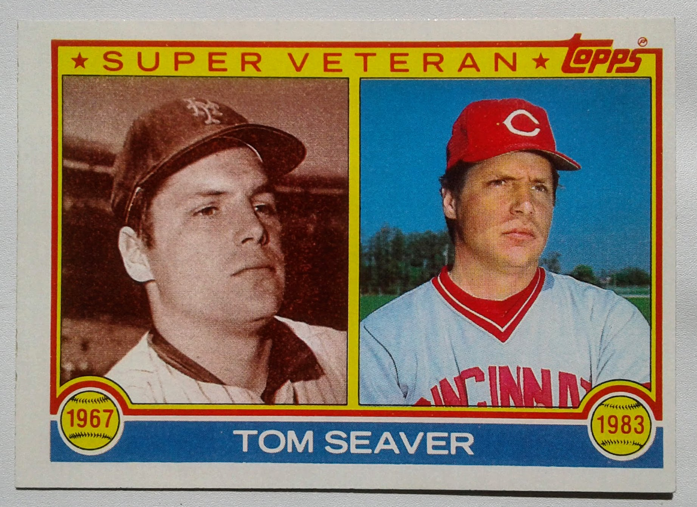
The Athletes Series: Tom Seaver (1977)
Source: New York Times
Notes:
Then on June 15 1977 The Midnight Massacre Happens
Now Weisman has the same problem as Solway. A Ballplayer in Cincinnati and an Artist in New York

Slide 24
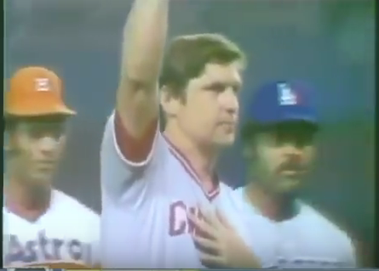
The Athletes Series: Tom Seaver (1977)
1977 July 19
All-Star Game
Yankee Stadium
New York City
Source:YouTube/ YES/ NBC, baseball-ref
Notes:
FIRST TRIP Back to NY is for the ASG at Yankee Stadium. Biggest OVATION of the night goes to Tom SEAVER
The Next day He goes to Andy Warhol’s Studio to be photographed.
https://www.mydaytondailynews.com/entertainment/arts--theater/dayton-art-museum-new-exhibit-combines-art-and-sports/5DTuo8jmvy8t68fGHEyEBL/

Slide 25
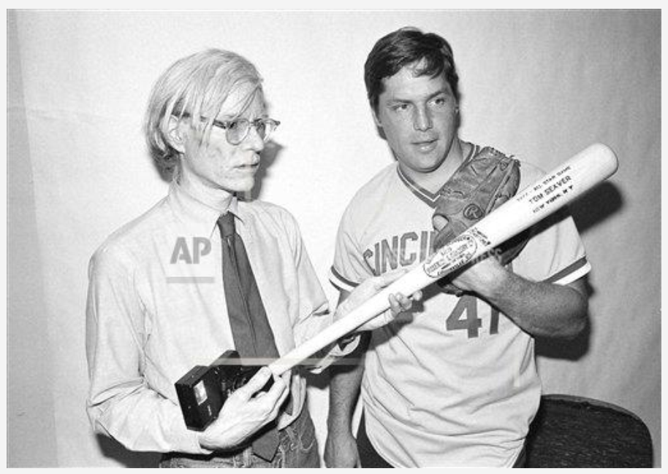
1977 July 20
AP Photo/ Rene Perez
Source: AP Images 1977 Jul 20 Photo by Carlos Rene Perez
Notes:
Fortunately the Fine Art photographer Rene Perez captured the Warhol-Seaver session on film.
This gives us a glimpse into Warhol’s portrait Process
http://www.apimages.com/metadata/Index/Watchf-AP-A-NY-USA-APHS475433-Seaver-Pop-Icon/b63352224a61490dba428906b4c88e4d/8/0

Slide 26
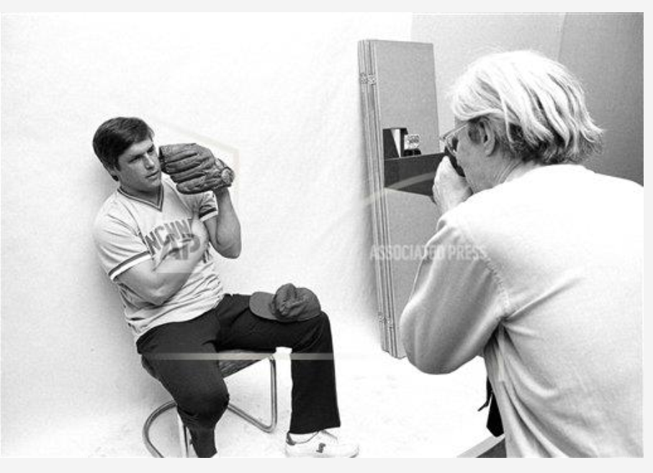
Tom Seaver poses for pop artist Andy Warhol.
1977 July 20
AP Photo/ Rene Perez
Source: AP Images 1977 Jul 20 Photo by Carlos Rene Perez
Notes:
His preferred camera was the Big SHOT Polaroid
He liked the Picture Quality
Requires photographer to be in close PROXIMITY to the subject.
Creates a degree of INTIMACY which allowed Andy to get to know subject.
http://www.apimages.com/metadata/Index/Watchf-AP-A-NY-USA-APHS475434-Seaver-Pop-Icon/caff9de2b3cd40ecb96c8da95c598b5f/11/0

Slide 27
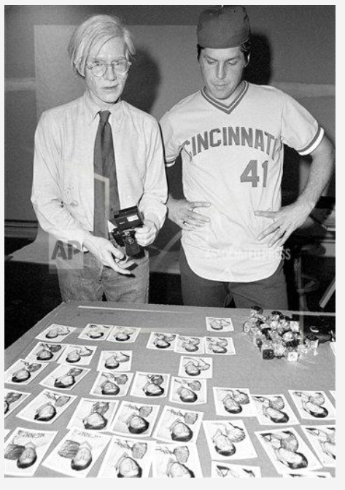
Notes:
And instant FEEDBACK - 1977 before digital photography allows SUBJECT to have input into which shot they like. .
The Seaver Painting based off these Polaroids is on the next slide:
http://www.apimages.com/metadata/Index/Watchf-AP-A-NY-USA-APHS475432-Seaver-Pop-Icon/4b20427422c048ca8c6812313141f778/3/0

Slide 28
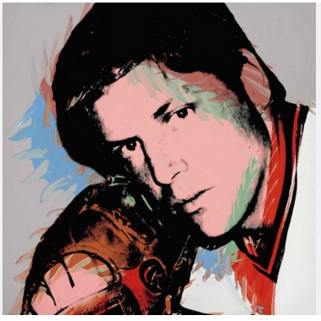
Notes:
The PHOTO Silks-screen 40x40. STANDARD size of a WARHOL PORTRAIT
Similar to a well known Marilyn Monroe, Liz Taylor, Mao Tse Teng from the era
This is 1 of 8 FLAVORs of the Seaver painting. By Flavor I mean there were 8 copies based off a single silkscreen (The Black stencil) , Each painting differs with the colored paint applied. In the case those colors include the green paint above Seaver’s Eye and the Red paint on the collar.
Notice that Seaver has a glove but is not wearing a cap. This allows us to better see the face of the subject.
Tom Seaver’s Wife, Nancy, was happy with the decision - “..almost every other picture of Tom was done in motion; this revealed another side, a softer, quieter side”

Slide 29
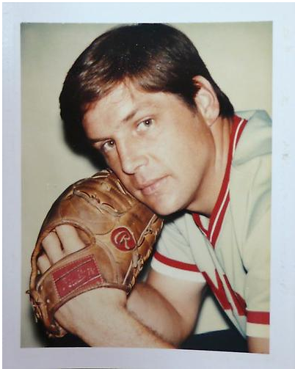
The Athletes Series: Tom Seaver (1977)
Source:https://www.christies.com/lotfinder/Lot/andy-warhol-1928-1987-tom-seaver-5739320-details.aspx, Danzig Gallery
Notes:
Zoomed in a bit tighter

Slide 30
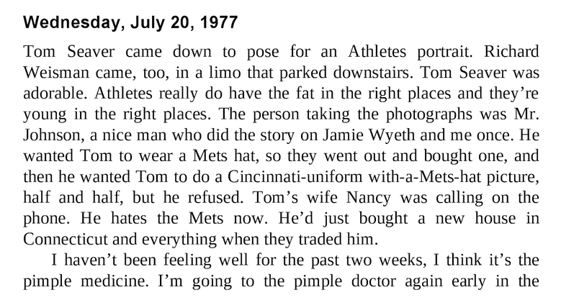
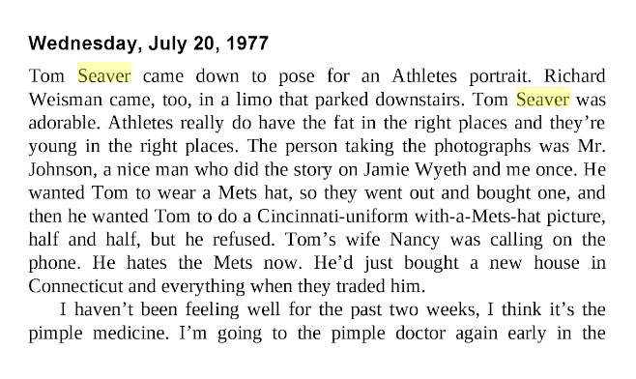
“The Andy Warhol Diaries“ - Warhol & Pat Hackett
Notes:
What did Warhol think of the Tom Seaver session
Well lets peek into his Diaries:
“Tom Seaver Was Adorable. Athletes really do have the fat in the right places and they’re young in the right places”
https://books.google.com/books?id=OmBQv6Ib6tgC&pg=PT143&dq=warhol+seaver&hl=en&sa=X&ved=0ahUKEwj9s7fvpbrZAhUCZawKHScaAZ0Q6AEIKTAA#v=onepage&q=warhol%20seaver&f=false The Andy Warhol Diaries Warhol & Pat Hackett

Slide 31
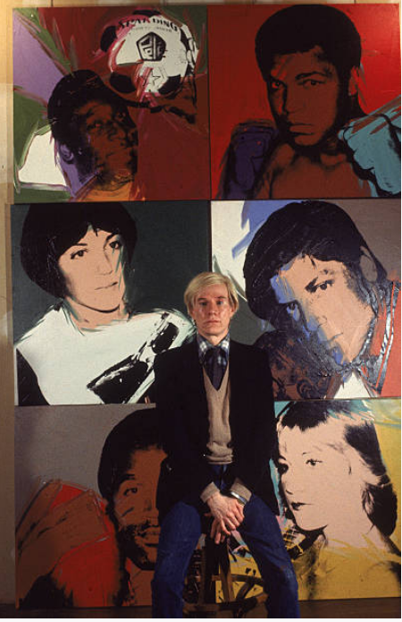
The Athletes Series (1977)
Opens at Coe Kerr Gallery 1977 Dec 9
Eight Portraits done of each subject
One portrait each to the Athlete & Andy Warhol
Other 60 portraits offered at Coe Kerr Gallery for $25,000 Each
Coe Kerr Gallery is owned by Fred Woolworth, part owner of the Detroit Tigers (1955-1962)
2017: $100,000
Source: Getty Images/Bernard Gotfryd, NYT 1977 Dec 11, Fred Woolworth Obituary, Coe Kerr Gallery, “Warhol” Carter Ratcliff (1983)
Notes:
SEAVER was originally shown with the other 10 ATHLETES SERIES at the Coe Kerr Gallery in New York on December 9 1977
Here are few of the other athletes in the series - Notably Muhammad Ali - who gets an assist for his reputation helping with the Pete Rose Painting.
A baseball related trivia, The Coe Kerr Gallery was owned by 5 & Dime Heir Fred Woolworth, who happened to be part owner of the Detroit Tigers franchise in the late 1950s.
http://www.apimages.com/metadata/Index/Associated-Press-Domestic-News-New-York-United-/c5594667fbe6da11af9f0014c2589dfb/2/0
https://www.gettyimages.com/license/57198098
https://www.nytimes.com/1977/12/11/archives/pictures-at-an-exhibit-sports-of-the-times-the-man-cant-draw-assist.html

Slide 32
Andy Warhol Triple Play
“..all the new movie stars are the sports people— they’re the real good-looking people, the exciting people—and they make the most money"
Andy Warhol (1975)
Notes:
Tom Seaver and the other athletes opened up a new world of possibilities for Andy Warhol.
In his 1975 Books the Philosphy of Andy Warhol he noted…
“..all the new movie stars are the sports people— they’re the real good-looking people, the exciting people—and they make the most money"
Part of the reason Warhol got involved with athletes was a request of a client (Richard Weisman), however Andy also realized that Athletes represented a new Market for his work both as subjects and customers.
http://www.sothebys.com/en/news-video/blogs/all-blogs/contemporary/2017/06/warhol-self-control.html

Slide 33
Andy Warhol Triple Play
Acknowledgements:
Tracey Boswell - Catalog/Reference Librarian at The Nelson-Atkins Museum of Art
Kristin Spangenberg - Curator of Prints at the Cincinnati Art Museum
Grace Marston - Gallery Educator Andy Warhol Museum
Carl Solway - Solway Gallery
Tom Shieber – 2018 Chadwick Award Winner
Rene Perez - Fine Art Photographer
Additional Sources:
Inflation Calculator: https://www.minneapolisfed.org/
Notes:
Thank you all for your attention, I hope you learned something about Andy Warhol today, I would also like to acknowledge a few folks.
http://www.sothebys.com/en/news-video/blogs/all-blogs/contemporary/2017/06/warhol-self-control.html

Slide 34
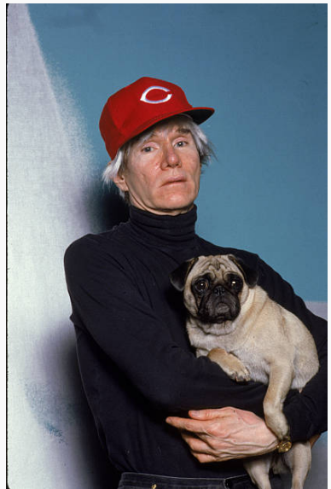
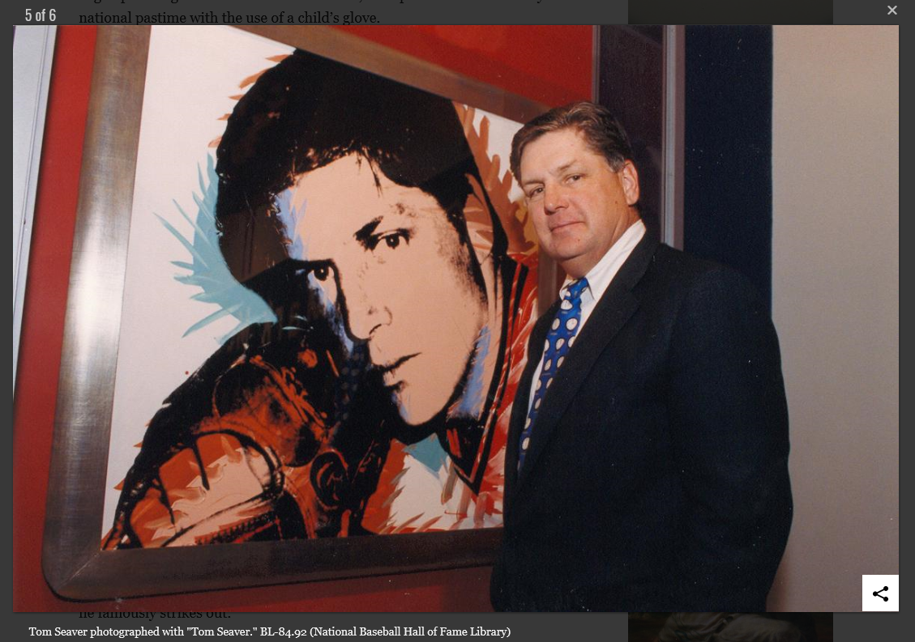
Andy Warhol Triple Play
Notes:
If you want to see these works,
Roger Maris is at the Nelson Atkins in Kansas City
Pete Rose is in Cincinnati art museum, The National Portrait Gallery in DC is among the places where you can see one of the 50 Lavender lithographs.
I tracked down 4 of the 8 Seavers, one is at the Warhol Museum (5th floor), The Baseball Hall of Fame had the copy seen here, Tom Seaver has one in his home in California and the University of Maryland has a complete set of the athletes series - but I think that is not on display currently.
http://www.sothebys.com/en/news-video/blogs/all-blogs/contemporary/2017/06/warhol-self-control.html
https://www.vegasnews.com/141808/pete-rose-sports-bar-and-grill-celebrates-grand-opening-on-the-las-vegas-strip.html
https://baseballhall.org/about-the-hall/hall-of-fame-artwork

Slide 35
Andy Warhol Triple Play
Paul Ember - SABR Connie Mack Chapter 2018 MM DD

Slide 36
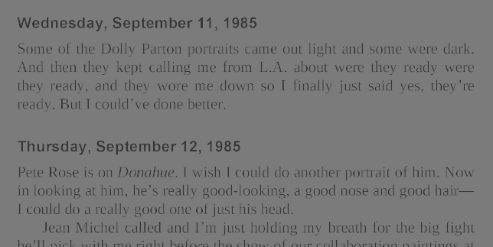
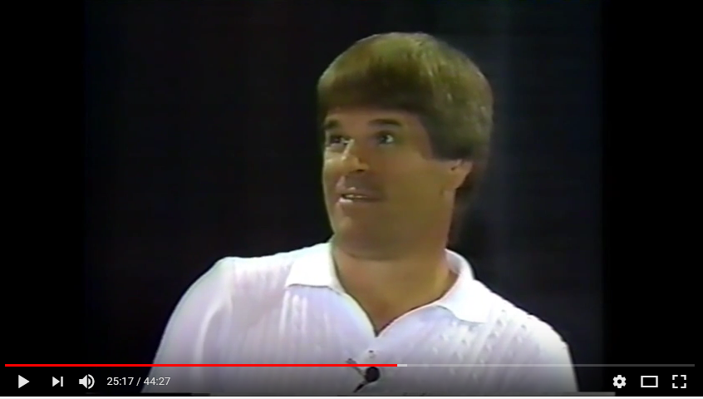
Pete Rose (1985)
Installed Cincinnati Art Museum 1985 September 10
Pete Rose breaks Hit Record 1985 September 11
Pete Rose on Donahue 1985 September 12
Source: Andy Warhol Diaries (Pat Hackett)
Notes:
OUTSIDE Photographs.
Not Meeting the SUBJECT

Slide 37
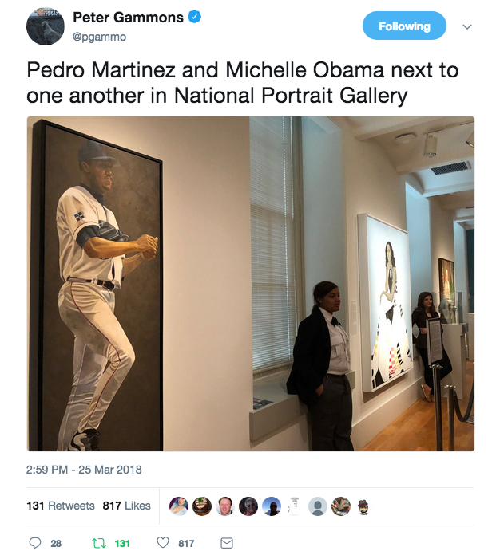

Slide 38
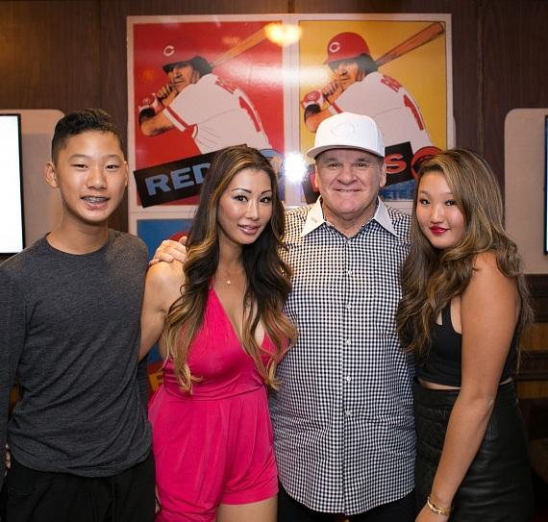
Pete Rose (1985)
4 Panels 54x44” each
Aspect Ratio 1.2
Golden Ratio 1.618
2 Panels = 54x88”
Source: photoinf.com
Notes:
http://photoinf.com/Golden_Mean/Eugene_Ilchenko/GoldenSection.html

