Slide 1
Dubuque, Iowa
An Early Cradle of Professional Baseball
with John T. Pregler
. .
SABR 19thcBB Speakers Series
May 9, 2023, 8:00pm EDT
. .

Slide 2
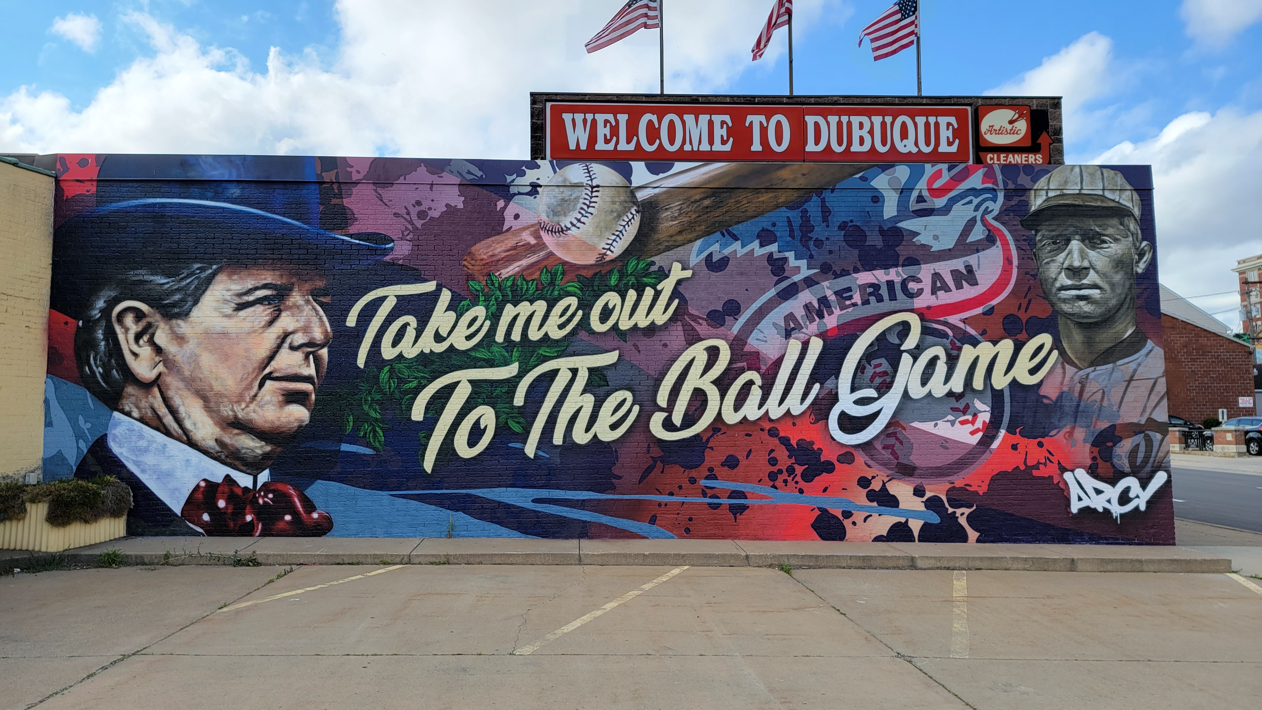

Slide 3
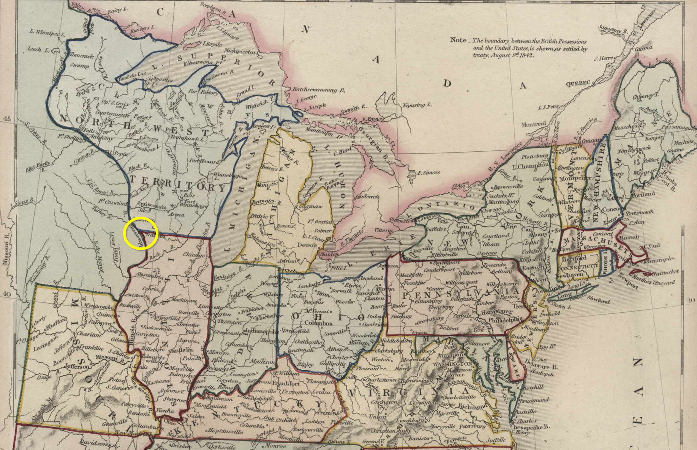

Slide 4
Early Baseball History
????-1870

Slide 5
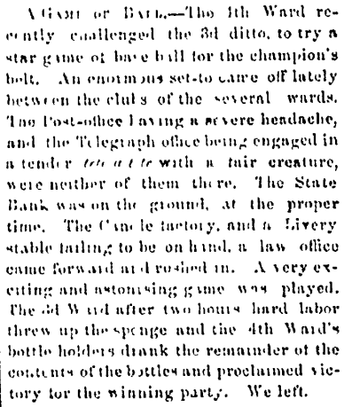
ABOVE: May 23, 1863, Dubuque Democratic Herald.
RIGHT: June 8, 1863, Dubuque Democratic Herald.

Slide 6
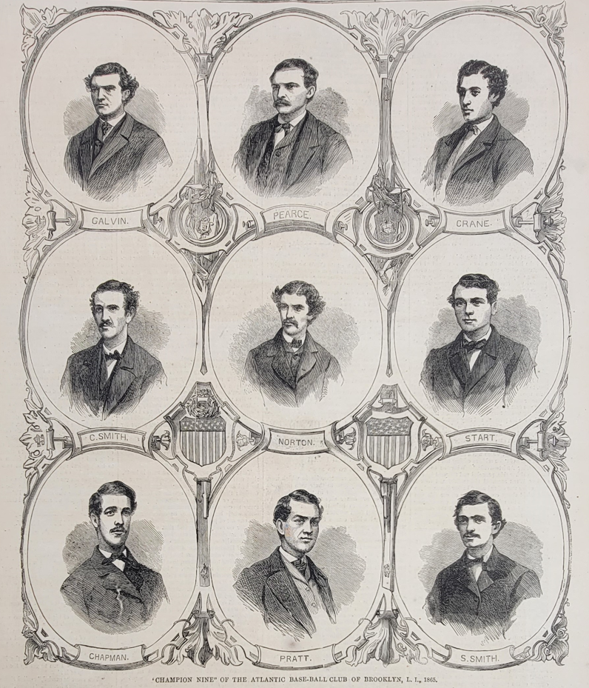
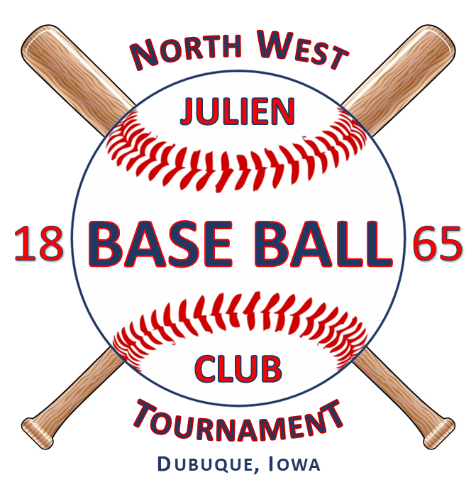
Champion Nine – Brooklyn Atlantics - 1865

Slide 7
Early Dubuque Protoball and Pro Ball
Year | Month | Day | Team 1 | Team 2 | Team 1 Score | Team 2 Score
1863 | June | 8 | Fourth Ward | Third Ward | Winner | Loser
1863 | August | 19 | Hawkeye BBC top nine | Hawkeye BBC 2nd nine
1863 | July |  | Dubuque Uptown club | Dubuque Downtown club | Winner | Loser
1865 | August | 30 | Key City BBC Married | Key City BBC Unmarried
1865 | September | 29 | St. Louis Empires | Freeport Empires | 12 | 5
1865 | September | 30 | St. Louis Empires | Julien BB Club - Dubuque | 16 | 9
1865 | September | 29 | Freeport Empires | Julien BB Club - Dubuque | 27 | 26
1866 | June | 27 | Milwaukee Cream Citys | Julien BB Club - Dubuque | 23 | 15
1870 | September | 21 | Rockford Forest Citys | Key City BBC | 80 | 1
1878 | September | 30 | Milwaukee Grays - NL | Dubuque Rabbits | 6 | 0
1878 | October | 1 | Milwaukee Grays - NL | Dubuque Rabbits | 16 | 4
1879 |  |  | Chicago White Stockings - NL | Dubuque Rabbits | 8 | 1
1879 |  |  | Chicago White Stockings - NL | Dubuque Rabbits | 0 | 1
1879 |  |  | Chicago White Stockings - NL | Dubuque Rabbits | 11 | 6
1879 |  |  | Chicago White Stockings - NL | Dubuque Rabbits | 10 | 1
1879 |  |  | Providence Grays - NL | Dubuque Rabbits | 16 | 2
1879 |  |  | Chicago Uniques - Negro Team | Dubuque Rabbits | 4 | 8
1879 |  |  | Chicago Uniques - Negro Team | Dubuque Rabbits | 0 | 31
1880 | April | 13 | Chicago White Stockings - NL | Dubuque Rabbits | 27 | 0
1880 | April | 14 | Chicago White Stockings - NL | Dubuque Rabbits | 6 | 1
1880 | April | 15 | Chicago White Stockings - NL | Dubuque Rabbits | 22 | 2
1880 | May | 21 | Cleveland NL | Dubuque Rabbits | 5 | 1
1881 | July | 16 | St. Louis Browns | Dubuque Rabbits | 9 | 1
1881 | July | 17 | St. Louis Browns | Dubuque Rabbits | 15 | 1
1881 | July | 18 | St. Louis Browns | Dubuque Rabbits | 10 | 4
1882 | September |  | St. Louis Browns - AA | Dubuque Rabbits | 9 | 5
1882 | September |  | St. Louis Browns - AA | Dubuque Rabbits | 4 | 7
1885 | May | 26 | Kansas City - WL | Milwaukee - WL | 17 | 8

Slide 8
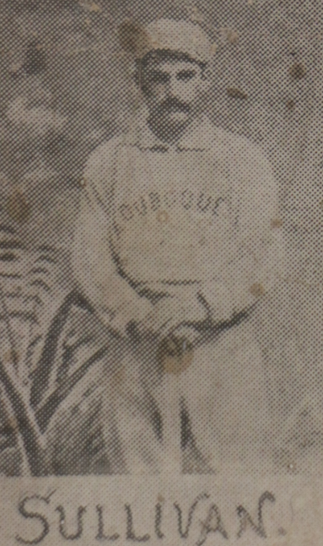
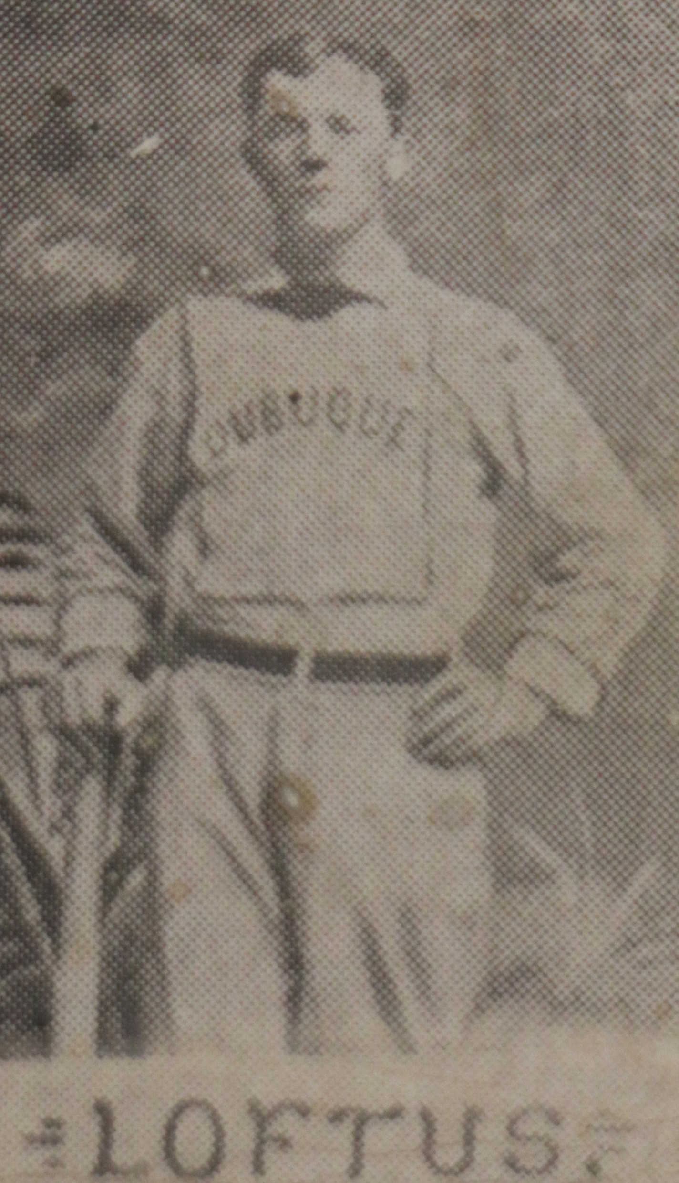
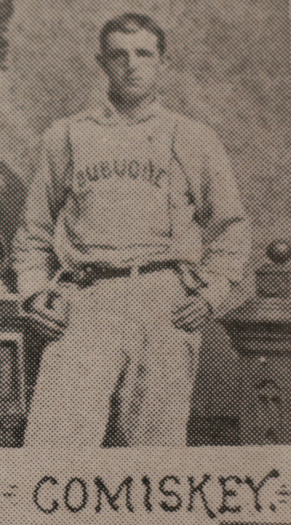
Sullivan – Loftus – Comiskey
Western Pioneers of Baseball

Slide 9
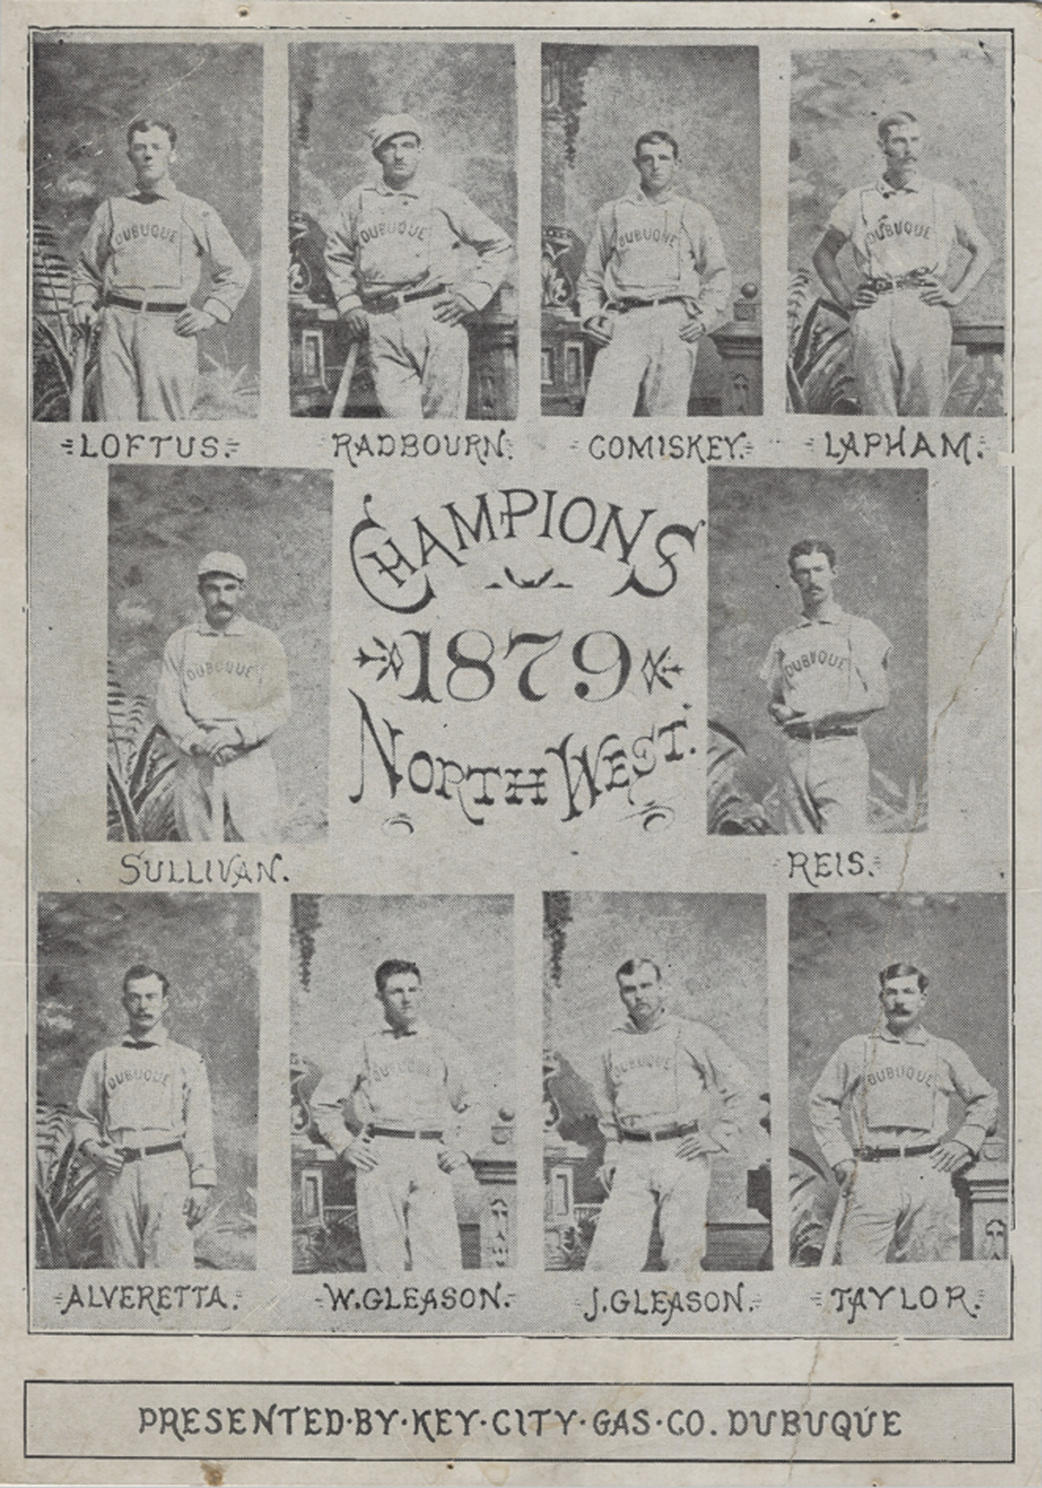
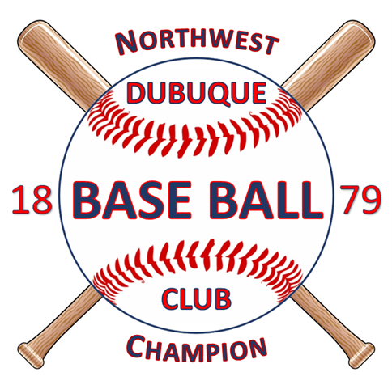

Slide 10
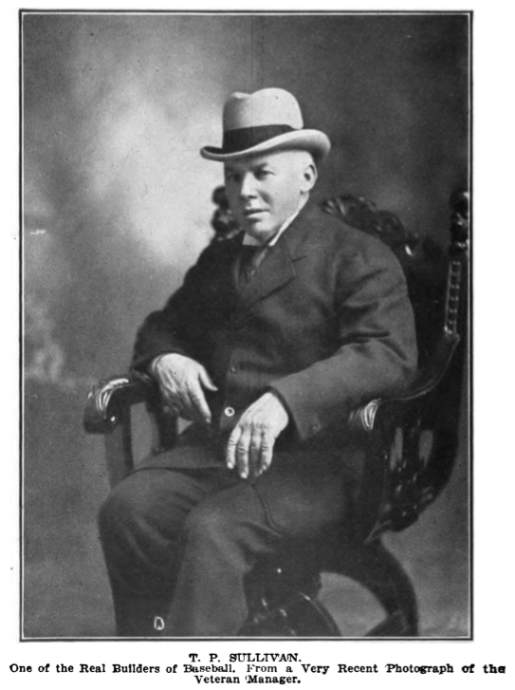
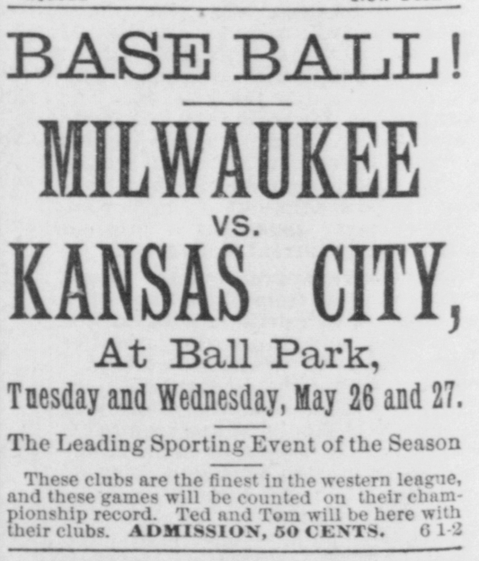

Slide 11
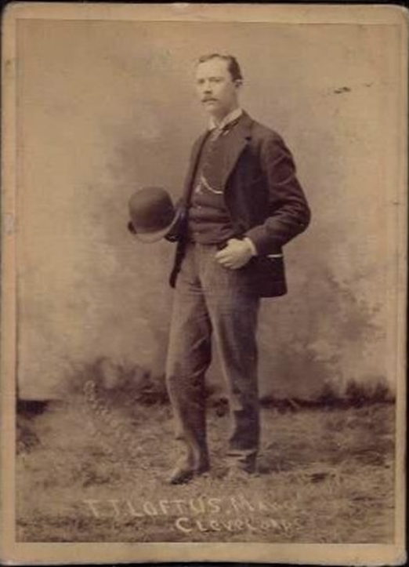
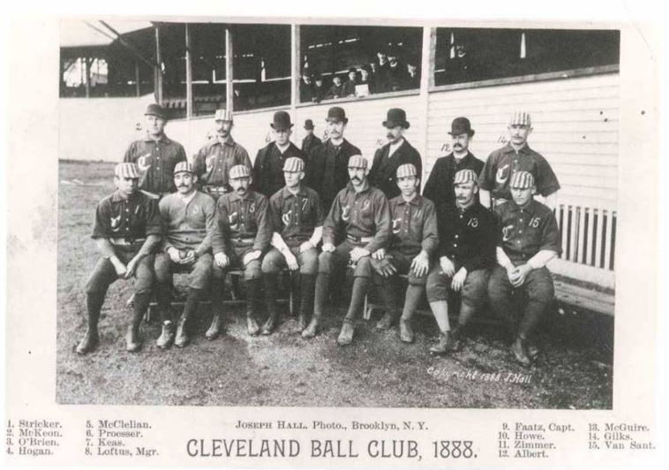

Slide 12
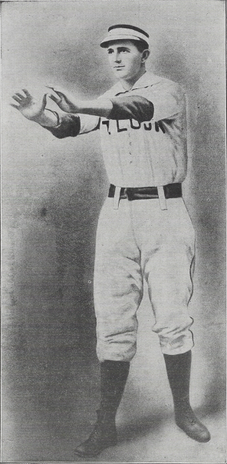
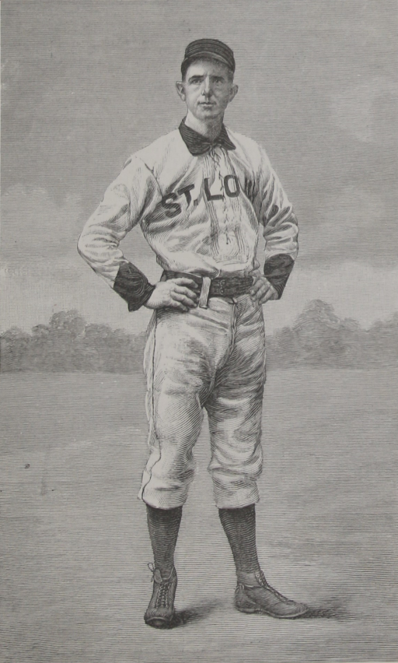

Slide 13
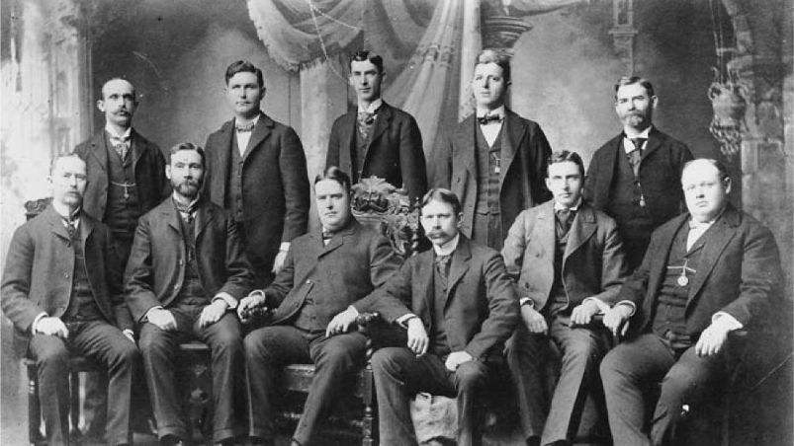
Founding of the American League
1894-1903

Slide 14
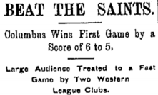
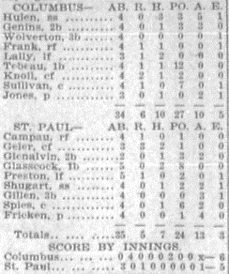

Slide 15
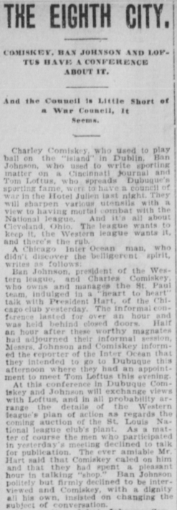
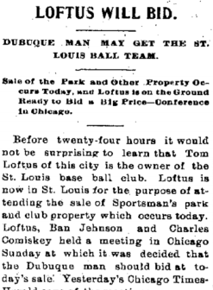
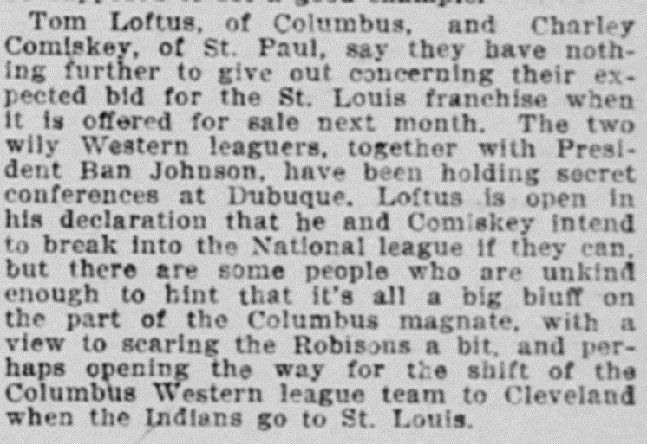
Dubuque Daily Times
February 17, 1899
St. Paul Globe
February 23, 1899
Dubuque Daily Herald
March 14, 1899

Slide 16
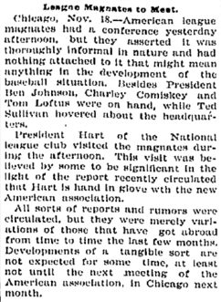
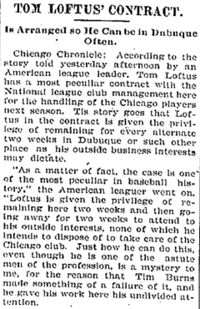
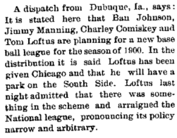
Sandusky Ohio
July 17, 1899
Dubuque Sunday Herald
November 19, 1899
Dubuque Daily Herald
December 5, 1899

Slide 17
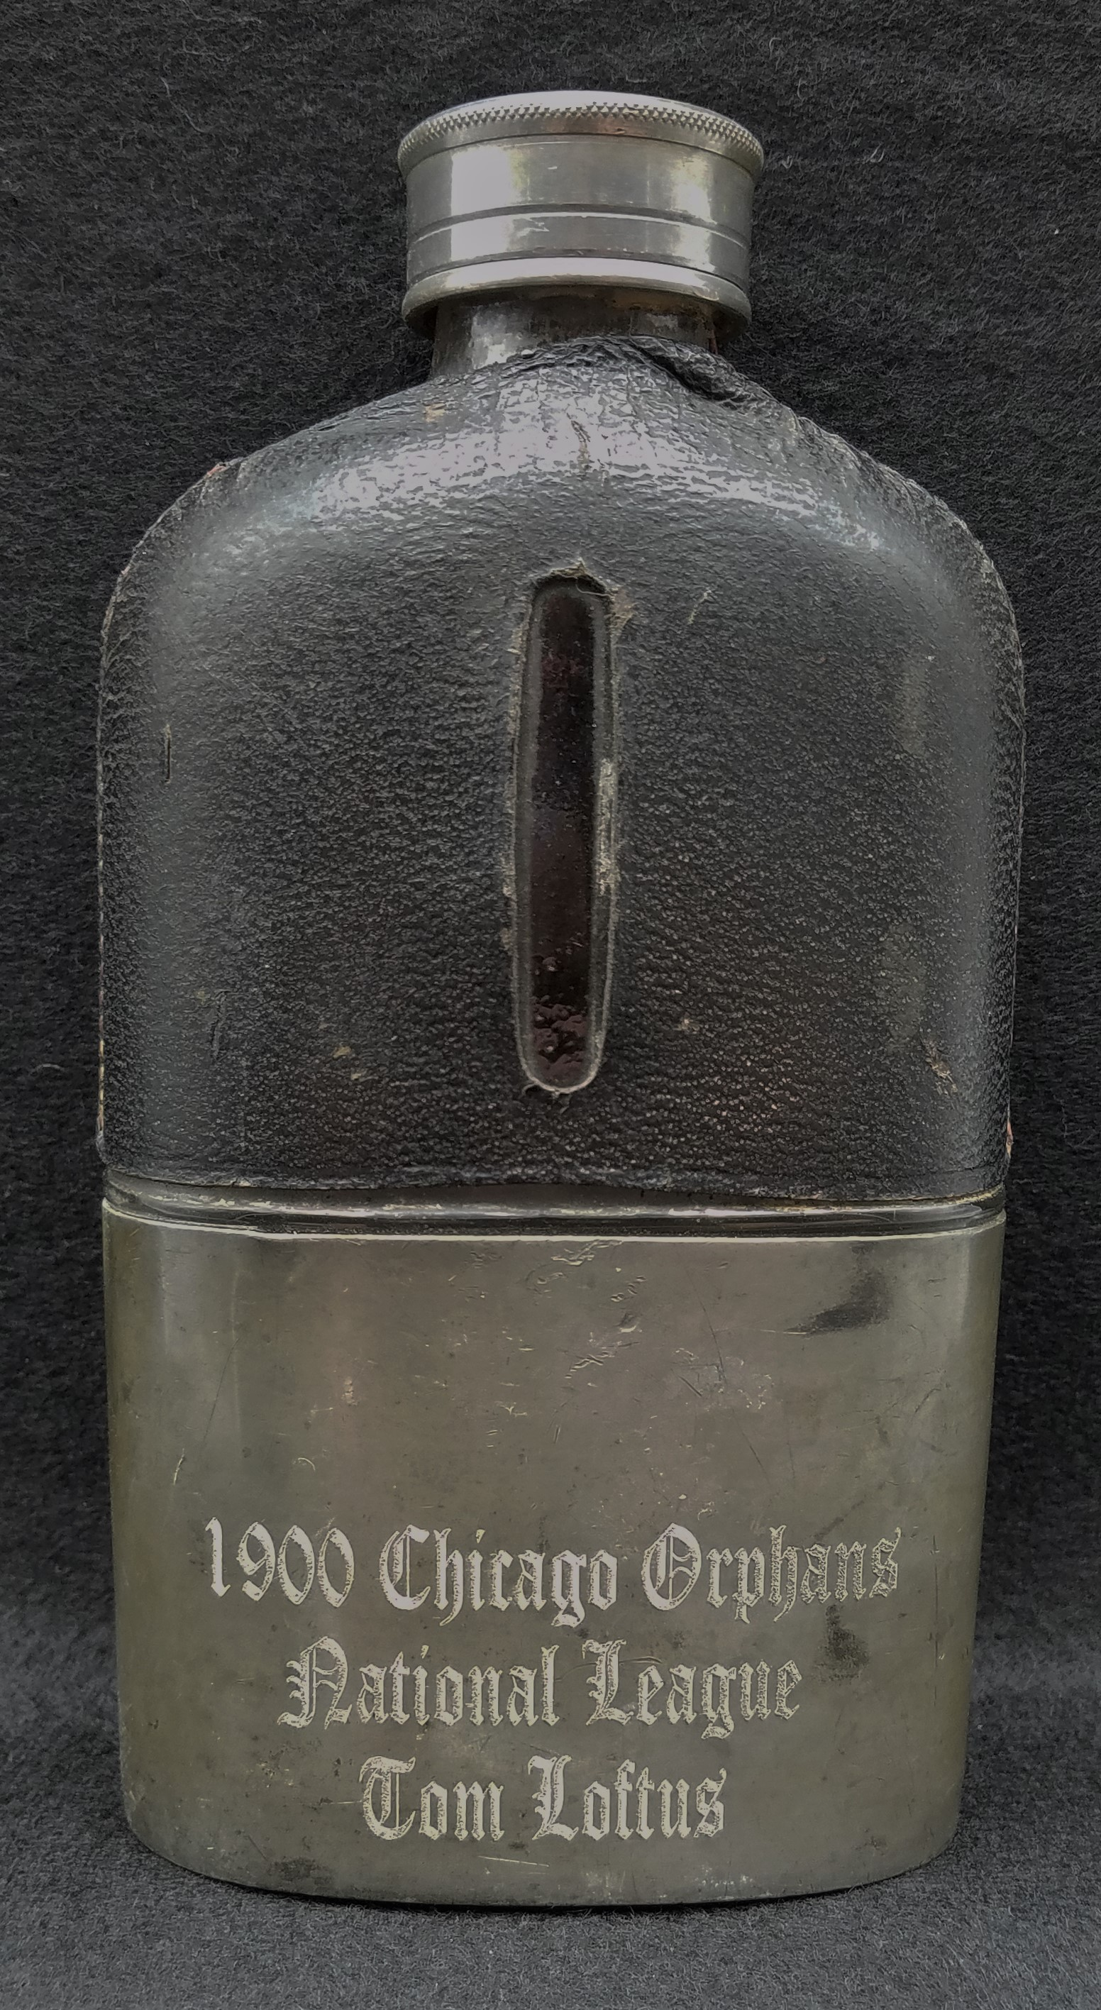
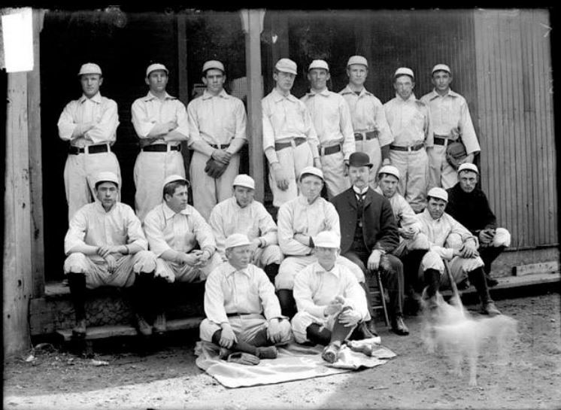

Slide 19
Dubuque Minor League Baseball
1903-1976

Slide 20
Dubuque Minor League Baseball
1879 | Northwestern League | Red Stockings / Reds / Rabbits
1888 | Central Inter-State League | Dubuques
1890 | Illinois-Indiana League | Giants
1895 | Eastern Iowa League | Colts
1895-1899 | Western Association | Dubs
1903-1915 | Three-I League | Shamrocks / Dubs/ Hustlers
1917 | Central Association | Dubs
1922-1932 | Mississippi Valley League | Climbers/Dubs/Ironmen/Speasmen/Tigers
1954-1955 | Mississippi-Ohio Valley League | Packers
1956-1968 | Midwest League | Packers / Midwest Dodgers (2nd team)
1974-1976 | Midwest League | Packers
Championship Seasons: 1879, 1905, 1923, 1929, 1955, and 1962.

Slide 21
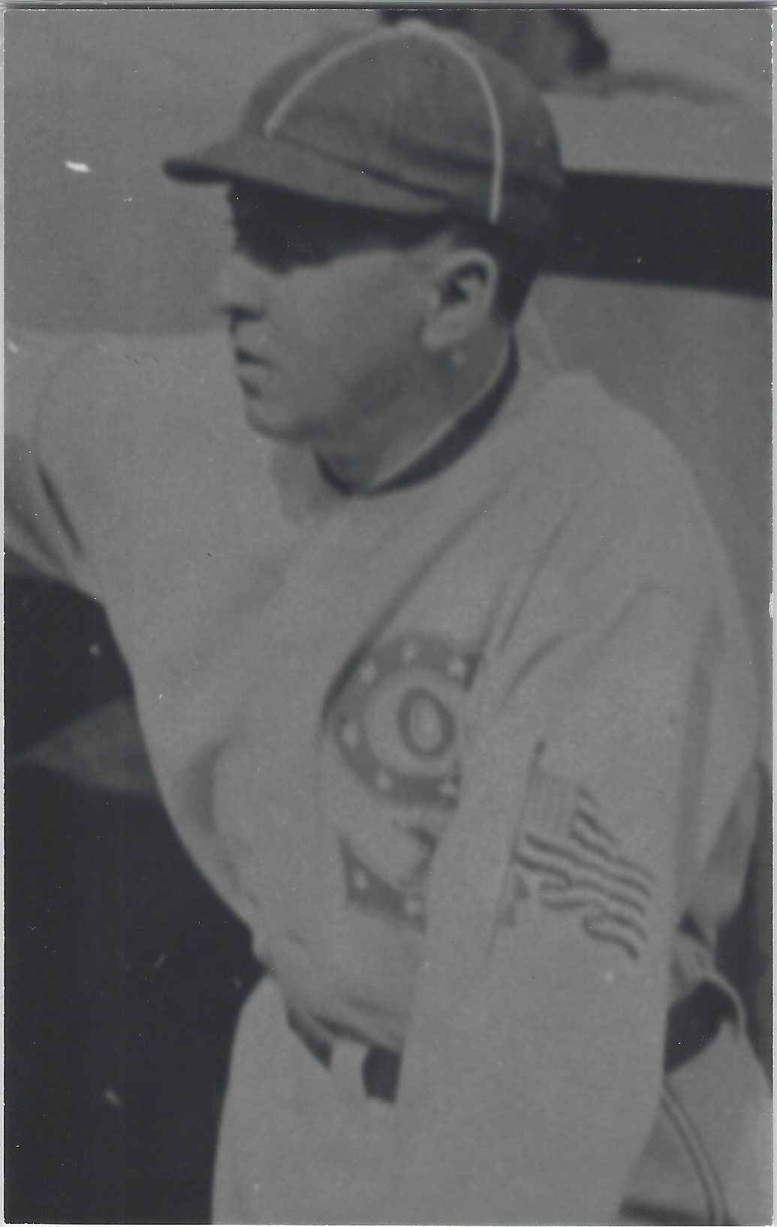
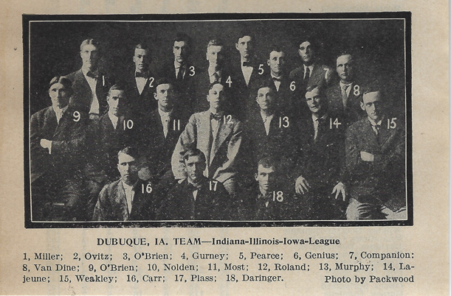

Slide 22
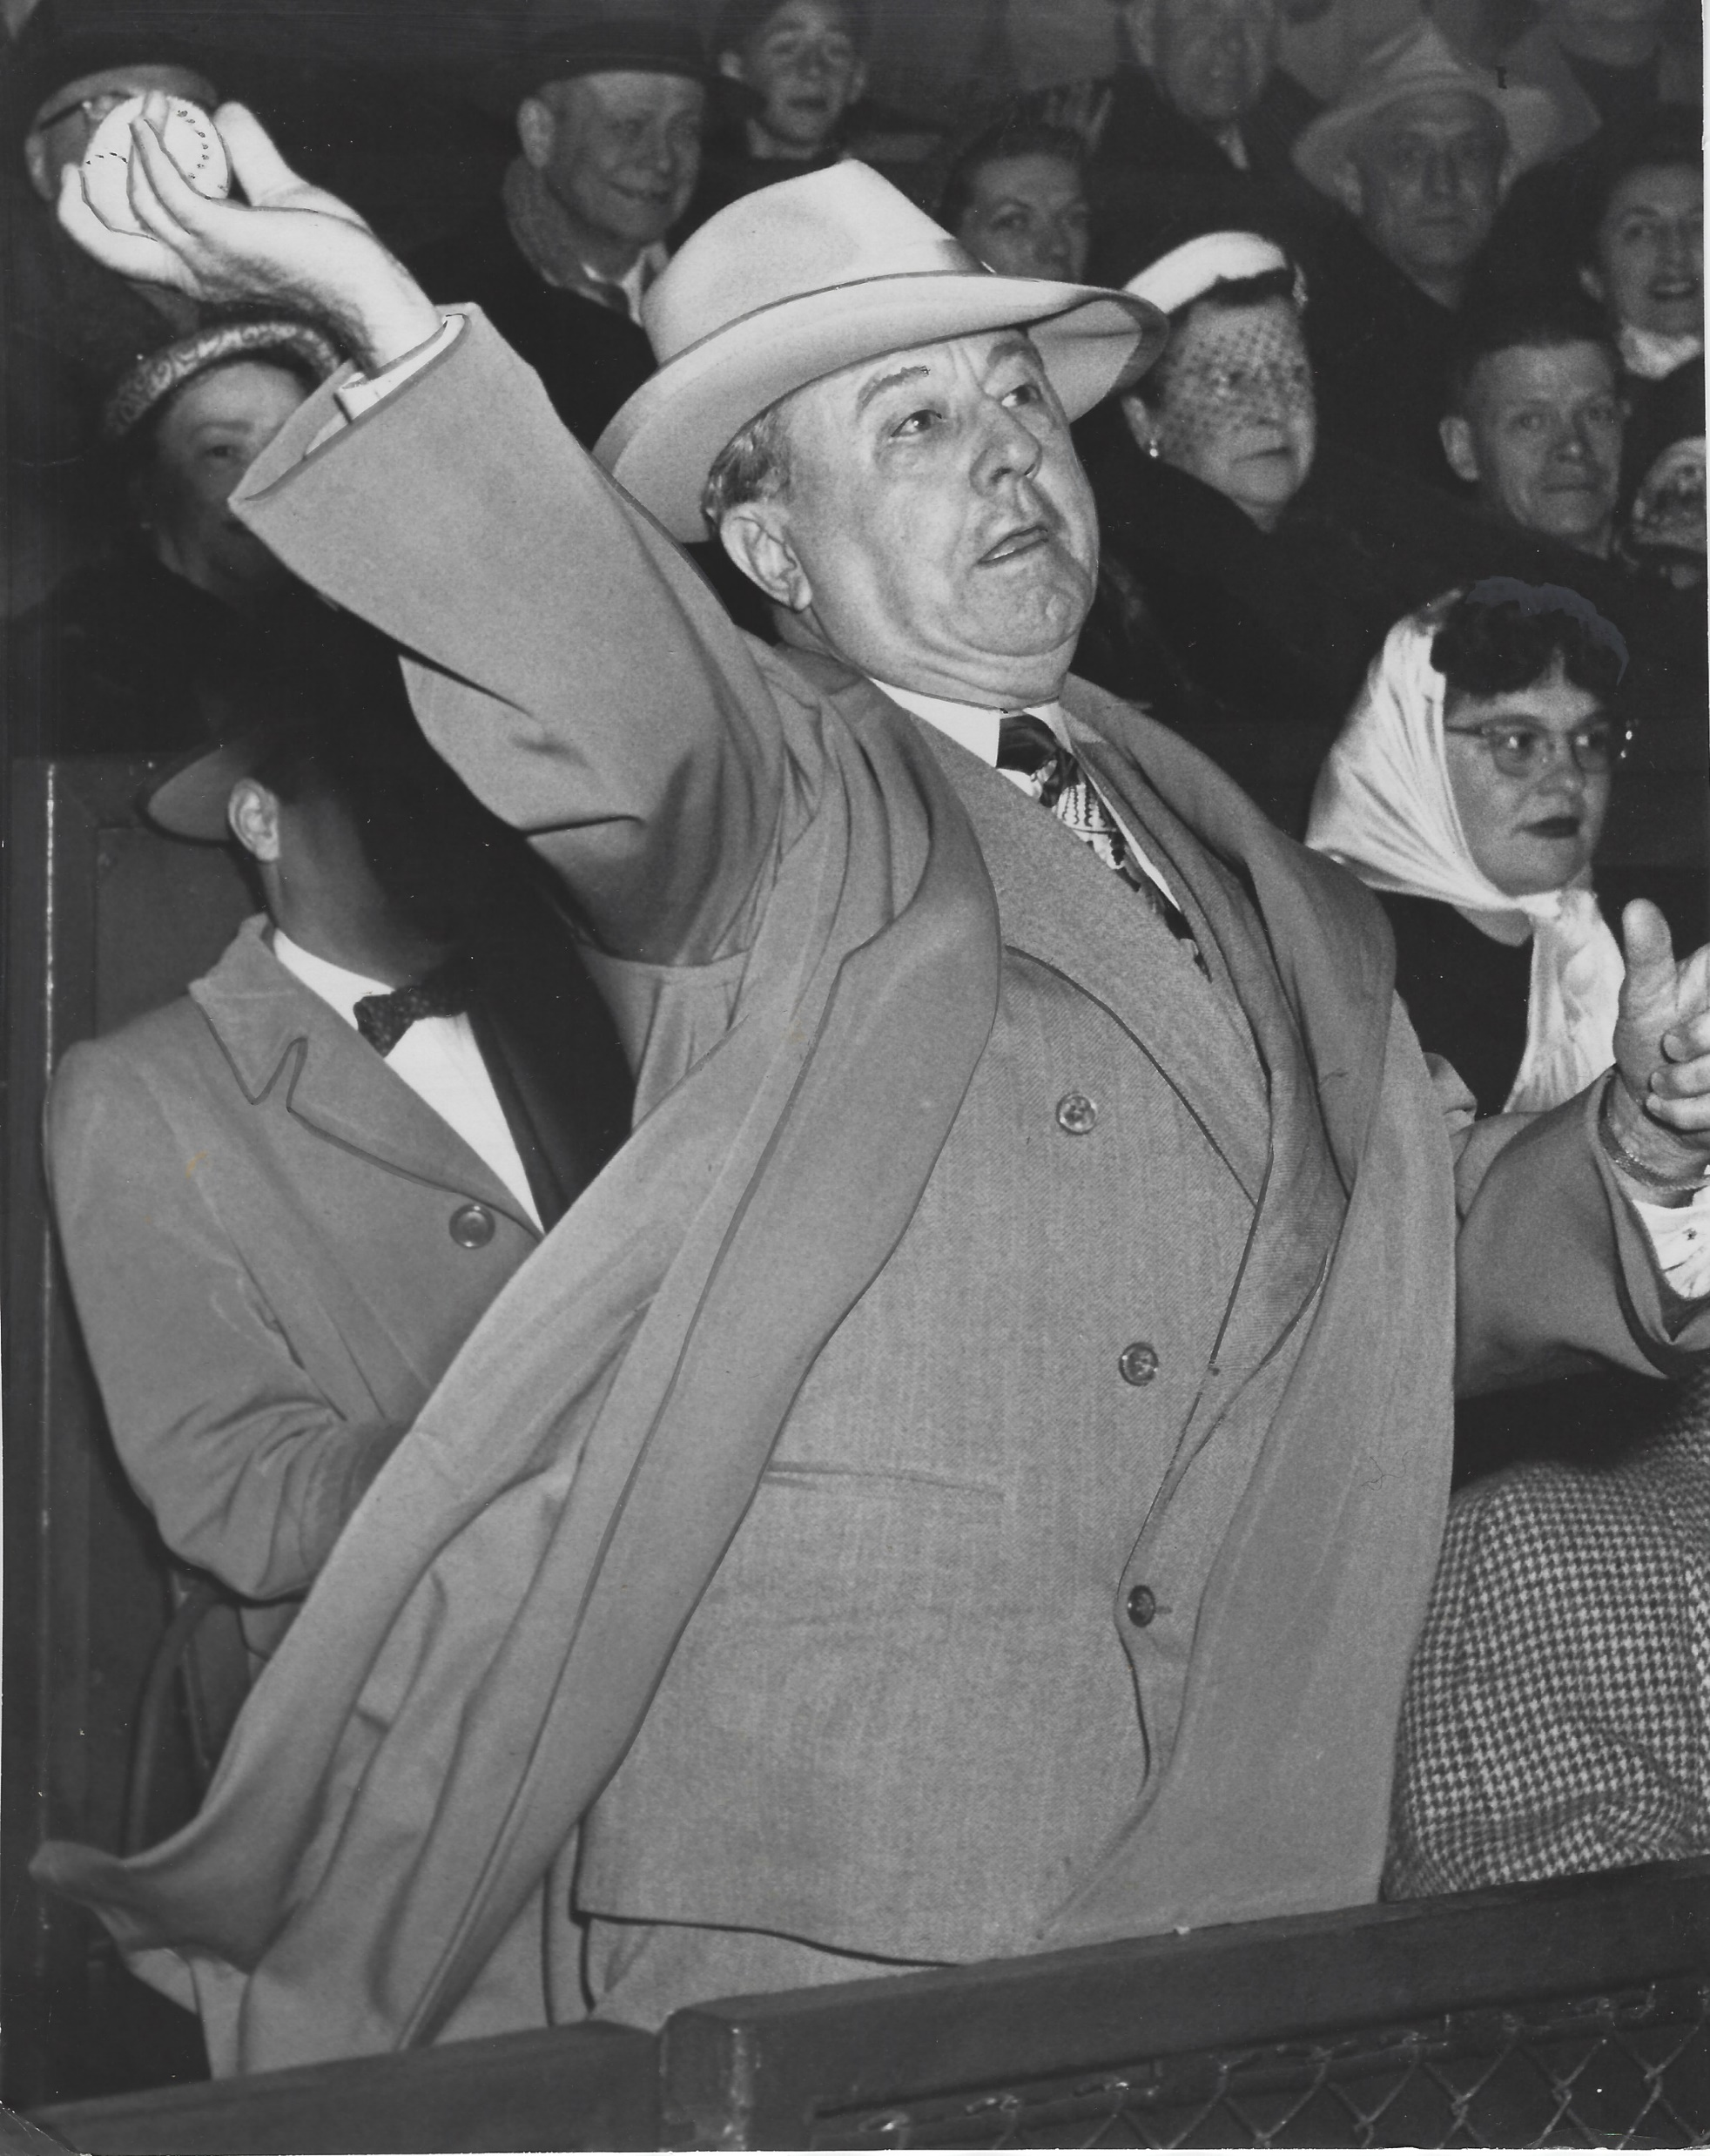
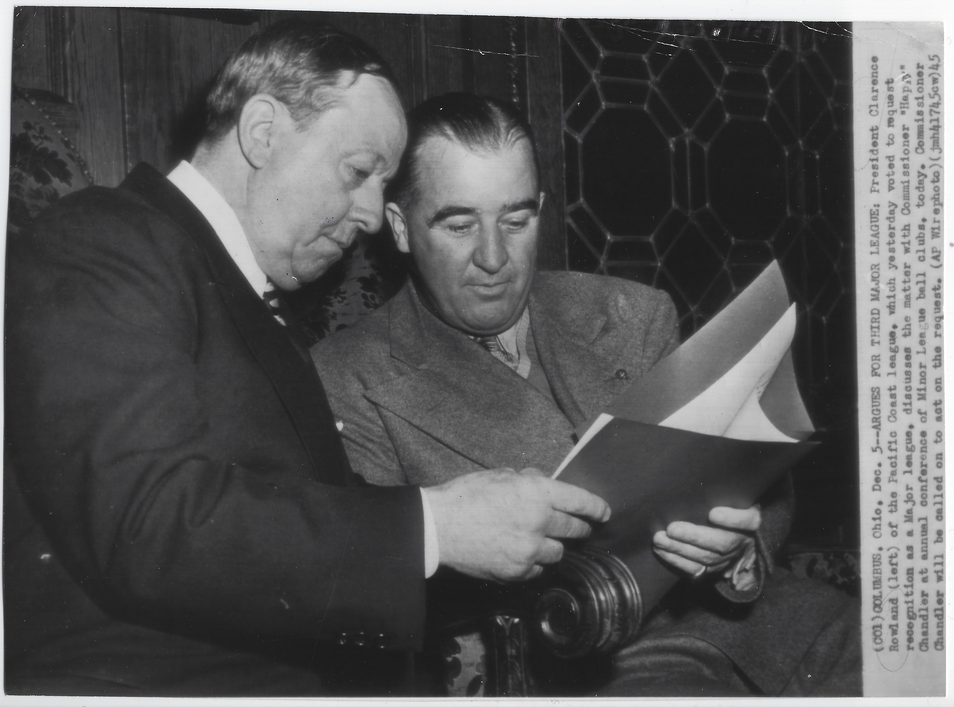

Slide 23
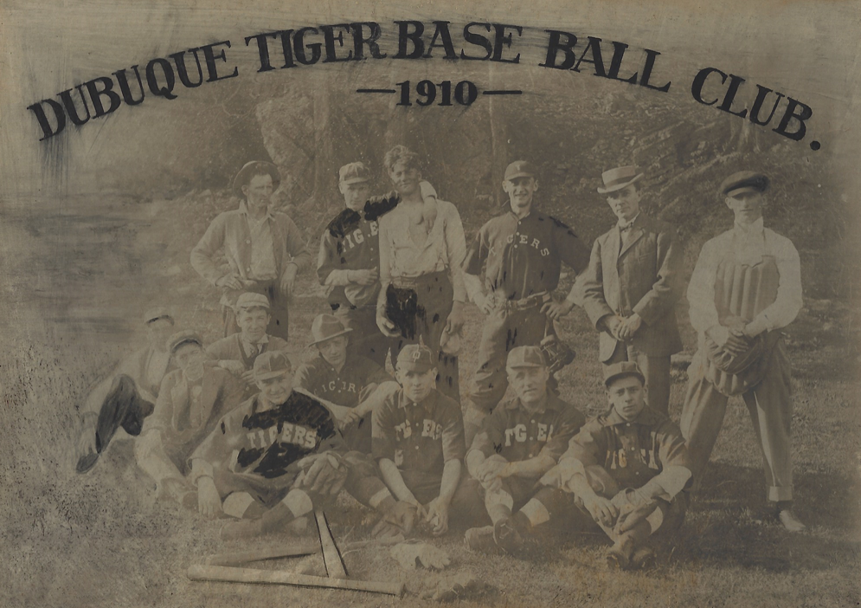

Slide 24
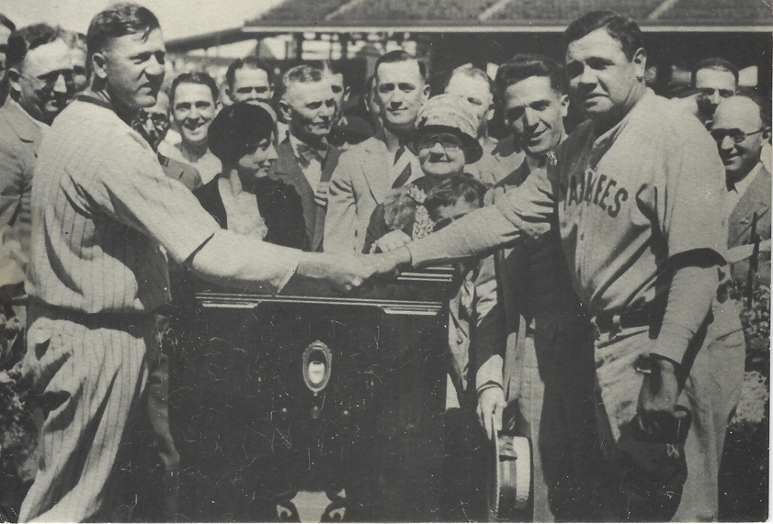

Slide 25
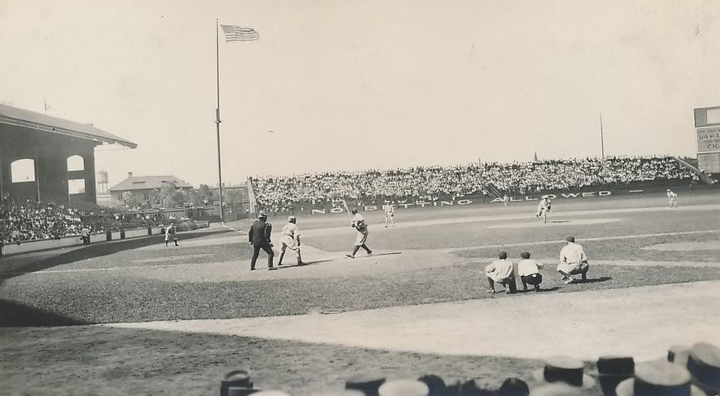

Slide 26
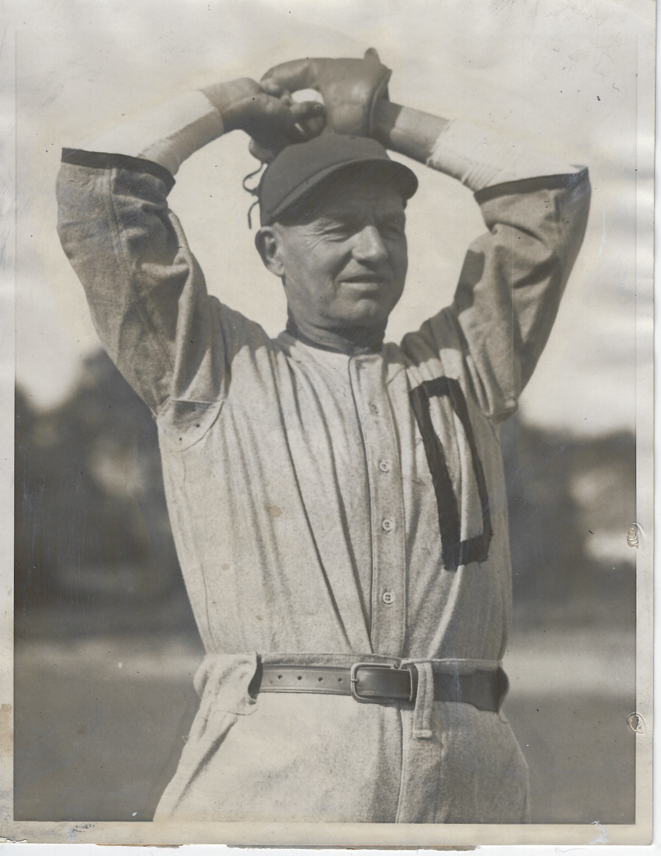

Slide 27
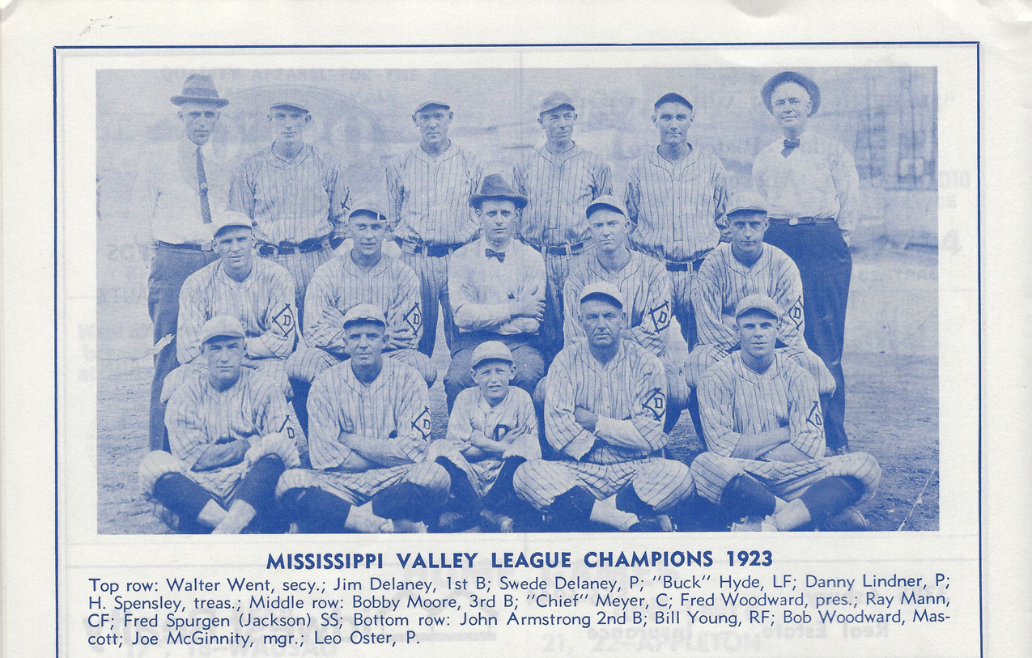

Slide 28
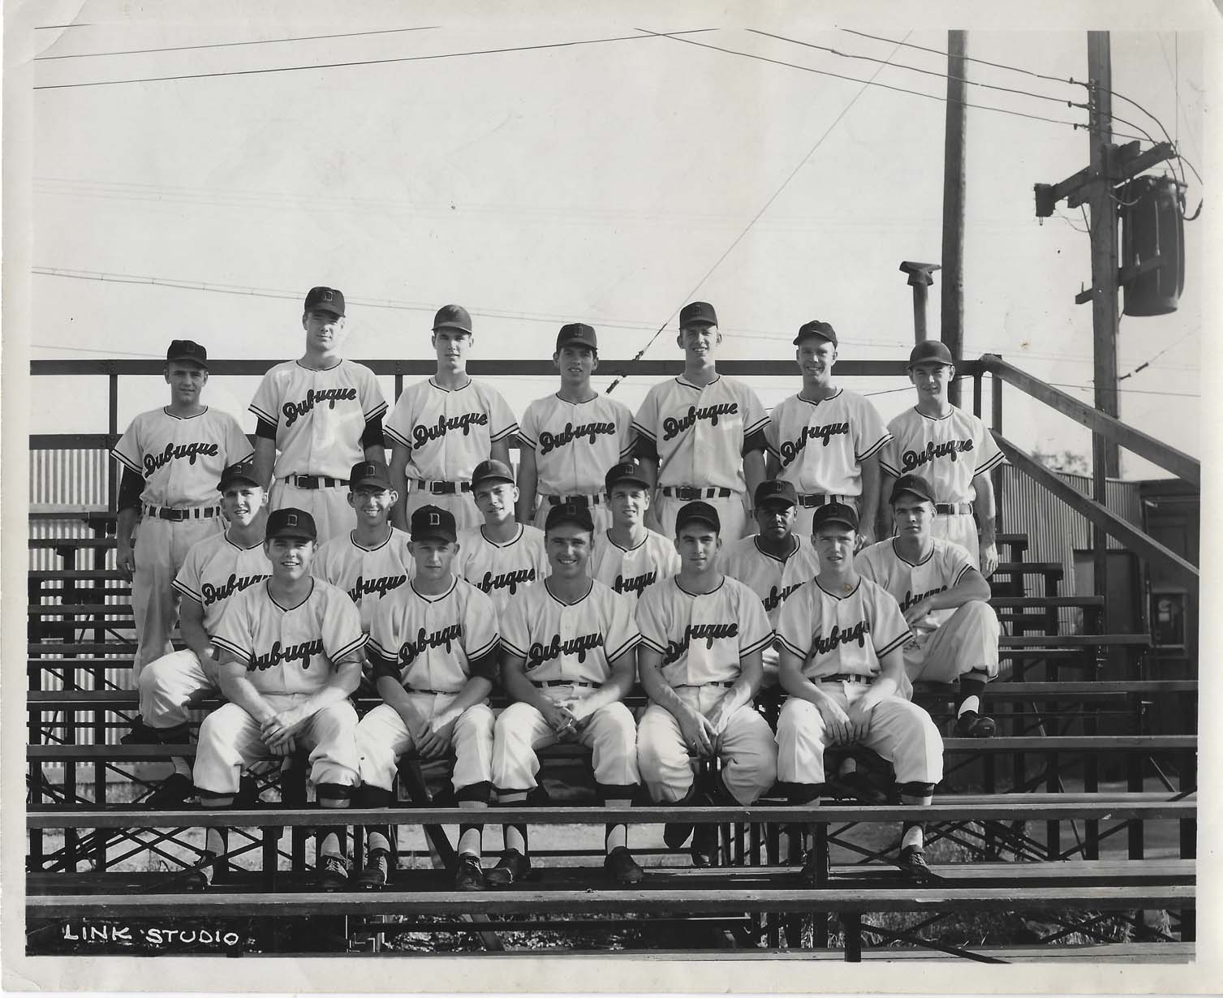

Slide 29
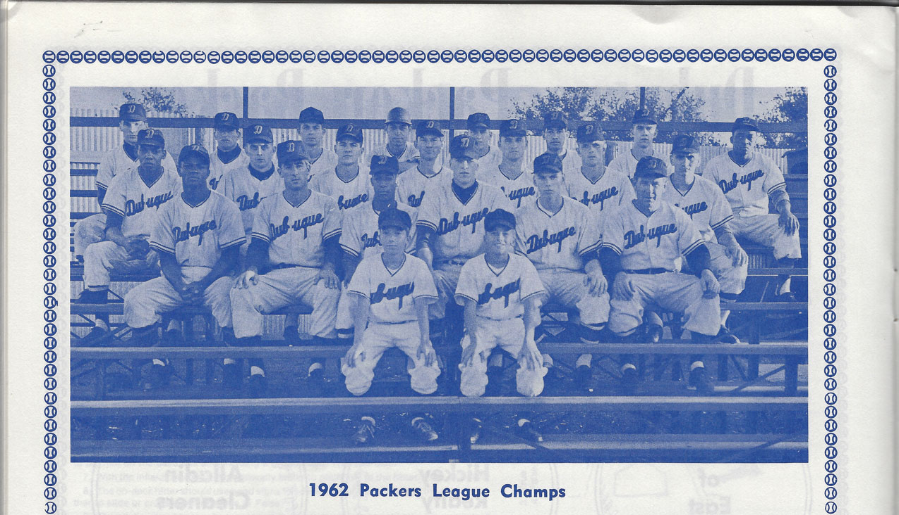

Slide 30
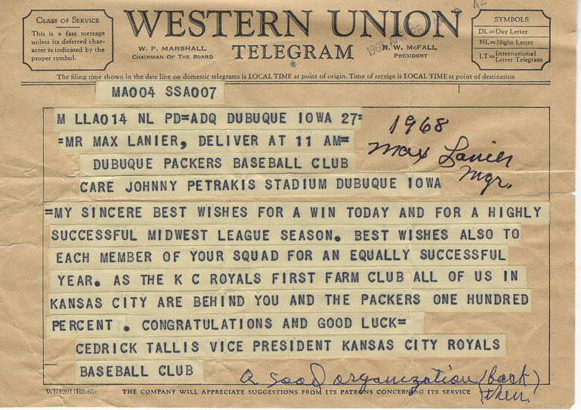
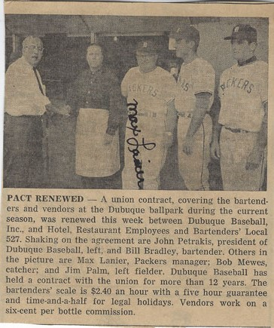

Slide 31
Early Dubuque Baseball Pioneers
Hall of Famers | MLB Owners | MLB Player-Managers | MLB Managers | AL Founding Fathers | Minor League Presidents
Charles Radbourne | Frank Robison | Ted Sullivan | Joe Cantillon | Charles Comiskey | Ted Sullivan
Charles Comiskey | M. Stanley Robison | Charles Comiskey | M. Stanley Robison | Tom Loftus | Tom Loftus
Red Faber | Henry Robison | Joe Quinn | Clarence Rowland |  | Al Clark
Joe McGinnity* | Tom Loftus | Billy Sullivan | Mel Harder |  | Clarence Rowland
 | Charles Comiskey | Harry Wolverton | Bruce Bochy
 | J. Louis Comiskey | Joe McGinnity*

Slide 32
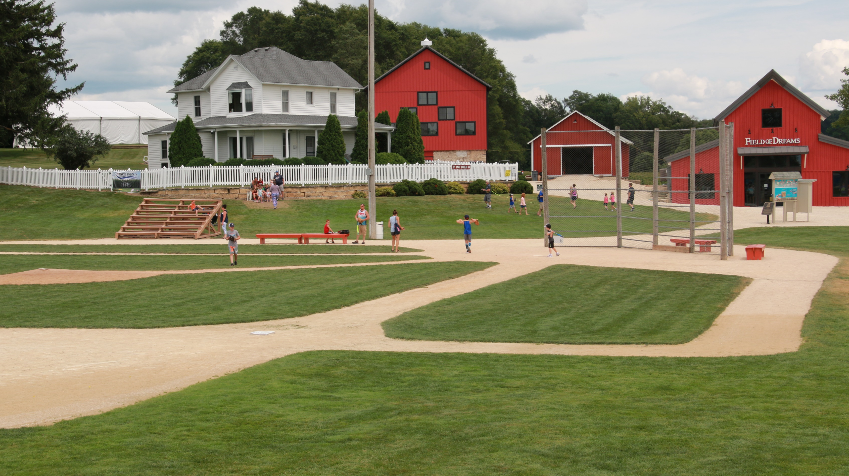
Is this Heaven?
Field of Dreams

Slide 33
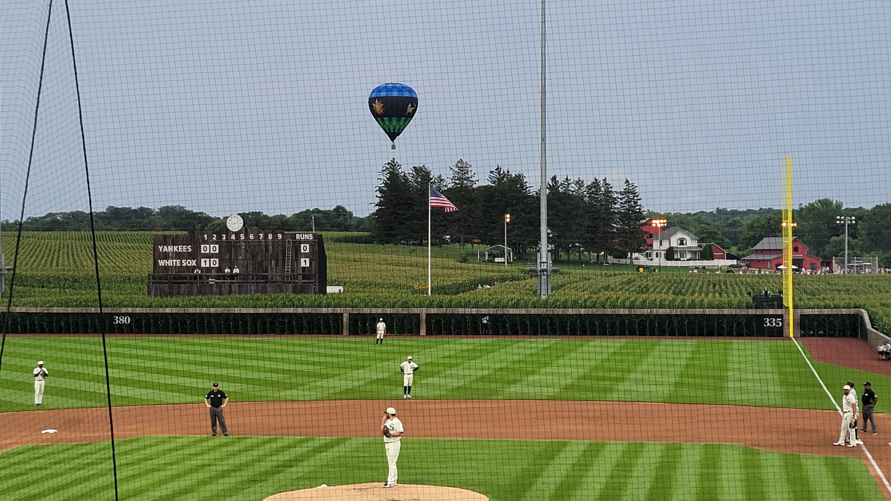

Slide 34
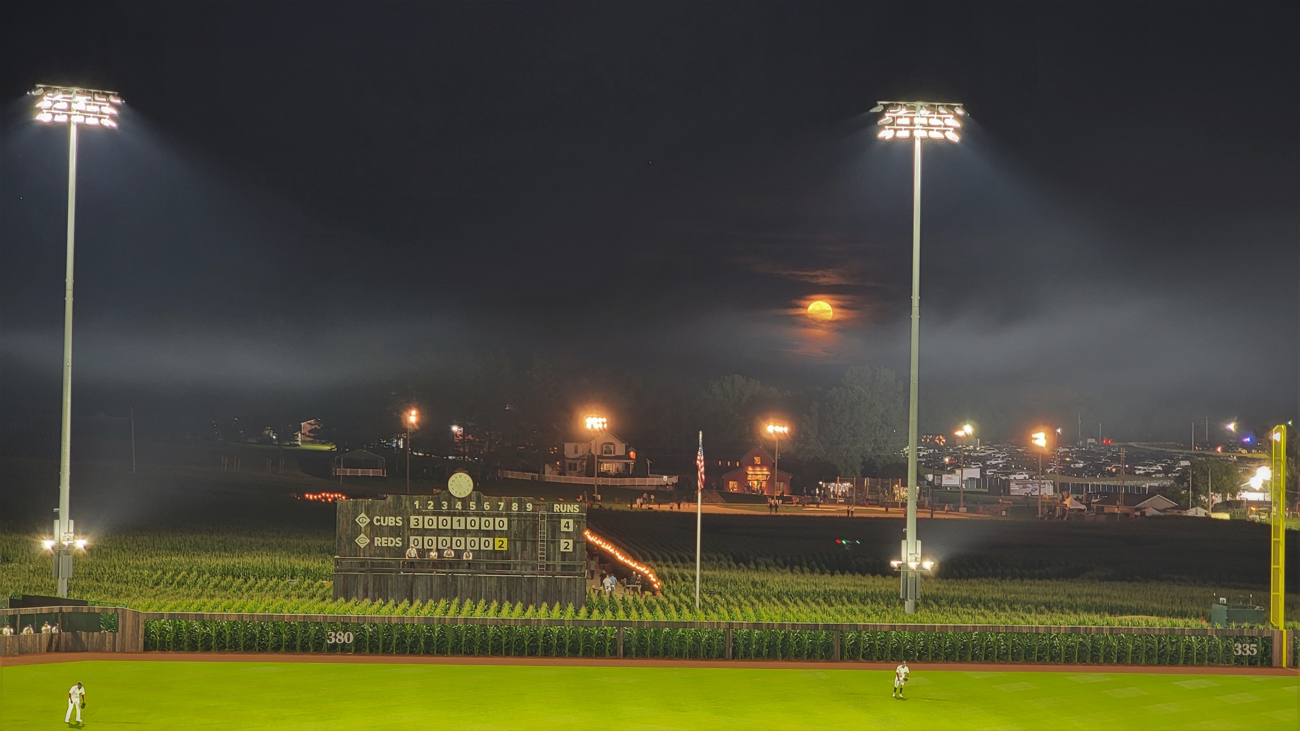

Slide 35
Thank You
Questions & Answers
with John T. Pregler
. .
SABR 19thcBB Speakers Series
May 9, 2023, 8:00pm EDT
. .

