Slide 1
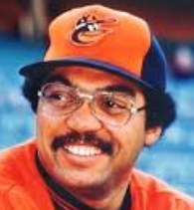
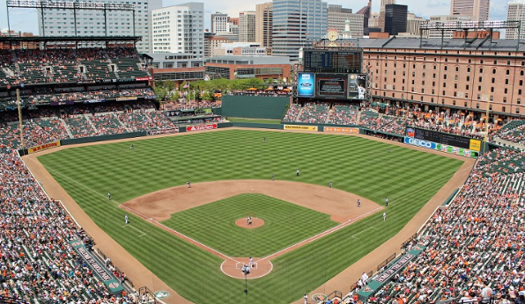
From Reggie to Camden Yards: Baltimore’s Small-Market Success in the Post-Messersmith Era
Paul Hensler
2022 Convention of
The Society for American Baseball Research

Slide 2
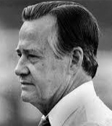
Blockbuster Trades of 1976
April
Sent to Oakland - Don Baylor, Mike Torrez, Paul Mitchell
Orioles received - Reggie Jackson, Ken Holtzman,
Bill Van Bommell
GM Hank Peters
June
Sent to NY Yankees - Ken Holtzman, Doyle Alexander, Grant Jackson,
Elrod Hendricks, Jimmy Freeman
Orioles received - Rudy May, Dave Pagan, Tippy Martinez, Scott McGregor,
Rick Dempsey

Slide 3
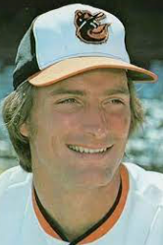
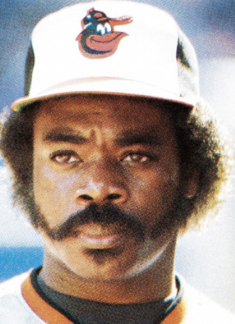
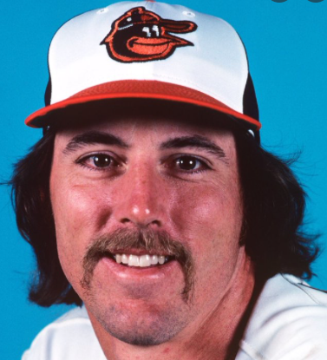
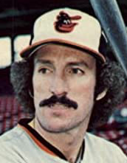
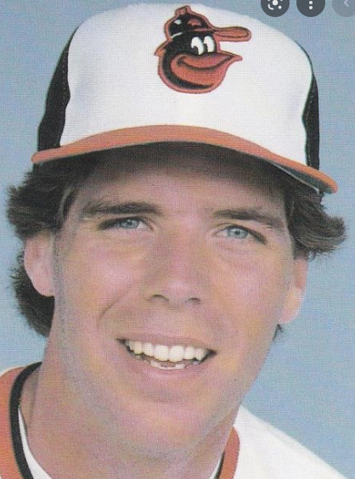
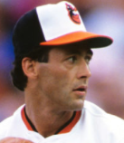
New Blood in the Lineup
DeCinces Murray Ripken, Jr.
Roenicke Lowenstein Davis Boddicker

Slide 4
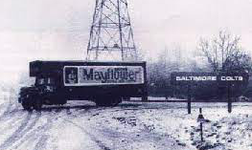
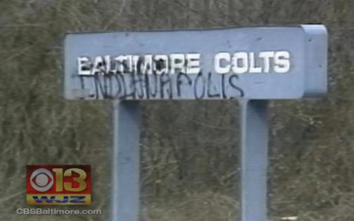
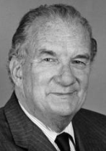
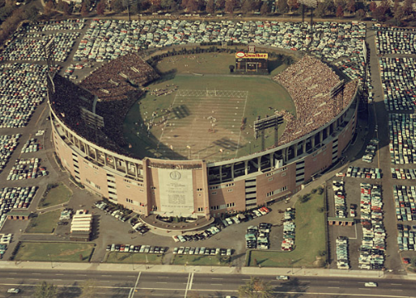
Baltimore’s Defining Moment
March 28, 1984
??? ??? ???
Edward Bennett Williams
Memorial Stadium

Slide 5
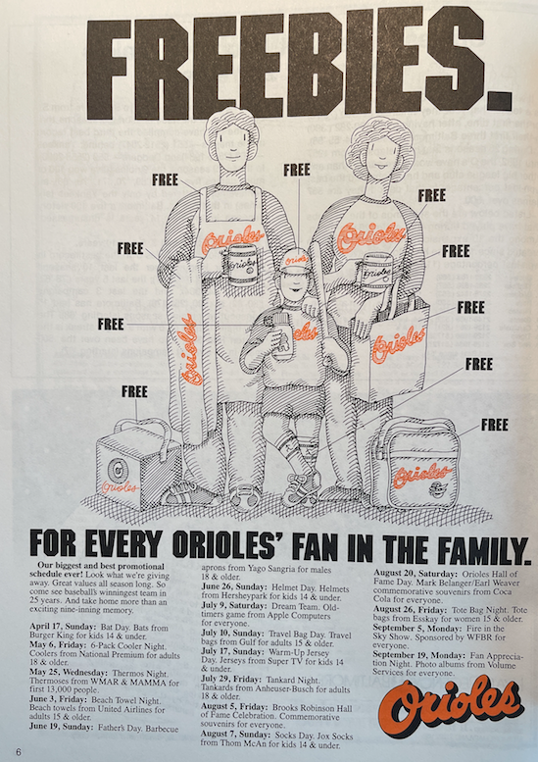
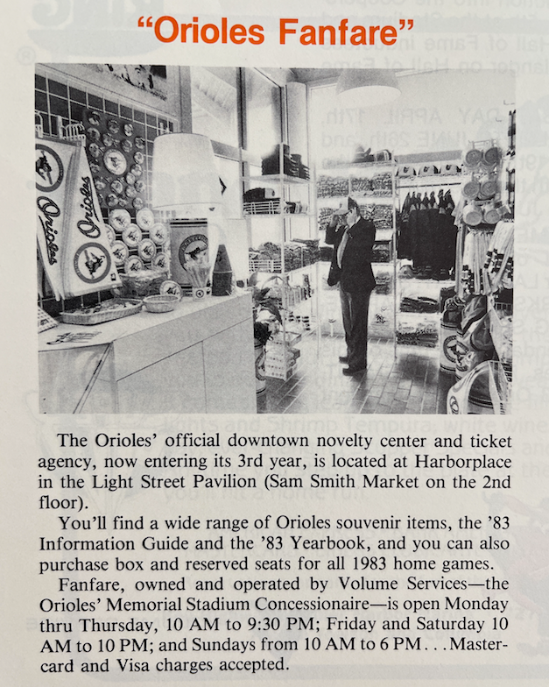
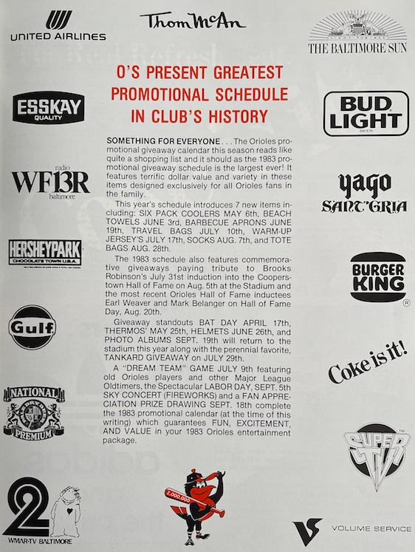
Marketing and Promotion

Slide 6
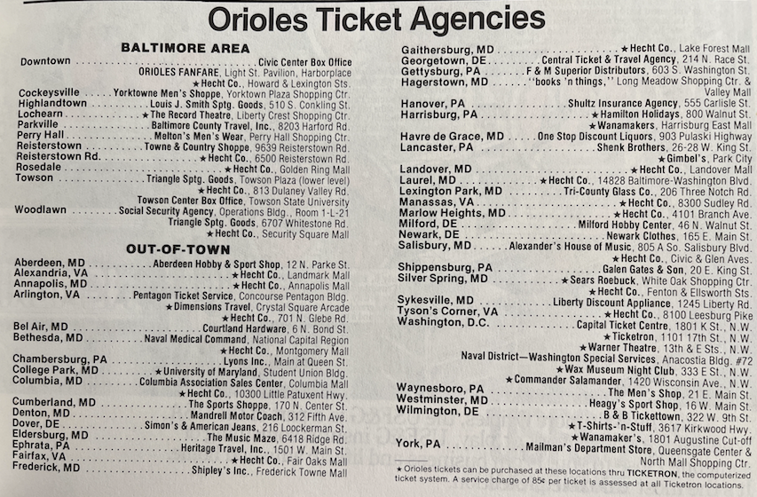
Ticket Sales Outreach
1979
1983

Slide 7
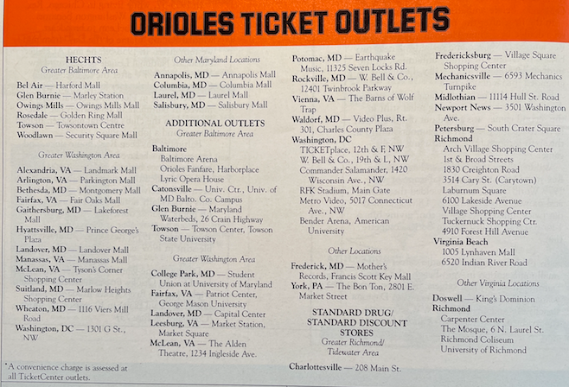
Ticket Sales Outreach
1989

Slide 8
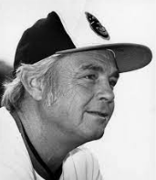
The Post-Series Decline
 | Won | Lost | GB | AL East Standing | Attendance
1984 | 85 | 77 | 19 | 5th place | 2,045,784
1985 | 83 | 78 | 16 | 4th place | 2,132,387
1986 | 73 | 89 | 22.5 | 7th place | 1,973,176
1987 | 67 | 95 | 31 | 6th place | 1,835,692
1988 | 54 | 107 | 34.5 | 7th place | 1,660,738
Earl Weaver’s Dubious Return
1985 53-52
1986 73-89

Slide 9
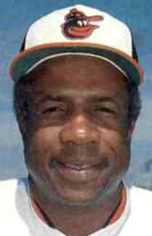
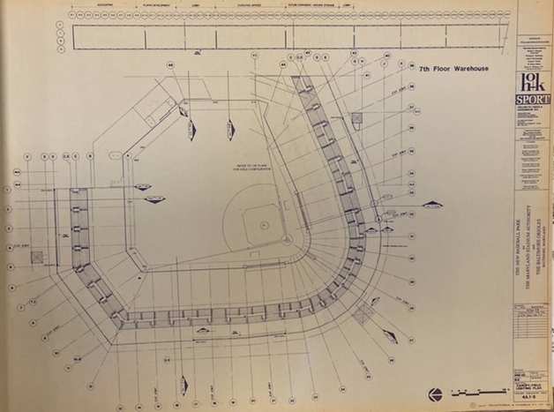
A Brief Rebound
 | Won | Lost | GB | AL East Standing | Attendance
1989 | 87 | 75 | 2 | 2nd place | 2,535,208
1990 | 76 | 85 | 11.5 | 5th place | 2,415,189
1991 | 67 | 95 | 24 | 6th place | 2,552,753
Frank Robinson
Oriole Park design, circa 1990

Slide 10
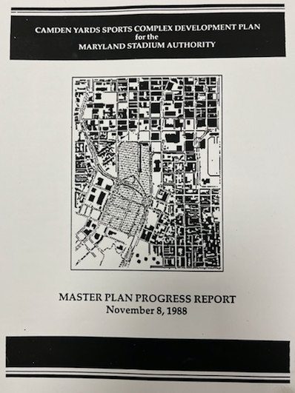
“Let’s do the Camden Yards things…”
“Building a ballpark halfway
between Baltimore and
Washington is like building a
house halfway between your
wife and your girlfriend.
You can’t do that.”
- Edward Bennett Williams

Slide 11
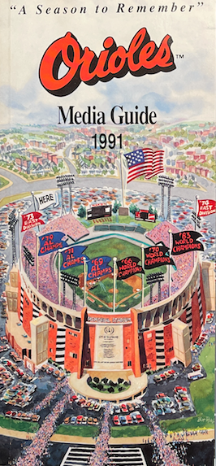
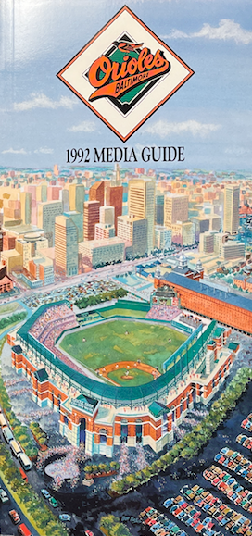
Out With the Old, In with the New

Slide 12
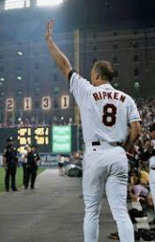
Success, and Safe at (New) Home…
Labor disputes notwithstanding…
…and a salute to a legend…
 | Won | Lost | GB | AL East Standing | Attendance
1992 | 89 | 73 | 7 | 3rd place | 3,567,819
1993 | 85 | 77 | 10 | 3rd place | 3,644,965
1994 | 63 | 49 | 6.5 | 2nd place | 2,535,359
1995 | 71 | 73 | 15 | 3rd place | 3,098,475
1996 | 88 | 74 | 4 | 2nd place | 3,646,950
1997 | 98 | 64 | - | 1st place | 3,711,132

Slide 13
Economic Impact
Baltimore Urban Affairs Report of 2010
“When you look at what Baltimore looked like before [stadium] development began, you have to make the conclusion that it is a great success.”
“According to the Orioles and the [Maryland] Stadium Authority, the location of the stadium downtown has been a boon to Baltimore’s economy.”
“[A] large percentage of fans come from out of town and spend their dollars in the city at area restaurants, hotels, businesses, and attractions.”

Slide 14
Economic Impact (Continued)
Bruce Hamilton & Peter Kahn - Johns Hopkins University (1996)
“The new stadium generated sufficient new revenue to more than cover the capital and maintenance cost.”
“The Orioles’ fiscal picture improved dramatically as a result of the move; they captured more than 100% of the revenue generated by the move.”
*** “If an expansion team comes to Washington, or if poor playing-field performance reduces fan support, the outlook for the Orioles and the [Maryland Stadium Authority] may be quite different.”

Slide 15
From Reggie to Camden Yards: Baltimore’s Small-Market Success in the Post-Messersmith Era
In conclusion…

