Slide 1
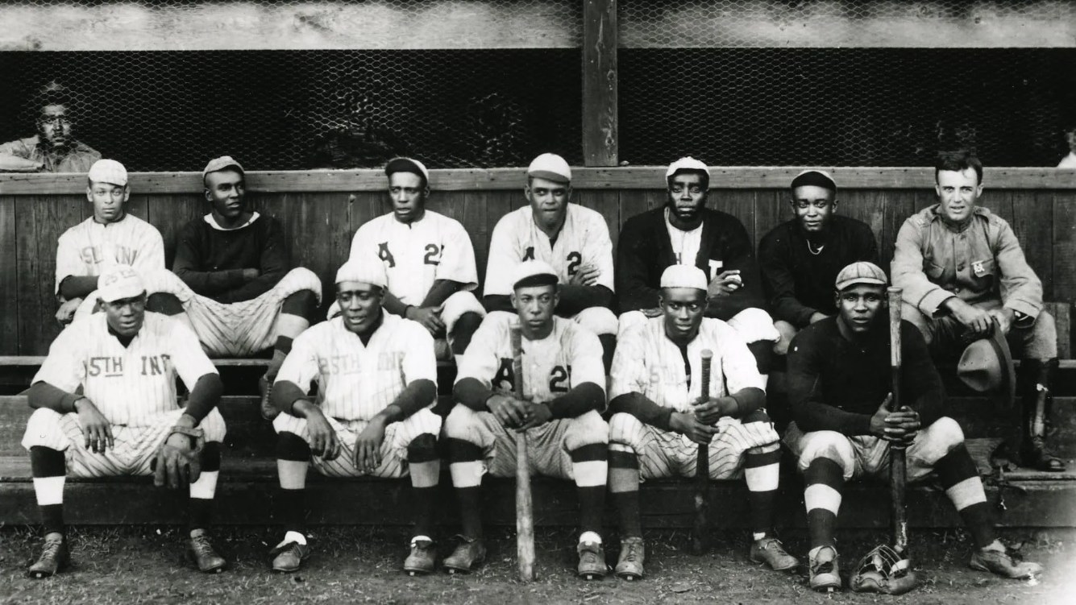
Wreckers in Hawaii
The Army Team that Became the Heart of the Kansas City Monarchs
Adam Darowski, Sports Reference

Slide 3
Wilber “Bullet” Rogan
P/OF (1920-29, 1933, 1935-38)
120-52, 2.65 ERA as pitcher
.338/.413/.521 as hitter
257-111, .698 as manager
Hall of Fame (1998)

Slide 4
Oscar “Heavy” Johnson
OF (1920, 1922-28, 1930-32)
2x Batting Title (1922, 1923)
Triple Crown (1923)
.406/.471/.722, 20 HR, 120 RBI in 1923
.370/.428/.592 career

Slide 5
Walter “Dobie” Moore
SS (1920-26)
1920-25, 3rd in WAR behind Rogan & Charleston
.350/.393/.524 career
8.7 WAR/162 career

Slide 6
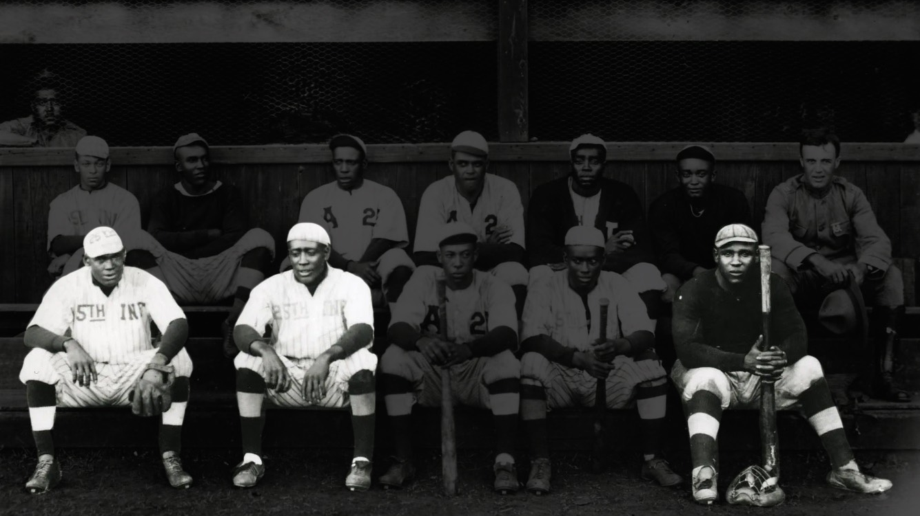

Slide 7
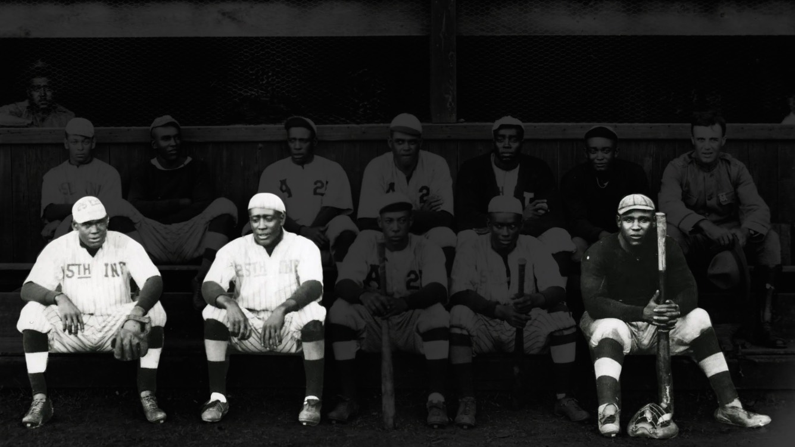

Slide 8
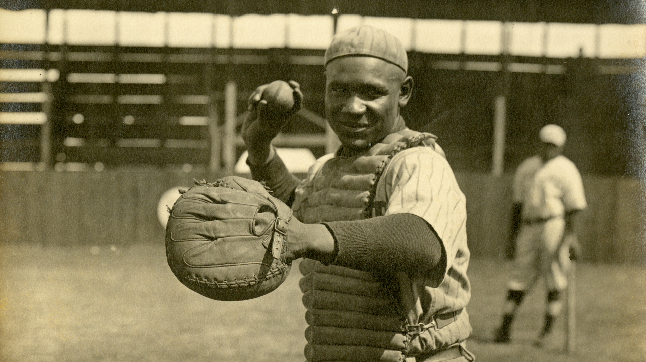

Slide 9
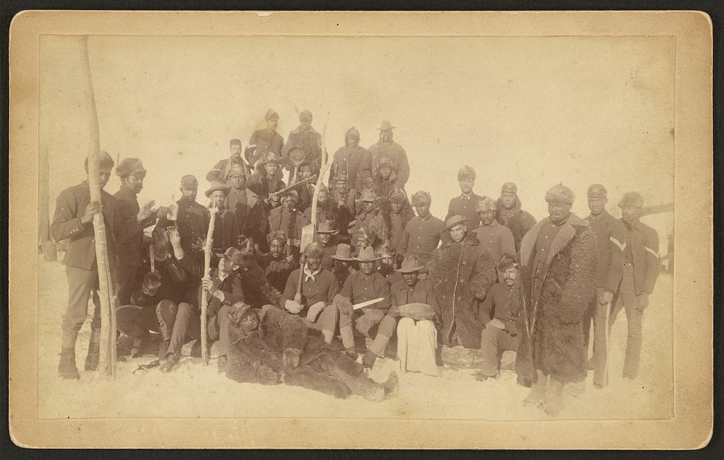

Slide 10
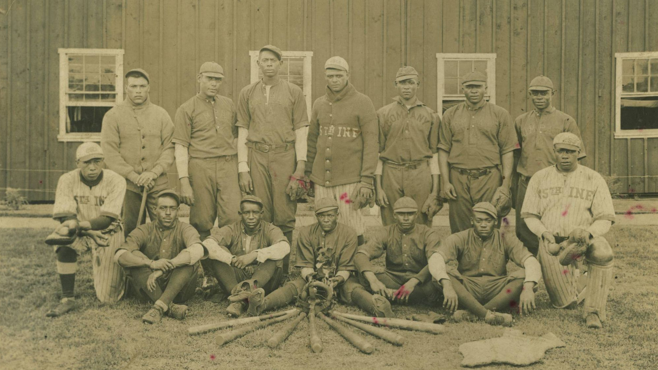
25th Infantry Wreckers
1869: The 25th Infantry is established.
1893: The Regiment baseball team is formed.

Slide 11
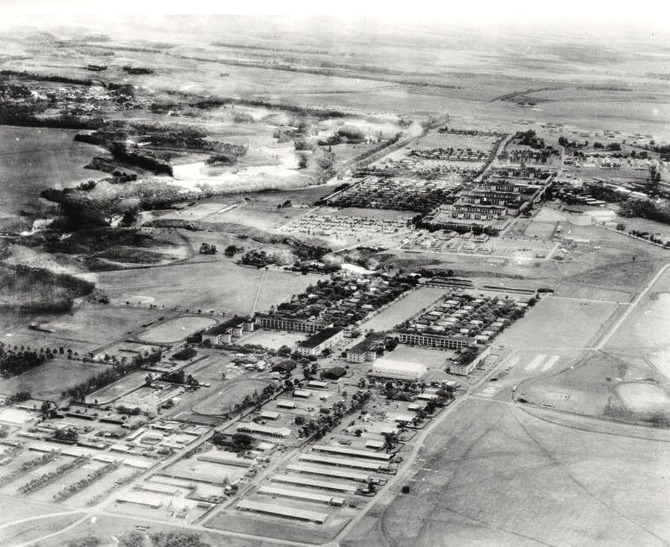

Slide 12
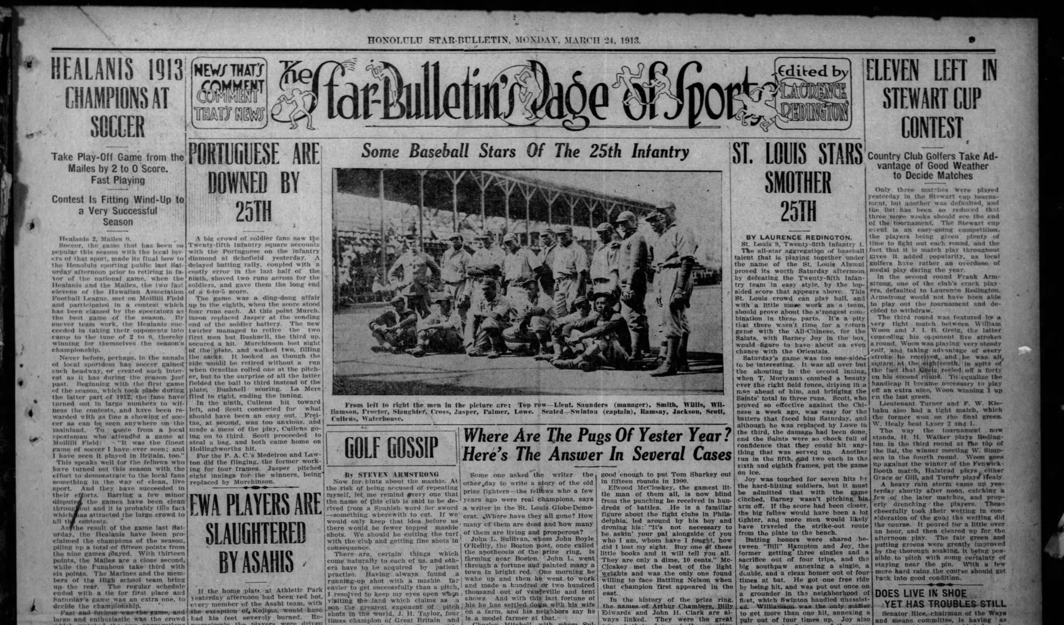

Slide 13
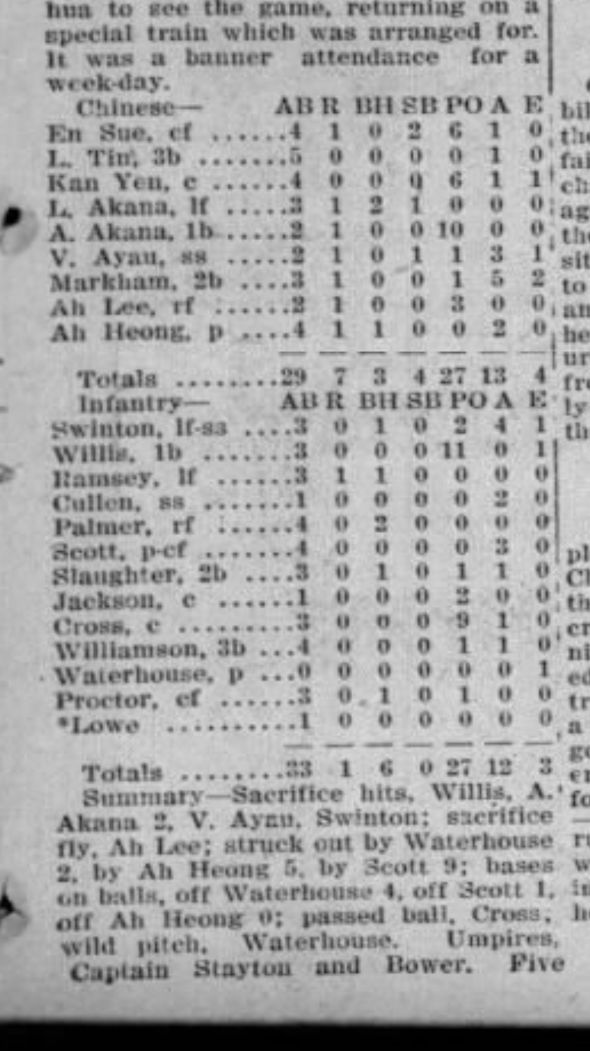
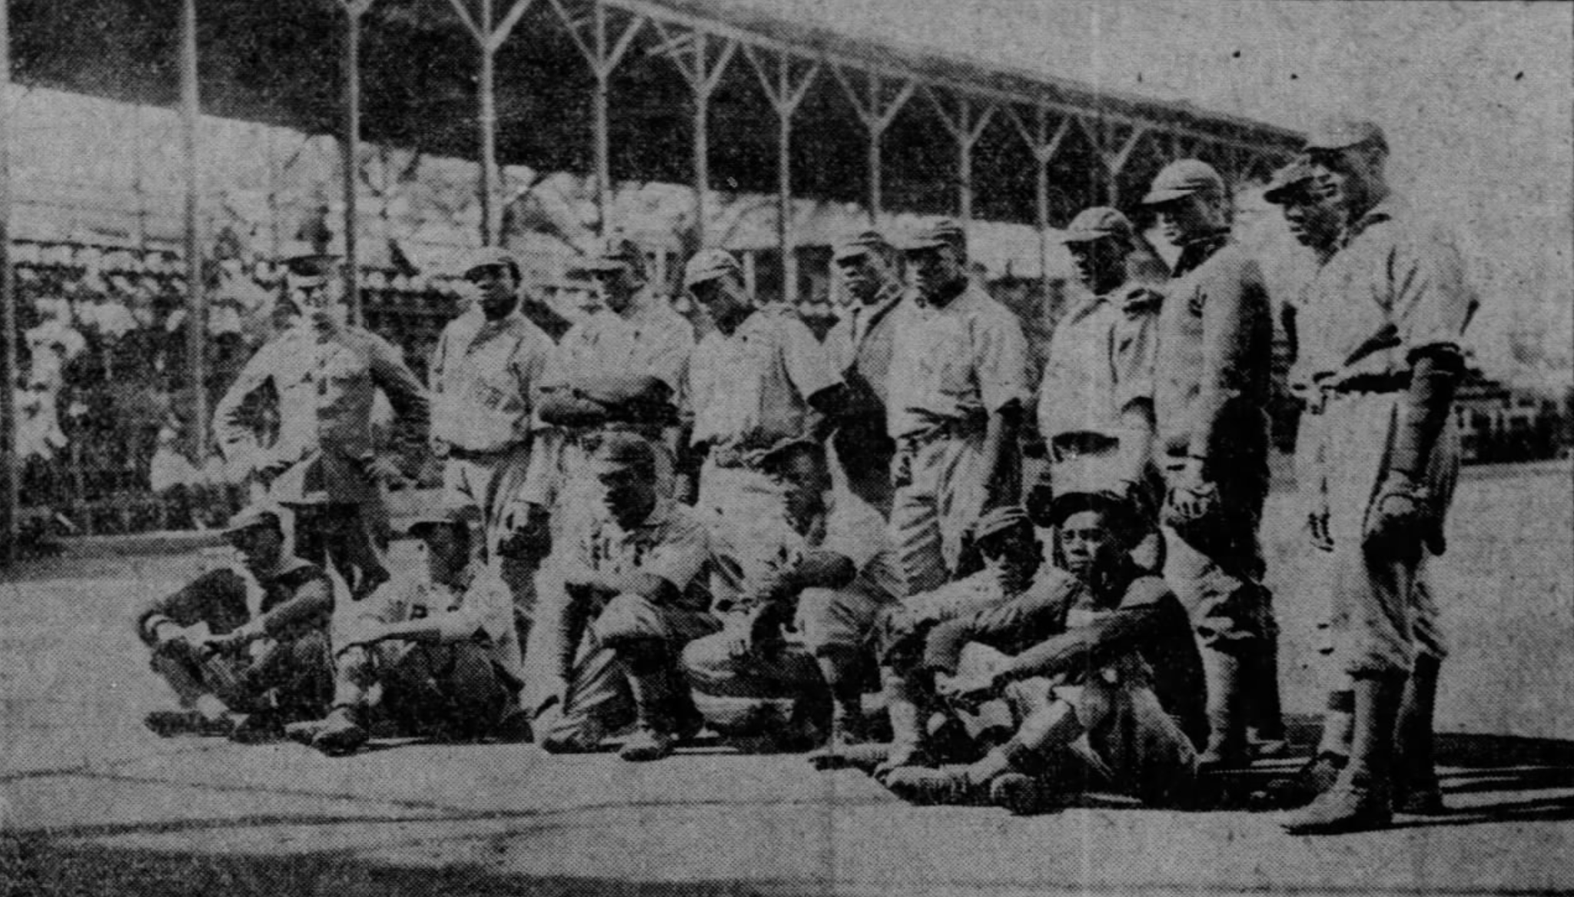
1913 Season
24-9 record
18-1 in the Schofield Barracks League
6-8 outside league play

Slide 14
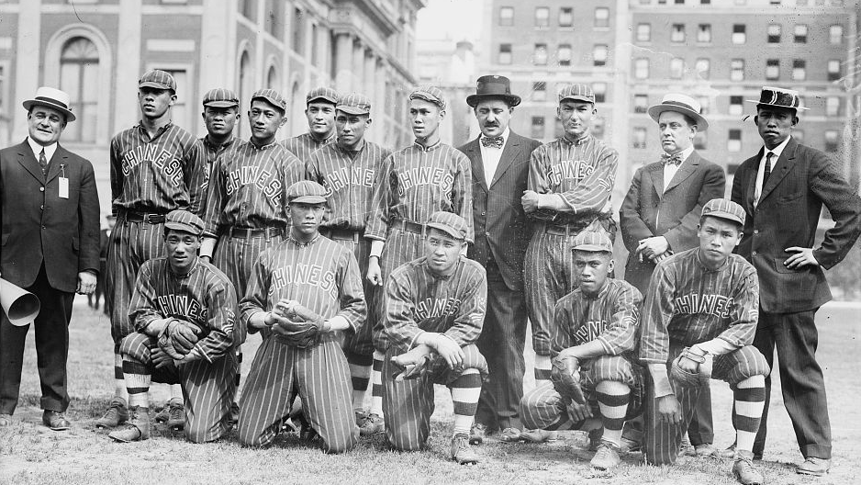

Slide 15
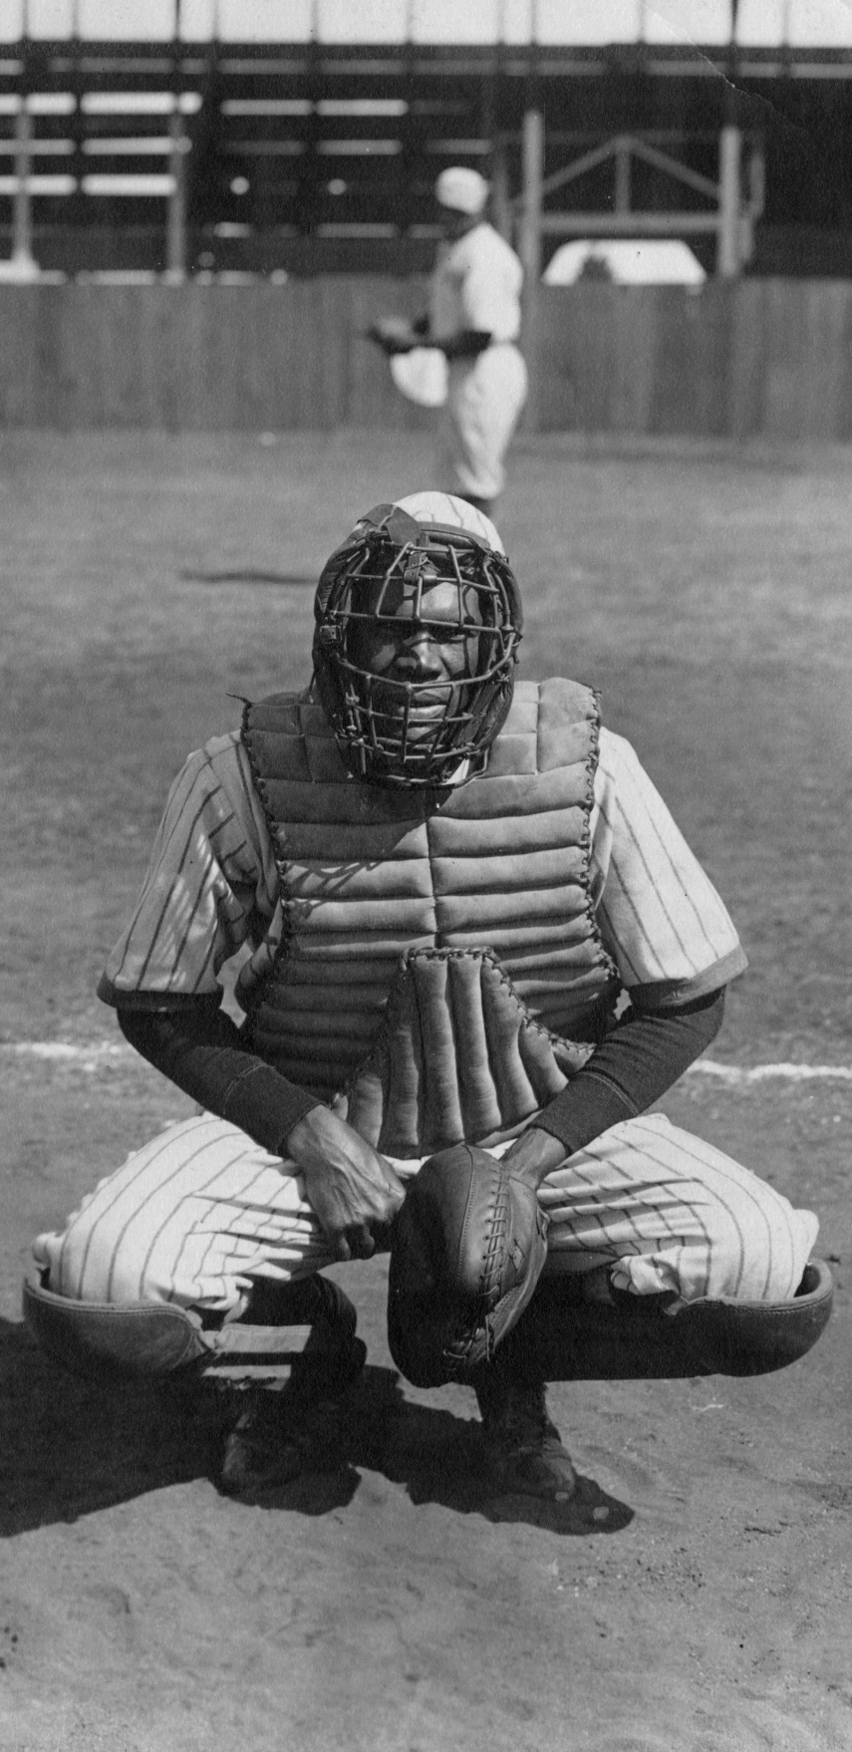
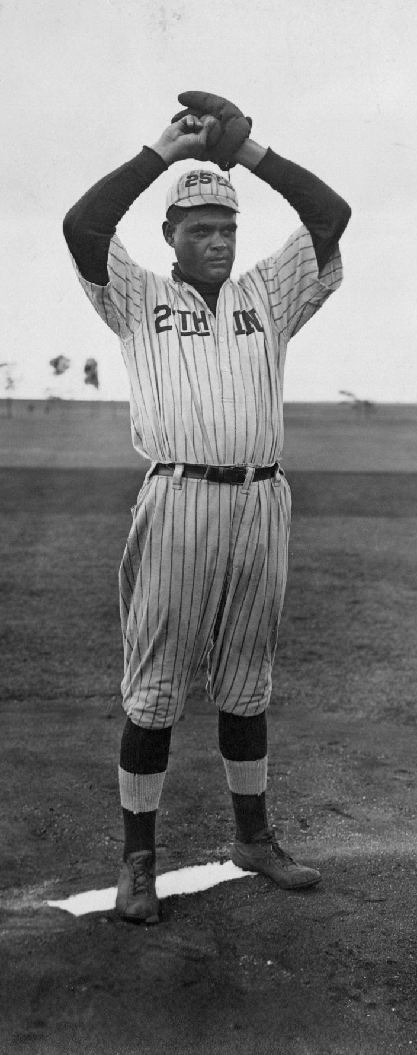
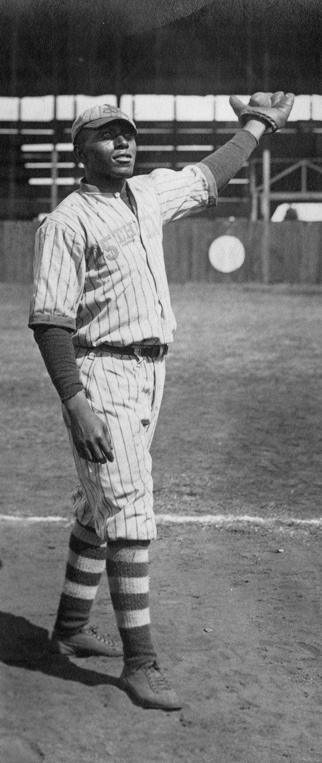

Slide 16
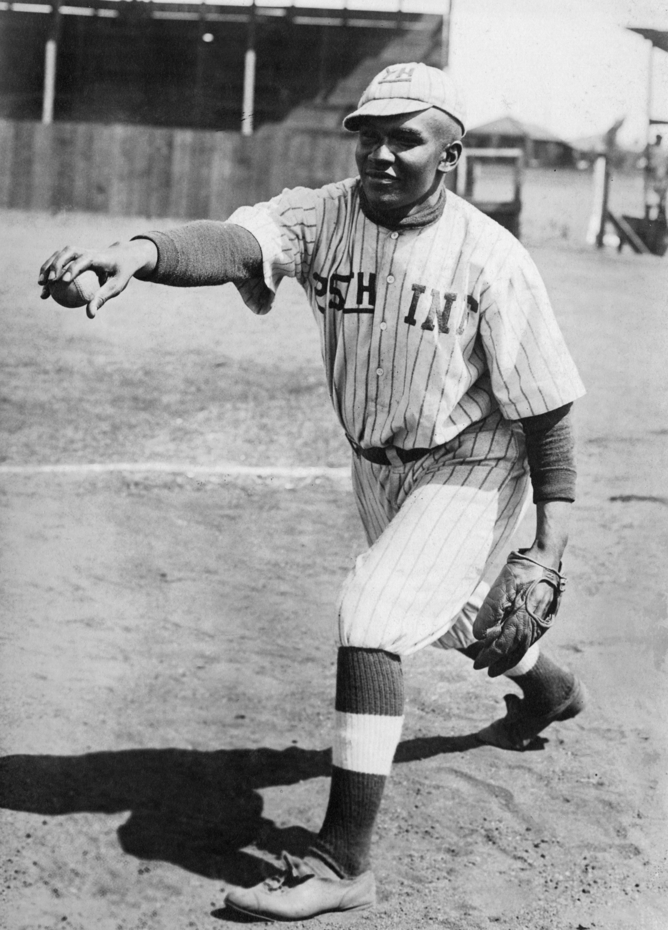
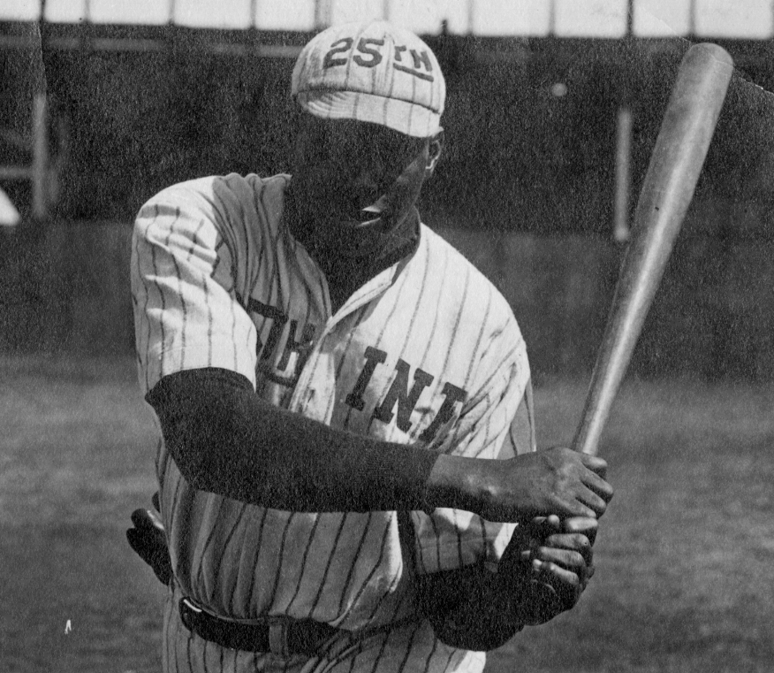
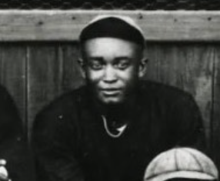
1914 Season
18-10-1 Record
Heavy Johnson Debut?
Bob Fagan, Fred Goliah, and Allie Crafton also debut

Slide 17
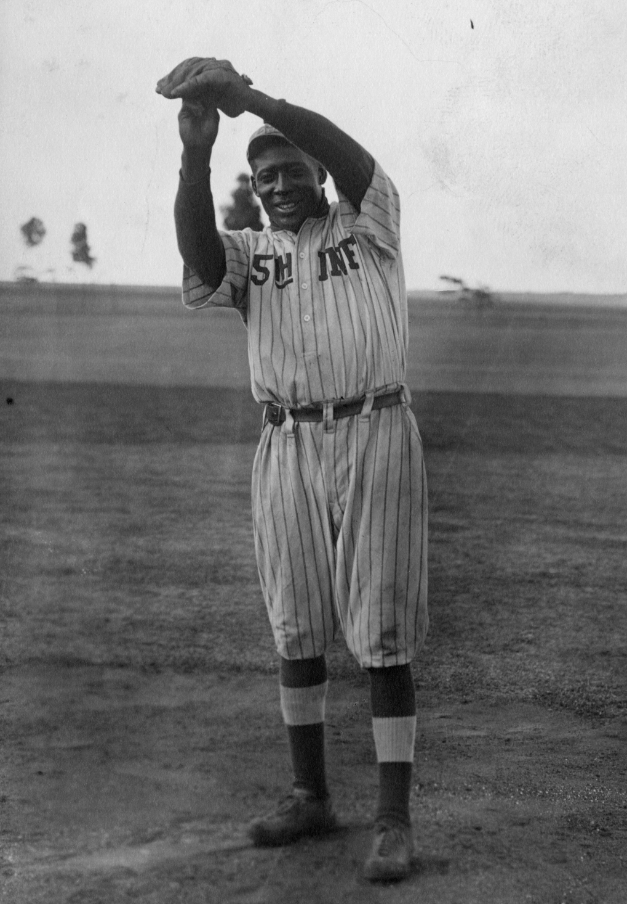
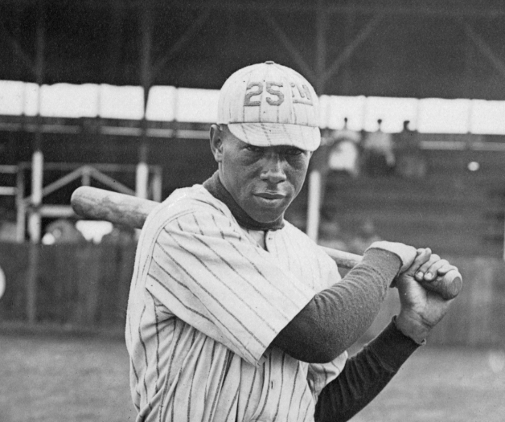
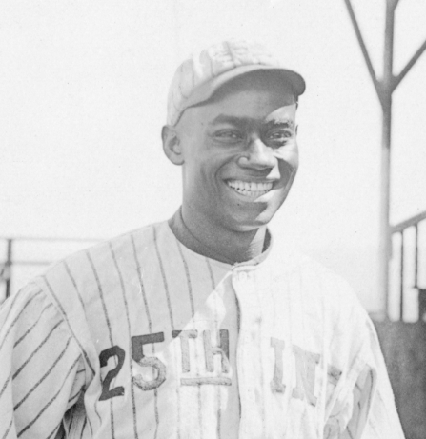
1915 Season
23-11 Record
The arrival of Bullet Rogan in July
Debuts of Hawkins and Smith

Slide 18
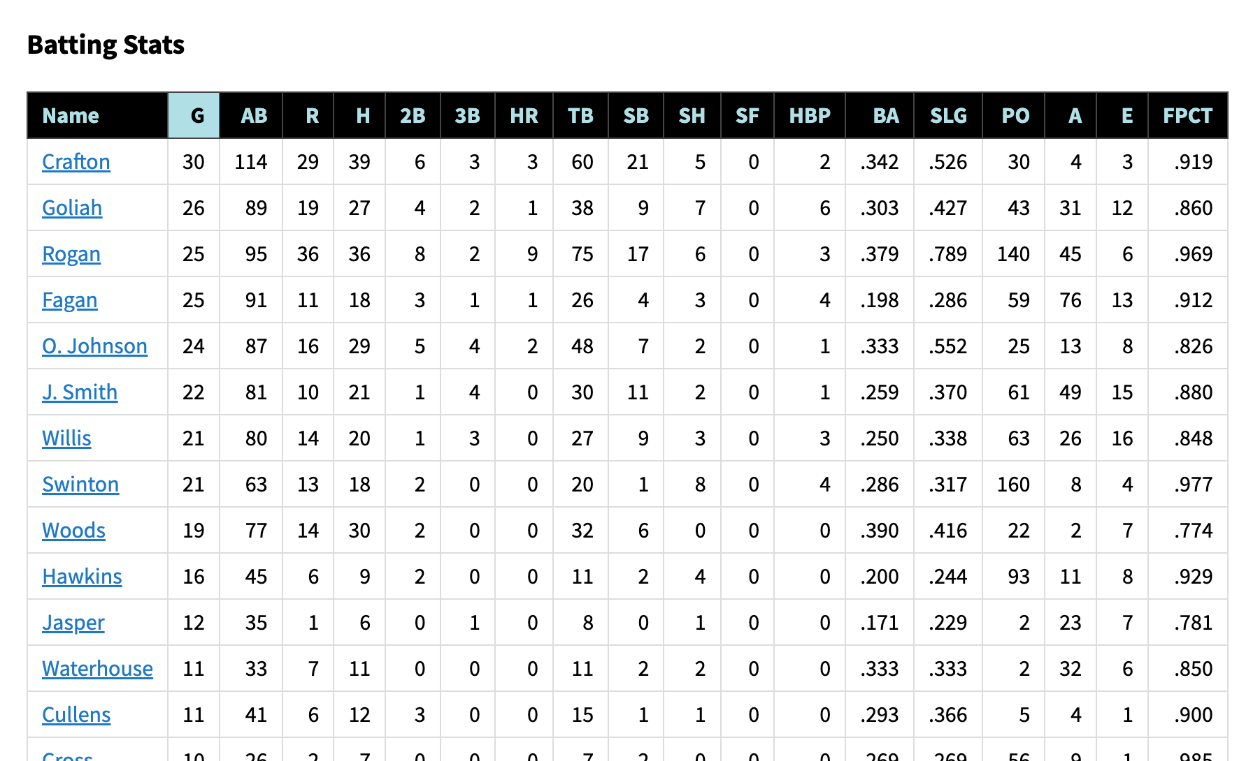

Slide 19
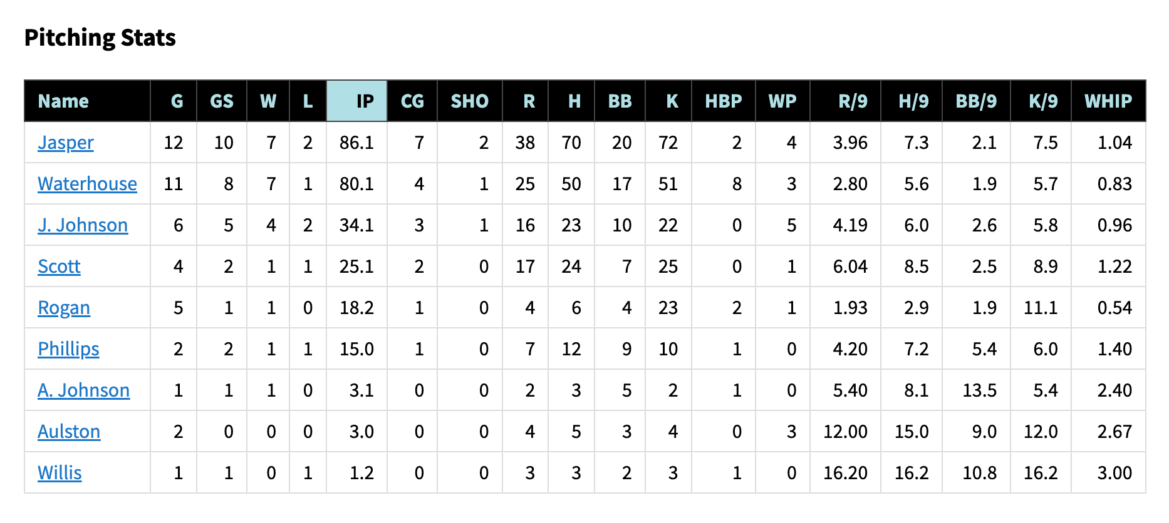

Slide 20
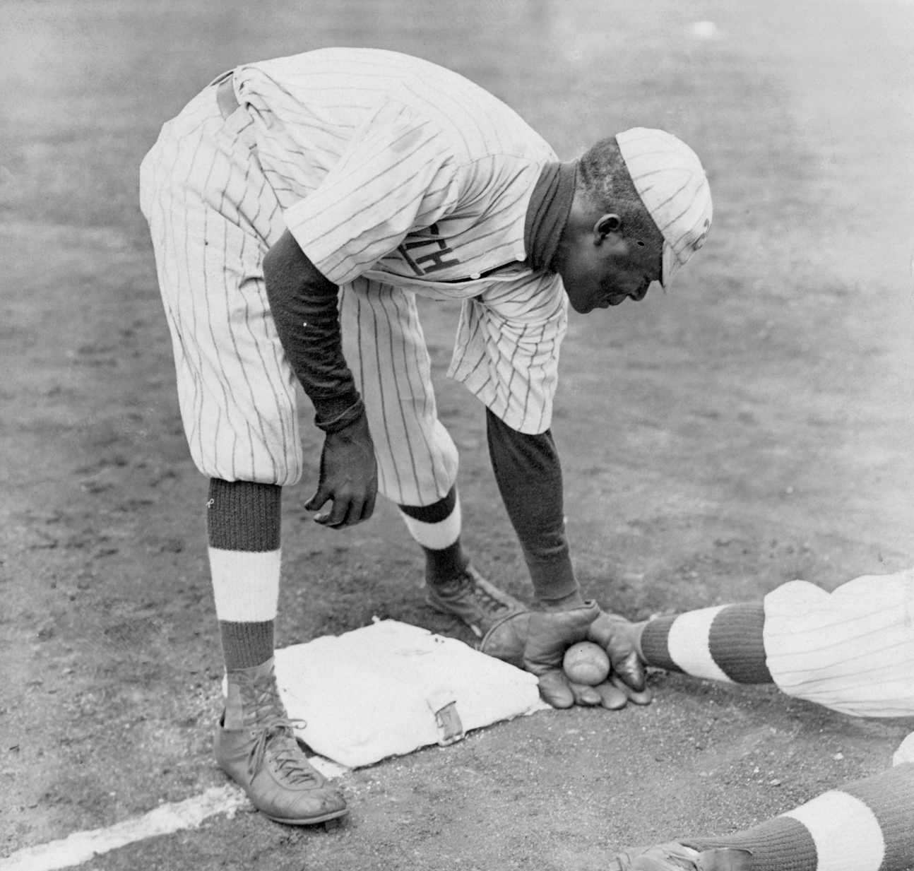
1916 Season
34-7 Record
Arrival of Dobie Moore
Inauguration of Rogan the ace

Slide 21
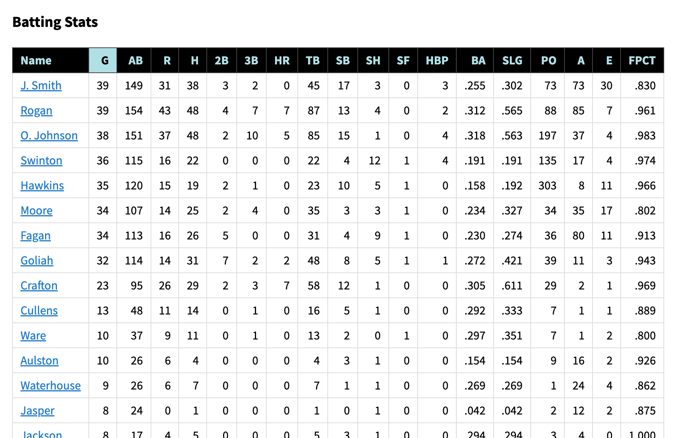

Slide 22
1917 Season
27-6 Record
Rogan on furlough 3/1 to 7/15
William “Big C” Johnson joins team

Slide 23
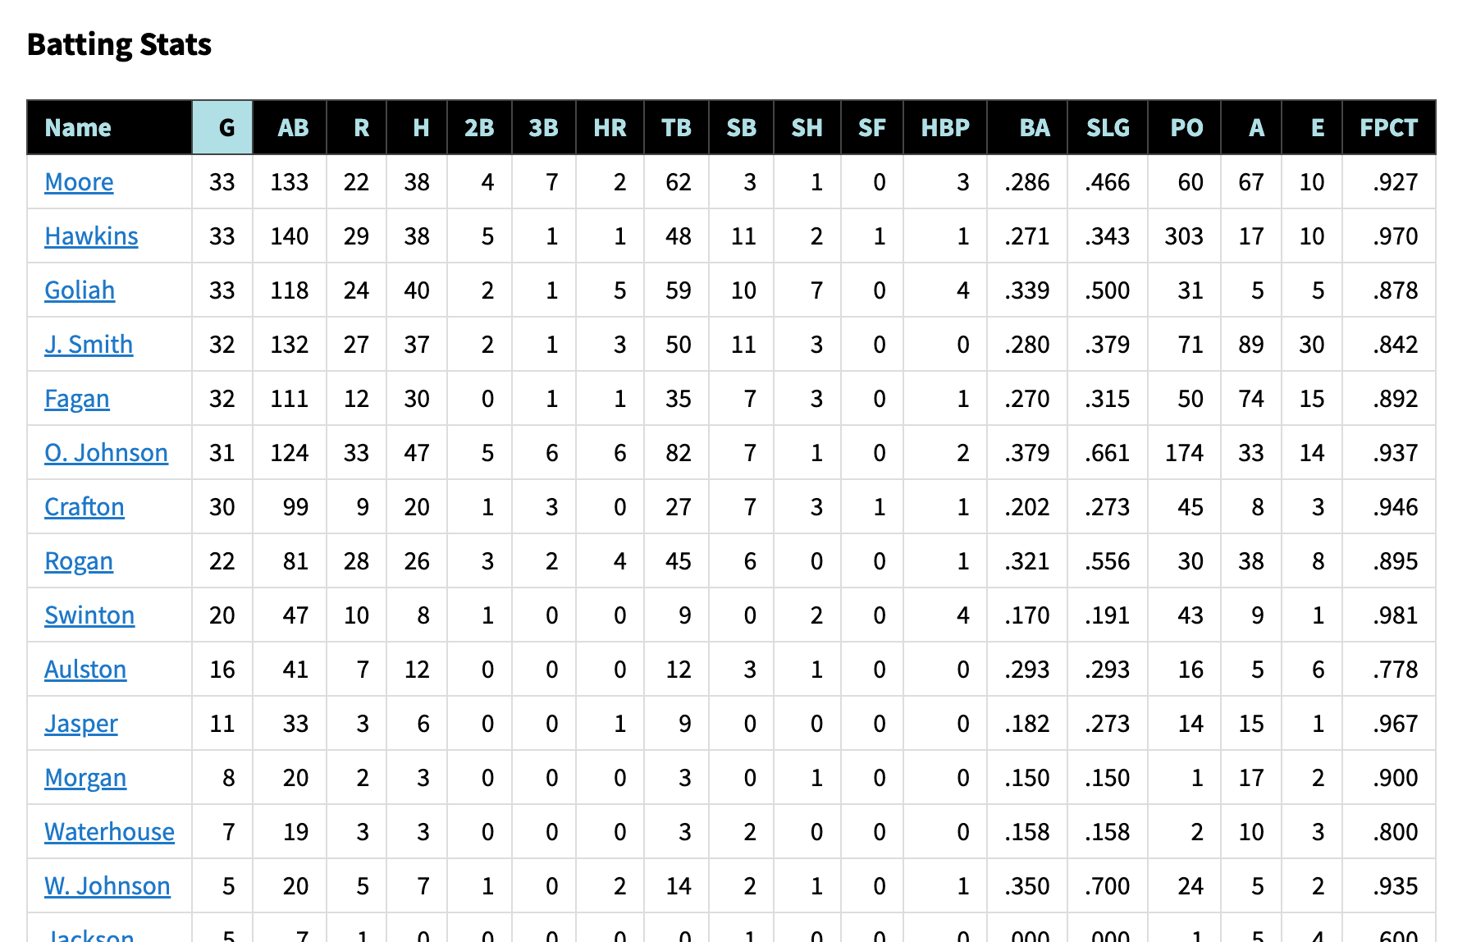

Slide 24
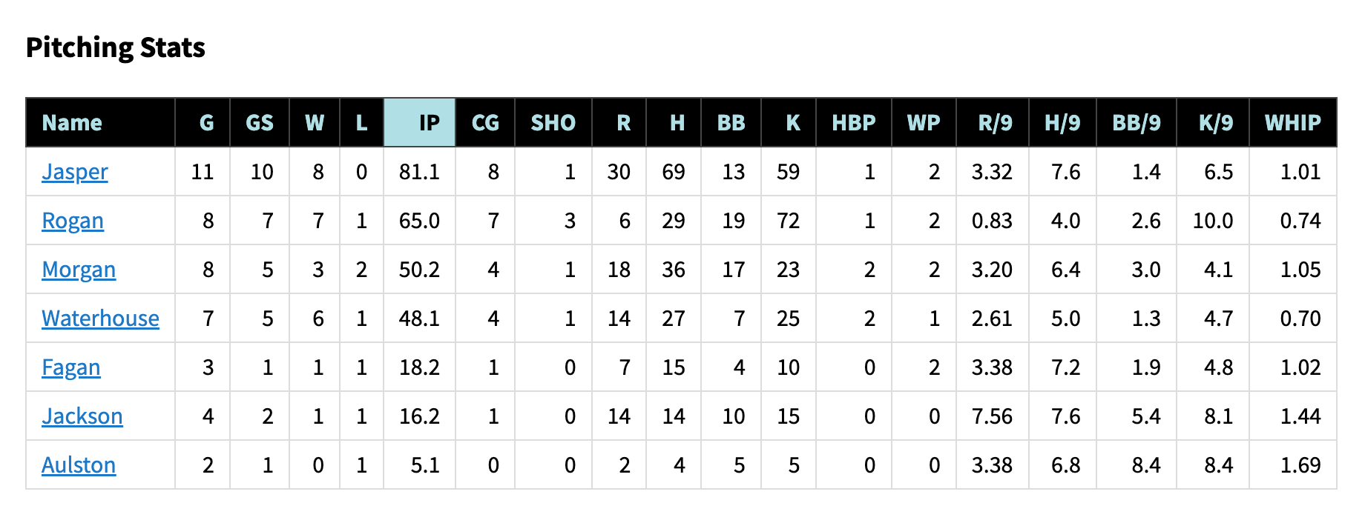

Slide 25
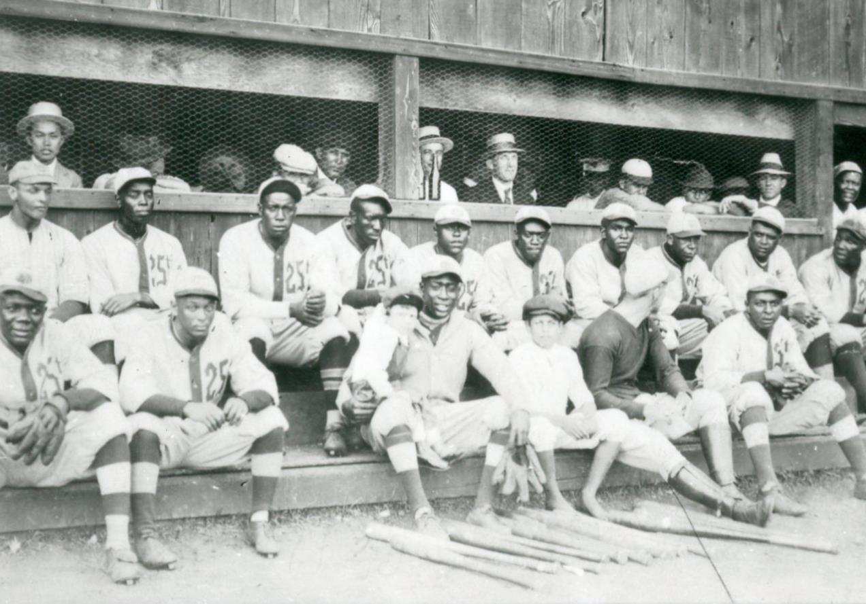
1918 Season
14-1 Record
Only loss was to Junior Wreckers
August 11: Final Game
August 27: Battle of Ambos Nogales
August 30: Began arriving in Arizona

Slide 26
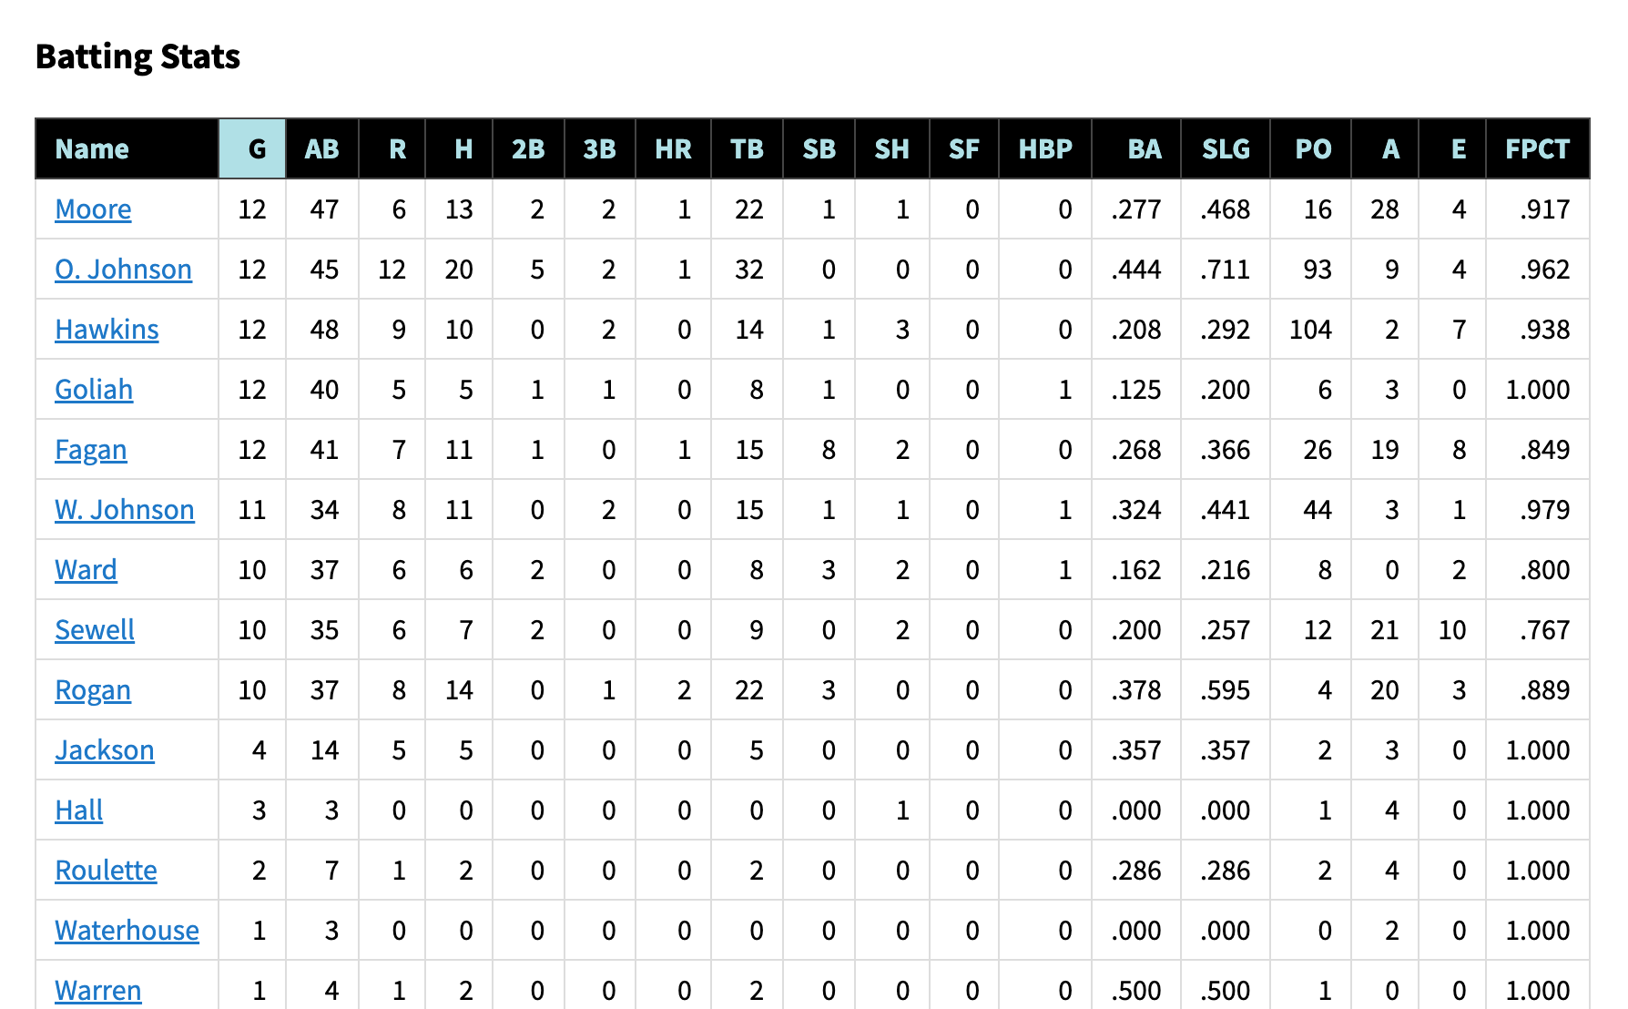

Slide 28
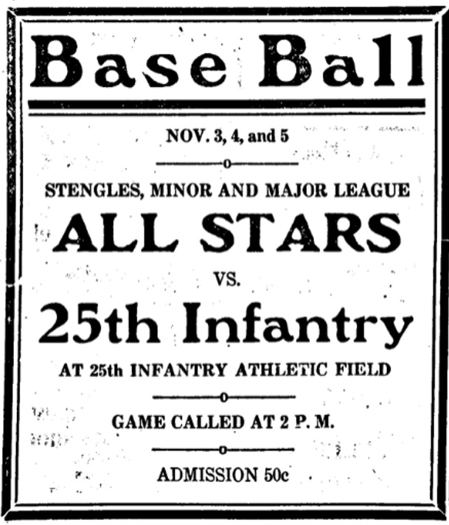
1919 Season
10-3 Record
In Nogales, Arizona
Very few scores published
No box scores
5 Games against Casey Stengel All-Stars

Slide 29
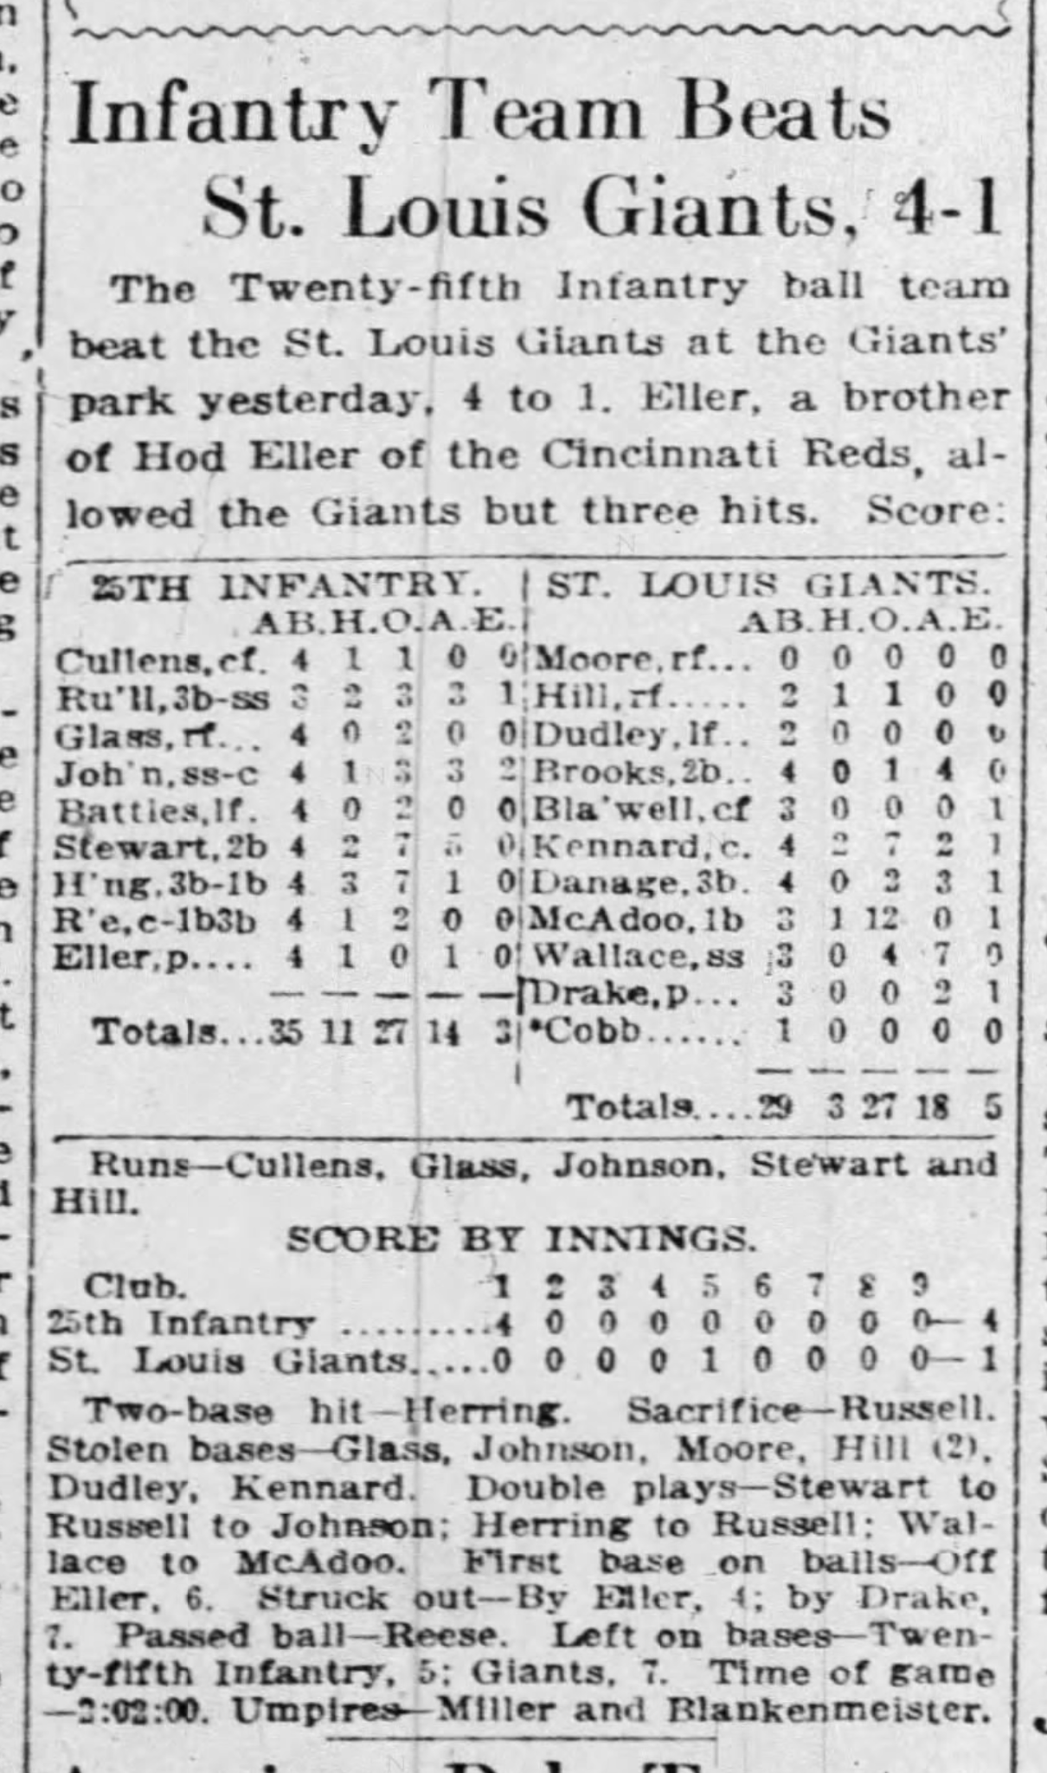
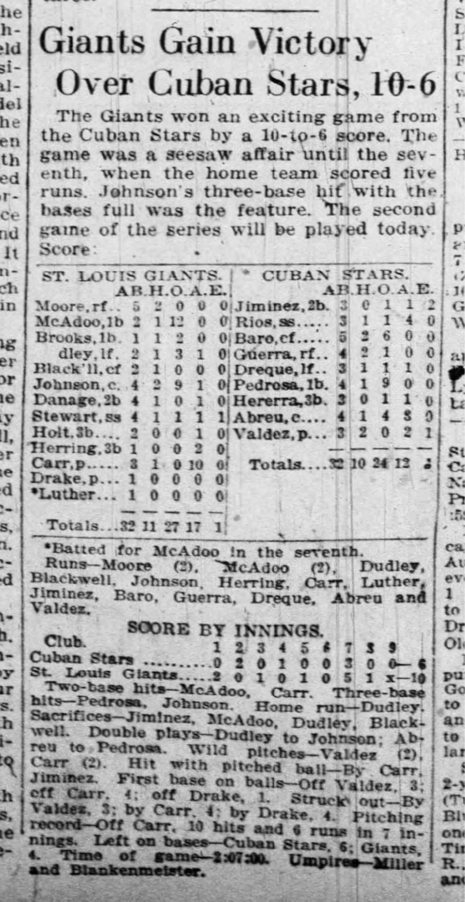
1920 Season
Hardly any scores found
One box score against Negro National League’s St. Louis Giants

Slide 30
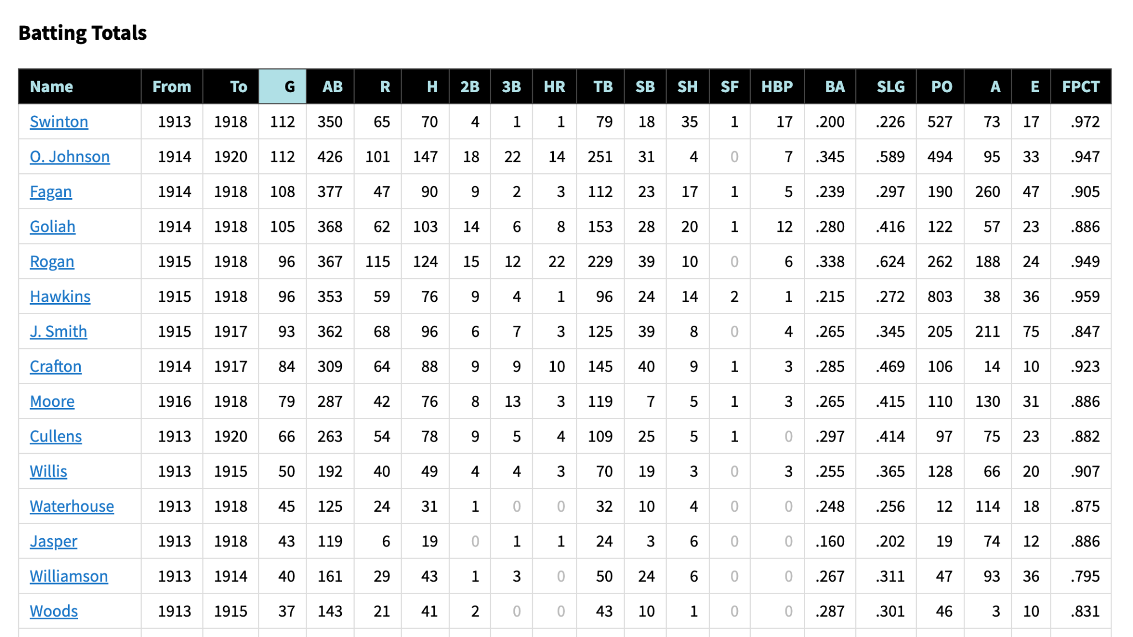

Slide 31
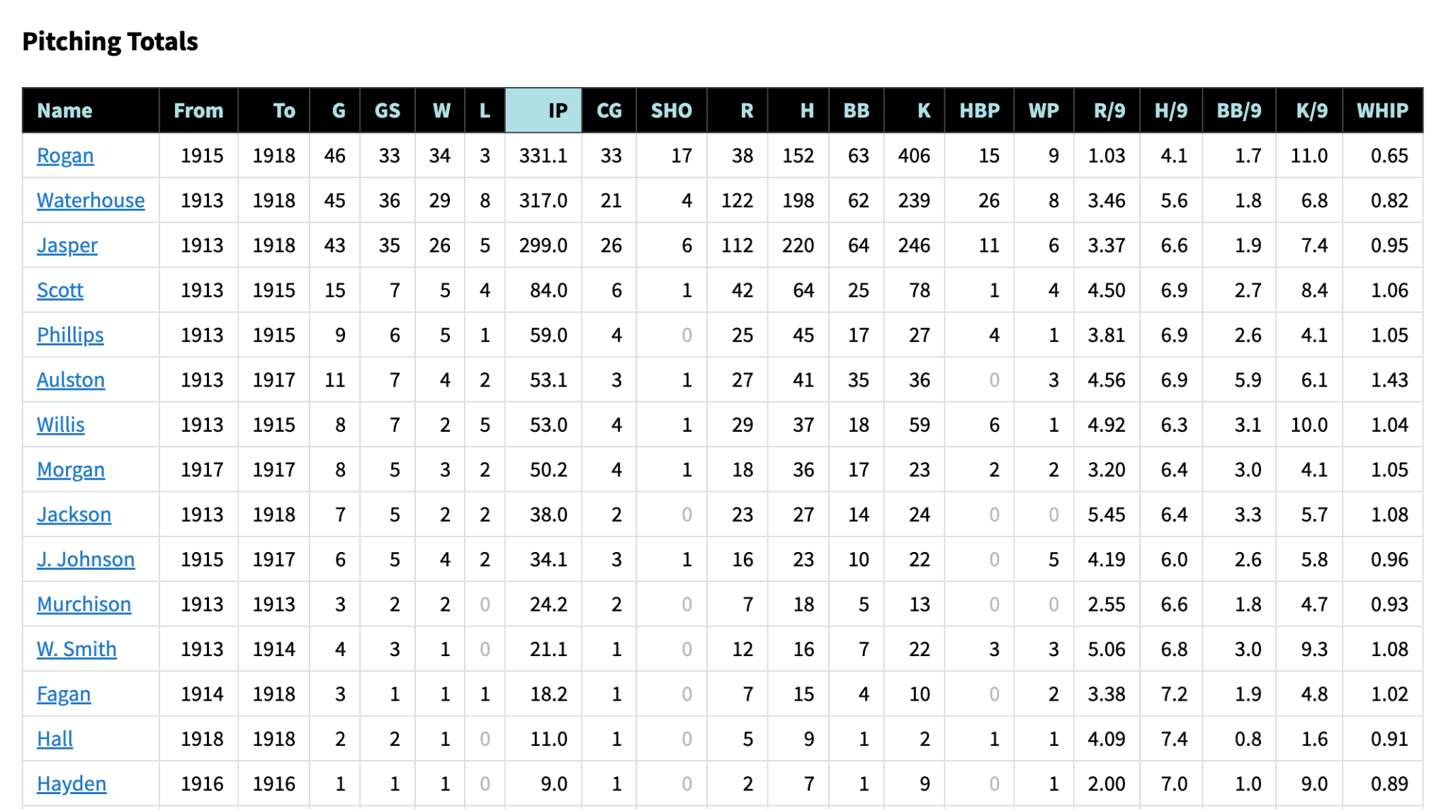
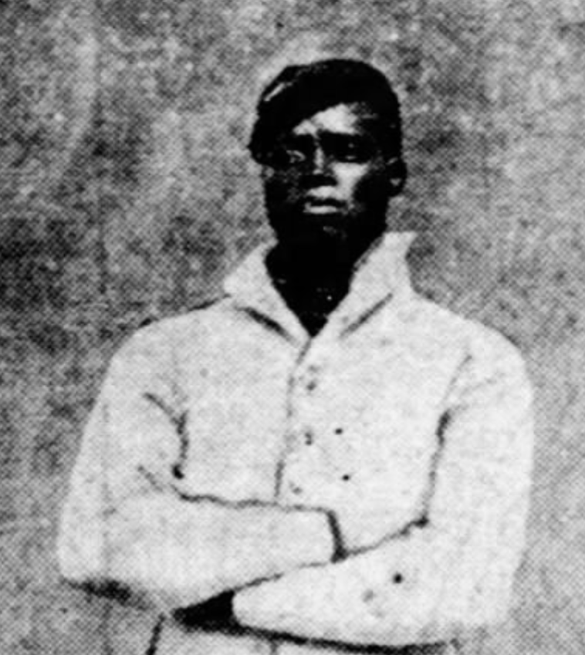
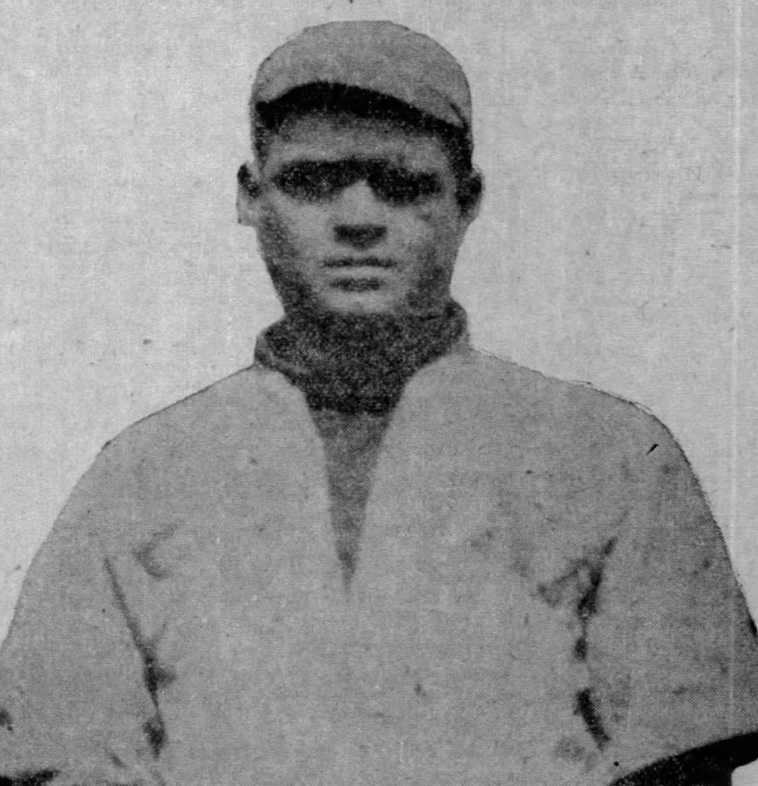

Slide 32
Negro Major Leaguers
Bullet Rogan: 13 seasons (1920-29, 1937-38)
Heavy Johnson: 11 seasons (1920, 1922-28, 1930-32)
Branch Russell: 11 seasons (1922-32)
Lemuel Hawkins: 8 seasons (1921-28) COG 1921
Dobie Moore: 7 seasons (1920-26)

Slide 33
Negro Major Leaguers
Carl Glass: 7 seasons (1924-30) CAG 1930
Pinky Ward: 7 seasons (1924-25, 1927-29, 1931-32) CAG 1924
William Johnson: 6 seasons (1920, 1924-28)
Army Cooper: 4 seasons (1928-30, 1932)
Stewart: 3 seasons (1920, 1924, 1940) CAG 1924
Bob Fagan: 2 seasons (1921, 1923)

Slide 34
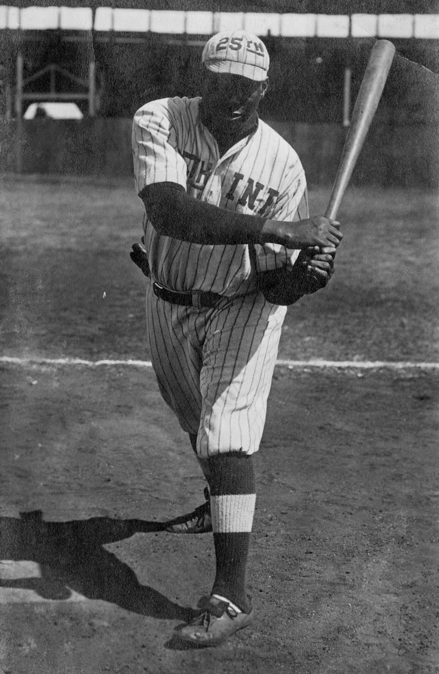
Negro Major Leaguers
Mose Herring: 1 season (1920)
William Linder: 1 season (1922)
Fred Goliah: 1 season (1920) COG 1920
But also 1909 Illinois Giants, 1911 Chicago American Giants, 1911 Chicago Leland Giants

Slide 35
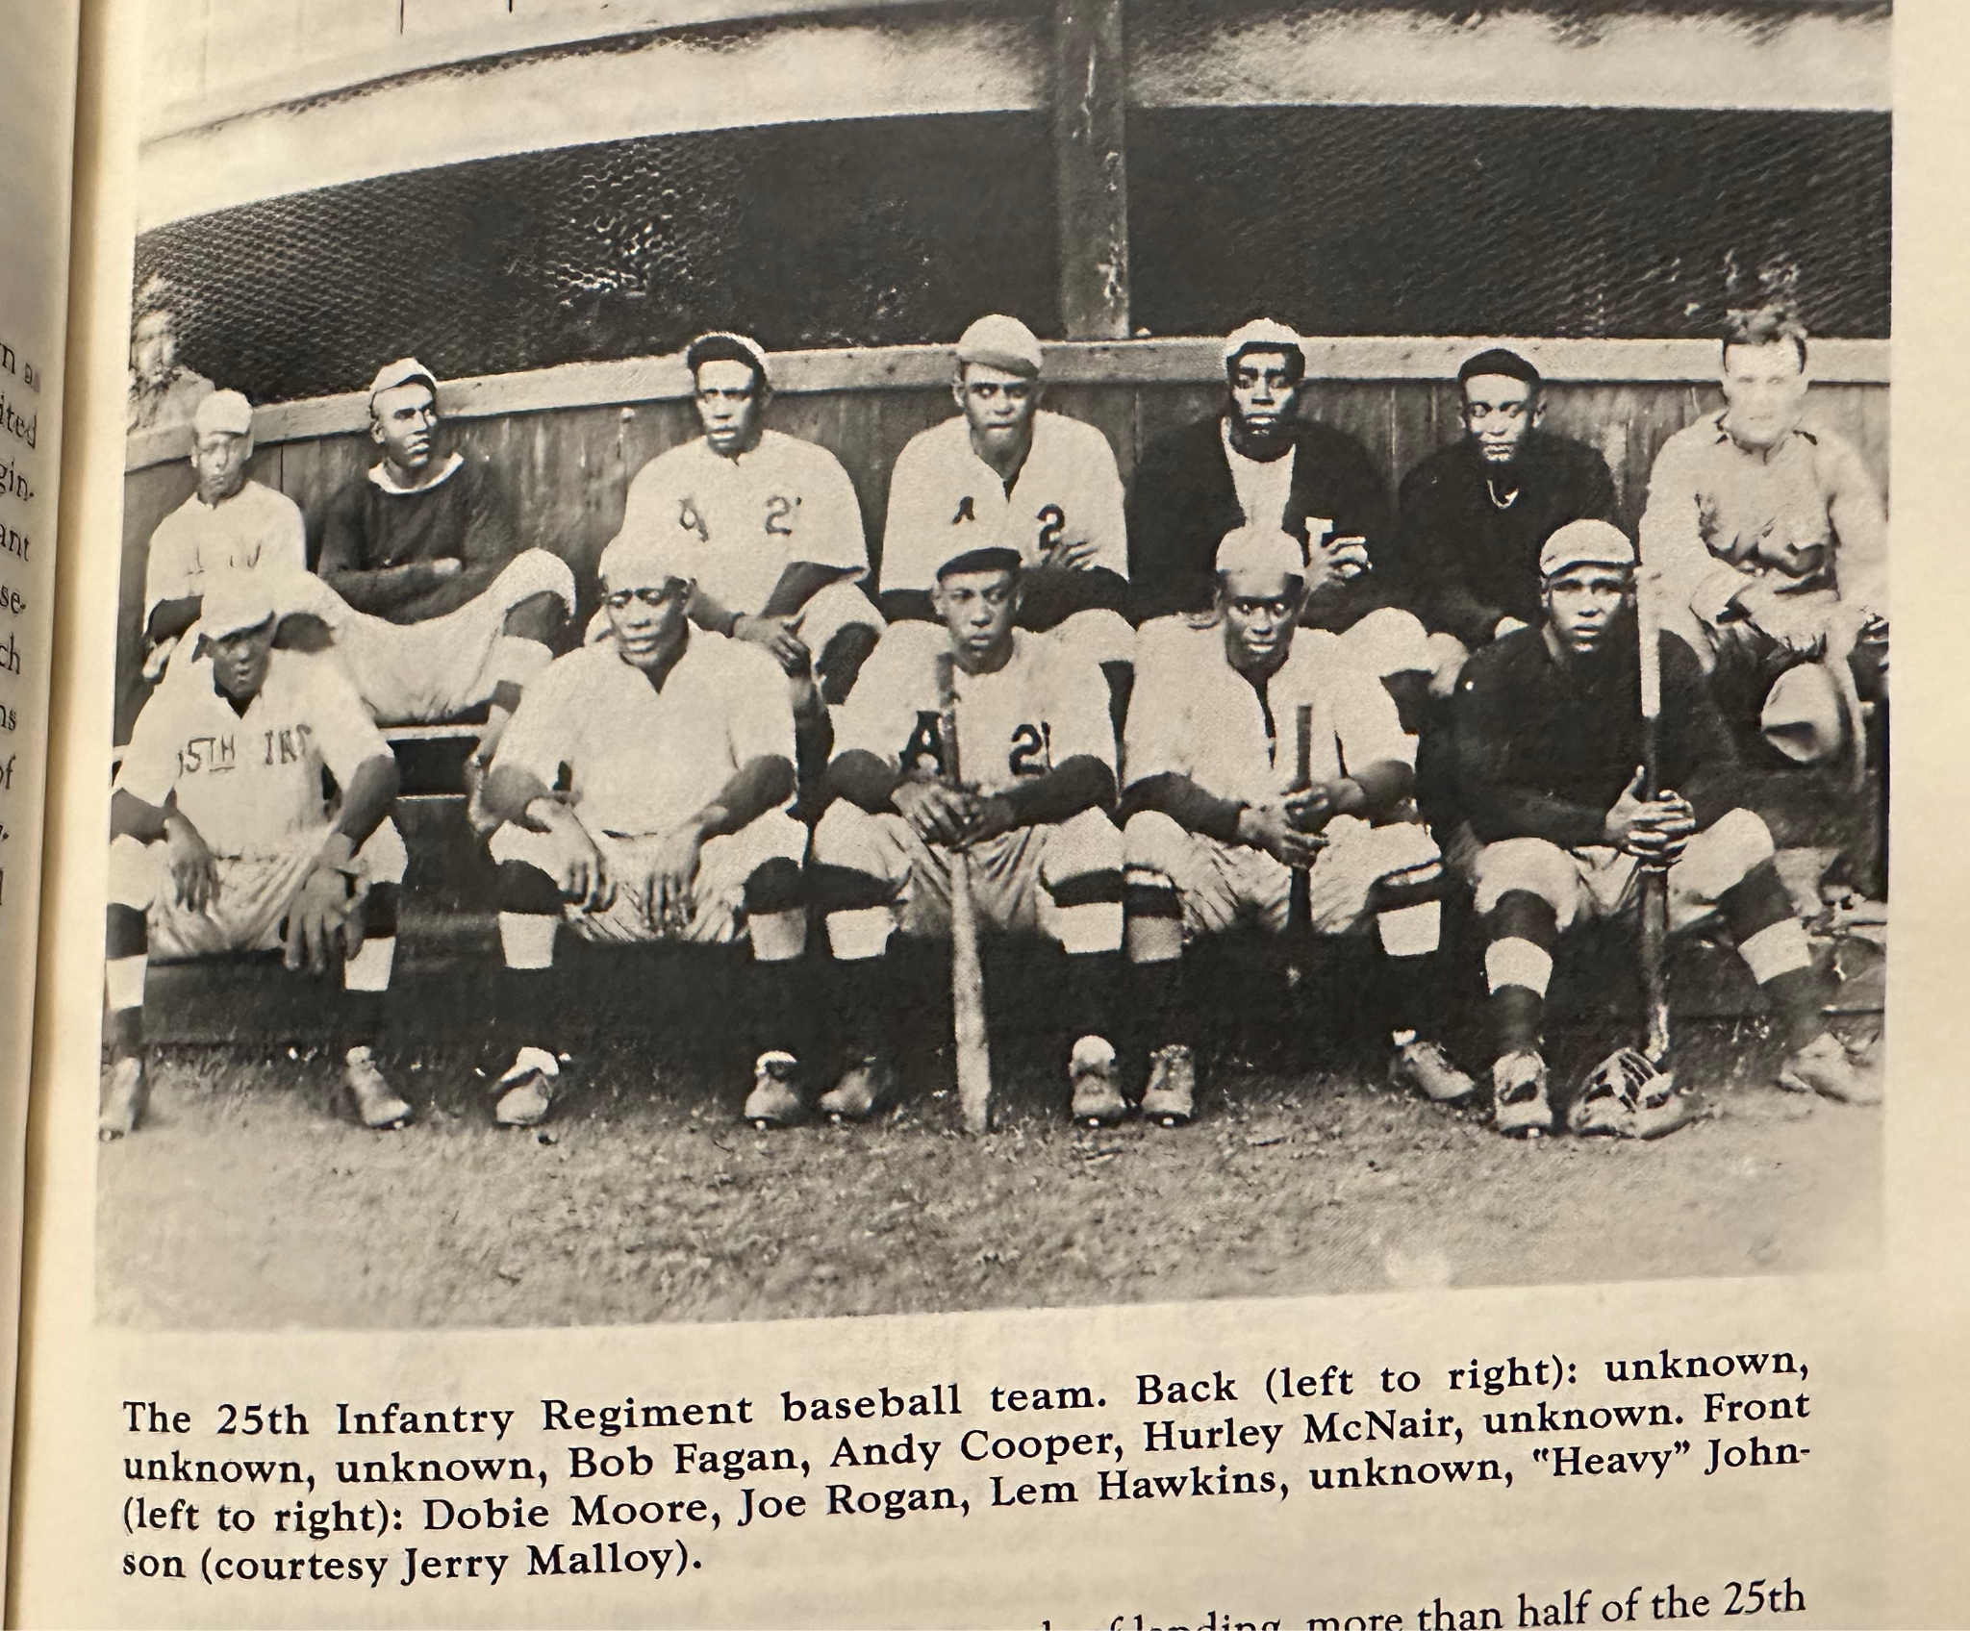
Not Members of the 25th Infantry
Andy Cooper
Hurley McNair

Slide 36
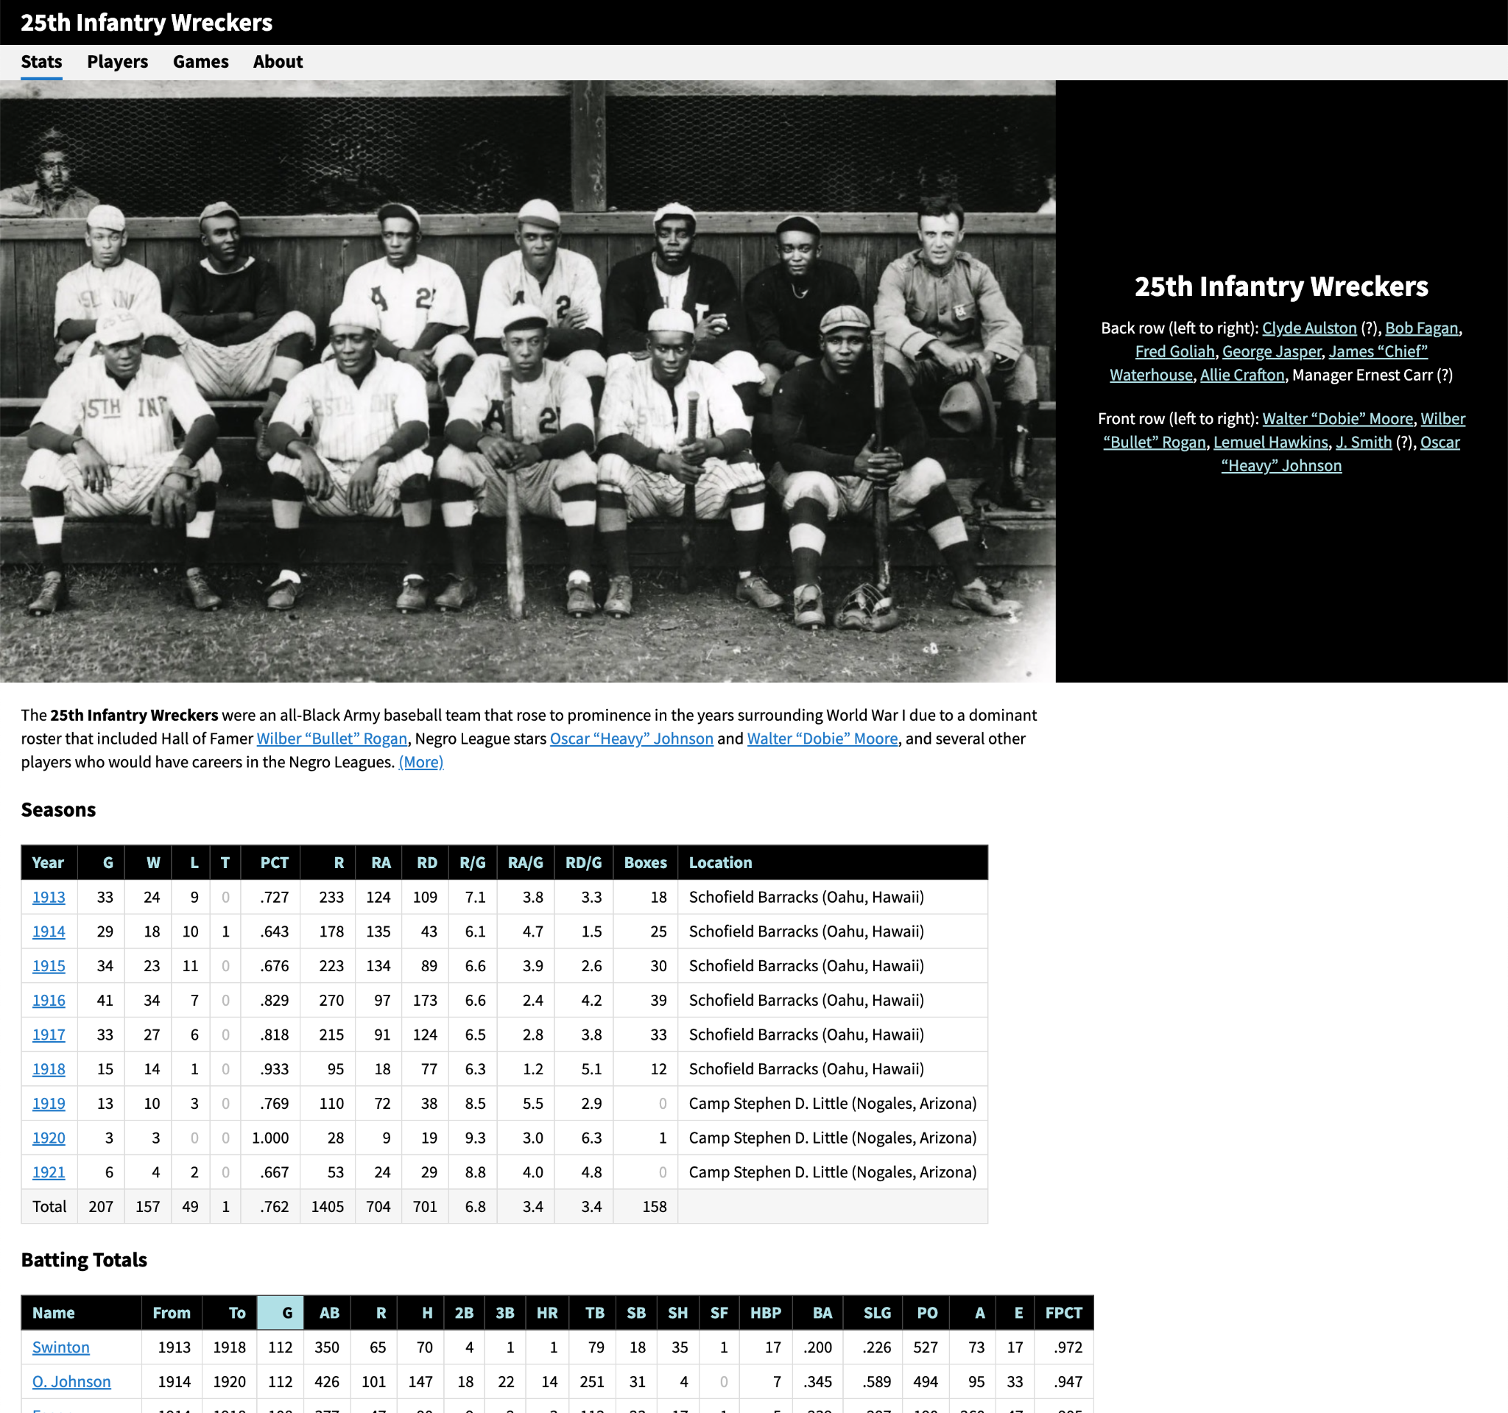
Thank You.
Adam Darowski Product Director Sports Reference ad@sports-reference.com @baseballtwit
darowski.com/wreckers
Thank you to the Fort Huachuca Museum, Stephen Gregory, Bill Staples Jr., Scott Simkus, Gary Ashwill, Kevin Johnson, Jacek Bonneville, and everyone else who has taken an interest in this project.

