Slide 1
Behavioral Biases in Daily Fantasy Baseball: The Case of the Hot Hand
Jeremy M. Losak (jmlosak@syr.edu)
Rodney J. Paul (rpaul01@syr.edu)
Syracuse University
Andrew P. Weinbach (aweinbac@coastal.edu)
Coastal Carolina University

Slide 2
Where We Are: The Hot Hand
“The hot hand is a massive and widespread cognitive illusion.” (Kahneman – Nobel Prize winner. Thinking Fast and Slow, 2011)
Where We Are Part 1: You need A LOT of data to break through the noise in sport data!
Where We Are Part 2: The hot hand question is still in debate
Green & Zwiebel (2018) find evidence of a “hot hand” (“short term predictability in performance”) in batting performance in MLB. Pitchers appear to respond, finding a pitching response to “hot opponents.”
When pitchers face batters with particularly high percentages of HRs or XBHs in recent games, they are more likely to be walked.

Slide 3
Is the hot hand present in DFS scoring?
Is the hot hand efficiently priced in DFS prices?
How do people respond to the hot hand?

Slide 4
The Hot Hand and Market Efficiency
Semi-strong form market efficiency is tested (all current and past information incorporated into player prices)
Market efficiency and hot hand:
If there is a hot hand: Is hot hand properly priced into current day prices?
If there is not a hot hand: Is hot hand correctly left out of current day prices?
Addressed in our previous work for other sports:
Paul, R., Weinbach, A., & Losak, J. (2020). Market Efficiency and the Setting of Salaries for NBA Daily Fantasy on Fanduel and Draft Kings. Journal of Prediction Markets, 14(2), 45–60.
Losak, J. (2021). Player Pricing Mechanisms and the Daily Fantasy Sport Chance Versus Skill Debate. International Journal of Sport Finance, 16(4), 204–220.

Slide 5
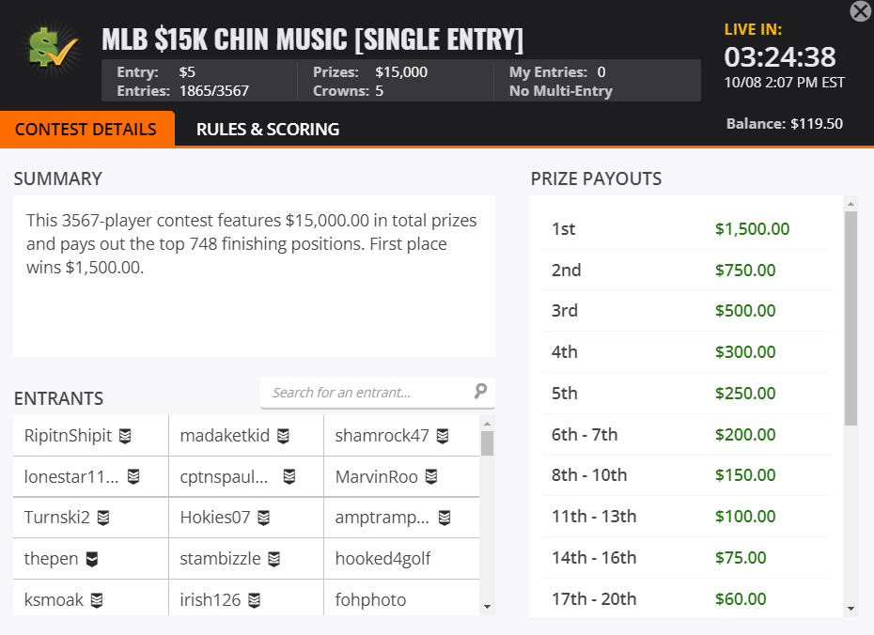
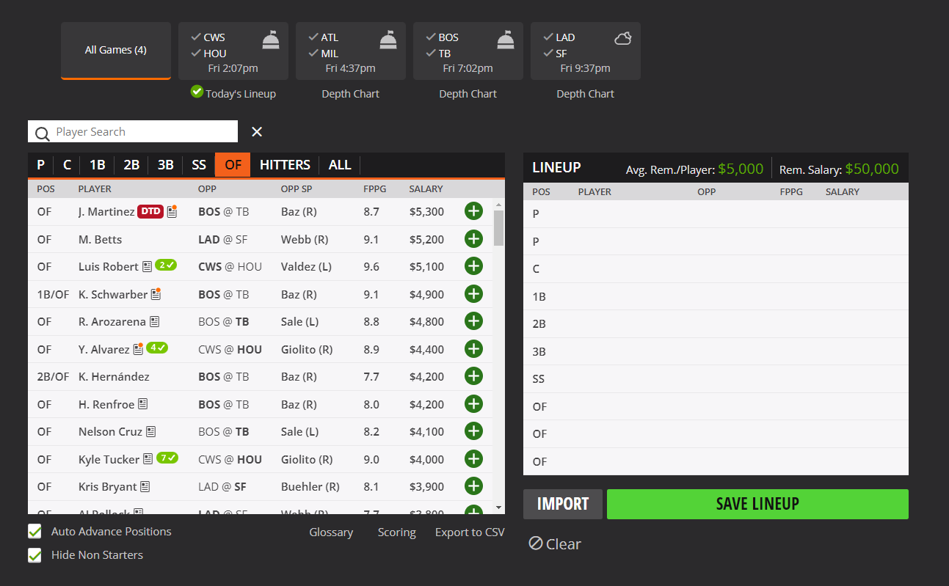
Rotogrinders.com/resultsdb (11,675 player-game obs)
We utilize 1 contest type from the 2019 MLB season:
Entries: 2,379 entries
# of contests: 80 contests (all on unique days)
We only consider hitters (exclude pitchers) that are in the starting lineup (exclude non-starters)
Data includes player usage percentage by contest and player points
Retrosheet game logs
Chadwick Baseball Bureau Register
Betting odds (implied run totals) from Sportbook Reviews

Slide 6
Scoring Categories
Single (1B) | +3 Pts | Run Batted In (RBI) | +2 Pts
Double (2B) | +5 Pts | Run (R) | +2 Pts
Triple (3B) | +8 Pts | Base on Balls (BB) | +2 Pts
Home Run (HR) | +10 Pts | Hit By Pitch (HBP) | +2 Pts
 |  | Stolen Base (SB) | +5 Pts
Salary/Pricing Summary By Position
Position | N | Mean | Min | First Qtile | Median | Third Qtile | Maximum
Catcher | 1,418 | 3,491 | 2,000 | 3,000 | 3,500 | 3,900 | 5,800
First Base | 1,226 | 4,133 | 2,100 | 3,700 | 4,100 | 4,600 | 5,800
Second Base | 870 | 3,683 | 2,000 | 3,200 | 3,650 | 4,100 | 5,500
Third Base | 886 | 4,171 | 2,000 | 3,700 | 4,200 | 4,700 | 5,800
Shortstop | 1,127 | 4,082 | 2,000 | 3,500 | 4,100 | 4,700 | 5,900
Outfield | 3,814 | 4,110 | 2,000 | 3,700 | 4,100 | 4,600 | 6,000

Slide 7
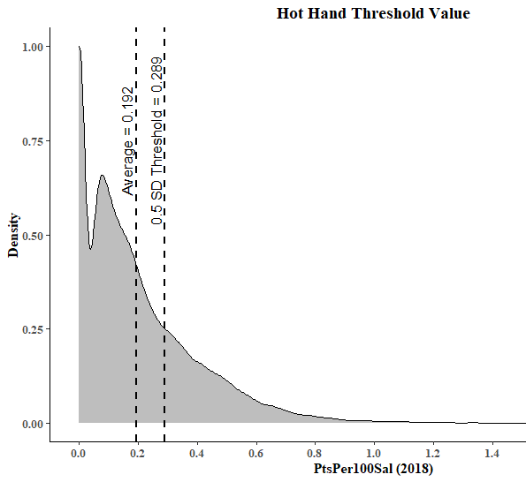
Defining The Hot Hand
Hot, not hot, or not qualified
To qualify, player must have started at least six games over previous 30 days
(Spec #1) A player is “hot” if his last six-start PtsPer100Sal average exceeds the threshold
(9.2% are hot, 83.6% not hot, 7.1% not qualified)
(Spec #2) A player is “hot” based on a continuous measure rather than binary measure
(Spec #3) A player needs three starts in the last 15 days to qualify; a player is “hot” if his last three-start PtsPer100Sal average exceeds the threshold
(16.4% are hot, 78.9% not hot, 4.7% not qualified)

Slide 8
Binary Variables
Home |  | Offhand Matchup |  | Switch Hitter
Home | Away | L/R or R/L | L/L or R/R | Yes | No
5,830 (50.1%) | 5,845 (49.9%) | 6,759 (57.9%) | 4,916 (42.1%) | 1,537 (13.2%) | 10,138 (86.8%)
Quantitative Variables
 |  | Mean | SD | Min | Max
Implied Runs |  | 4.675 | 1.244 | 1.470 | 9.208
Positional Options |  | 1.202 | 0.343 | 0.308 | 1.849
Defensive Position
Catcher | First Base | Second Base | Third Base | Shortstop | Outfield
1,484 (12.7%) | 2,026 (17.4%) | 1,997 (17.1%) | 1,958 (16.8%) | 1,705 (14.6%) | 4,839 (41.4%)
Lineup Spot
Lineup – 1st | Lineup – 2nd | Lineup – 3rd | Lineup – 4th | Lineup – 5th
1,332 (11.4%) | 1,381 (11.8%) | 1,393 (11.9%) | 1,394 (11.9%) | 1,393 (11.9%)
Lineup – 6th | Lineup – 7th | Lineup – 8th | Lineup – 9th
1,369 (11.7%) | 1,360 (11.6%) | 1,328 (11.4%) | 725 (6.2%)

Slide 9
Is the hot hand present in DFS scoring?
 | ${PtsPer100Sal}_{i,t}=β_{0}+β_{1}{Hot}_{i,t}+β_{2}{NotQualified}_{i,t}+β_{3}{Handed}_{i,t} + β_{4}{SwitchHitter}_{i,t}+β_{5}{ImpliedRuns}_{i,t}+β_{6}{Home}_{i,t}+β_{7}{PositionalOptions}_{i,t} + \sum_{pos}{β_{8,pos}{Position}_{i,t}}+\sum_{spot}{β_{9,spot}{Lineup}_{i,t}}+ϵ_{i,t}$
$${PtsPer100Sal}_{i,t}=\frac{{DKPoints}_{i,t}}{{{DKSalary}_{i,t}}/{100}}$$

Slide 10
Is Hot Hand Apparent in MLB DFS Scoring? (${Y_{i,t}=PtsPer100Sal}_{i,t}$)
Variable | Coefficient | Std Err | Coefficient | Std Err | Coefficient | Std Err
Constant | 0.176*** | 0.012 | 0.186*** | 0.014 | 0.174*** | 0.012
Hot Hand (6-Gm Binary) | -0.009 | 0.006
Hot Hand (6-Gm Continuous) |  |  | -0.058** | 0.026
Hot Hand (3-Gm Binary) |  |  |  |  | 0.003 | 0.005
Less Active/Not Qualified | -0.002 | 0.008 | -0.004 | 0.008 | 0.002 | 0.010
Offhand | 0.017*** | 0.004 | 0.017*** | 0.004 | 0.017*** | 0.004
Switch Hitter | -0.010* | 0.006 | -0.010* | 0.006 | -0.010* | 0.006
Home Team | -0.007* | 0.004 | -0.007* | 0.004 | -0.007* | 0.004
Implied Runs | 0.008*** | 0.002 | 0.008*** | 0.002 | 0.008*** | 0.002
Positional Options | -0.014*** | 0.005 | -0.014*** | 0.005 | -0.014*** | 0.005
Other Variables | Position, Lineup Spot |  | Position, Lineup Spot |  | Position, Lineup Spot
F Statistic | 3.4012*** |  | 3.4793*** |  | 3.2797***
$$R^{2}$$ | 0.006 |  | 0.006 |  | 0.006
There is no evidence that playing the hot hand improves expected scoring

Slide 11
Is the hot hand efficiently priced in DFS prices?
 | ${Pts}_{i,t}=γ_{0}+γ_{1}{Salary}_{i,t}+γ_{2}{Hot}_{i,t}+γ_{3}{NotQualified}_{i,t}+γ_{4}{Handed}_{i,t} + γ_{5}{SwitchHitter}_{i,t}+γ_{6}{ImpliedRuns}_{i,t}+γ_{7}{Home}_{i,t}+γ_{8}{PositionalOptions}_{i,t} + \sum_{pos}{γ_{9,pos}{Position}_{i,t}}+\sum_{spot}{γ_{10,spot}{Lineup}_{i,t}}+ε_{i,t}$.

Slide 12
Is Hot Hand Efficiently Priced in MLB DFS Pricing? (${Y_{i,t}=Points}_{i,t}$)
Variable | Coefficient | Std Err | Coefficient | Std Err | Coefficient | Std Err
Constant | 2.931*** | 0.644 | 3.096*** | 0.666 | 2.856*** | 0.641
Salary (/100) | 0.078*** | 0.014 | 0.080*** | 0.014 | 0.079*** | 0.013
Hot Hand (6-Gm Binary) | -0.221 | 0.248
Hot Hand (6-Gm Continuous) |  |  | -1.120 | 1.043
Hot Hand (3-Gm Binary) |  |  |  |  | 0.118 | 0.194
Less Active/Not Qualified | -0.363 | 0.260 | -0.393 | 0.263 | -0.311 | 0.324
Offhand | 0.497*** | 0.154 | 0.496*** | 0.154 | 0.498*** | 0.154
Switch Hitter | -0.239 | 0.228 | -0.238 | 0.228 | -0.238 | 0.228
Home Team | -0.432*** | 0.147 | -0.432*** | 0.147 | -0.432*** | 0.147
Implied Runs | 0.575*** | 0.068 | 0.572*** | 0.068 | 0.578*** | 0.068
Positional Options | -0.556*** | 0.207 | -0.555*** | 0.207 | -0.543*** | 0.207
Other Variables | Position, Lineup Spot |  | Position, Lineup Spot |  | Position, Lineup Spot
F Statistic | 20.683*** |  | 20.625*** |  | 20.525***
$$R^{2}$$ | 0.036 |  | 0.036 |  | 0.036
Batting Order | Coef (HH6GB) | Std Err | Std Err
1 | Excluded Category
2 | 0.175 | 0.301
3 | 0.421 | 0.324
4 | 0.067 | 0.312
5 | -0.374 | 0.309
6 | -0.717** | 0.302
7 | -1.164*** | 0.307
8 | -1.114*** | 0.325
9 | -1.762*** | 0.357
Since being “hot” does not increase expected point production, DK does not include that information in its pricing

Slide 13
How do people respond to the hot hand?
 | $ln\left({Field}_{i,t}\right)=δ_{0}+δ_{1}{Salary}_{i,t}+δ_{2}{Hot}_{i,t}+δ_{3}{NotQualified}_{i,t}+δ_{4}{Handed}_{i,t} + δ_{5}{SwitchHitter}_{i,t}+δ_{6}{ImpliedRuns}_{i,t}+δ_{7}{Home}_{i,t}+δ_{8}{PositionalOptions}_{i,t} + \sum_{pos}{δ_{9,pos}{Position}_{i,t}}+\sum_{spot}{δ_{10,spot}{Lineup}_{i,t}}+φ_{i,t}$

Slide 14
How Do People Respond to Hot Hand? (${Y_{i,t}=lnField}_{i,t}$)
Variable | Coefficient | Std Err | Coefficient | Std Err | Coefficient | Std Err
Constant | 1.313*** | 0.077 | 1.068*** | 0.079 | 1.280*** | 0.077
Salary (/100) | -0.035*** | 0.002 | -0.037*** | 0.002 | -0.035*** | 0.002
Hot Hand (6-Gm Binary) | 0.346*** | 0.027
Hot Hand (6-Gm Continuous) |  |  | 1.677*** | 0.115
Hot Hand (3-Gm Binary) |  |  |  |  | 0.329*** | 0.022
Less Active/Not Qualified | -0.138*** | 0.037 | -0.094** | 0.037 | -0.222*** | 0.046
Offhand | 0.353*** | 0.018 | 0.355*** | 0.018 | 0.359*** | 0.018
Switch Hitter | -0.232*** | 0.025 | -0.234*** | 0.025 | -0.235*** | 0.025
Home Team | -0.182*** | 0.017 | -0.182*** | 0.017 | -0.180*** | 0.017
Implied Runs | 0.570*** | 0.008 | 0.573*** | 0.008 | 0.566*** | 0.008
Positional Options | -0.935*** | 0.024 | -0.937*** | 0.024 | -0.929*** | 0.024
Other Variables | Position, Lineup Spot |  | Position, Lineup Spot |  | Position, Lineup Spot
F Statistic | 514.14*** |  | 519.78*** |  | 530.21***
$$R^{2}$$ | 0.490 |  | 0.492 |  | 0.494
Variable | Marginal Effect (HH6GB)
Hot Hand (=1) | +41.3%
Less Active (=1) | -12.9%
Offhand (=1) | +42.3%
Offhand - Switch (=1) | +12.9%
Home (=1) | -16.6%
Implied Runs (+1.2, 1 SD) | +103.2%
The response from consumers is much greater than what would be reasonably expected even if a minor hot hand effect exists (especially compared to other identified inefficiencies)

Slide 15
Takeaways
Mixed evidence of negative hot hand in our data!
Regression to the mean?
Overcorrection on DFS pricing?
No evidence of mispricing of hot hand
There is value (inefficiencies) in: taking offhand, away hitters (guaranteed to bat in 9th inning?), higher implied run totals, and players towards the top of the batting order
We are agnostic towards the cause of market inefficiency
Heavy DFS participant response to hot hand
A “hot” player has usage increase of 41.3%
Participants heavily believe in the hot hand even if the strategic benefits are non-existent/marginal

