Slide 1
Statcast and The Value of Defense- An Initial Metric
By Jonathan Dine

Slide 2
‘Webgems’—What Are They Worth?
At the wall:
Infield Defense:
This presentation will explore how we can use Statcast to value these plays.

Slide 3
Advanced Defensive Metrics— Current State
DRS and UZR
Both use BIS Data.
Both have the same idea- break down balls in play by type, location, velocity.
Both are measured on an above/below average scale.
Both have runs saved systems with components for GDP, OF Arms, Range.

Slide 4
Advanced Defensive Metrics— Current State Problems
DRS and UZR
Both use BIS Data –From Fangraphs:
“ This data is compiled by human scorers, which means that it likely includes some human error. Until Statcast data gets released to the public, we are never going to have wholly accurate defensive data
DRS and UZR usually rate players within 2 runs of one another—but there can be large differences in how they rate players

Slide 5
Statcast
Statcast through its on the field radar technology and tracking the launch angle and exit velocity:
Expected Batting Average (xBA)
Expected wOBA: every batted ball has been given a single, double, triple and home run probability based on the results of comparable batted balls
wOBA=Statcast probabilities and metric translated into runs
Notes:
xwOBA is a valued in the same fashion as the formula for standard wOBA

Slide 6
Current Research Attempts With Statcast- Importance of the Outfield
Casey Boguslaw (Hardball Times)
Why did the Royals keep winning despite below average starting pitching and hitting?
Outfield UZR: “When playoff baseball began, even the best offenses in the league couldn’t find open space to land their line drives. The Royals had successfully embodied an adage most typically applied to other sports: Defense can win championships
Notes:
2013,2014, 2015 Royals 1st,1st, and 2nd UZR in all of baseball Cubs defense 2016
“line drives, hitters had a remarkable .684 batting average. If teams are able to lower that latter number, the results could be monumental. The Royals and Cubs took strides in achieving that goal, and now other teams are starting to do the same.

Slide 7
Current Research Attempts With Statcast- Catch Probability
Catch Probability
Likelihood that a batted ball to the outfield will be caught:
distance traveled
hang time of batted ball
Accounts for fielding direction (As of May)
Not available for infielders
Inaccurate tracking for plays at the wall
Not Accounting for Runs Prevented/Value if fell for a hit
Notes:
.Catch Probability has a few issues besides ones listed here. Unclear how opportunity is tracked for leaderboard and data is not released on the aggregate so can’t normalize

Slide 8
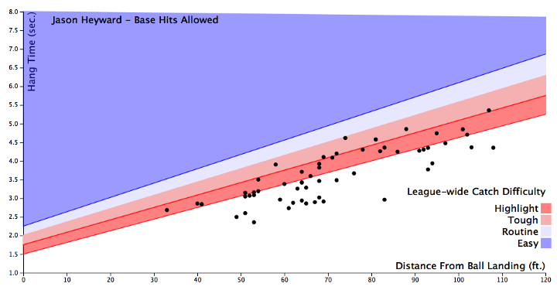
Current Research Attempts With Statcast- Defensive Spray Chart
Spray Charts
Visualize Base Hits allowed based on catch probability
No Metric For value/impact
Notes:
.Catch Probability has a few issues besides ones listed here. Unclear how opportunity is tracked for leaderboard and data is not released on the aggregate

Slide 9
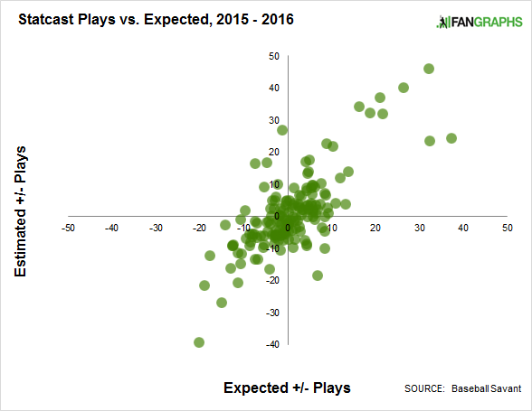
Current Research Attempts With Statcast— Catch Probability vs DRS/UZR
Via Jeff Sullivan
Notes:
Linear relationship between expected +/- from Statcast (based on opportunities and catches) and URS/DZR there are outliers and get closer to understand statcast in terms o f value of defense and where it can improve on current advanced metrics
Underrated:
Adam Eaton
Adam Jones
Leonys Martin
Jake Marisnick
Lorenzo Cain
And overrated
Nick Markakis
Matt Kemp
Kole Calhoun
Bryce Harper
Curtis Granderson

Slide 10
New Metric- Statcast Defensive Runs Saved (Webgems)
Expected Batting Average (xBA)
All plays from 2015 through 26 June 17 where xBA is .684 and above
.684 is batting average of line drives* from 2016
Dataset includes all outs
Sacrifice out
Double play
Force out
Dataset includes all types of hits
Does not include quality of contact descriptor
Adding expected wOBA values together from catches provides metric for runs prevented by play made
Notes:
Players who made the initial catch has to be extracted from baseball savant not provided in a column from MLB!
wOBA better than RE24 as takes into account more information including value of an out

Slide 11
New Metric- Statcast Defensive Runs Saved Shape of Dataset
Number of Players in dataset (from 1 catch to 88 catches)— 567 unique players
Infielders: 323
Outfielders: 308
Players have multiple positions
If player has played multiple positions in infield or outfield, out is awarded based on position at time of catch
Number of catches by Year:
2015: 2,884
2016: 2,993
2017: 1,391

Slide 12
Leaderboard in Statcast Defensive Runs Saved…
2015 | 2016 | 2017 | Total
Kevin Kiermaier (49.89) | Kevin Pillar (39.95) | Byron Buxton (27.50) | Kevin Kiermaier (89.09)
Lorenzo Cain (43.65) | Mike Trout (38.15) | Adam Jones (25.40) | Kevin Pillar (83.718)
Billy Burns (33.30) | Jackie Bradley (34.68) | Jackie Bradley (16.31) | Mike Trout (81.29)
Odubel Herrera (33.29) | Jacoby Ellsbury (33.35) | Jacoby Ellsbury(16.17) | Lorenzo Cain (80.45)
Mike Trout (32.3) | Kevin Kiermaier (28.09) | Kevin Pillar (16.07) | Jacoby Ellsbury (75.45)
A. J. Pollock (30.24) | Cameron Maybin (27.65) | Ender Inciarte (15.80) | Odubel Herrera (75.14)
Anthony Gose (29.72) | Leonys Martin (27.60) | Carlos Gomez (15.08) | Adam Jones (74.43)
Median For All Players: 3.71 | Median For All Players: 4.36 | Median For All Players: 2.58 | Median For All Players: 6.543

Slide 13
Leaderboard in Statcast Defensive Runs Saved—Infield
2015 | 2016 | 2017 | Total
Brian Dozier (20.38) | Ian Kinsler (19.18) | Cesar Hernandez (9.51) | Ian Kinsler (37.73)
Neil Walker (15.82) | Scooter Gennett (18.09) | Danny Espinosa (8.57) | Addison Russell (37.26)
Jace Peterson (14.43) | Logan Forsythe (15.85) | Ian Kinsler (7.86) | Brian Dozier (33.04)
Dee Gordon (12.12) | Cesar Hernandez (15.12) | Jonathan Schoop (7.45) | Cesar Hernandez (31.64)
Brandon Phillips (11.39) | DJ LeMahieu (15.11) | Jonathan Villar (6.98) | Elvis Andrus (30.51)
Ian Kinsler (10.69) | Robinson Cano (13.04) | Rougned Odor (6.87) | Jean Segura (30.28)
Logan Forsythe (10.44) | Joe Panik (12.41) | Yolmer Sanchez (6.35) | Andrelton Simmons (29.99)
Median For All Players: 1.53 | Median For All Players: 2.25 | Median For All Players: 1.51 | Median For All Players: 6.543
Notes:
2017 lot of hard hit balls

Slide 14
Statcast Defensive Runs Saved Total— Relationship to Catches
Notes:
Out to woBA: .088 woBA slightly greater than a single
Strong correlation between catches and total woBA prevented
Outliers Jackie Bradley
Any guesses as to who might be below: (Addison Russell and Ian Kinsler) catch a lot of hard hits with high probability of being a hit but infield are “low value” in terms of runs. Runs saved for infielders needs to be normalized

Slide 15
New Metric- Statcast Defensive Runs Saved Further Analyses
Webgem Total Runs Saved Per Season (2016) | Defensive Rank
14 And Above | Top 10%
8 and Above | Top 25%
4.3 and Above | Top 50%
2 and Above | Top 75%
0-2 | Bottom 25%
Notes:
Normalize by position and determine runs saved to run differential totals how much is saving 14 runs a season worth in term of wins?

Slide 16
Further Research
Include all outs
MLB Baseball Savant provide column for who made catch for each play on aggregate
Normalize runs prevented rankings by position
Compare Statcast Defensive Runs Saved as calculated from current method (xBA) to catch probability
Need catch probability metric play by play to accomplish
Park adjust expected batting average (e.g Mike Trout really as good as these numbers seem in terms of opportunities for hard hit balls?)
Determine from runs saved/prevented to win probability and wins:
Isolate runs saved to Win Probability
Integrate runs saved (after three seasons) into WAR calculations
Questions?
Notes:
Determine runs saved to win probability e.g. royals second in the league in UZR, but KC’s 4.42 FIP was bad enough that it didn’t matter.

