Slide 1
Trader Jack:
The San Diego Years
1980-1990
SABR 49

Slide 2
Before San Diego
Jack was born in South Amboy, NJ
Went to St. Mary’s High School in South Amboy
Signed with the Pittsburgh Pirates in 1949 after the intercession of Saint Theresa
Played in the minor leagues and became a playing manager at the age 24 with Fayetteville in the Carolina League
Graduated from Elon College in 1962
Continued to play and manage in the minors until 1973

Slide 3
Before San Diego (cont.)
Replaced Bob Lemon as manager of the Kansas City Royals in 1973
Managed KC until 1975 when he was replaced in season with a 50-46 record
Named manager of Oakland A’s in 1977 but Charlie Finley replaced him with Bobby Winkles after the A’s started the season with a 26-27 record
Jack stayed in Oakland organization and replaced Winkles during the 1978 season
Managed Triple-A Denver in Montreal organization in 1979

Slide 4
Arrives in San Diego
In 1980, Jack started in the Padres front office as a Scout/Assistant to GM Bob Fontaine
At the All-Star game break, Fontaine was fired by owner Ray Kroc and president Ballard Smith
Jack became the GM of the Padres at age 49

Slide 5
“Trader Jack”
Baseball writers refer to him as “Trader Jack” as he begins rebuilding the Padres by trading players he considered “washed up”
His biggest transaction was an 11-player trade in which Rollie Fingers, Bob Shirley, Bob Geren and Gene Tenace going to the St. Louis Cardinals for Terry Kennedy, Steve Swisher, Mike Phillips and others

Slide 6
1981 Season - Not Just trades
Other notable acquisitions:
  Drafted Kevin McReynolds in the first round of the 1981 amateur draft
  Drafted Tony Gwynn in the third round
  Drafted Greg Booker, his future son-in-law, in the 10th round. Greg passed away this past spring.
  Drafted John Kruk in the third round of secondary phase

Slide 7
After 1981 Season
Replaced Frank Howard as manager with Dick Williams
Traded Ozzie Smith was to the Cardinals for Garry Templeton and Sixto Lezcano

Slide 8
1982 and 1983 Seasons
Gwynn made debut in 1982 collecting two hits in first game
Padres finished in 4th place in both 1982 and 1983 showing considerable improvement
Attendance increased as Padres drew over 1.5 million fans in 1983
In preparation for 1984 season, Jack signed free agents Steve Garvey and Graig Nettles, and traded for Dave Dravecky and Carmelo Martinez

Slide 9
1984 Season: It All Comes Together
Won NL West going away
Played Chicago Cubs in 5 game playoff for NL pennant
  Cubs won first two at Wrigley Field 13-0 and 4-2 to jump to 2 game lead
  Cubs fans believed this is their year
  Padres won Game 3 behind Ed Whitson
  In Game 4 San Diego won and tied the series on Steve Garvey two-run home in bottom on the 9th
  Cubs get early lead in Game 5 but Padres aided by Leon Durham fielding error rally to win game 6-3 and series

Slide 10
1984 Season: It All Comes Together (cont.)
Acquisitions such as Kennedy, Martinez, Templeton, Gwynn, Wiggins, Nettles and Gossage all contributed to the 1984 NL championship
Steve Garvey, another acquisition, was the NLCS MVP
Enthusiasm for Padres was unprecedented
  Goose Gossage: “It was the loudest crowd I’ve heard anywhere”
Padres fans united as Cub-Busters

Slide 11
1984 Season: It All Comes Together (cont.)
Padres lost World Series to Detroit Tigers in 5 games
Jack McKeon returned in 2003 to once again break the hearts of Cubs fans

Slide 12
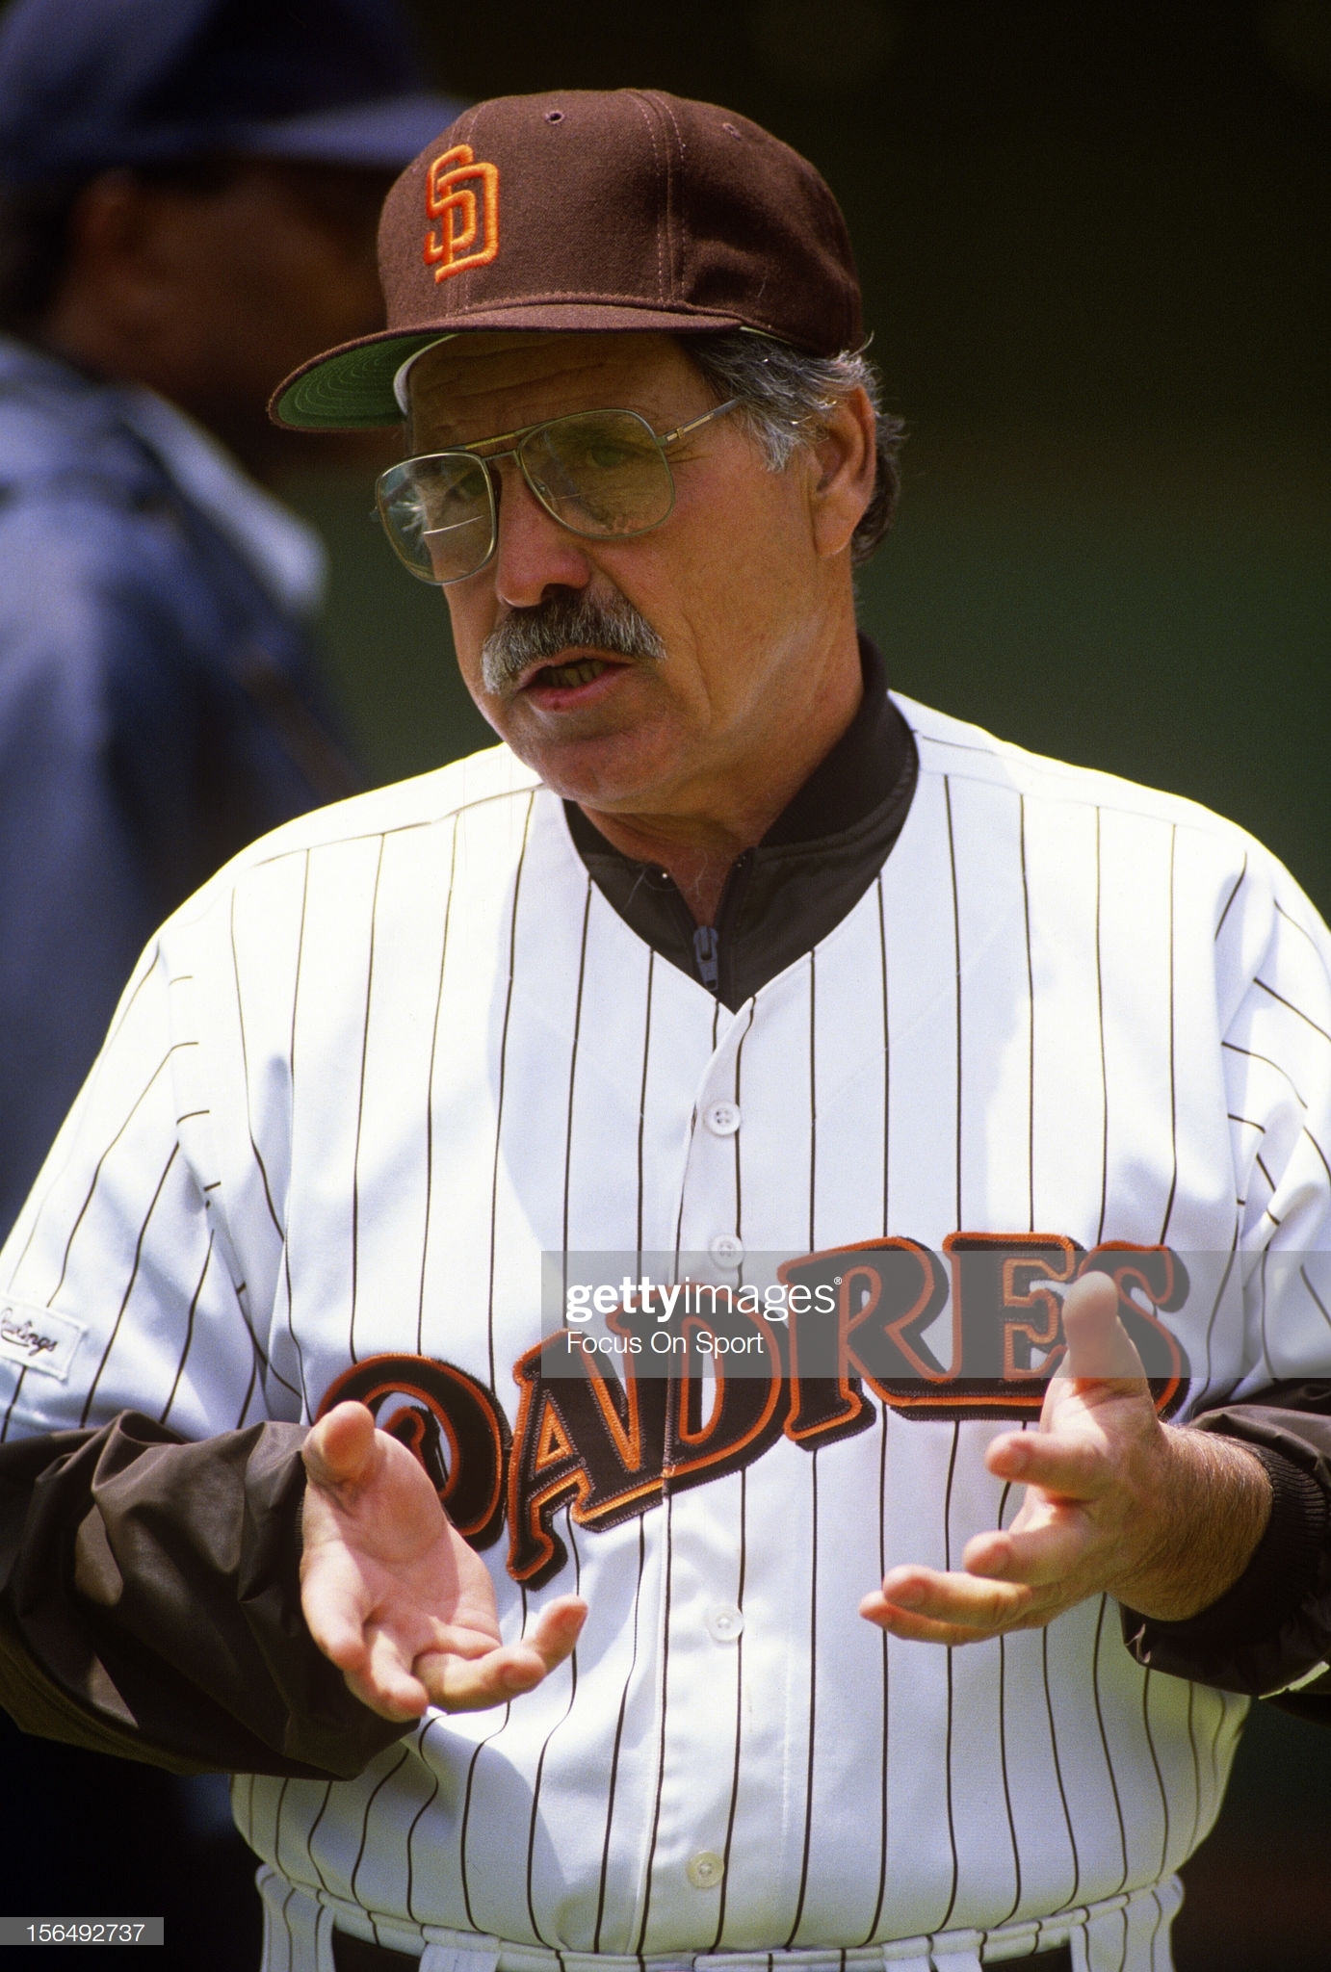
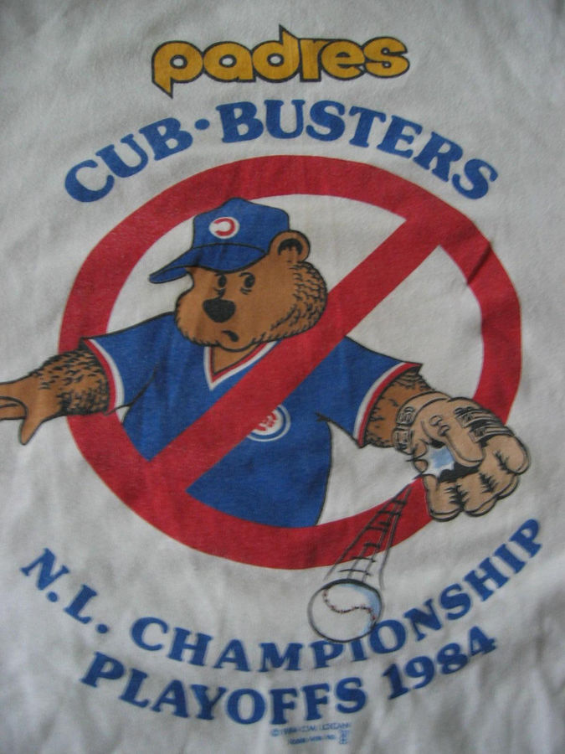
Jack and the Cub-Busters

Slide 13
The Rest of the 80s
After a good start, Padres faded during the 1985 season finishing 3rd
Dick Williams was let go at beginning of the 1986 season and replaced by Steve Boros
Boros was then replaced by Larry Bowa for the 1987 season
Bowa was eventually replaced by Jack early in the 1988 season

Slide 14
The Rest of the 80s
Jack’s Padres finished 1988 with a 67-48 record and 89-73 in 1989, showing once again his ability to lead a team
Traded son-in-law Greg Booker to Minnesota Twins in 1989
In 1990 Padres struggled and Jack stepped down as manager
Fired from his GM perch in September 1990 when new owner Tom Werner took over the Padres

Slide 15
A Very Curious Trade
In 1987 Chub Feeney was named president of the Padres so Jack found himself with a new boss
Chub had long career with the NY and SF Giants before becoming president of NL in 1970
Due to his Giants’ background, Feeney wanted Chris Brown from the Giants and he put pressure on Jack to get him

Slide 16
A Very Curious Trade
Jack wanted Mark Davis, and was willing to trade Kevin Mitchell, but had some concerns about the durability of Dave Dravecky
On July 5, Giants traded Chris Brown, Mark Davis, Keith Comstock and Mark Grant to Padres for Dave Dravecky, Craig Lefferts and Kevin Mitchell
Both teams were helped but trio going to Giants contributed significantly to the Giants winning the NL pennant in 1989 while Mark Davis wins the Cy Young Award that same year

Slide 17
The Trader Jack Years
Successful in that Padres become competitive and won NL pennant in 1984
San Diego became more of a baseball town as attendance increased
Jack’s managerial years in 1988 and 1989 showed he could still lead a team

Slide 18
The Trader Jack Years
Jack was quoted in NY Times as to his philosophy, “Why do I trade? I’m aggressive. I’m confident. I’m a gambler. I’m willing to make a trade and not be afraid I’d get nailed.”
While trades were a significant contributor to Jack’s success, the 1984 Padres were also greatly aided through the draft and free agent signings. Jack used all the moves necessary to create a winner.
Jack became a Cub-Buster

Slide 19
The Trader Jack Years
In 2017, John Aloysius “Trader Jack” McKeon was inducted into the San Diego Padres Hall of Fame

