Slide 1
Harry Simmons Major League Schedule Maker

Slide 2
Harry Simmons

Slide 3
So You Think You Know Baseball

Slide 4
Boston Braves move to Milwaukee

Slide 5
Clement J. Schwener

Slide 6
Harry Simmons – Schedule Maker

Slide 7
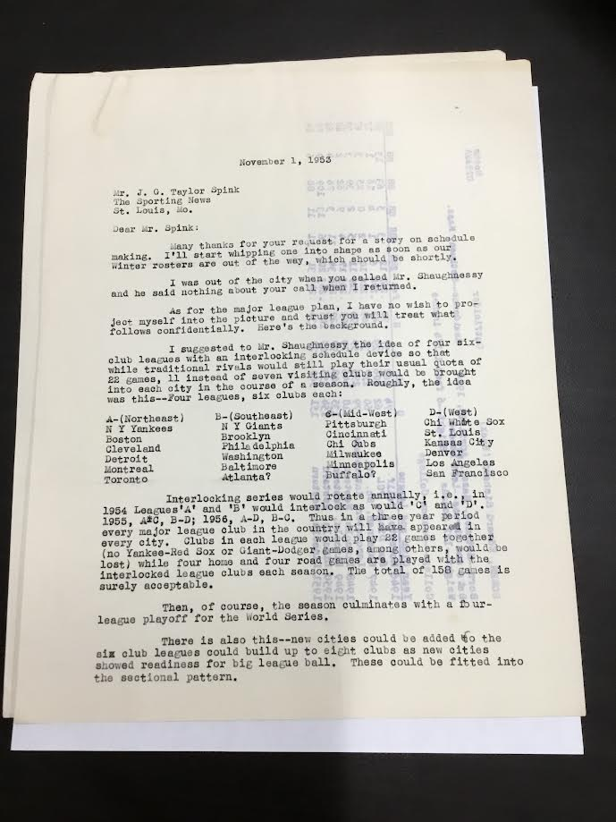
Proposal for a Four League setup

Slide 8
Other Scheduling Work

Slide 9
Hockey Scheduling

Slide 10
1972 International Hockey Tournament

Slide 11
Bowling Schedule

Slide 12
NFL Schedule

Slide 13
Harry Simmons – Baseball Historian

Slide 14
Team Schedule Requests

Slide 15
Schedule Requirements

Slide 16
Blue Jay Requests

Slide 17
Mistake By The Lake

Slide 18
How to handle Schedule Complaints

Slide 19
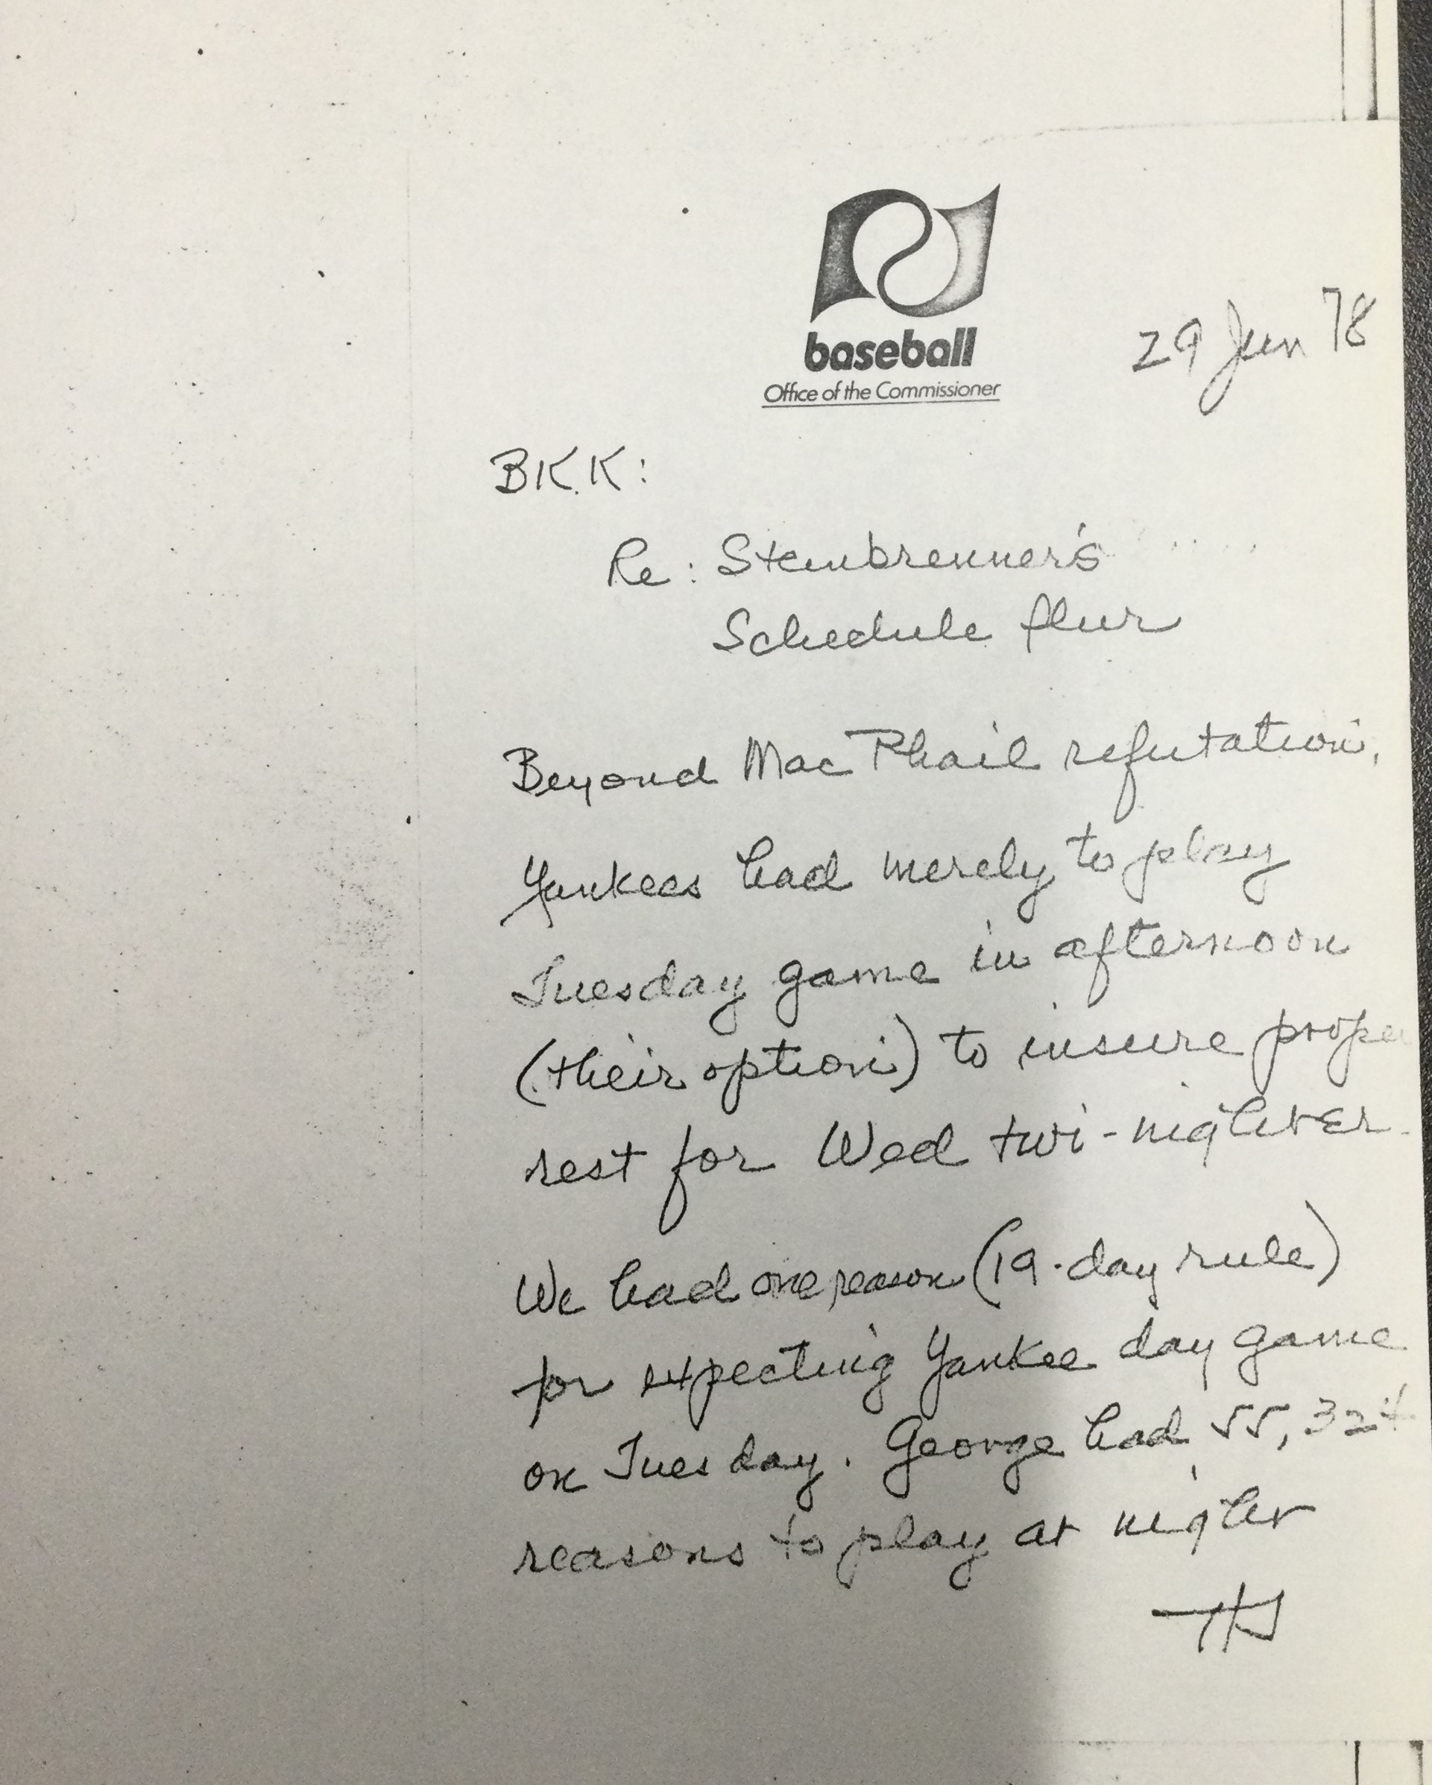
Steinbrenner Complaint
Memo about Yankee complaint

Slide 20
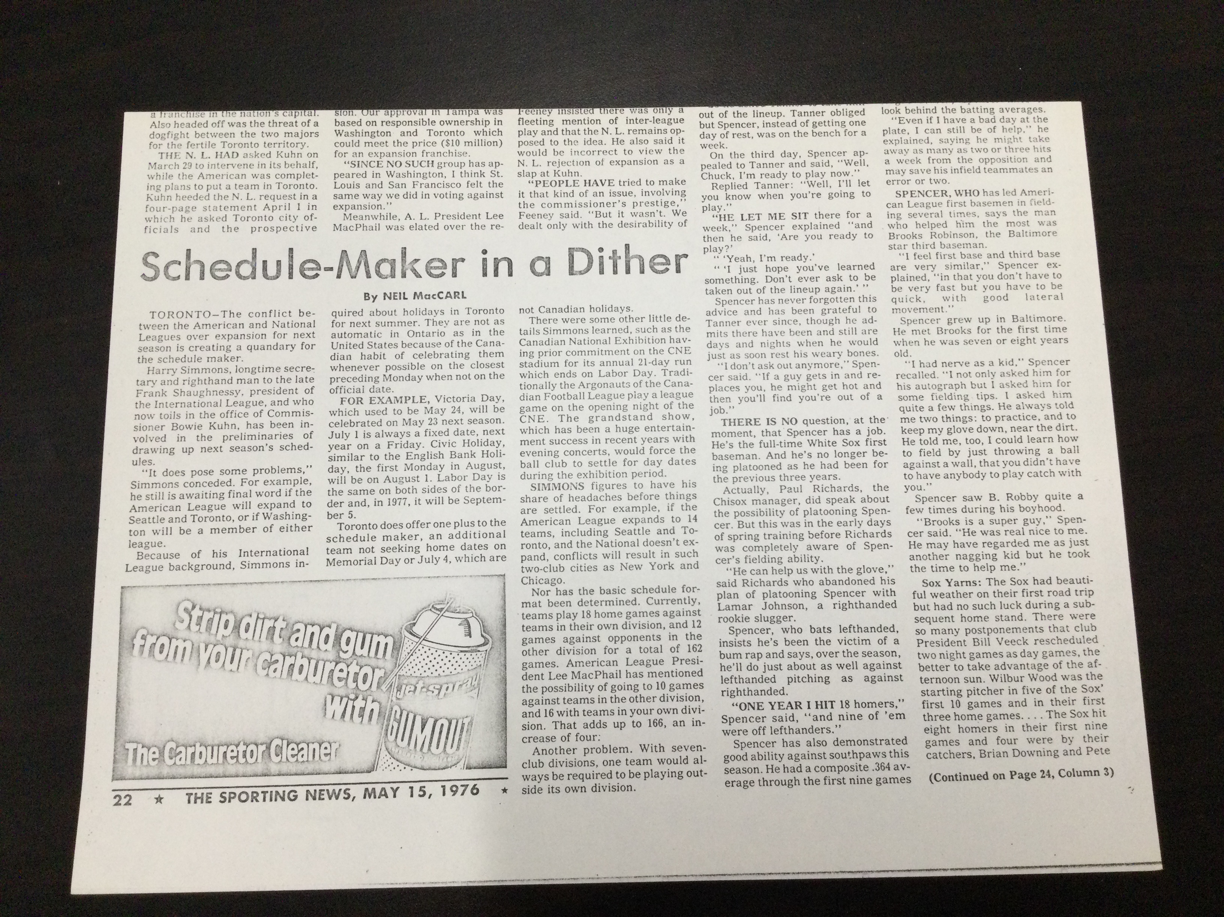
Scheduling Problems 1

Slide 21
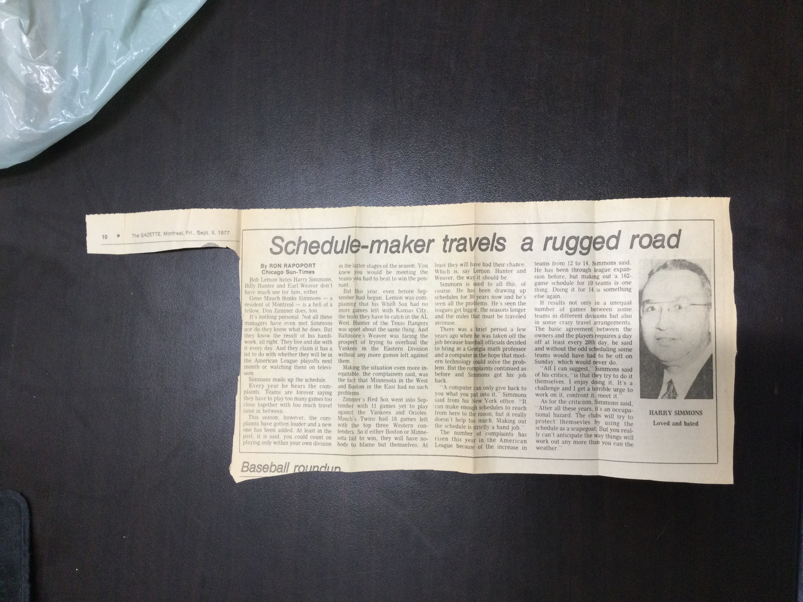
Scheduling Problems 2

Slide 22
Henry & Holly Stephenson

Slide 23
Harry Simmons Collection

Slide 24
Scheduling Papers

Slide 25
Harry Simmons – Schedule Maker

