Slide 1
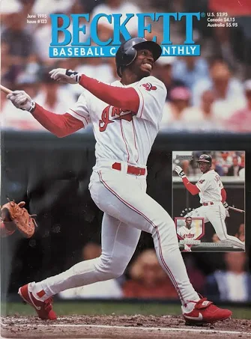
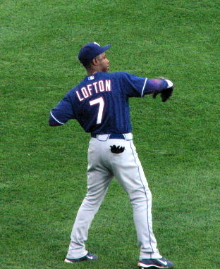
Kenny
Lofton
Portfolio for Induction Into the National Baseball Hall of Fame (HOF)
By: Nogales High School
Sports Analytics Club
Nogales, Arizona
June 30, 2007 game between the Tampa Bay Rays and the Cleveland Indians
Beckett Baseball Card Monthly Magazine 1995 June Kenny Lofton

Slide 2
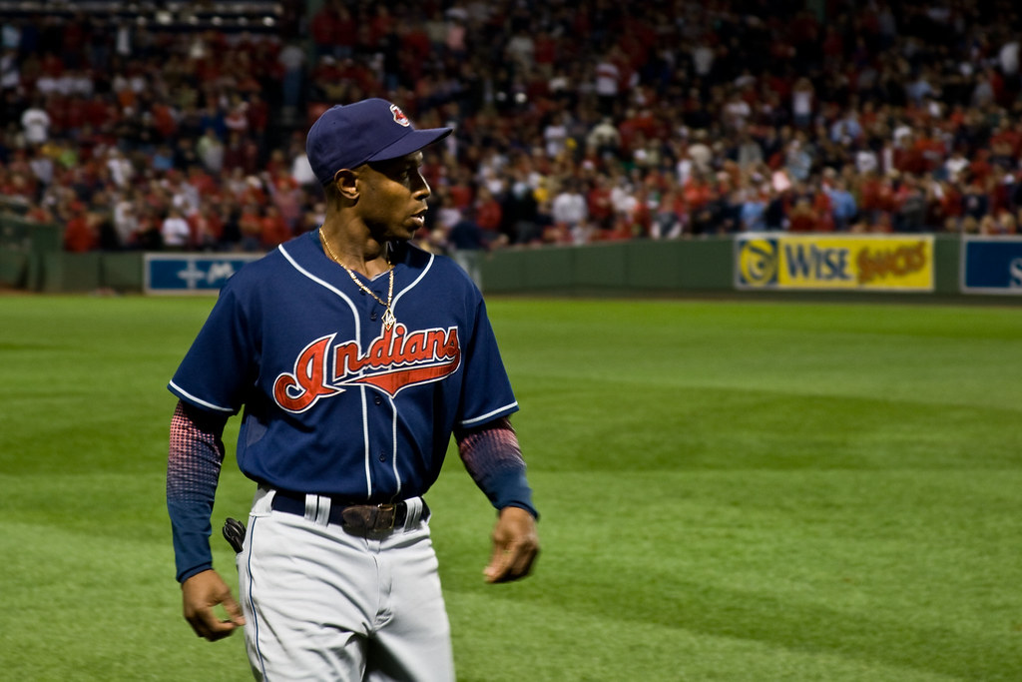
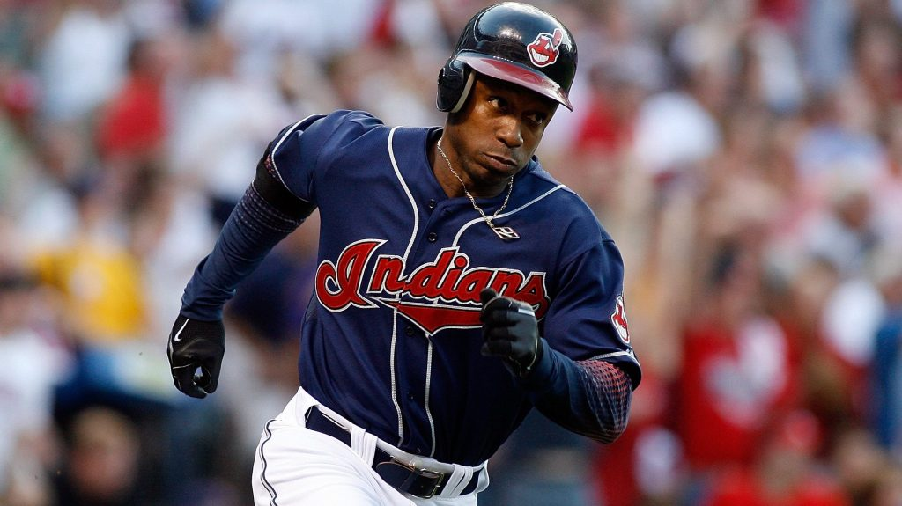
Kenny Lofton Player Bio:
Born: May 31, 1967
Bats/Throws: Left/Left
Height: 6’0”
Weight: 180 lbs
Lifetime OBP: 0.372
Teams: Astros, Indians/Guardians, Braves, White Sox, Giants, Pirates, Cubs, Yankees, Phillies, Dodgers, Rangers

Slide 3
Significant MLB Accomplishments
Six-time All-Star
2 World Series Appearances (1995 and 2002)
Four-time Gold Glove Award Winner
622 Stolen Bases, 15th in MLB History
Record for most stolen bases in postseason
Member of the Cleveland Indians/Guardians Hall of Fame

Slide 4
Introduction
We, the Nogales High School Sports Analytics Club, have produced this presentation to support the induction of Kenny Lofton into the National Baseball Hall of Fame (HOF) in Cooperstown, New York.
In making this case, we compare Lofton’s performance in a variety of measures to three key groups:
(1) HOF Group: center fielders in the HOF
(2) Peer Group: players who were contemporaries of Lofton but not in the HOF
(3) Base Stealers: a group of leading base stealers.
The goal of this presentation is to demonstrate that Kenny Lofton deserves to be in the National Baseball Hall of Fame given his overall ability as a hitter, base stealer, and elite centerfielder.

Slide 5
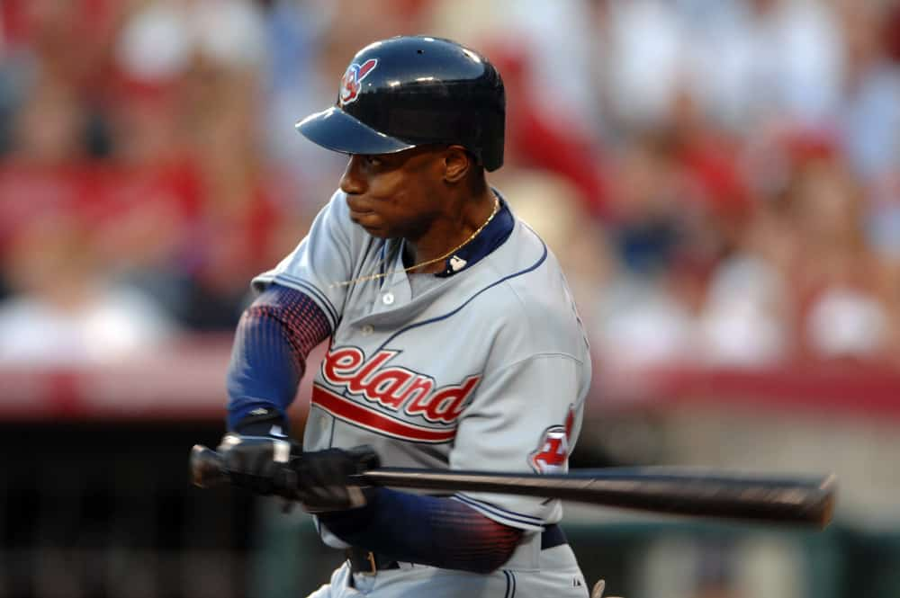
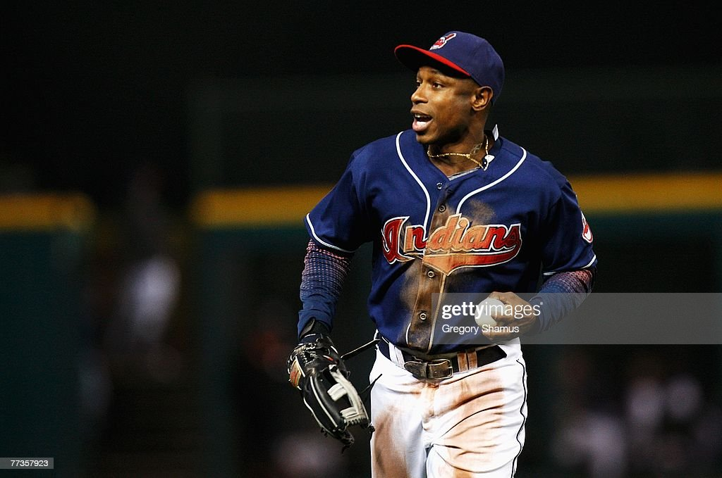
Statistics Considered
Offensive Stats
Stolen Bases 622
Defensive Stats
Defensive Wins Above Replacement (dWAR) 15.5
2. Total Zone/Total Zone with Location Data (TZ/TZL) 115
Overall Performance Stats
Wins Above Replacement (WAR) 68.4
Jaffe Wins Above Replacement Score (JAWS) 55.9
Peak Wins Above Replacement(Peak WAR) 43.5

Slide 6
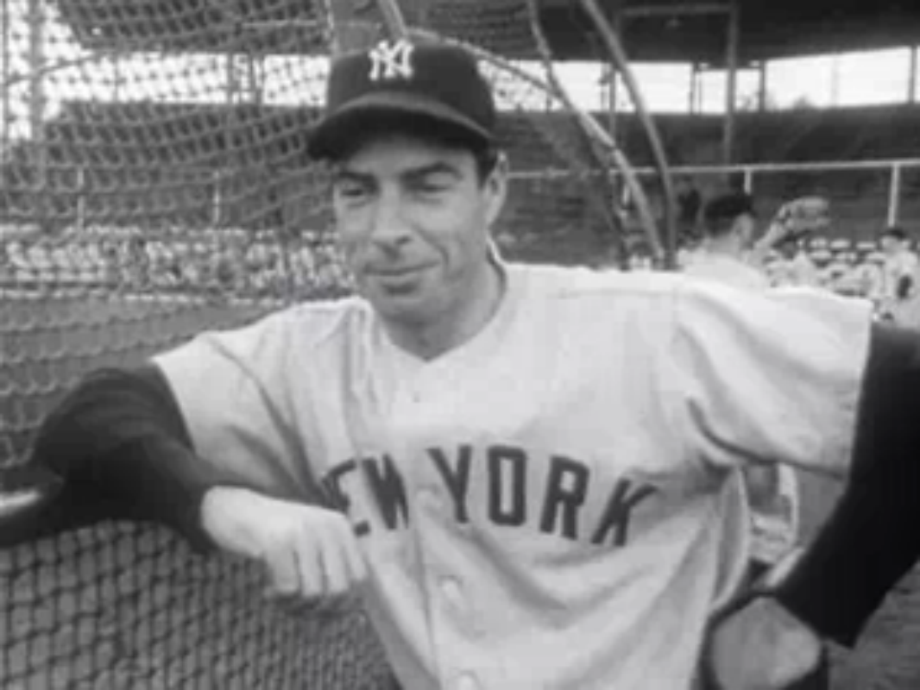
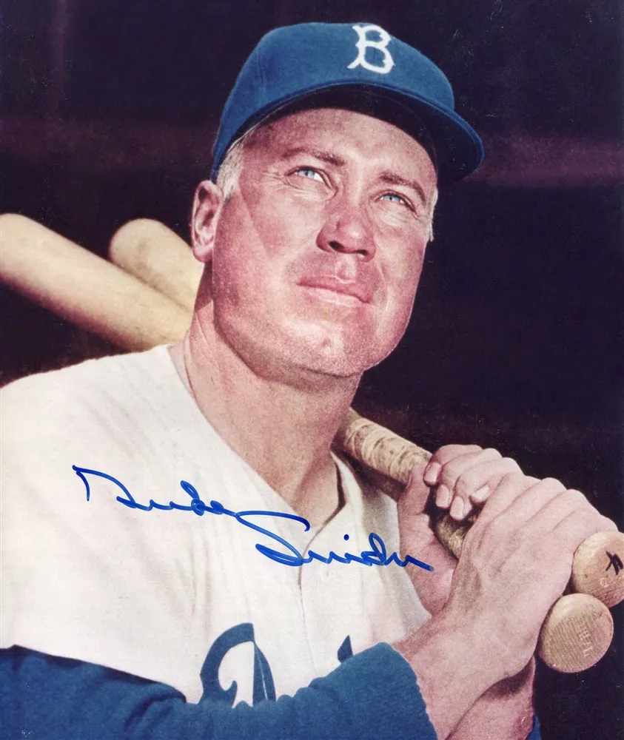
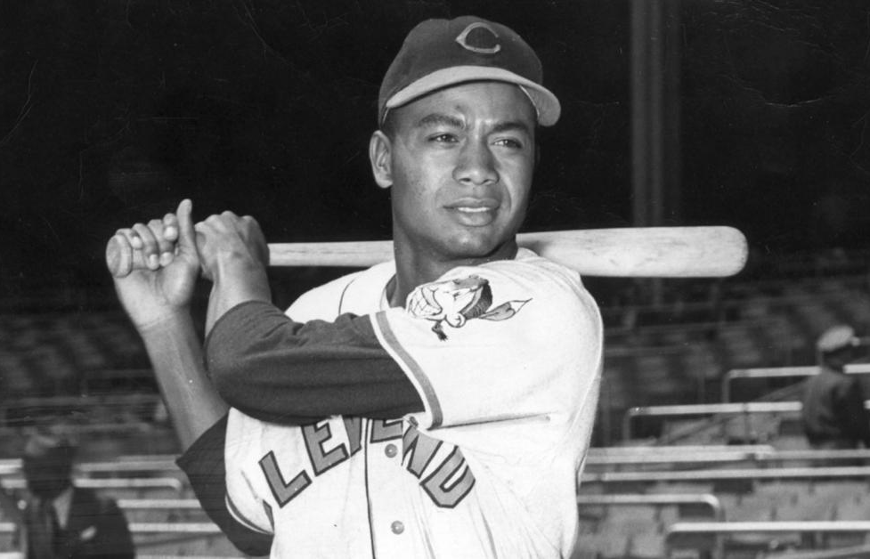
HOF Group
Ken Griffey Jr.
Kirby Puckett
Andre Dawson
Duke Snider
Richie Ashburn
Larry Doby
Mickey Mantle
Joe DiMaggio

Slide 7
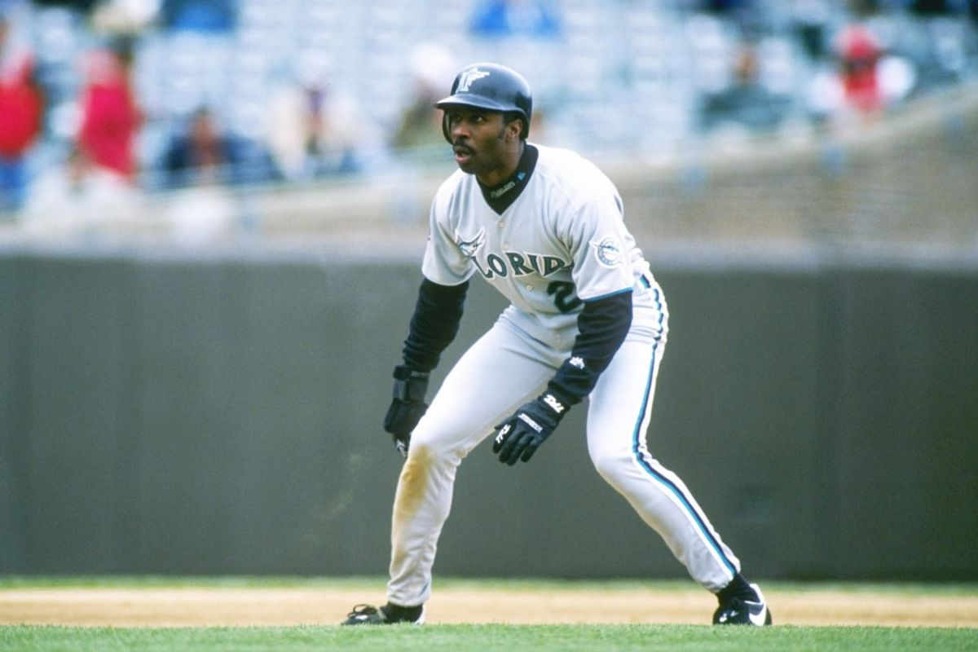
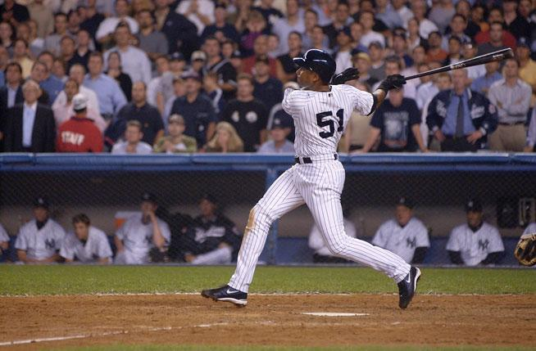
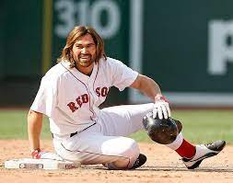
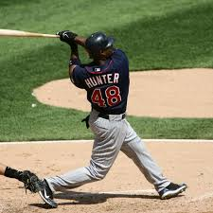
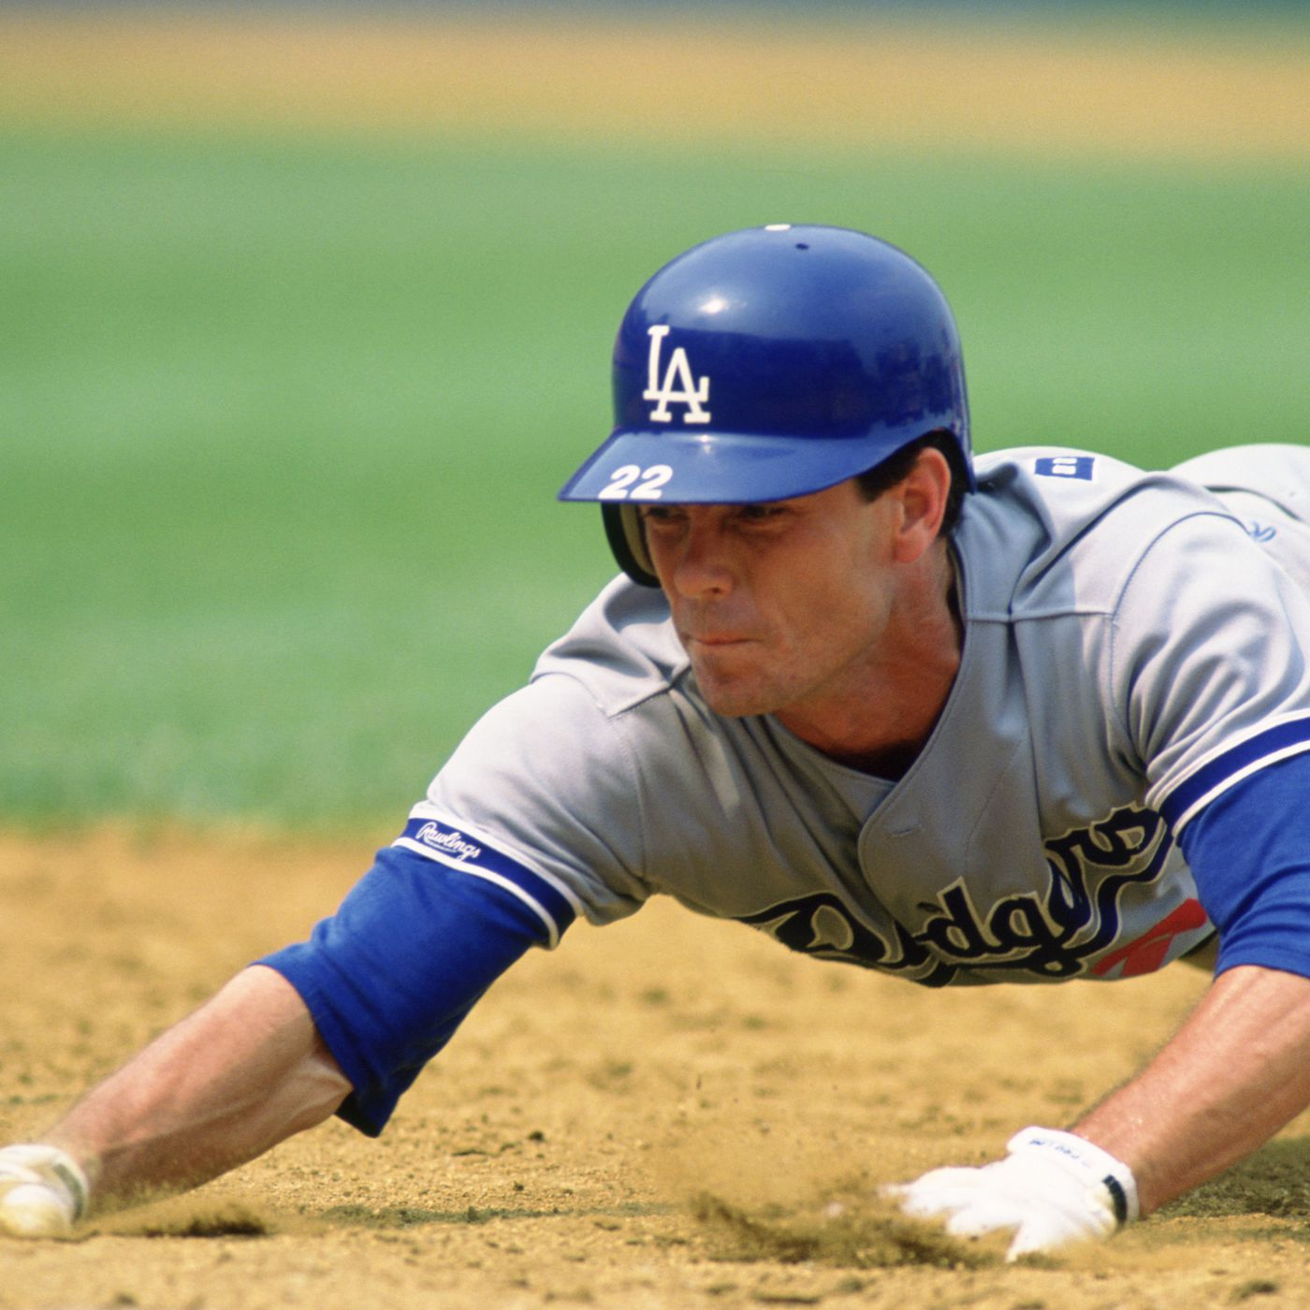
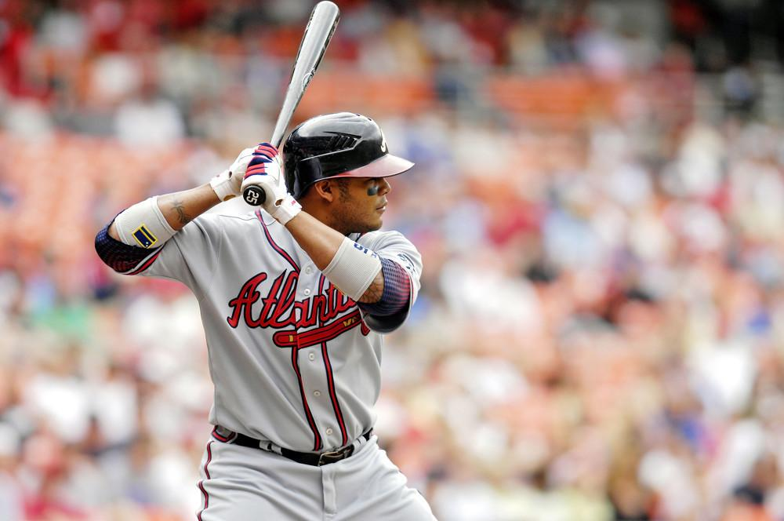
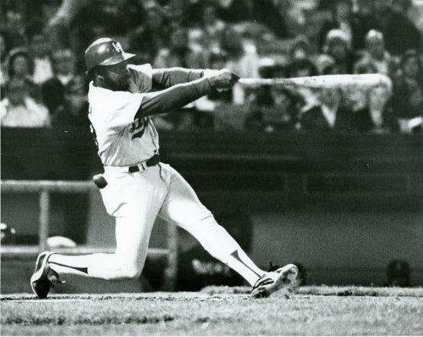
Peer Group
Andruw Jones
Jim Edmonds
Andy Van Slyke
Torii Hunter
Bernie Williams
Ray Lankford
Brett Butler
Johnny Damon
9. Steve Finley
10. Devon White
11. Lenny Dykstra

Slide 8
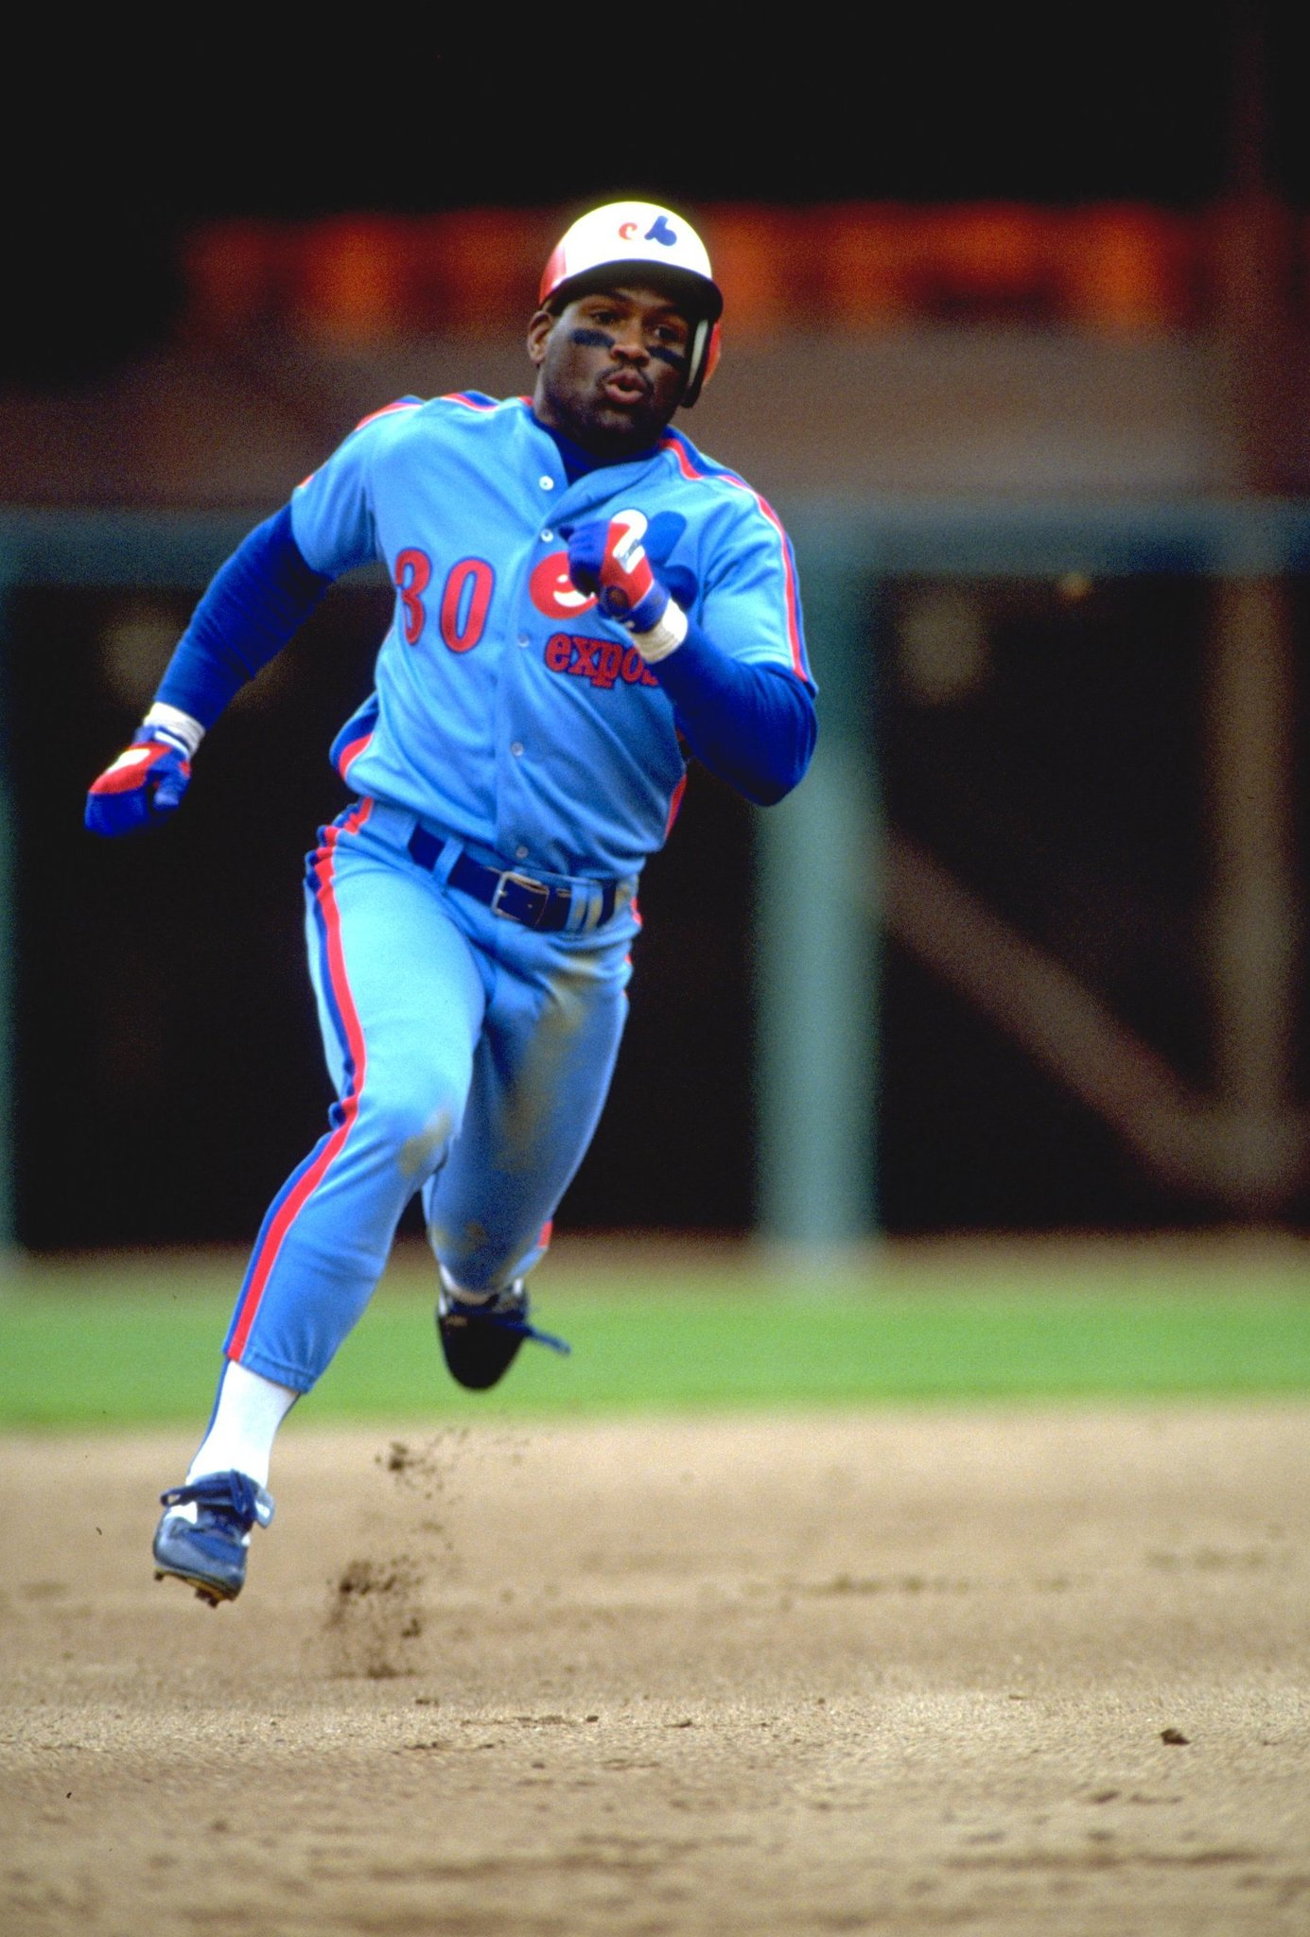
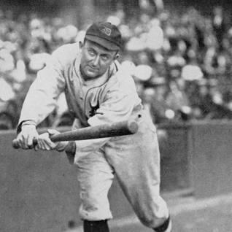
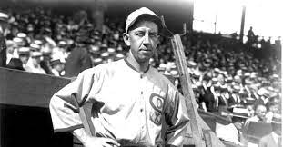
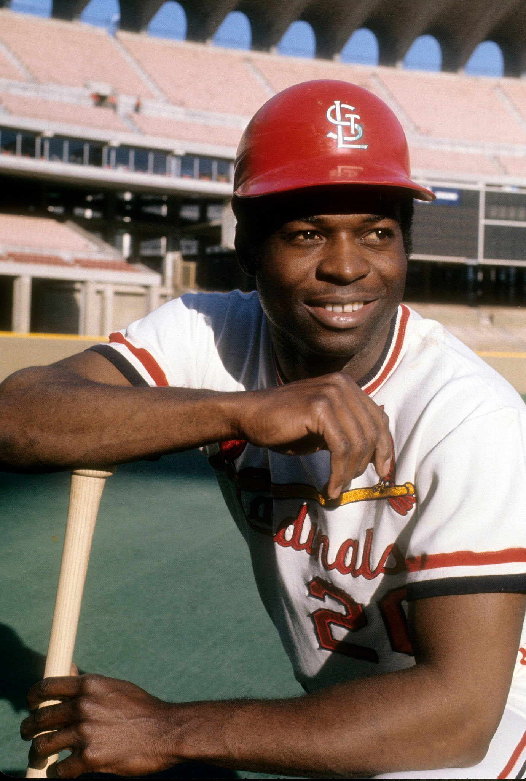
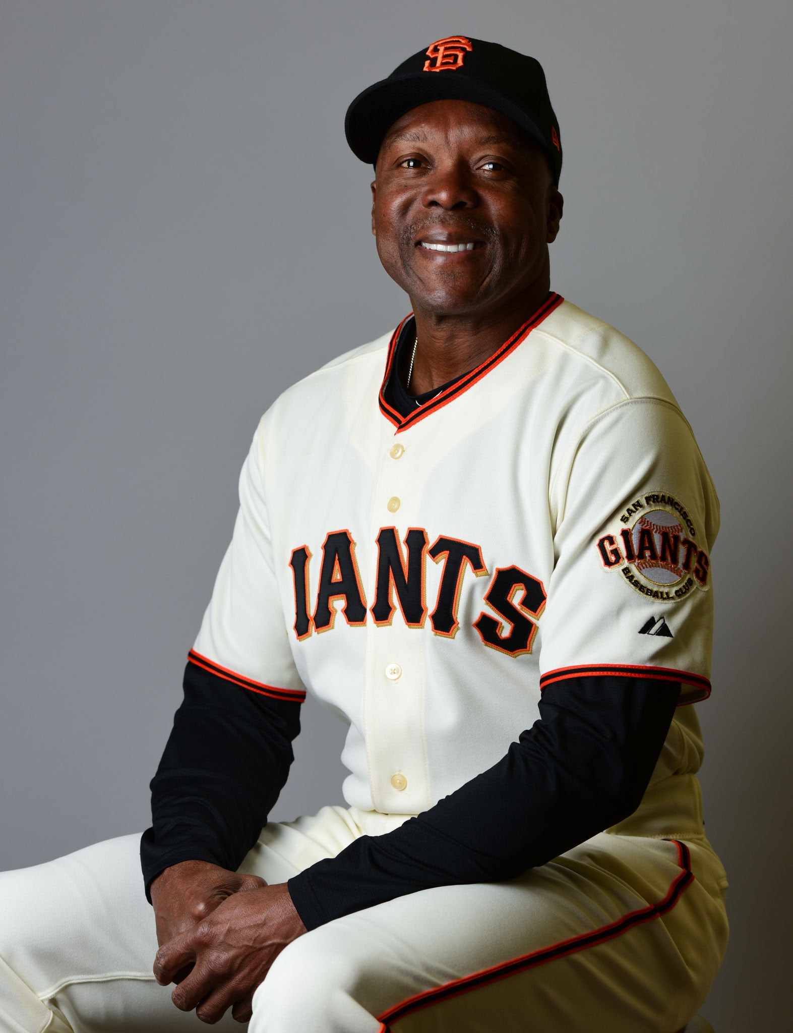
Historic Base Stealers
Ty Cobb (HOF)
Lou Brock(HOF)
Tim Raines (HOF)
Vince Coleman
Eddie Collins (HOF)
Max Carey (HOF)
These players have all have a minimum of 730 total stolen bases. They rank in the top ten in stolen bases lifetime.

Slide 9
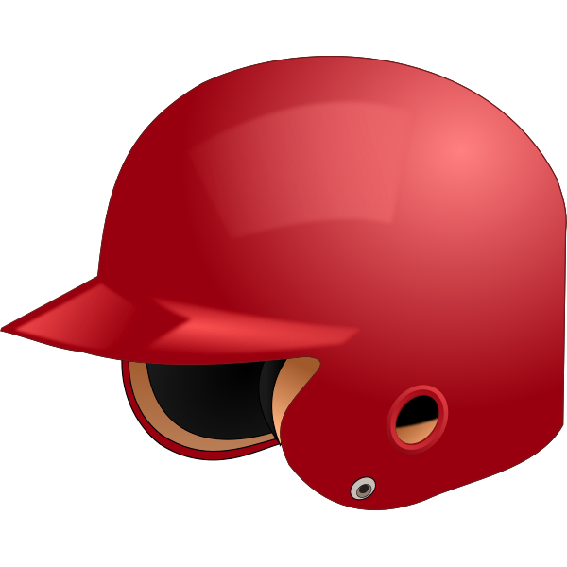
Part 1
Overall Worthiness

Slide 10
Overall Performance Metrics (WAR, Peak War, and JAWS)
Wins Above Replacement (WAR) – WAR measures a player's value in all facets of the game by determining how many more wins he's worth than a replacement-level player at the same position (e.g., a minor league replacement or a readily available free agent).
Peak WAR – The sum of the seven highest annual WAR values.
JAWS (Jaffe Wins Above Replacement Score) – JAWS is a system created by Jay Jaffe that evaluates a player's worthiness for enshrinement in the National Baseball Hall of Fame by comparing him to the Hall of Famers at his position. The stated goal of JAWS is to maintain or improve the Hall of Fame's standards by electing players who are at least as good as the average Hall of Famer at those players' positions. A player's JAWS is calculated by averaging his career WAR with the total WAR from his seven-year peak—that is, his seven most valuable seasons (consecutive or non-consecutive).
These statistics combine both offense and fielding to provide an overall assessment of the player and whether he is deserving of the HOF.

Slide 11
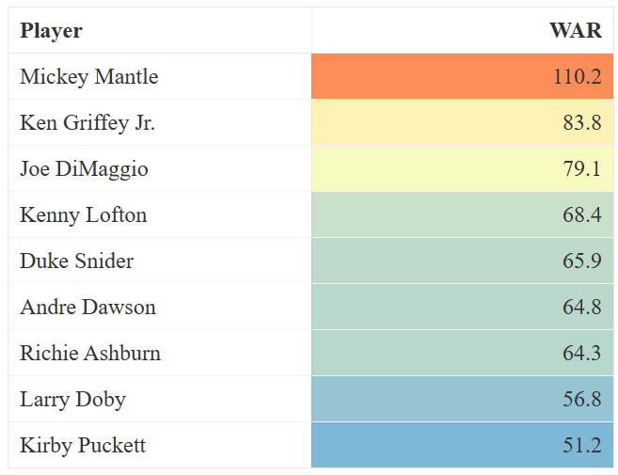
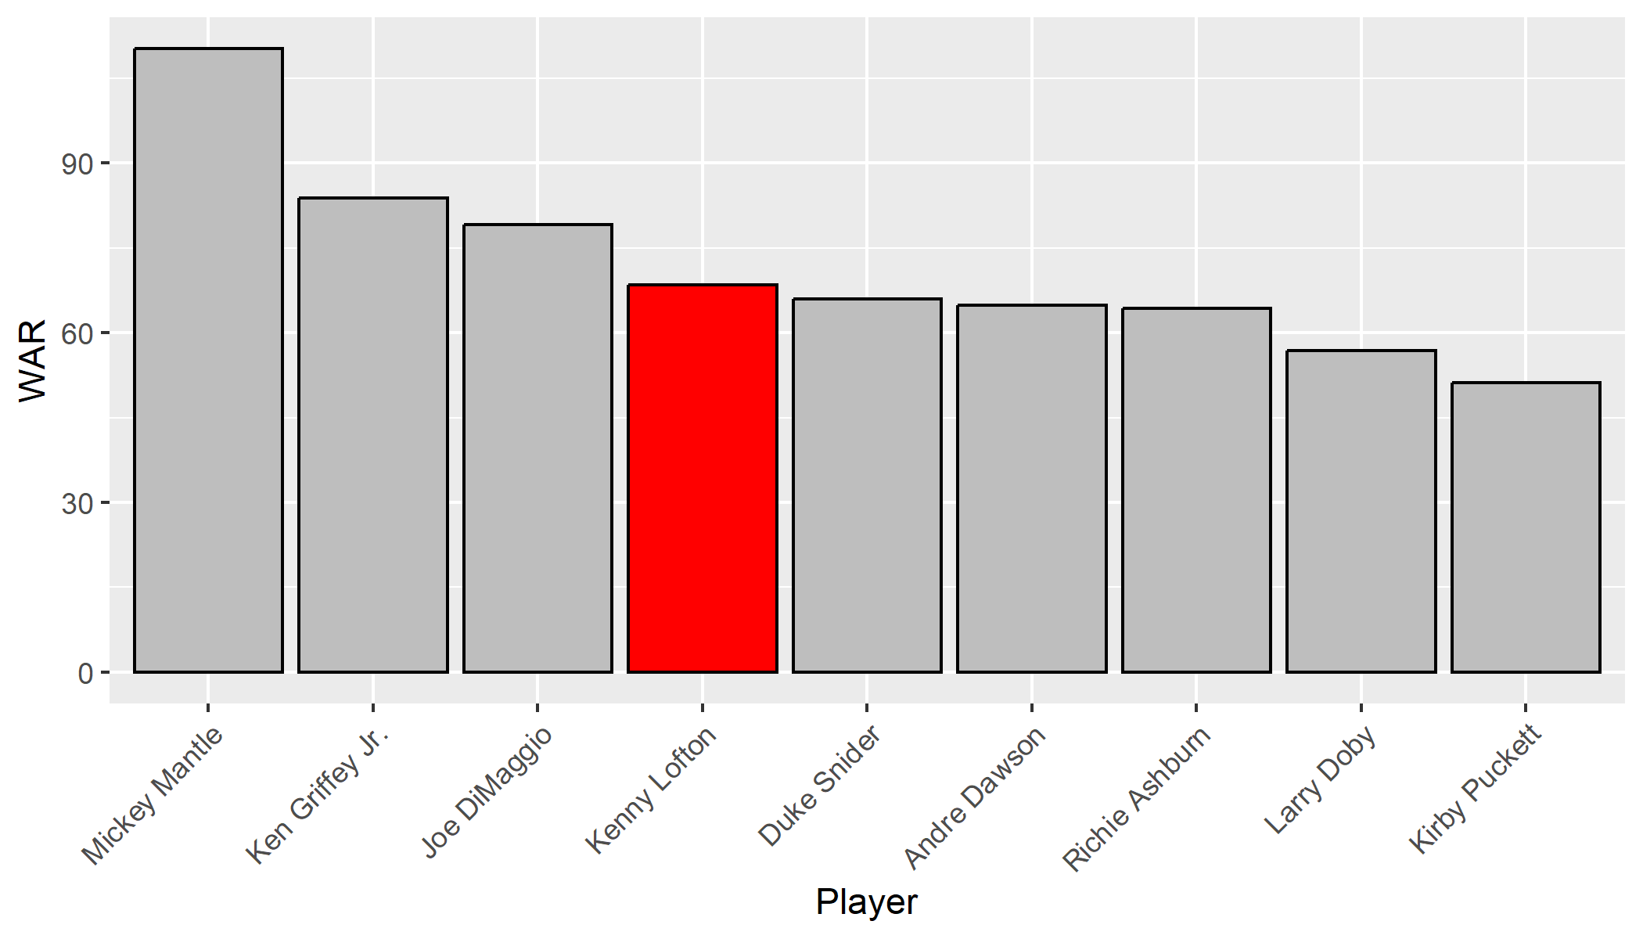
WAR: Kenny Lofton vs. HOF Group
The data shows that Kenny Lofton ranks fourth best when compared to the HOF group, and that Lofton was more valuable than five of the center fielders in the HOF group.

Slide 12
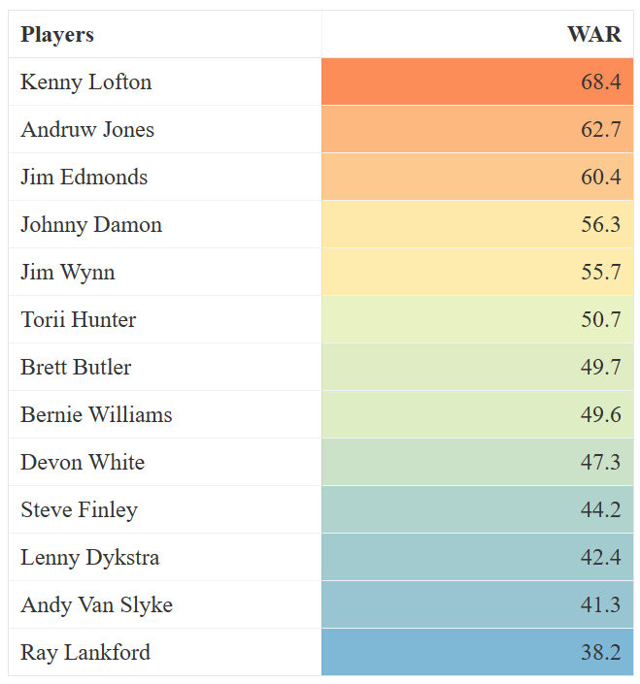
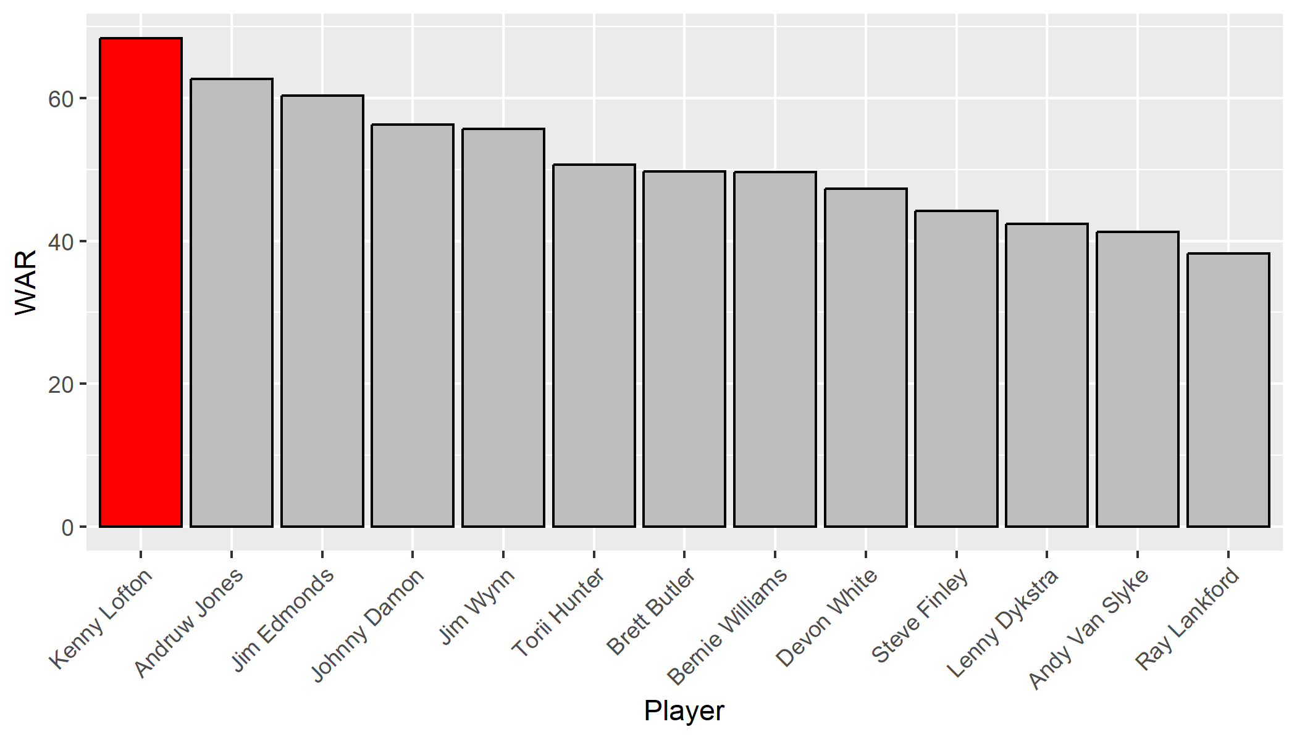
WAR: Kenny Lofton vs. Peer Group
Within his peer group, Kenny Lofton has the highest WAR (68.4), showing how valuable he was to his team’s success.

Slide 13
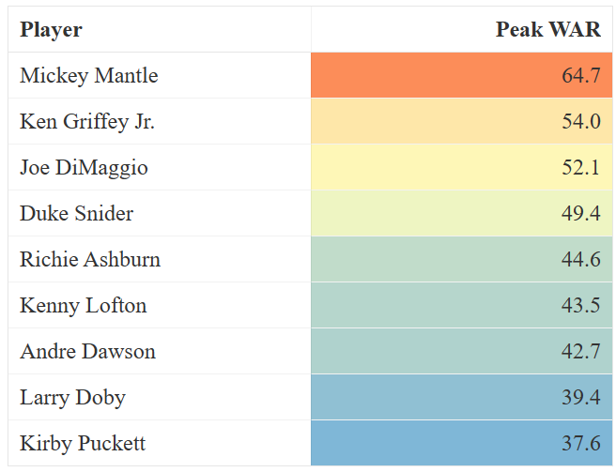
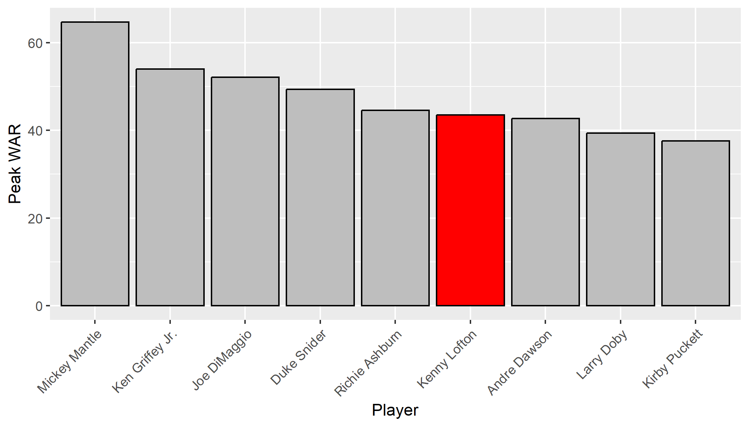
Peak WAR: Kenny Lofton vs. HOF Group
Kenny Lofton has a higher Peak War than HOFers Larry Doby, Andre Dawson, and Kirby Puckett. Dawson and Puckett played in the same era as Lofton.

Slide 14
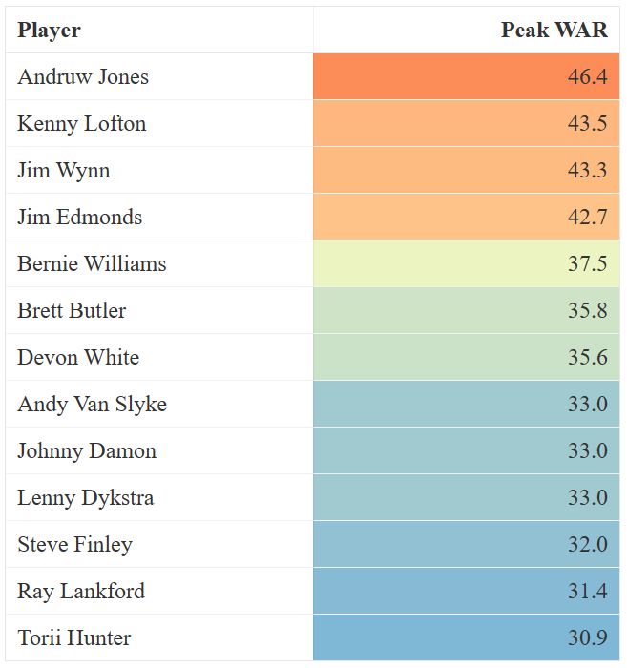
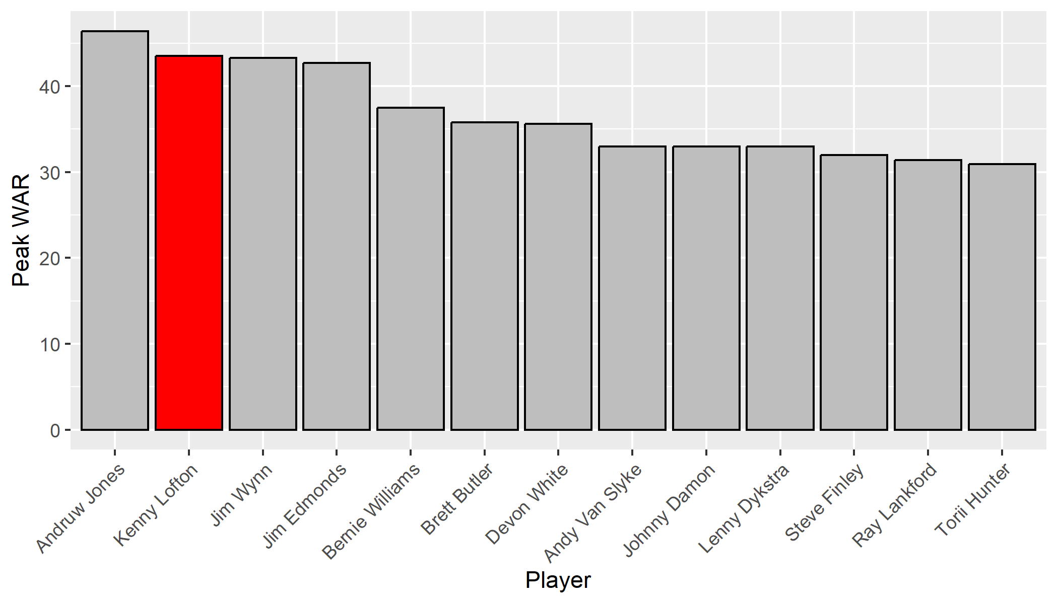
Peak WAR: Kenny Lofton vs. Peer Group
Takeaway: In the Peer Group, only Andruw Jones, who could soon be in the HOF, has a higher Peak WAR.

Slide 15
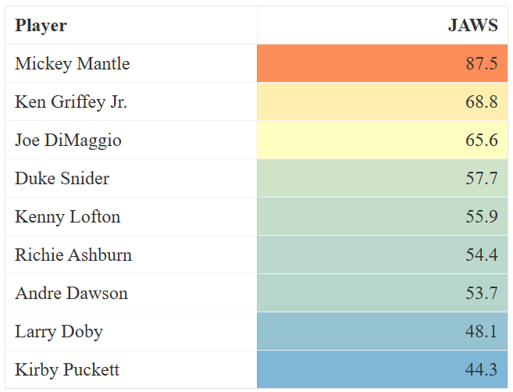
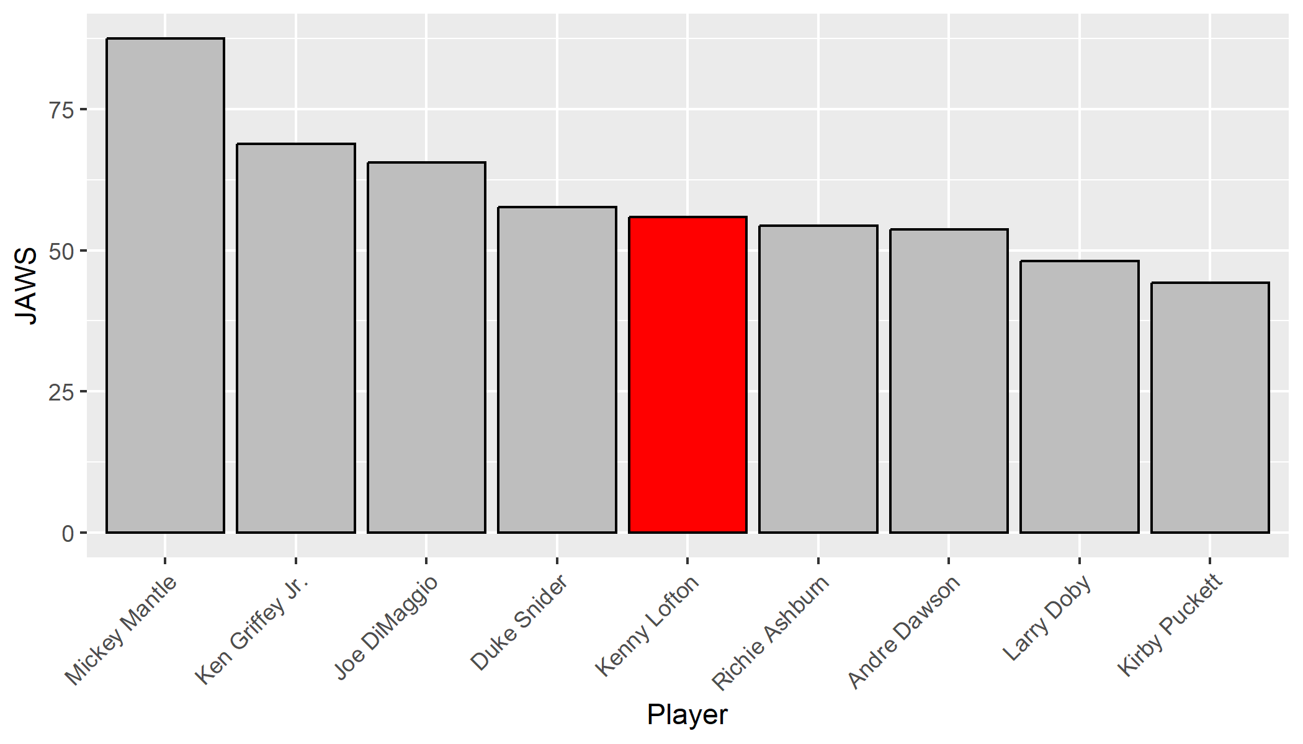
JAWS: Kenny Lofton vs. Hall-of-Fame Group
Kenny Lofton’s JAWS statistic exceeds that of HOFers Kirby Puckett, Larry Doby, Andre Dawson, and Richie Ashburn.

Slide 16
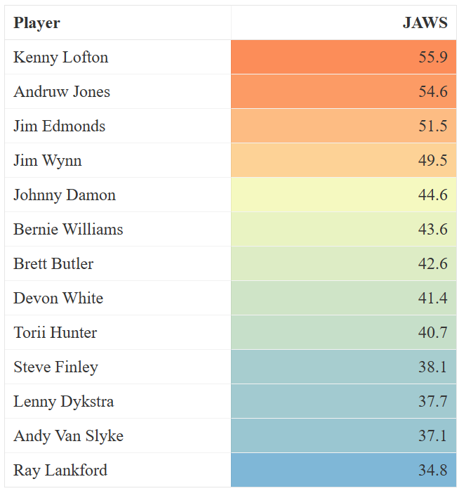
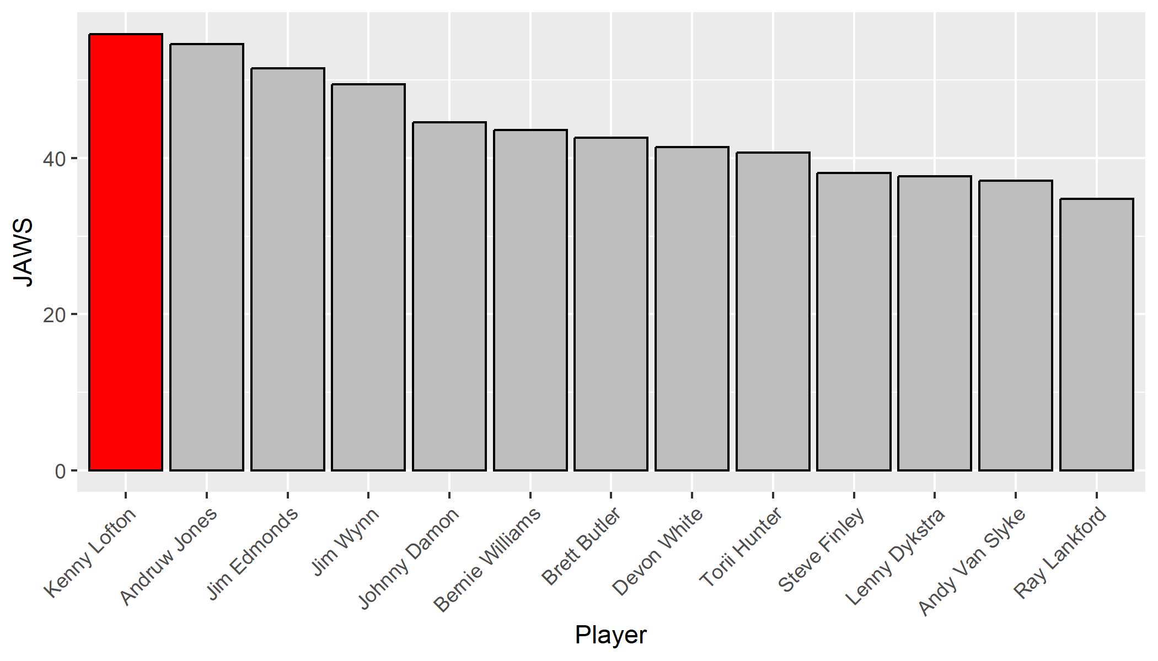
JAWS: Kenny Lofton vs. Peer Group
Kenny Lofton has the highest JAWS score amongst his peers including Andruw Jones who could soon be elected to the HOF. This furthers Lofton’s credentials for his HOF selection.

Slide 17
Overall Performance - Summary
WAR, Peak WAR, and JAWS are statistics that measure both offensive and defensive value.
Kenny Lofton had the highest JAWS in his peer group and was in the top five in the HOF Group.
Kenny Lofton has the highest WAR in his peer group and is in the top four in HOF Group.
These results show that Kenny Lofton provided significant value to his teams. His performance exceeds that of several players who have already been elected to the HOF.

Slide 18
Offense
Part 2

Slide 19
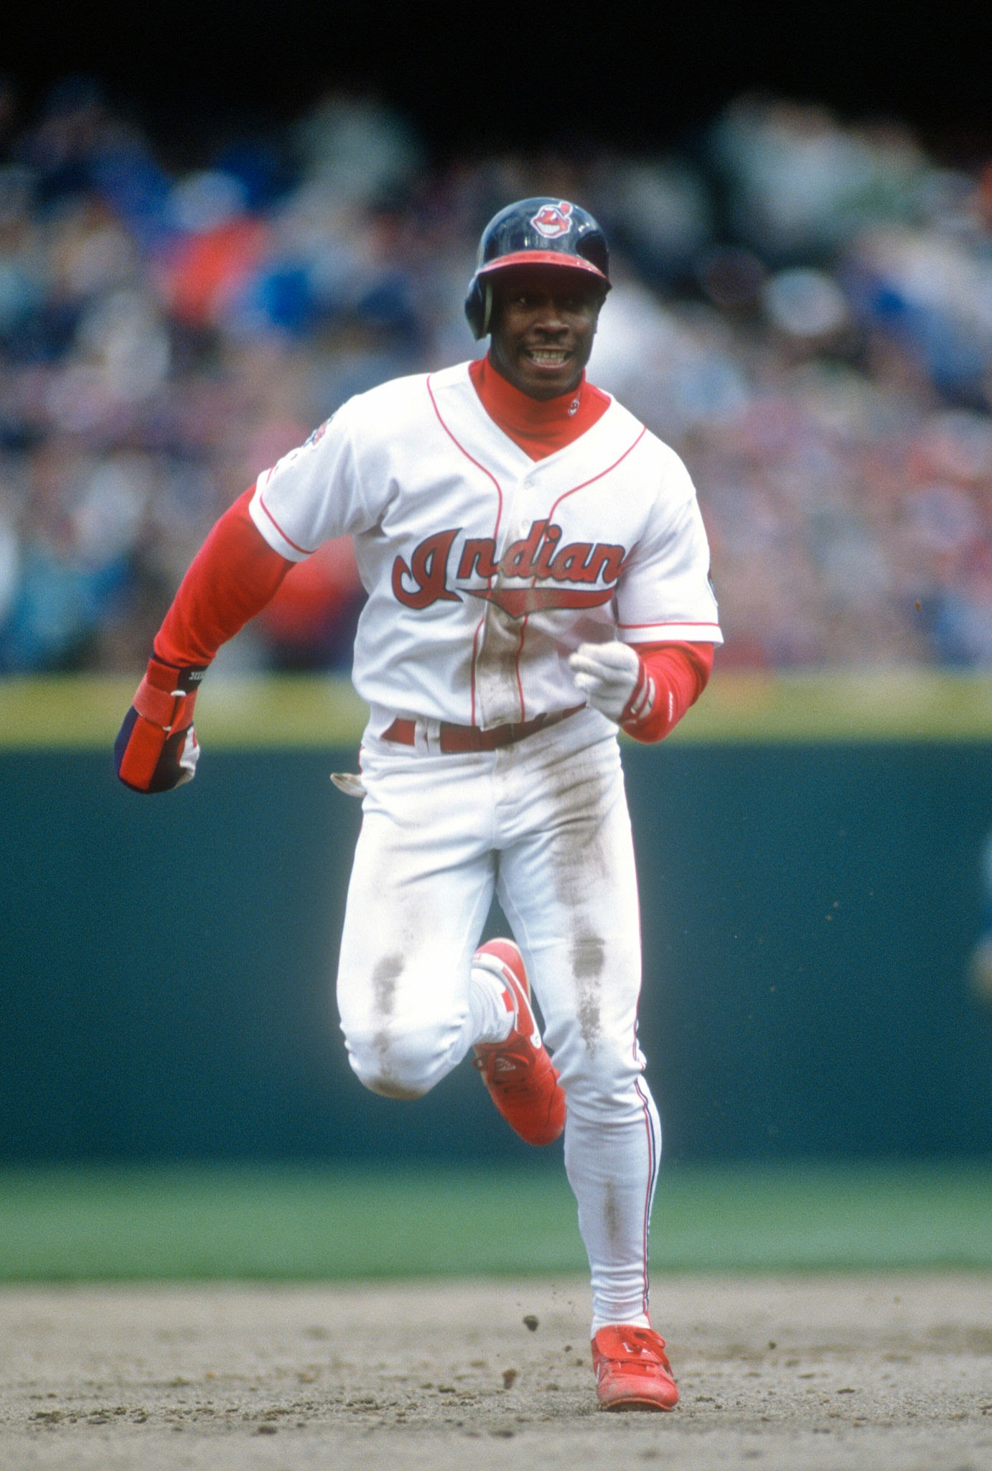
Stolen Bases
One of Kenny Lofton’s most potent weapons was his ability to steal bases, creating a notable offensive advantage for his team by generating run-scoring opportunities and disrupting the rhythm of opposing teams.
In this part of the presentation, we will quantify Lofton’s base stealing abilities and compare them to other players of his time and to members in the Baseball HOF.

Slide 20
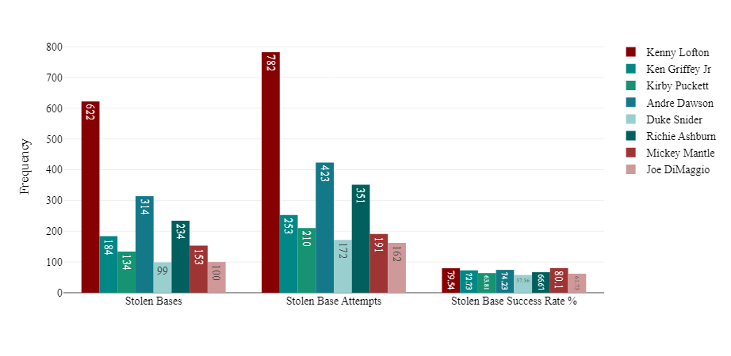
Kenny Lofton compared to Hall-of-Fame Group
Player | Stolen Bases | Stolen Base Attempts | Stolen Base Success Rate %
Kenny Lofton | 622 | 782 | 79.5%
Ken Griffey Jr | 184 | 253 | 72.7%
Kirby Puckett | 134 | 210 | 63.8%
Andre Dawson | 314 | 423 | 74.2%
Duke Snider | 99 | 172 | 57.6%
Richie Ashburn | 234 | 351 | 66.7%
Mickey Mantle | 153 | 191 | 80.1%
Joe DiMaggio | 100 | 162 | 61.7%
Kenny Lofton surpasses 22 HOF centerfielders in stolen bases by a minimum of 186 stolen bases.
Takeaway: Kenny Lofton ranks 2nd in SB success rate of the eight HOF CF’s, not to mention he has maximum numbers of stolen bases than any other players in this group illustrating his stature among HOF CFers

Slide 21
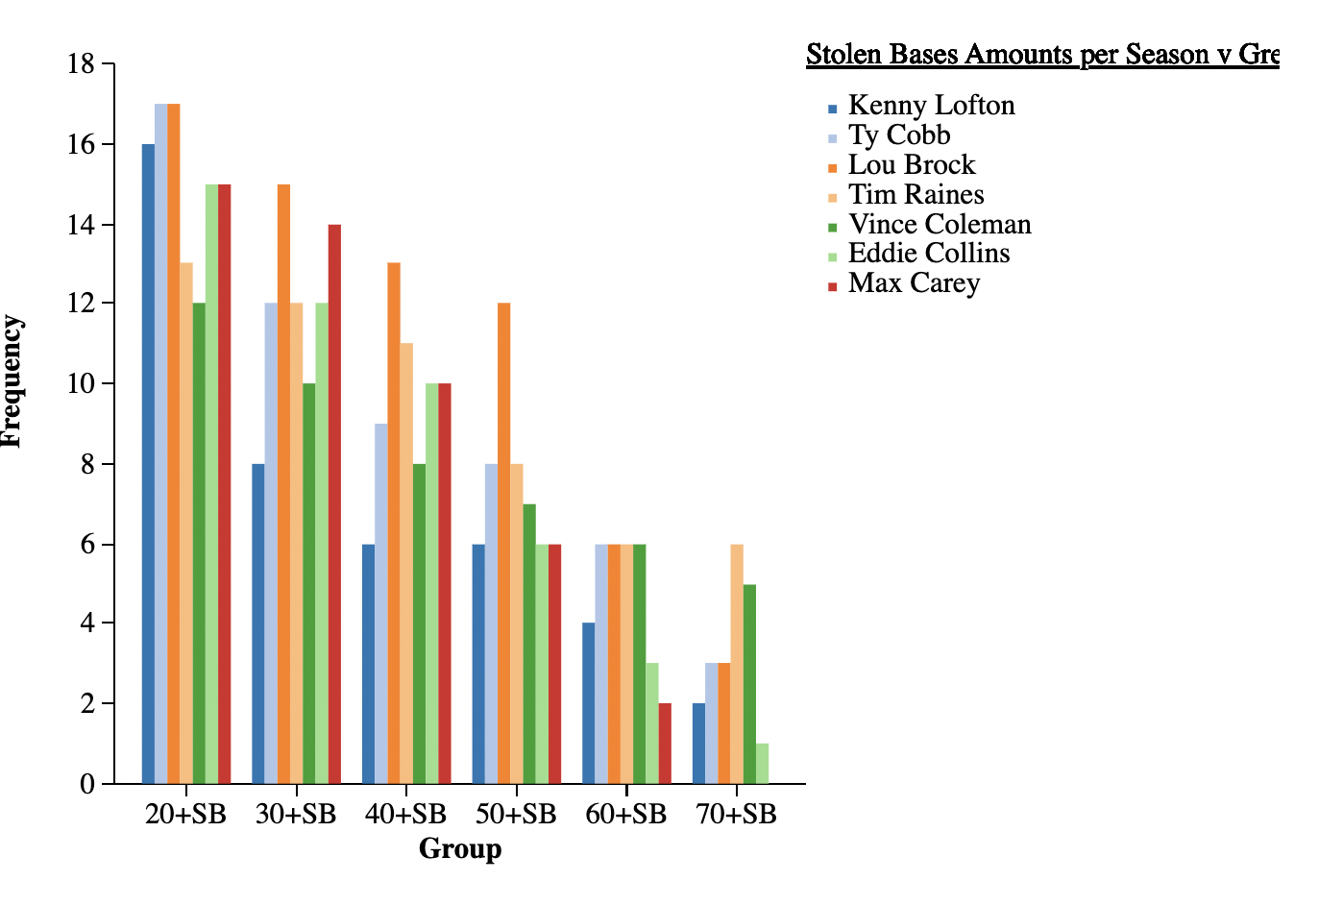
Kenny Lofton compared to Historic Base Stealers
Player | 20+ SB | 30+ SB | 40+ SB | 50+ SB | 60+ SB | 70+ SB
Kenny Lofton | 16 Seasons | 8 Seasons | 6 Seasons | 6 Seasons | 4 Seasons | 2 Seasons
Ty Cobb | 17 Seasons | 12 Seasons | 9 Seasons | 8 Seasons | 6 Seasons | 3 Seasons
Lou Brock | 17 Seasons | 15 Seasons | 13 Seasons | 12 Seasons | 6 Seasons | 3 Seasons
Tim Raines | 13 Seasons | 12 Seasons | 11 Seasons | 8 Seasons | 6 Seasons | 6 Seasons
Vince Coleman | 12 Seasons | 10 Seasons | 8 Seasons | 7 Seasons | 6 Seasons | 5 Seasons
Eddie Collins | 15 Seasons | 12 Seasons | 10 Seasons | 6 Seasons | 3 Seasons | 1 Season
Max Carey | 15 Seasons | 14 Seasons | 10 Seasons | 6 Seasons | 2 Seasons | 0 Seasons
Kenny Lofton had more seasons with 20 or more stolen bases than four all-time great base stealers.
Lofton also had more 70+ stolen base seasons than all-time great Eddie Collins.

Slide 22
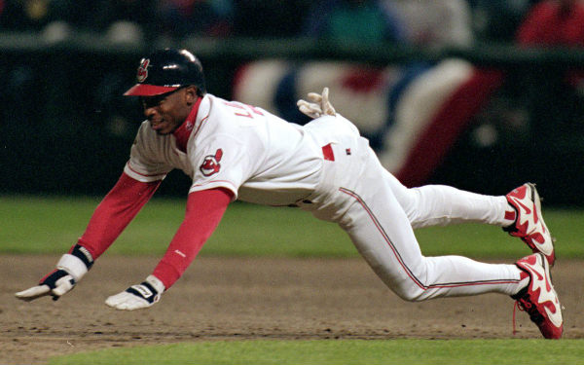
Stolen Base Summary
Kenny Lofton is 15th all time for stolen bases and is 4th all-time for stolen bases among centerfielders.
There are only 9 HOF players (all positions) with more stolen bases than Kenny Lofton.
There are only 3 HOF centerfielders with more stolen bases than Kenny Lofton.
Kenny Lofton has the highest stolen base total when compared to his centerfielder peers.

Slide 23
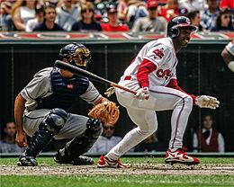
Conclusion-Offensive Stats
Kenny Lofton was an exceptional baserunner and stealer. He ranks 15th all-time in stolen bases.
Lofton surpasses every player in his peer group by a minimum of 64 stolen bases.
Lofton has the highest stolen base success rate when compared to the peer group, and the second-highest stolen base success rate when compared to the eight HOF centerfielders.
Kenny Lofton’s offensive stats are very impressive. His consistent production as a top-of-the-lineup hitter and baserunner made him an extremely valuable asset to the teams on which he played.

Slide 24
Defense
Part 3

Slide 25
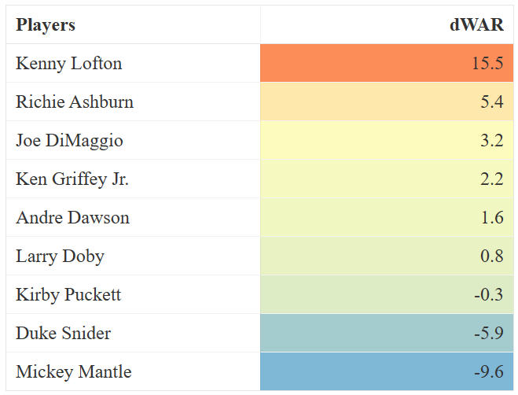
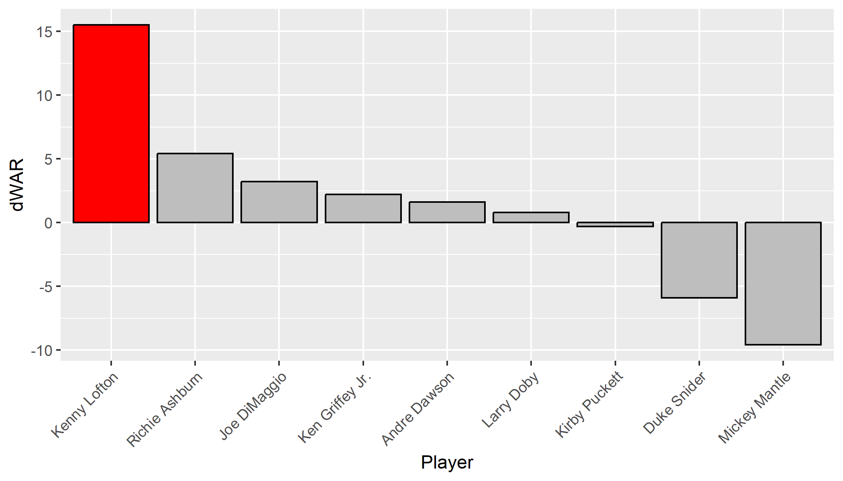
dWAR-Kenny Lofton vs. HOF Group
Kenny Lofton’s dWAR is remarkably higher then any of the eight HOF Group centerfielders. The dWAR of 15.5 is a strong indicator of his HOF worthiness.

Slide 26
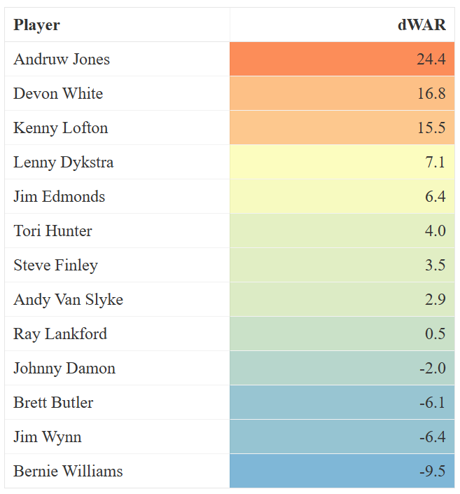
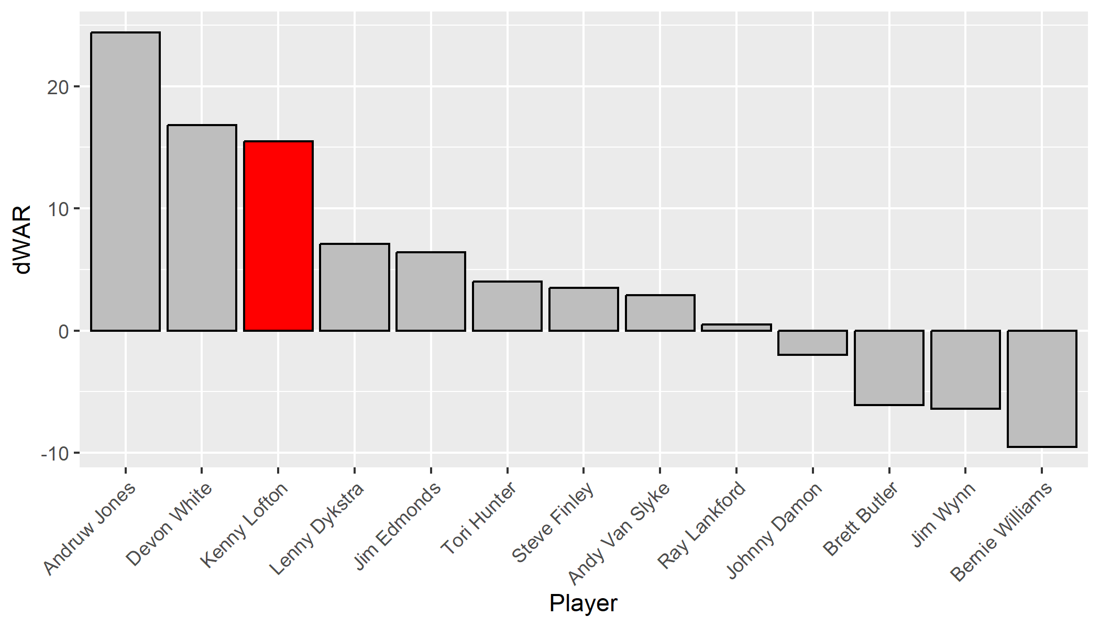
dWAR-Kenny Lofton vs. Peer Group
Only two players in the peer group, Andruw Jones and Devon White, have dWARs greater than that of Kenny Lofton. Once again, Lofton’s dWAR highlights his HOF worthiness.

Slide 27
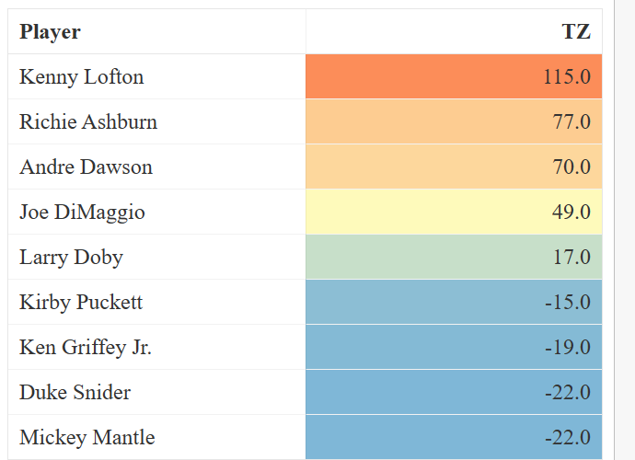
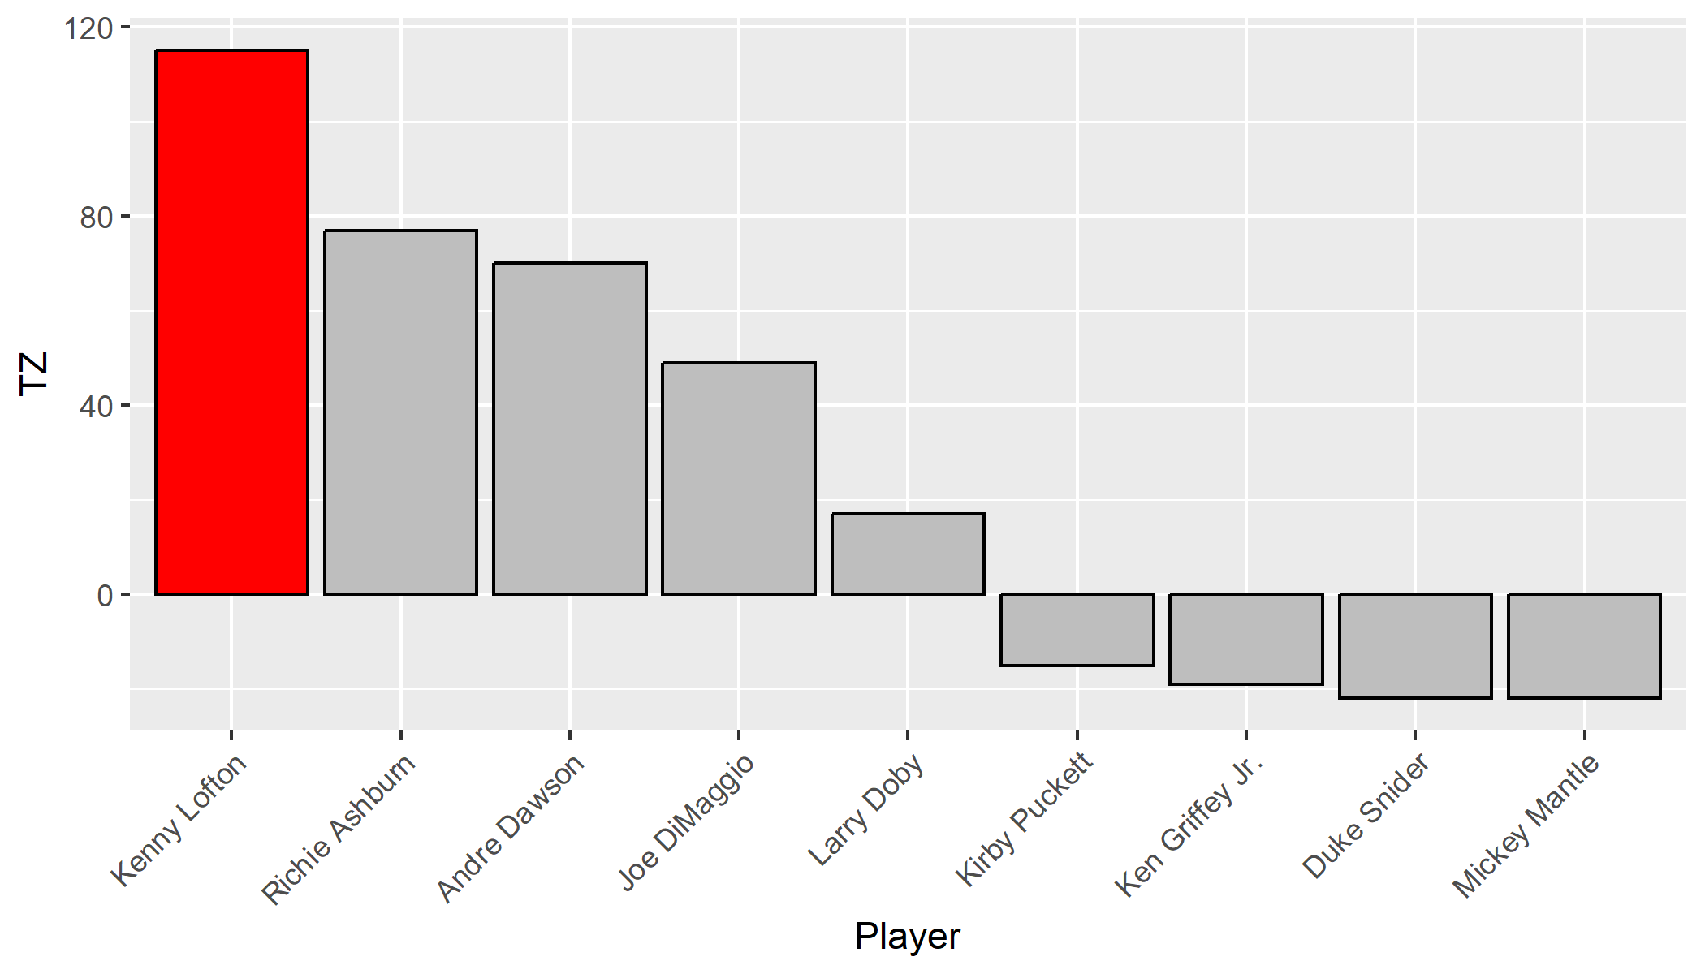
Total Zone: Kenny Lofton vs. HOF Group
Kenny Lofton has a career TZ of 115 which is higher than any of the eight HOFers.

Slide 28
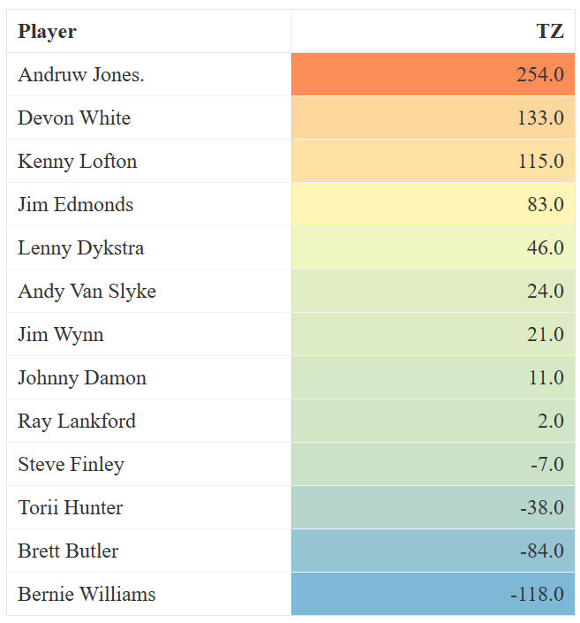
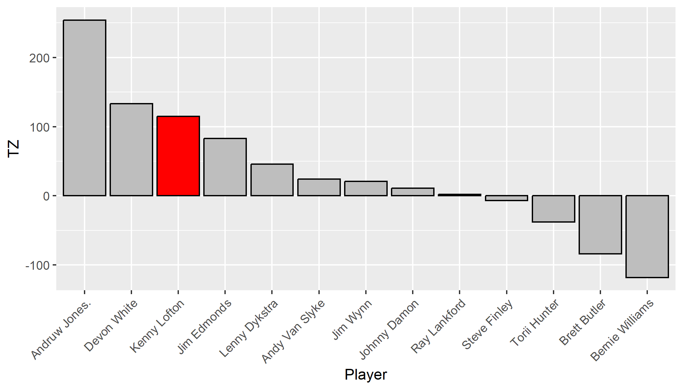
Total Zone: Kenny Lofton vs. Peer Group
In Kenny Lofton’s Peer Group, only Andruw Jones and Devon White exceed his TZ rating.

Slide 29
Conclusions: Defensive Stats
In the prior analysis it has been shown that Lofton is an exceptional fielding center fielder worthy of being included in the HOF. The following is a summary of that analysis.
dWar - When Kenny Lofton’s dWAR is compared with the HOF Group, his dWAR is remarkably higher then any HOF players in this list.
Total Zone (TZ) - Kenny Lofton has a career TZ of 115 which is higher than any player in the HOF Group. When compared to his peers, only two of the 11 exceed Lofton’s TZ.

Slide 30
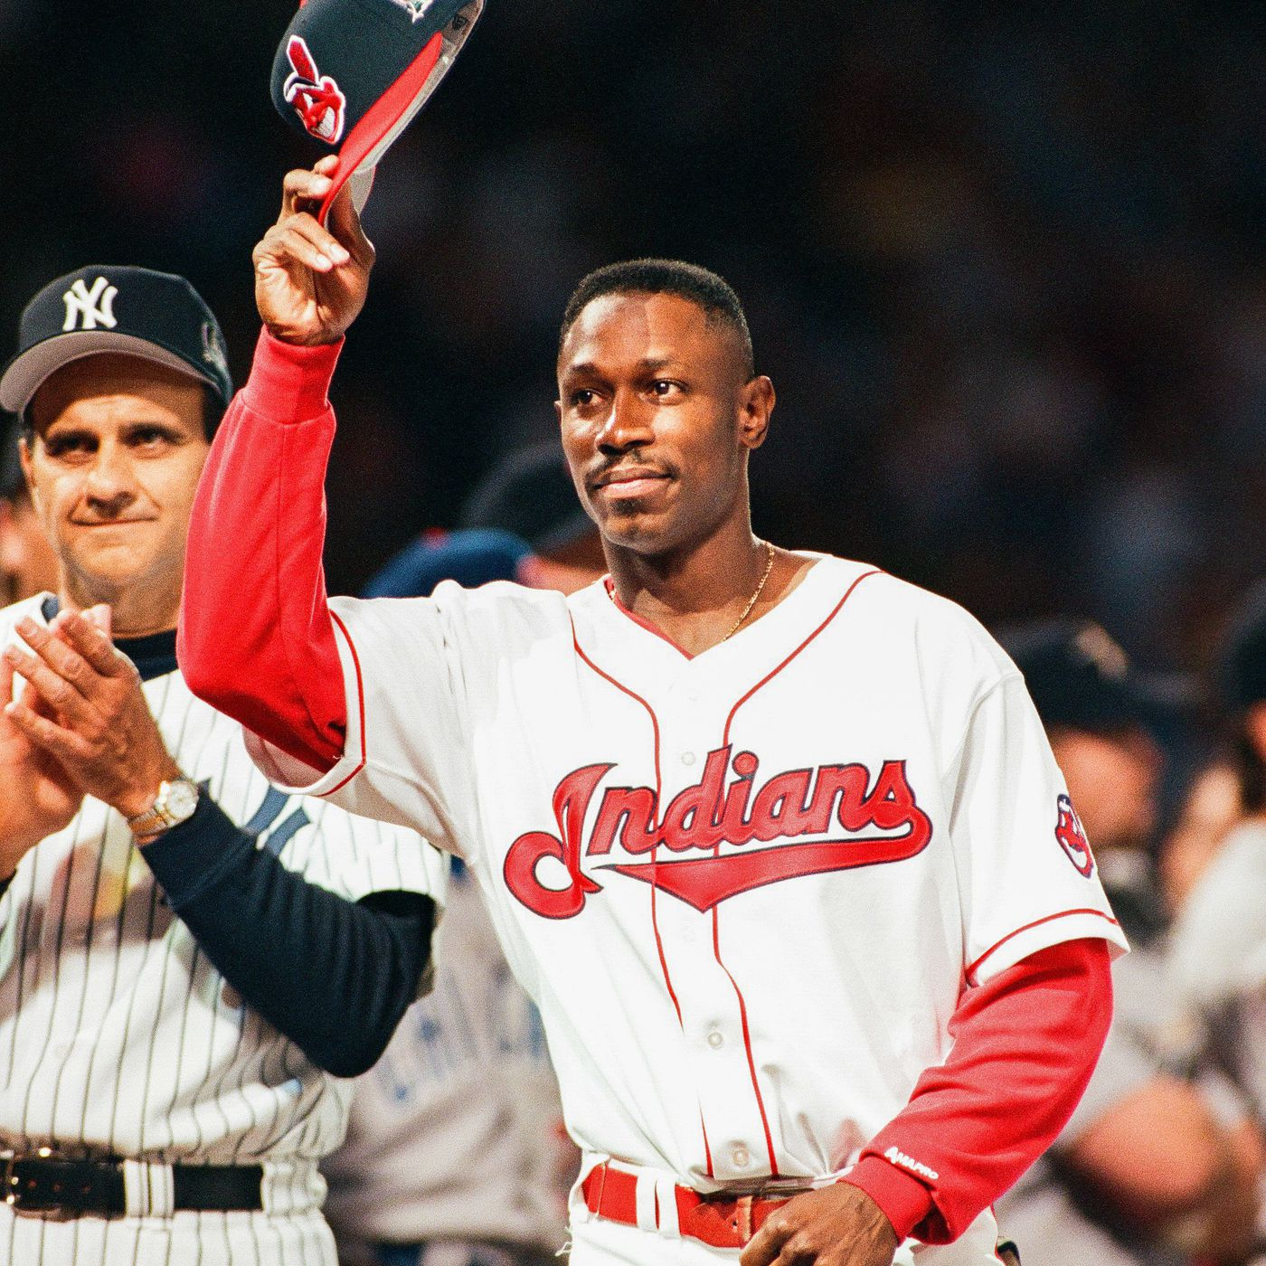
Conclusions
Kenny Lofton’s legacy is one of excellence, speed, and the ability to field his position. To summarize:
In conclusion, Kenny Lofton deserves to be in the Baseball Hall of Fame given his overall ability as a hitter, base stealer, and elite centerfielder.
Lofton surpassed 22 HOF centerfielders in stolen bases by a minimum of 186 stolen bases. His ability to get on base and steal bases made him a superb leadoff hitter, rivaling any players in the HOF.
Lofton’s Total Zone (TZ) score surpasses any in the HOF Group.
Lofton has the highest WAR in his peer group with a 68.4, showing his status as a great, well-rounded player.
Lofton has a JAWS score which is very comparable to HOF centerfielders.

Slide 31
Acknowledgement of Advisers and Mentors
Nogales High School
Angel Canto, Superintendent
Tim Colgate, Principal
Ravi Dutt Chauniyal, SACP Advisor
University Advisors
Dr. Anton Dahbura, Professor and Researcher, Johns Hopkins University Computer Science
Dr. John Burbridge, Elon University
Tad Berkery, Johns Hopkins University
Santa Cruz County
Christopher Young, Chief Deputy
Rachel Sedgwick
Sports Analytics Advisor
Cody Callahan, Baseball Analytics, Arizona Diamondbacks
The Sports Analytics Club Program
Robert L. Clayton, CEO and Co-Founder
Christien Oliver, National Program Manager

Slide 32
References: Background Information & Additional Insights
Baseball Almanac, I. (n.d.). Stats for hall of fame center fielders. Baseball Almanac. Retrieved November 8, 2022, from https://www.baseball-almanac.com/hof/hofstce.shtml.
Baseball Prospectus, Insightful Analysis. Baseball Prospectus. Retrieved November 8, 2022, from https://www.baseballprospectus.com/.
Baseball Reference, Active leaders & records for stolen bases. Baseball. (n.d.). Retrieved November 8, 2022, from https://www.baseball-reference.com/leaders/SB_active.shtml.
Baseball Reference, Career Leaders & Records for Stolen Bases. Baseball. (n.d.). Retrieved November 8, 2022, from https://www.baseball-reference.com/leaders/SB_career.shtml.
Baseball Reference, JAWS. Baseball. (n.d.). Retrieved November 8, 2022, from https://www.baseball-reference.com/about/jaws.shtml.
Baseball Reference, JAWS for Centerfielders. Baseball. (n.d.). Retrieved November 8, 2022, from Major League Baseball, Kenny https://www.baseball-reference.com/leaders/jaws_CF.shtml
Lofton stats, Fantasy & News. MLB.com. (n.d.). Retrieved November 8, 2022, from https://www.mlb.com/player/kenny-lofton-117863
Fansided, Examining the Hall of Fame case for Cleveland legend Kenny lofton (n.d) Retrieved January 16, 2023, from https://calltothepen.com/2022/02/13/examining-hall-of-fame-case-cleveland-indians-kenny-lofton/#:~:text=In%20his%2017%2Dyear%20career,four%2Dtime%20Gold%20Glove%20winner

