Slide 1
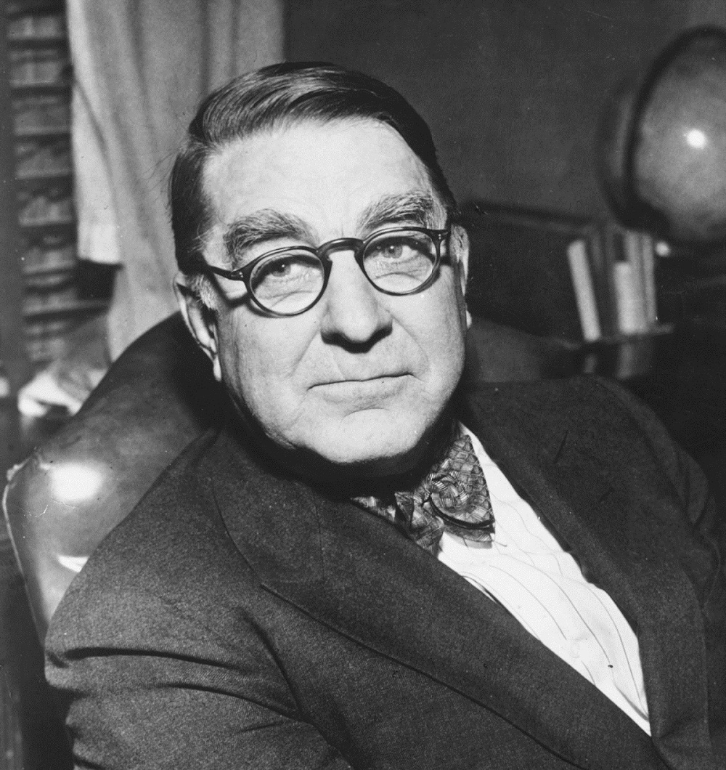
In a profession where the physical is dominant in the triune nature of man, it would be surprising indeed if we did not find here and there an occasional scalawag – Branch Rickey

Slide 2
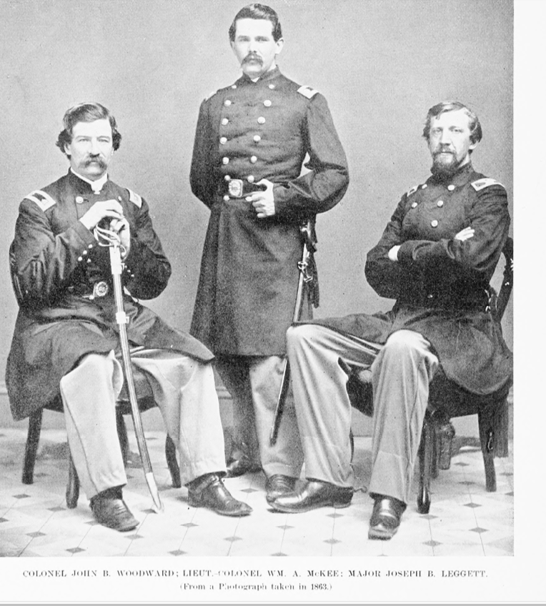
JOSEPH LEGGETT: EMBEZZLER

Slide 3
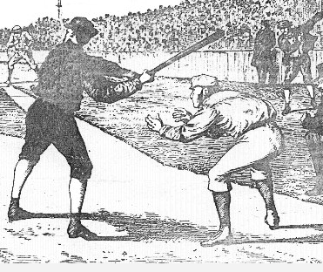
“Taking balls sharp off the bat a la Joe Leggett….”sharp off the bat, a la Joe Leggett t, a la Joe Leggett

Slide 4
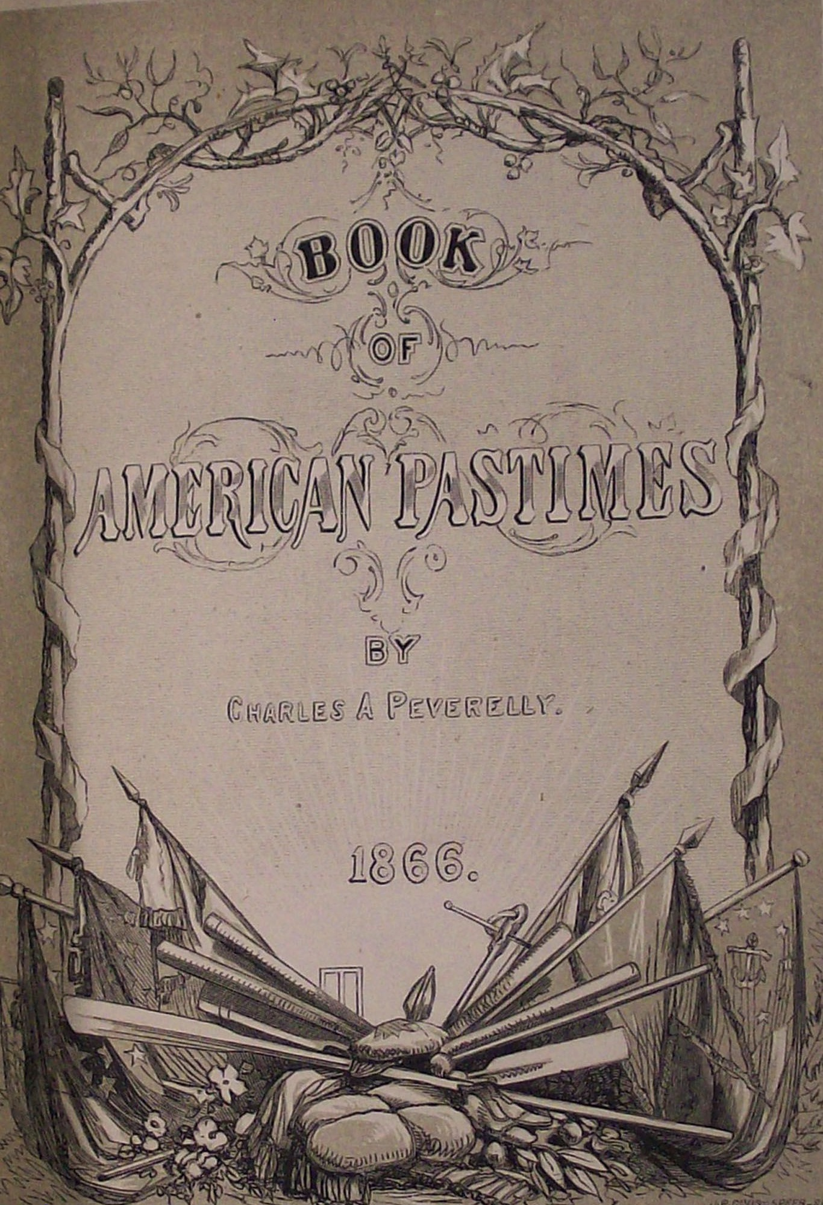
CHARLES A. PEVERELLY:
ARSONIST

Slide 5
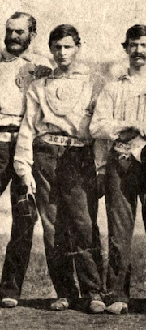
ANDREW T. PEARSALL:
TRAITOR

Slide 6
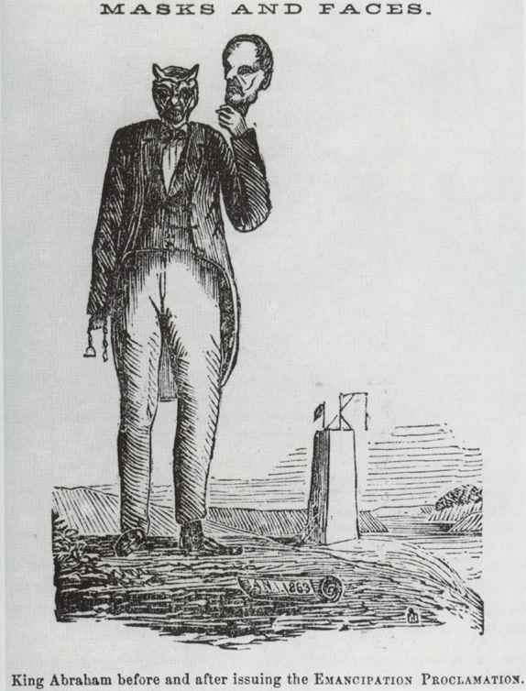
“KING ABRAHAM BEFORE AND AFTER ISSUING THE EMANCIPATION PROCLAMATION”

Slide 7
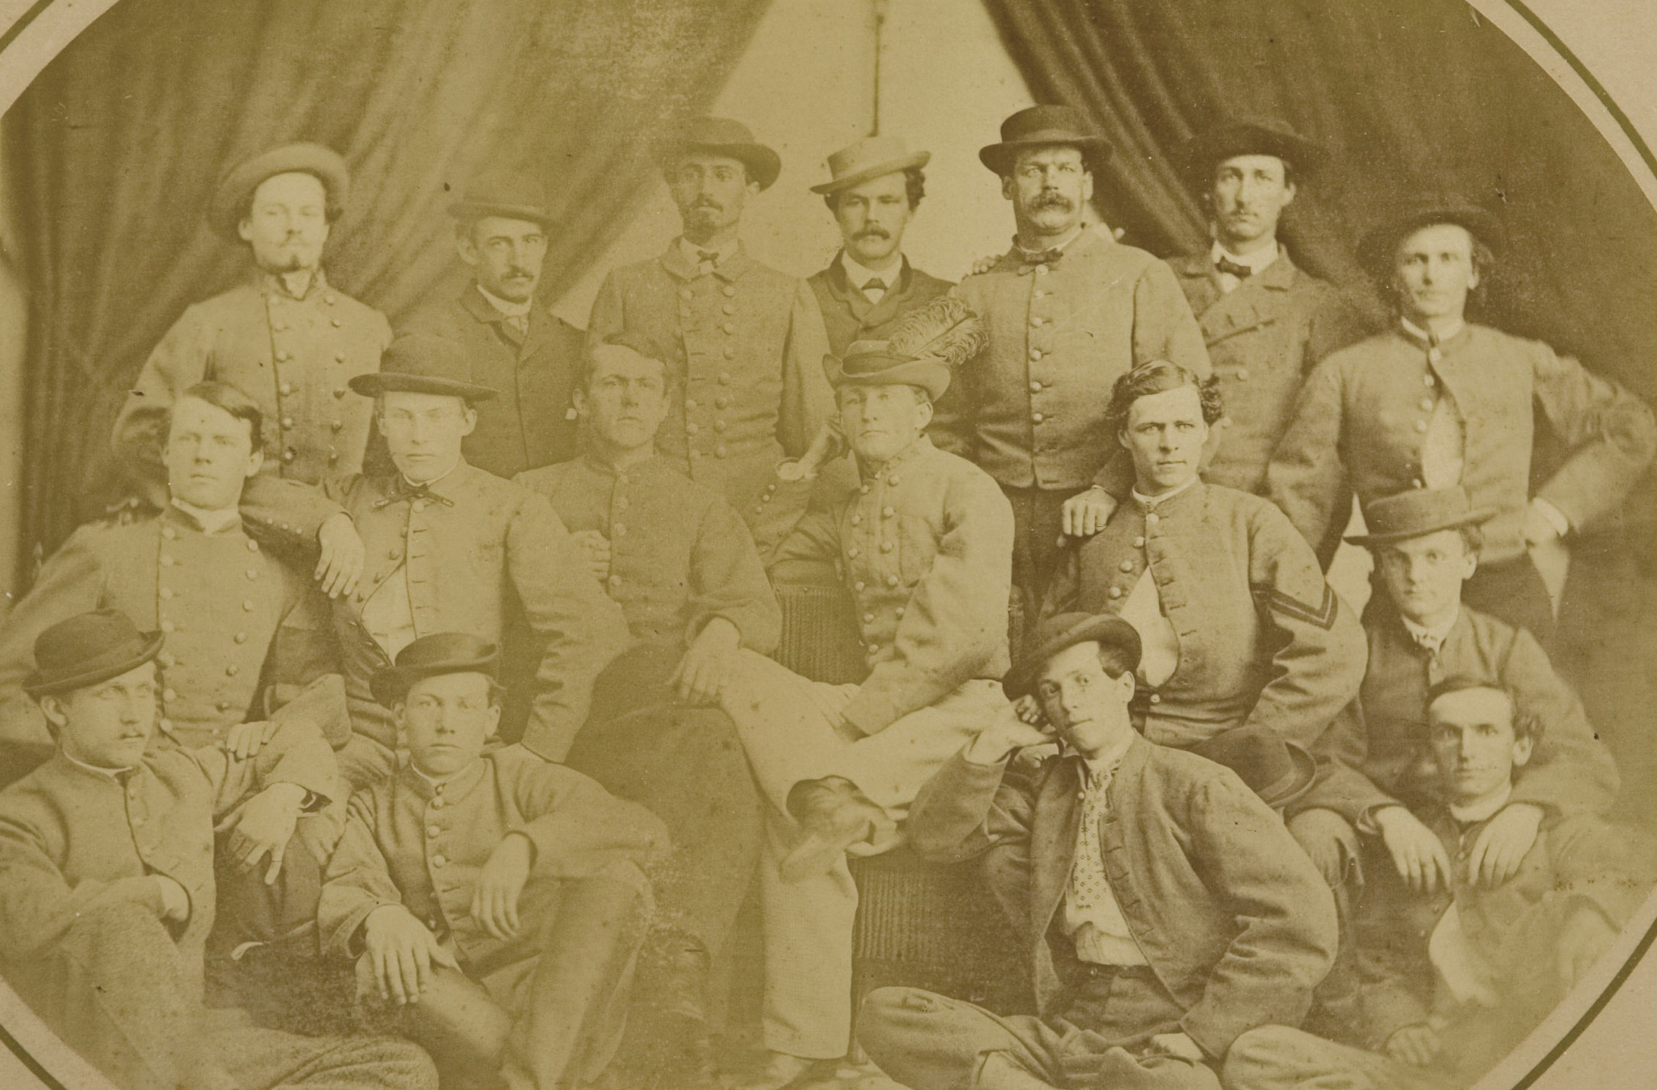
Alexander babcock:
War criminal?

Slide 8
ALEXANDER SAMUELS:
WIRETAPPER

Slide 9
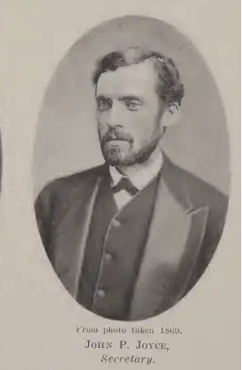
Johnny joyce: racketeer

Slide 10
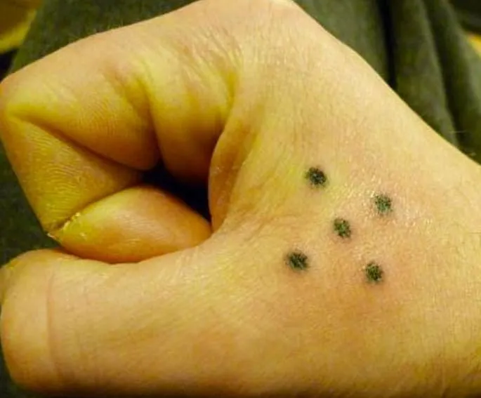
PATSY DOCKNEY: THIEF

