Slide 1
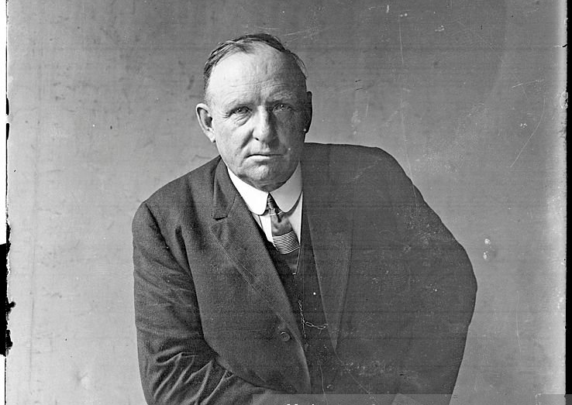
The Inglorious Exit of Cap Anson
Mike Haupert
SABR 51 Chicago
July 6, 2023

Slide 2
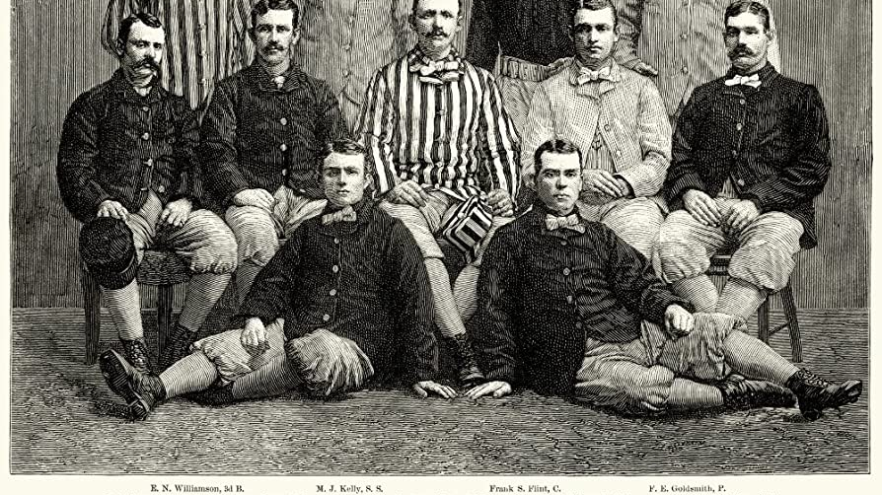
“The most conspicuous ballplayer in the nation” – Chicago Tribune
“The greatest man in the history of baseball” – Hugh Fullerton

Slide 3
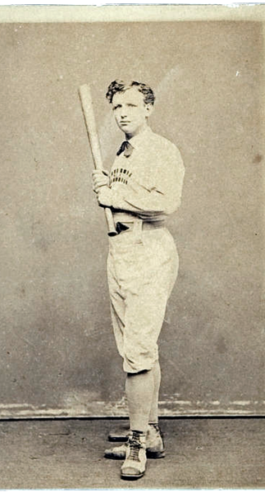
Adrian Constantine Anson
Born April 17, 1852
Age 15 earned a spot on the Marshalltown team alongside his father (Henry) and older brother (Sturgis)
1870 exhibition game v Rockford
1871 first professional contract with Rockford
$66.66 per month
.325, league leading 11 doubles
4-21 record, team dissolved at season’s end
1872-75 Philadelphia NA
.359 BA, .376 OBP, 195 RBI in 247 games

Slide 4
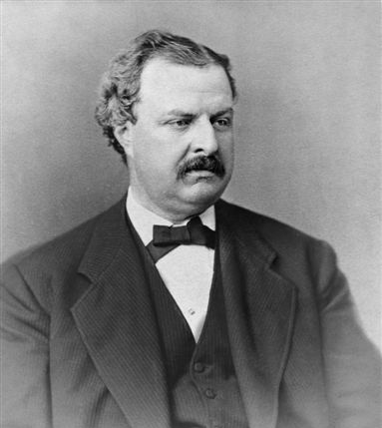
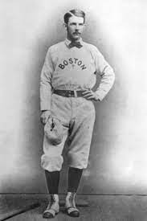
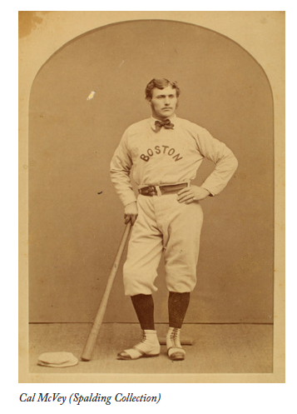
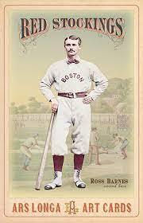
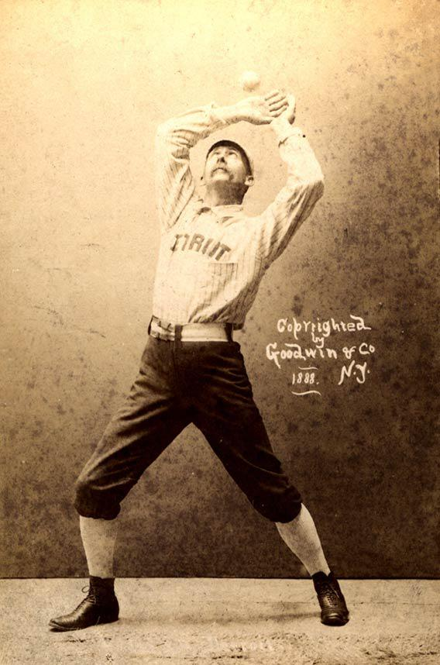
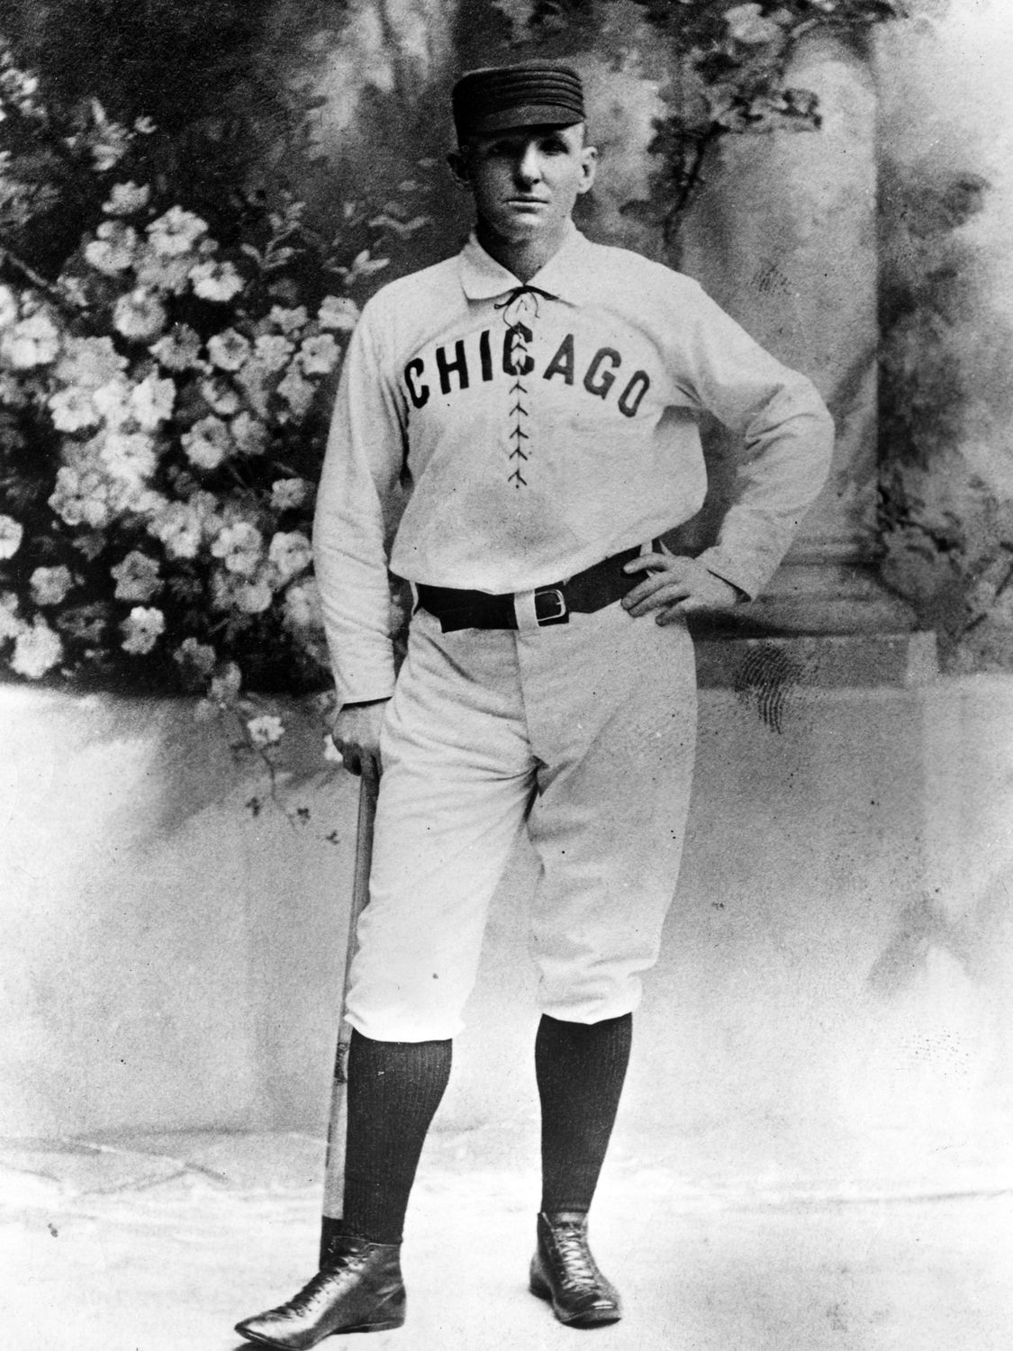
The National League
1875 Spalding letter to Whitestockings
William Hulbert signings
$2000
30%
Board member
$2000
$2000
25%
$2000
$2000
$200 advance

Slide 5
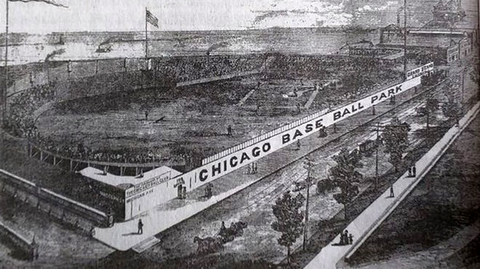
A Glorious Debut
Inaugural pennant winners
Anson top five in hits, HR, RBI, BA, OBP, SLG
Spalding retires at season’s end
Manager 1876-77
Club secretary 1878

Slide 6
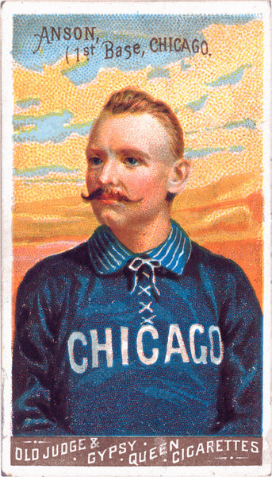
“Cap” Anson in White Stockings
1876-1897
4 time batting champ, 8 time RBI leader
.331 BA, 3022 hits
Exclusive member of 3000 hit club until 1914
1879-97 player manager
5 pennants
11th all time
1282-932 record (.579 win %)
Second to 1000 wins behind Harry Wright
8th highest win% of managers with 1000 or more games

Slide 7
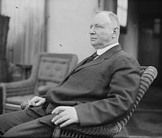
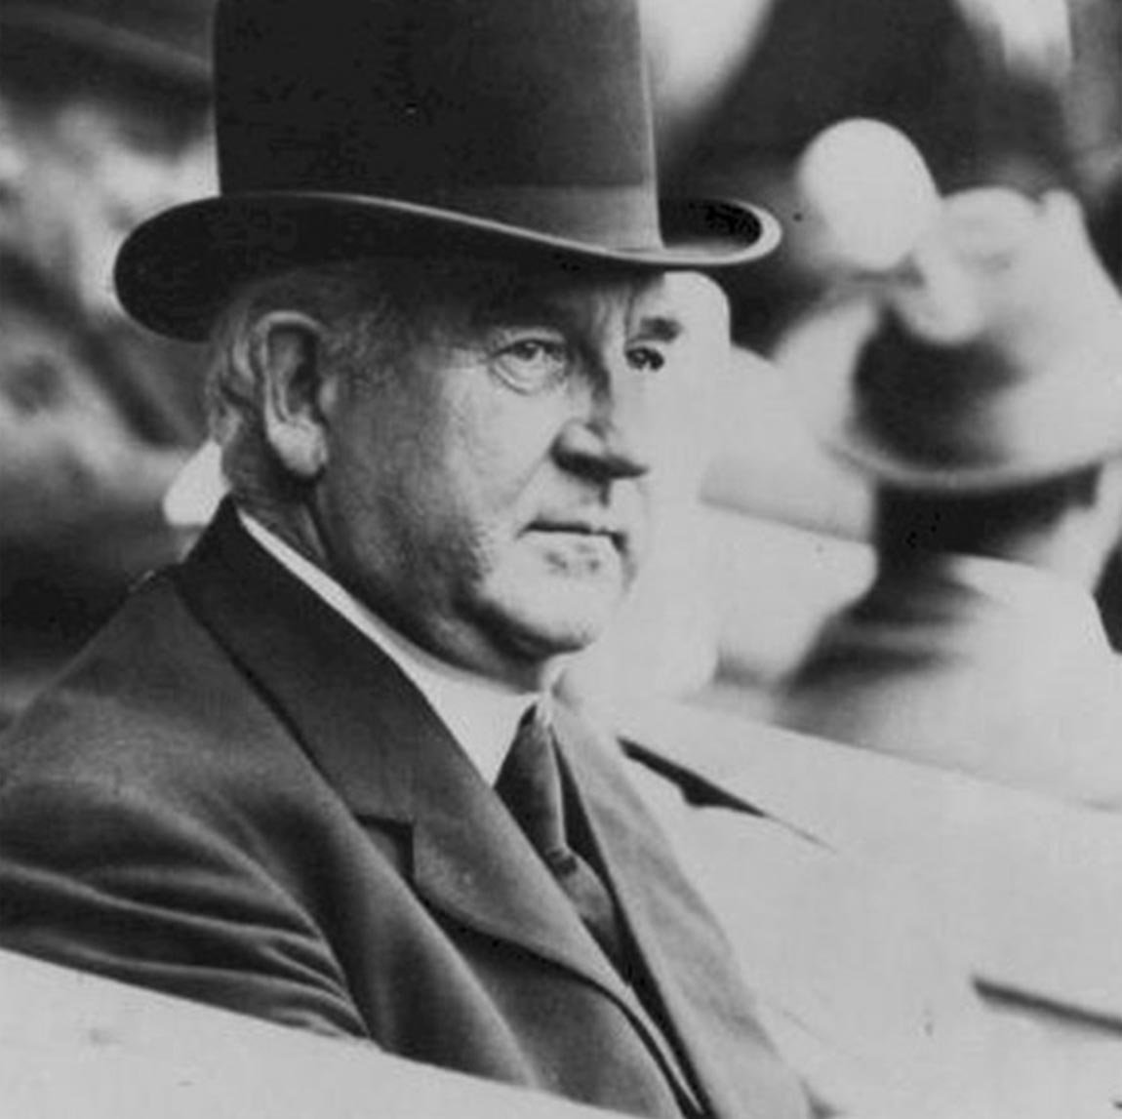
The Anson- Spalding Connection
1870 Rockford v Marshalltown
1874 England baseball tour
Anson’s Athletics and Spalding’s Red Stockings led by Harry Wright
1875 Spalding recruits Anson to Chicago
1888 World Tour
1889 Spalding signs Anson to 10-year pact

Slide 8
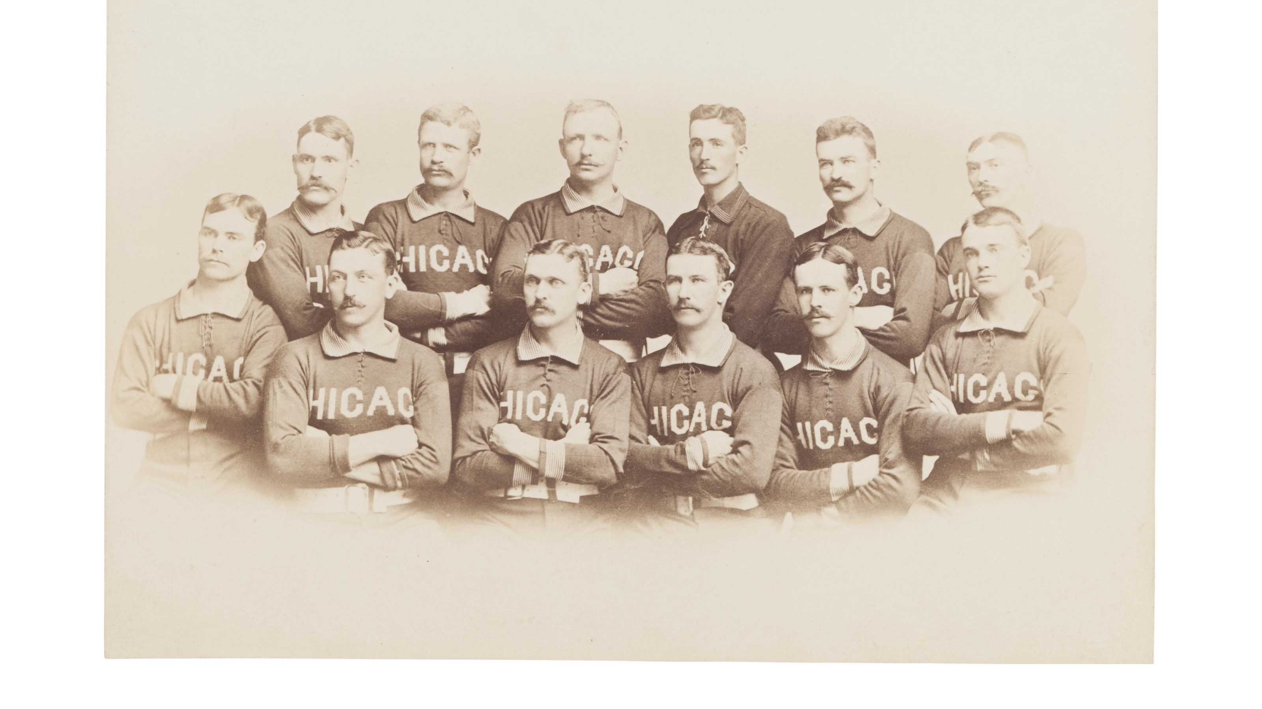
Building a Legacy
1879 named manager
April 1, 1880 purchases ownership share from Edwin Dexter
1880s
Five pennants, .640 win percentage
.344 BA, .398 OBP, three batting titles, 7 RBI titles, appeared in 99% of games
1890 purchases $5000 stock to help save Giants

Slide 9
Building a Legacy
1890 “the man who saved the National League”
But lost the respect of its players
Chicanery cost Whitestockings 1891 pennant
“I [tried] to dissuade . . . my players from what I regarded a foolish step”
“. . . They have betrayed their old employers”
“Our old players will be little missed”
“The Brotherhood . . . is made up of stars playing on their reputations”
“There won’t be any compromise on my consent”

Slide 10
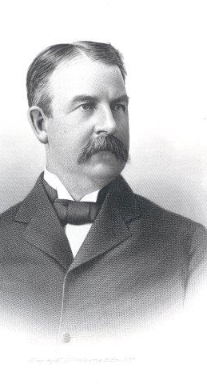
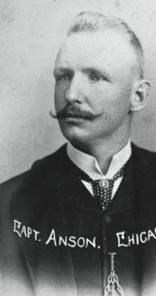
The seeds of discord
1878 Bob Ferguson named manager
Spalding moves into front office as team secretary
President 1882
1891 Spalding resigns club presidency
James Hart named his replacement
“A man thoroughly and well qualified”

Slide 11
The seeds of discord
1892 franchise reorganization
New corporate charter with Hart at helm
Spalding and Anson retain stock
Anson contract taken over by new organization, but one year shorter
1898 Spalding offers Anson 60-day window to buy club
$150 share
1905 sold to Murphy for $105

Slide 12
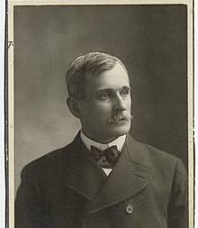
The Hart Years
1891 named president
Previous experience as owner, manager, executive
Successful businessman
1892 heads new Whitestockings corporation
Frequent clashes with Anson
Losing seasons

Slide 13
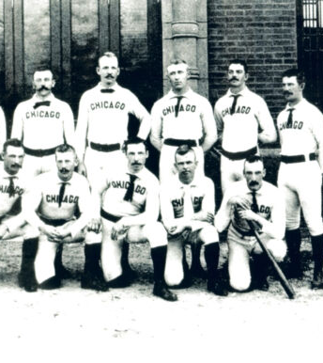
A Fading Star
Final six seasons
Four losing records
Five second division finishes
1897
9th place finish
At 45, a below average player
Hart declines to renew his contract at season’s end
Anson claims to be unaware

Slide 14
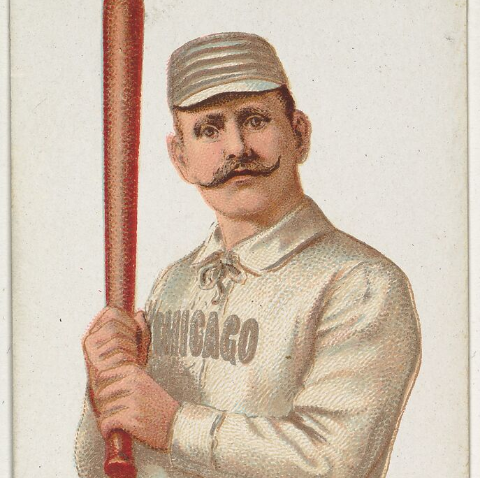
Tarnishing a Legend
Anson contract
Salary plus 10% of net profits
Paid double his contracted salary despite several years of no profits
Gifted his stock
Debts to the club forgiven

Slide 15
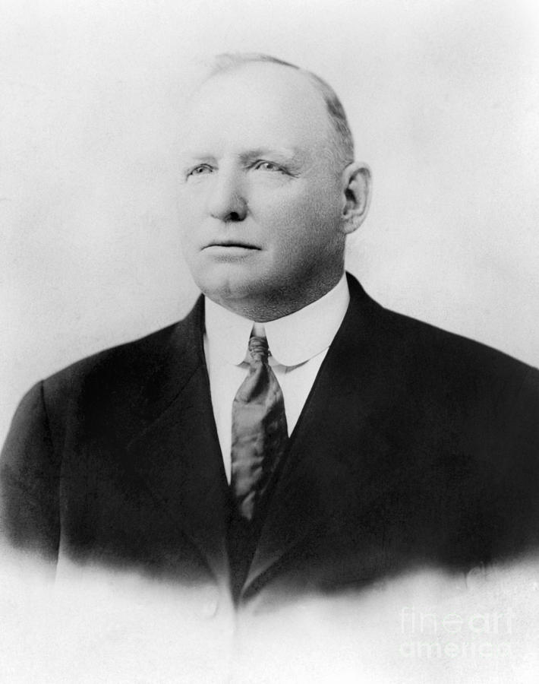
After the Fall
1898 manager NY Giants
Fired after 9-13 start
1898 rebuffs offer of testimonial dinner
Failed attempt to acquire a Western League franchise
President of ill-fated American Association
1899 bowling & billiards parlor

Slide 16
After the Fall
Semi-pro “Anson’s Colts”
1904 Failed purchase of Senators
Stock in ballclub pays no dividends
Sold in 1905 for $77/share
1906 City clerk scandal
1909 NL presidency

Slide 17
After the Fall
1910 bankruptcy
Refuses offer of pension from NL
1910 campaign for Phils manager job
1920 commissioner of baseball
Vaudeville career

Slide 18
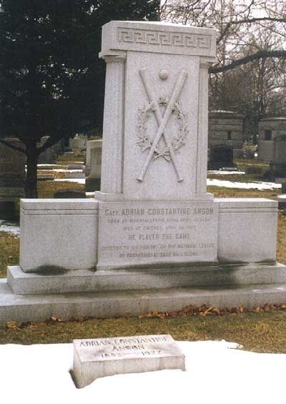
The End
Died penniless on April 15, 1922
NL pays his hospital, funeral, burial expenses, reinters his wife’s remains, erects monument
“We should pattern our lives after this man, whose steadiness in crises can be compared only with the pyramids or with Gibralter” – Judge Kennesaw M. Landis

Slide 19
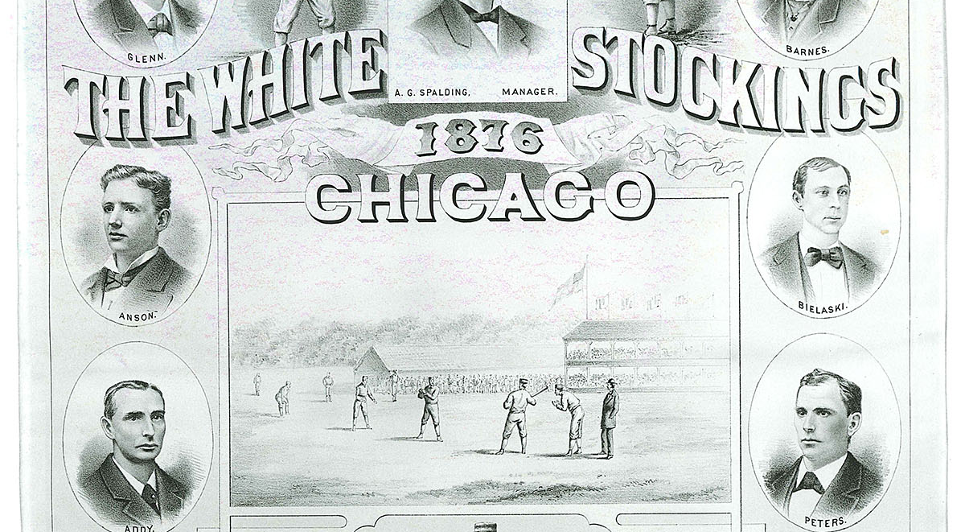
Thank you

