Slide 1
Bringing Pitching+ to DIII Baseball: The Art of W.A.R. Model
Benjamin Reinhard & Henry Gliedman

Slide 2
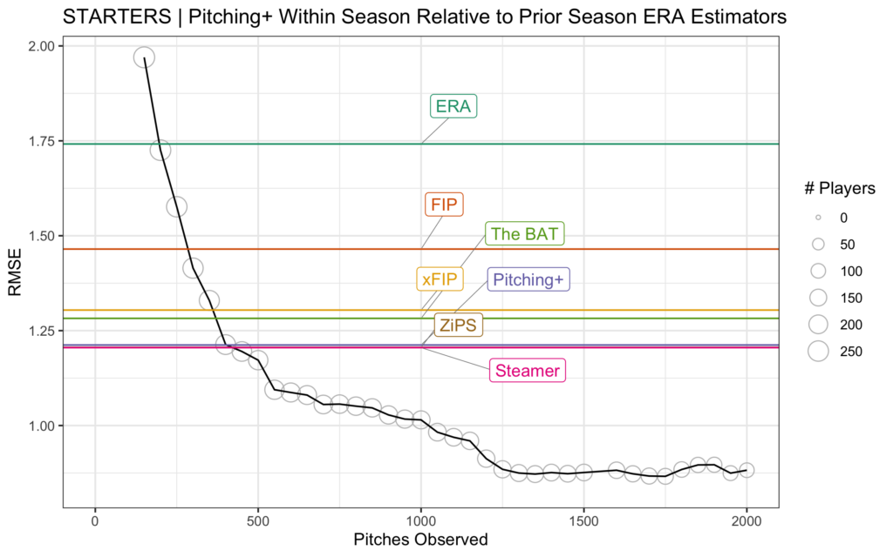
What is Pitching+?
Quantitative model to more accurately measure the pitching ability of a player; Stuff+, Location+, and Pitching+
Original Pitching+ created by Eno Sarris & Max Bay
Public models typically utilize run values to create their models
Notes:
Ethan Moore, Harry Pavlidis, and Jeremy Greenhouse – lack of access to run values & thus no way to proceed as such. No access to EV, LA, swing/take etc, xwOBA. Taking out statistical noise

Slide 3
The Purpose of our Model
Financial constraints and differences in level of play
Average Fastball Velocity of 82 mph vs. 94 mph (St. Olaf v. MLB Average)
How can we quickly and accurately evaluate pitchers in a collegiate program?
Notes:
Not widely available, and not skill-level appropriate. No statcast, and no trackman. At a minimum, schools need a rapsodo or even a pitch logic ball.

Slide 4
Methodology of Stuff+
We measured thrown ball data (velocity, spin rate, movement) with a Rapsodo
Created a “Stuff Constant” for each pitch by using machine learning to weight various statistics
Final statistics were: Whiff%, CSW% (Called Strike% + Swinging Strike%), and FN% (Percent of 2-Strike counts that result in a Strikeout)
Notes:
Also mention trackman & pitch logic.

Slide 5
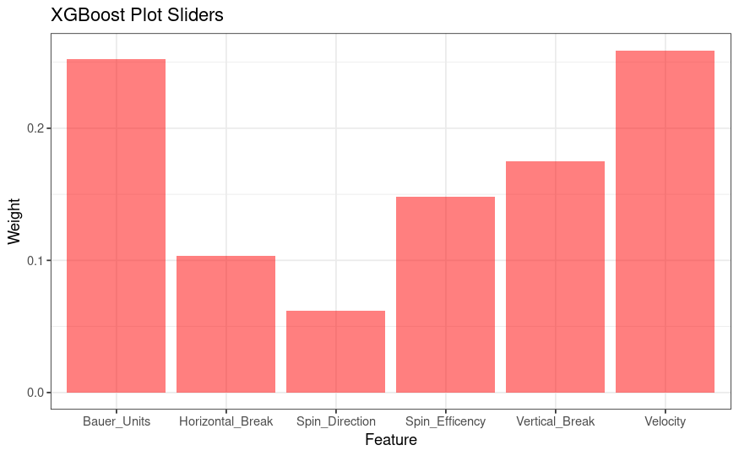
Stuff+ Cont.
Machine Learning
“Stuff Constants” served as response variable – Boruta and XGBoost machine learning used to select and weight thrown ball metrics
Regressions between each metric and “Stuff Constant”
Each regression was centered around 100
Notes:
Talk about graph – the 6 factors. Boruta: Feature selection algorithm used to pick which thrown ball statistics from Rapsodo should be included. XGBoost: Quantifies correlation between “Stuff Constant” and response variables. Created weights for each variable.

Slide 6
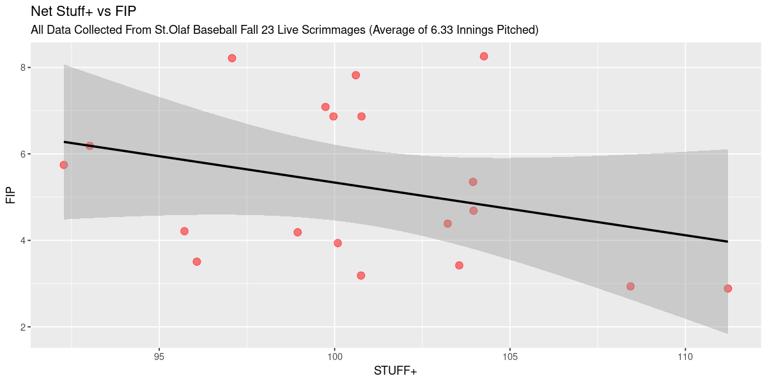
Final Stuff+

Slide 7
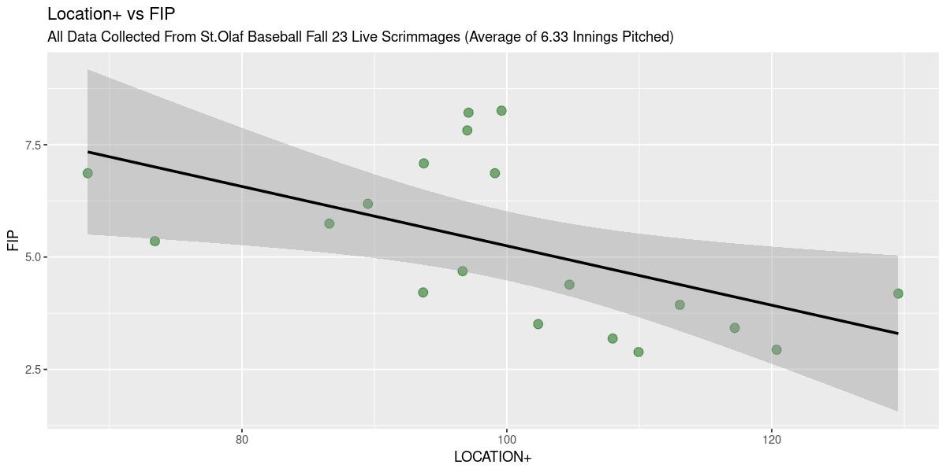
Location+
Location+ operates very similarly to our Stuff Constants – FIP as response variable
Groundball to Flyball Rate, Called Strike Percentage, Controlled Count Percentage (% of ABs reaching 2-0, 3-1), Competitive Pitch Percentage, First ⅔ strikes, First Pitch Strikes
Regressions for each stat vs FIP in similar fashion

Slide 8
Creation of Final Pitching+
Final Pitching + is calculated as a weighted average of Stuff+ & Location+
Based on adjusted R^2 of models against FIP
Final Adjusted R^2 of our Pitching+
Against FIP = .394
Against ERA= .619

Slide 9
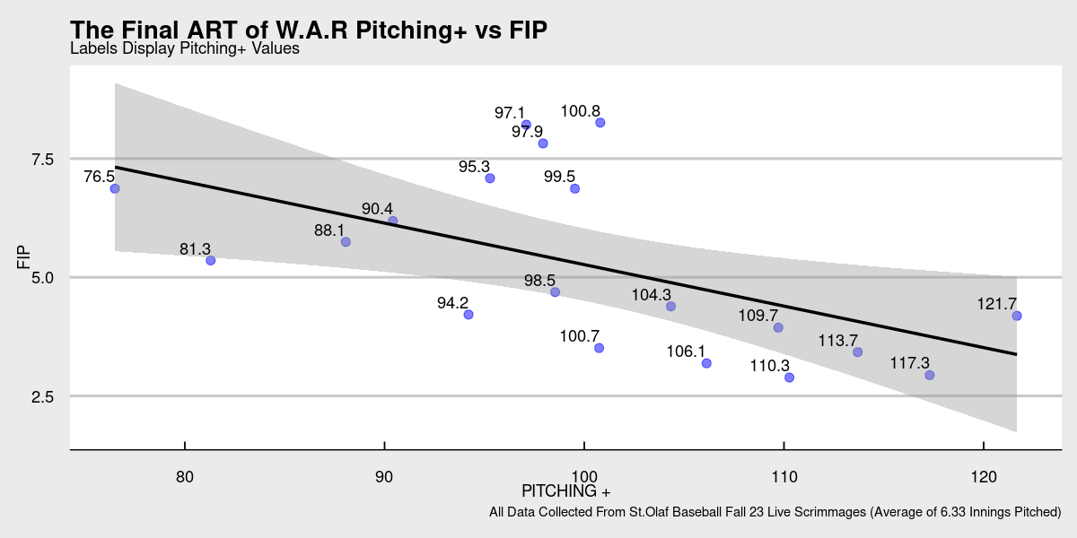
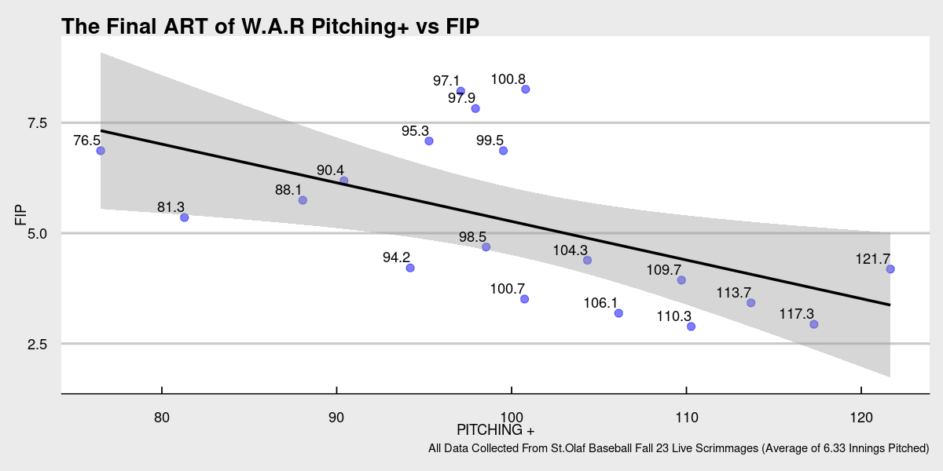
Notes:
This slide probably won’t exist in our final presentation but we would explain on the prior slide the application of our model. We think that this model could be used as the foundation for a detailed development program. When implemented our model could be extremely beneficial towards helping college programs recruit with more accuracy and develop pitcher more efficiently.
Explain that we hope to make the information that statcast provides MLB organizations accessible to all college programs.
P-value against fip = .01

Slide 10
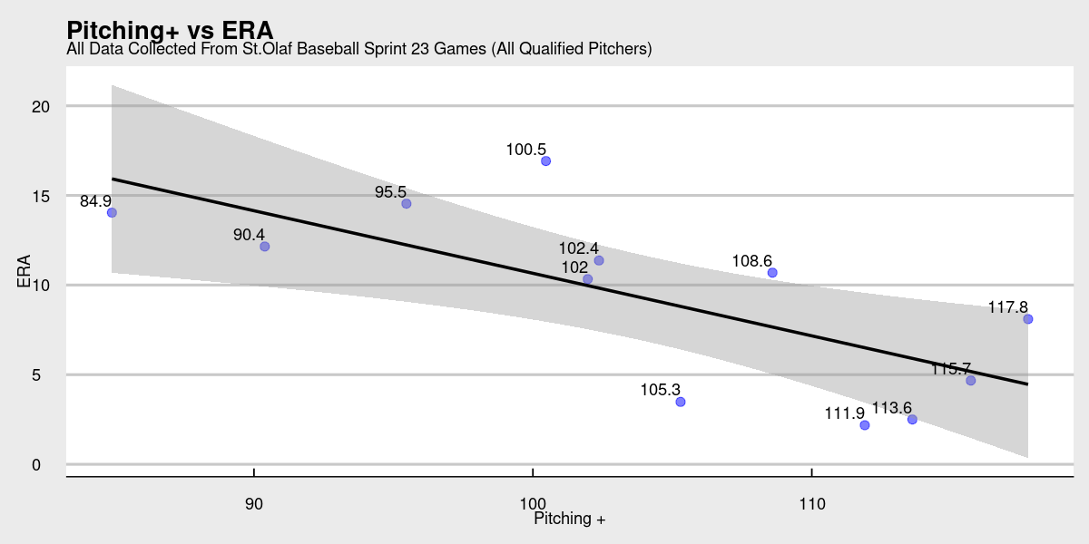
Notes:
This Slide will also not be in the final presentation. We will discuss all of this on our next meeting. Explain that we have made a company with the mission to make advanced baseball analytics accessible to all collegiate ,and high school programs. This access will hopefully give development aid to young baseball players all across the country. Our first product is the Art of W.A.R Pitching+ Server which contains, a Stuff+ calculator for our Pitching+, one of the most advanced publicly accessible charting softwares, and a large library of baseball research to help with development. Goal is to make this app become a sort of robot pitching coach.

