Slide 1
Refining Baseball Pitching Accuracy: Assessing the Impact of Immediate Feedback on Pitching Precision
Takafumi Hayashi (Asahi University)
Takaaki Nara (University of Tsukuba)
Takehiko Sano (Keio University)

Slide 2
Self-introduction
I am a Japanese baseball researcher.
I used to be a baseball player.
During my time playing baseball, my team defeated the team representing US colleges (1997).

Slide 3
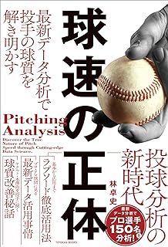
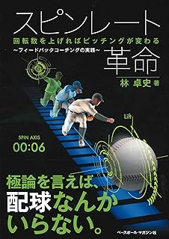
Self-introduction: My Books
The Secret of
Ball Velocity
The Spin Rate Revolution

Slide 4
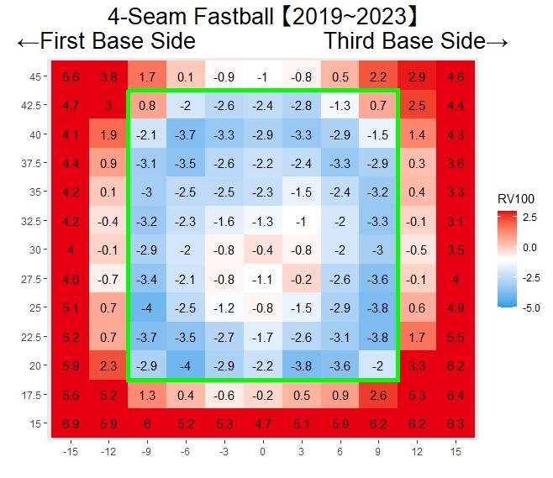
Introduction: The Importance of Pitching Accuracy
Accurate pitching is key in baseball
Securing outs hinges on precise pitching
High pitching accuracy decreases pitch count (Manzi et al., 2022)
Notes:
武田さんのスライドを入れる

Slide 5
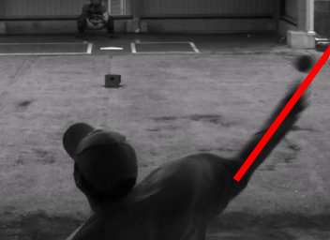
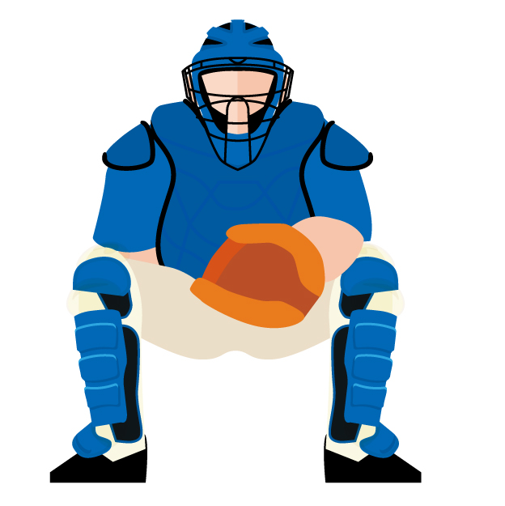
Introduction: The Distribution of Pitching Error
Shinya et al. (2017)
The arrival points of a thrown ball form an elliptical shape; notably; the trajectory of the pitcher’s arm is linked to the direction of the pitching error
Kusafuka et al. (2020)
Elevation angle and velocity impact vertical arrival; azimuth angle influences the ball’s horizontal arrival point
How to improve pitching errors?
Notes:
ラプソードから、投球分布の絵を持ってくる

Slide 6
Introduction: Pitching Accuracy Training
Marsh（2004）
Leg elevation and closed-eye training reduce pitching errors
Bauer (2021)
Training with one eye closed enhances pitching accuracy
Agresta et al. (2022):
Control and velocity are separate, biomechanically linked skills
Further studies are needed on how to enhance pitching accuracy

Slide 7
KR & KP
KP: Knowledge of performance
KR: Knowledge of results
The tracking system's velocity and quality measurements correspond to KR; the feedback is KRFB.

Slide 8
The Potential of KRFB
External focus is effective in motor learning（Wulf, 2013).
Immediate velocity feedback enhances handball players’ velocity (Štirn et al., 2017).
Immediate KRFB: Enhancing pitching accuracy?

Slide 9
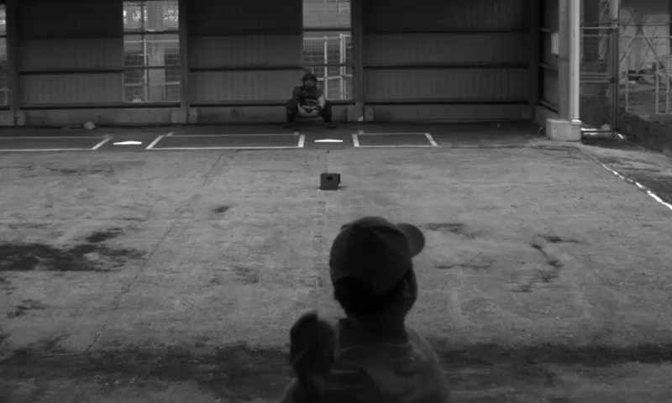
Purpose
To investigate whether providing immediate feedback on pitching errors during practice enhances pitching accuracy among male semi-professional or college-level pitchers

Slide 10

Method: Subjects
Twelve male pitchers (Mean age: 21.4±1.8 years)
The pitchers were semi-professional or college-level players.
They were assigned to intervention and control groups (six subjects per group).
Notes:
日本地図を入れる

Slide 11
Method: Experimental Protocol
The intervention group received pitching sessions with immediate feedback on errors.
“Aiming for the outside low corner”
Five sessions held once a week, with 20 pitches per session
The intervention group received
100 pitches of immediate feedback.
Notes:
日本地図を入れる

Slide 12
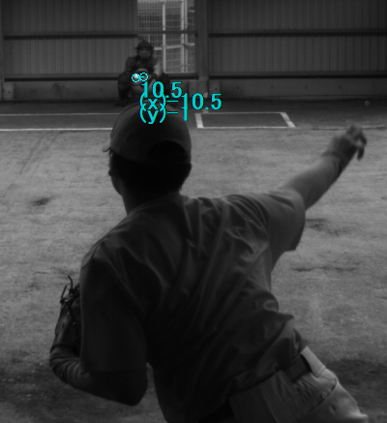
Method: Measuring Pitching Error

Slide 13
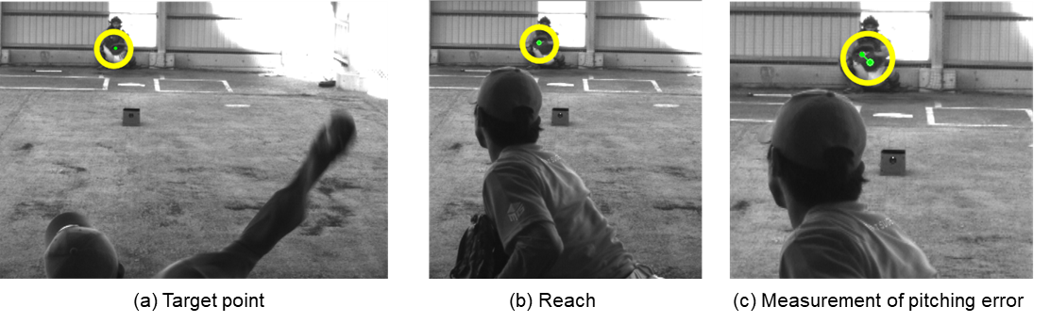
Method: Measuring Pitching Error
Using a high-speed camera (HAS-U2, 300Hz)
The distance from the mitt's center at the release to the ball's center just before the catch
Using the two-dimensional direct linear- transformation method
Notes:
Pre-トレーニング-post を図で示す。

Slide 14
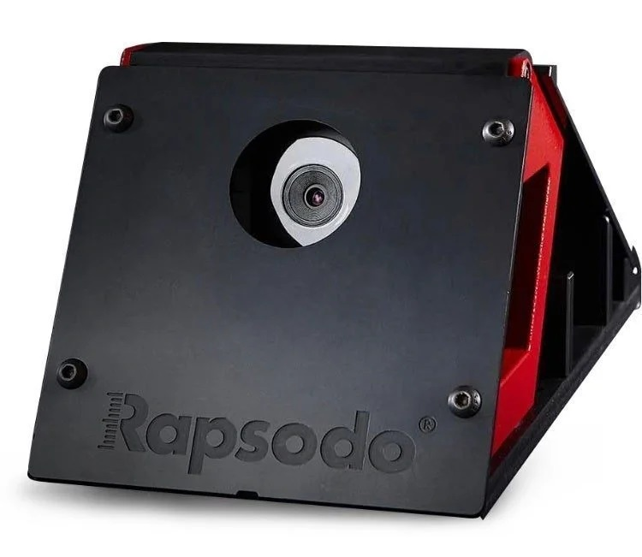
Method: Measuring Velocity
Using Rapsodo Pitching 2.0 (Rapsodo, Inc., MO, USA)
Velocity feedback not provided

Slide 15
Method: Statistical Analysis
Pitching error: Utilized the 95% confidence ellipse area as the metric for pitching error (Kusafuka et al., 2020)
Pitching velocity: Calculated as the average of ten pitches pre- and post-experiment
A two-way ANOVA was conducted at the 5% significance level.

Slide 16
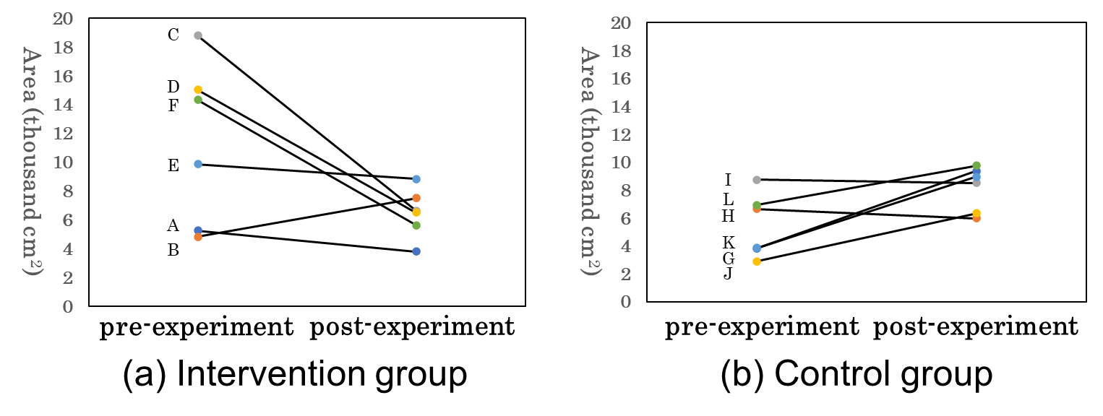
Result: Pitching error
Pre- and Post-Intervention Evaluation Results Depicted with 95% Confidence Ellipse Areas

Slide 17
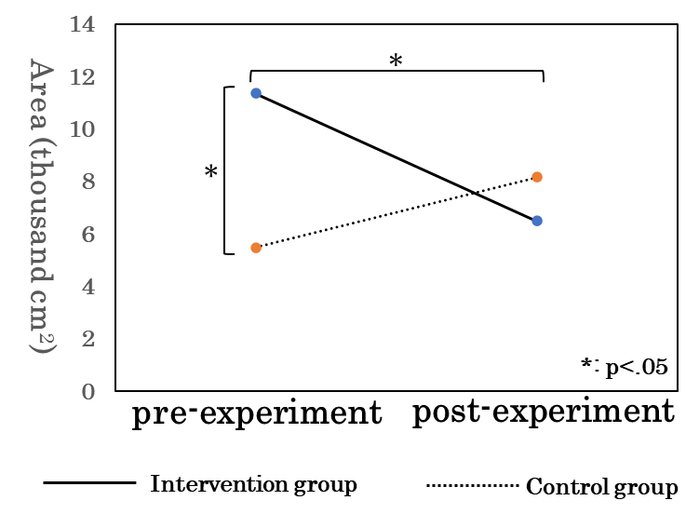
Result: Pitching Error
Intervention group: from 11,344 ± 5,654 cm² to 6,483 ± 1,701 cm², p = 0.024
Control group: smaller 95% confidence ellipse area than intervention group (11,344 ± 5,654 cm² vs. 5,485 ± 2,293 cm², p = 0.040)
Comparison of 95% Confidence Ellipse Areas between the Intervention and Control Groups
Notes:
数字も入れる

Slide 18
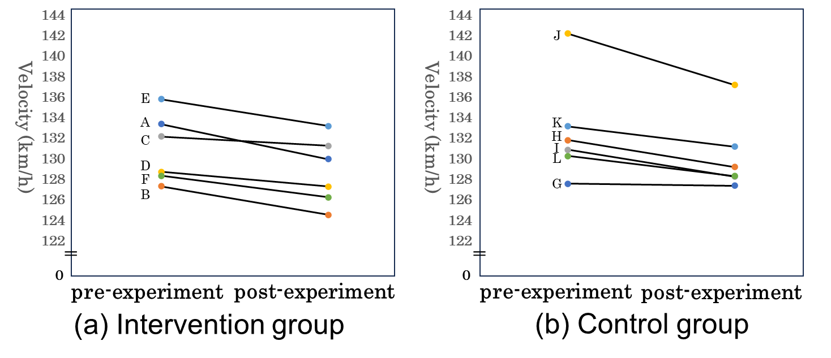
Result: Pitching Velocity
Comparison of 95% Confidence Ellipse Areas between the Intervention and Control Groups

Slide 19
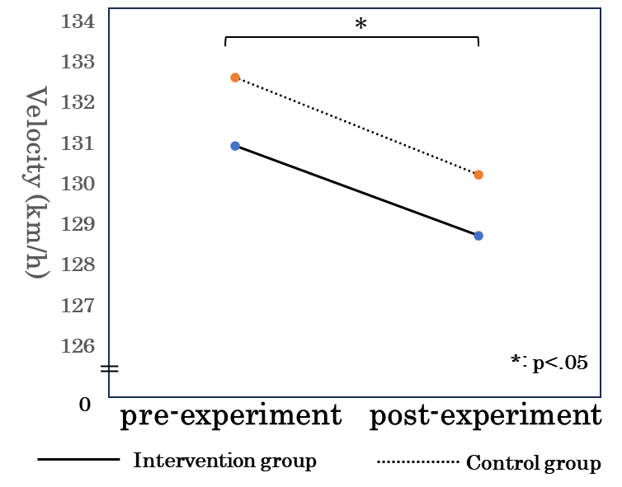
Result: Pitching Velocity
The post-experiment velocities are lower than the pre-experiment velocities.
Intervention group: from 130.9 ± 3.3 km/h to 128.7 ± 3.3 km/h, p= 0.02
Control group: from 132.6 ± 5.0 km/h to 130.2 ± 3.6 km/h, p= 0.01
Comparison of Pitching Velocity between the Intervention and Control Groups
Notes:
数字も入れる

Slide 20
Discussion: Pitching Error and Velocity
Immediate error feedback may enhance pitching accuracy.
The effect may be more pronounced in pitchers with low accuracy (> 14,000 cm²).

Slide 21
Discussion: Why was it effective?
Using KRFB to promote external focus is suitable for target-aiming competitions (Keller et al., 2022).
KRFB enhances understanding of pitching error magnitude and distribution shape (Ota et al., 2015; Yamamoto et al., 2019).
Feedback required approximately 40 seconds

Slide 22
Limitations and Directions for Future Work
Future studies should:
  Use samples with participants from various age groups
  Verify the effects of changing the course and pitch type
  Explore the impact of altering the practice frequency and duration
  Involve more participants
  Revise the feedback unit

Slide 23
Conclusion
To examine whether immediate error feedback during pitching practice improves pitching accuracy in male semi-professional or college-level pitchers.
In the intervention group, a significant reduction in the 95% confidence ellipse area post-experiment compared to pre-experiment was observed.
Immediate feedback during pitching practice tends to benefit pitchers with lower accuracy, suggesting the presence of a potential threshold effect.

Slide 24
Acknowledgments
This work was supported by JSPS KAKENHI Grant Number 20K11376 Grant-in-Aid for Scientific Research(C).

Slide 25
References
Agresta, C., Freehill, M. T., Nakamura, B., Guadagnino, S., & Cain, S. M. (2022). Using sensors for player development: Assessing biomechanical factors related to pitch command and velocity. Sensors, 22(21), 8488.
Bauer, T. (2021, 2021/11/18). Trevor Bauer's Command Training Program | Baseball 401. Retrieved from https://youtu.be/qtgtQFihXZw?si=v50gP3gcCLEqoWCO
Keller, M., Schweizer, J., & Gerber, M. (2023). Pay attention! The influence of coach-, content-, and player-related factors on focus of attention statements during tennis training. European Journal of Sport Science, 23(6), 1001–1009.
Kusafuka, A., Kobayashi, H., Miki, T., Kuwata, M., Kudo, K., Nakazawa, K., & Wakao, S. (2020). Influence of release parameters on pitch location in skilled baseball pitching. Frontiers in Sports and Active Living, 2, 36.
Manzi, J., Dowling, B., Wang, Z., Luzzi, A., Thacher, R., Rauck, R., & Dines, J. (2022). Pitching mechanics and the relationship to accuracy in professional baseball pitchers. The American Journal of Sports Medicine, 50(3), 814–822.
Marsh, D. W., Richard, L. A., Williams, A. L., & Lynch, K. J. (2004). The relationship between balance and pitching error in college baseball pitchers. The Journal of Strength & Conditioning Research, 18(3), 441-446.

Slide 26
References
Ota, K., Shinya, M., & Kudo, K. (2015). Motor planning under temporal uncertainty is suboptimal when the gain function is asymmetric. Frontiers in Computational Neuroscience, 9, 88.
Shinya, M., Tsuchiya, S., Yamada, Y., Nakazawa, K., Kudo, K., & Oda, S. (2017). Pitching form determines probabilistic structure of errors in pitch location. Journal of sports sciences, 35(21), 2142–2147.
Štirn, I., Carruthers, J., Šibila, M., & Pori, P. (2017). Frequent Immediate Knowledge of Results Enhances the Increase of Throwing Velocity in Overarm Handball Performance. Journal of Human Kinetics, 56(1), 197-205.
Wulf, G. (2013). Attentional focus and motor learning: A review of 15 years. International Review of Sport and Exercise Psychology, 6(1), 77–104.
Yamamoto, H., Shinya, M., & Kudo, K. (2019). Cognitive bias for the distribution of ball landing positions in amateur tennis players (cognitive bias for the motor variance in tennis). Journal of Motor Behavior, 51(2), 141–150.

Slide 27
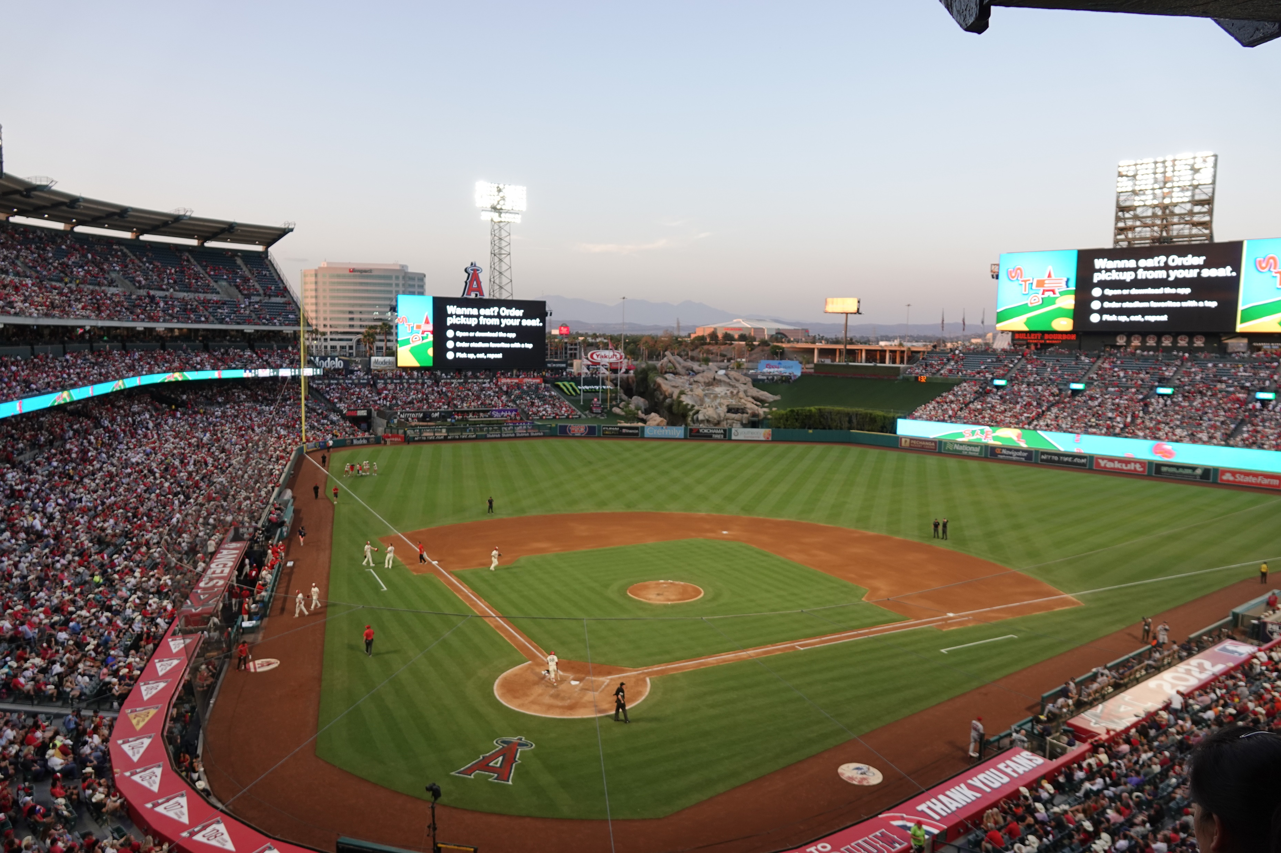
Thank You!

