Slide 1
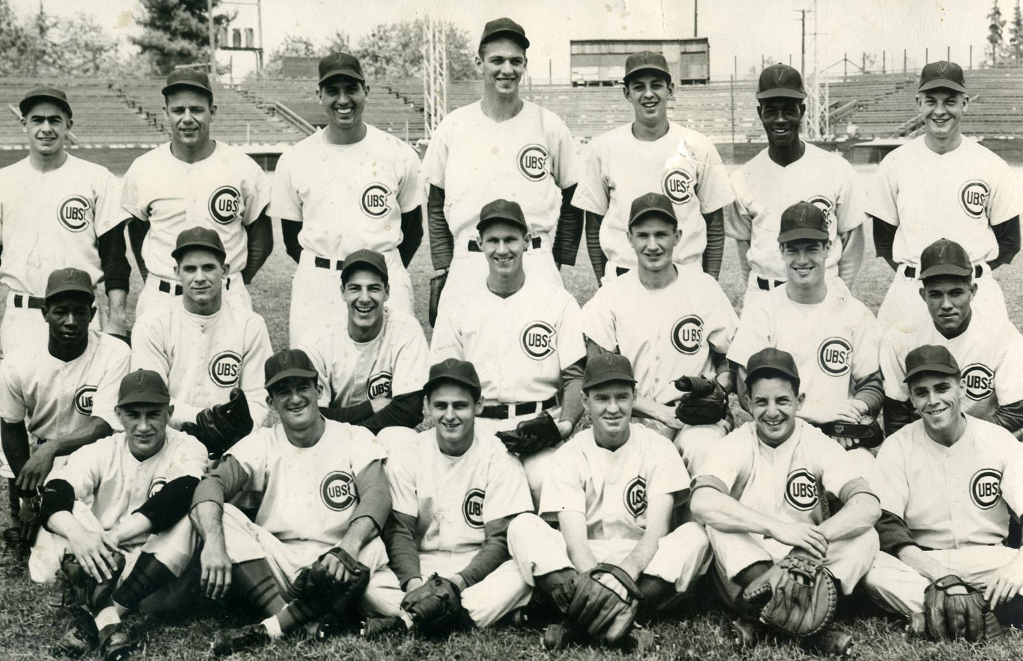
8 Strong Men: The Chicago Cubs’ First Move Toward Integration
Don Zminda
SABR 51
July 7, 2023

Slide 2
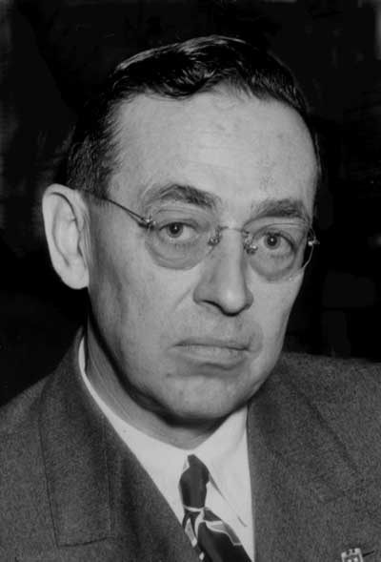
Philip K. Wrigley
Owner
Chicago Cubs
1932-1977

Slide 3
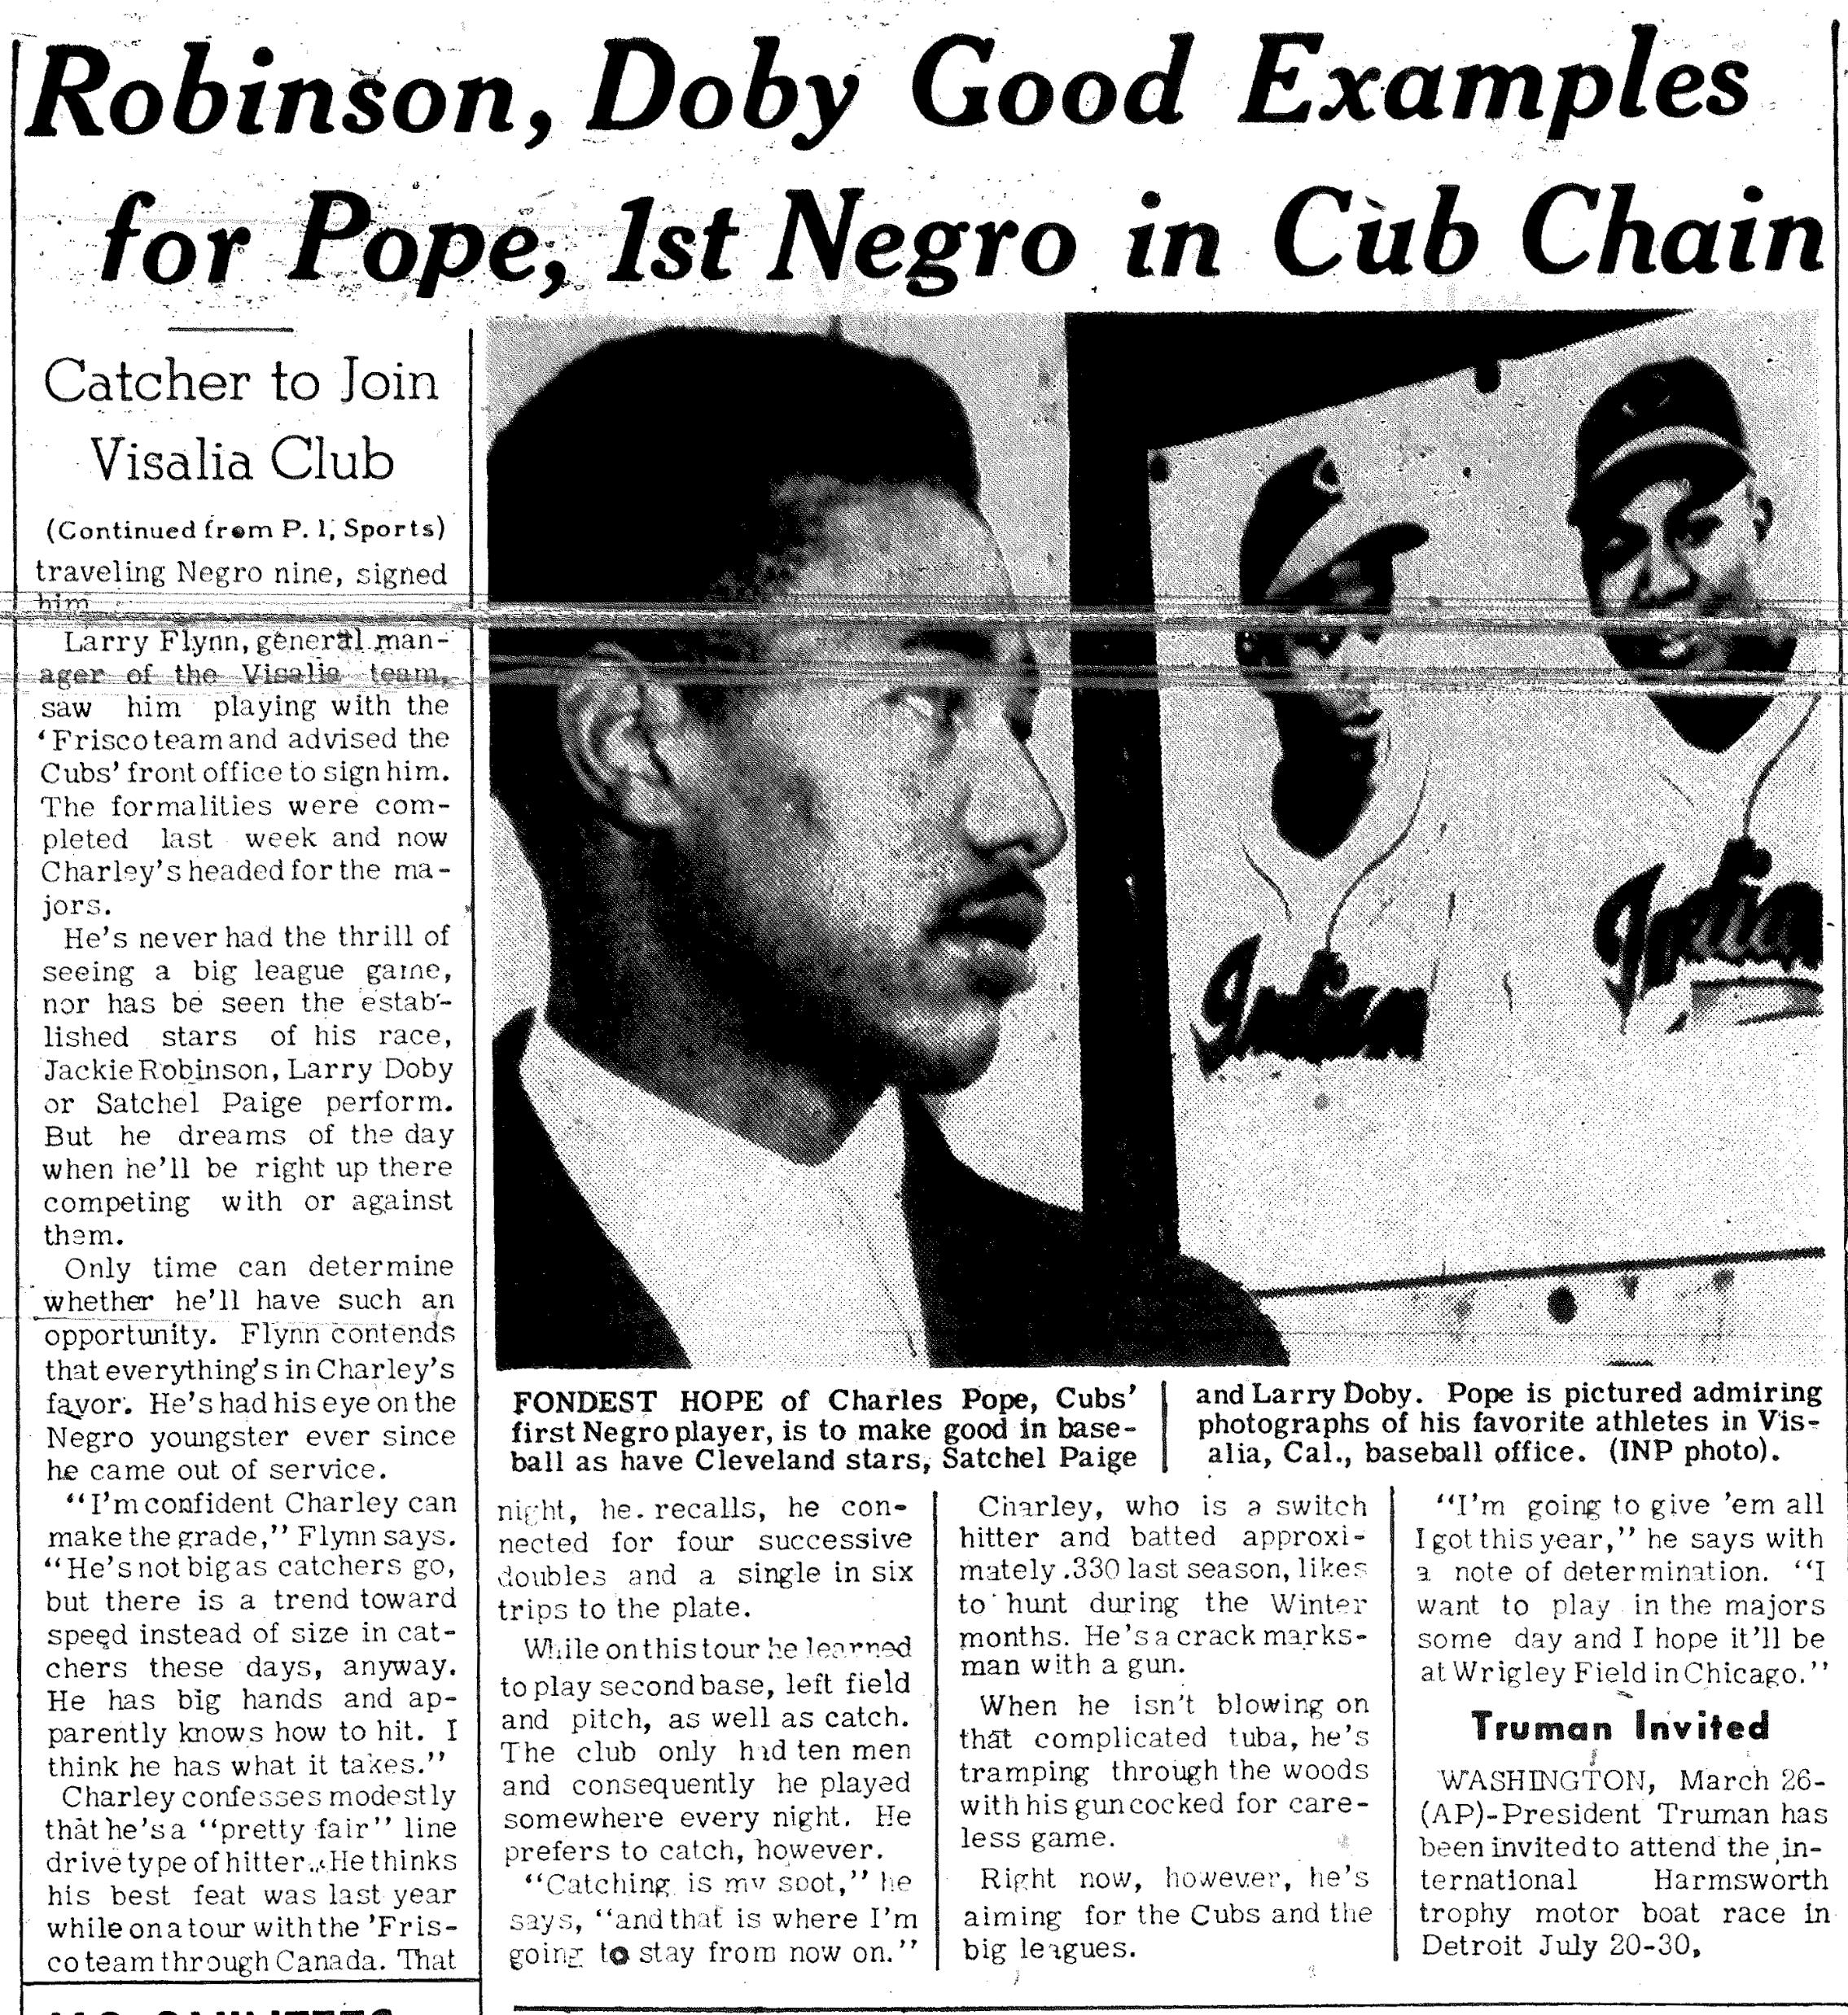
Charles Pope
Visalia Cubs

Slide 4
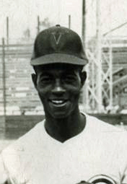
Ken Taylor
Visalia Cubs

Slide 5
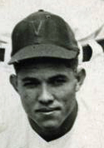
Walt McCoy
Visalia Cubs

Slide 6
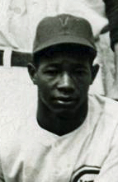
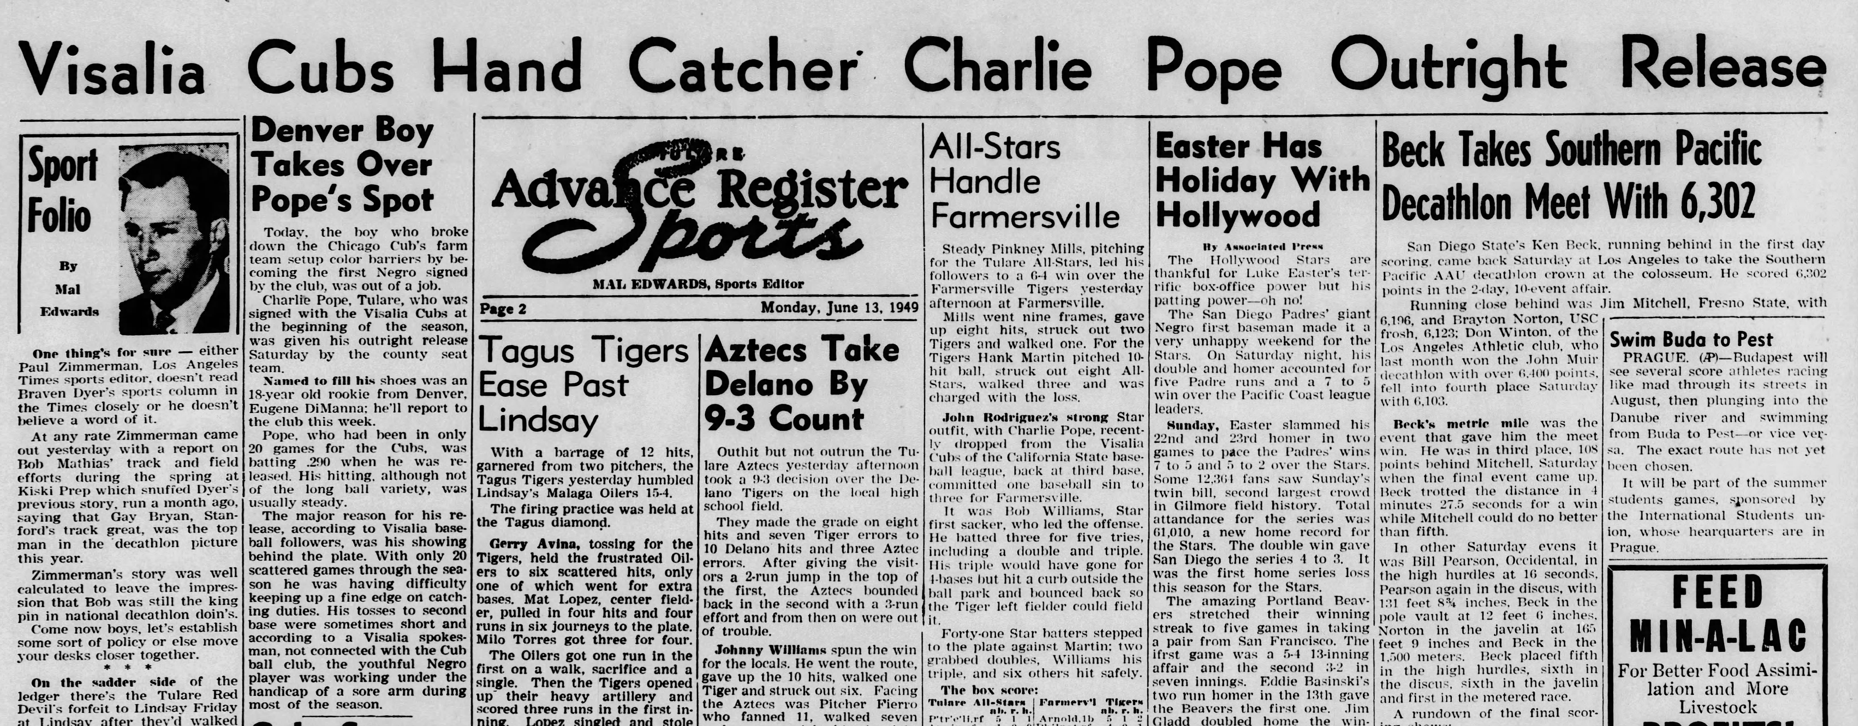
Charles Pope released (June 11)

Slide 7
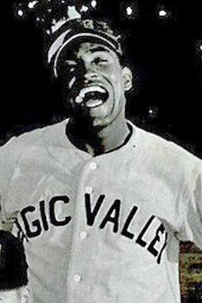
Bob “Blood” Burns
Springfield Cubs
Sioux Falls Canaries

Slide 8
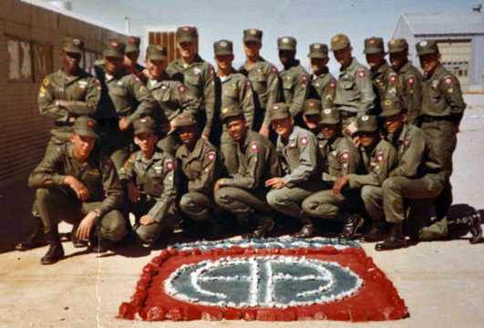
Burns in Battle
In Vietnam, Burns always walked with the point squad on patrols, the most dangerous spot, because that position was the first to run into trouble.
“Because of him, many of us are alive today.“
- Infantry Sgt. Jim Quisenberry
173rd Airborne Division
Vietnam War

Slide 9
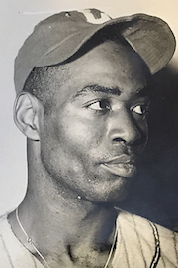
Booker McDaniel
Los Angeles Angels

Slide 10
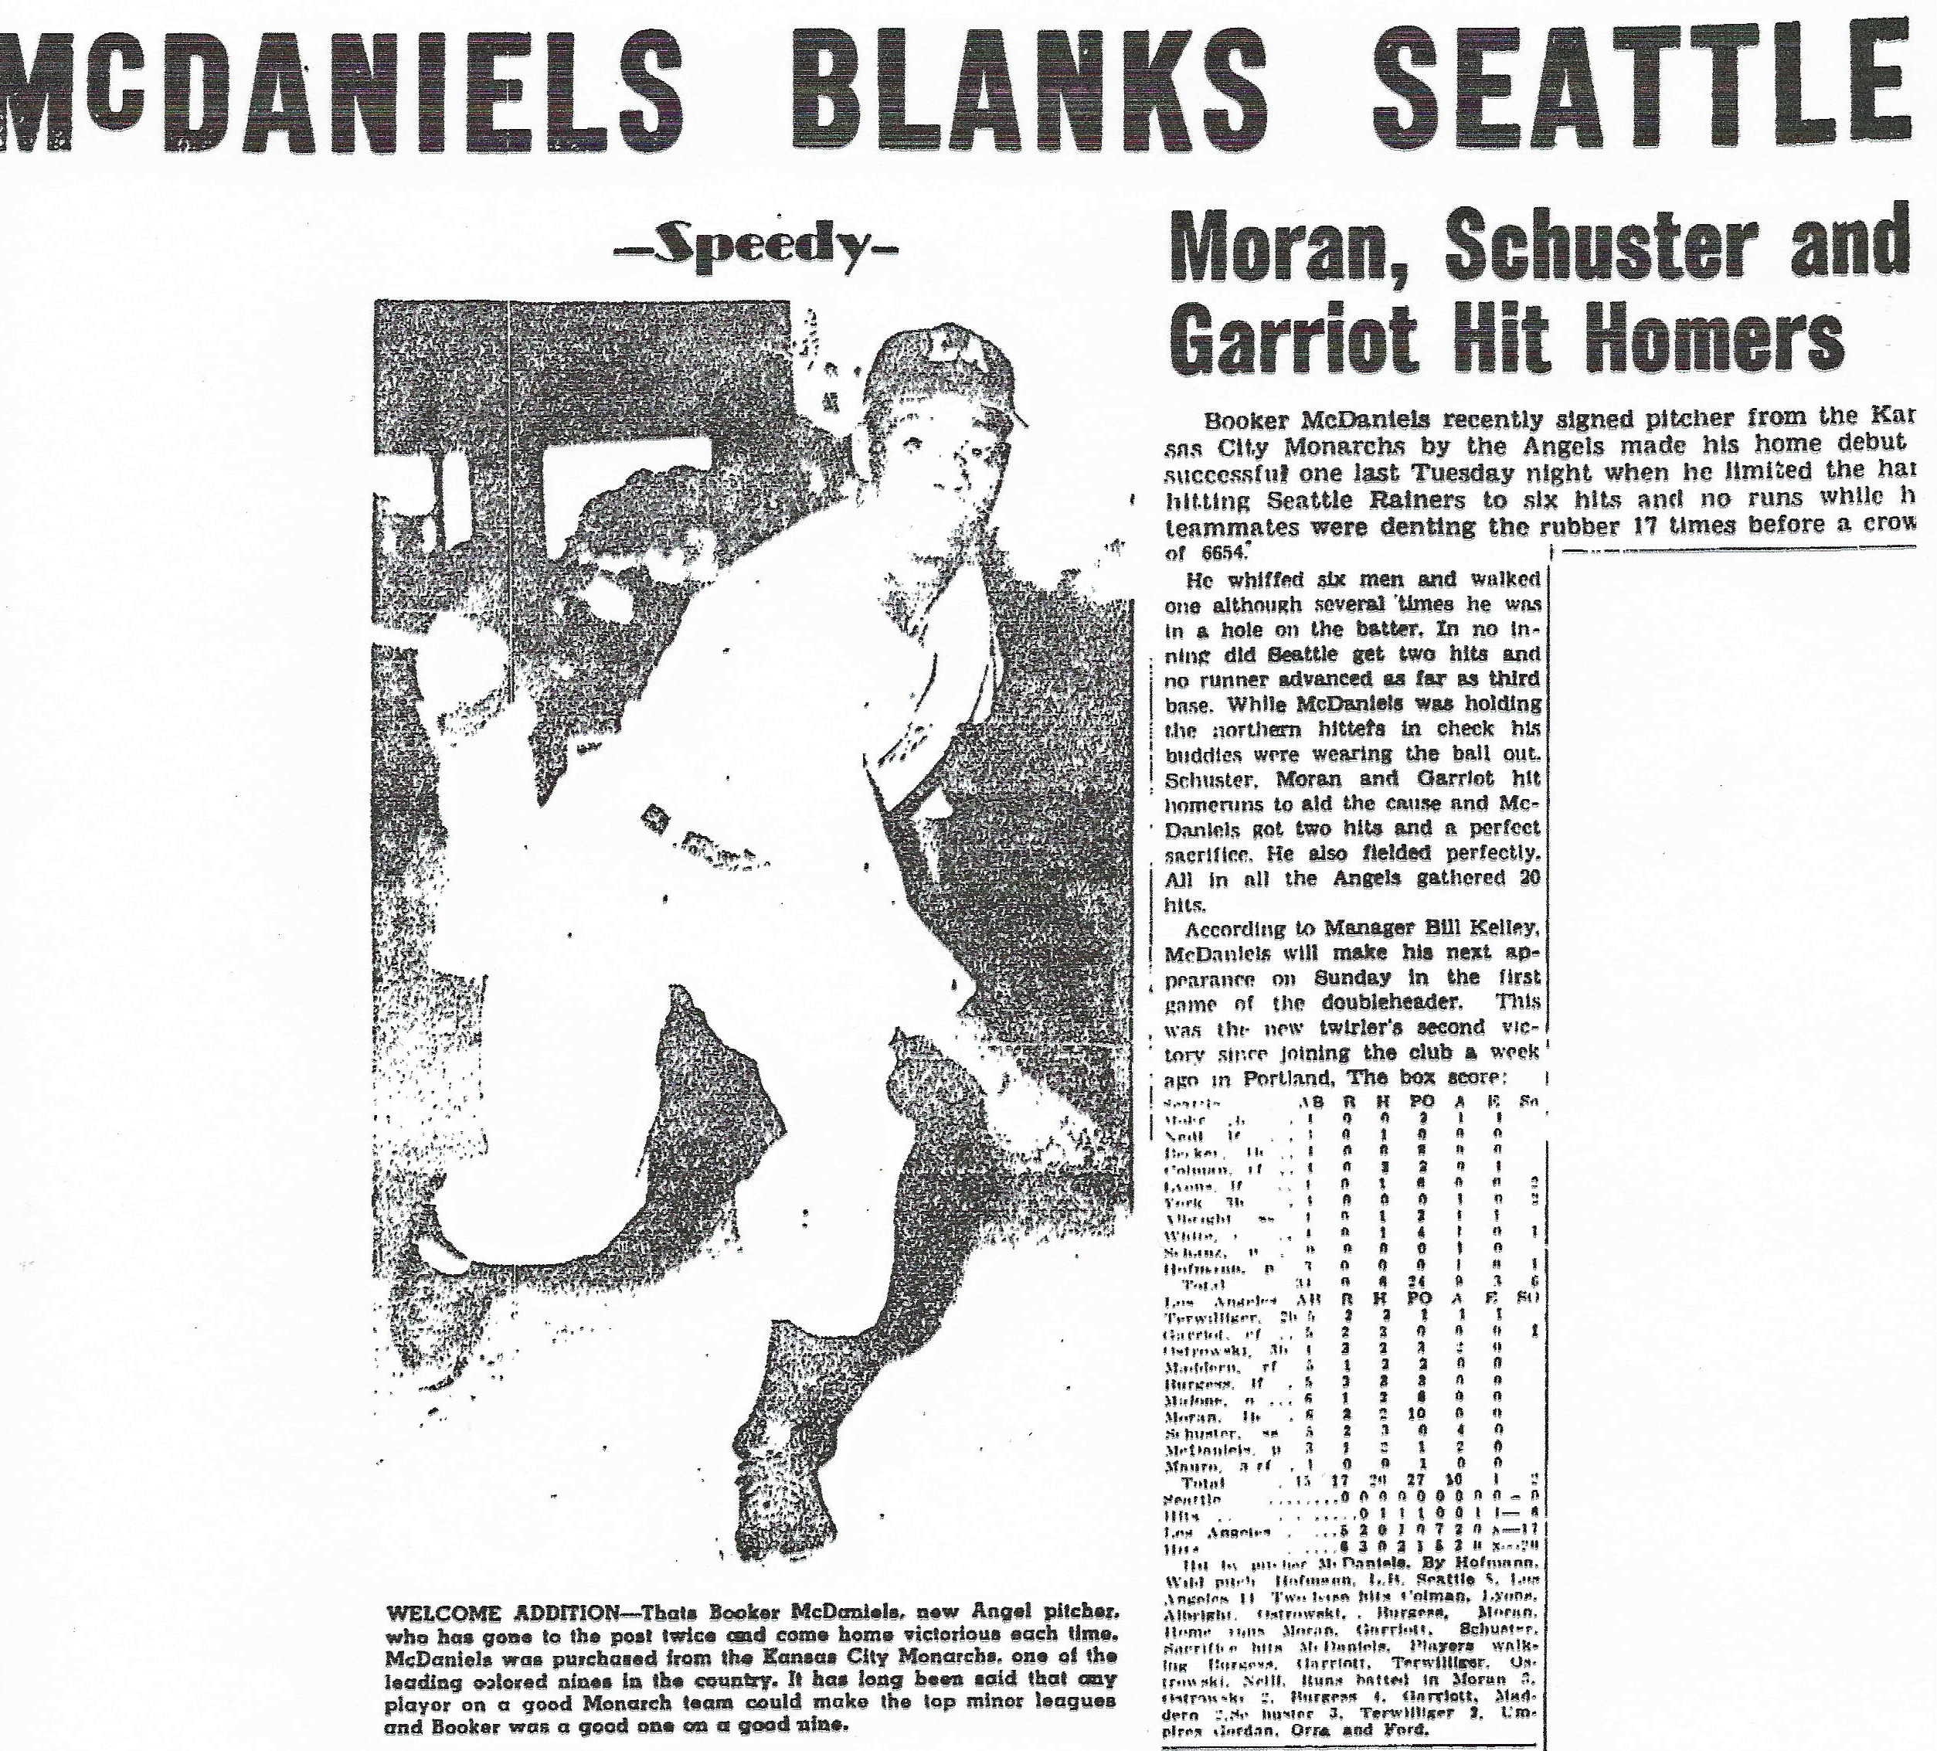
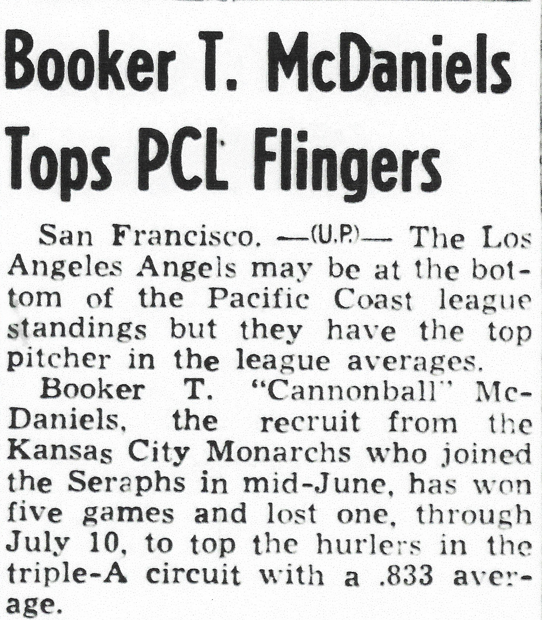
Hot Start with Angels

Slide 11
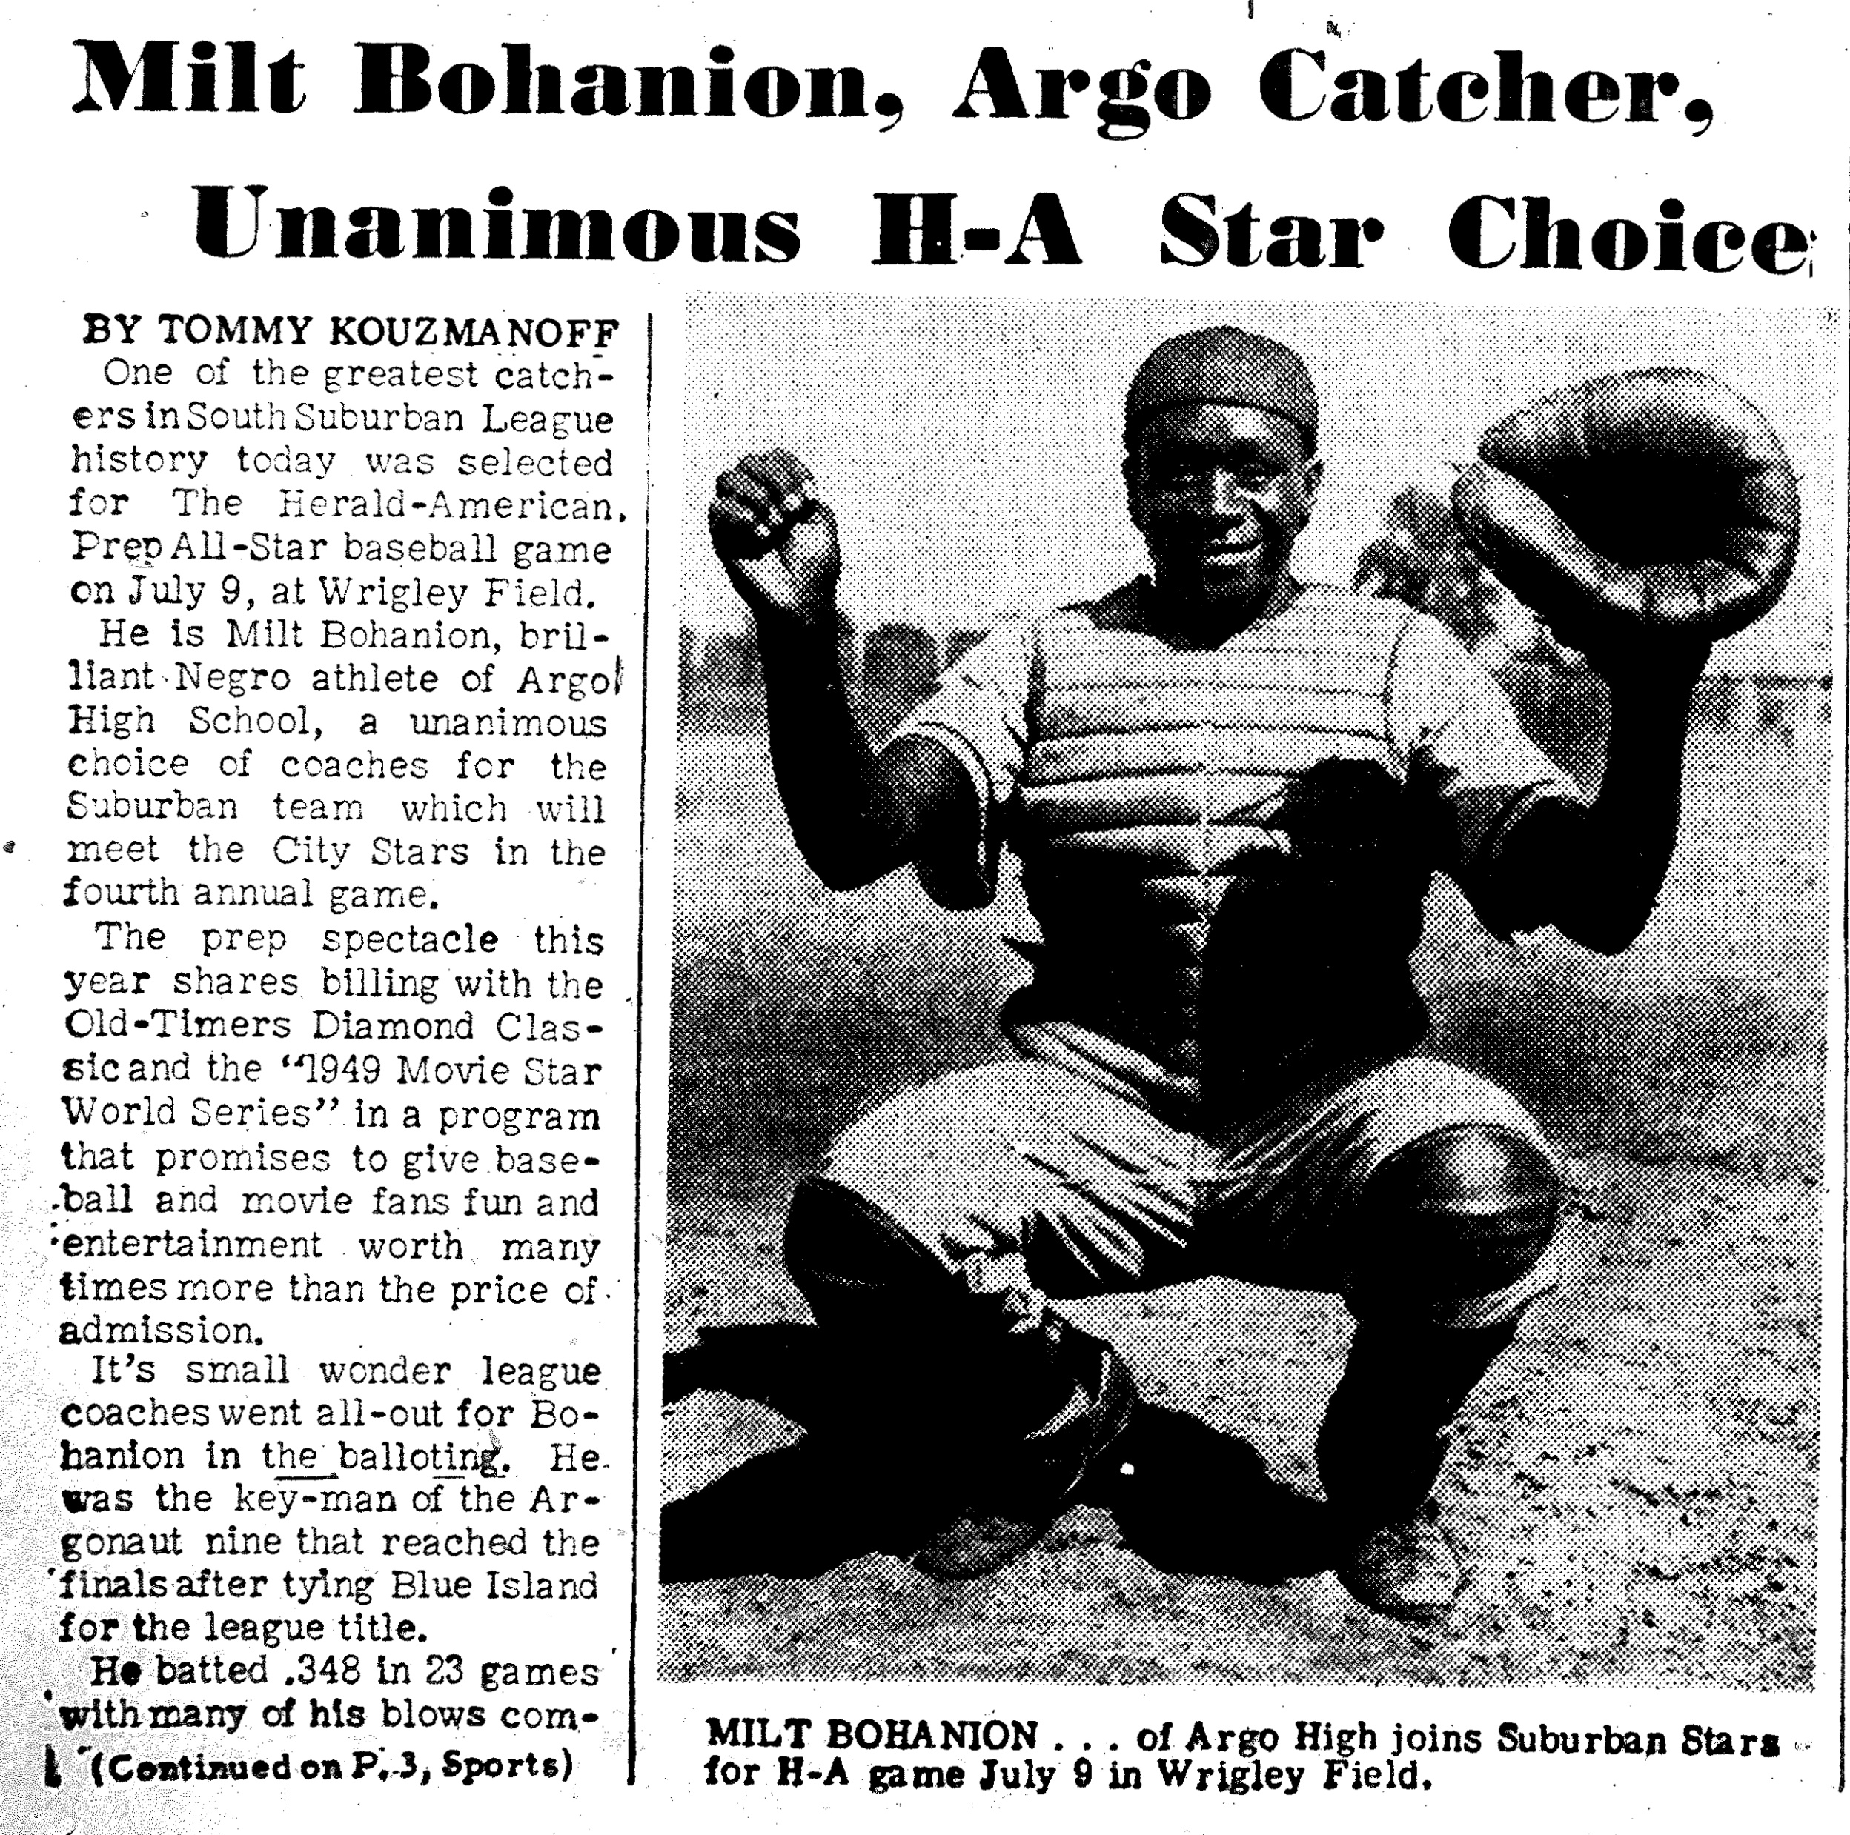
Milton Bohannion
Janesville Cubs

Slide 12
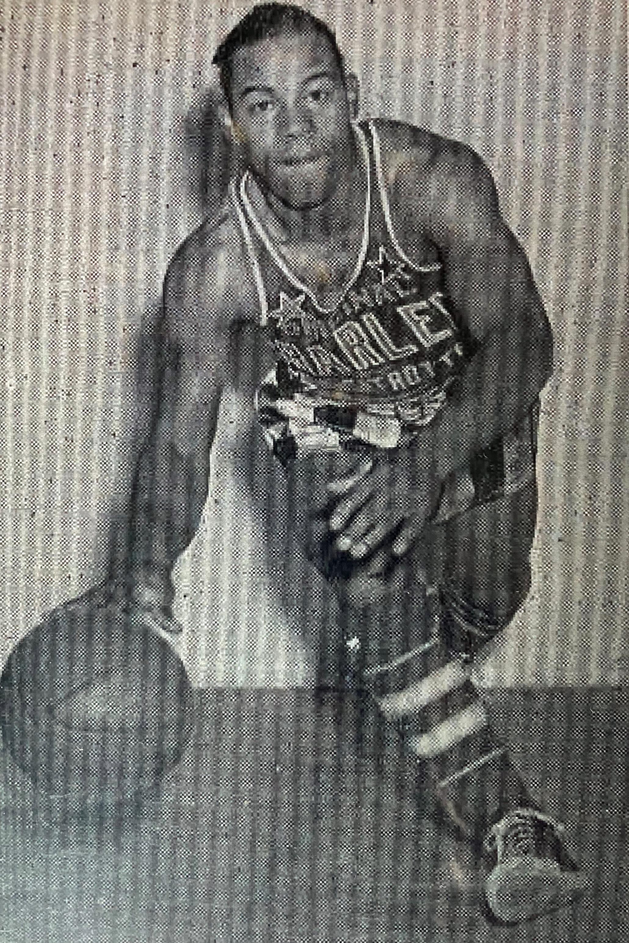
Sammy Gee
Sioux Falls Canaries

Slide 13
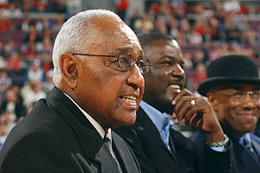
Sammy Gee (1928-1969)
“Sammy Gee was the best all-around high school athlete in Detroit history… he was THE best.”
Will Robinson
Naismith Basketball Hall of Fame (1992)
Will Robinson

Slide 14
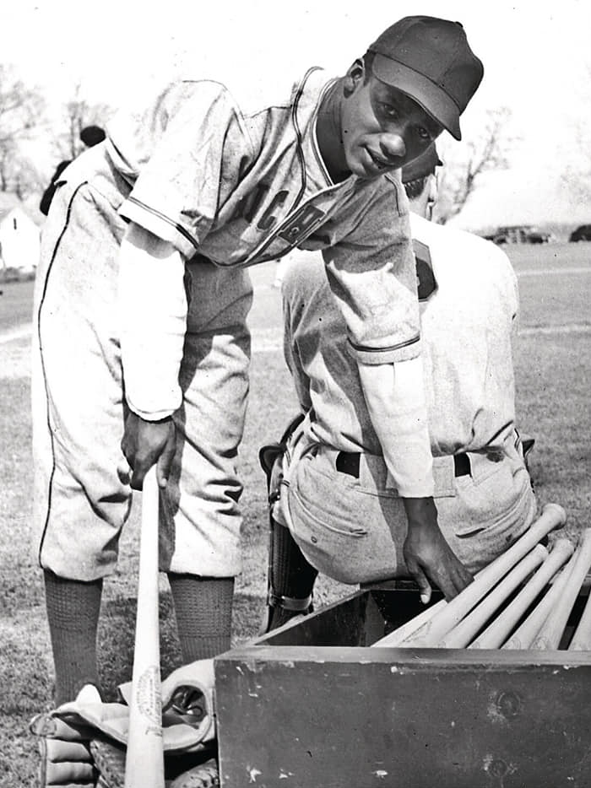
Billy Hart
Sioux Falls Canaries

Slide 15
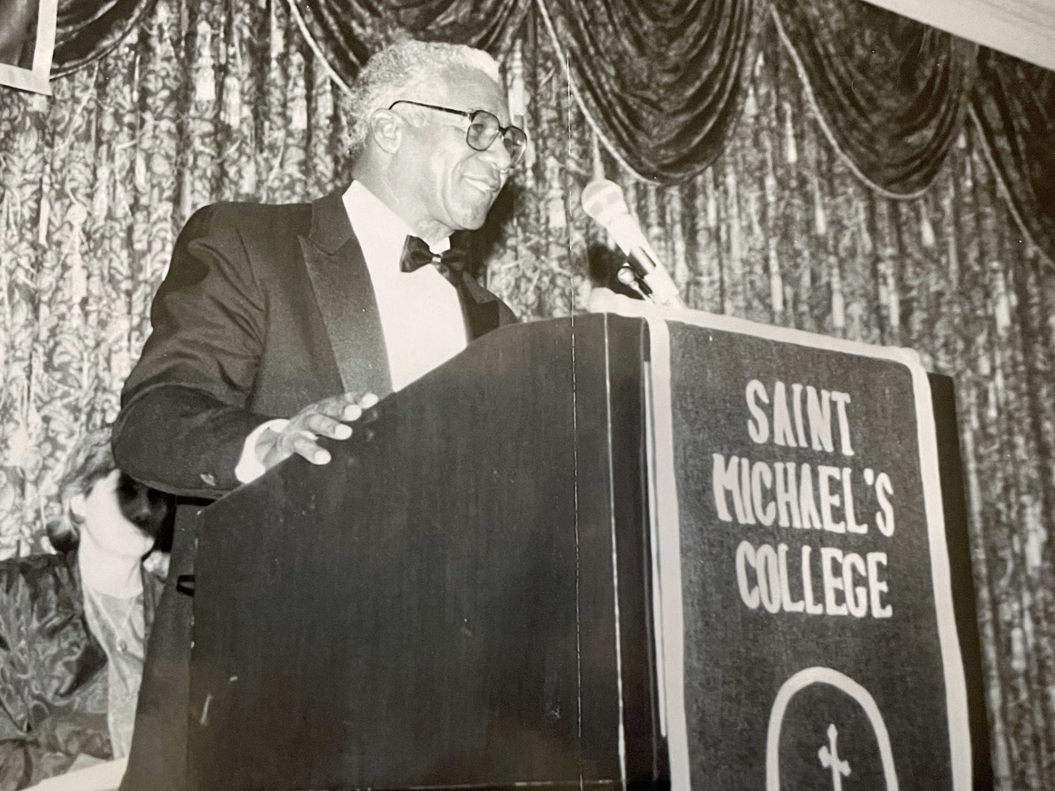
Billy Hart (1927-1995)
Captain of baseball/football/basketball teams at Williamstown (MA) High; all-state in all 3 sports
All-New England basketball player at St. Michael’s College (VT)
Won combat medals for service in Korean War
Played semi-pro basketball for Lenox Merchants (HOFer Bob Cousy: “we couldn’t guard him”)
Inducted into New England Tennis HOF (2010)
Voted No. 2 on list of 50 greatest 20th century athletes in Berkshire (MA) County
Partner and General Mgr, Henry Hart Construction Co.

Slide 16
Eight Strong Men
Charles Pope (1925-2003)
Ken Taylor (1925-1993)
Walt McCoy (1920-2015)
Booker McDaniel (1913-1974)
Blood Burns (1925-2021)
Milton Bohannion (1931-1993)
Sammy Gee (1928-1969)
Billy Hart (1927-1995)

Slide 17
Thanks to…
Shelley Arnold
Traci Carr
Gary Fink
Gary Gillette
Ed Hartig
Leslie Heaphy
Bill Hoover
Sarah Nicholson
Ron Teasley
Chicago History Museum
Don Zminda
dzminda@gmail.com
@dzminda

